Slide 1
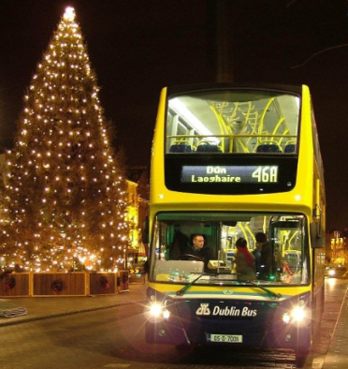
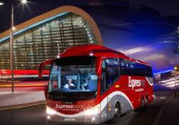
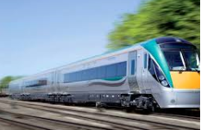
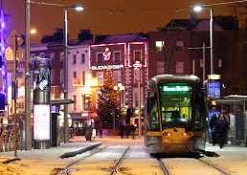
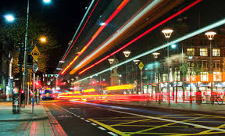
An Garda Síochána
Dublin Metropolitan Regional Roads Policing
Operation Open City 2022
Stakeholders Meeting 24th November 2022

Slide 2
Operation ‘Open City’
Operation ‘Open City’ runs from 1 December to 24th December 2022.
Aims:
To ensure the City is Open for Business at this important retail time;
Sustainable Movement and Transportation is facilitated and Managed; and
The City is Safe for our Citizens at all times.

Slide 3
An Garda Síochána Open City 2022, 1st – 24th December
Operation Objective: ‘To facilitate the movement of Public Transport and minimise traffic disruption to the general public, through high visibility and enforcement activity’.
Arterial Beats 7am-10am, 4pm-7pm
City Centre Beats
High Visibility Policing - HVP/ Beats

Slide 4
Operation ‘Open City’
Key Garda Actions:
Increase in Mobile traffic units to ensure freeflow
Concentration on the M50, M1, N2, N3, N4, and N7, N81 and
M11/N11.
Increased vehicle Checkpoints to ensure Drink and Drug driver compliance.
New Drug testing sets will be used. Cartridge Type – more accurate and wide ranging test results possible.
Main City Centre Car parks patrolled and traffic movement managed around these locations.

Slide 5
Operation ‘Open City’
Key Garda Actions (Continued):
Twice Weekly Conference Calls from Garda HQ Dublin Castle with all the transport Stakeholdes
Local liaison between the Garda Area Inspectors and the LA Traffic Management Teams.
Extra patrols at late night drinking hotspots, Railway stations and Bus terminals to ensure law order prevails.
New Garda Traffic Centre behind Heuston Station – twice the camera capacity
Garda Numbers are limited – “the best service possible will be delivered with the resources at their disposal”.

Slide 6
Operation ‘Open City’
Other Stakeholder Actions
Additional night Bus Services being facilitated – Additional Cover Staff and Maintenance crews
Additional night Luas Services being facilitated – additional security measures being put in place
Additional night Irish Rail Services on key lines – additional security measures
Inner City Managers – Weekday Footfall is down 20% from pre-Covid levels. Saturday footfall up 25% - needs additional management
Garda Press Office and Transport Stakeholders – “promote the message of travel at non peak times “

