Slide 1
LUPT SPC 24 November 2022
Planning Application Lodged with ABP
“Lucan to City Centre Core Bus Corridor”

Slide 2
Lucan to City Centre Core Bus Corridor Planning Application
The NTA has applied under Section 51(2) of the Roads Act 1993 to an Bord Pleanála for approval in relation to a road proposal consisting of the construction of the Lucan to City Centre Core Bus Corridor Scheme.
Submission are invited in writing to an Bord Pleanála (Strategic Infrastructure Division)
64 Marlborough Street, Dublin1, D01 V902 between Wednesday 2nd November 2022 and Wednesday 11th January 2023.
Further information on the particulars of the scheme can be obtained at www.lucanscheme.ie
SDCC will make an official submission on the scheme as part of this consultation process.

Slide 3
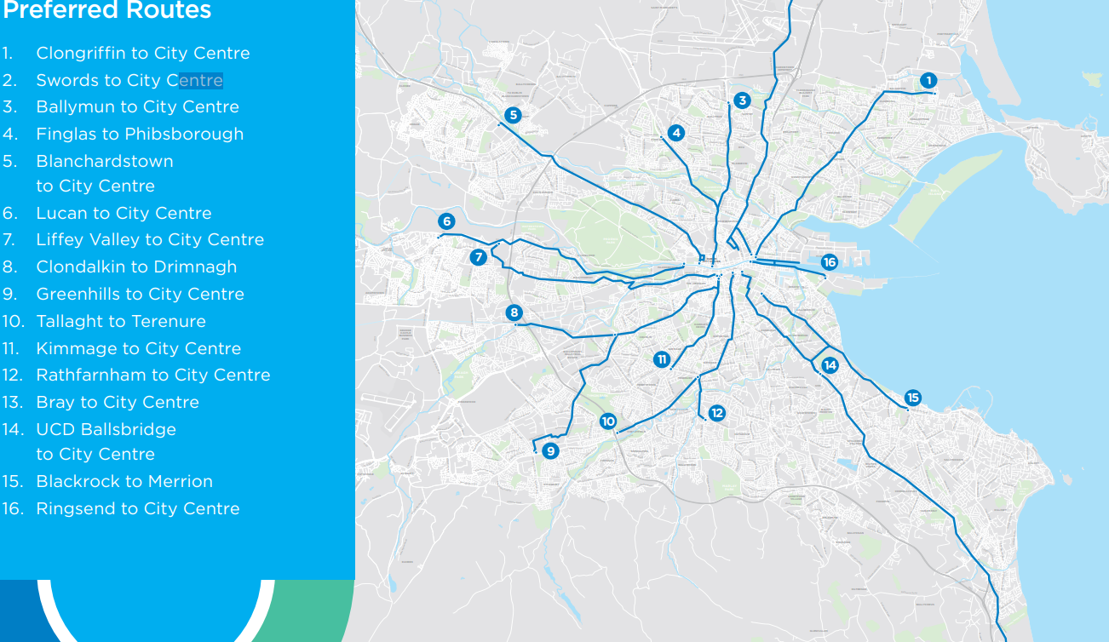
Lucan to City Centre Core Bus Corridor Planning Application

Slide 4
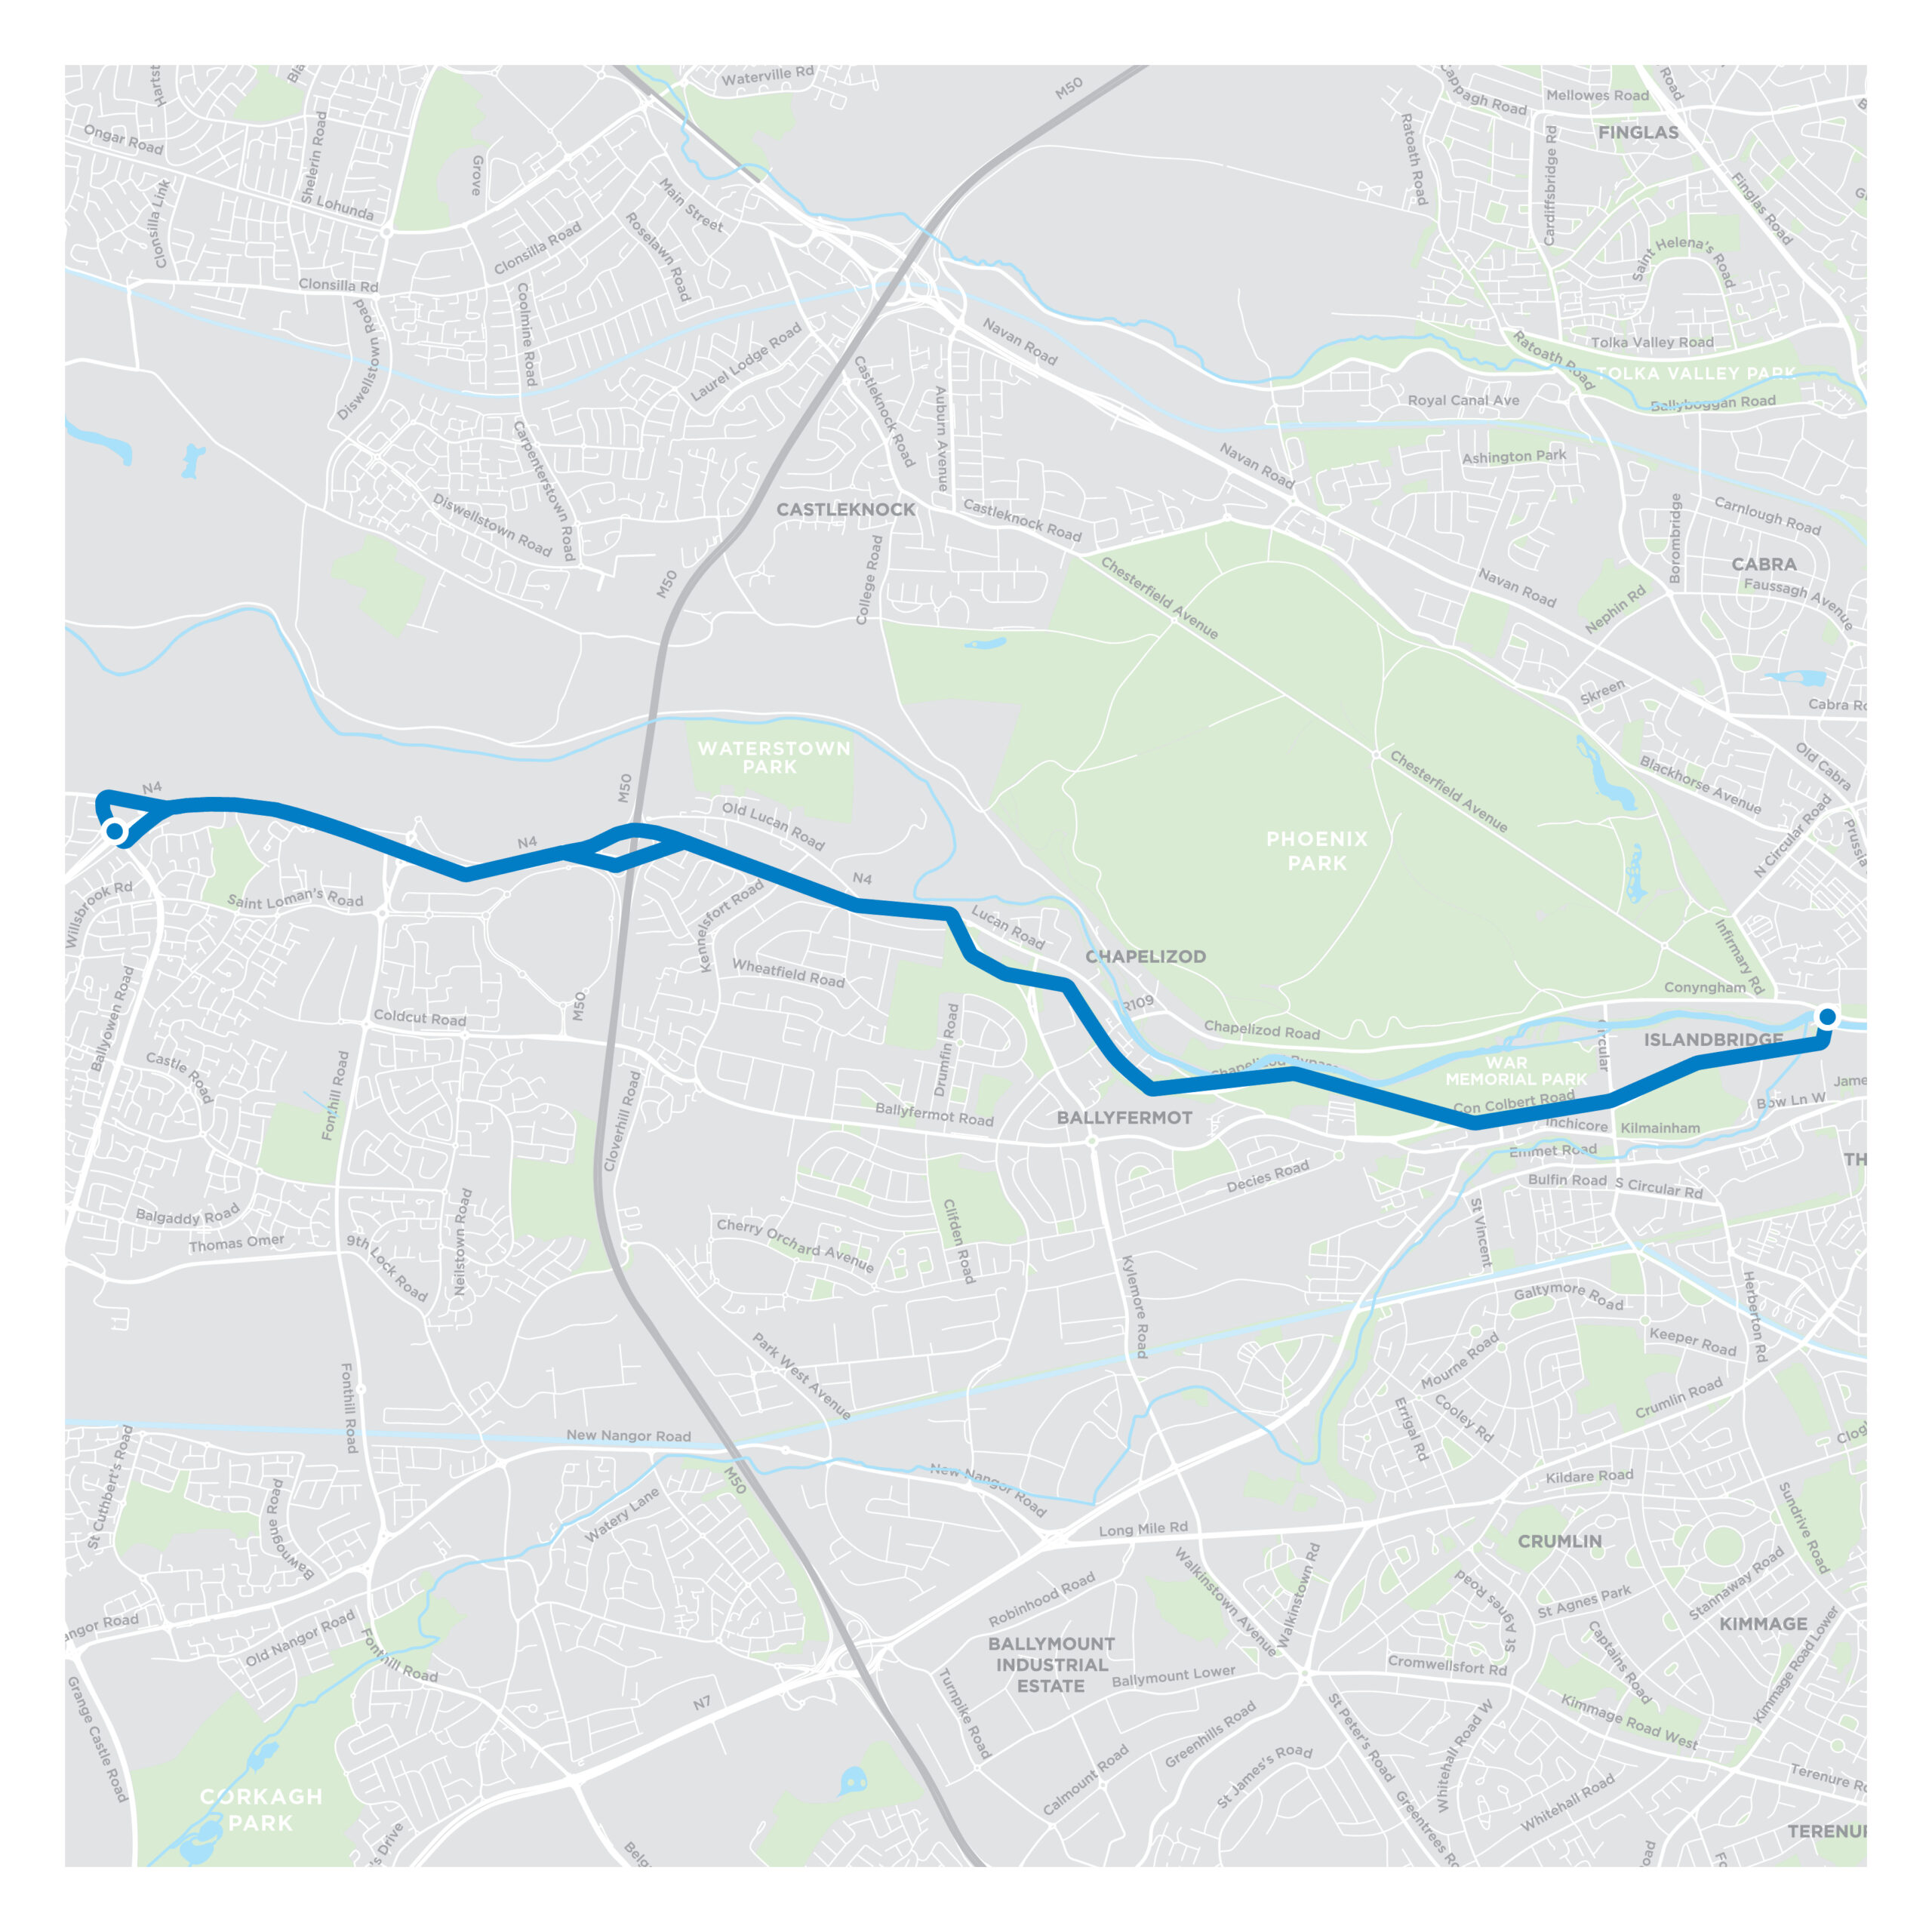
Lucan to City Centre Core Bus Corridor Planning Application
6. Lucan to City Centre Route

Slide 5
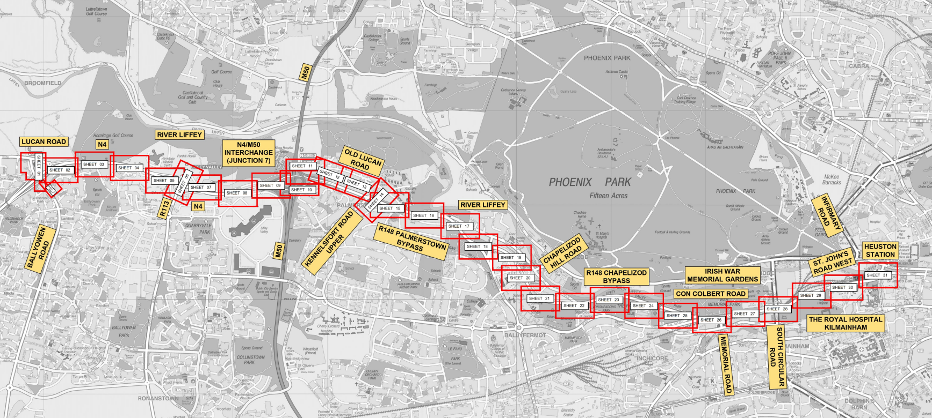
Lucan to City Centre Core Bus Corridor Planning Application
6. Lucan to City Centre Route

Slide 6
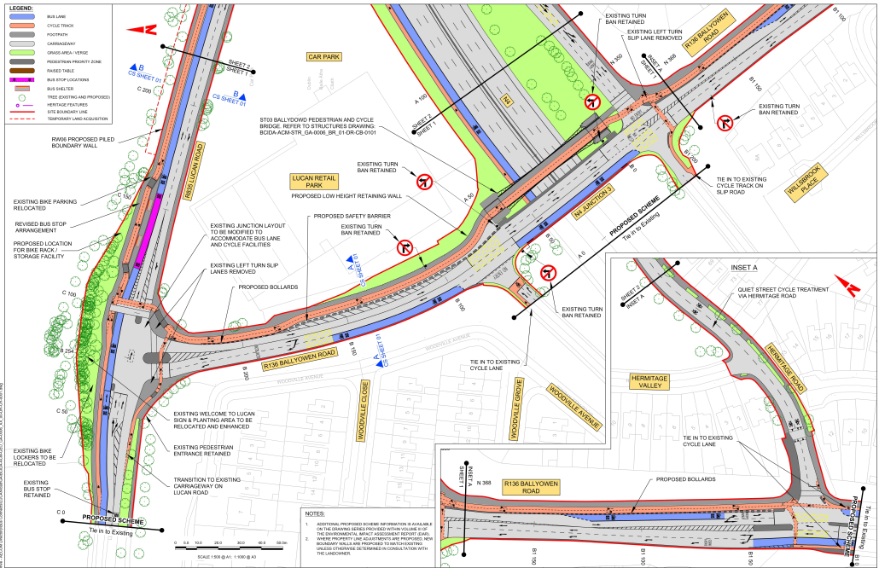
Lucan to City Centre Core Bus Corridor Planning Application
SHEET 1
Junction of
Ballyowen Rd to
Lucan Rd

Slide 7
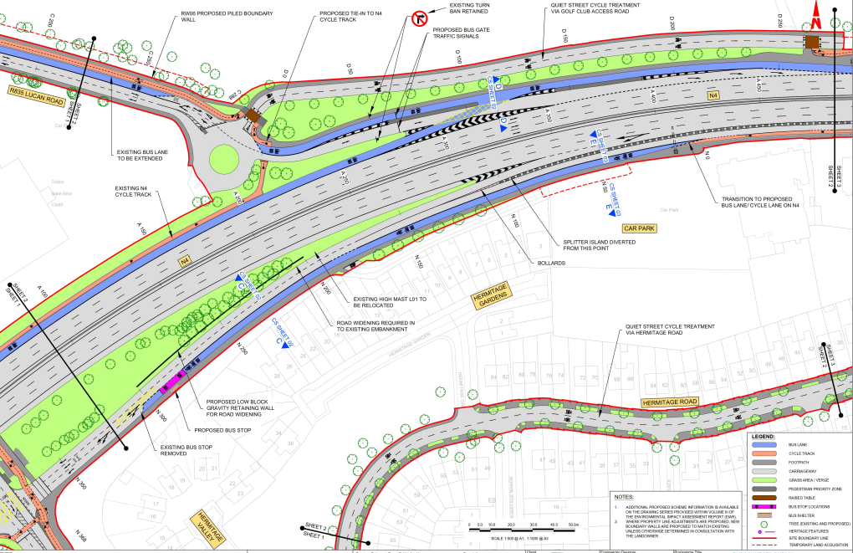
Lucan to City Centre Core Bus Corridor Planning Application
SHEET 2
Junction of
Lucan Rd to N4

Slide 8
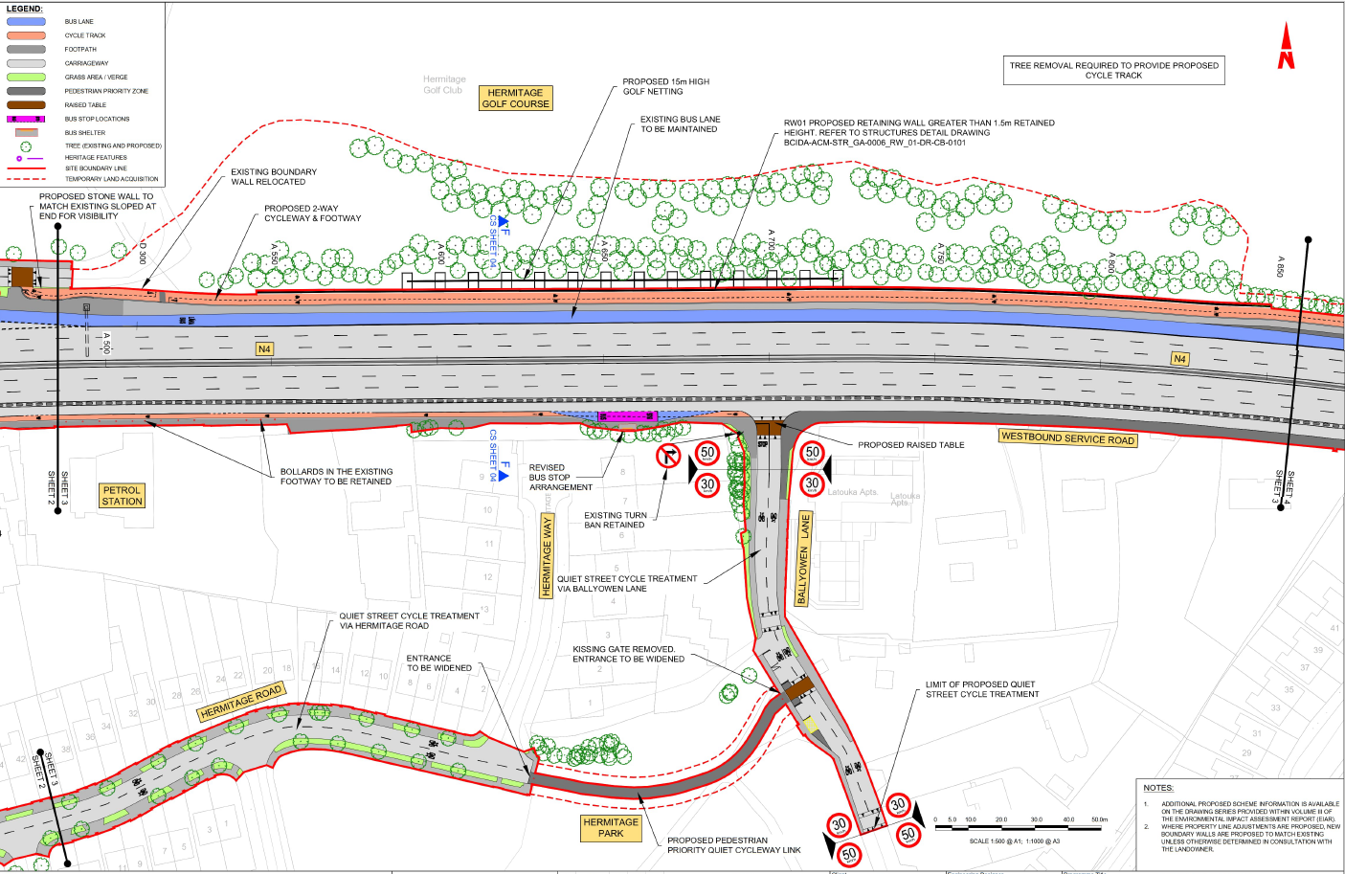
Lucan to City Centre Core Bus Corridor Planning Application
SHEET 3
Junction of
Ballyowen Lane to
N4

Slide 9
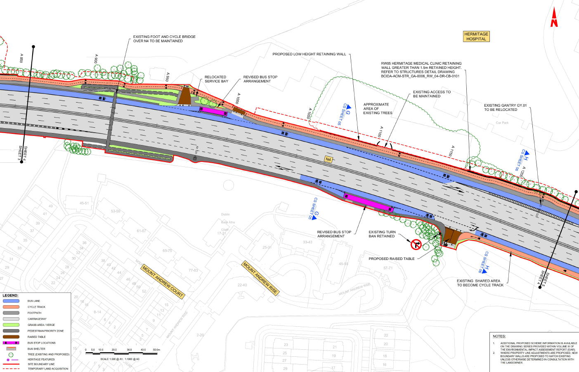
Lucan to City Centre Core Bus Corridor Planning Application
SHEET 4
Section of N4
before J2

Slide 10
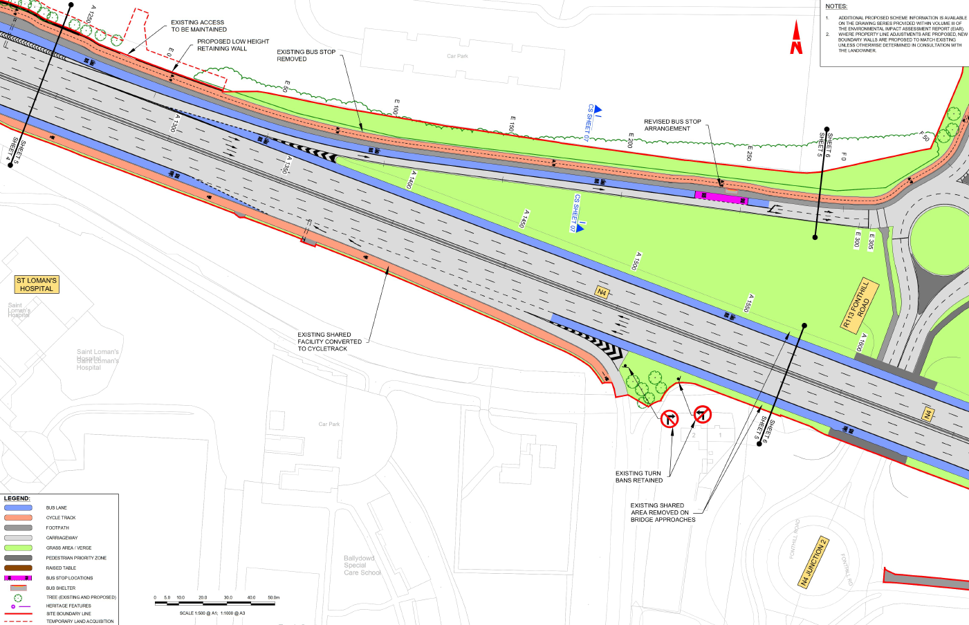
Lucan to City Centre Core Bus Corridor Planning Application
SHEET 5
Junction of
N4 at Junction 2

Slide 11
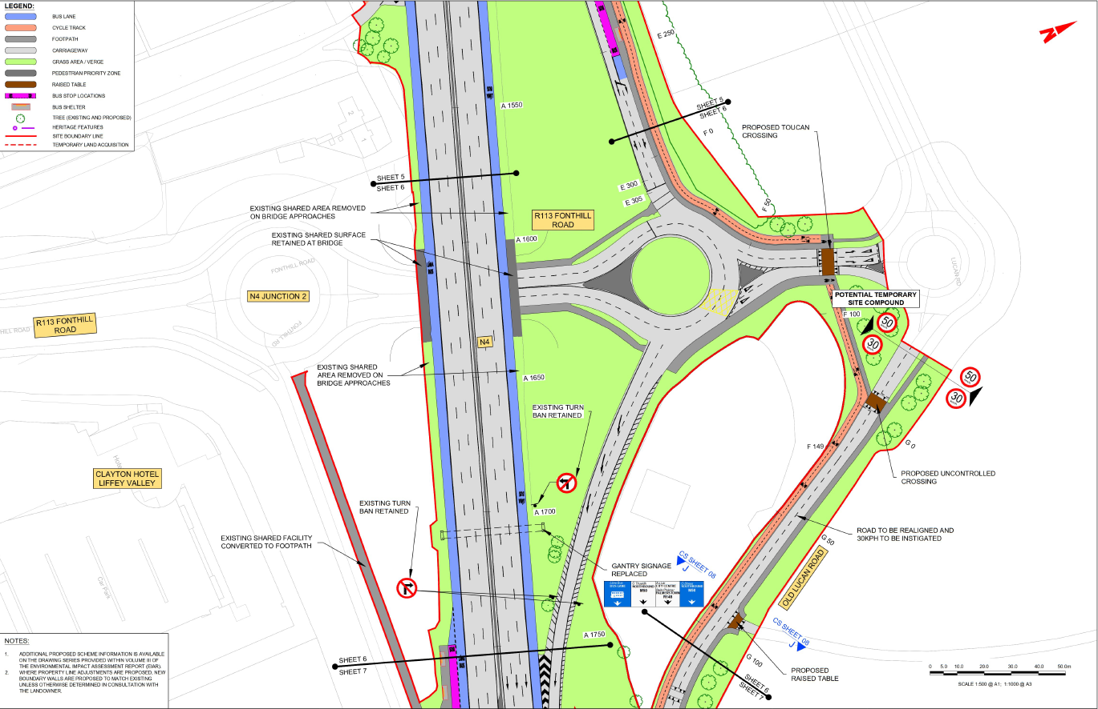
Lucan to City Centre Core Bus Corridor Planning Application
SHEET 6
Junction of
N4 at Junction 2

Slide 12
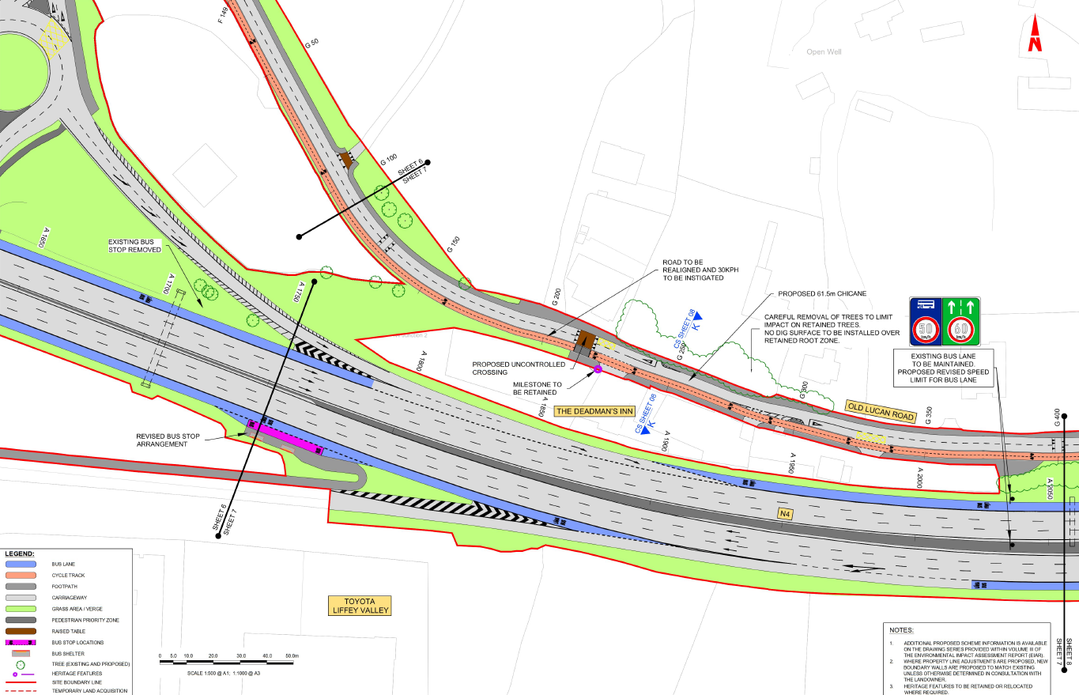
Lucan to City Centre Core Bus Corridor Planning Application
SHEET 7
Junction of
N4 at Junction 2 at
Deadman’s INN

Slide 13
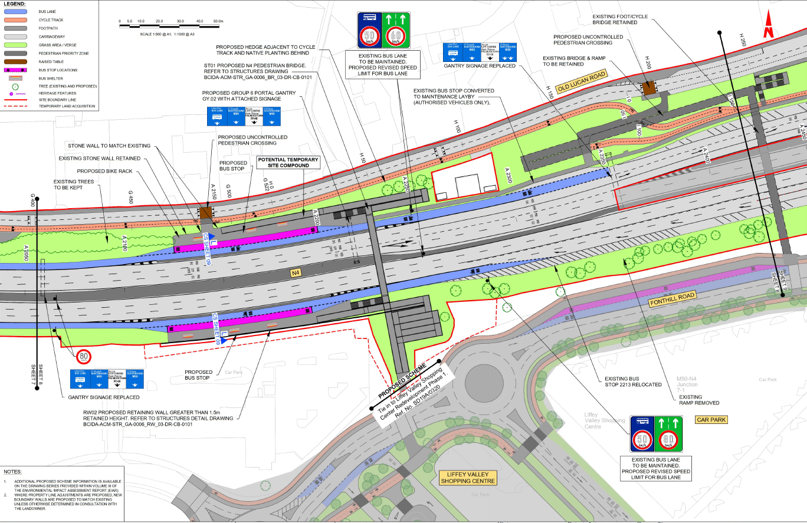
Lucan to City Centre Core Bus Corridor Planning Application
SHEET 8
Section of N4
West of M50

Slide 14
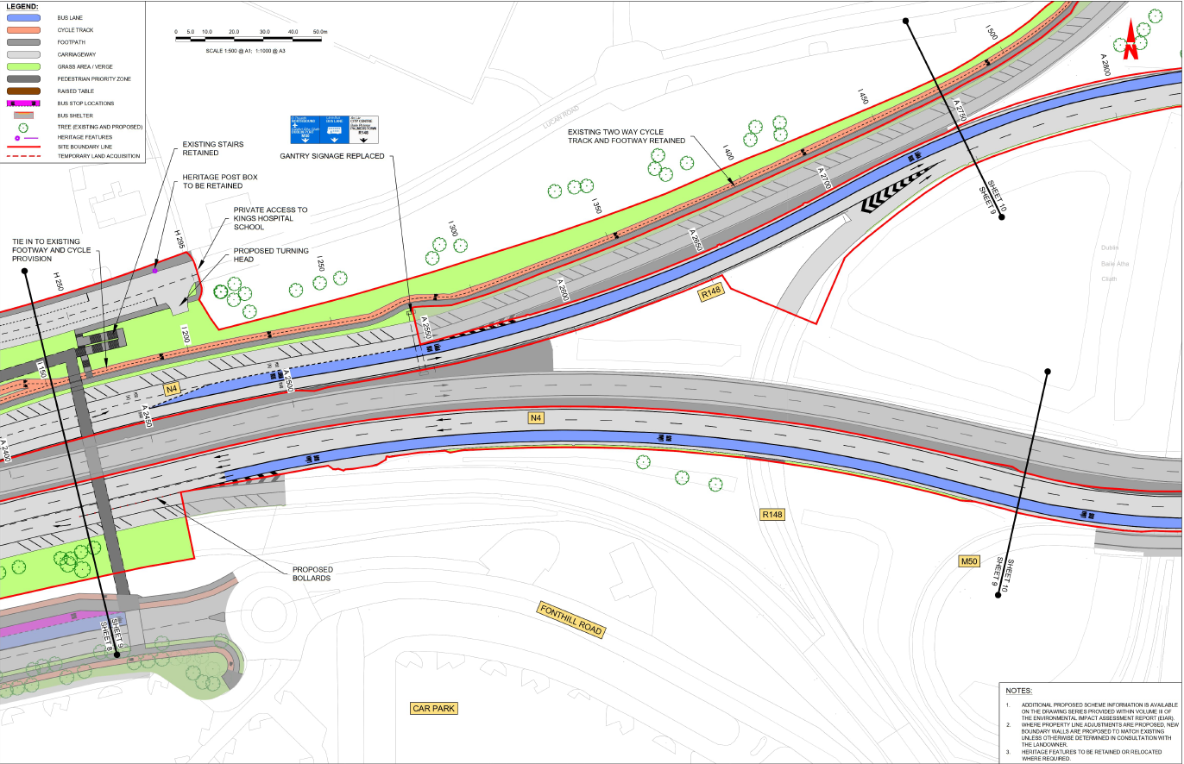
Lucan to City Centre Core Bus Corridor Planning Application
SHEET 9
Junction of
N4 and M50
(Western)

Slide 15
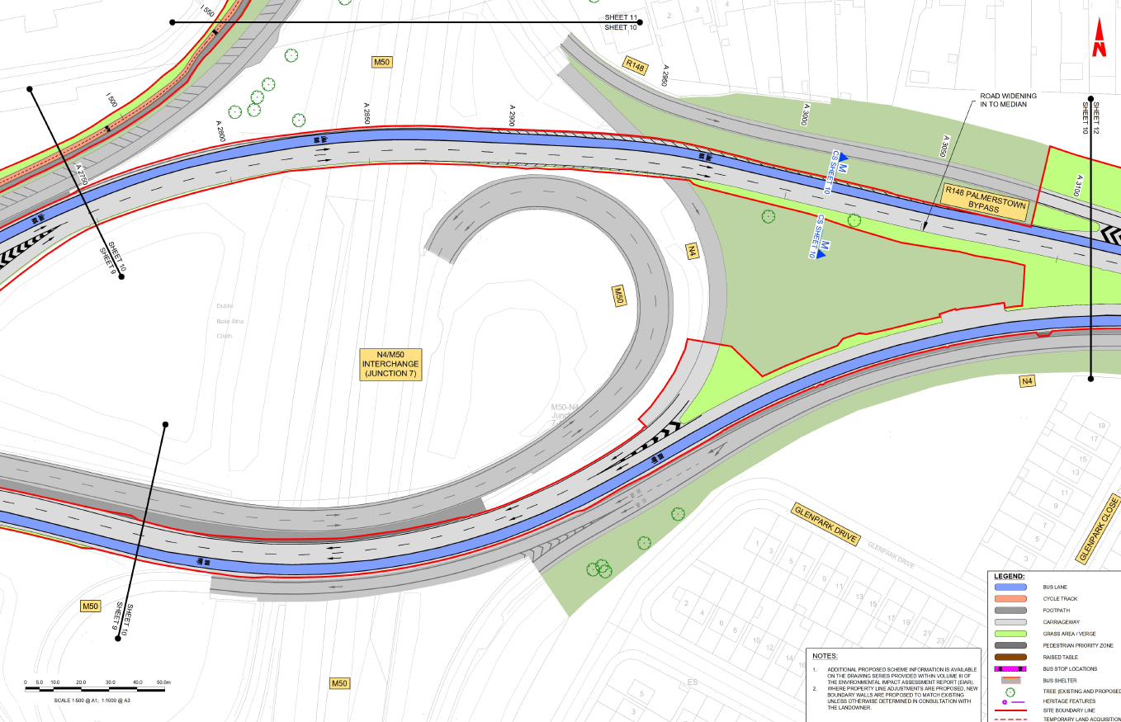
Lucan to City Centre Core Bus Corridor Planning Application
SHEET 10
Junction of
Palmerstown By Pass and M50
(Eastern)

Slide 16
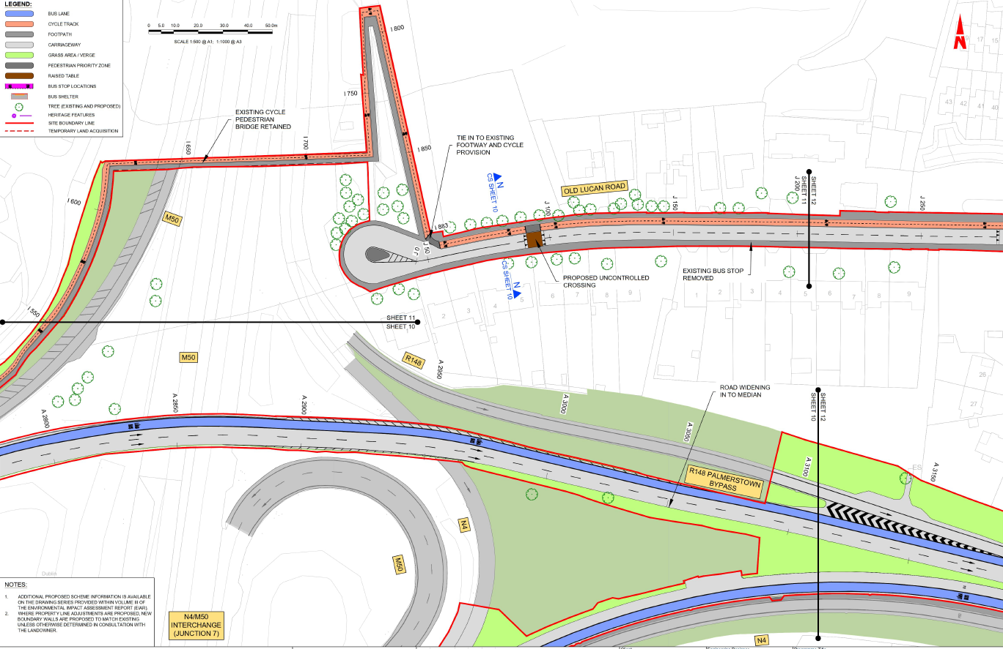
Lucan to City Centre Core Bus Corridor Planning Application
SHEET 11
Section of Old Lucan Rd, Palmerstown
(East of M50)

Slide 17
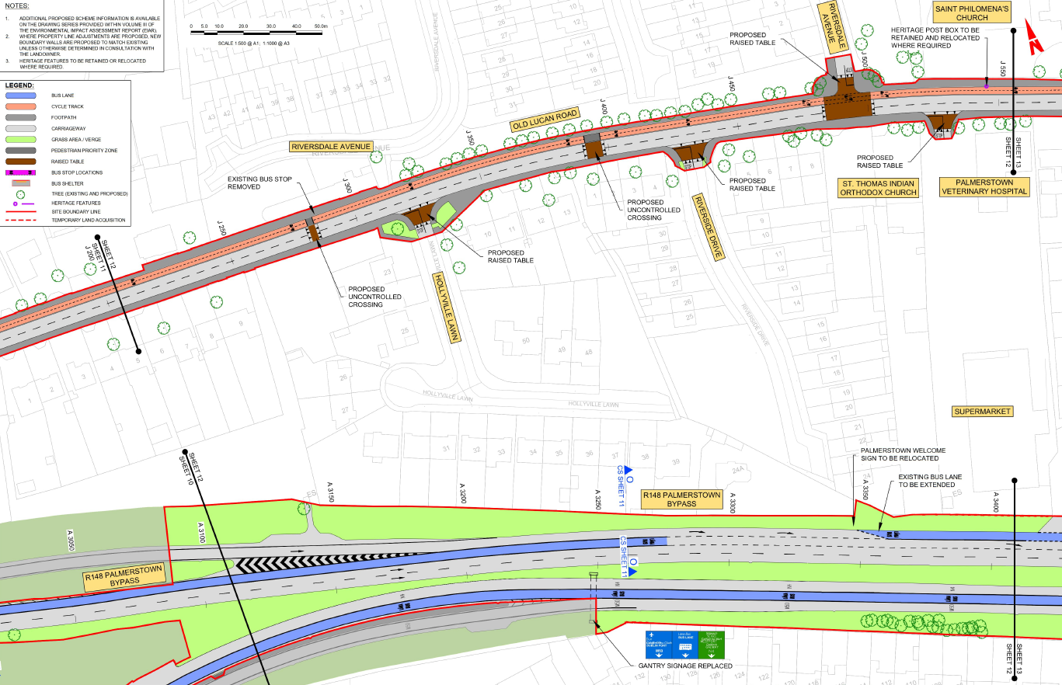
Lucan to City Centre Core Bus Corridor Planning Application
SHEET 12
Section of Palmerstown Bypass
and
Old Lucan Rd

Slide 18
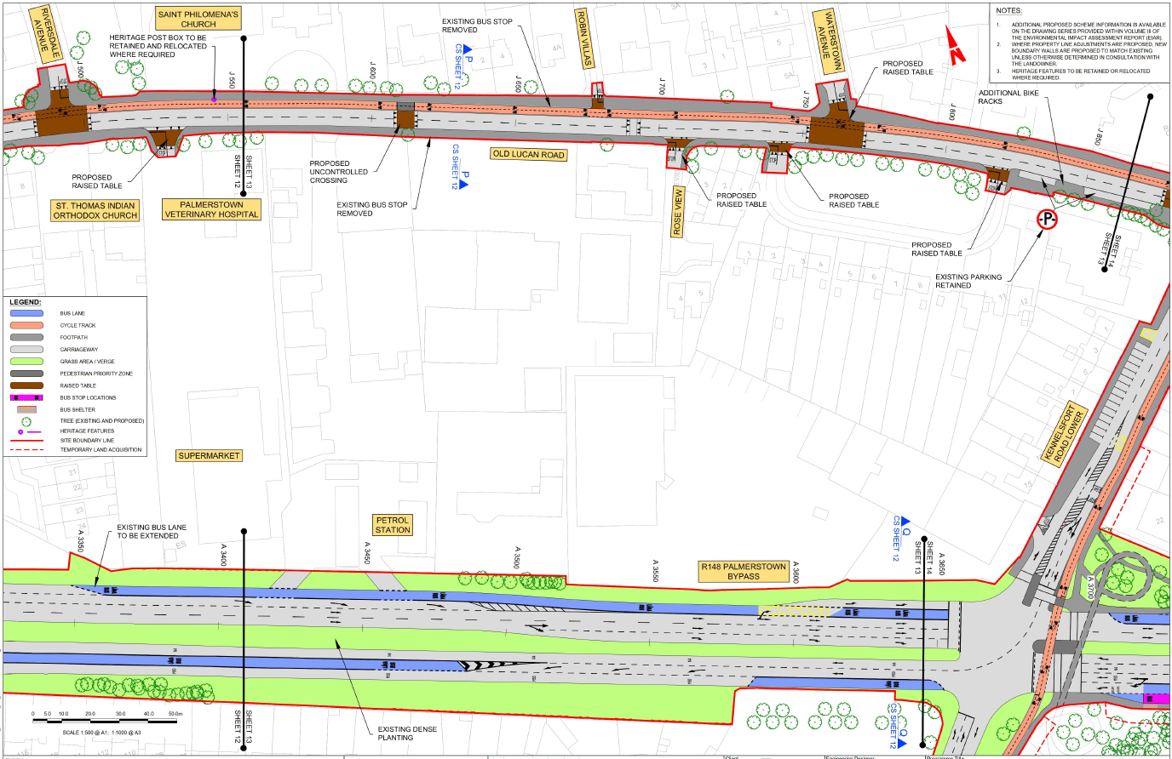
Lucan to City Centre Core Bus Corridor Planning Application
SHEET 13
Section of Old Lucan Rd
and
Junction of Palmerstown Bypass to Kennelsfort Rd Lower

Slide 19
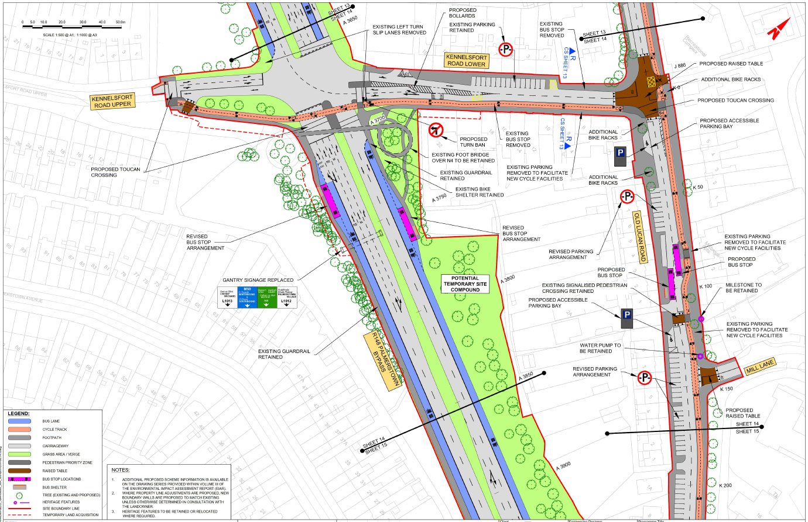
Lucan to City Centre Core Bus Corridor Planning Application
SHEET 14
Junction of Kennelsfort Rd Lower to Old Lucan Rd
and
Junction of Palmerstown Bypass to Kennelsfort Rd Lower

Slide 20
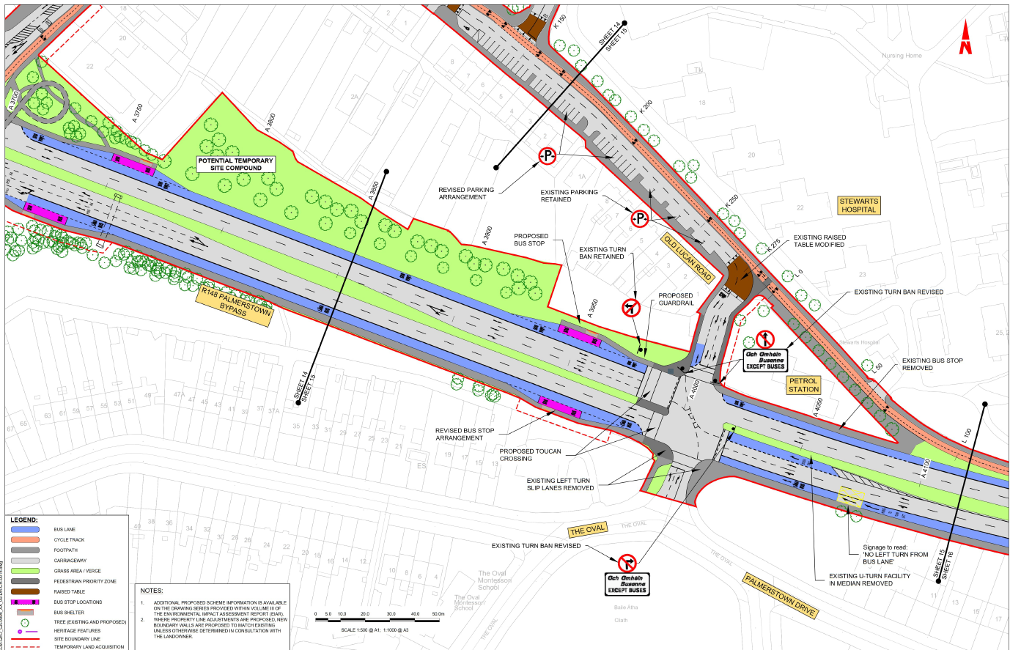
Lucan to City Centre Core Bus Corridor Planning Application
SHEET 15
Section of Palmerstown Bypass
and
Old Lucan Rd at Junction with The Oval

Slide 21
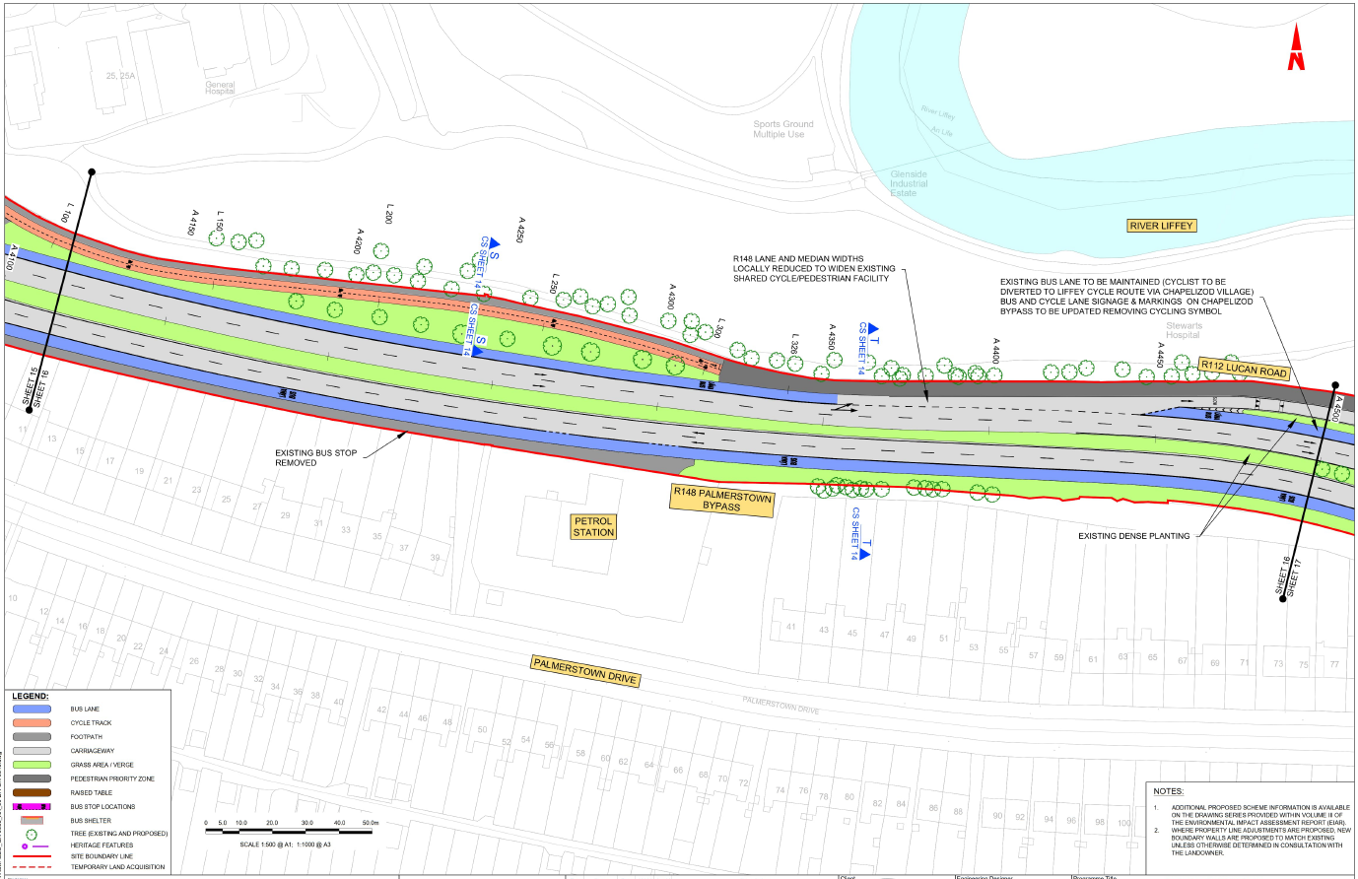
Lucan to City Centre Core Bus Corridor Planning Application
SHEET 16
Section of Palmerstown Bypass

Slide 22
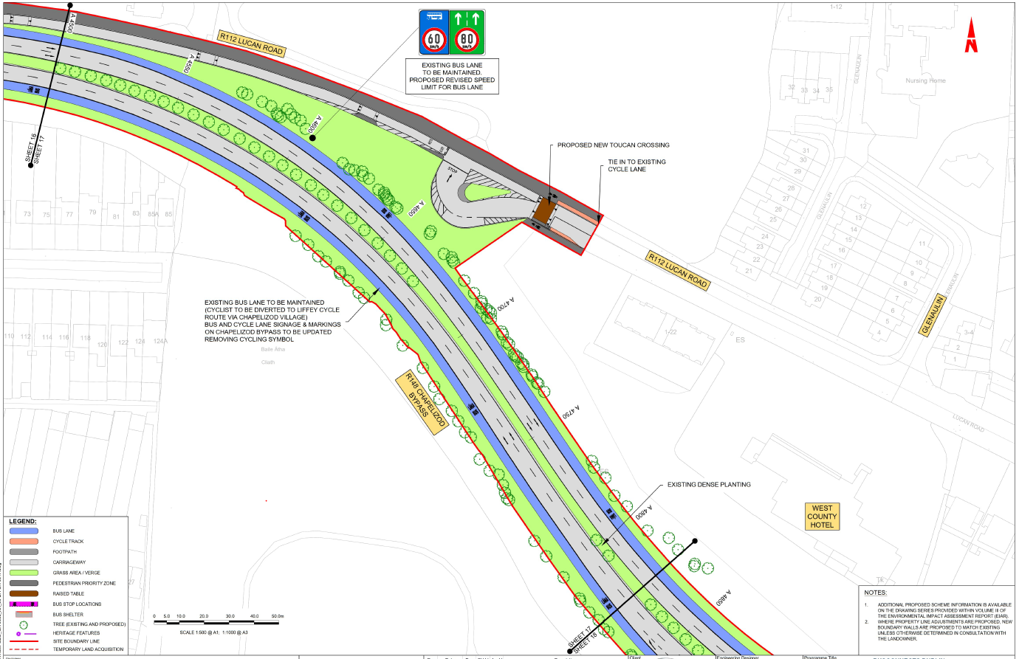
Lucan to City Centre Core Bus Corridor Planning Application
SHEET 17
Section of Chapelizod Bypass

