Slide 1
Draft Budget 2023
Ronan FitzGerald
Head of Finance
10th November 2022

Slide 2
Budget Strategy
Local Property Tax would be reduced by 15% for 2023, which was approved by the Members at the October Council meeting
There is no increase in the Differential Rent Scheme for 2023
There is no increase in the Annual Rate on Valuation (ARV) or Commercial Rates Multiplier
Commercial Rates Vacancy Scheme will continue to provide a 50% refund for properties vacant in 2023
There would be a focus on key priorities including maintaining front lines services, housing, climate action, community infrastructure, supporting our vulnerable groups and communities.

Slide 3
Revenue Expenditure 2023 v 2022
Divisions | Budget Expenditure 2023 | Budget Expenditure 2022 | Budget Income 2023 | Budget Income 2022
Housing & Building | €111,822,500 | €101,829,000 | €101,170,900 | €93,302,500
Road Transport & Safety | €39,087,700 | €34,800,500 | €5,613,800 | €5,215,400
Water Services | €14,447,200 | €14,241,400 | €10,007,800 | €9,692,400
Development Management | €25,834,900 | €22,990,400 | €8,363,600 | €7,961,900
Environmental Services | €43,702,900 | €40,117,500 | €8,018,300 | €5,047,400
Recreation & Amenity | €56,137,200 | €50,534,700 | €4,506,800 | €5,057,600
Agriculture, Education, Health & Welfare | €1,761,900 | €1,802,000 | €650,600 | €671,300
Miscellaneous Services | €13,276,300 | €15,398,200 | €18,177,400 | €9,515,000
Total | €306,070,600 | €281,713,700 | €156,509,200 | €136,463,500

Slide 4
Sources of Expenditure

Slide 5
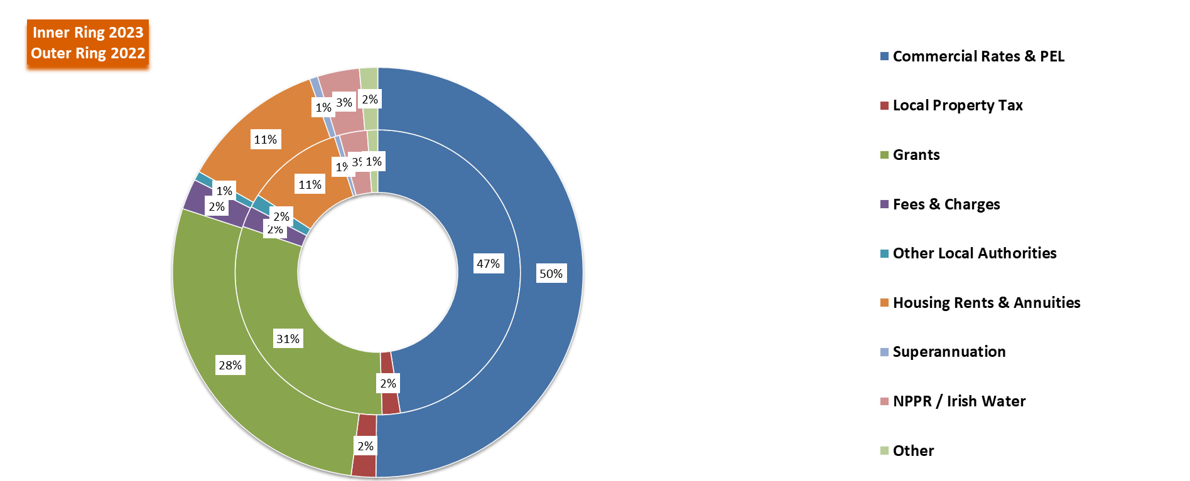
Revenue Income 2023 v 2022

Slide 6
Director of Housing, Social & Community Development

Slide 7
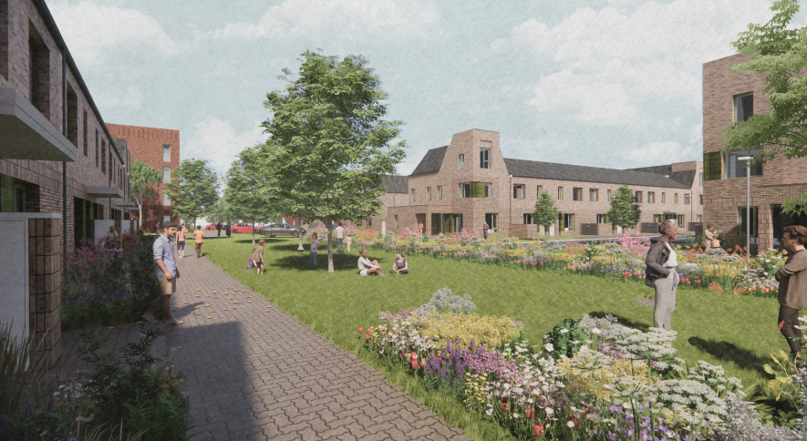
Division A
Expenditure of €111.8 million proposed for Housing Services in 2023:
(Increase of €10m on 2022)
€57.7m: for the provision of approx. 3,350 RAS, AHB and Leasing properties
€17.6m: maintenance of over 10,000 homes including €4.6m for re-lets/rightsizing transfers & €1.4m transfer to planned maintenance fund
€10.1m: supporting housing strategy, construction and delivery including Part V
€9.9m: housing services, grants & supports for Travellers, homeless, disabled & older persons
€5.6m: estate & tenancy management including housing welfare supports
€6.6m: loans & rents assessment (including debt management)
€1.4m: private rented inspections, managing HAP & monitoring vacant homes
Income of €101.2 million projected for 2023 (up €7.9m on 2021):
DHLGH funding: €66.7m for RAS/ Leasing/AHB supply, re-lets, Traveller accommodation, housing grants, inspections etc.
Projected rental income of €31.4m from social housing, leasing & RAS tenancies

Slide 8
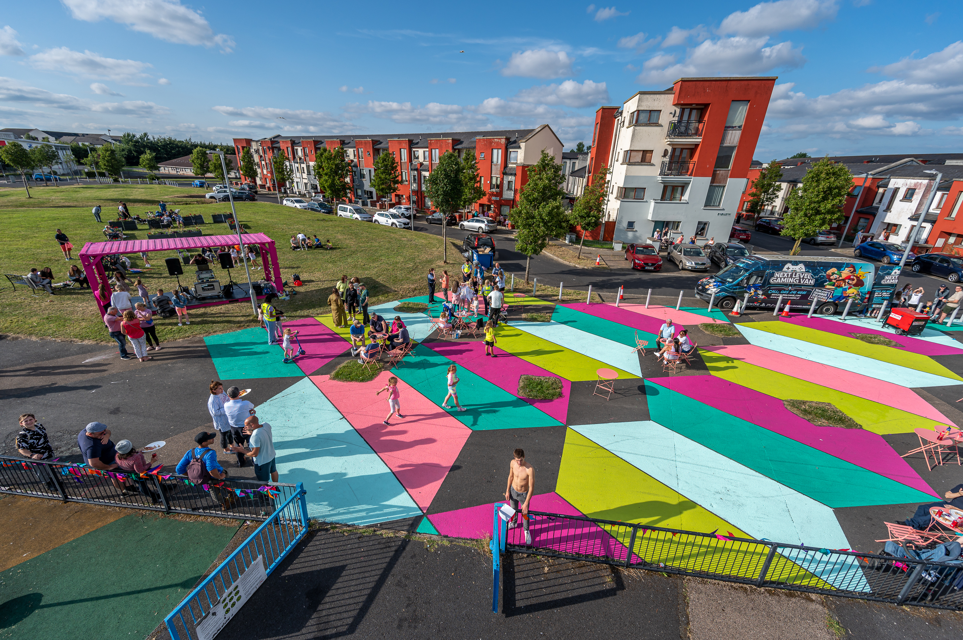
Part of Division D, F & G
Community Development, Sports, Interagency & Social Inclusion Programmes Division D
€2.3m: SICAP programme including additional funding for Ukrainian responses
€ 1.7m for social inclusion, age friendly & interagency work
Division F (€10.9 million expenditure in 2022)
€2.2m: running of community facilities including €500k for governance/management supports & €200k for solar panel installations
€1.1m: community grants, initiatives & events
€1.05m: funding for priority new facilities in Citywest, Newcastle & Clondalkin
€2.2m: sports, leisure & wellbeing programmes including new sports plan implementation and supporting operations/community access for sports & leisure facilities
€2.3m: Community Employment scheme & community CCTV operational costs
Division G
€0.2m: school meals programme & education/sports bursaries

Slide 9
Director of Land Use, Planning and Transportation

Slide 10
Division B – Road Transport & Safety
Overall expenditure proposed for 2023 is €39,087,700
This is an increase €4,287,200 from 2022, however, 87% of this is projected inflation increases
National and regional road works: €4,034,800
Includes general and winter maintenance along national (N81) and regional roads (note: national roads are the responsibility of TII)
Local road maintenance: €19,247,200
County wide Local Road and Footpath improvements €6,150,000
Cycle Track, Quality Bus Corridor maintenance and footpath dishing €550,000
Bridge safety works €430,900
District centre improvements €650,000 with enhancements set to commence on site in Lucan and Castletymon, and designs will progressed for Clondalkin, Rosemount and Bawnogue

Slide 11
Division B – Road Transport & Safety
Public lighting: €6,169,000
LED programme €850,000 with over 600+ LED upgrades to be completed in 2023
Maintenance of the Council’s 30,000 public lights and minor improvement works €5,311,300
Traffic management improvement, road safety & promotion and car parking: €8,711,300
Traffic Management and Improvement works €3,639,200 (traffic lights, traffic management centre)
Road safety works, education and promotion €4,430,900 (traffic calming, street improvements, training, school wardens)
Management of on and off street car parking €641,200
Alongside this, c.20 active travel (pedestrian and cycle) schemes are being progressed through the Cycle South Dublin programme

Slide 12
Division D – Development Management
Overall expenditure proposed for 2023 is €9,833,200 (+€1,302,600 from the 2022 adopted budget)
Forward Planning: €3,920,400 (+€552,100 from 2022)
Implement the newly adopted County Development Plan and address final Ministerial Directions
Manage delivery of SDZ schemes at Adamstown & Clonburris including URDF and LIHAF funded strategic infrastructure
Mange delivery of adopted LAPs at Newcastle, Tallaght, Ballycullen-Oldcourt
Commence a CDP variation for the City Edge lands
Commence the Clondalkin Local Area Plan
Commence a review of the County’s Employment Land, Rural Housing and the Brittas area
Active Land Management including the RZLT, Vacant Sites Register, Housing Task Force monitoring
Heritage and biodiversity projects €136,100 and Conservation projects €208,000

Slide 13
Division D – Development Management
Planning Control and Enforcement at €4,894,300 (+€728,700 from 2022)
At the end of Sept. 2022 the Council received 972 planning applications compared to 797 for the same period in 2020
At the end of Sept. 2022 a total of 150 planning enforcement cases had been opened and 301 cases closed
E.Planning €49,000
Building Control at €652,000 (+€20,700 from 2022)
As of the end of September 2022 the Council had received
173 Disability Access Certs, an increase from 128 for the same period in 2021
220 Fire Certs, an increase from 190 for the same period in 2021
371 Commencement Notices, a decrease from 413 for the same period in 2021

Slide 14
Director of Environment, Water and Climate Change

Slide 15
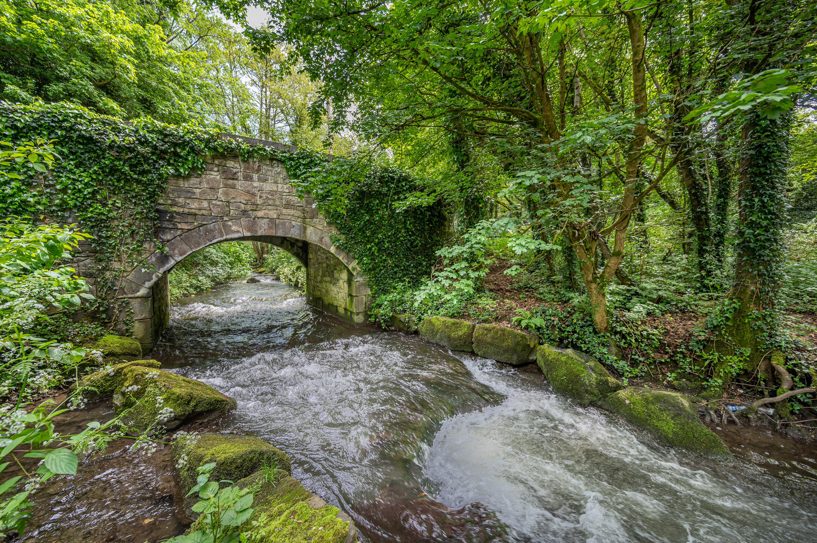
Division C, G & H
Water Services (Division C)
Expenditure of €14,447,200
€9,335,600 is recoupable from Irish Water under the SLA.
The expenditure for Surface Water/Flood Management
is €4,934,000 for 2023.
Agriculture, Education, Health and Welfare (Division G)
The overall expenditure on Veterinary Services is €1,552,300
Machinery Yard (Division H) 2023
The total Machinery Yard budget for 2023 is €3,924,400.
Of that €1,020,100 is provided for updating and modernising the Council’s fleet in order to maintain operational efficiency and reliability.

Slide 16
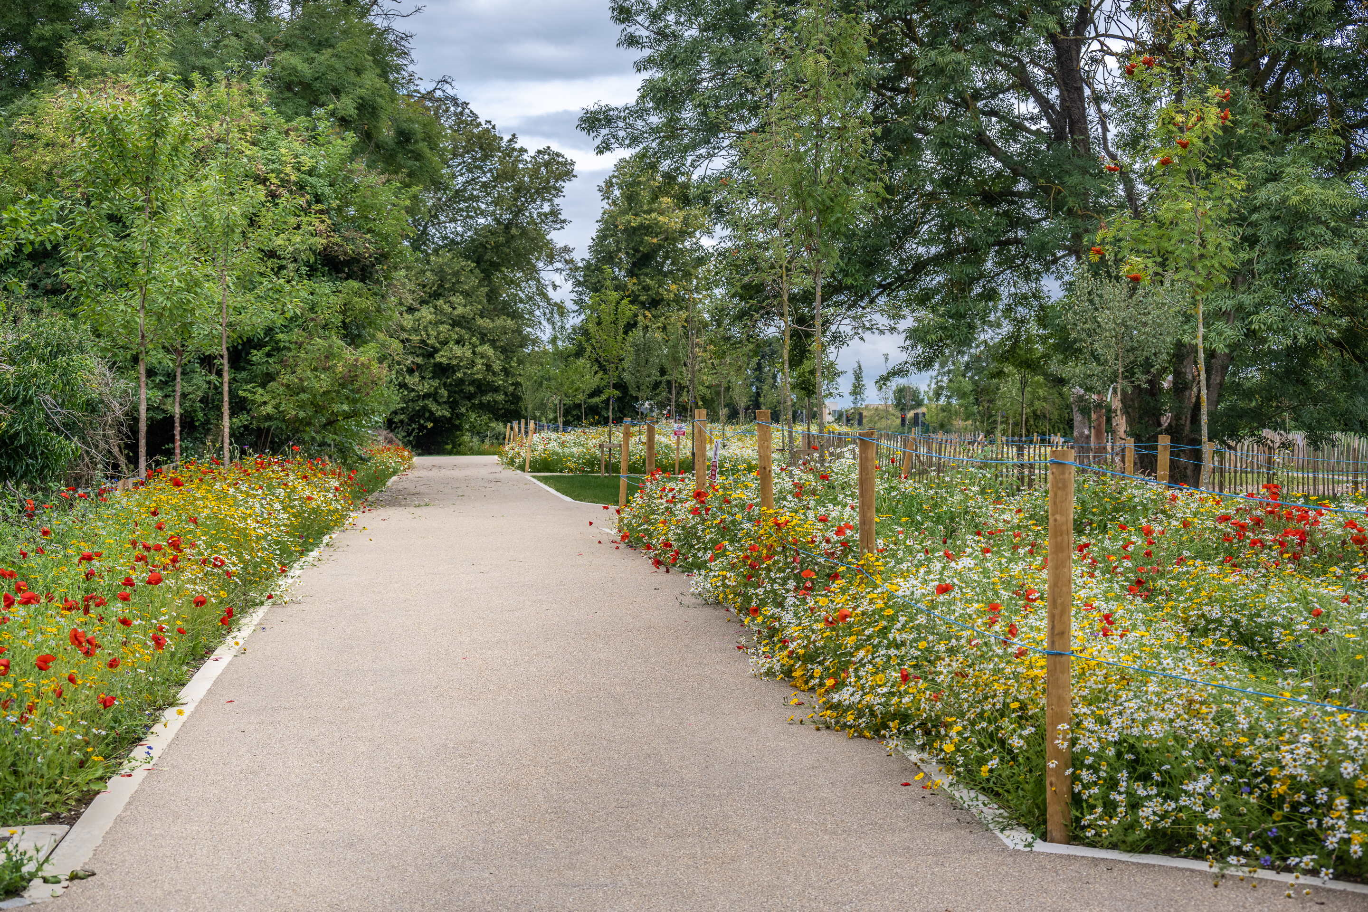
Environmental Services (Division E)
The overall expenditure in Division E is €43,702,900
The main areas of expenditure include:
Landfill Operations €1,091,700
Fire Service €23,190,000
Public Realm Cleansing Programme €13,210,700
Water Quality, Air & Noise Pollution Control €925,700
Burial Grounds Maintenance €1,352,100
Derelict Sites & Dangerous Buildings €360,500
Climate Change Action Fund €300,000

Slide 17
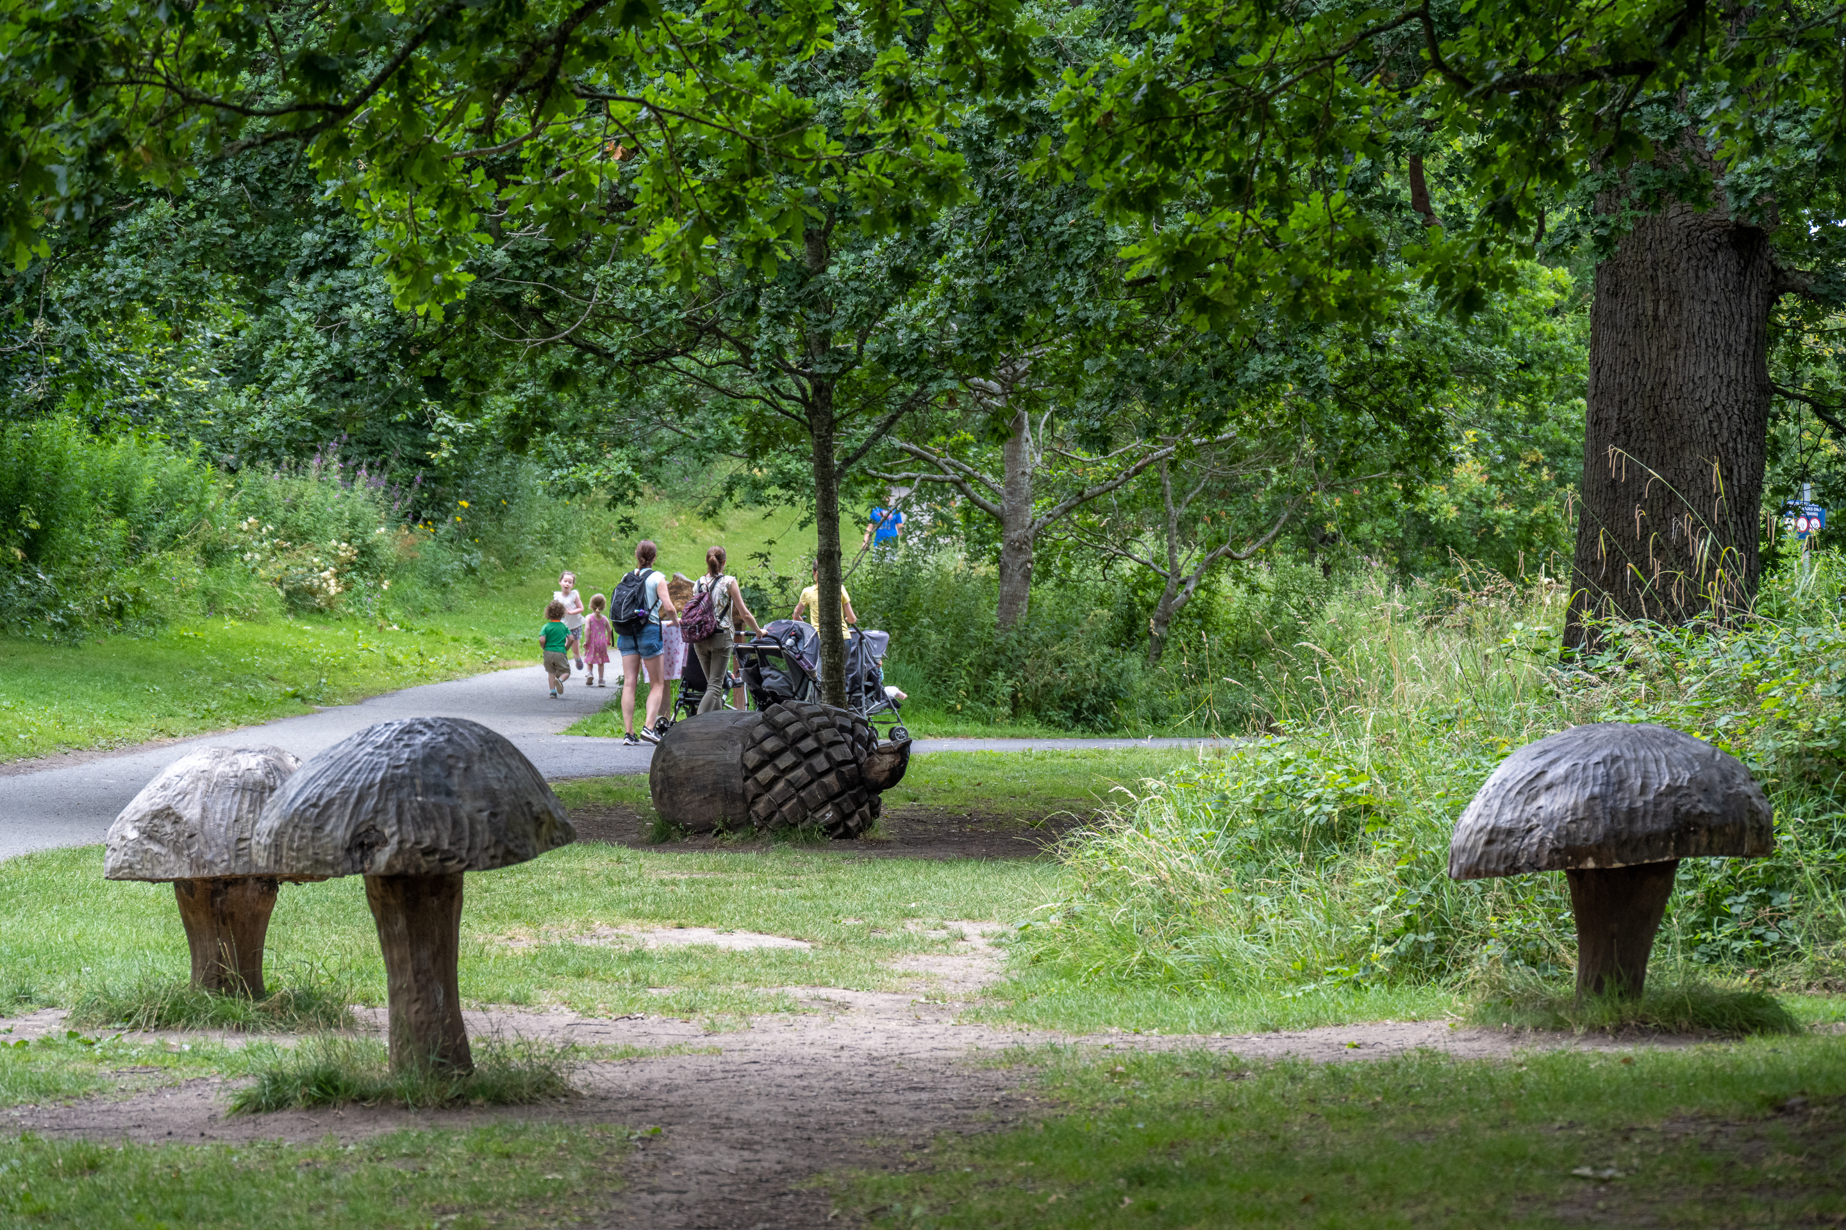
Recreation & Amenity (Div F)
The overall expenditure for the Maintenance & Improvement of Public Realm is €25,338,900
The main areas of expenditure are:
Grass Cutting Programme & Weed Control €5,174,200
Tree/Hedge Cutting Programme €3,068,500
Public Realm/Parks Management & Operation €3,448,700
Public Realm Improvement Works €2,313,800
Pitch Maintenance €394,100
Leisure Facility & Playground Improvement €2,413,000
Delivery of Astro Pitch & Teenspace Programme €1,500,000

Slide 18
Director of Economic Enterprise & Tourism Development

Slide 19
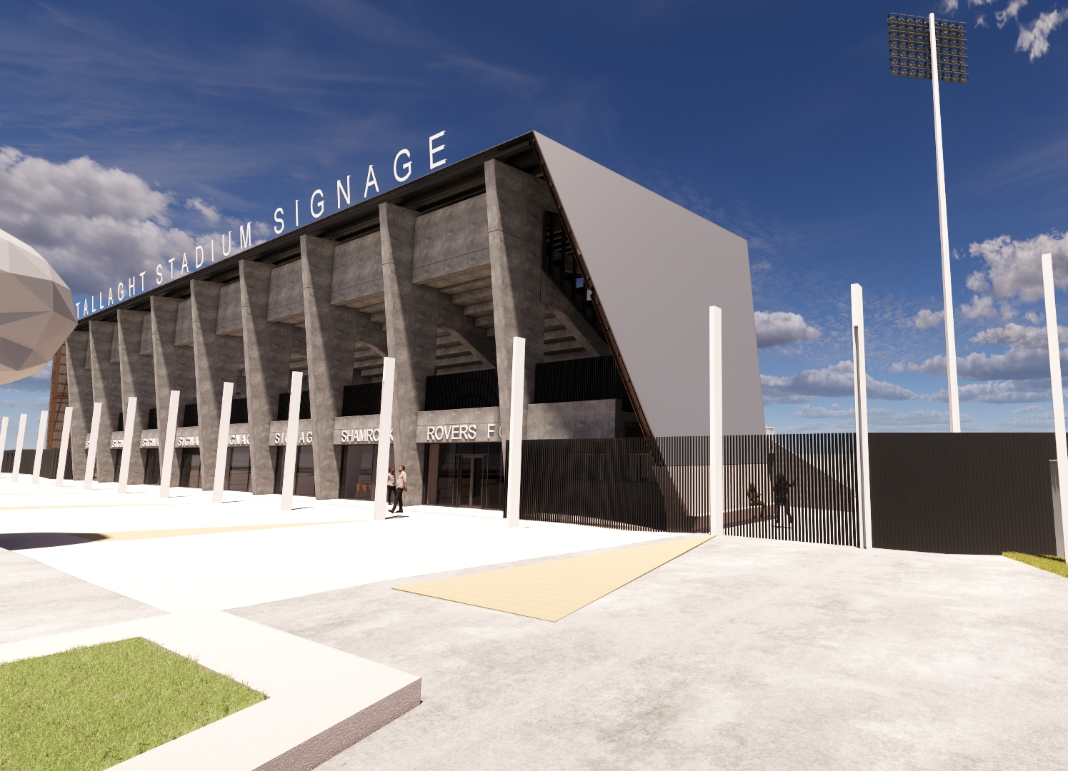
Working with Business
Division D & F: €27,815,500 (2023) / € 25,305,900 (2022)
Business Support Fund: €1,000,000
Grange Castle Business Park & Expansion
LEO Feasibility, Priming & Business Expansion Grants: €650,000
Development of Business Networks: €697,000
12th Lock Masterplan: €1,500,000
Tallaght Heritage Centre: €1,000,000
Dublin Mountains, Rathfarnham Castle, Canal Greenway & Lucan Village Tourism Projects
Tourism Strategy 2023 - 2028
Tallaght Stadium 4th Stand & West Stand Upgrade Works

Slide 20
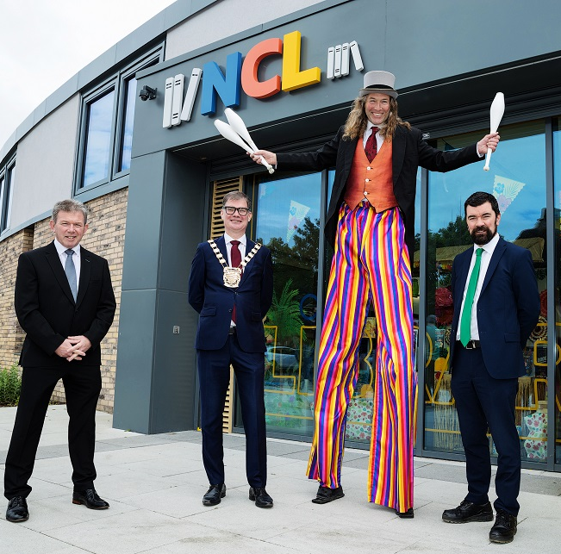
Managing & Promoting Cultural assets
Library Services: €13,871,600
Arts Programme: €4,751,900
Library Branch Running Costs: €930,000
Books, periodicals & other materials: €880,000
Dublin West Library Revenue to Capital Transfer: €1,800,000
Library Development Plan Strategy 2023-2027
Music Generation Programme: €357,800
Other Arts Programmes: €522,000
Creative Ireland & Cruinniú na nÓg Programmes: €218,000
Live Outdoor Performance Programme: €160,000
Cultural Quarter Programme: €60,000
Civic Theatre: €277,300
Rua Red Arts Centre: €320,000

Slide 21
Director of Corporate Performance & Change Management

Slide 22
Corporate Performance & Change Management
Division D – Development Management
D06 Collaborative Budgeting €300K Have Your Say
D06 Women in Politics Campaign €10,000
D09 Twinning €20,000
D09 Eastern and Midland Regional Assembly annual contribution €160,000
Division H – Miscellaneous Services
H04 Franchise Costs €523,600
H09 Local Representation & Civic Leadership €1,893,000

Slide 23
Head of Finance

Slide 24
Div. H – Miscellaneous Services
2023 2022
Expenditure €13.2m €15.4m
Income €18.1m €9.5m
Net Cost (€4.9m) €5.9m

Slide 25
Division H03: Admin. of Rates Exp
2023 2022
Refund due to Vacancy €3.25m €4.3m
Provision for Irrecoverable Rates €4.0m €4.0m
Bad Debt Provision €0.0m €1.0m
Provision for Tribunal Appeals €0.0m €1.0m

Slide 26
Division H: Miscellaneous Services - Income
2023 2022
Government Grants
Payroll Recoupment €10.1m €5.8m
Energy Grant €3.0m
Goods & Services
PEL €2.0m €1.5m
IPB €1.3m €0.4m

Slide 27
Draft Budget 2023 & Adopted 2022
Divisions | Budget Expenditure 2023 | Budget Expenditure 2022 | Budget Income 2023 | Budget Income 2022
Housing & Building | €111,822,500 | €101,829,000 | €101,170,900 | €93,302,500
Road Transport & Safety | €39,087,700 | €34,800,500 | €5,613,800 | €5,215,400
Water Services | €14,447,200 | €14,241,400 | €10,007,800 | €9,692,400
Development Management | €25,834,900 | €22,990,400 | €8,363,600 | €7,961,900
Environmental Services | €43,702,900 | €40,117,500 | €8,018,300 | €5,047,400
Recreation & Amenity | €56,137,200 | €50,534,700 | €4,506,800 | €5,057,600
Agriculture, Education, Health & Welfare | €1,761,900 | €1,802,000 | €650,600 | €671,300
Miscellaneous Services | €13,276,300 | €15,398,200 | €18,177,400 | €9,515,000
Total | €306,070,600 | €281,713,700 | €156,509,200 | €136,463,500
Local Property Tax |  |  | €6,276,000 | €5,454,600
Rates |  |  | €143,285,400 | €139,795,600
Total |  |  | €306,070,600 | €281,713,700

