Slide 1

Grand Canal to Lucan Urban Greenway
Part 8 Presentation 2022
SDCC Phase 1 of the Canal Loop Urban Greenway
SDCC Full Council November 14th, 2022

Slide 2

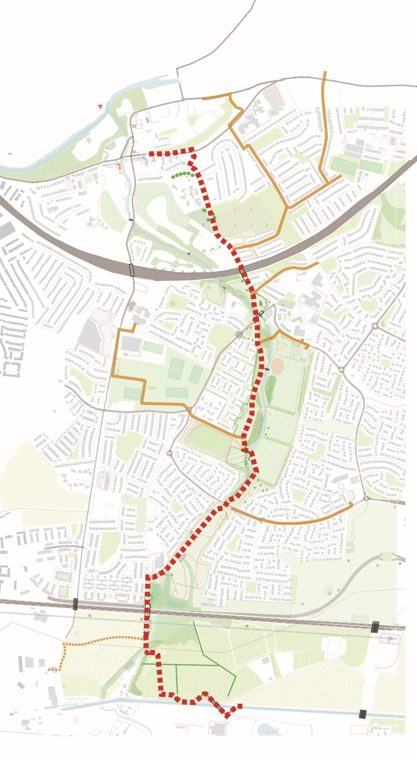
Proposed Development
The Grand Canal to Lucan Urban Greenway includes:
Construction of 4.2 km shared pathways pedestrian and cycle facilities within parklands and quiet streets and traffic calming measures on vehicle carriageway from Grand Canal to Lucan Village.
Construction of 4.29km school connections with improved footpaths, cycle facilities, and school zones.
Junction amendments to provide safer movement of pedestrians and cyclists.
Associated services.
Landscaping and Public Realm works.

Slide 3
Visuals of the proposed scheme

Slide 4
Pre-Part 8 - Non-Statutory Summary
From December 1st, 2021, to Jan 14th 2022 a non-statutory public consultation was undertaken via a virtual consultation room.
After the 2021 non-statutory public consultation was completed, the SDCC team continued to carry out non-statutory public consultation through Resident Association meeting, letter drops, and site meeting with stakeholders to better understand the outcomes of the 2021 non-statutory public consultation.
From this emerging preferred route, the Part 8 was designed and proposed by means of a statutory consultation as outlined in Section 1.2.2 of this report.

Slide 5
Part 8 – Consultation Summary
The formal consultation for the Part 8 application ran from 8th of September 2022 to 21st of October 2022: https://grand-canal-to-lucan-urban-greenway.virtual-engage.com/
During the consultation, there was:
  69 Individual Observation/Submissions
  92 Questionnaire Responses

Slide 6
Part 8 – Consultation Summary
From the questionnaire, 91% of responders where in support of the scheme.
Most responses were local; living less than 5km from the scheme and travel through the area daily.
87% responded that the proposed scheme will make the area more pedestrian and cycle friendly.

Slide 7
Submission Consultation Summary
Within the 69 Individual Observation/Submissions, there were several recuring themes:
Key Themes
Vesey Park Connection
  This requires additional study and will be examined during the next phase of the Canal Loop Urban Greenway (SDCC to FCC)
  This would be a Material change, as it was out of the scope and would require substantial change to the environmental reports.
Lucan Newlands Road
  alternating one-way traffic movements, at one time, with traffic lights
  two-way access for all modes of travel is retained
Loop/FCC/Village
  The Grand Canal to Lucan Urban Greenway is the first phase of the Canal Loop Urban Greenway. The Active Travel team in FCC are currently working on the route design in FCC and will be working closely with SDCC to finalise route options and design proposals, during the second half of 2023.
Brookvale
  Accessible gradients proposed
  Provide a new park to the area
  Suggestions on improvements
St Marys Crossing and Schools Improvements
  There were several suggestion and requests for improved connection to St Mary’s Boy School. Elements to be recommended.
Suggestions/General Comments
Public Lighting
Material
Additions/Suggestions
Maintenance
Seating
Kissing gates
Biodiversity
ASB
Segregation

Slide 8
Part 8 Proposed Amendment
St Marys Crossing and Schools Improvements which will be explored during detailed design:
  Move zebra crossing approximately 40m west of the proposed location (at Chapel Hill)
  Extend the Greenway westwards to connect with St. Mary’s Boys School
  Introduction of Safe School Street treatments, including bollards, road markings/art, and/or placemaking elements outside St. Mary’s Boys School will be examined further in detail design.
  These improvements will require the removal of 4 parking spaces across from St Mary’s Boys School to allow for the widening of the southern footpath and to connect west into the Grand Canal to Lucan Urban Greenway.

Slide 9
Part 8 Proposed Amendment St Marys Crossing and Schools Improvements

Slide 10
Questions?

