Slide 1
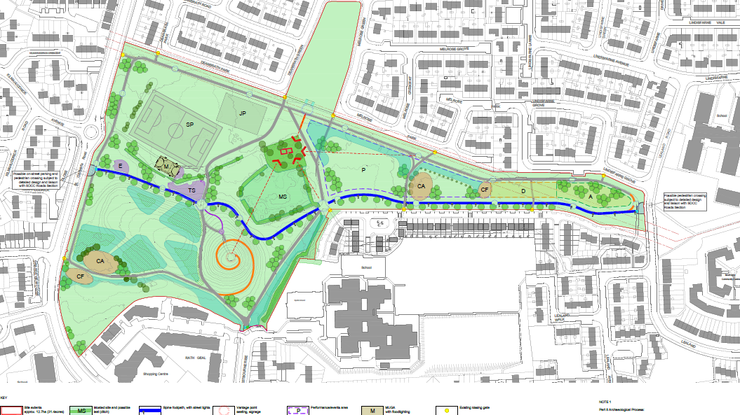
St Cuthbert’s Park Upgrade Part 8 Report Presentation

Slide 2
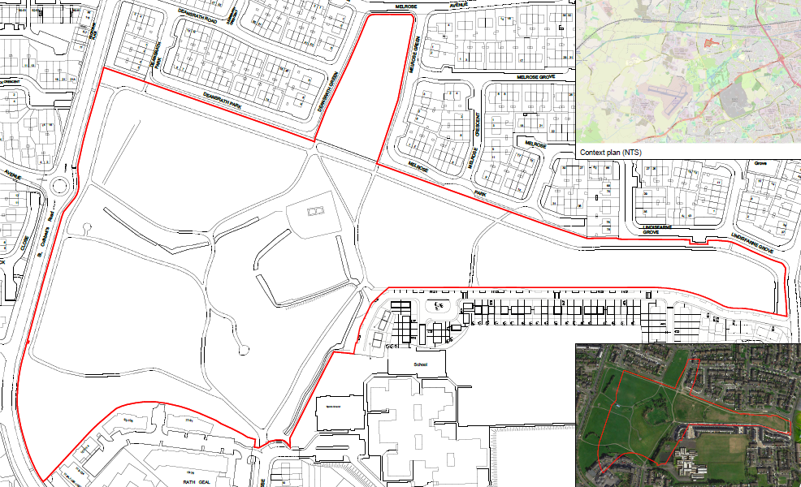
St Cuthbert’s Park Upgrade Part 8 Report Presentation
12.71 ha local park, located less than 0.5km south of the Grand Canal. It forms the public open space for the Deansrath, Kilmahuddrick and Bawnogue neighbourhoods. The park is set in a residential area.
A High-Level Task Force has delivered several on-the-ground improvements to date and were actively involved with the development of the design and informal consultation processes.
The proposed upgrade will further invest in the park and provide amenity and recreational activity for the local community.
The proposed works are within the curtilage of a Protected Structure (RPS133) and Monuments of Archaeological Interest (DU017-038001-/02-/03-) are located within the subject site.
Context of project & location

Slide 3
St Cuthbert’s Part 8 proposal
Proposed hard-surfaced primary walking/ cycling route with public lighting; traversing east-west, through the park;
Proposed hard-surfaced secondary walking/ cycling routes through the park;
3 No. Nodal points with seating as required;
Proposed on-street car parking and pedestrian crossing points (subject to detailed design with SDCC Roads Dept.);
Proposed vantage point, seating and signage;
Proposed Teenspace area with equipment, seating and surfacing;
Proposed outdoor exercise area with calisthenics or similar;
Proposed natural and equipped playspaces for children;
Proposed performance/ events area;
Proposed dogs off-leash area with dog-friendly features;
Proposed arboretum with edible fruits and nut trees;
Proposed grass sports pitches;
Proposed Multi Use Games Area (MUGA) with floodlighting;
Proposed play/exercise trail along the walking / cycling routes.
Proposed new planting to include: wildflower grassland with drifts of native bulbs; formal avenue trees; informal tree groups; community woodland; informal tree groups with native species; and other planting as required;
Vegetation clearance of St Cuthberts Church, Moated Site and Graveyard Site and further assessment of works to conserve the structures as advised; (Monuments of Archaeological Interest and a Protected Structure);
Seating, bicycle parking and signage;
Works to boundaries, accesses and entrances;
All associated landscape design including furniture and planting;
All ancillary works.

Slide 4
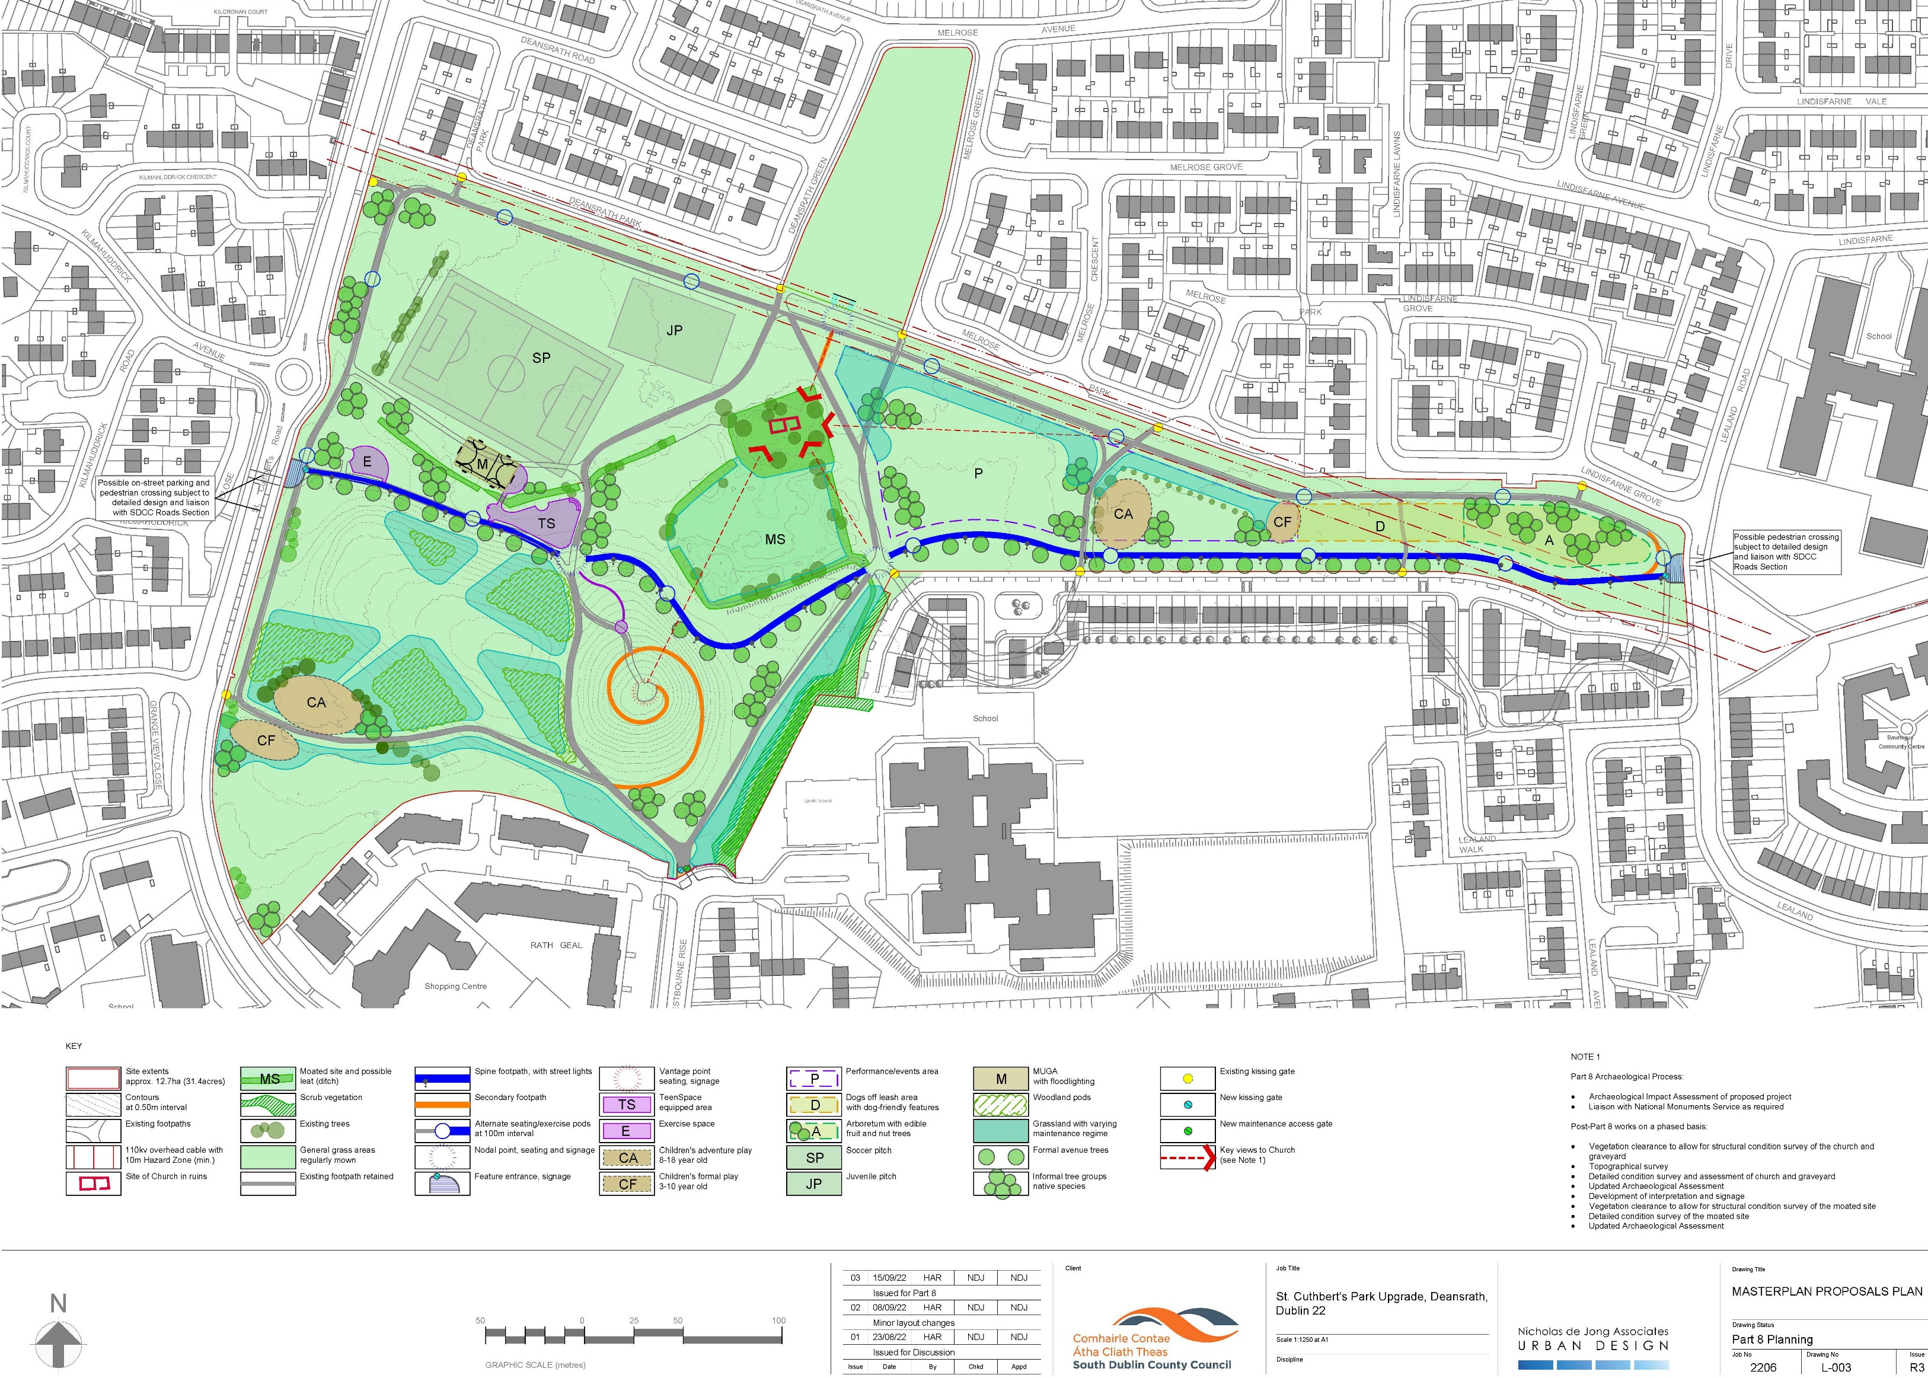
St Cuthbert’s Park Upgrade Masterplan

Slide 5
Background
The park has not been achieving its potential and has been subject to issues of vandalism and anti-social behaviour.
A multi-faceted and partnership approach has been developed with a High-level Task Force (HLTF) for St. Cuthbert’s Park.
This task force involves SDCC elected members and SDCC officials, An Garda Siochana, community representatives and other stakeholders with several actions taken and underway.
A key element to the project is local community and stakeholder engagement.
Non-Statutory Period
Engagement with HLTF
Informal Non-Statutory Consultation with key community stakeholders (residents, schools, clubs, groups, etc.)
Community Survey and meetings
Statutory Period
Public Consultation from 20th September 2022 to 2nd November 2022.
13 No. submissions were made during the Statutory Consultation process. They have been summarized and responded to in the CE Report.
Summary of St Cuthbert’s Park Part 8 Process

Slide 6
Issues/ Comments Raised:
Please see CE report for full summary, response and recommendation in relation to the submissions received
Planting.
Park rangers.
Litter collections and litter bins.
Consulting with An Garda Siochana in relation to anti-social behaviour mitigation.
Improving access and excluding unauthorised access.
Lighting within the park.
CCTV.
Facilities for local football club.
Perimeter boundaries and access points.
Archaeological features within the park.
Playgrounds and other recreational facilities.
Cycle facilities and width of shared route.

Slide 7
Recommendation for Part 8 Adoption
Following consideration of the submissions, the Chief Executive is of the view that the issues raised by way of the submissions can be satisfactorily addressed at the detailed design stage, operational stages and as outlined in the foregoing report and as set out in the conditions below. It is recommended that, as the proposal is consistent with the County Development Plan and the proper planning and sustainable development of the area, that the Council proceed with the Part 8 proposal for the upgrade of St Cuthberts Park in the townland of Kilmahuddrick and Deansgrange, Clondalkin, Dublin 22 with the following modifications:
It is proposed that the proposed main east-west shared route through the park be 3.5m wide.
All mitigation measures in relation to archaeology and cultural heritage set out in the Archaeological Impact Assessment St Cuthbert’s Park Upgrade Works Deansrath, Dublin 22 by Daniel Noonan Archaeological Consultancy shall be implemented, except as may otherwise be required to comply with the following conditions:
A suitably qualified archaeologist will be engaged to carry out archaeological monitoring under licence from this Department of all groundworks within the Zone of Archaeological Notification for the three monuments and of the proposed vegetation clearance works. No sub-surface work should be undertaken in the absence of the archaeologist without his/her express consent.
Should significant archaeological features be found, any works which would affect them shall cease pending agreement with the Department as to how they are to be dealt with. Where archaeological material/features are shown to be present, preservation in situ, preservation by record (excavation), or further monitoring may be required.
An archaeologist will be retained as part of the Design Team at detailed design stage for the upgrade works to the park, to further advise on archaeological risk of different elements as they evolve.
A ‘no-dig’ approach to the new paths be used, whereby at detailed design stage the paths are designed to minimise digging and the potential for subsurface disturbance.
Following the groundworks and the careful removal of the vegetation the following actions are required:
A written report detailing the results of the archaeological monitoring and an update of the Archaeological Assessment of the monuments, with mitigation measures to address the conservation measures required shall be submitted to this Department.
Conservation engineers condition assessment of the church, and the graveyard, its boundaries, and any monuments or grave markers it contains; Creation of a topographic and building survey of the church and graveyard, to support the archaeological and conservation assessments.
Regular liaison with the Department on the results of the assessments, for advice as required and the securing of any required permissions to enact the conservation measures.

Slide 8
Thank You

