Slide 1
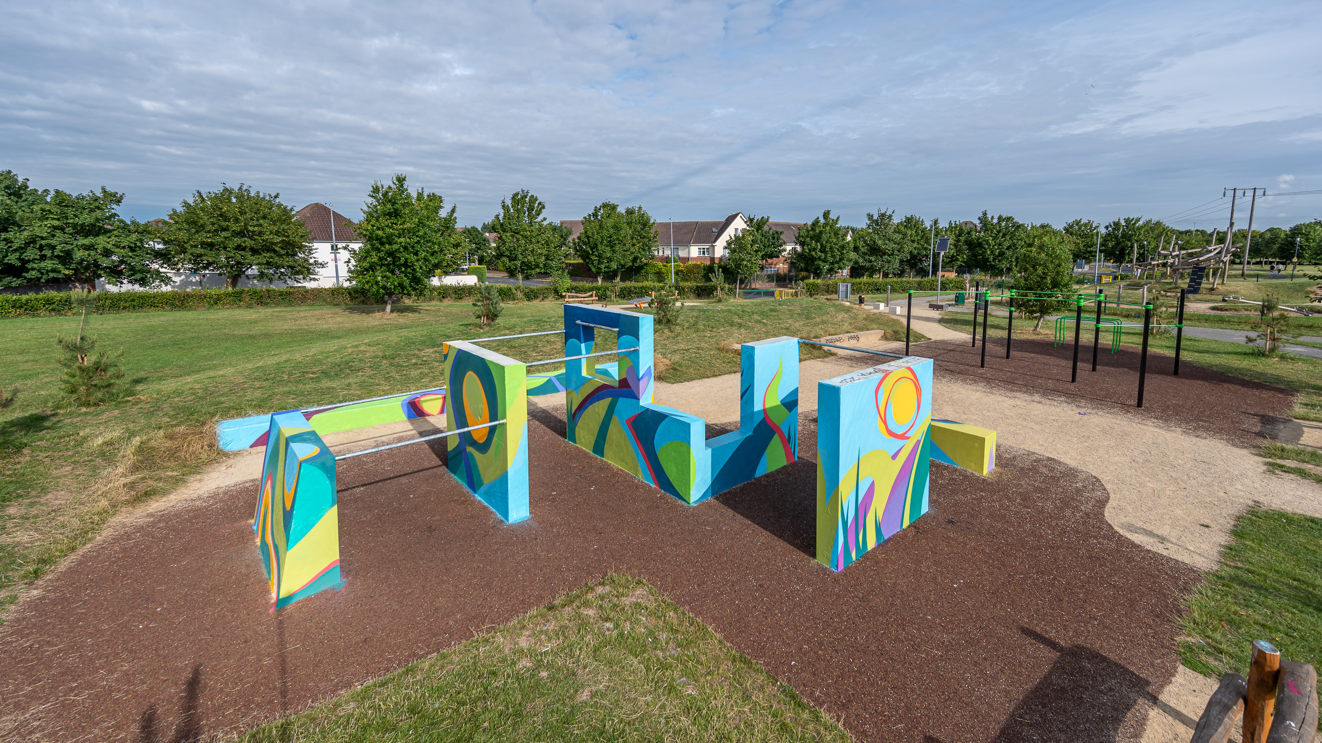


Teenspace Programme Report 2022
Public Realm Planning & Projects Team

Slide 2
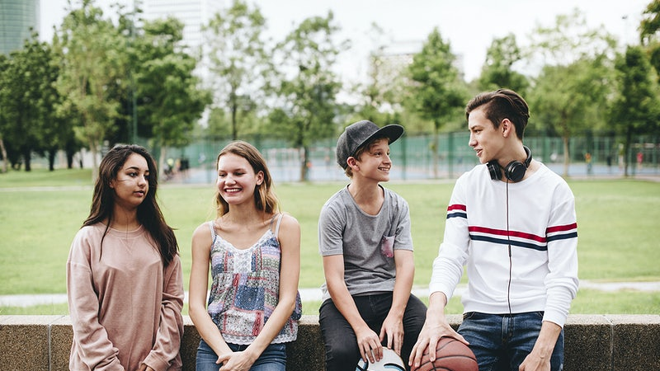
Teenspace Programme to date
We initially commenced the consultation process with teenagers in 2018, followed up with more in depth consultations, followed by site by site consultations with the teens from each area when locations were decided.
Teenagers wanted a place to hang out with friends, with the option for physical activity but with more emphasis on group activity and fun.
Currently we have 3 fully completed Teenspaces; Collinstown; Ballycragh; and Tandy’s Lane.
Griffeen Valley Park is operational, informal kick about area is left to be completed.
Avonbeg MUGA is to commence this side of Christmas.
Three more in the pipeline for early 2023; Bancroft; Tymon Limekiln; and Kingswood.

Slide 3
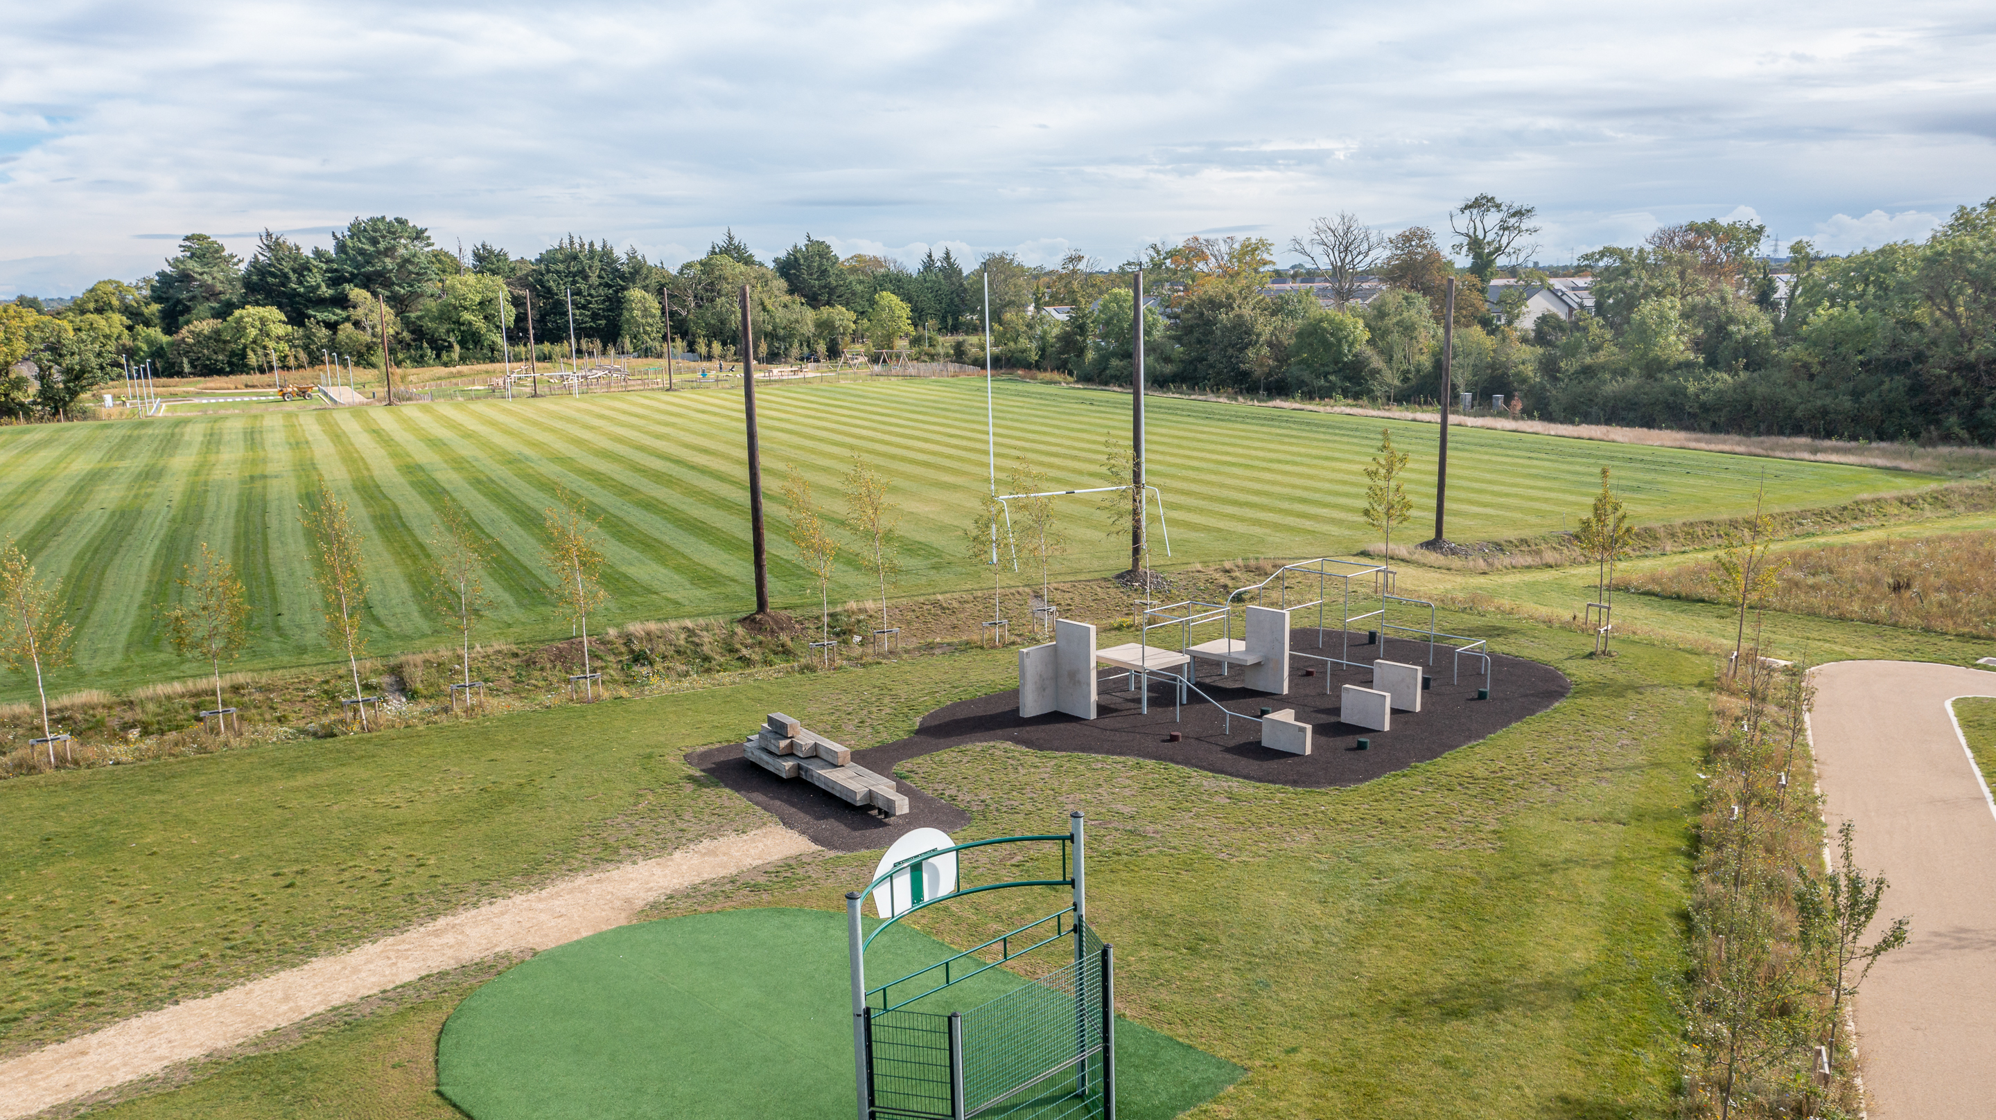
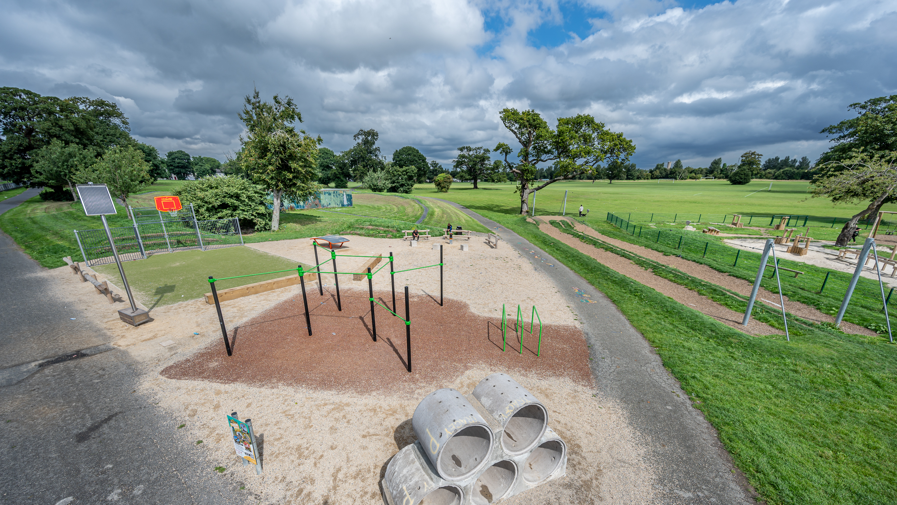
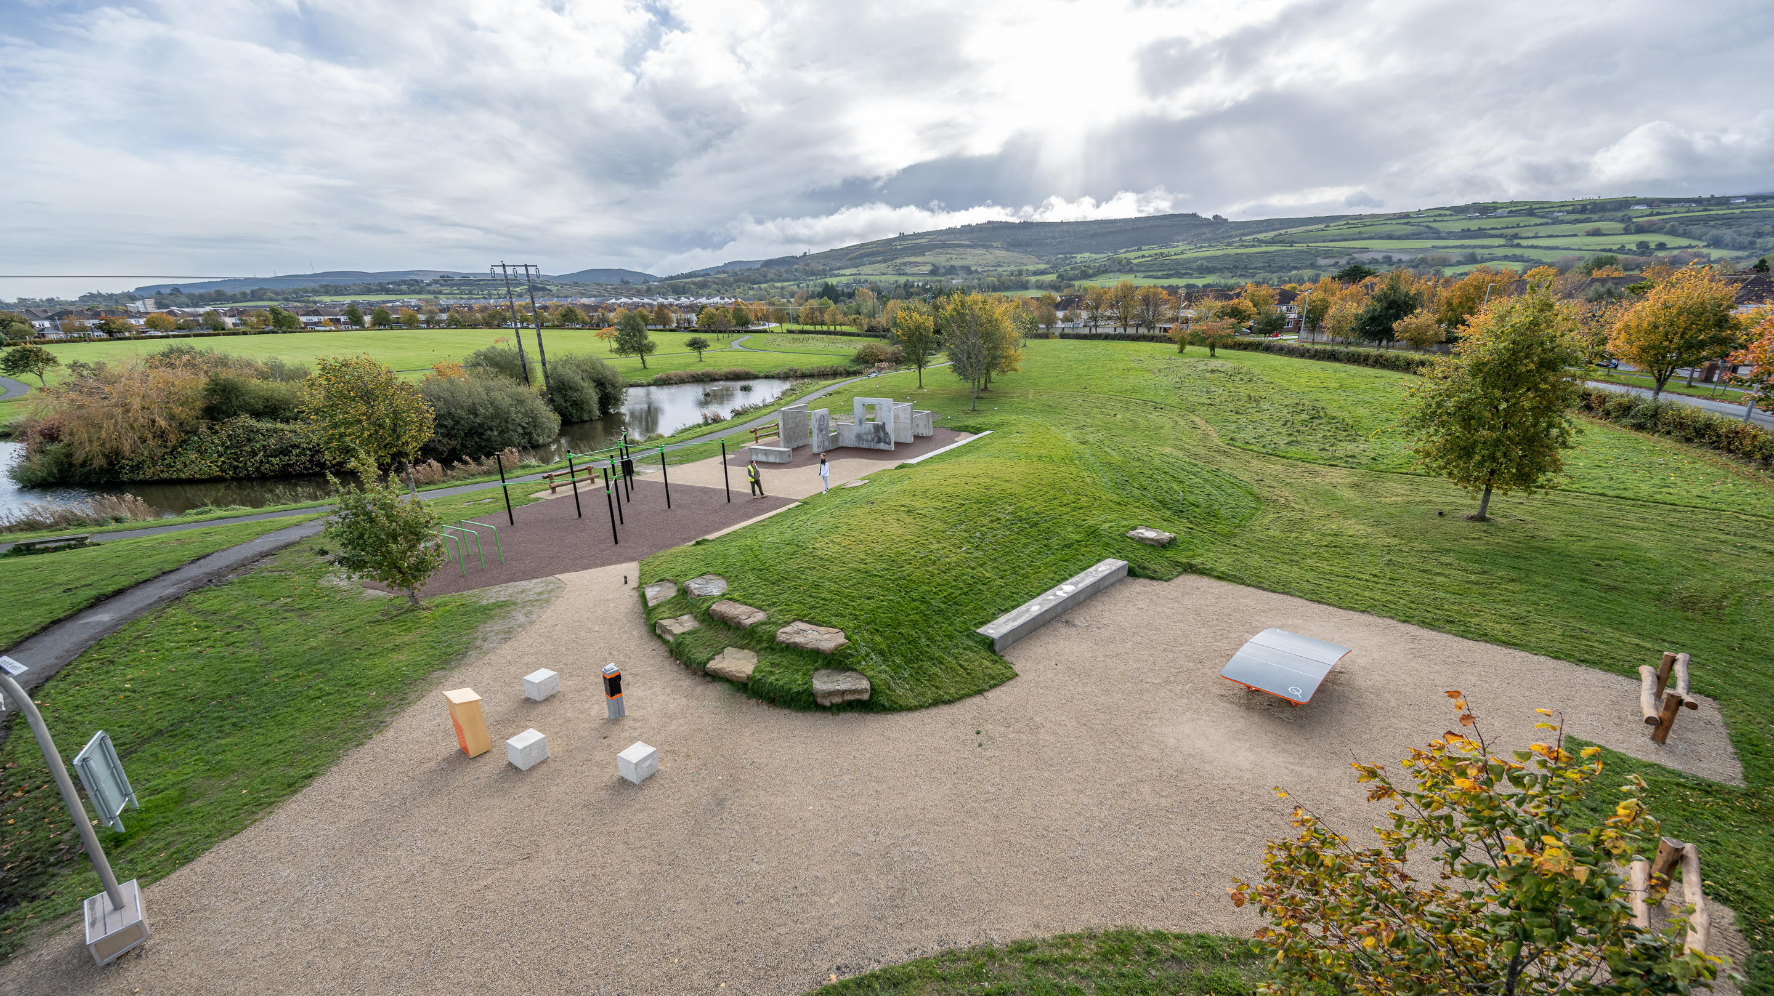
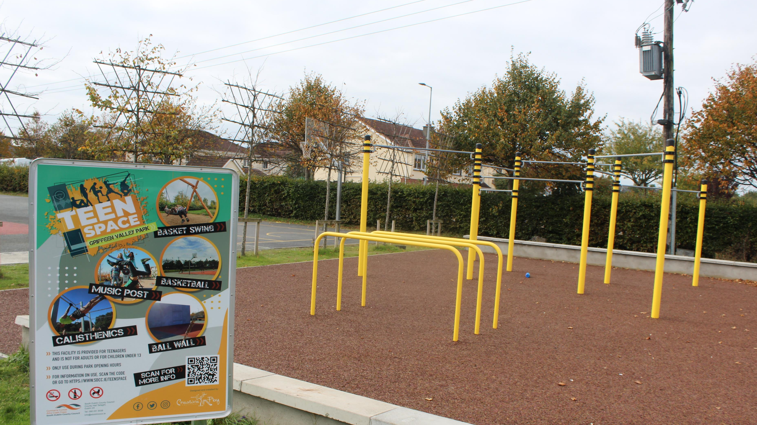
Existing/Completed Teenspaces
Tandy’s Lane Park
Collinstown Park - €105,703
Ballycragh Park - €96,916.30
Griffeen Valley Esker Park - €105,727

Slide 4
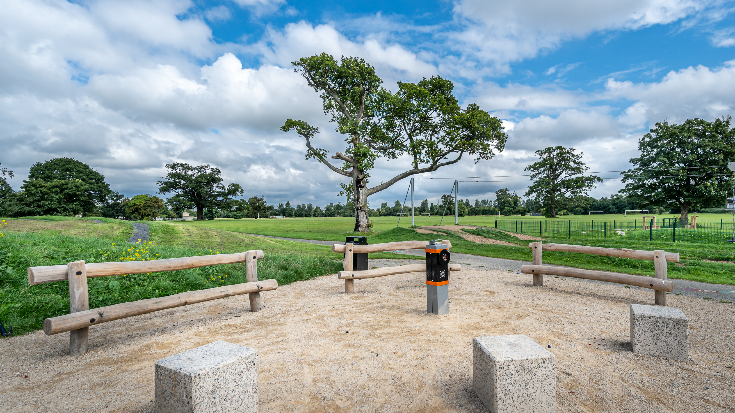
2022 Teenspace Programme Review Survey - Outcomes:
There were 297 participants for our teenspace feedback survey in 2022. The survey asked a number of questions looking for standard information in order to understand the participants with gender and age range. We asked about their experience with the existing teenspaces, have they visited one, how long they spend there, and generally when they visit. As well as what element they use the most.
Based on the results, most participants have not yet visited one. We also wanted to know what they wanted to see included in future teenspaces, where they wanted them, and what they would change about the existing ones. There were a high number of over 19’s recorded with these numbering 27.1% of the participants, with the majority of our participants aged between 12-14 years old.
During our consultations for phase 1 of the programme, we received up to 500 responses on each site from teenagers in the local areas.

Slide 5
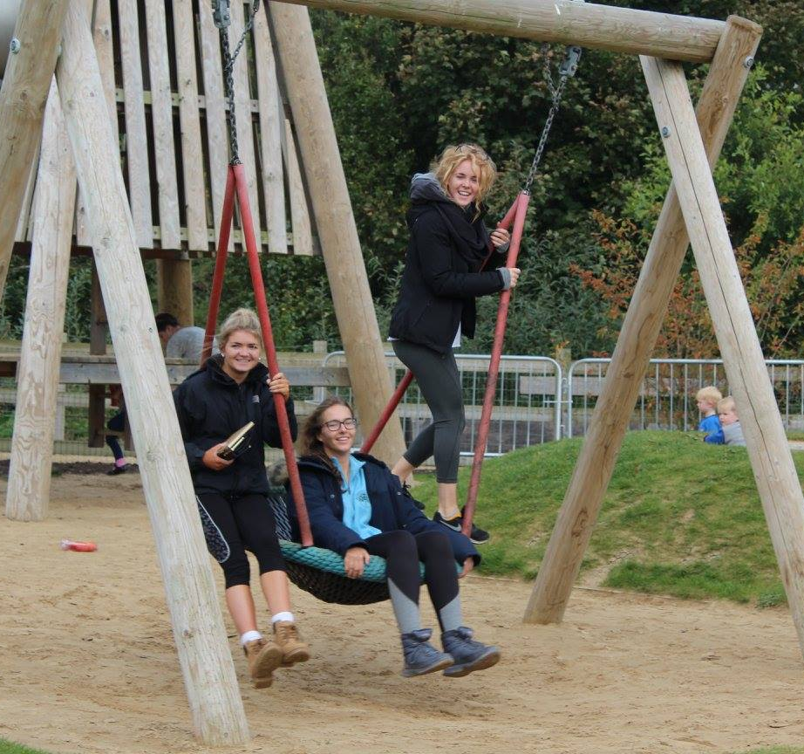
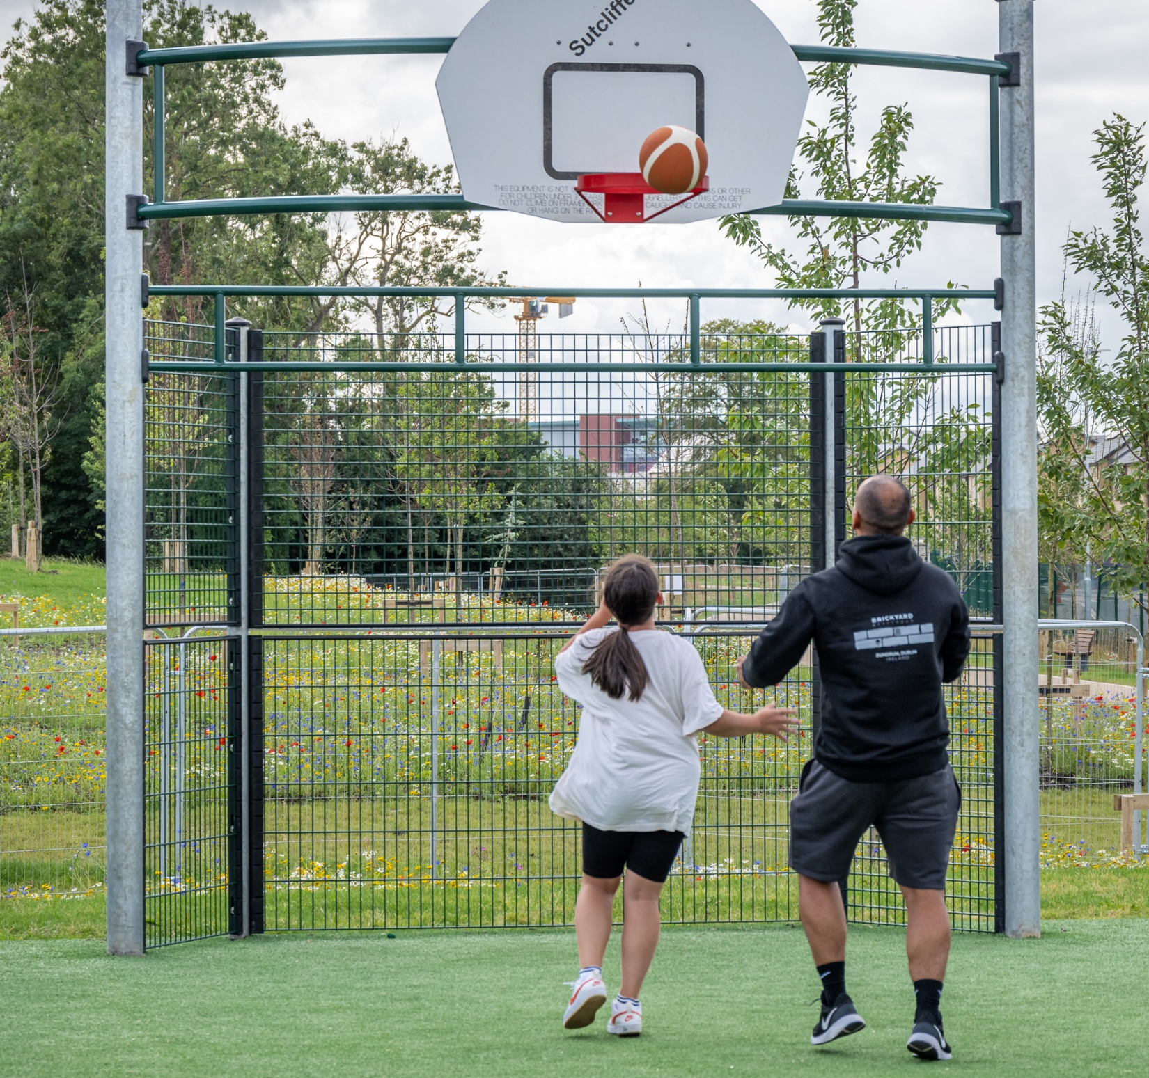
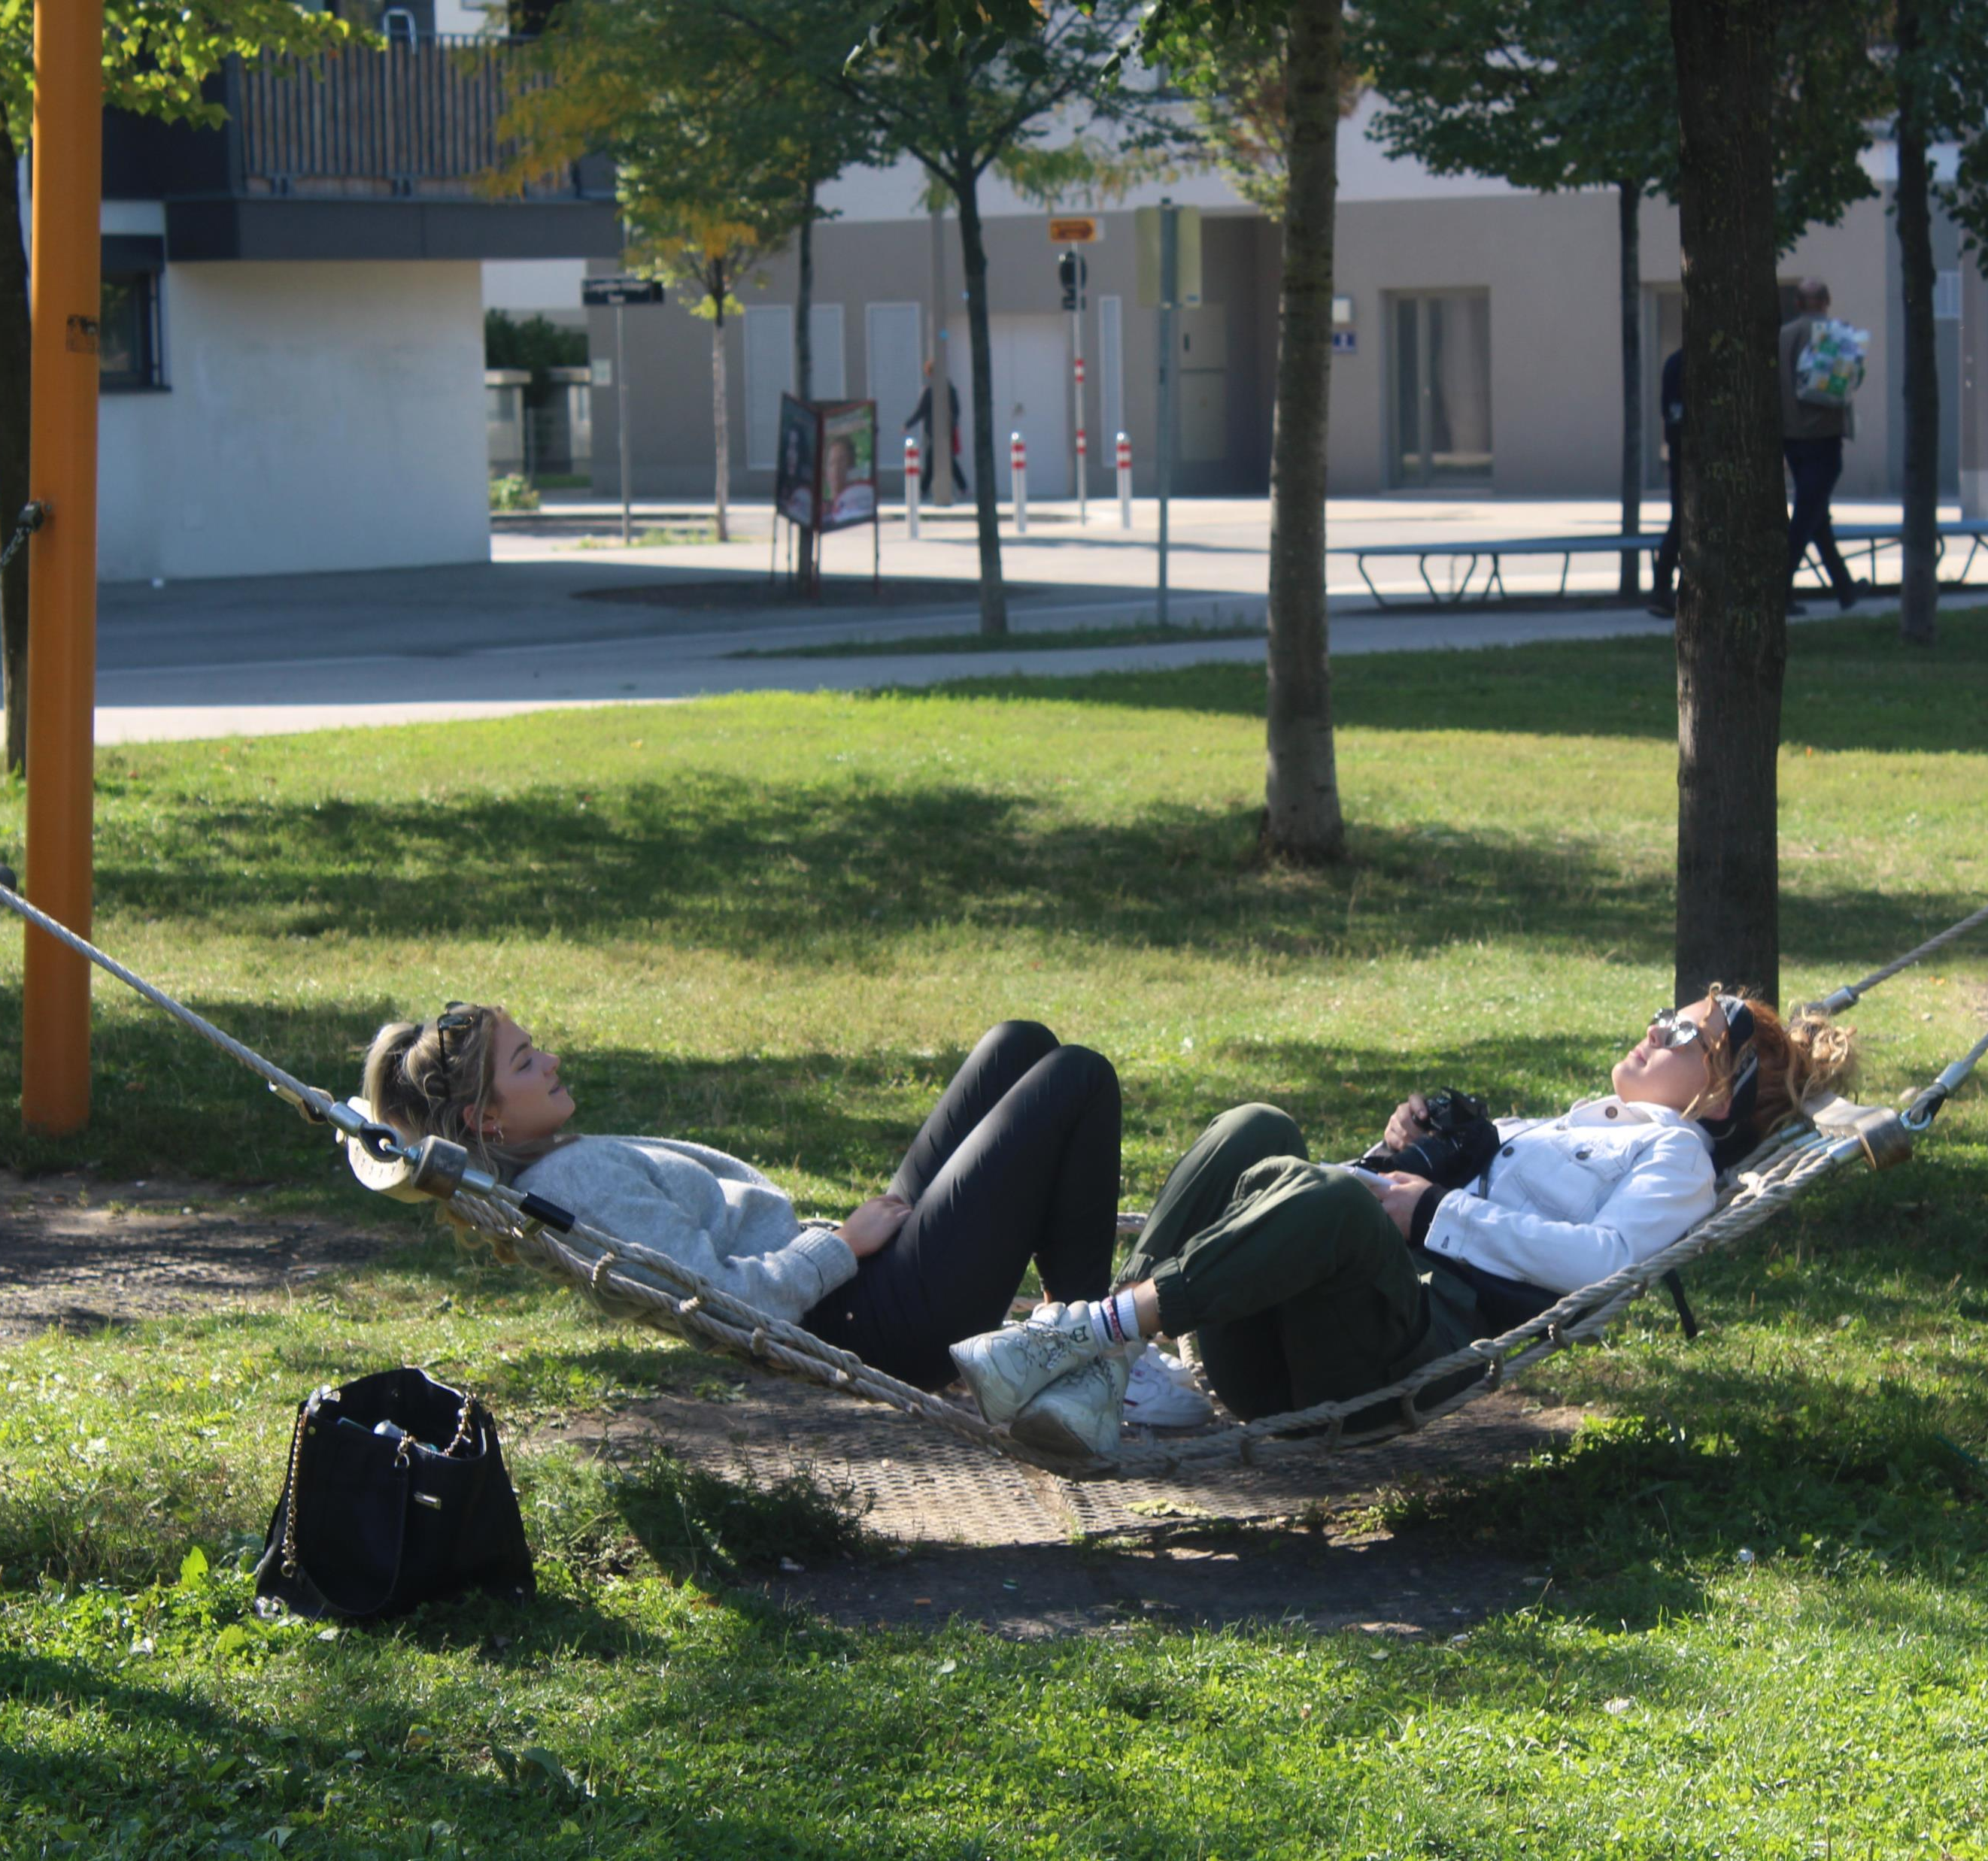
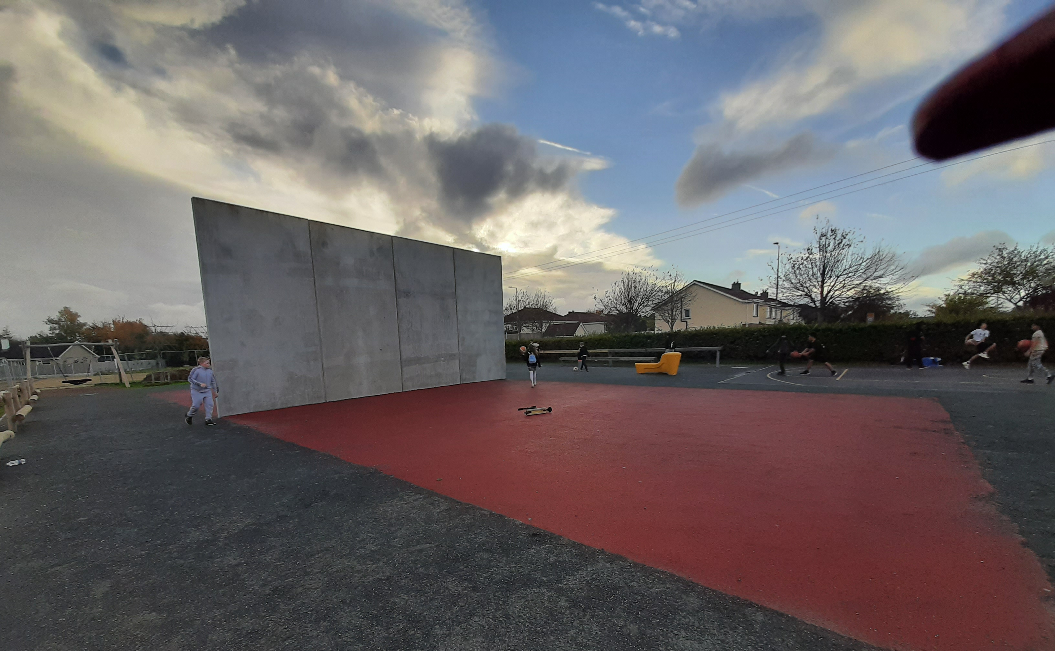
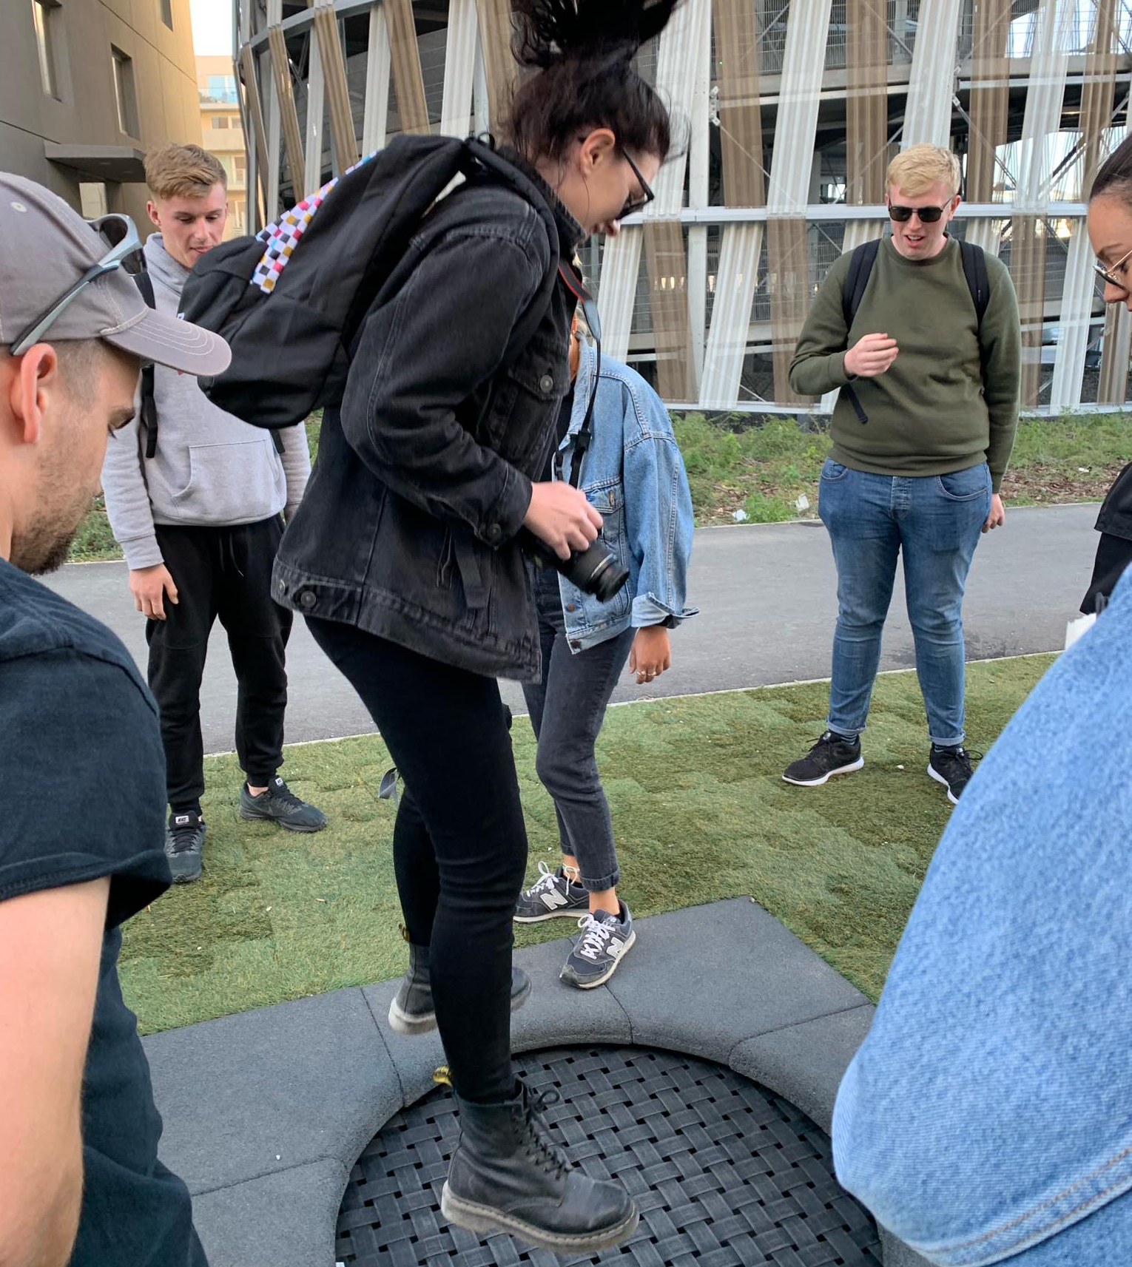
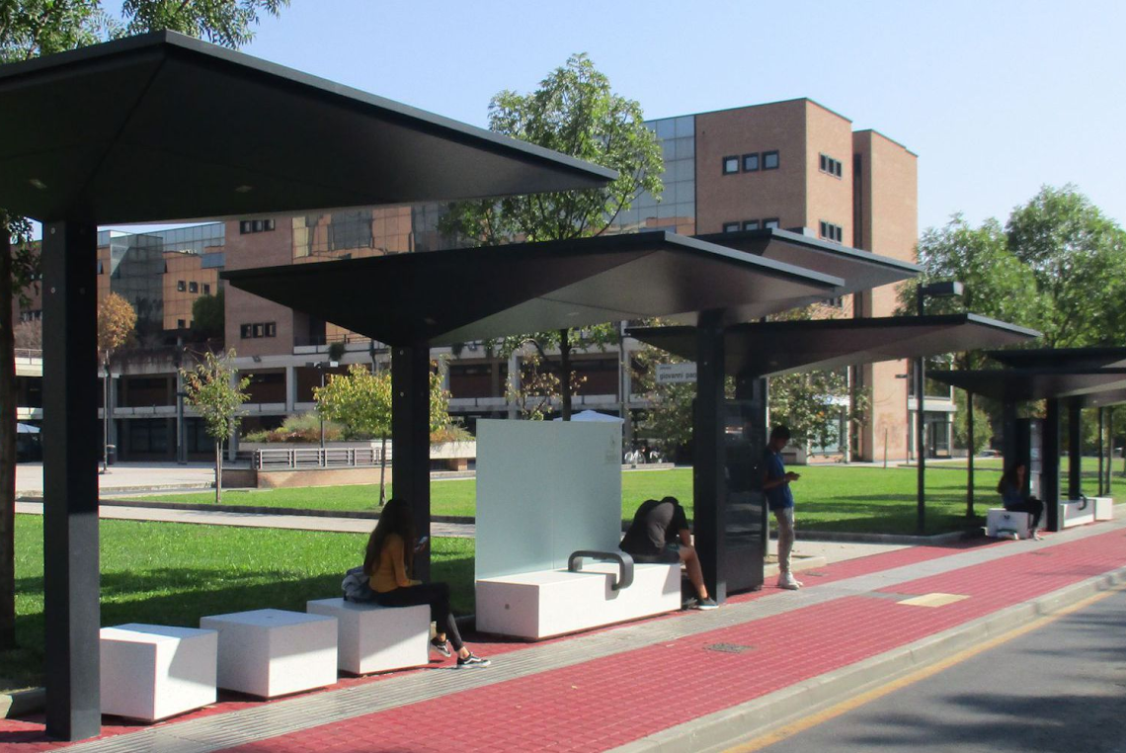
Suggested Improvements to our Teenspaces
More Play equipment.
Casual Sports Facilities
MUGAs (Multi Use Games Areas).
Skateparks
Lighting
Sheltered areas
More Bins
More Trees and Planting
Inclusivity and Safety

Slide 6
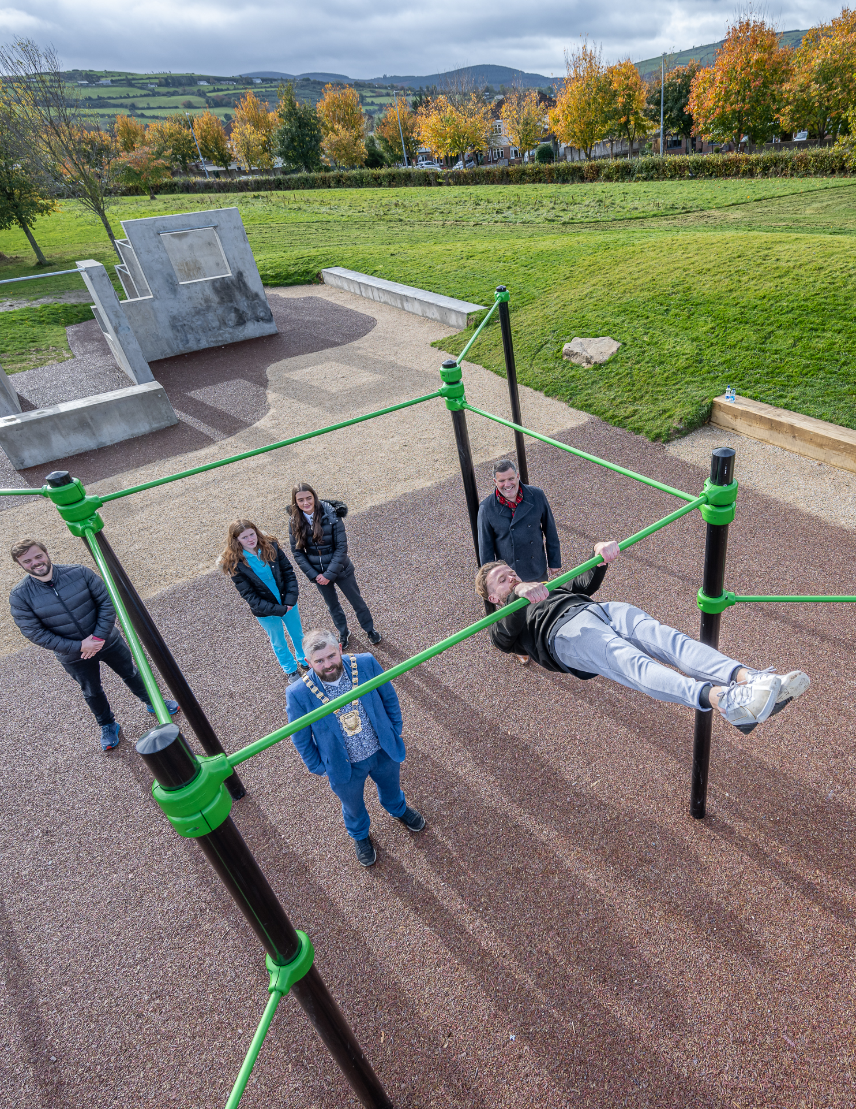
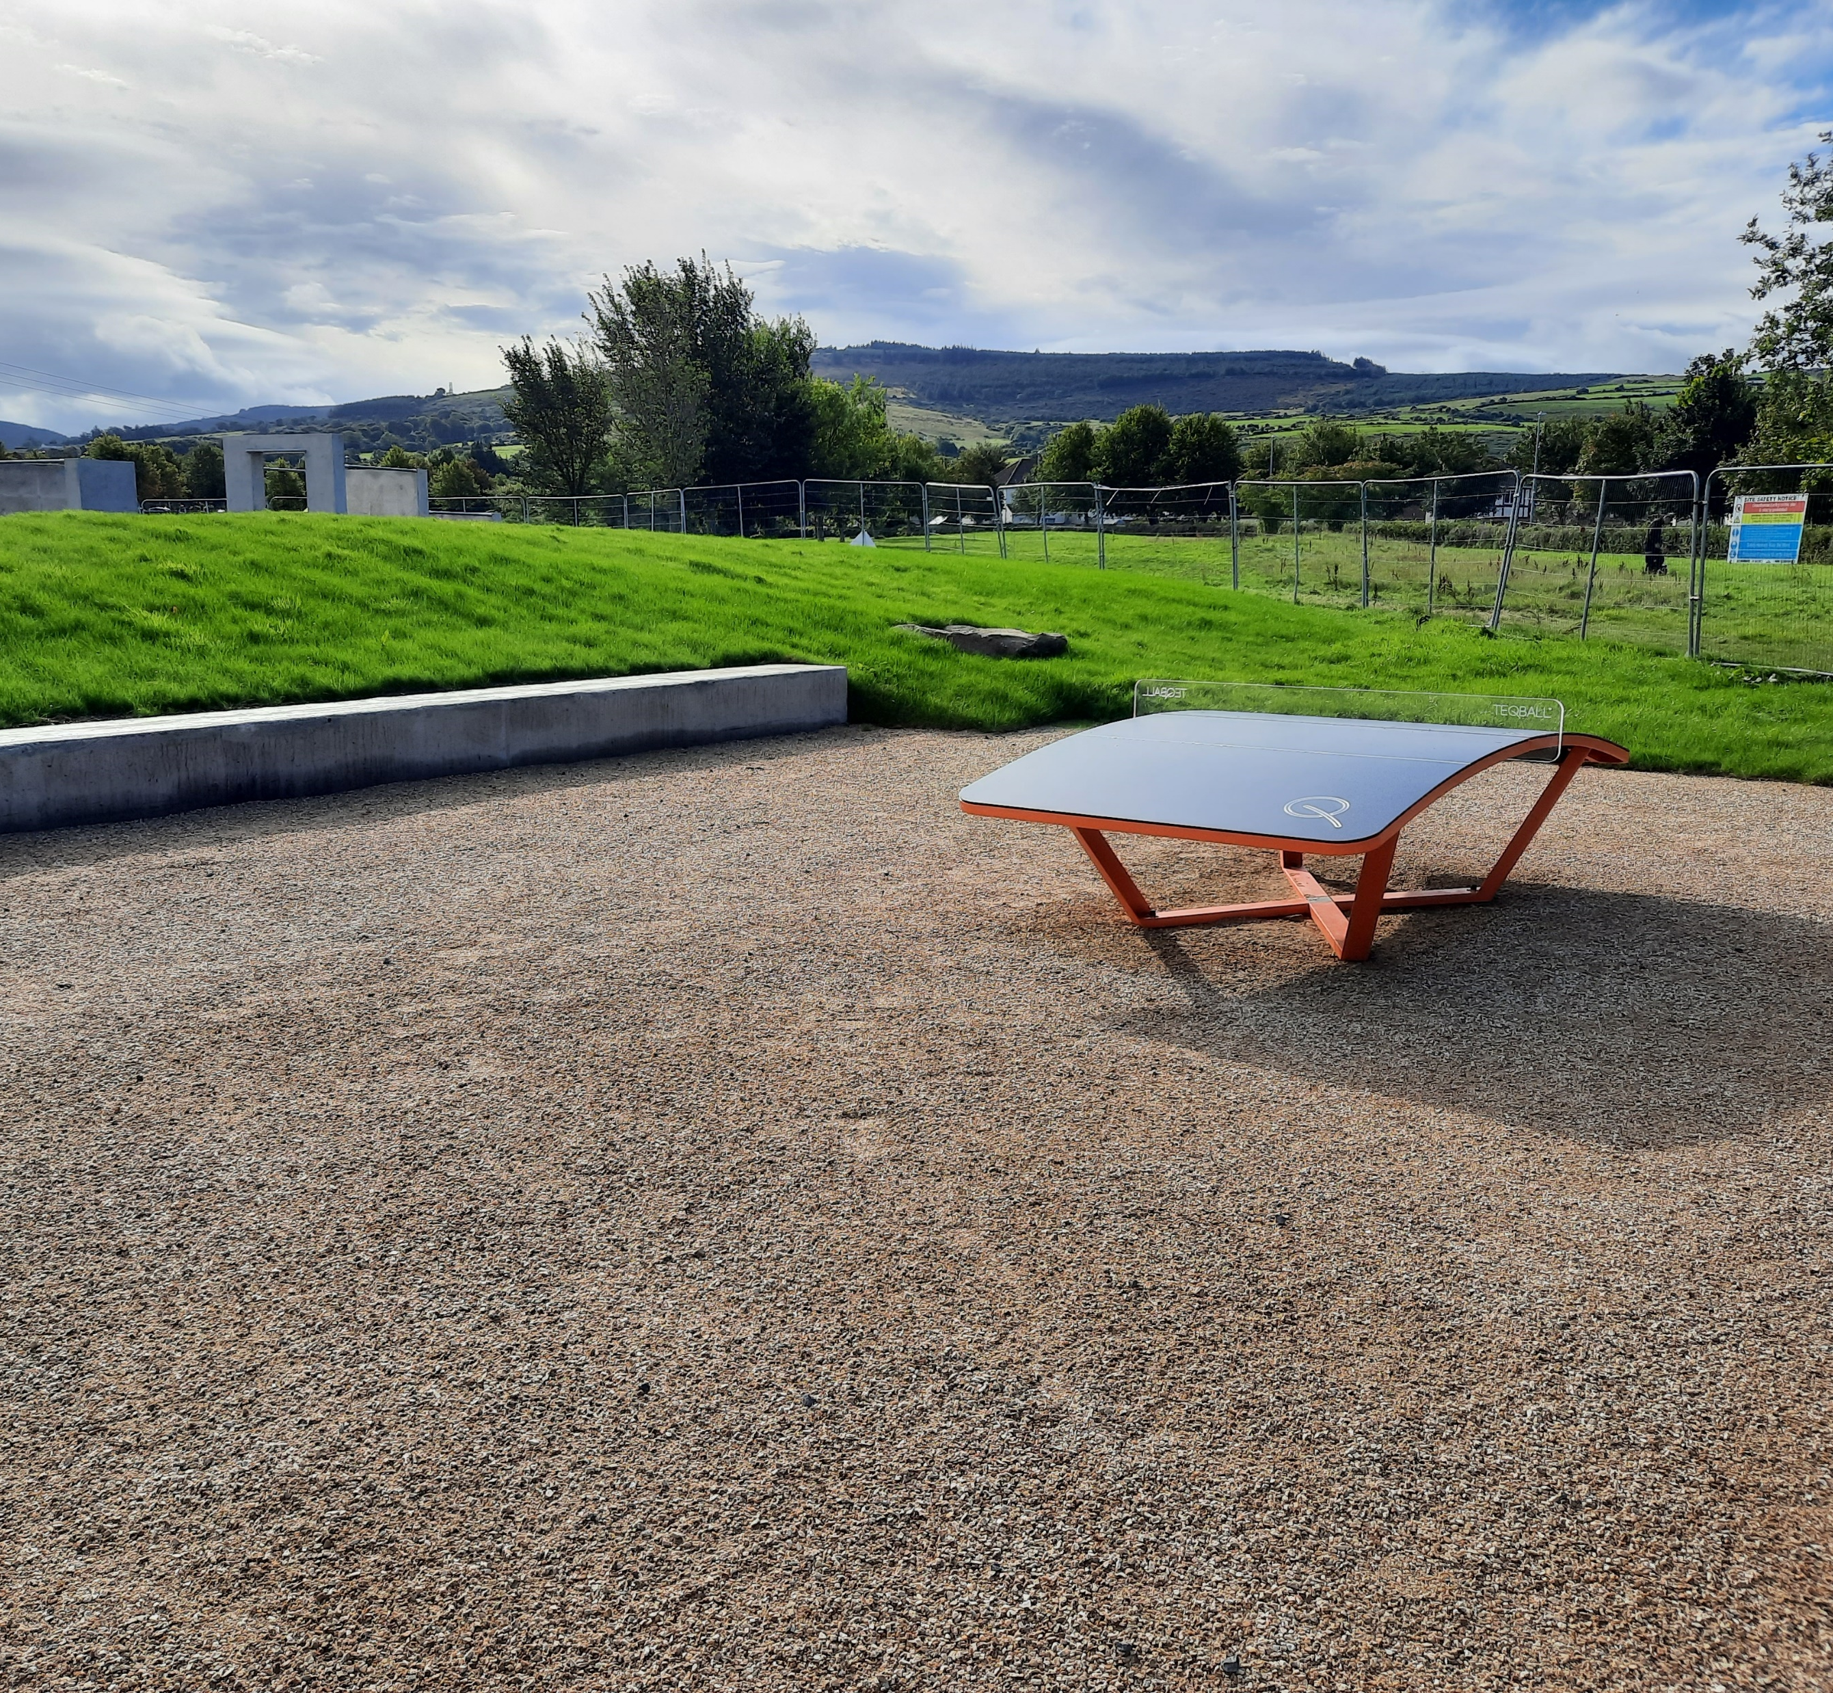
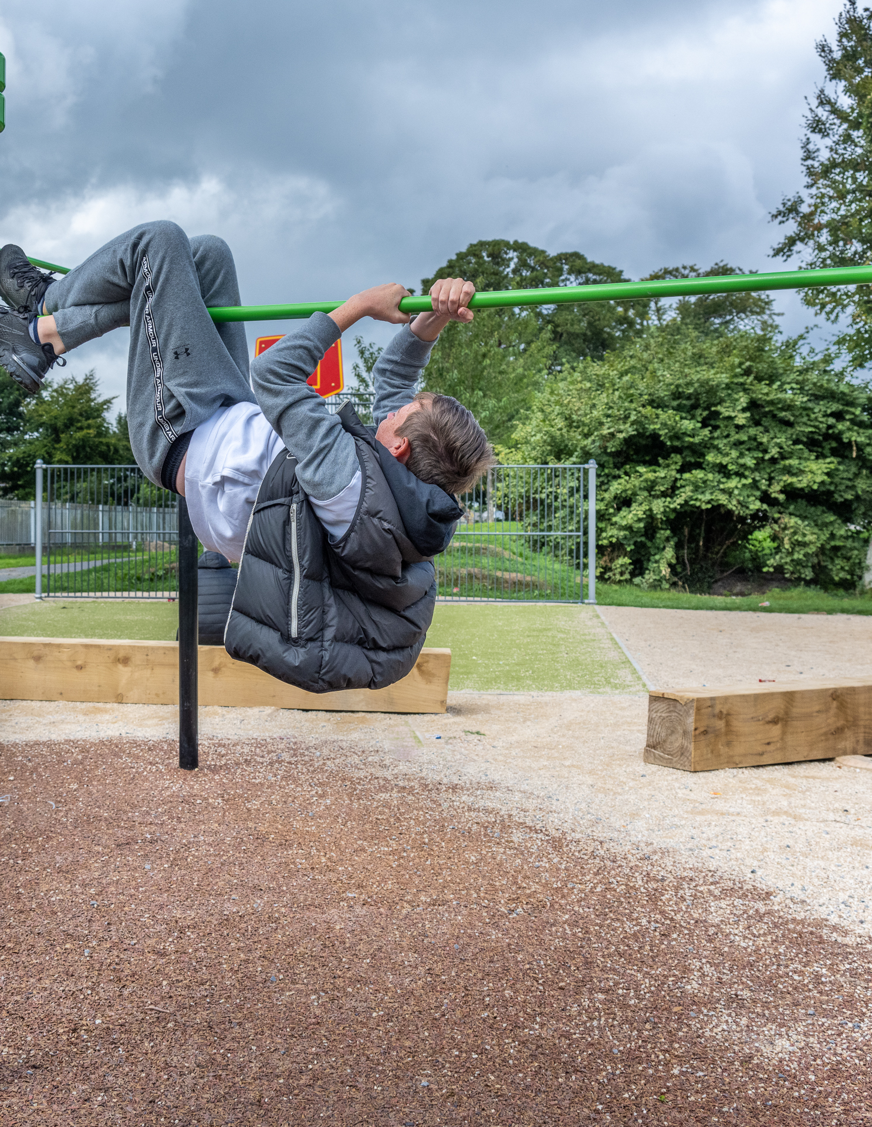
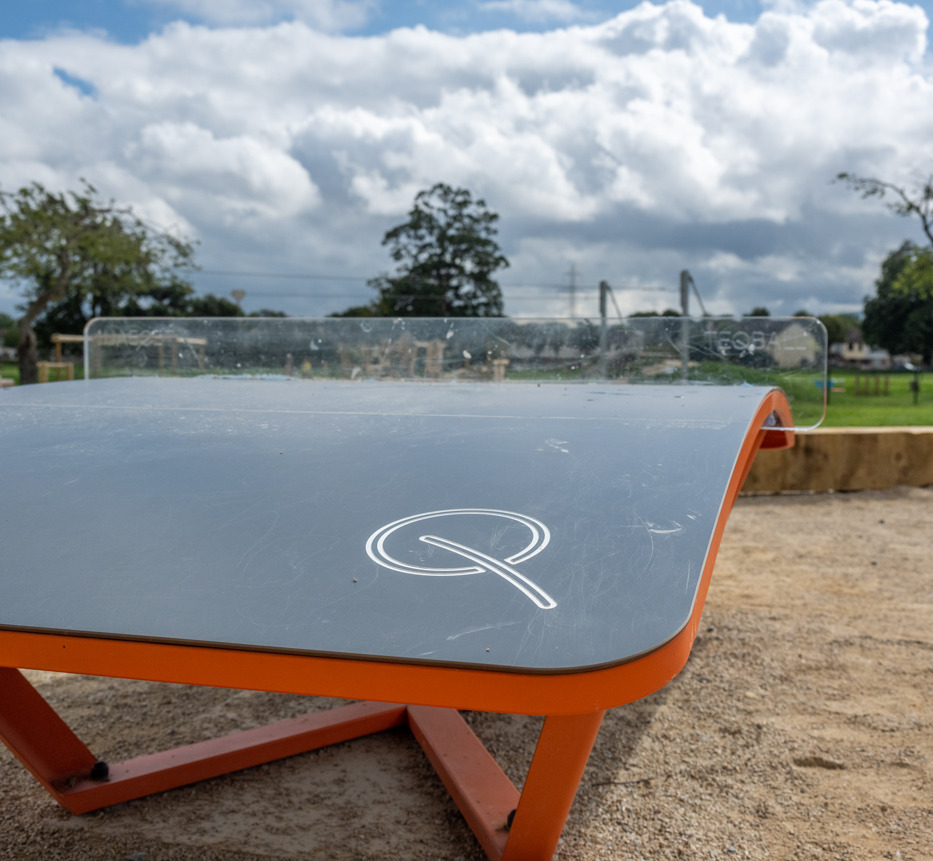
Suggested Improvements to our Teenspaces
Teqball
Teqball has garnered the least amount of popularity votes in our survey for Ballycragh with only 11%, and Collinstown with 12%.
Calisthenics
It has been reported in the Teenspace Feedback Survey that the calisthenics units provided are often too high for many teenagers to use alone, especially those in their early teen years. In Collinstown, Calisthenics is the least popular item in the teenspace with 10% of the votes, while in Ballycragh it received 18% of the votes.
Wi-Fi
Keeping Wi-Fi provision under review and whether or not it is necessary to include wi-fi in future sites based on connectivity and location of each teenspace.

Slide 7
New locations requested during the 2022 Teenspace Survey
All Locations | Area | Responses | Comments/Conclusion
Quarryvale Park | Palmerstown-Fonthill | 6 | Recommended to consider a teenspace as part of Masterplan currently underway for the park.
Rathcoole Park | Clondalkin | 6 | Recommended to add this to the programme as an additional project
Knocklyon | Rathfarnham-Templeogue | 2 | Not recommended to proceed as a high priority as location is not as suitable as higher priority projects. (See Dodder valley and Whitechurch). Could be considered at a later date.
Dodder Valley Park | Tallaght Central,Fir-Boher & Rath-Temp. | 7 | Recommended to add Dodder Valley at 2 No. locations (east and west) to the programme as 2 additional projects
Clondalkin | Clondalkin | 3 | Recommended to add this to the programme as an additional project
St Cuthberts Park | Clondalkin | 4 | Currently proposed as part of current programme and will be included in current upgrade of the park underway.
Sean Walsh Park | Tallaght | 4 | Recommended to add this to the programme as an additional project
Carrigmore Park | Tallaght South | 18 | Recommended to add this to the programme as an additional project
Killinarden Park | Tallaght South | 1 | Currently proposed as part of current programme and is included in current upgrade of the park underway.
Firhouse | Firhouse-Bohernabreena | 1 | Not recommended to proceed as a high priority as location is not as suitable as higher priority projects. (See Dodder valley and Ballycragh-existing). Could be considered at a later date.
Adamstown | Lucan | 2 | Teenspace already existing at Tandy’s Lane Park and is under construction at Airlie Park.
Griffeen | Lucan | 2 and also requested directly by teenagers and local councillors in the area via ACM. | Recommended to proceed with a teenspace adjacent to the existing skatepark.
Butterfield | Rathfarnham | 1 | Not recommended to proceed as a high priority as location is not as suitable as higher priority projects. Could be considered at a later date.
Whitechurch | Rathfarnham | Requested directly by teenagers in the area and local councillors via ACM. (See below) | Recommended to add this to the programme as an additional project

Slide 8
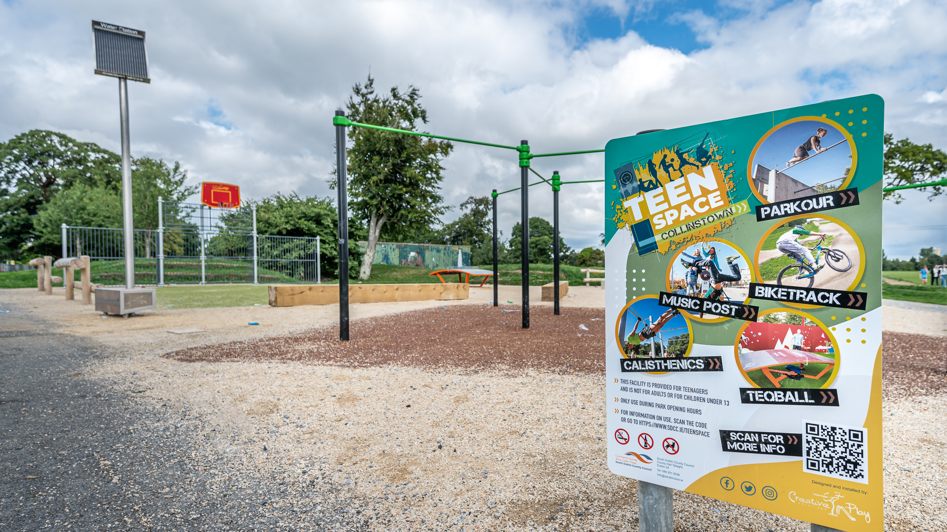
Recommended new locations | €500,000 budget allocated for 2023
Carrigmore Park
Rathcoole Park
Clondalkin
Griffeen Valley Park (Northern Section)
Sean Walsh Park
Dodder Valley Park, Western Section
Dodder Valley Park, Eastern Section
Whitechurch

Slide 9
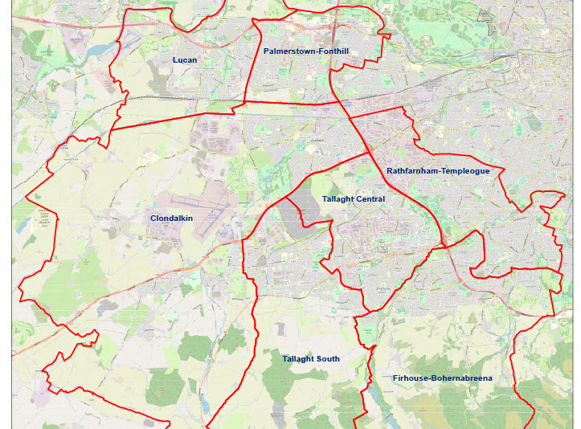
Existing and Proposed Teenspace Locations
­
­
­­
­
Existing Locations (completed or underway as part of current programme or otherwise)
Proposed Locations from 2022 survey and other consultations

Slide 10
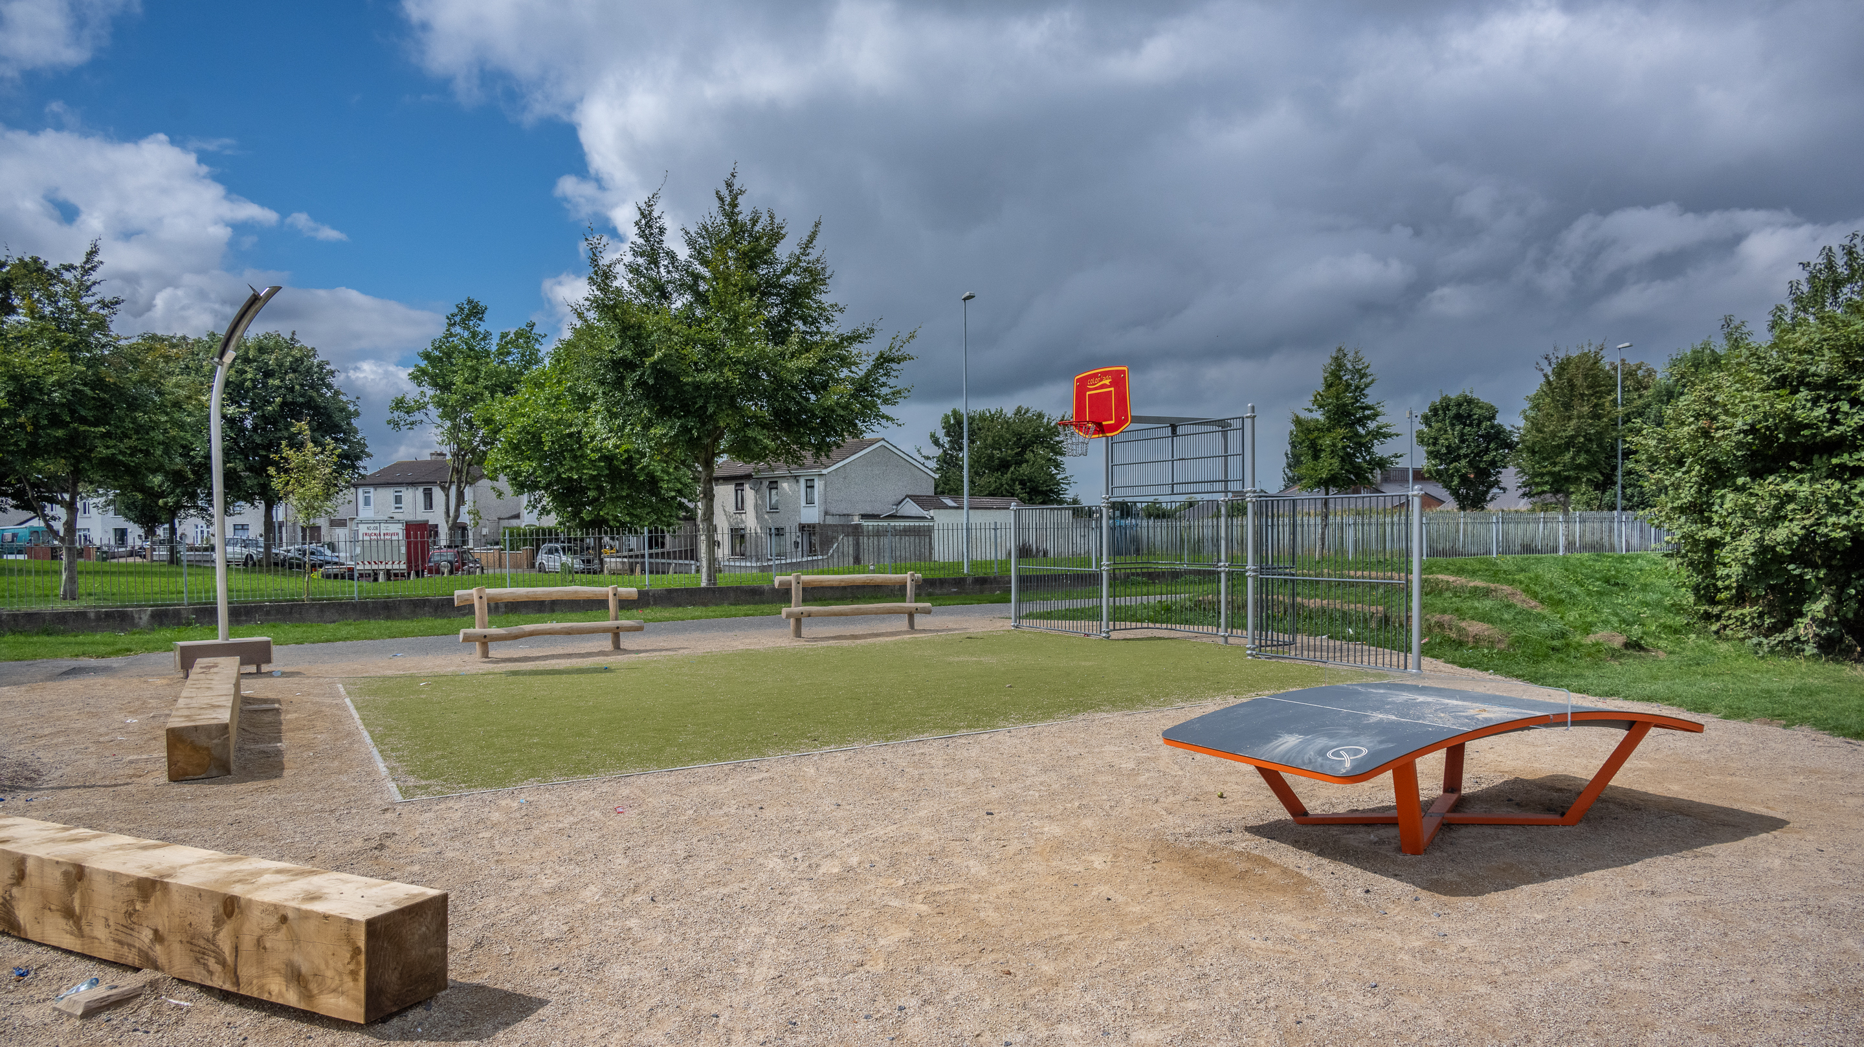
THANK YOU

