Slide 1
SDCC Road Safety Plan 2022 – 2024 (DRAFT)

Slide 2
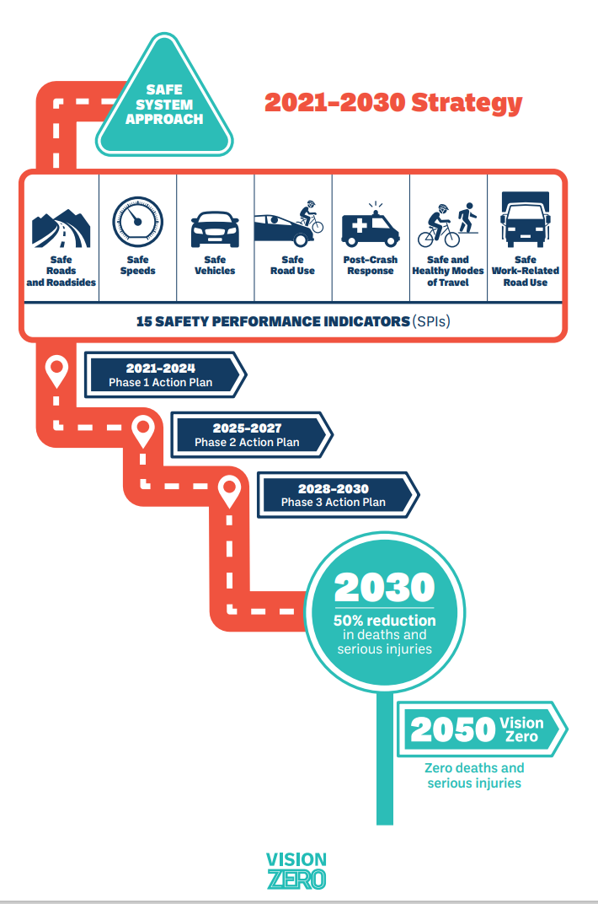
Towards Vision Zero
The Government Road Safety Strategy (GRSS) has adopted a Vision Zero Policy to be achieved by 2050. Vision Zero means that there are zero road deaths and fatalities. In line with the GRSS South Dublin County Council will also adopt a Vision Zero policy within this new, and subsequent, road safety plan.
Vision Zero was formally adopted in Ireland’s Programme for Government in 2020 and underpins the EU Road Safety Policy Framework (2021 – 2030).

Slide 3
Synopsis Evaluation of SDCC RSP 2016 – 2020
Support and delivery of Cycle Right training at 122 primary schools for 6320 pupils,
Delivery of a pilot adult Cycle Right initiative with Go-Ahead Ireland employees,
32 schools within the County received their Green Flag for Travel or Global Citizenship Travel as part of the Green-Schools Programme,
30 km/h as the default speed limit in all residential estates that are in charge,
20 X 30 km/h periodic speed limits outside schools,
Cycle tracks is currently at 215 km
Footpaths increased from 1264 km to 1500 km

Slide 4
Collision Statistics 2016 – 2021
 |  | 2016 |  | 2017 |  | 2018 |  | 2019 |  | 2020 |  | 2021
 | Population 2016 | Fatalities (count) | Fatalities (per 100,000) | Fatalities (count) | Fatalities (per 100,000) | Fatalities (count) | Fatalities (per 100,000) | Fatalities (count) | Fatalities (per 100,000) | Fatalities (count) | Fatalities (per 100,000) | Fatalities (count) | Fatalities (per 100,000)
Dublin County | 1,347,359 | 21 | 1.6 | 24 | 1.8 | 14 | 1.0 | 19 | 1.4 | 20 | 1.5 | 21 | 1.6
SDCC | 278,767 | 4 | 1.4 | 7 | 2.5 | 3 | 1.1 | 4 | 1.4 | 5 | 1.8 | 6 | 2.2
These collision statistics indicate the number of fatalities per 100,000 people within Dublin County and SDCC for 2016 – 2020

Slide 5
Collision Statistics continued.
 | 2016 |  | 2017 |  | 2018 |  | 2019 |  | 2020
 | Serious Injury Collisions | Serious Injuries | Serious Injury Collisions | Serious Injuries | Serious Injury Collisions | Serious Injuries | Serious Injury Collisions | Serious Injuries | Serious Injury Collisions | Serious Injuries
Dublin County | 240 | 247 | 306 | 326 | 367 | 379 | 424 | 435 | 328 | 352
South Dublin County Council | 37 | 38 | 45 | 47 | 50 | 52 | 49 | 50 | 44 | 47
These collision statistics indicate the number of collisions and serious injuries for Dublin County and SDCC.
Fatalities by road user | 2016 | 2017 | 2018 | 2019 | 2020 | 2021
Pedestrian | 1 | 2 | 1 | 0 | 1 | 0
Pedal Cycle Users | 0 | 3 | 0 | 0 | 0 | 2
Motorcycle Users | 1 | 0 | 1 | 1 | 0 | 1
Car Users | 1 | 2 | 1 | 3 | 4 | 3
Goods Vehicle Users | 0 | 0 | 0 | 0 | 0 | 0
PSV Users | 0 | 0 | 0 | 0 | 0 | 0
Other | 1 | 0 | 0 | 0 | 0 | 0
Totals | 4 | 7 | 3 | 4 | 5 | 6
These collision statistics indicate the number of fatalities by road user mode for SDCC.

Slide 6
Local Targets
The rates for local targets have been informed by the Road Safety Authority.
South Dublin County Council has set the following targets for Killed or Seriously Injured (KSI) as part of this plan.
2024: the target will be to reduce KSI by 10%, and
2030: the target will be to reduce KSI by 50%.

Slide 7
Safety Performance Indicators
South Dublin County Council will use the following measures to monitor road safety performance.
Delivery of Cycle Right training to primary school children within the County,
Increase the number of cycle totems and monitoring,
Cycling parking installations,
KM’s of cycling and walking infrastructure installed,
Use of Speed Display Signs to monitor speed limit compliance,
Improved junction safety/redesign of junction,
Speed limit review to commence in 2023,
HGV mobility policy review,
School Crossings Reviews and safety measures implemented outside schools,
Continuing collaboration with SDCC RSWTG on a quarterly basis in oversight of the strategic aspects of the Council’s Road Safety Strategy and Plan.
Continuing liaison with ASG in the analysis of collision data

Slide 8
Actions 2022 – 2024
27 actions in our 2022 – 2024 plan which are linked to the Safe System Approach and areas of intervention areas.
These can be viewed in greater details within the draft RSP 2022 – 2024.
These actions will also be linked to the Annual Action Plan developed in collaboration with the Road Safety Working Together Group who will oversee the delivery and evaluation of the plan.

