Slide 1
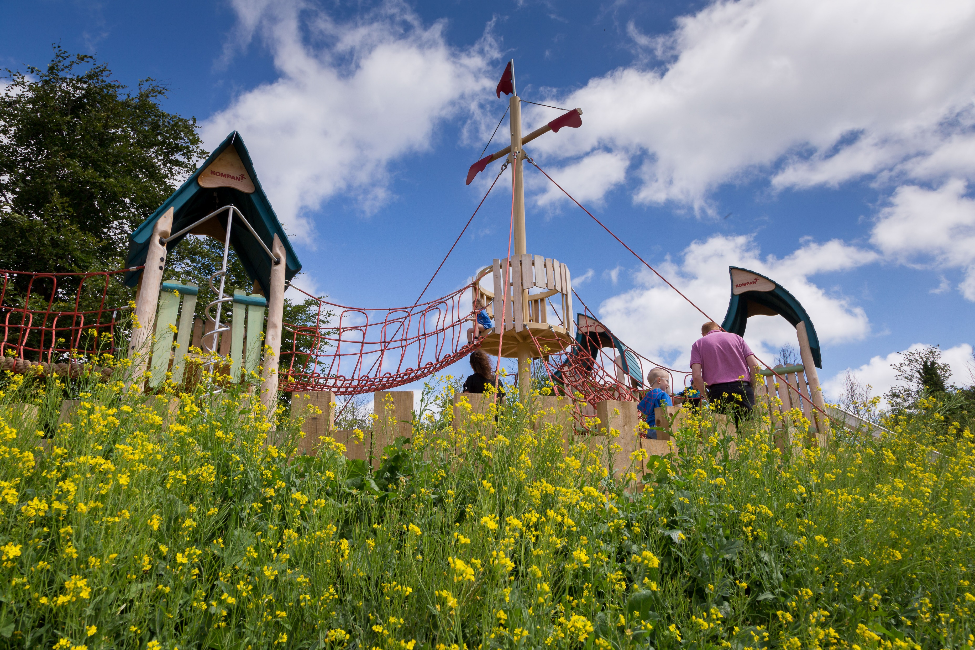
Draft Parks and Open Space (POS) Strategy
01 11 2022
Update to EWCC SPC

Slide 2
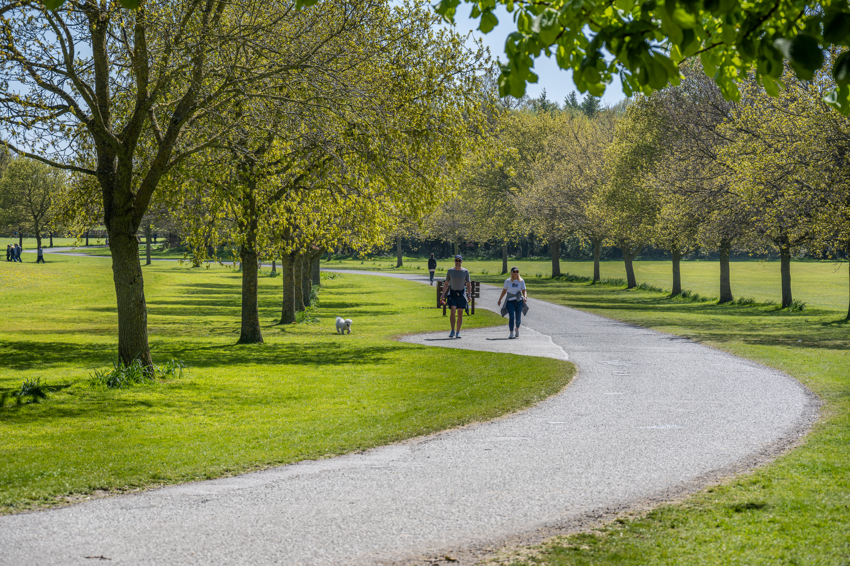
Parks and Open Spaces Strategy
Parks and Open Space Survey & Review
Strategic level assessment has been carried out for Parks and Open Spaces.
Related policies and objectives included in SDCC County Development Plan
Public Survey completed (4274 submissions received)
Review of Existing Parks completed and existing facilities within parks and open spaces.
Provision of new open space: requirement identified

Slide 3
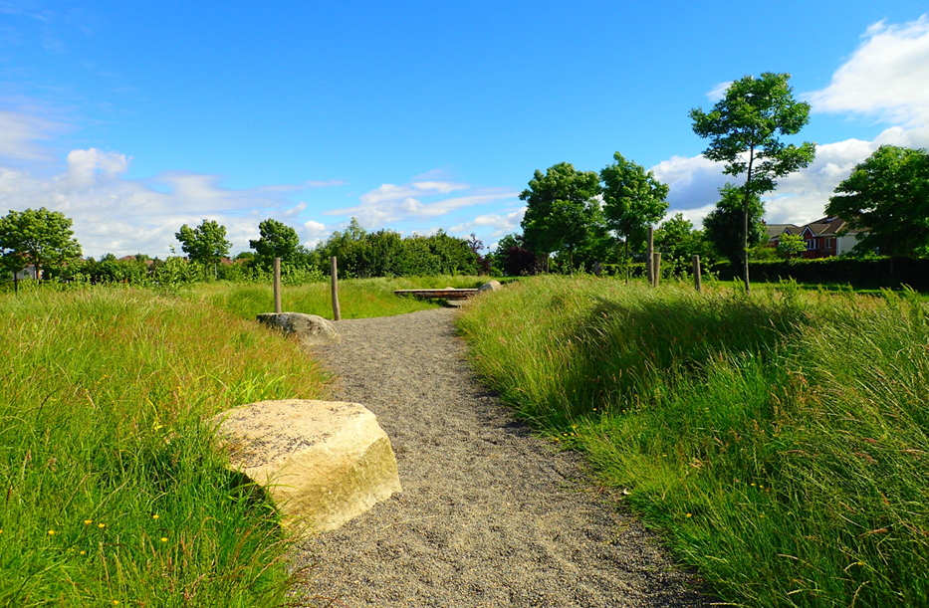
Parks and Open Spaces Strategy
Scope and Content
Contents
1. Introduction
2. Guiding Policy
3. Value of Parks and Open Spaces
4. Existing Parks and Open Spaces
5. Sports and Active Recreation
6. Neighbourhood Provision
7. Park Management
8. Implementation of the Strategy

Slide 4
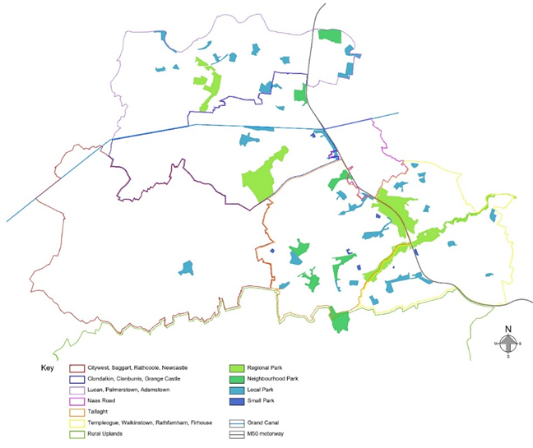
Parks and Open Spaces Strategy
Basic Principles guiding Open Space Provision
Quantity of Public Open Space
There are currently 57 public parks distributed throughout the South Dublin urban area, comprising:
Regional Parks 48.16% (of total area)
Neighbourhood Parks 19.80%
Local Parks 30.88%
Small Parks 1.16%
Planned and New Parks:
Griffeen Valley Park Extension
Grand Canal Park
Adamstown Airlie Park and Tandy’s Lane Park
Park Upgrades:
Corkagh Regional Park
Dodder Valley Regional Park
Killinarden Neighbourhood Park
Whitestown Stream Local Park
Kiltipper Park
St. Cuthbert’s Local Park
Jobstown Park Local Park
Quarryvale Park Local Park

Slide 5
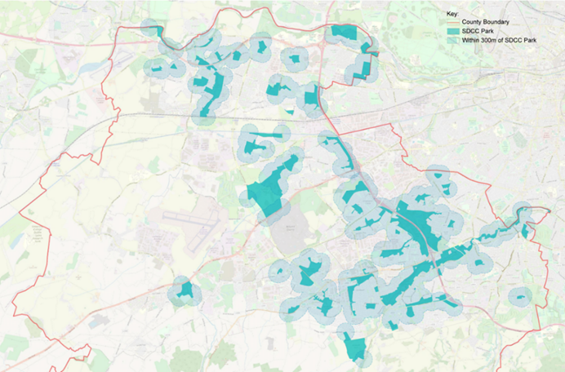
Parks and Open Spaces Strategy
Basic Principles guiding Open Space Provision
Accessibility of Public Open Space
The majority of existing residential areas are within 300m distance (5-minute walking) of a park, with the exception of areas such as Adamstown, parts of Clondalkin, parts of the south-east.
This also relates to access points and design issues which will be addressed under ‘Park Management’ and ‘Implementation’.
Parks within 300m (5-minute walking) accessibility (excluding Regional Parks)

Slide 6
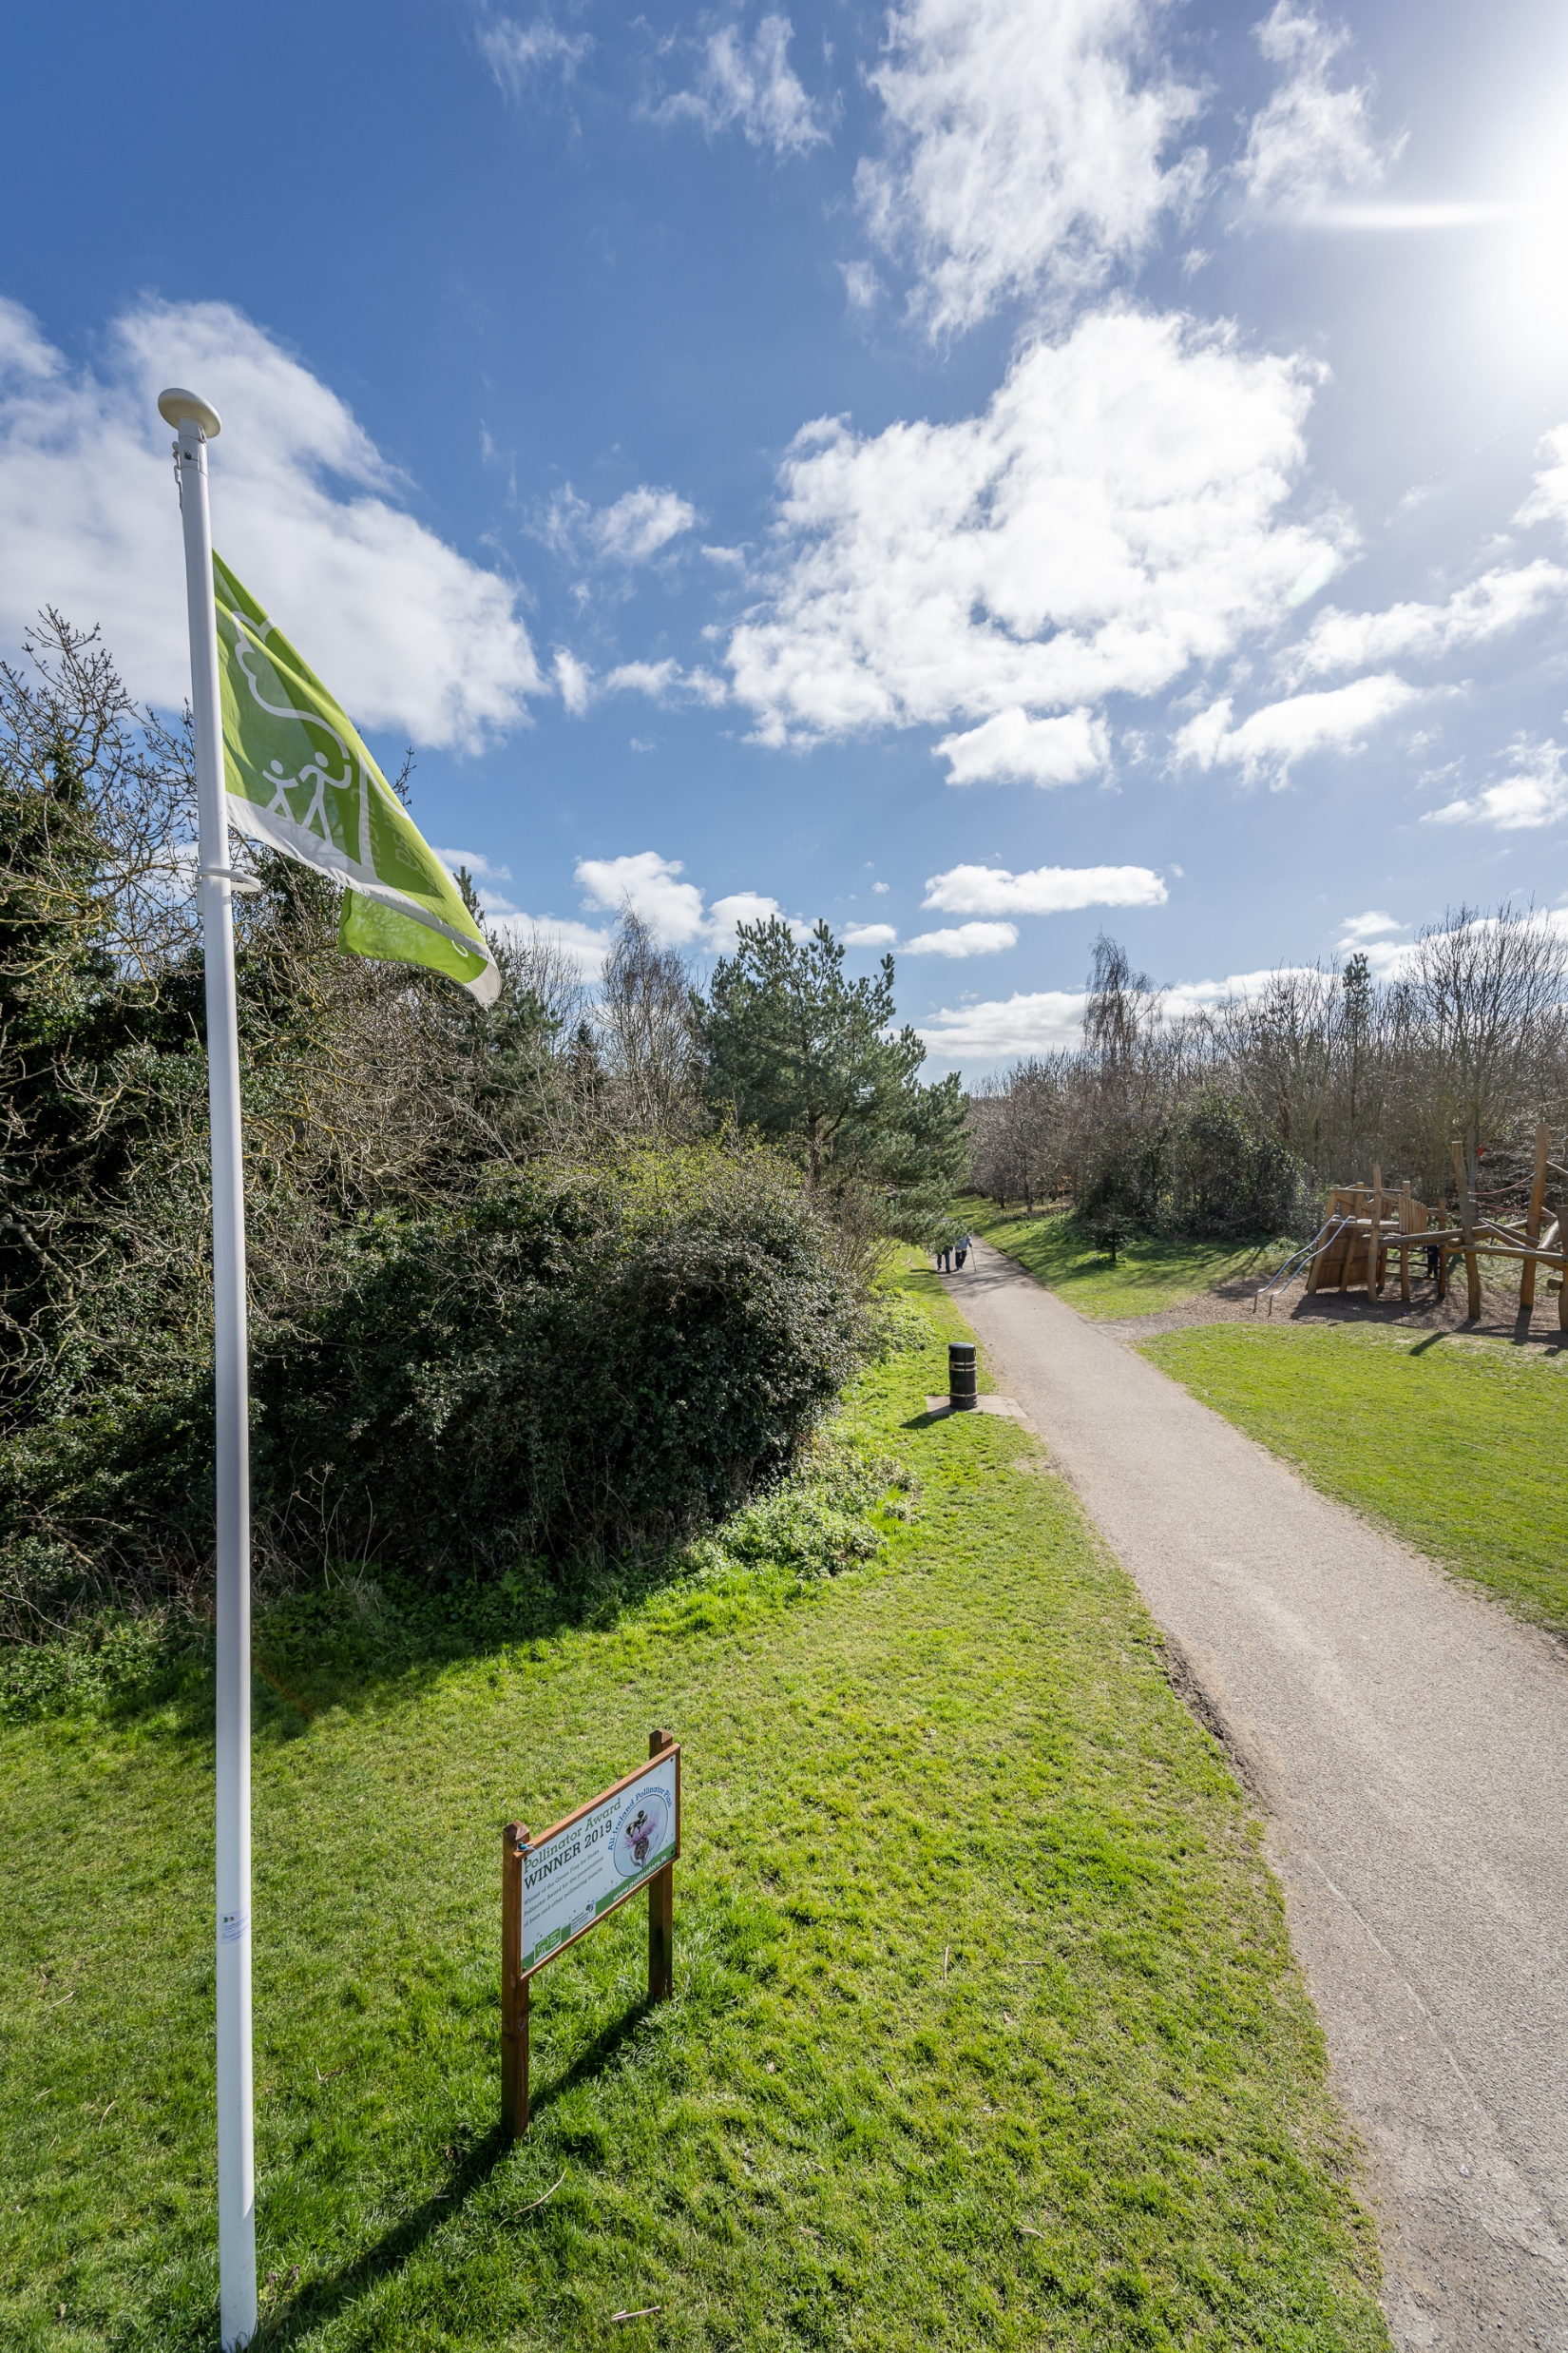
Parks and Open Spaces Strategy
Quality Criteria
A Welcoming Place
1. Welcoming entrances
2. Good and safe access
3. Signage
4. Equal access for all
Healthy, Safe and Secure
5. Safe and accessible equipment and facilities
6. Personal security
7. Appropriate provision of facilities
8. Quality of places
Management
9. Clean and well-maintained
10. Litter and waste management
11. Grounds maintenance and horticulture
12. Building and infrastructure maintenance
Potential for Biodiversity
13. Linkages to GI network
14. Native tree and shrub planting
15. Hedgerows
16. SuDS features (incl. integrated wetlands)
17. Natural water features (including stream re-profiling)
Quality Standards – Green flag standard with developed biodiversity section.
A locally set quality assessment for each area of open space. Scores are given against a basic expected level of quality/maintenance, potential for biodiversity and community value.
Five parks in South Dublin have been awarded Green Flag status.

Slide 7
Parks and Open Spaces Strategy
Community Engagement – Pre draft
Over 4,200 responses were received on the Park Users Survey questionnaire. Key highlights include:
Corkagh Park and Tymon Park are the most visited, and Waterstown Park least visited (6%).
Tymon Park was given as the closest park to most respondents (23%), followed by Corkagh Park (19%), and with Clondalkin Park being the furthest away for a few (3%).
The parks most visited were those closest to home (80%).
Majority of respondents travel on foot to their nearest parks, followed by car. Only a low number travel by bicycle.
Main reasons given for visiting the park were to exercise and to spend time outdoors. Only a low number used the park to play sports.
Prior to Covid, 28% of respondents visited a park daily and 50% weekly; post-Covid the daily visits increased for 48% of respondents while weekly visits decreased for 38%.
Majority of respondents stayed in the park for 30 minutes to 1 hour, with fewer staying between 1 to 2 hours
Most visitors rated the parks as Excellent (20%) or Good (49%), while a relative few (8%) considered the condition to be Poor.
The most popular responses to further park enhancements were to provide/improve toilet facilities, increased personal safety and improved cleanliness. The least popular enhancements were signage and expanded opening hours.
Around 26% of respondents indicated that they would be interested in becoming involved with volunteer activities in parks.
The Teenspace Programme consultation also highlighted that nearly all respondents considered areas for hanging out and unstructured physical activity as most important, compared to only 5% looking for more sports facilities.

Slide 8
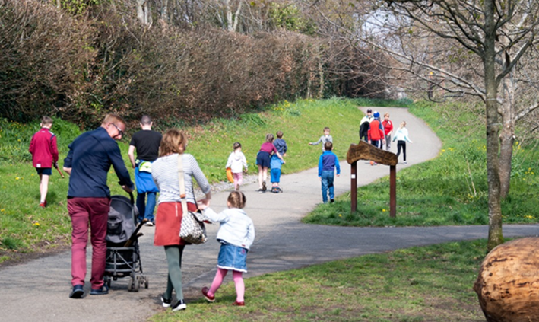
Parks and Open Spaces Strategy
Implementation of the Strategy
Parks and Open Spaces Action Plan
This sets out how the Council intend to deliver against the policies and objectives of the County Development Plan where relevant to parks and open spaces, and subsequent reports, guidelines and initiatives. Clear priorities, informed by public consultation, are reflected in the Action Plan together with responsibilities and anticipated timeframes for delivery.
The Council will undertake an annual review of the delivery of the strategy’s actions through an assessment of what progress has been made against objectives. An overall review and refresh of parks and open space objectives and actions will take place in conjunction with the county development plan review to ensure the strategy remains relevant and can adapt to changing need.
Key Delivery Mechanisms
• Detailed Management Plan for the larger parks
• County Development Plan
• South Dublin County Council Development Contribution Scheme
• Contributions in Lieu
• Other innovative delivery opportunities

Slide 9
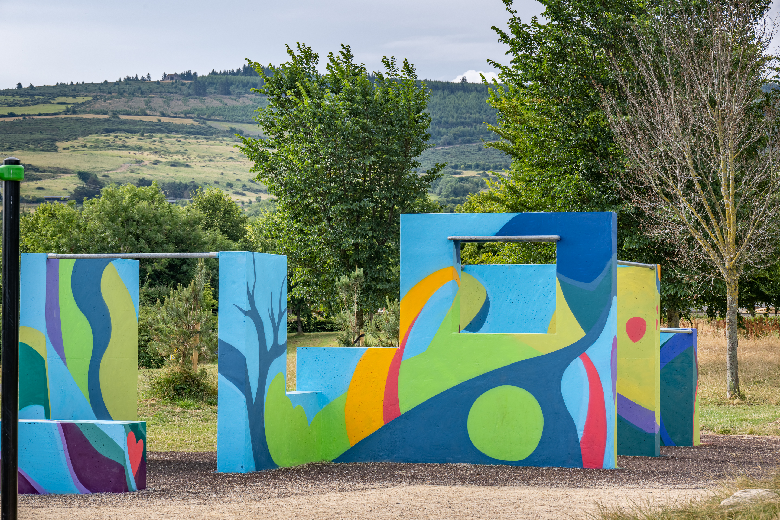
Parks and Open Spaces Strategy
Programme
Programme:
Draft POS Strategy: circulate and SPC feedback November 2022
Public Consultation: Dec 2022/ Jan 2023
Final Document: May SPC
Strategy Approval: June Council Meeting

Slide 10
Draft Parks and Open Space (POS) Strategy
Thank you

