Slide 1
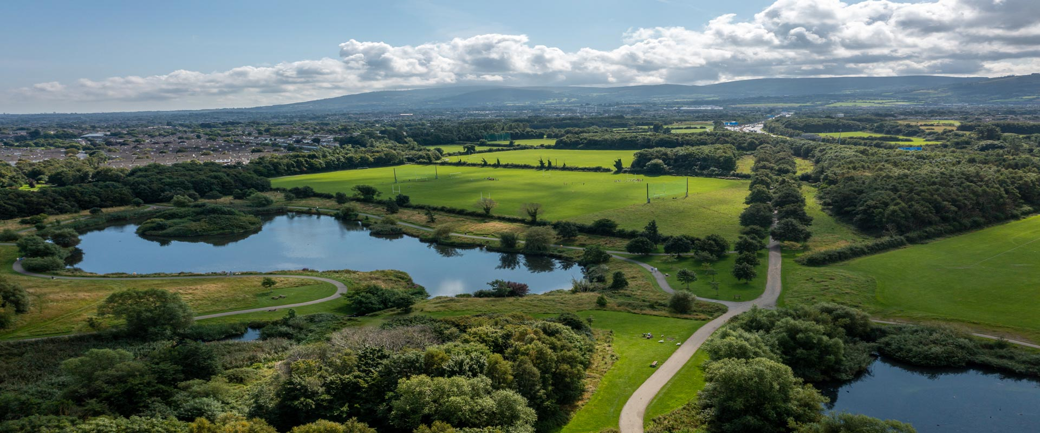
SDCC Environment, Public Realm and Climate Change SPC
November 2022

Slide 2
SPC Agenda - Overview of Climate Action and CCAP
Climate Change Action Plan Update
Dublin Climate Action Week 2022
Ongoing Projects
Decarbonisation Zones
EV Charging Strategy
Solar PV Projects
Anaerobic Digestor Feasibility Study
Fleet Review
Climate Innovation Fund
Community Climate Action Fund (CAF)

Slide 3
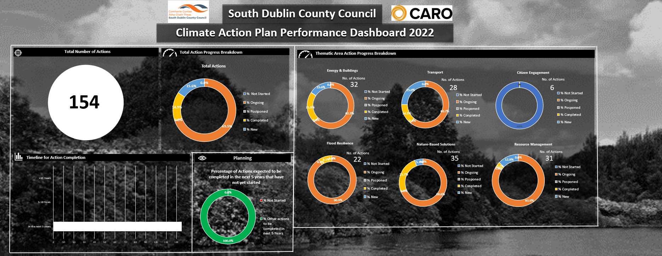
SDCC Climate Change Action Plan 2019-2024
154 Actions
23 Complete
107 Ongoing
0 Not Started
24 New Actions
SDCC progress Report to DECC End of September 2022

Slide 4
Green Tallaght Stadium
Progression of the DeliveREE
Procure Energy Audits on County Hall, Clondalkin Office
Implementation Plans for Clondalkin and Tallaght Decarbonising Zones
Align Objectives of Clondalkin Decarbonising Zones with LAP
Dublin Regional Air Quality Plan
Interim Urban Traffic Related Air Pollution (UTRAP) Report
Participate in Clean Air Together pilot project
Support School Streets projects (Safe Routes to Schools)
Support WeCount/I-Change Air quality monitoring project
Support South Dublin Sports Partnership on community active travel projects
Include/Support active travel options for travelling for Work
Implement actions from the Biodiversity Action Plan
Carry out wetland surveys of lakes and ponds in South Dublin
Investigate sustainable solutions to the management of grass cuttings
Investigate option to replace fossil fuelled hand tools with battery powered alternatives
Provide Climate Awareness training for all staff
Establish Green Procurement working group
Develop SDCC Climate Change website
Produce Climate Action newsletters
Support the SEAI Sustainable Energy Communities project
Support GAA Green Clubs project
Support/Participate with DLAs Climate Action Awareness Campaign Climate Action Week
Support local schools and universities on Climate Change awareness projects and studies
24 New Actions in the CCAP

Slide 5

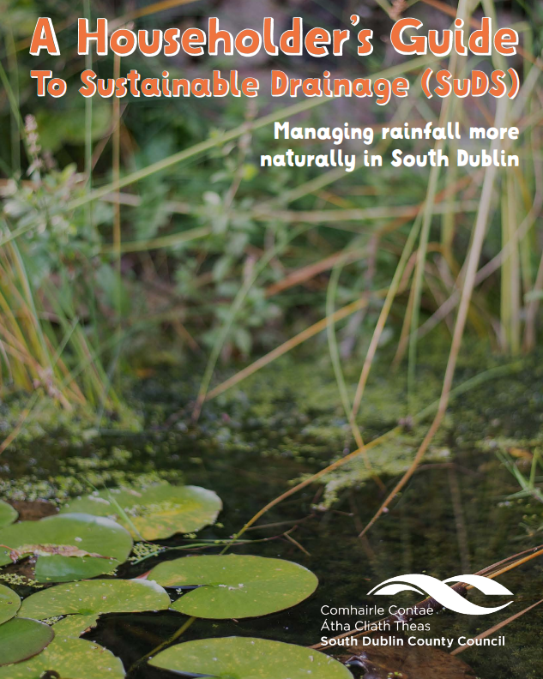
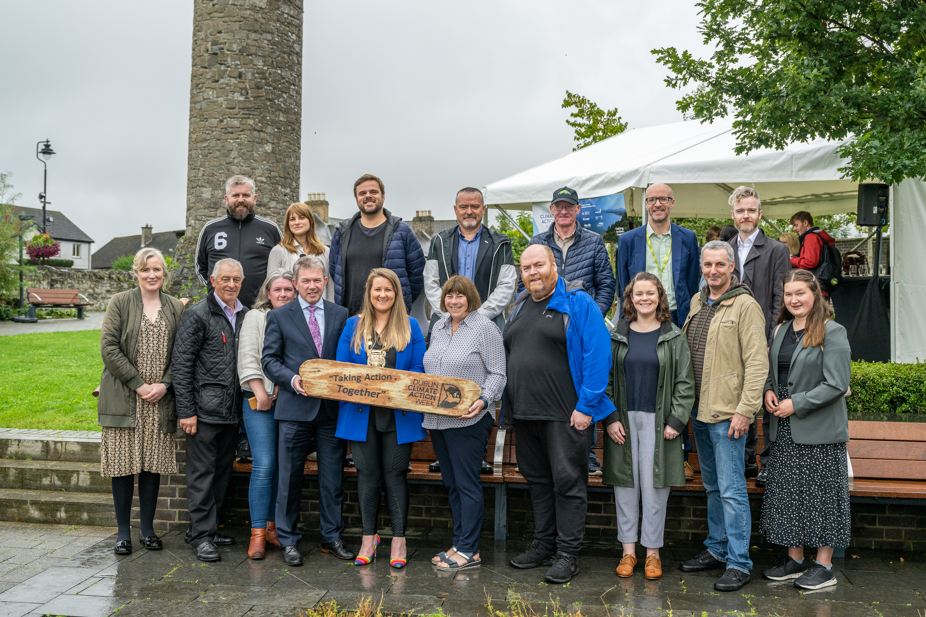


Dublin Climate Action Week
Launched on 12th September at Round Tower Visitors Centre
Series of successful events held by each of the Dublin Local Authorities
South Dublin County Council events:
  SuDS Householders Guide Webinar
  Biodiversity Walk at Tymon Park and Waterstown Park
  Open Data Challenge Showcase – Winner announced ‘My Remote Working Hub’
  Youth Climate Conference – Clondalkin and Ballyroan Libraries
  Repair or Replace – ‘What Drives our Energy Use’ – TCD Webinar
  Climate Festival – Tymon Park

Slide 6
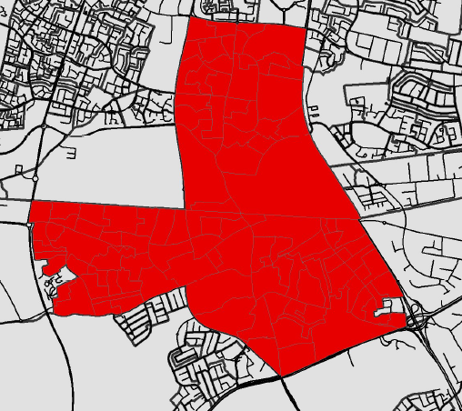
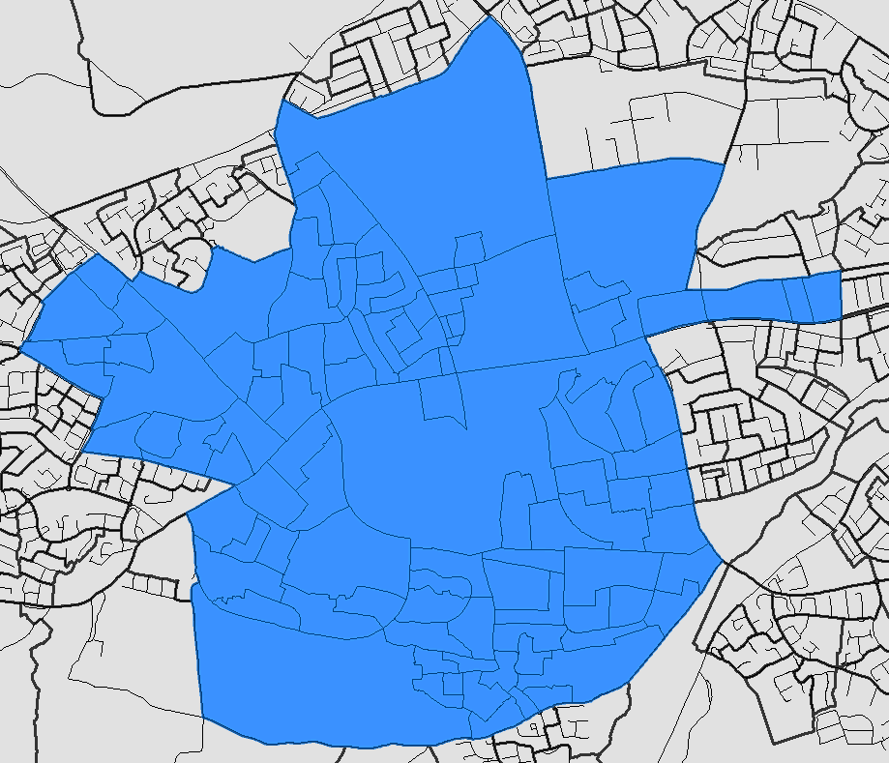
Decarbonising Zones (DZ)
Option Assessment – April 2021
SDCC submitted proposal identifying Clondalkin and Tallaght
Delivery Approach
4 Dublin LAs approached CoDEMA to develop Decarbonising Zone Implementation Plans
SDCC Project Commencement – Sept 2022
Cost proposal accepted
Planned Work
Project potential increases/decreases
Develop Gap to Target Analysis Register of Opportunities
Prepare Cost Estimates
Project Planning meeting held with CoDEMA
Establish Baseline Data
Outline funding opportunities and project partners/stakeholders
Ongoing work: develop full evidence base of emissions sources
Action 165 of the National Climate Action Plan (2019), to enable Ireland meet its carbon emissions reduction targets by 2030
DZ Implementation:
Map and analyse energy demand across the Decarbonising Zone, mapping stakeholders, identifying early stage projects to create a Register of Opportunities
Define the portfolio and pipeline of decarbonisation projects and develop an appropriate plan for delivery
Clondalkin
Tallaght

Slide 7
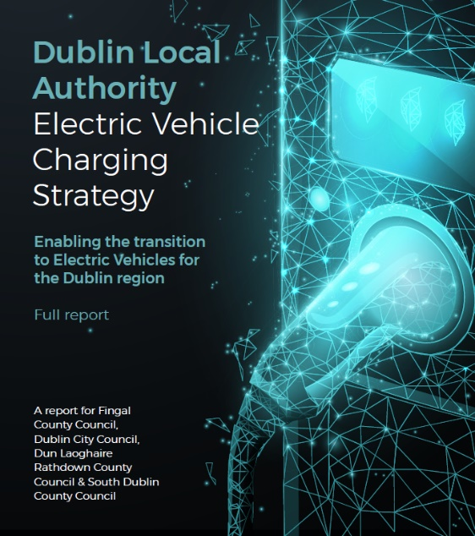
EV Strategy
SDCC Working Group Established (EWCC, LUPT, Planning)
Review of Fleet and Depot Requirements underway – Sustainability Consultant being procured
Pilot scheme for Public charging at SDCC facilities
  Identified 14 trial locations for public charging at SDCC public facilities, predominately in SDCC carparks near amenities.
  Coordinated tender with Dublin Region LAs planned for delivery
Identifying solutions around Taking in Charge – (parking spaces, equipment)
Steering Group continue to meet, engage with stakeholders
PV Projects
Arthurstown Landfill – Project Appraisal stage
Review of SDCC buildings/facilities with potential for Solar PV installations to meet operational energy costs.
Planned procurement of consultant to assess site for potential commercial solar PV opportunities
Arthurstown Landfill PV
Project Appraisal

Slide 8
Anaerobic Digestor Feasibility Study
To review/examine sustainable solutions/options to managing grass cuttings
SDCC allow grassland meadows to grow for pollinators and biodiversity purposes
Currently 4,000 tonnes of grass cutting used as fodder
Calculate and outline the greenhouse gas emissions for different options
Quantify the monetary cost for different options
Quantify potential to generate biofuels from grass cuttings
Review options for biofuels produced (fleet, district heating….)
Fleet Review Feasibility Study
Prepare a robust plan to achieve a sustainable, decarbonised fleet to 2030.
Two Packages of work:
    Vehicle, Plant and Machinery Review
    Fleet Management System Review
Procurement Process at Award Stage

Slide 9
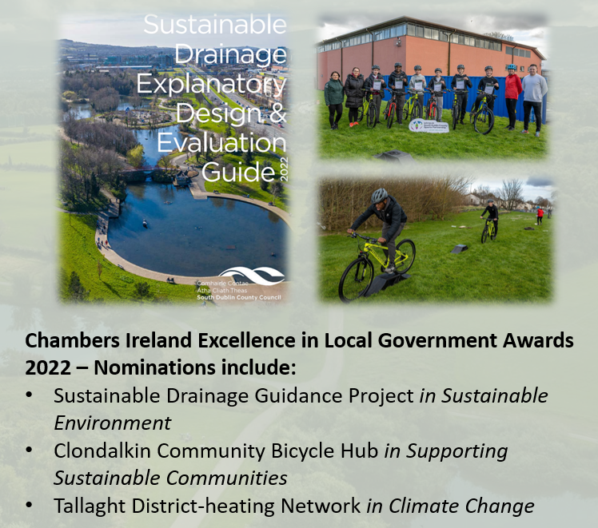
SDCC Climate Innovation Fund 2022
UCD - WeCount Community Air Quality Monitoring - €1,660.50
SDCC Climate Action Website - €14,637.00
SuDS Guidance - €22,447.50
EV Strategy – €5,462.13
Energy Elephant – €14,760.00
South Dublin Sports Partnership - North Clondalkin Bicycle
Hub - €30,000
E-Bicycles for Park Rangers - €6,900.30
GPS Equipment to support SuDS, ICWs and Drainage projects - €24,354.00
Mini Woodlands Media and Information - € 7,500
Biodiversity Video - €4,875.00
Dublin Climate Action Week 2022 - €22,871.85
Fast Fashion Video – €25,000 (Contributions from DLAs)
Climate Action Family Event at SDCC Libraries - €3,630.00
Anaerobic Digestor Feasibility Study - €25,000
Greening Tallaght Stadium Feasibility Study - €20,000
DLAs, Smart Dublin - Open Data Challenge - €2,000
Total Approved Funding €211,000 (Approx.)

Slide 10
Community Action Fund (CAF)
Strand 1- Action: Building Low Carbon Communities
€24 million is being provided to local authorities to partner communities, within their areas of operation to build low carbon communities in a considered and structured way.
Strand 2 Education: Climate Education, Capacity Building and Learning by Doing
€6 million is being provided to Pobal and the Creative Ireland Programme to build community capacity to undertake and step-up climate action. The focus of this strand is on education directly leading to action as opposed to awareness education.
Department has agreed with the CCMA that 12% of the €24 million allocated for Phase 1 of the Programme may be assigned for administrative purposes towards the cost of resourcing a Community Climate Action Officer (Grade 6) in each local authority to oversee the Programme.

Slide 11
Thank You

