Slide 1
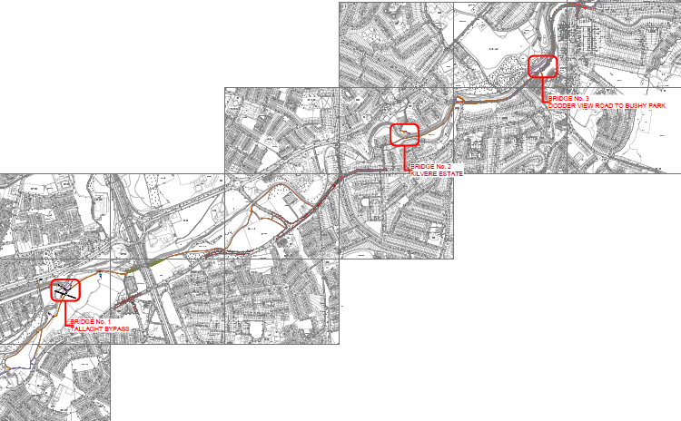
DODDER GREENWAY Part 8 Firhouse Rd & Butterfield Avenue

Slide 3
Section 5 – Firhouse Road & Butterfield
This is a short section of the Greenway which links the completed works in Dodder Valley to the completed works in Kilvere Park.
The works allow for a segregated 2-way cycle track to the Western side of Firhouse Road and Butterfield Avenue which is protected from traffic with a permanent kerb
The works also allow for single cycling facilities on both sides of Spawell Link Road
This works incorporate two busy junctions (photomontages shown later in this presentation):
Firhouse Road and Spawell Link Road
Firhouse Road/Butterfield Avenue and Ballyroan Road/ Old Bridge Road (Blue Haven)

Slide 4
Pre Part 8 – Non Statutory Summary
Prior to the non-statutory public consultation a project briefing was held online with Councillors on 29th August 2021 with a follow up briefing on October 22nd 2021
From Dec 1st 2021 to Jan 14th 2022 the non-statutory public consultation was undertaken via a virtual consultation room at the following link: https://consult.sdublincoco.ie/en/consultation/dodder-greenway-blue-haven-firhouse-road-spawell-link-road
During this consultation the options were presented to the public via the options report and explanatory videos and feedback sought to inform the preferred route of the scheme.
From the feedback received during this consultation the scheme received minor amendments and presented by means of the Part 8 statutory consultation as outlined in the next slide

Slide 5
Part 8 Consultation – Summary
Following the non-statutory public consultation the updated scheme was presented to the public by way of a virtual consultation room via the following link from 5th of July 2022 to 31st of August 2022: https://consult.sdublincoco.ie/en/consultation/dodder-greenway-firhouse-road-butterfield-avenue
During this period all relevant documents including drawings, reports, photomontages, and drone imagery indicating existing and proposed works were displayed.
All relevant information was also available on the Councils consultation portal. Submissions could be made via the portal or in writing by post to: Senior Engineer, NTA Schemes, LUPT, South Dublin County Council.
During the consultation 22 submissions were received. A summary of these is in the following slide

Slide 6
Part 8 Submission Summary
Total number of Submissions | 22 (100%)
Supports the Scheme | 2 | 9.10%
Supports the Scheme with changes | 20 | 90.90%
Do not Support the Scheme | 0 | 0.00%

Slide 7
Part 8 Proposed Amendment
The provision of one-way cycle facilities on the Southeast side of Firhouse Road (outbound) has been added to the scheme as an amendment to the Part 8 as a result of submissions received from the public and at the request of the NTA.
The amendment is as per drawing 1604, relevant extract shown in the next slide

Slide 8
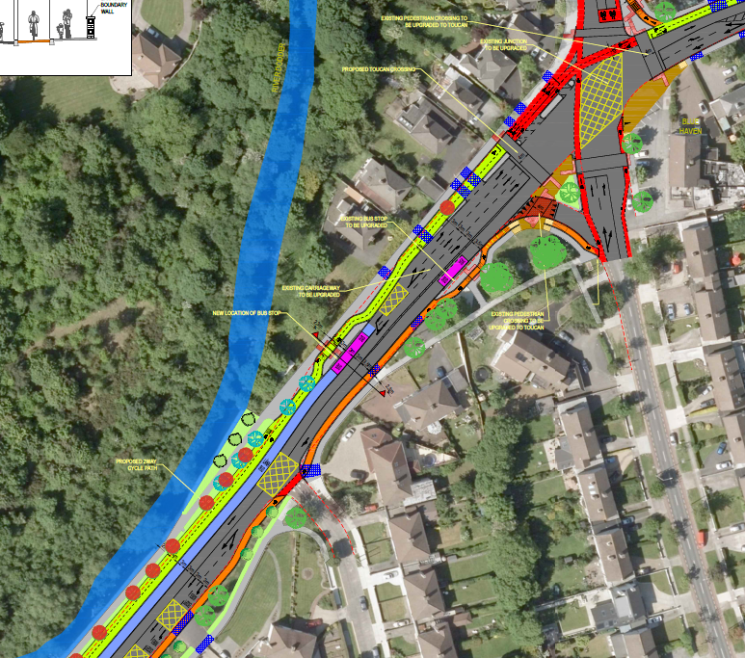

Slide 9
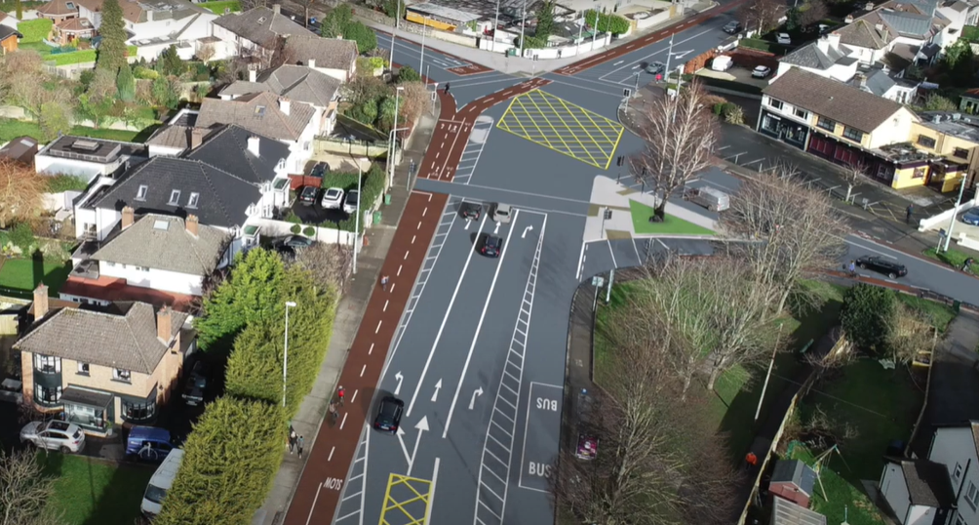
Section 5 – Blue Haven Junction

Slide 10
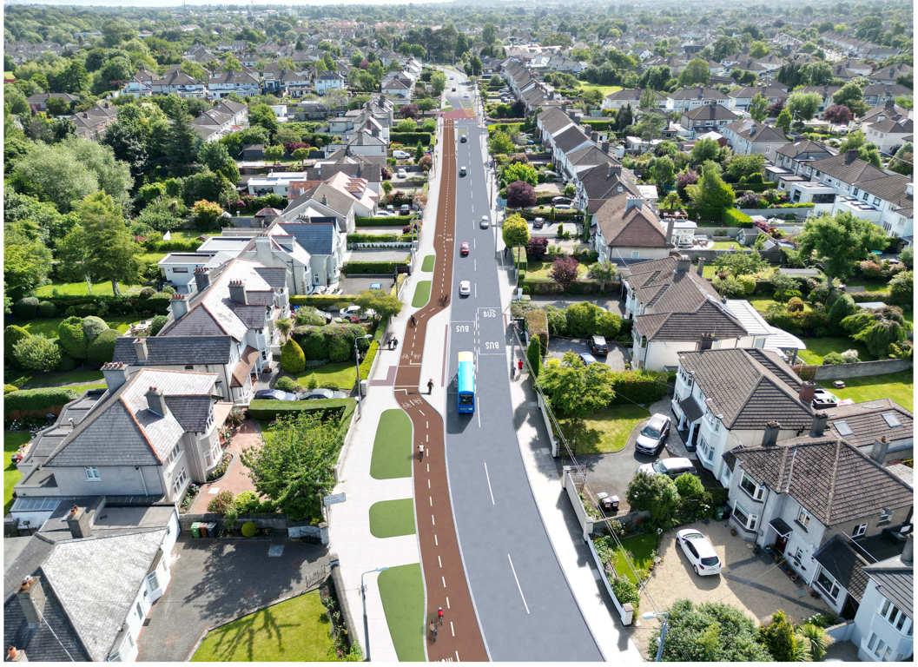
Section 5 – Butterfield Avenue

Slide 11
Thank you
Questions Welcome

