Slide 1
SDCC Palmerstown Depot – Dublin 20
Proposed Development:
‘Additional salt barn, new mechanical services depot and 2no. new diesel pumps with associated underground fuel storage tanks at the existing Palmerstown Depot, adjoining the Deadman’s Inn, Old Lucan Road, Dublin 20.’
Proposed Salt Barn:
Construction of an additional Salt Barn (16m x 16m internally, designed to meet or exceed the existing salt barn design and specifications)
Proposed Mechanical Services Depot:
New 5 bay vehicle maintenance workshop (450 sq m)
New offices, sanitary facilities & store (187 sq m)
New canteen (38 sq m)
Site:
New site entrance
2no. new diesel pumps with associated underground fuel storage tanks.
Approx. 40 spaces on the site for parking of plant and cars
New Wastewater Treatment System and percolation area to EPA guidelines

Slide 2
Existing Site location

Slide 3
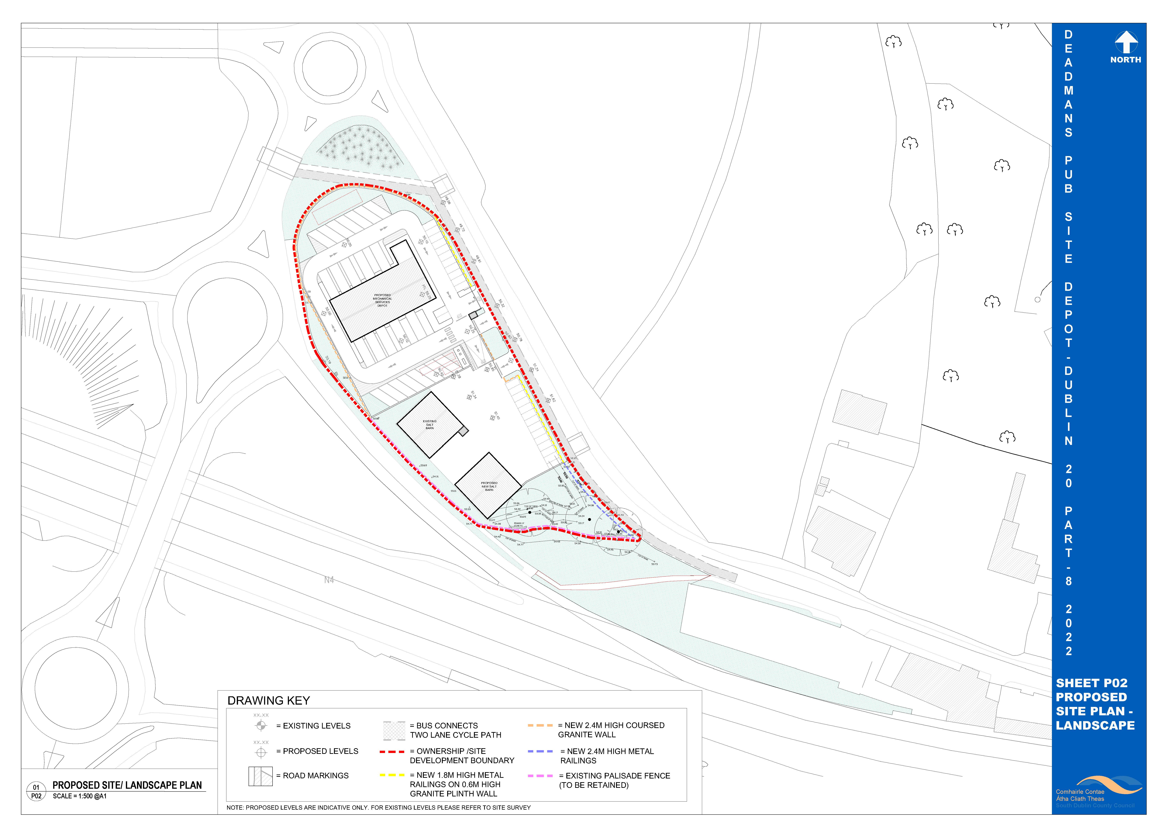
Proposed site
PROPOSED Site LAYOUT
Proposed Mechanical Services Depot
Proposed Depot Site Entrance & Exit
Proposed Salt Barn Site Entrance & Exit
Proposed Additional
Salt Barn
Existing
Salt Barn

Slide 4
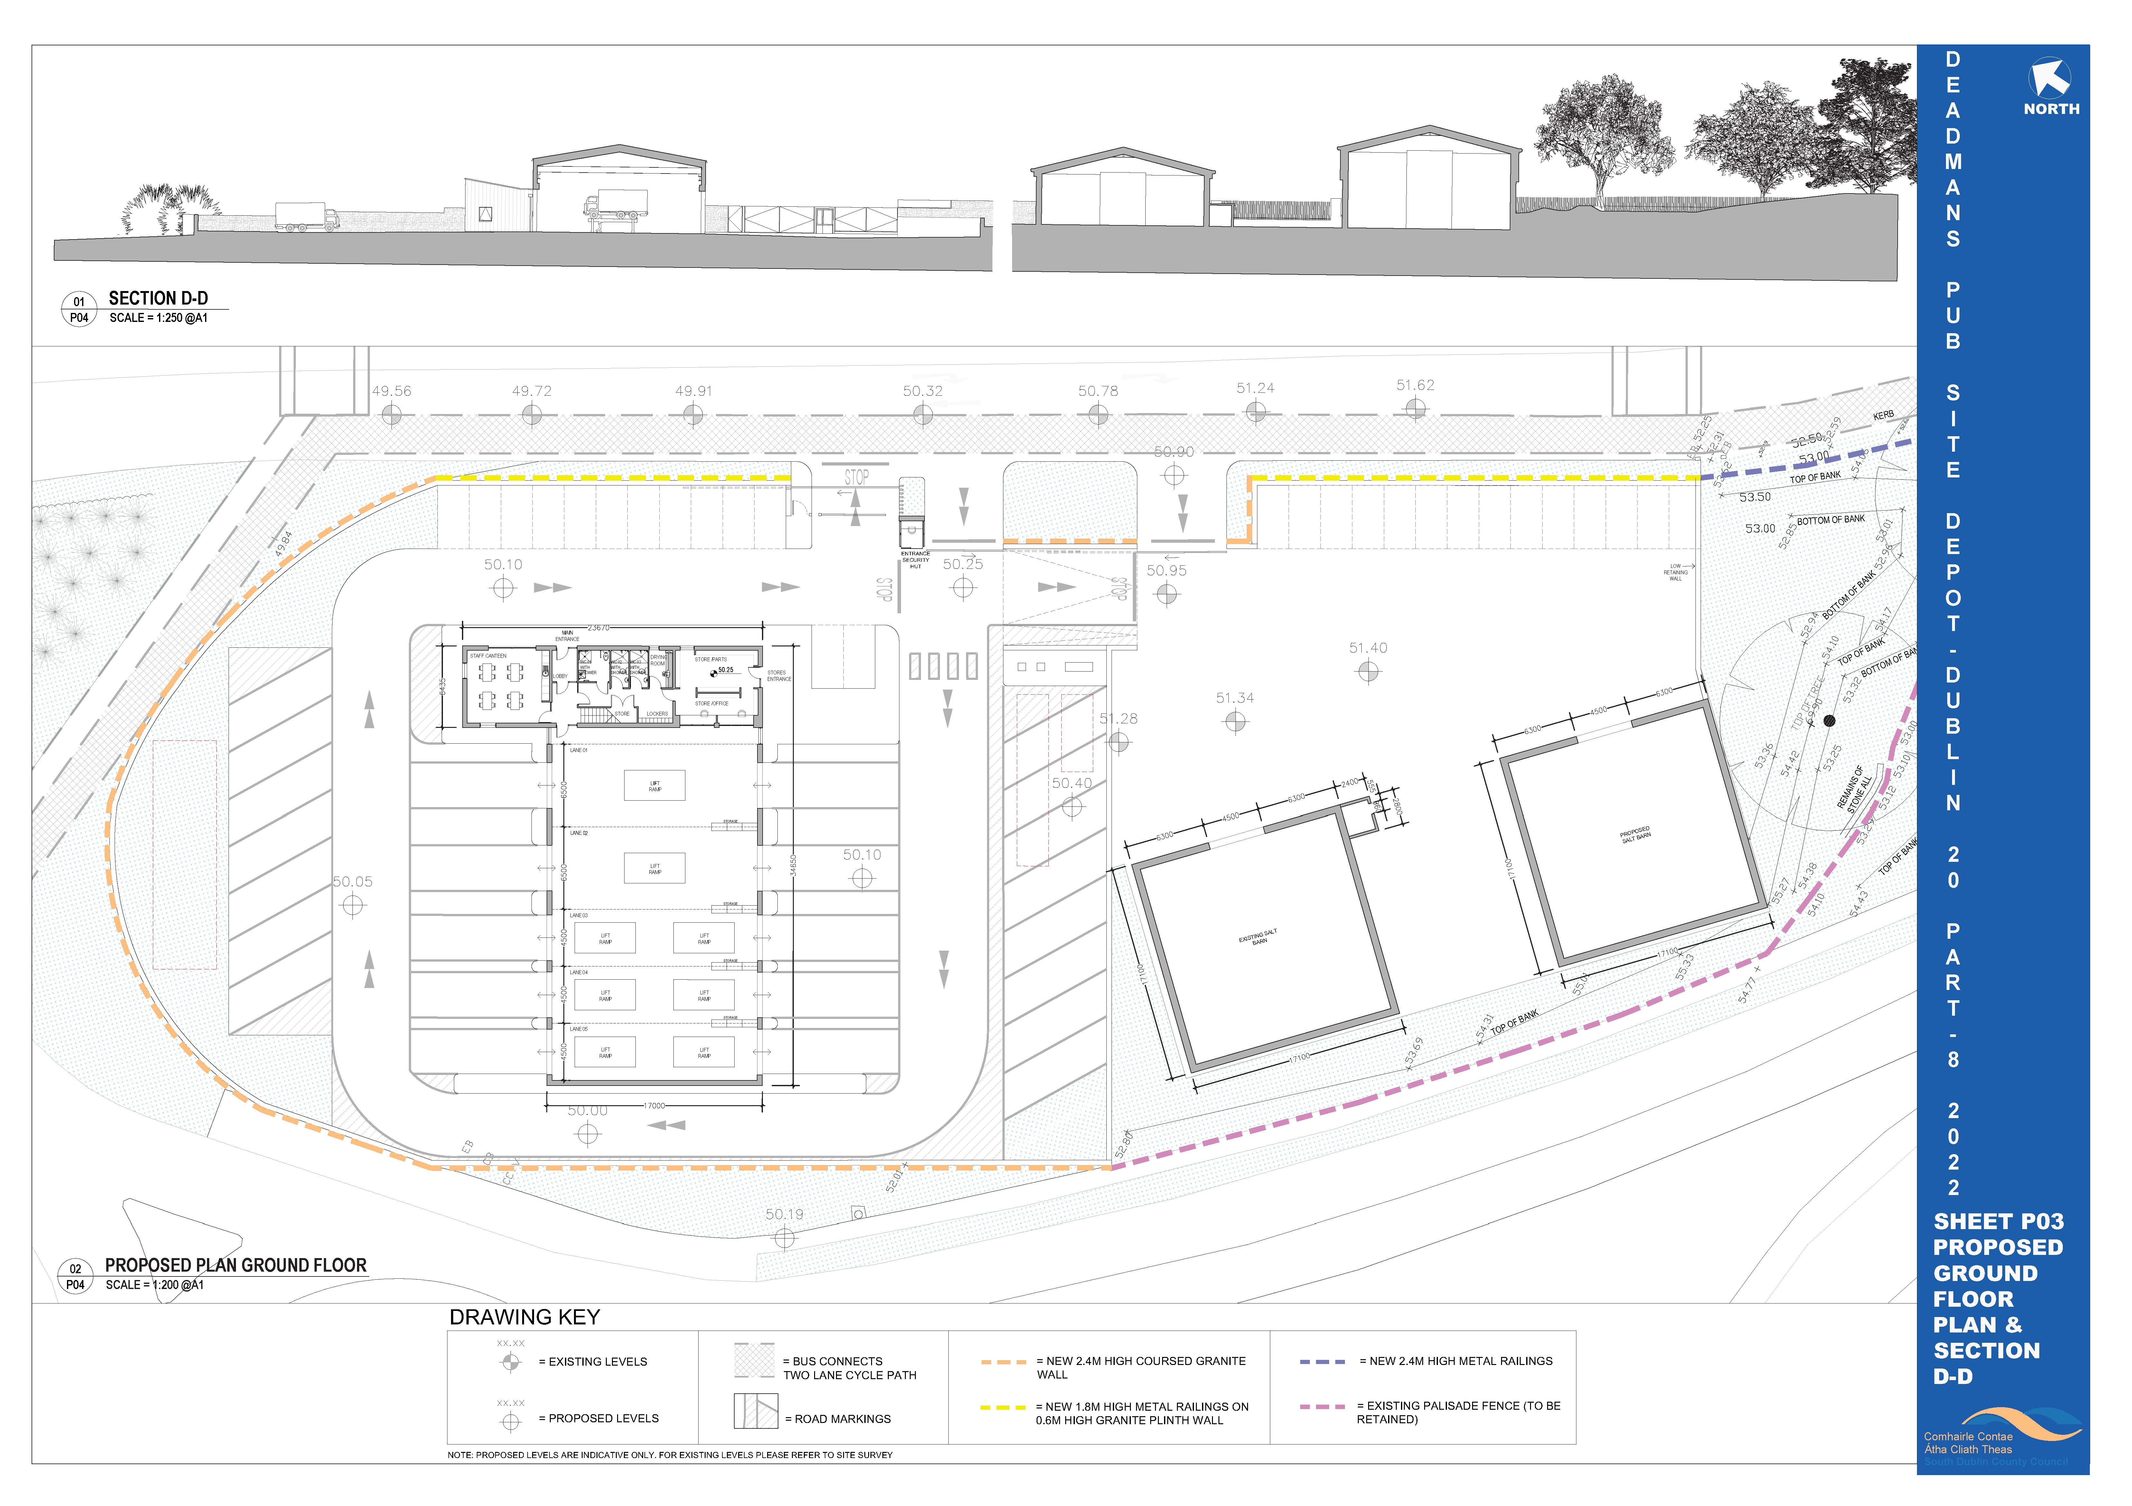
PROPOSED ground floor site LAYOUT & site section

Slide 5
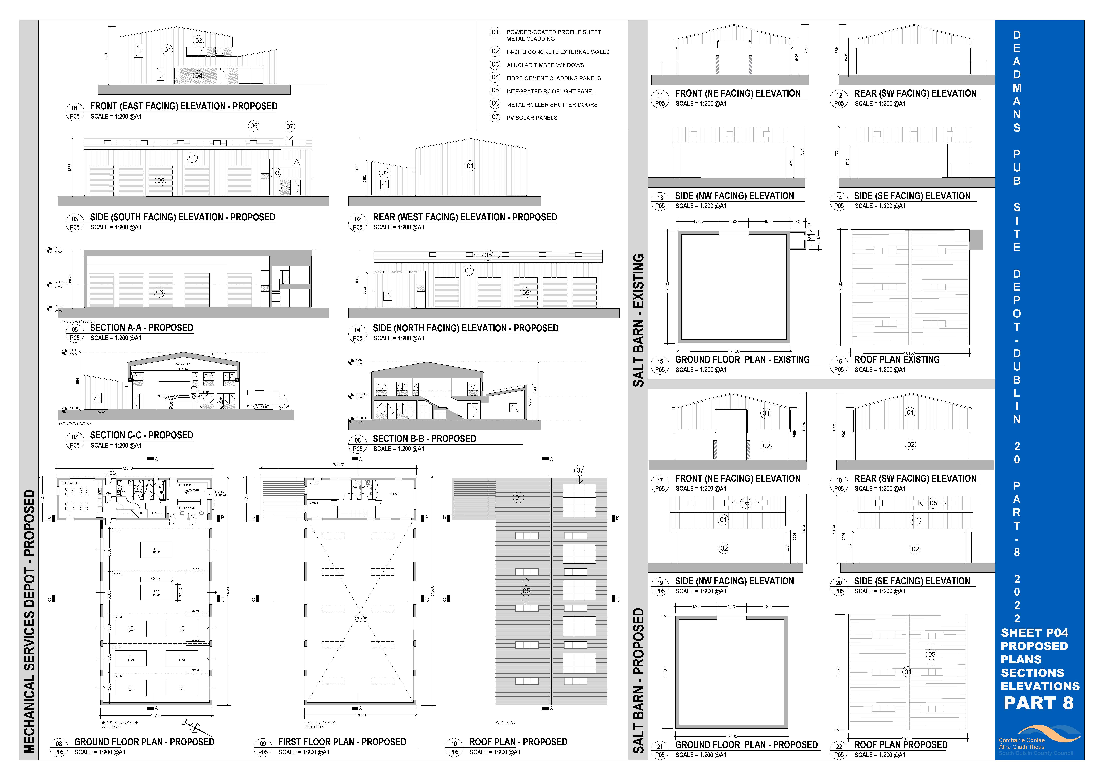
PROPOSED PLAns, Sections & elevations

