Slide 1
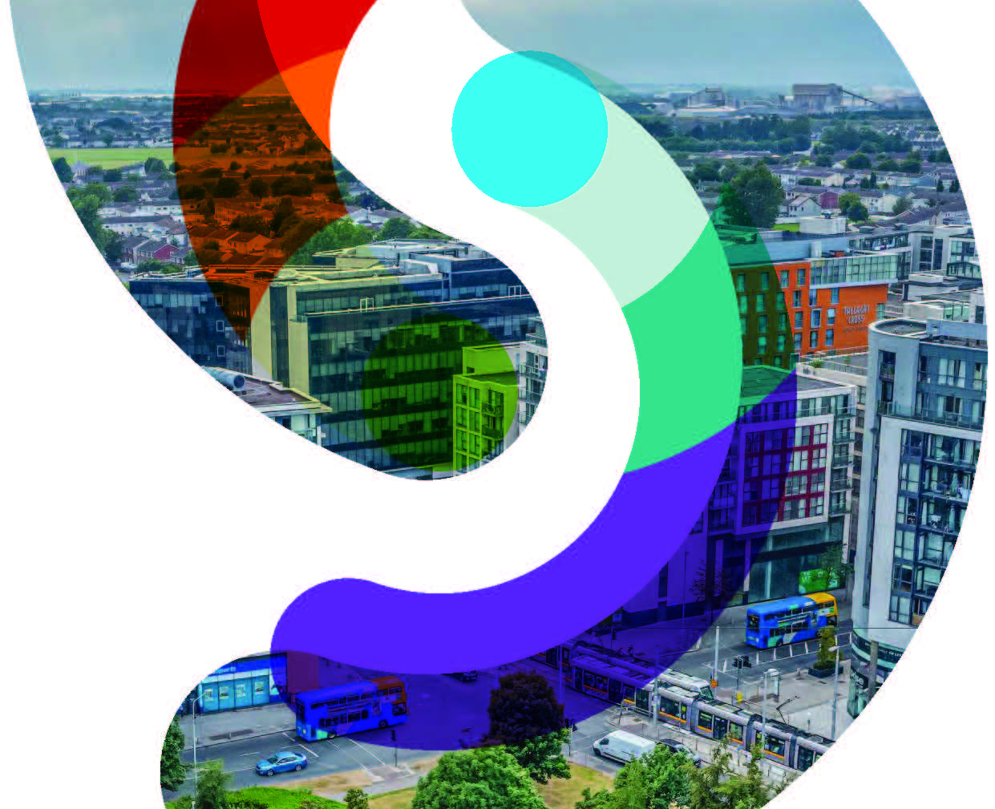
Draft Ministerial Direction
SPC Briefing 29th Sept 2022

Slide 2
Quick Review – Where we are now
South Dublin County Development Plan 2022-2028 made 22nd June 2022
Council receives draft Ministerial Direction 28th July 2022
The Plan came into effect on 3rd August with the exception of those matters raised in the Ministerial Direction
Public consultation on the draft Direction 10-23 August (Cllrs had from the date of receipt of the draft direction to the closing of public consultation to make submissions to the OPR, as set out in emails)
CE issued a report on 19th September to the OPR on the submissions and how best to give effect to the direction within 4 weeks
29th September 2022

Slide 3
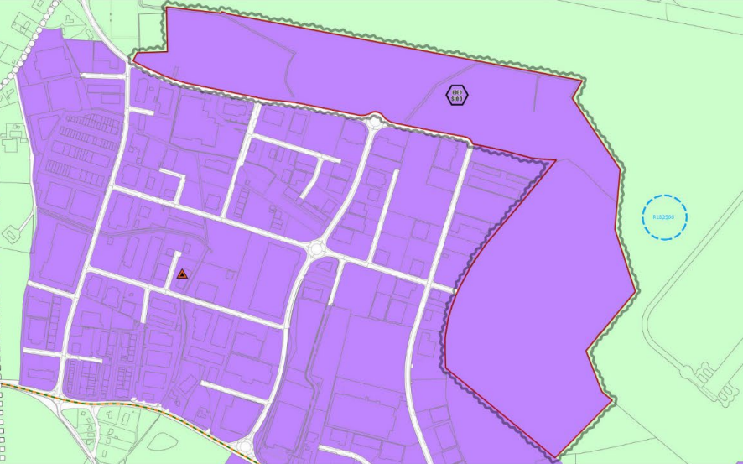
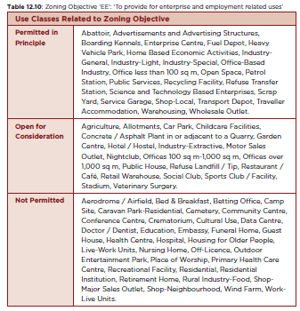
Draft Ministerial Direction
The Planning Authority has been directed to take the following steps:
Omit the Enterprise and Employment zoning and the specific local objective which requires site-specific flood alleviation measures introduced as Material Amendments 2.20 and 9.4 from the lands to the north and east of the existing Greenogue Business Park and retain the Rural RU zoning objective.
b) Amend the land use zoning objectives in tables 13.4, 13.8 and 13.10 to reinstate data centre use class as an ‘open for consideration’ use class in the REGEN, Enterprise & Employment (EE) and Major Retail Centre (MRC) zoning objectives.
29th September 2022

Slide 4
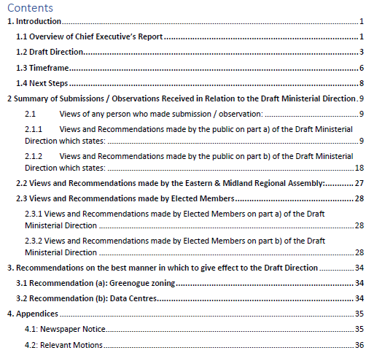
CE Report: Requirements and Table of Contents
The report is required to: summarise the views of any person who made submissions or observations to the planning authority, summarise the views of and recommendations (if any) made by the Elected Members of the planning authority, summarise the views of and recommendations (if any) made by the regional assembly, make recommendations in relation to the best manner in which to give effect to the draft direction.
29th September 2022

Slide 5
Submissions
A total of 27 submissions were received during the display period.
In relation to Greenogue 14 submissions were submitted with 3 supporting the Minister’s direction and 11 against the Minister’s direction on the matter.
In relation to Data Centres, 12 submissions were received in total with 6 supporting the Minister’s Direction and 6 against the Minister’s Direction on the matter.
Submission | No. | For | Against
Greenogue | 14 | 3 | 11
Data Centres | 12 | 6 | 6
Both | 1 | 1 (Greenogue) | 1 (Data Centres)
Total | 27 | 10 | 17
29th September 2022

Slide 6
CE Recommendation to give best effect to the Draft Direction Greenogue
Draft Direction Omit the Enterprise and Employment zoning and the specific local objective which requires site-specific flood alleviation measures introduced as Material Amendments 2.20 and 9.4 from the lands to the north and east of the existing Greenogue Business Park and retain the Rural RU zoning objective.
Chief Executive’s recommendation in order to give best effect to the draft Ministerial order
The DRAFT DIRECTION IN THE MATTER OF SECTION 31 OF THE PLANNING AND DEVELOPMENT ACT 2000 (as amended) South Dublin County Development Plan 2022-2028 is very clear in its requirements. It states that “The Planning Authority is hereby directed to take the following steps: ”a) Omit the Enterprise and Employment zoning and the specific local objective which requires site-specific flood alleviation measures introduced as Material Amendments 2.20 and 9.4 from the lands to the north and east of the existing Greenogue Business Park and retain the Rural RU zoning objective.
Recommendation on the best manner in which to give effect to the Draft Direction Delete the following provisions from the adopted Development Plan: Omit the Enterprise and Employment zoning from the lands to the north and east of the existing Greenogue Business Park and retain the Rural RU zoning objective. Omit the specific local objective (SLO) which reads as follows: Specific Local Objective ‘EDE5 SLO3’: To ensure development on lands within Greenogue Business Park will be subject to site specific flood alleviation measures forming part of any future planning application for these lands.
29th September 2022

Slide 7
CE Recommendation to give best effect to the Draft Direction Data Centres
Draft Direction B) Amend the land use zoning objectives in tables 13.4, 13.8 and 13.10 to reinstate data centre use class as an ‘open for consideration’ use class in the REGEN, Enterprise & Employment (EE) and Major Retail Centre (MRC) zoning objectives.
Chief Executive’s recommendation in order to give best effect to the draft Ministerial order
The DRAFT DIRECTION IN THE MATTER OF SECTION 31 OF THE PLANNING AND DEVELOPMENT ACT 2000 (as amended) South Dublin County Development Plan 2022-2028 is very clear in its requirements. It states that “The Planning Authority is hereby directed to take the following steps: ”a) Amend the land use zoning objectives in tables 13.4, 13.8 and 13.10 to reinstate data centre use class as an ‘open for consideration’ use class in the REGEN, Enterprise & Employment (EE) and Major Retail Centre (MRC) zoning objectives.
Recommendation on the best manner in which to give effect to the Draft Direction Delete the following provisions from the adopted Development Plan: Reinstate Data Centres use class as an ‘open for consideration’ use class from ‘not permitted’ in table 12.4. Reinstate Data Centres use class as an ‘open for consideration’ use class from ‘not permitted’ in table 12.8. Reinstate Data Centres use class as an ‘open for consideration’ use class from ‘not permitted’ in table 12.10. Note: For reference, tables 13.4, 13.8 and 13.10 are numbered in the adopted Development Plan as 12.4, 12.8 and 12.10.
29th September 2022

Slide 8
Next Steps
Chief Executive’s report wasprepared in accordance with Section 31(8) of the Planning and Development Act 2000 (as amended)
Section 31(AN) sets out that on receipt of the Chief Executive’s report, the Office of The Planning Regulator:
‘shall consider the report of the chief executive on the submissions, together with any submission made under section 31(10), and shall, no later than 3 weeks after receipt of that report—
recommend to the Minister that he or she issue the direction with or without minor amendments, or
for stated reasons, where the Office is of the opinion that—
a material amendment to the draft direction may be required,
further investigation is necessary in order to clarify any aspect of the report furnished or submissions made, or
it is necessary for any reason,
appoint a person to be an inspector.’
If the Minister agrees with the Recommendation, then he shall issue the Direction (6 week deadline) with or without minor amendments.
If (b) comes into play, following a report from the inspector (if required) the OPR recommends to the Minister to issue or not issue the direction.
Pursuant to Section 31(17) of the Act, the direction issued by the Minister is deemed to have immediate effect and its terms are considered to be incorporated into the Plan, or, if appropriate, to constitute the plan.
29th September 2022

