Slide 1
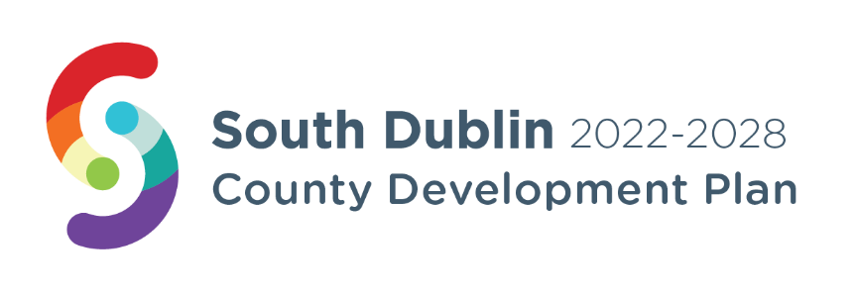
Clondalkin – Local Area Plan
SPC Meeting 29th September 2022

Slide 2
County development Plan Context
Objectives: QDP14 - 3 and EDE4 - 14
“To prepare a LAP for Clondalkin, the extent of the boundary to be defined, which will be guided by the Local Area Plans Guidelines for Planning Authorities, 2013 (Department of the Environment, Community and Local Government) or any superseding guidelines and which will incorporate:
A vision for the development of Clondalkin
Wider urban design principles
Framework plans for larger infill sites
A Conservation Plan
A local Green Infrastructure strategy derived from the County GI Strategy
Transport movement study.”

Slide 3
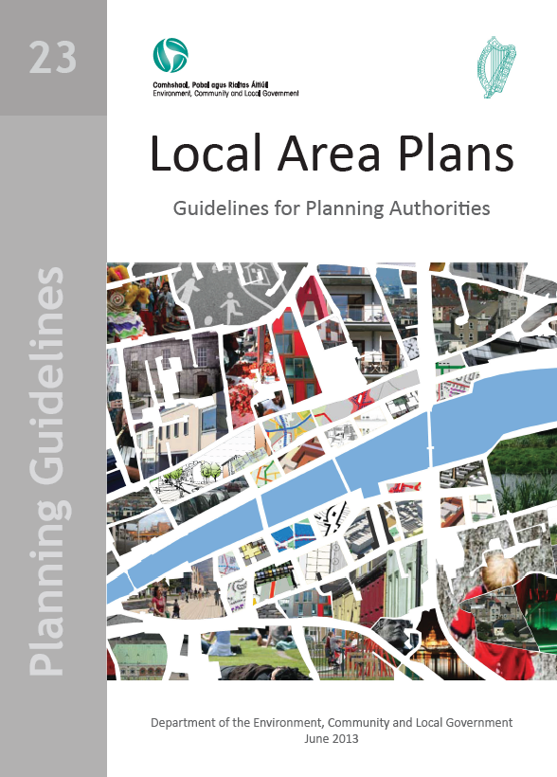
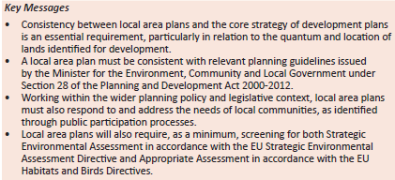
requirements of local area plans

Slide 4
Why Prepare a Local Area Plan for Clondalkin?
Clondalkin is an important and growing settlement within South Dublin
It sits within the Dublin City and Suburbs area within the Regional Spatial and Economic Strategy
There are sites which have potential for further housing development to help meet identified targets up to 2028 and beyond
It will provide for a review of social infrastructure needs to meet population growth and the different age profiles
There are opportunities to improve movement within and around the centre and wider area
It has an historic context through its medieval urban form which will inform placemaking and urban design
It has opportunities to improve green infrastructure and create/ improve linkages
There are opportunities to implement policies and objectives to combat climate change

Slide 5
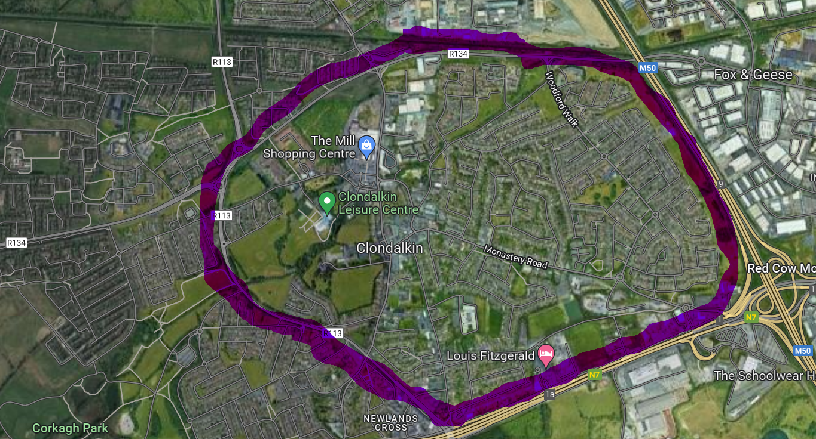
Boundary of LAP???

Slide 6
Provisional Timeframe
Stages | Description | Provisional Timeframe | Statutory Status
1-3 | Preparing the Draft Plan - Background research and information gathering including informal public and stakeholder consultation and procurement of necessary consultants | Q3 2022 – Q3 2023 | Non-Statutory
4-7 | Publication of Draft Plan, further consultation and adoption | Q3 2023 – Q2 2024 | Statutory
Total |  | Approx 99 weeks

Slide 7
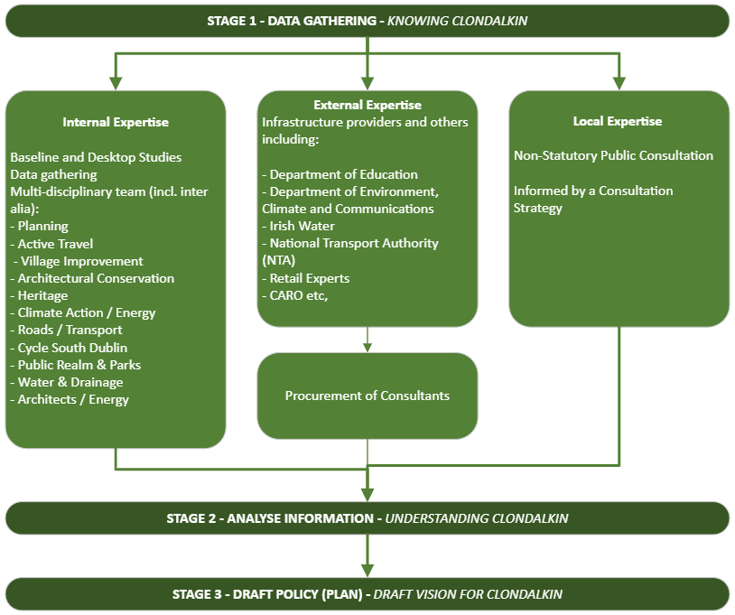
Preliminary Stages in the Preparation of Plan – Non- statutory
Stage 1 – Knowing Clondalkin
Stage 2 – Understanding Clondalkin
Stage 3 – Draft Vision for Clondalkin

Slide 8
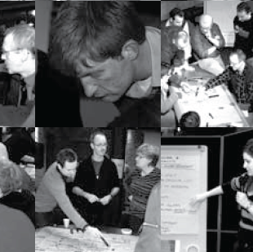
Public consultation
Consultation Plan will be developed Q1 2023
There will be early, informal engagement with multiple stakeholders to inform the Draft Plan
There will also be statutory formal public consultation on the Draft Plan

Slide 9
Delivery
a. Identify projects that the Council can deliver
Parks/public realm
Village Design
Conservation
Transport improvements
Active Travel & Cycle South Dublin
Decarbonization projects
Notes:
Built Heritage Investment Schemes - grant scheme to support the repair and conservation and repair of privately owned properties that are protected under the Planning and Development Act 2000
Historic Structures Fund - assists with works to safeguard historic structures in urgent need of repair to help prevent the loss or deterioration of Ireland’s architectural heritage

Slide 10
Clondalkin LAP
Will respond to objectives in the adopted County Development Plan
Will ensure that Cllrs, the SPC and ACM are kept informed and can inform the draft plan through the consultation and preparatory process
Will involve the local community and stakeholders through a consultation strategy involving public consultation
Will examine funding models for identified capital projects

