Slide 1
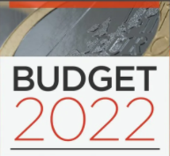
Residential Zoned Land Tax
LUPT Update to SPC 29th September 2022

Slide 2
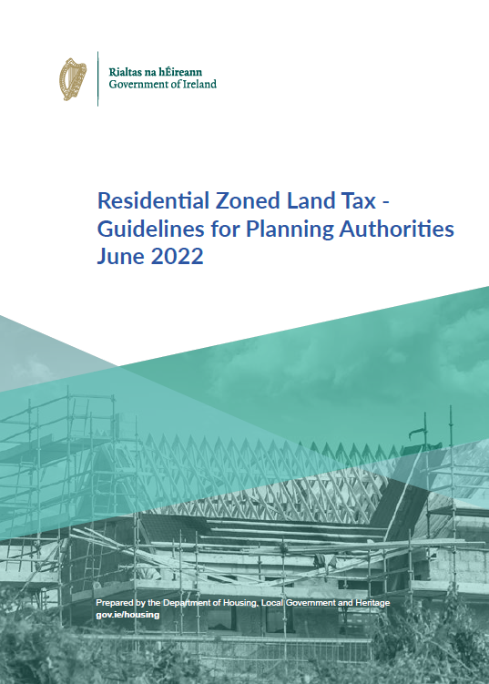
What is the Residential Zoned Land Tax?
Introduced under the Finance Act 2021 in December of that year
By 2023, it will replace the Vacant Site Levy
Tax will be collected by Revenue

Slide 3
Draft Map will be published on 1st November 2022
Land which is zoned:
Primarily for residential use
Mixed use
Lands must be suitably serviced to accommodate development
By default, all residentially zoned lands are in scope
Criteria allows for exclusions from the map
Mapping the Residential Zoned Land Tax
Notes:
Land which is suitably zoned and serviced to be on the map

Slide 4
Exclusions from the Map
Required for or integral to or occupied by:
Social, community or governmental infrastructure and facilities, including:
infrastructure and facilities used for the purposes of public administration or the provision of education or healthcare,
transport facilities and infrastructure,
energy infrastructure and facilities,
telecommunications infrastructure and facilities,
water and wastewater infrastructure and facilities,
waste management and disposal infrastructure, or
recreational infrastructure, including sports facilities and playgrounds
Notes:
Land which is suitably zoned and serviced to be on the map but the above is not included in the criteria for mapping purposes

Slide 5
Exclusions from the Map
Contaminated land
Statutory designation which precludes development
Archaeology
Derelict Site
Zoned residential, is in use as premises, in which a trade or profession is being carried on, that is liable to commercial rates, that it is reasonable to consider is being used to provides services to residents of adjacent residential areas
Mixed use zoned land except where the land is ‘vacant or idle’
Notes:
Land which is suitably zoned and serviced to be on the map but the above is not included in the criteria for mapping purposes

Slide 6
On the Map / In Scope but not liable for the Tax
Not Liable: Residential Property
existing habitable dwellings and their curtilage
Notes:
Res properties with curtilage over 0.4ha are not liable for the tax but must register for the RZLT with Revenue and supply certain info

Slide 7
Potential for Public to be uncertain when map is published
DHLGH and Dept Finance have advised that they will run a communications campaign prior to publication of the Draft map
SDCC will communicate through social media, public notice and other formats
Communicating Non-Liability for Residential Property
Notes:
a number of exclusions from the zoned land tax, being: • existing habitable dwellings and their curtilage; • land that is used for certain infrastructure or facilities, for example utilities, transport, social or community or recreational purposes; • land where a site is designated as a derelict site and liable for the Derelict Sites Levy; and • land which is zoned for residential use but is used to provide services consistent with a residential area (such as a corner shop).

Slide 8
Residential Zoned Land Tax Process - Progression
Owner can appeal the determination within one month
Owner can request a variation of the zoning of their land
LA can publish a ‘supplemental map’ by 1st May 2023, where additions to the draft map have been identified
Further public consultation up to 1st June
Owner notified of LA determination by 1st August 2023
Determination may be appealed to An Bord Pleanála

