Slide 1
Housing Delivery Update Report Lucan/Palmerstown/Fonthill/North Clondalkin Area Committee Meeting 27th September 2022

Slide 2
Housing Action Delivery Plan 2022-2026
HDAP 2022-2026 approved by Dept. & published on www.sdcc.ie Link: housing-delivery-action-plan-2022-2026-final.pdf (sdcc.ie) HFA Target = 3,381 SDCC Projected Output= 3,409 (for comparison 2016-21 build output was 1,899)
Social Housing Council construction sites Large Council-led mixed tenure sites AHB proposals (up to 50%) Part V yield Leasing
Affordable Housing Purchase/Cost rental Large Council owned Sites AHBs - Cost Rental Equity Loan (CREL) Private mixed tenure developments Additional Part V yield – extra 10% Clonburris - URDF

Slide 3
2022-2026
Notes:
image
No alt text provided
textbox
No alt text provided
lineClusteredColumnComboChart
No alt text provided

Slide 4
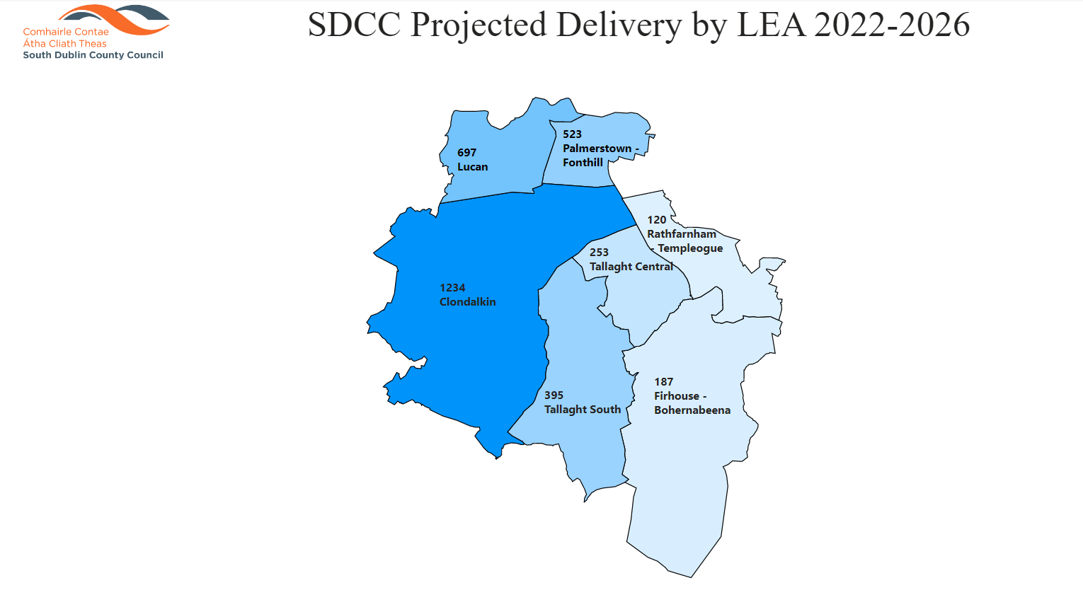
2022-2026
Notes:
image
No alt text provided
textbox
No alt text provided
lineClusteredColumnComboChart
No alt text provided

Slide 5
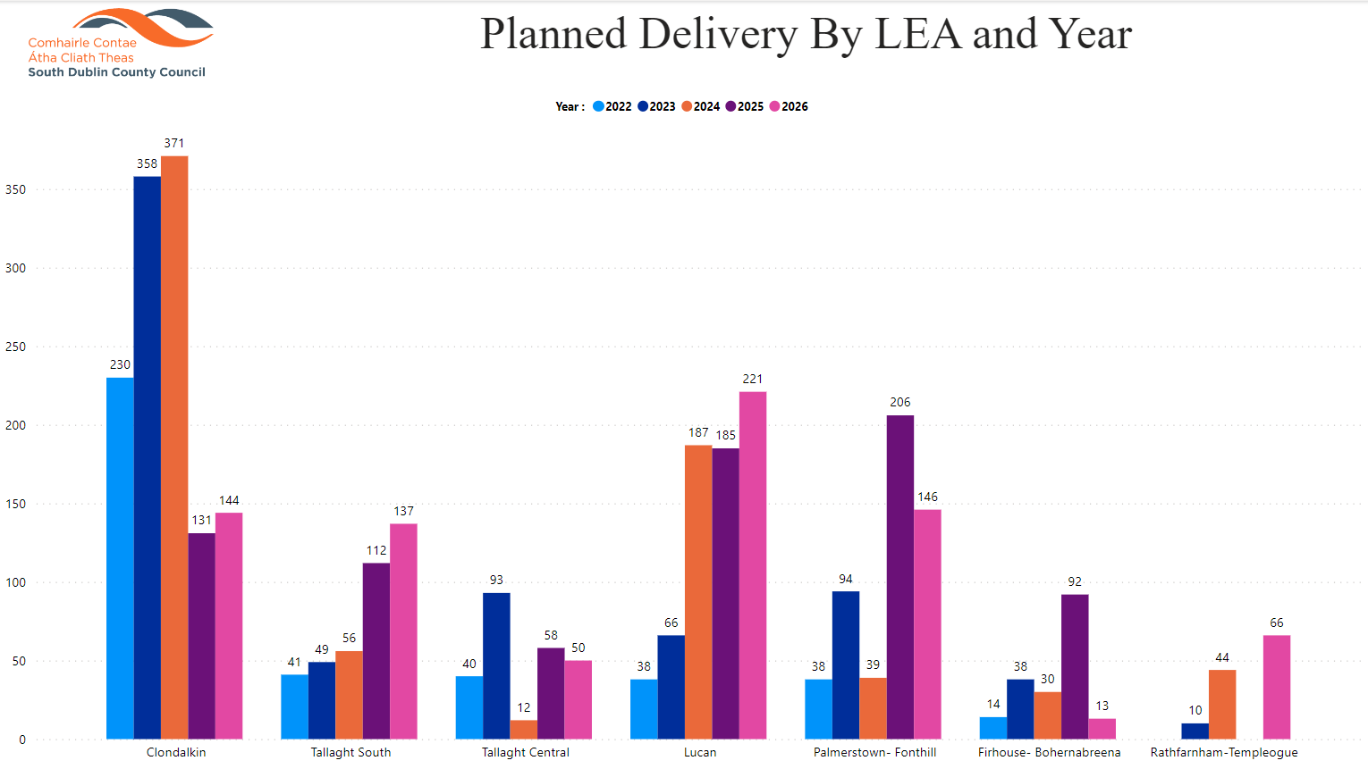

Slide 6
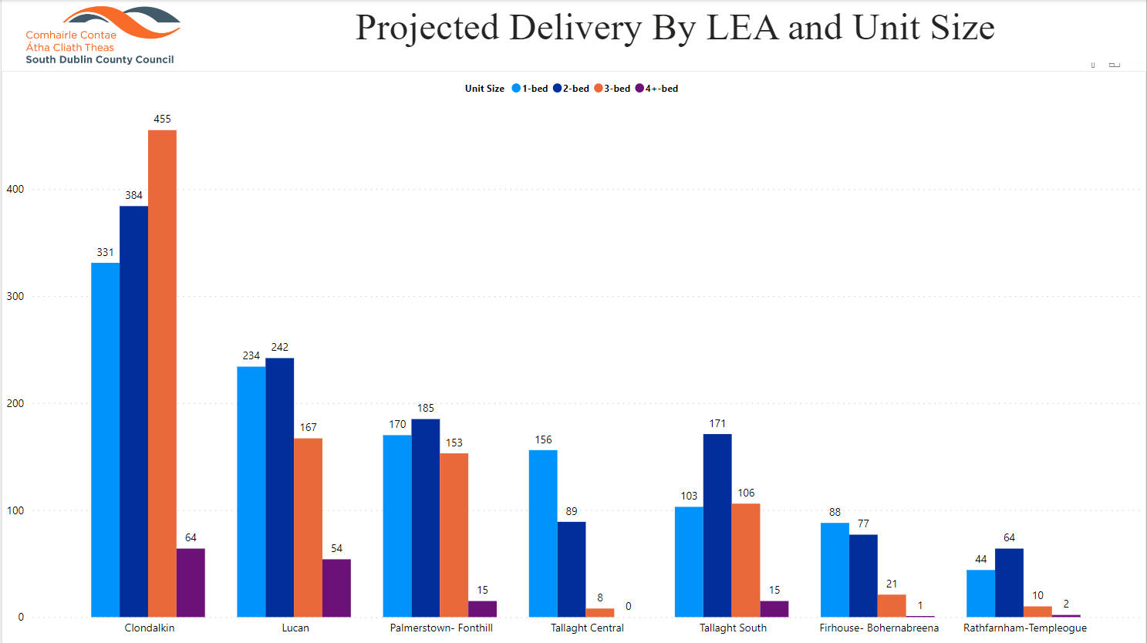

Slide 7
2022
Notes:
Housing for All Delivery Pipeline 2022
No alt text provided
textbox
No alt text provided
textbox
No alt text provided
tableEx
No alt text provided
Housing for All Delivered
No alt text provided
actionButton
No alt text provided
textbox
No alt text provided
tableEx
No alt text provided

Slide 8
Approved/Proposed Developments by LEA (2)
LEA | Site | No. | Update
Lucan | Aderrig (Part V) | 25 | 2 x unit in Q2 2022 & balance in Q4 2023
 | Somerton Phase 2 (Part V) | 24 | On site, due for completion Q2 2023
 | St Helens/Somerton (Part V) | 12 | On site, due for completion Q2 2023
 | Tandys Lane (Part V) | 24 | Due for completion 2023
 | St Helens Plaza (Part V) | 4 | Due for completion 2023
Palmerstown Fonthill | St. Mark’s | 38* | On site–due for completion Dec 2022
 | Balgaddy | 69 | Tender process currently being completed
 | Old Lucan Rd (Túath) | 4 | Tenders received by AHB unviable financially in current climate, AHB assessing options
 | St. Ronan’s | 9 | Design team appointed Aug 2022
 | Kennelsfort Road | 20 | BTR due for completion 2023

Slide 9
SDCC Owned Large Sites
Kilcarbery: 1,034 homes with 30% social (310 homes)
Also includes affordable housing - 74 cost rental & 50 “discounted” homes
36 social homes delivered plus 16 affordable purchase homes, balance of 37 social homes due by year end.
Killinarden: 620 homes including 125 social homes & 372 affordable purchase
LSRD Planning process – LSRD preplanning meeting held 22/8/22. Formal option to issue from Planning authority max 4 weeks after meeting date (19/9/22)
Delivery from 2024 (subject to planning)
Clonburris: Phases 1 & 2 comprising approx. 400 homes (120 social) under design
Part 8s for Phase 1 (Kishogue) & Phase 2 (Canal Extension-Ashwood) approved. Preparation of tender documents to appoint contractors underway. Contractors to be appointed by end of Q1 2023.
Rathcoole: Revised proposal to be developed
Cost rental homes (74 units) delivered Q3 2022 - Tuath
Draft tender currently being prepared to appoint Design teams for Phases 3,4 and 5 Clonburris
To be considered Q3 2022 as County Development Plan published.
Belgard Square North - Cost Rental Apartments
Tender currently being assessed for appointment of ER team, tender for contractor advertised due to close early Oct 2022

