Slide 1
Housing Delivery Update Report Clondalkin Area Committee Meeting 21st September 2022

Slide 2
Housing Action Delivery Plan 2022-2026
HDAP 2022-2026 approved by Dept. & published on www.sdcc.ie Link: housing-delivery-action-plan-2022-2026-final.pdf (sdcc.ie) HFA Target = 3,381 SDCC Projected Output= 3,409 (for comparison 2016-21 build output was 1,899)
Social Housing Council construction sites Large Council-led mixed tenure sites AHB proposals (up to 50%) Part V yield Leasing
Affordable Housing Purchase/Cost rental Large Council owned Sites AHBs - Cost Rental Equity Loan (CREL) Private mixed tenure developments Additional Part V yield – extra 10% Clonburris - URDF

Slide 3
2022-2026
Notes:
image
No alt text provided
textbox
No alt text provided
lineClusteredColumnComboChart
No alt text provided

Slide 4
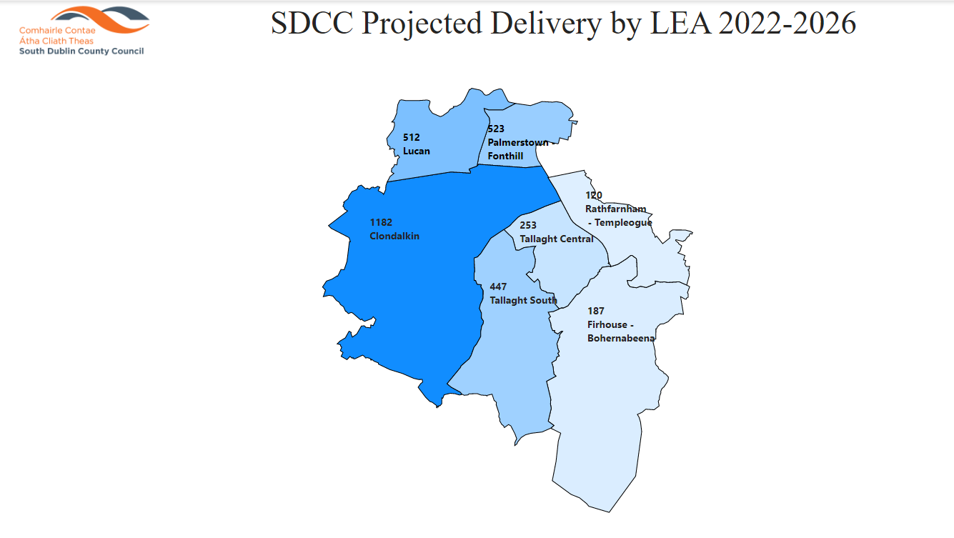
2022-2026
Notes:
image
No alt text provided
textbox
No alt text provided
lineClusteredColumnComboChart
No alt text provided

Slide 5
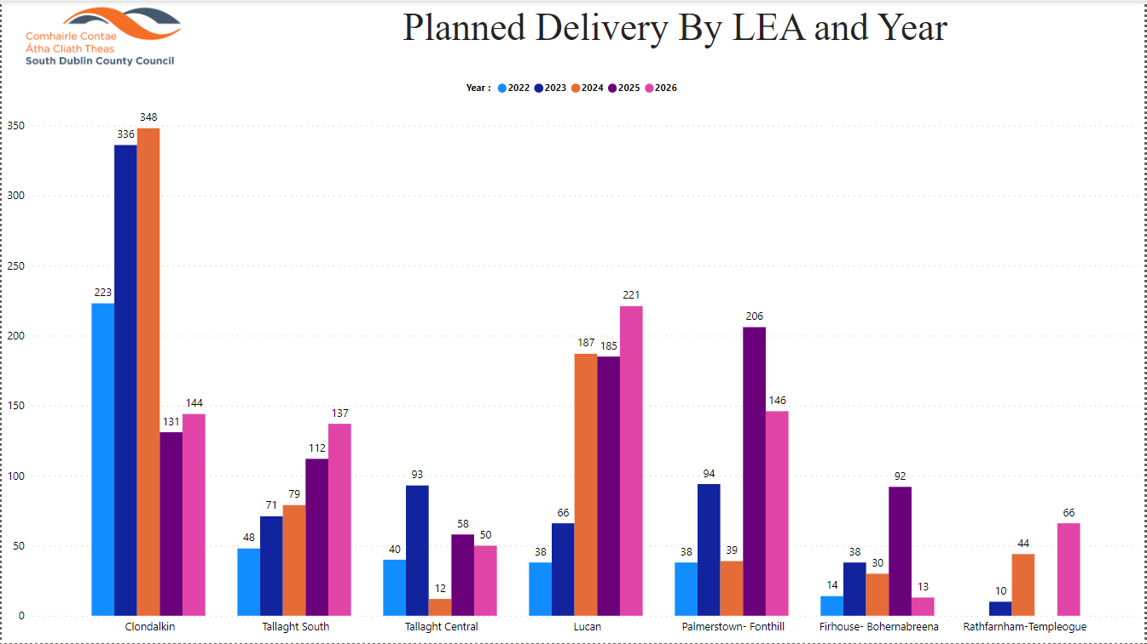

Slide 6
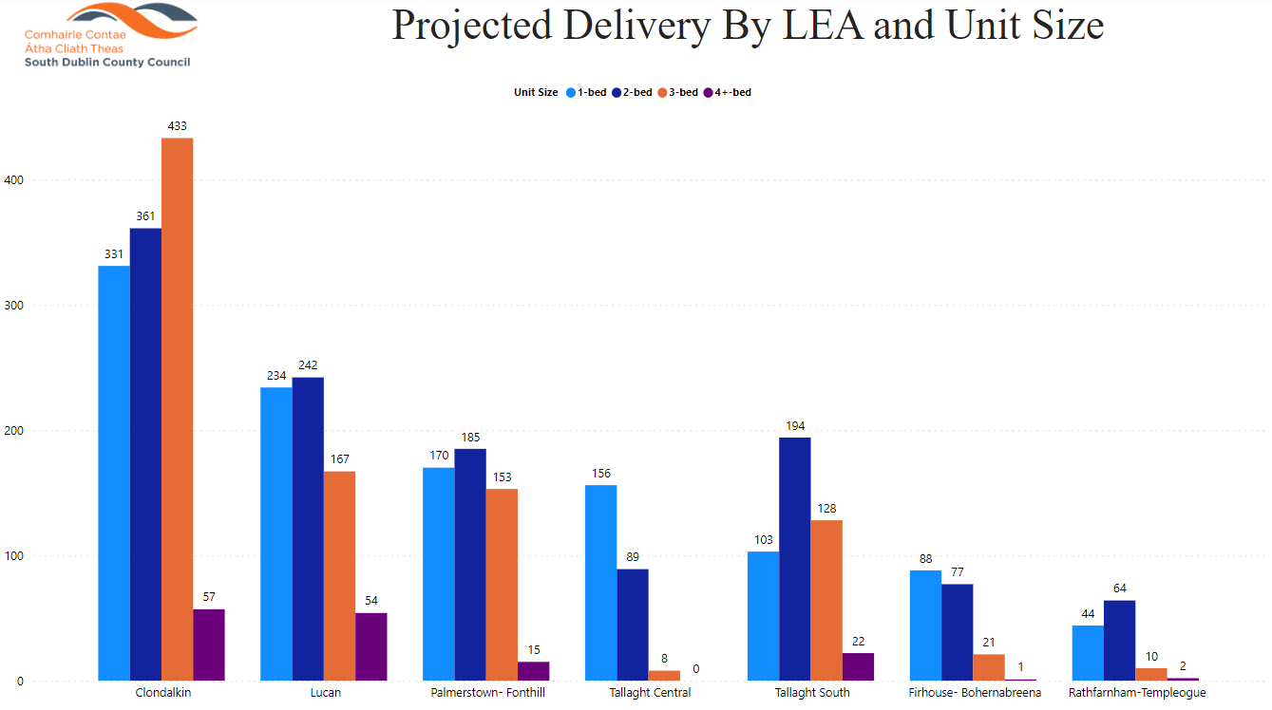

Slide 7
2022
Notes:
Housing for All Delivery Pipeline 2022
No alt text provided
textbox
No alt text provided
textbox
No alt text provided
tableEx
No alt text provided
Housing for All Delivered
No alt text provided
actionButton
No alt text provided
textbox
No alt text provided
tableEx
No alt text provided

Slide 8
Approved/Proposed Developments by LEA
LEA | Site | No. | Update
Clondalkin | Riversdale | 25* | On site, due for completion Oct 2022
 | Nangor/”eircom” site | 93 | On site, due for completion Oct 2023
 | Lindisfarne | 19 | Contractor appointed Sept 2022
 | Sallypark (Clúid/Part V) | 85 | On site, due for completion Nov 2022 Renamed Sallymills
 | Nangor Road (Simon) | 10 | Revised planning application to be made
 | Alpine Heights | tbc | Design to ACM Q4 2022
 | Deansrath / Melrose | tbc | Design to ACM Q4 2022
 | Oldcastle Park | tbc | Design to ACM Q4 2022
 | Kilcarbery 2 | tbc | Design to ACM Q4 2022
 | Graydon (Part V) | 15 | 8 delivered June, Bal of 7 due Oct 22
 | Cloverhill (Part V) | 4 | Due for completion 2023
 | New Road Clondalkin (Part V) | 2 | Due for completion 2023

Slide 9
LEASING 2022
Notes:
image
No alt text provided
textbox
No alt text provided
shape
No alt text provided
Number of Leases Completed Each QTR
No alt text provided
Number of Leasing Completed by Type
No alt text provided
Number of Leases Completed by Lease Type and Bed Size
No alt text provided
Number of Leases Completed by LEA and Lease Type
No alt text provided
Number of Leases Completed by LEA and Bed Size
No alt text provided

Slide 10
SDCC Owned Large Sites
Kilcarbery: 1,034 homes with 30% social (310 homes)
Also includes affordable housing - 74 cost rental & 50 “discounted” homes
36 social homes delivered plus 16 affordable purchase homes, balance of 37 social homes due by year end.
Killinarden: 620 homes including 125 social homes & 372 affordable purchase
LSRD Planning process – LSRD preplanning meeting held 22/8/22. Formal option to issue from Planning authority max 4 weeks after meeting date (19/9/22)
Delivery from 2024 (subject to planning)
Clonburris: Phases 1 & 2 comprising approx. 400 homes (120 social) under design
Part 8s for Phase 1 (Kishogue) & Phase 2 (Canal Extension-Ashwood) approved. Preparation of tender documents to appoint contractors underway. Contractors to be appointed by end of Q1 2023.
Rathcoole: Revised proposal to be developed
Cost rental homes (74 units) delivered Q3 2022 - Tuath
Draft tender currently being prepared to appoint Design teams for Phases 3,4 and 5 Clonburris
To be considered Q3 2022 as County Development Plan published.
Belgard Square North - Cost Rental Apartments
Tender currently being assessed for appointment of ER team, tender for contractor advertised due to close late Sept 2022

