Slide 1
Economic Enterprise & Tourism Development SPC
14th September2022

Slide 2
12th Lock Masterplan Consultants Brief
Examine the potential and deliver a plan outlining recommendations /setting out phasing programme for delivery to achieve the following
to provide for additional public amenity
cultural/enterprise/artisan and craft space,
accommodation options for both residential and hotel, café and restaurant options
leisure facilities including potentially a marina /water related leisure activities in conjunction with Waterways Ireland.
To establish a destination amenity and a connection to and from the Clonburris SDZ and to the wider residential areas of Lucan, Adamstown and Clondalkin.
To complement and be an asset for the locality, the adjacent business park staff and the wider County and region

Slide 3
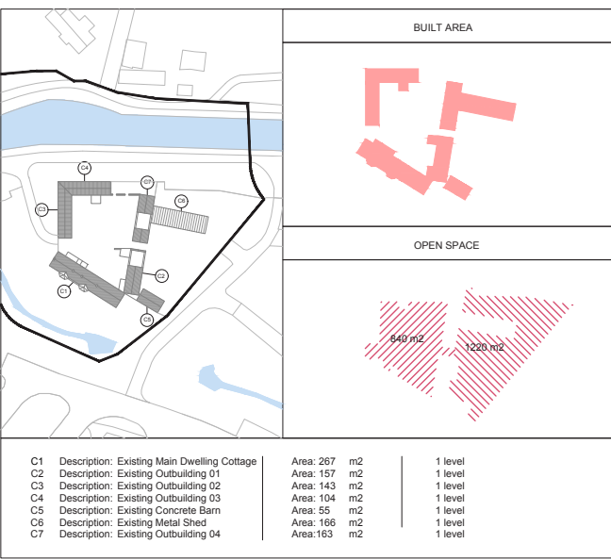
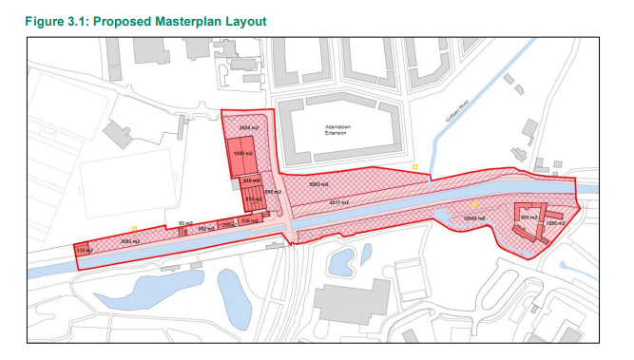
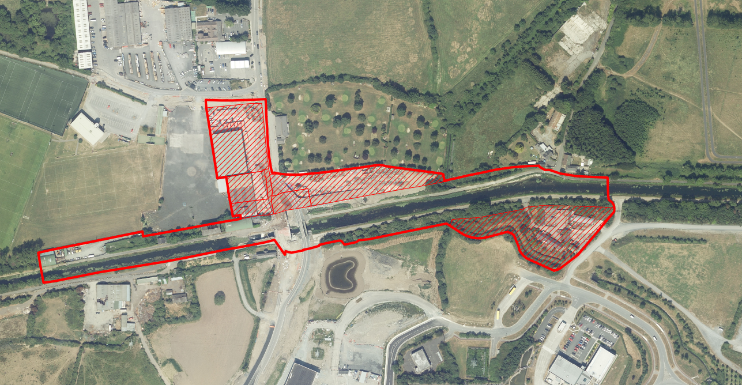
Study Area

Slide 4
Masterplan
Stage 1
Stage 1 of Development of the Masterplan has focussed on baseline studies to inform the future uses
• Topography
• Traffic Study
• Ecology /Arborist
• Architecture & Urbanism
• Landscape
• Archaeology

Slide 5
Masterplan
Stage 1 – Concepts
Stage 1 of Development of the Masterplan has also explored use concepts/ examined case studies
• Bike rental facility.
• Café and Terrace.
• Co-work office.
• Gastropub.
• Food Lab Restaurant/ Cookery School.
• Craft Brewery.
• Art Studios / Film Production.
• Garden Café.
• Facilities for Waterways Ireland.

Slide 6
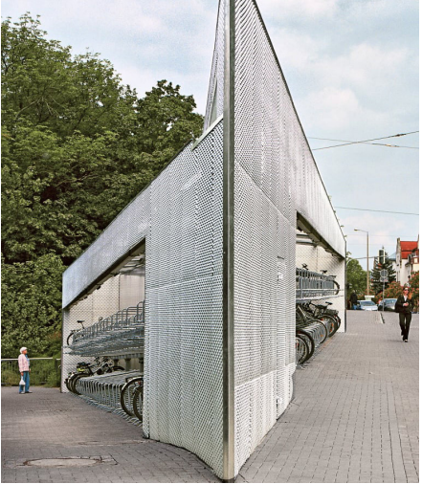
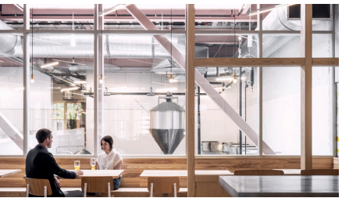
Case Studies /Concept Development
Bicycle Parking
Café /Artisan Space

Slide 7
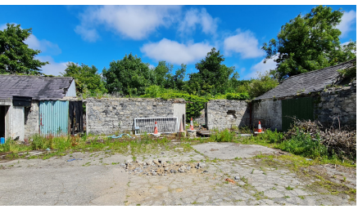
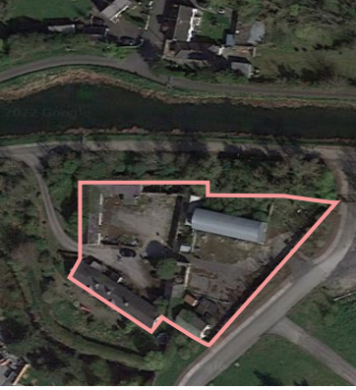
Beattie's Cottage

Slide 8
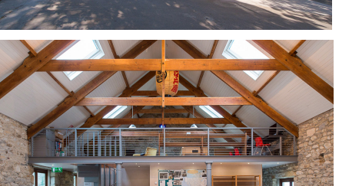
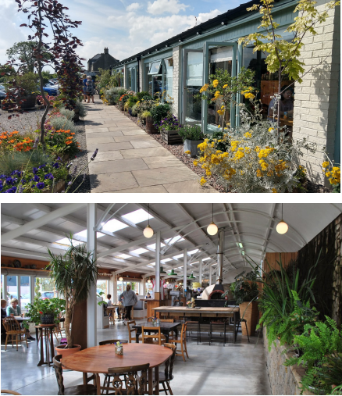
Case Studies

Slide 9
Masterplan Progress & Next Steps
Stage 1 Reports Reviewed by Working Group
In-House review meeting
Masterplan development moving to Design stage
  Collation of reviews, surveys & stakeholder input
  Preparation of integrated Masterplan draft
  Review with SDCC & stakeholders
  Economic appraisal and cost analysis of key infrastructure
  Urban design to address issues of heritage, biodiversity, landscape features

Slide 10
Grange Castle Masterplan, Marketing Strategy
Grange Castle West, South, Adjoining Lands
High Level Strategic Document
Illustrate concept and potential of GCW
Include
Landscaping, Infrastructure, Services, Wayleaves, Potential sites, Optimum Layout
Website redevelopment
Marketing /Branding Review and Strategy

Slide 11
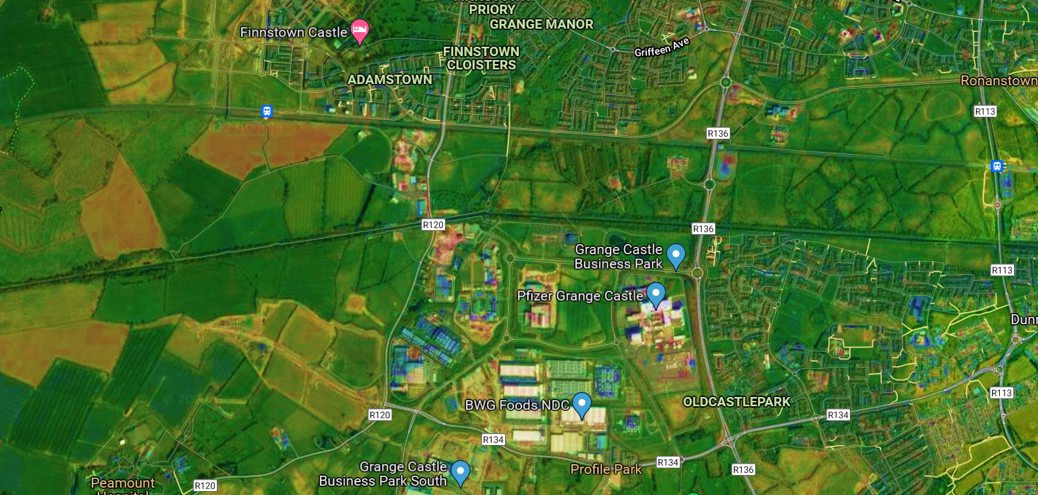
Adamstown SDZ
Kishogue Train Station
Adamstown Train Station
Clonburris Train Station
Clonburris SDZ
12th Lock Lands
Grand Canal
Grand Canal
Grange Castle
Business Parks
Grange Castle West

Slide 12


INFRASTRUCTURAL PLAN LAYOUT
Notes:
Site availability

Slide 13
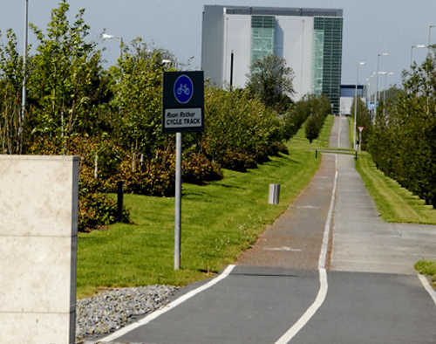
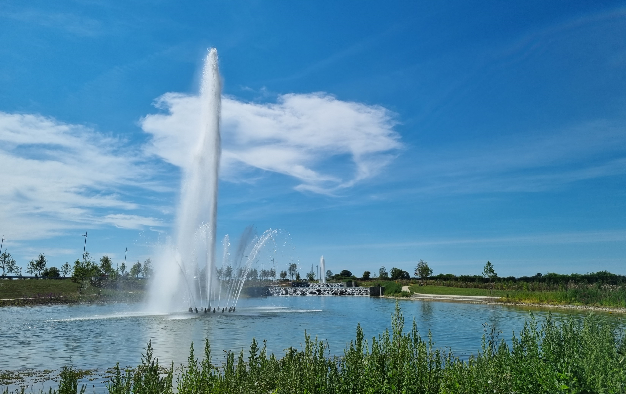
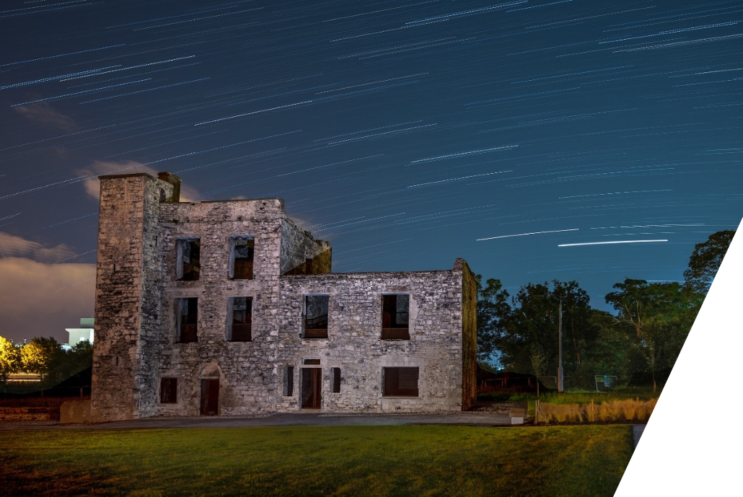
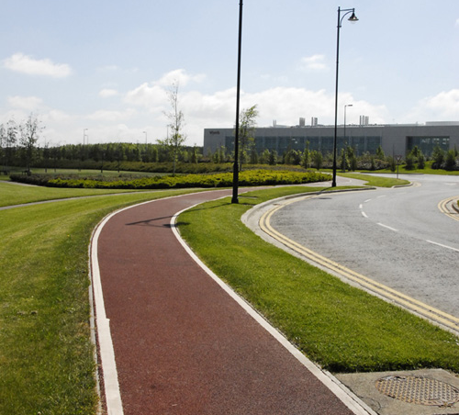
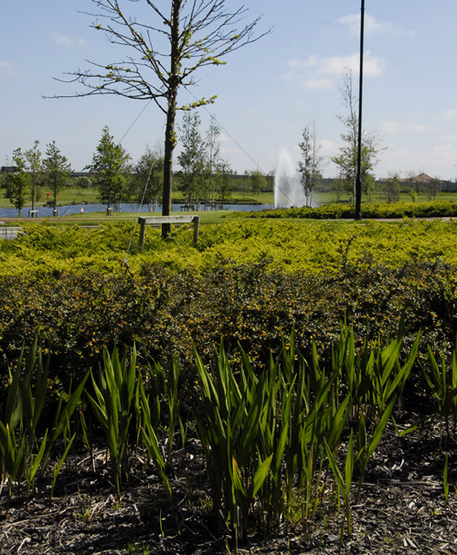


Website
Marketing /Branding Strategy

