Slide 1
Innovation Centre
Update – September 2022

Slide 2
Plan
Singular landmark 4 storey building
Views in 4 directions and southwards to the Dublin Mountains over the public park
Public area on ground floor with town hall space and café – open building designed to see through from side to side
Outdoor south facing café terrace space engaging with park
Central atrium space gives visual connection to upper levels
Lettable offices in various sizes on upper floors informed by Oxford Innovation - the successful operator
Break out space and tea stations on each level – space for conversations and chance encounters to happen
Provides a new location for work opportunity and employment
2 stair cores and one lift
Integrated staff facilities
Day and night presence

Slide 3
Innovation Centre Tallaght
Timeline
Project Stage | Status | Date
Planning | Complete | 14/12/2020
Detailed Design | Complete | 10/06/2021
Final Tender- Construction | Complete | 01/02/2022
Project Implementation | Build in progress Mobilisation Plan Initiated | 04/04/2022
Project Completion | Target Date | 26/10/2023

Slide 4
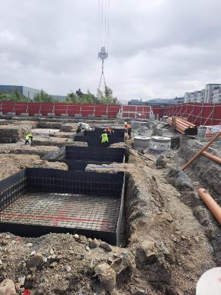
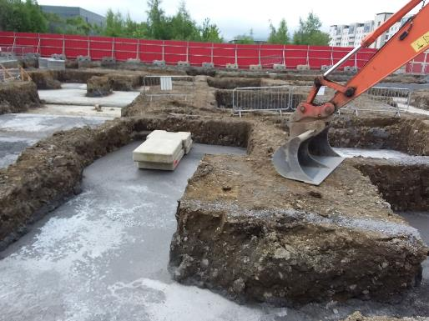
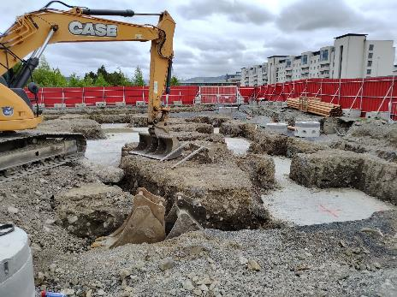
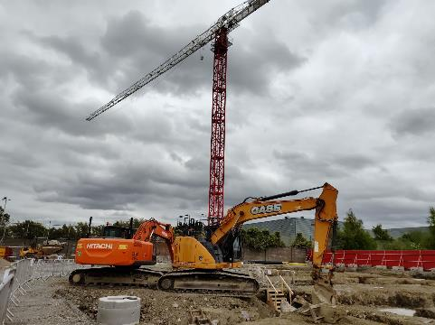
Construction Commenced 4th April

Slide 5
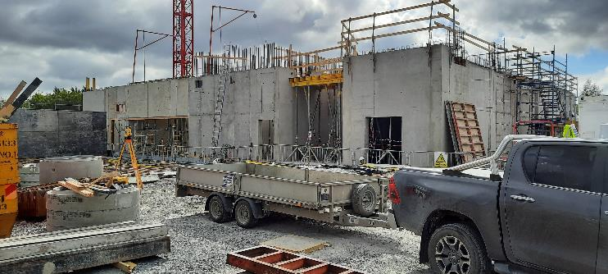
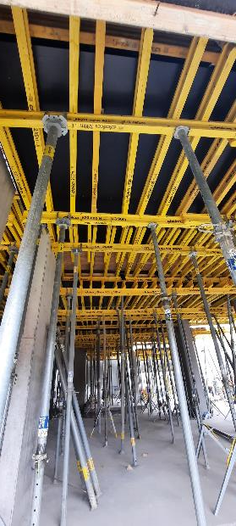
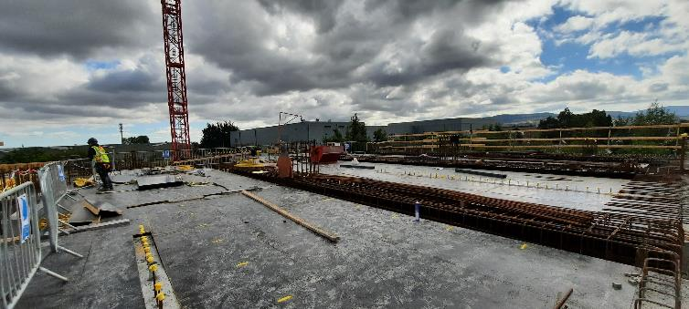
Current Status

Slide 6
Oxford Innovation
Mobilisation Activity
Initial focus with OI is around marketing
  Working with Wonder Works to develop Work IQ
  Social Media accounts have been set up
    Working with LEO and SDCC teams to coordinate social media activity
  Web landing page is live – www.workiq.ie
    OI will manage the expression of interests received.

Slide 7
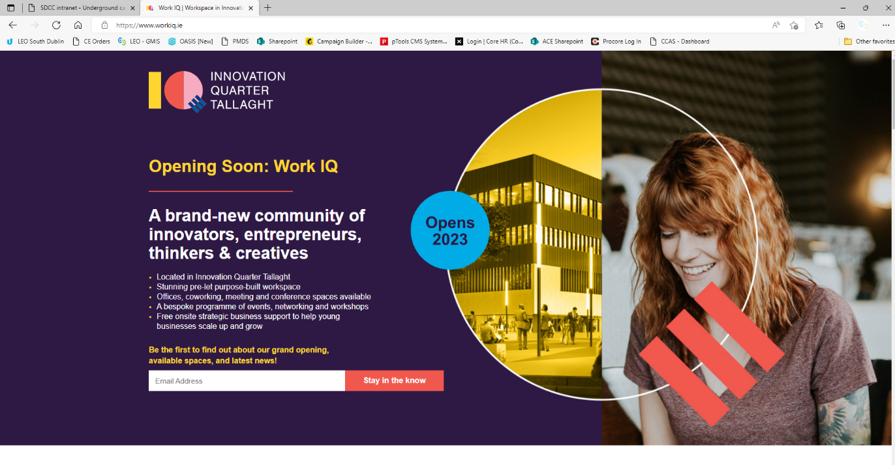
  www.workiq.ie

Slide 8
Innovation Quarter Tallaght
Fly Through

Slide 9


Slide 10
Thank You!

