Slide 1
Local Enterprise Office & County Promotion Unit Update on Key Activities year to date
Economic Development, Enterprise & Tourism SPC
September 14th 2022

Slide 2
Agenda
Financial Supports
M1 Financial Supports
TOVS – Trading Online Voucher Scheme
TAME
Business Supports
Mentoring
Training
Programmes & Networks
NEWS
SCENe
Export Development
Student Enterprise Programme
National Enterprise Awards
LECP Update
Innovation Centre Update

Slide 3
Financial Supports Measure 1 Supports year to date end of August v 2021
Year to date 2022
Previous Year to date 2022
Grant Type | Qty | Value |  | Target | Vs Target
Feasibility Grant | 6 | €43,687.50 |  | 10 | 60%
Priming Grants | 7 | €241,250.00 |  | 15 | 47%
Business Expansion | 5 | €189,775.00 |  | 10 | 50%
 | 18 | €474,712.50 |  | 35 | 51%
Qty | Value
7 | €79,665.00
8 | €300,355.00
6 | €203,614.42
21 | €583,634.42
New Jobs Supported 28.5 Year to date 2022 26 Previous Year to date 2022
Next EVAC September 14th– includes 9 business applications – Seeking Grants of €189,000 and supporting 11.5 jobs and pipeline
Notes:
Application and Approvals for 2021 still exceed normal levels by in excess of 100%

Slide 4
Breakdown of Business Sectors Receiving M1 Supports

Slide 5
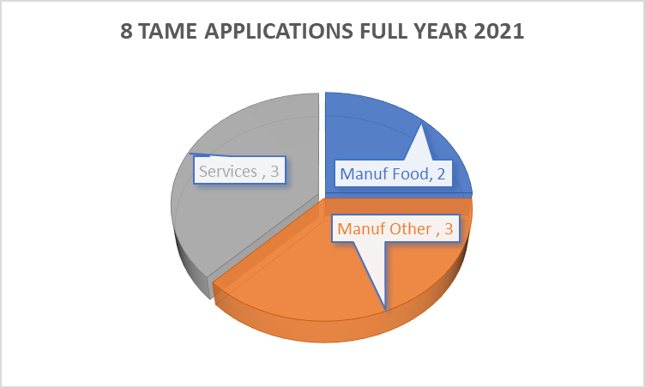
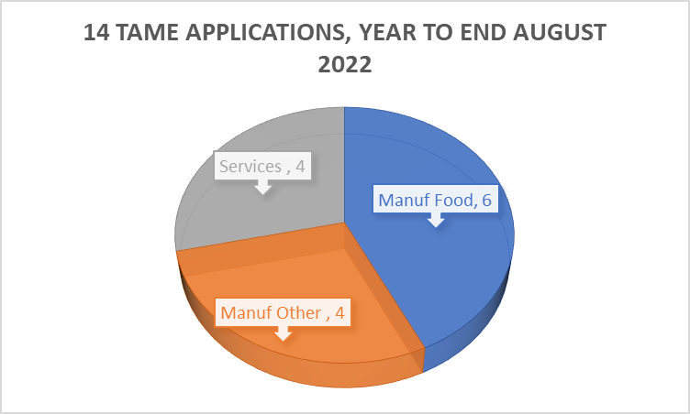
Financial Supports TAME Year to August 2022 V full year 2021
(3 applications were approved to Aug 2021 – 5 additional Sept – Dec 2021)
Notes:
All 2020 applications have now been closed out. All qualifying project have received payment.

Slide 6
Trading Online Voucher Scheme

Slide 7
Business Supports Mentoring & Training
Measure 2 – Mentoring & Training
Item | 2021 To Date | 2022 To Date | 2022 Vs 2021
LEO training programme - Attendees | 1790 | 1461 | 82%
LEO training programme - Courses | 97 | 93 | 96%
Mentoring Assignments | 391 | 444 | 114%
Mentoring Clinics - Attendance
Mentoring Totals

Slide 8
LEAN and Green Programmes
Building Sustainable and resilient businesses
10 client companies have started across first 3 programmes further 3 programmes to year end (6 are signed up for Programme 4)
Lean For Micro is designed to encourage clients to adopt Lean business principles in their organisations to increase performance and competitiveness. Lean is for all companies, regardless of sector – it is not just for manufacturing companies.

Slide 9
Building sustainable and resilience………………………………
Additional programmes launched 2022
Launched during summer and 6 have signed up for this pilot ( full allocation for South Dublin)
Digital Start provides support to obtain digital strategy, technical and/or advisory services for eligible businesses.
Added expert digital consultants to our panel to help to develop a unique digital strategy that transforms businesses by identifying where they are on your digital business journey, developing a digital adaptation plan based on their identified
need and assisting them to implement your digital plan.
First GradStart Application finalised and others in the pipeline
Enterprise Ireland Programme

Slide 10
Programmes & Networks Export Development
June
5 Programmes since June 2021 with 60 participants to date . 6th programme Starting in October
2021
Growth in LEO Client Companies Export Activities - 18 Current LEO Clients now actively since 2021 & listed as FTE with Enterprise Ireland (First Time Exporter FTE - <€10,000 Export Sales)
2022
Positive outlook for further growth in Export Activity in 2022
LEO South Dublin launching Export Focused Strategy and Leadership Development Programme mid October – in association with Optimum Results.
6 Month Management & Leadership development programme which is ETF Accredited

Slide 11
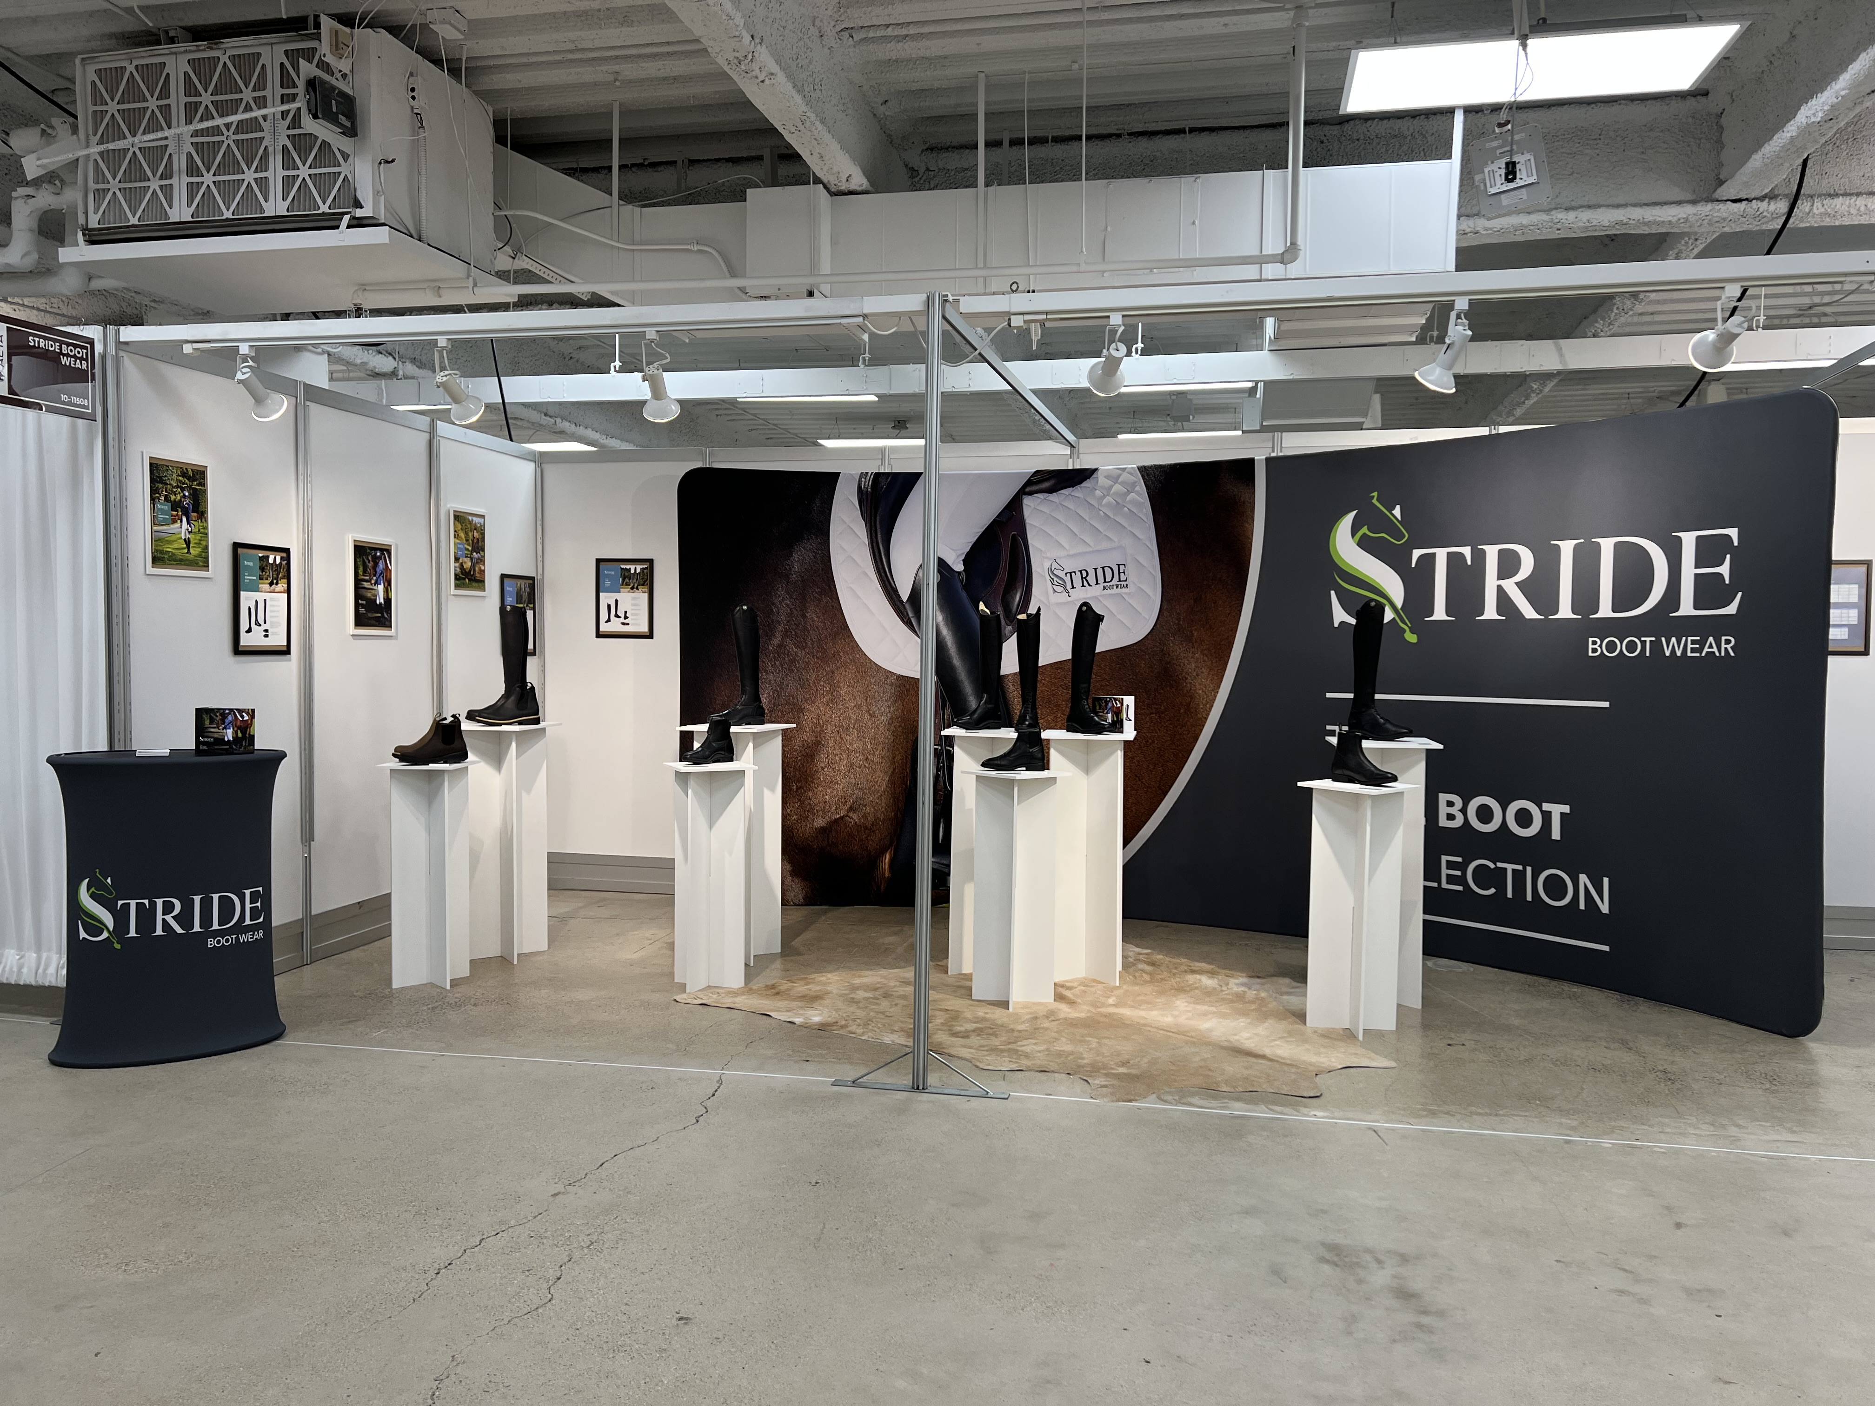
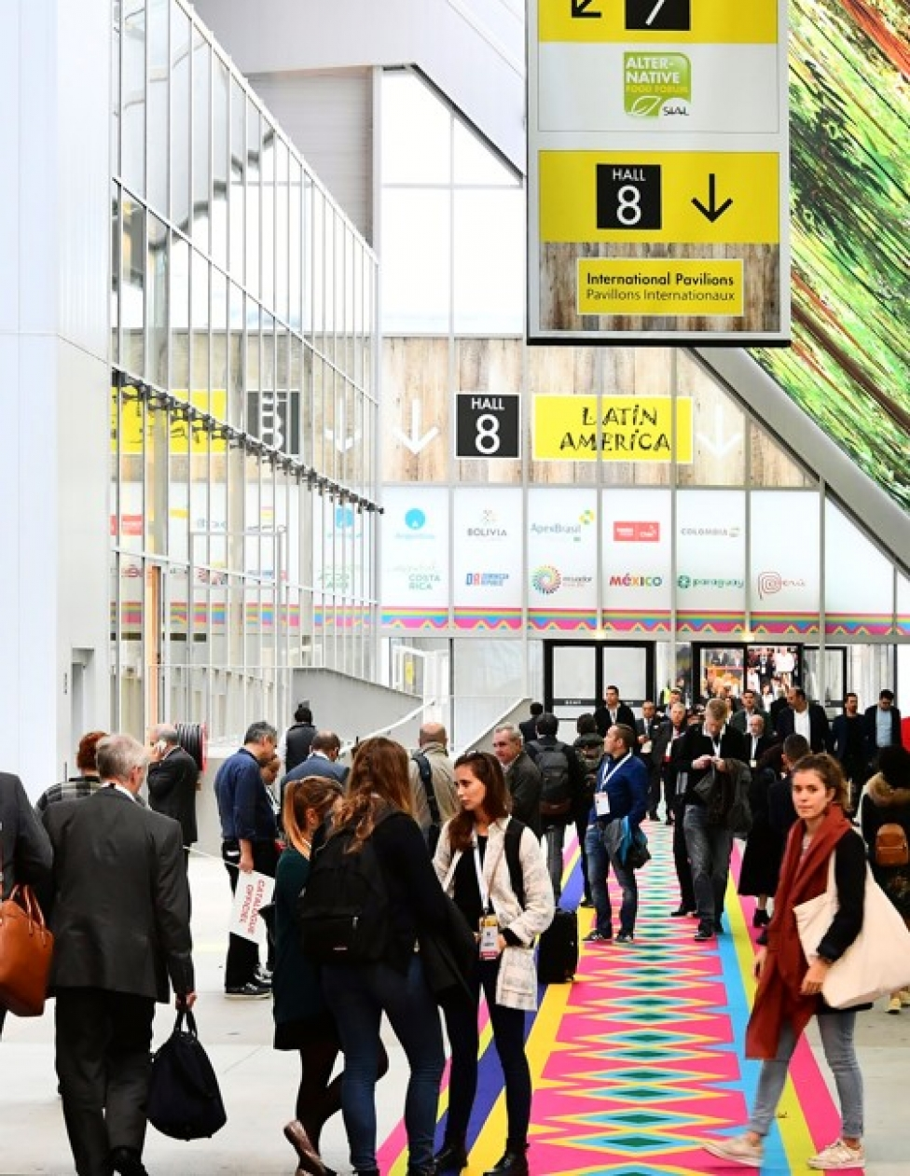
Stride Bootwear First time exporter 2021 – Target Market US World Equestrian Center Magazine Volume III 2022 Published on Jul 13, 2022 featured Boot Designer – Emma Hedderman on Finding your stride ( 5 page feature plus photography)
6 Innovative / Artisan Food Producers Travelling to SIAL Paris October 2022
Throughout the SIAL, Paris will be a source of inspiration for the entire food community. Discover all the latest trends and innovations, meet the right business partners for you and rise to the challenges facing the industry together.
Export Development continued……….

Slide 12
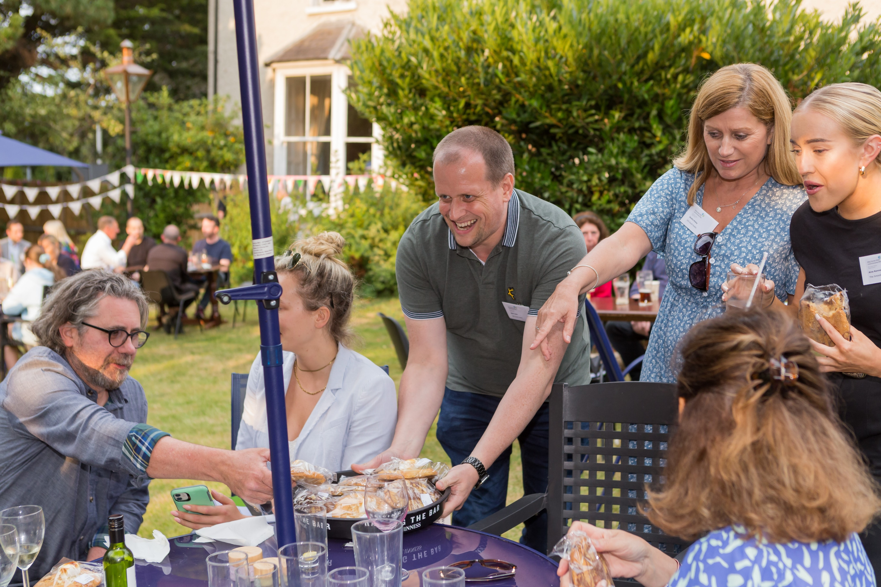
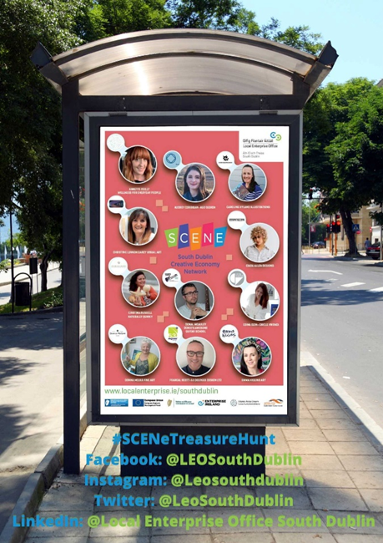
Programmes & Networks NEWS – Network of Enterprising Women in South Dublin & SCENE South Dublin Creative Economy Network & SCENe – South Dublin Creative Economy Network
Back to live Networking Events
Focus on broadening social media marketing of benefits of network & LEO supports – other initiatives
Bus Shelter Campaigns
Photo Shoot initiative – oversubscribed !!!
National Women’s Enterprise Day – 13th October

Slide 13
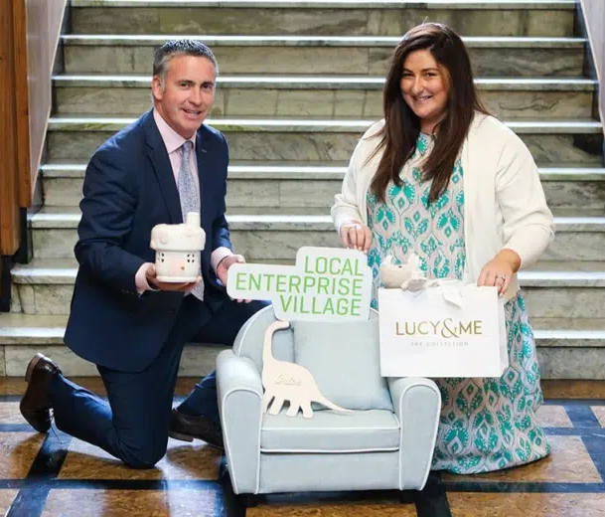
National Enterprise Awards BiaBelle Winners of Local Enterprise Awards 2022 represented South Dublin at National; Enterprise Awards in Mansion House on 2nd June last.
Press Coverage and leading Lights for LEO South Dublin
National Ploughing Championships
Lucy and Me who was selected to represent South Dublin and founder Sarah Power together with Minister English recently featured in the National Awards Promotional Campaign for this year!
Other Press Coverage…………….post National Enterprise Awards
‘Beauty Queens! Dublin sisters build €1m business with a little help from Maura Higgins’
“The sisters' products are also sold in the Hickey’s pharmacy chain and Biabelle exhibits at annual Cosmetic Association trade show in the RDS. To cope with growth in trade, two years ago BiaBelle rented a unit in Greenhills in Tallaght, where two people are employed for order fulfilment. In 2021, with a grant from South Dublin LEO, Biabelle installed a mezzanine floor in the warehouse to create more space.”
.
Inspire 15th July 2022

Slide 14
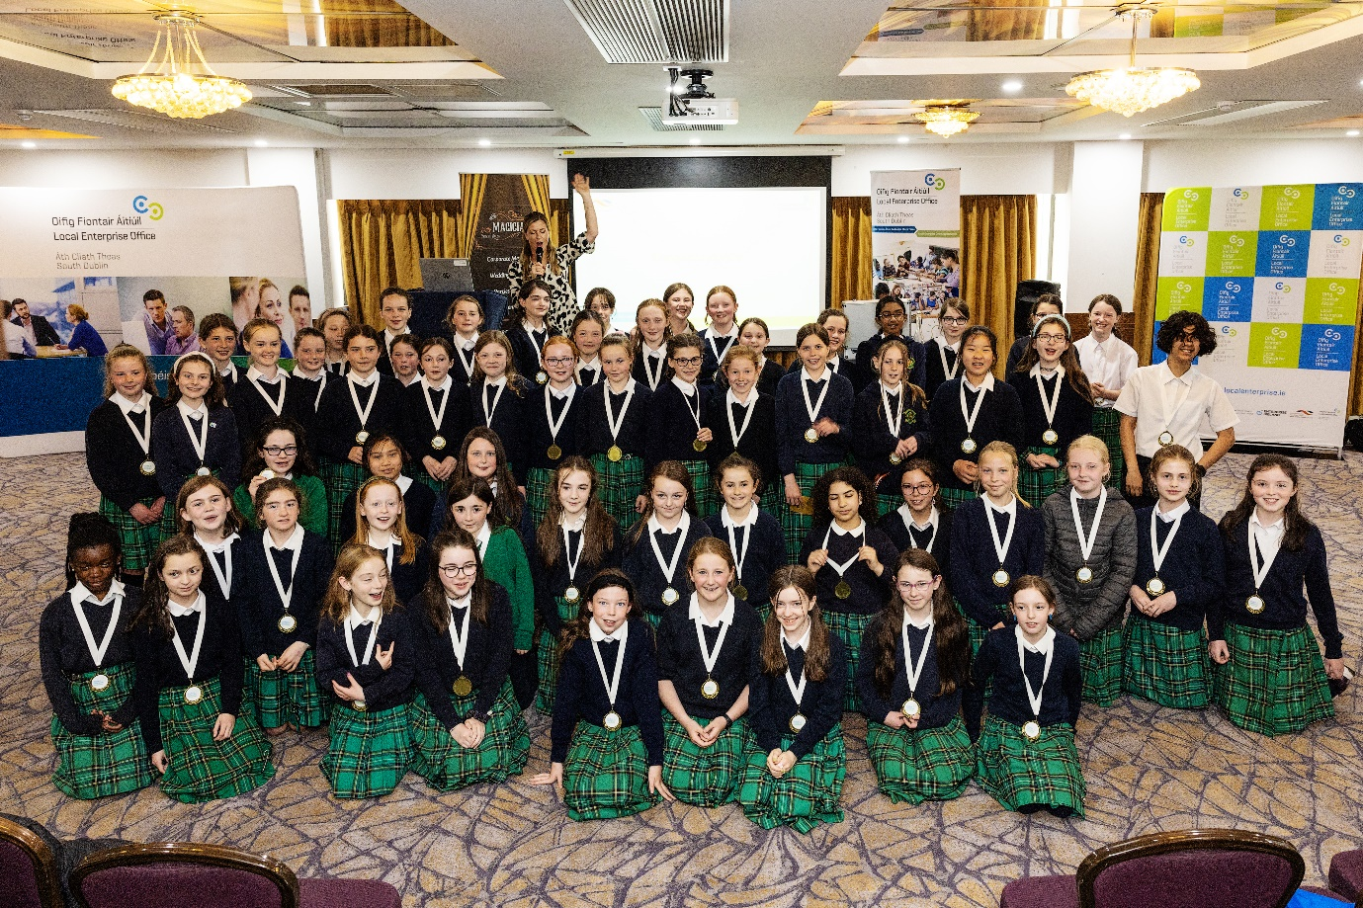
Programmes & Networks SEP – Student Enterprise Programme
2022 / 2023 Programme kicking off
Pre Launch Event with Teachers to
Expand Recruitment of Teachers / Grow Registration levels
Further Targeting Deise Schools, Teachers and Students.
Real Nation Programme Co-ordinators
Launch event on the 22nd September
The 2022 County Final was held in the Maldron Hotel, Tallaght on Thursday 26th May 2022 and there was over 175 pupils in attendance. The pupils displayed their business projects and presented their business idea to the judges. Their products were promoted and sold to their fellow students and within their communities with all profits made going local and national charities.

Slide 15
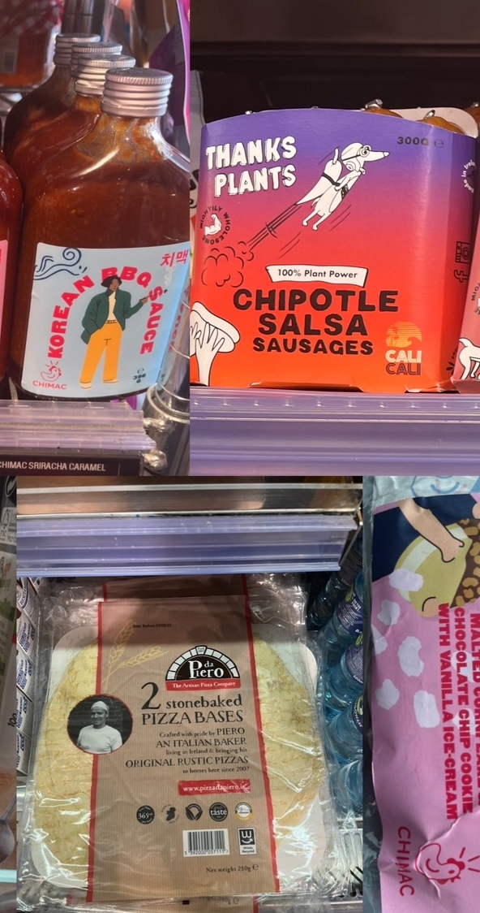
Feasibility Study – Food Production Hub
Food Innovation Hub - Application under Regional Enterprise Innovation Scoping Scheme 2022 REISS
The main purpose of the Regional Enterprise Innovation Scoping Scheme 2022 (REISS) is the support the investigation and preparation of major new collaborative and innovative initiatives that have the potential to make a significant impact on enterprise development in a region, across regions or nationally.
The Scheme provides early-stage financial assistance to potentially significant projects which can define and scope out their potential and/or can prime them to deliver regional impact through the ensuing final project.
Enterprise Ireland approved the funding for a Feasibility Study Grant to the value of €45,000 in July. This grant which is 80% funded under the Regional Enterprise Innovation Scoping Scheme 2022 (REISS) will support a research study into the Food Production Ecosystem in South Dublin (including Food Production Space).
This study will address gaps and key objectives identified in South Dublin Food Strategy 2022 – 2025 plan to explore opportunities for a ‘food experiences market’ and for the expansion of food production facilities in brownfield sites for small artisan food producers in the county.
Timeline
Applied May 2022 and Confirmation of Funding from Enterprise Ireland mid July
Completed Tender Process September 2nd- Evaluation of Submissions & Consultants will be appointed w/c 12th September
Start – mid September and complete before end of November 2022

Slide 16
LECP 2022 – 2028 Update
To EETD SPC
Date 6th September 2022

Slide 18
Key Actions in progress
Establishment of Advisory Group
Drafting of Economic and Community - High Level Goals

Slide 19
LECP ADVISORY GROUP
ECONOMIC MEMBERS:
Director of Economic Development Enterprise – Jason Frehill
EETD SPC Council
Member – Cllr Pamela Kearns
EETD SPC Industry
Member – Ms Sherri Brennan
Head of Enterprise – Tom Rooney
COMMUNITY MEMBERS :
Chief Officer LCDC – Prof Mary Corocran
LCDC Council Member – Cllr t.b.c.
SEO Community Department
SDCC – Jennifer Moroney Ward
/
Role of the Advisory Group is to advise and assist on the implementation and monitoring arrangements through the Implementation Plan Process
Needs to reflect the balance of public/private interests
Plays a Key Role in All Stages

Slide 20
Next Stage : Set up First Advisory Group Meeting
Key items for Agenda
Share Draft Level High Level Goals
Set ‘date by’ for the agreement of High Level Goals
Share Context documents
Decision on Tender Process for work on the Socio-Economic Analysis
Timeline: During September / early October – date to be confirmed

Slide 21
HIGH–LEVEL GOALS
A High level goal can be viewed as the setting of the general direction of travel for the LECP. It will generally not change throughout the plan and inputs and interventions supported through the lifetime of the plan will be designed to reach the High Level Goals identified.
Goals should be ambitious with their foundation in the analysis of the socio-economic data as well as consultation process undertaken as part of the development of the plan
Goals must also be achievable and realistic

Slide 22
QUESTIONS?

