Slide 1
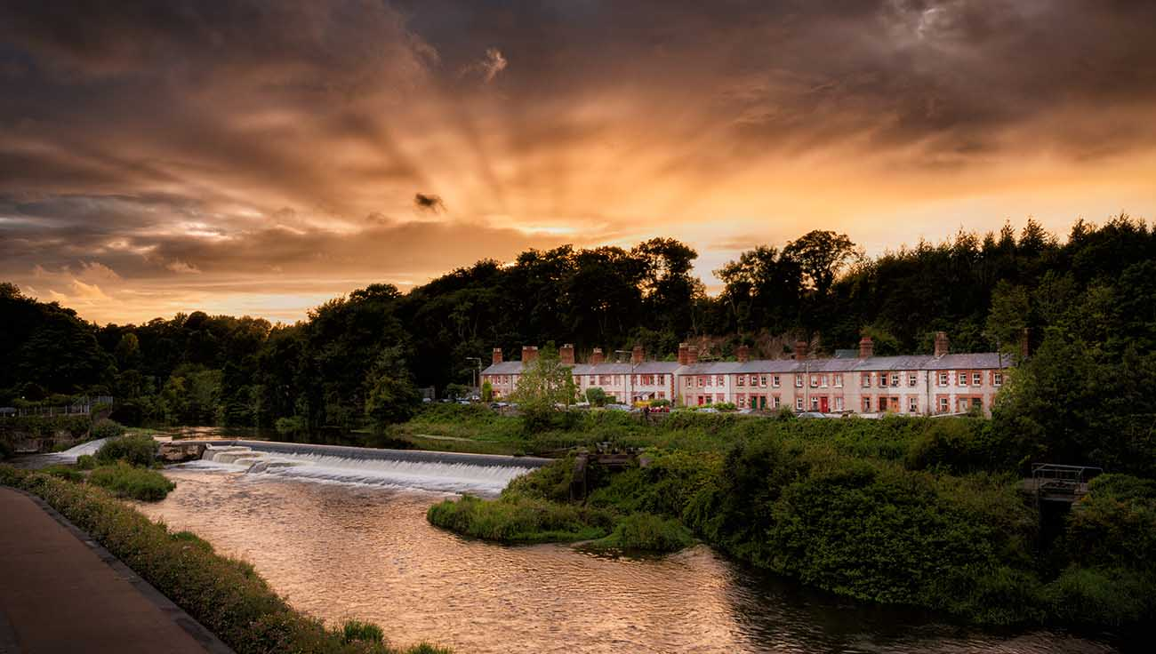

County Promotions Unit
Project Updates

Slide 2
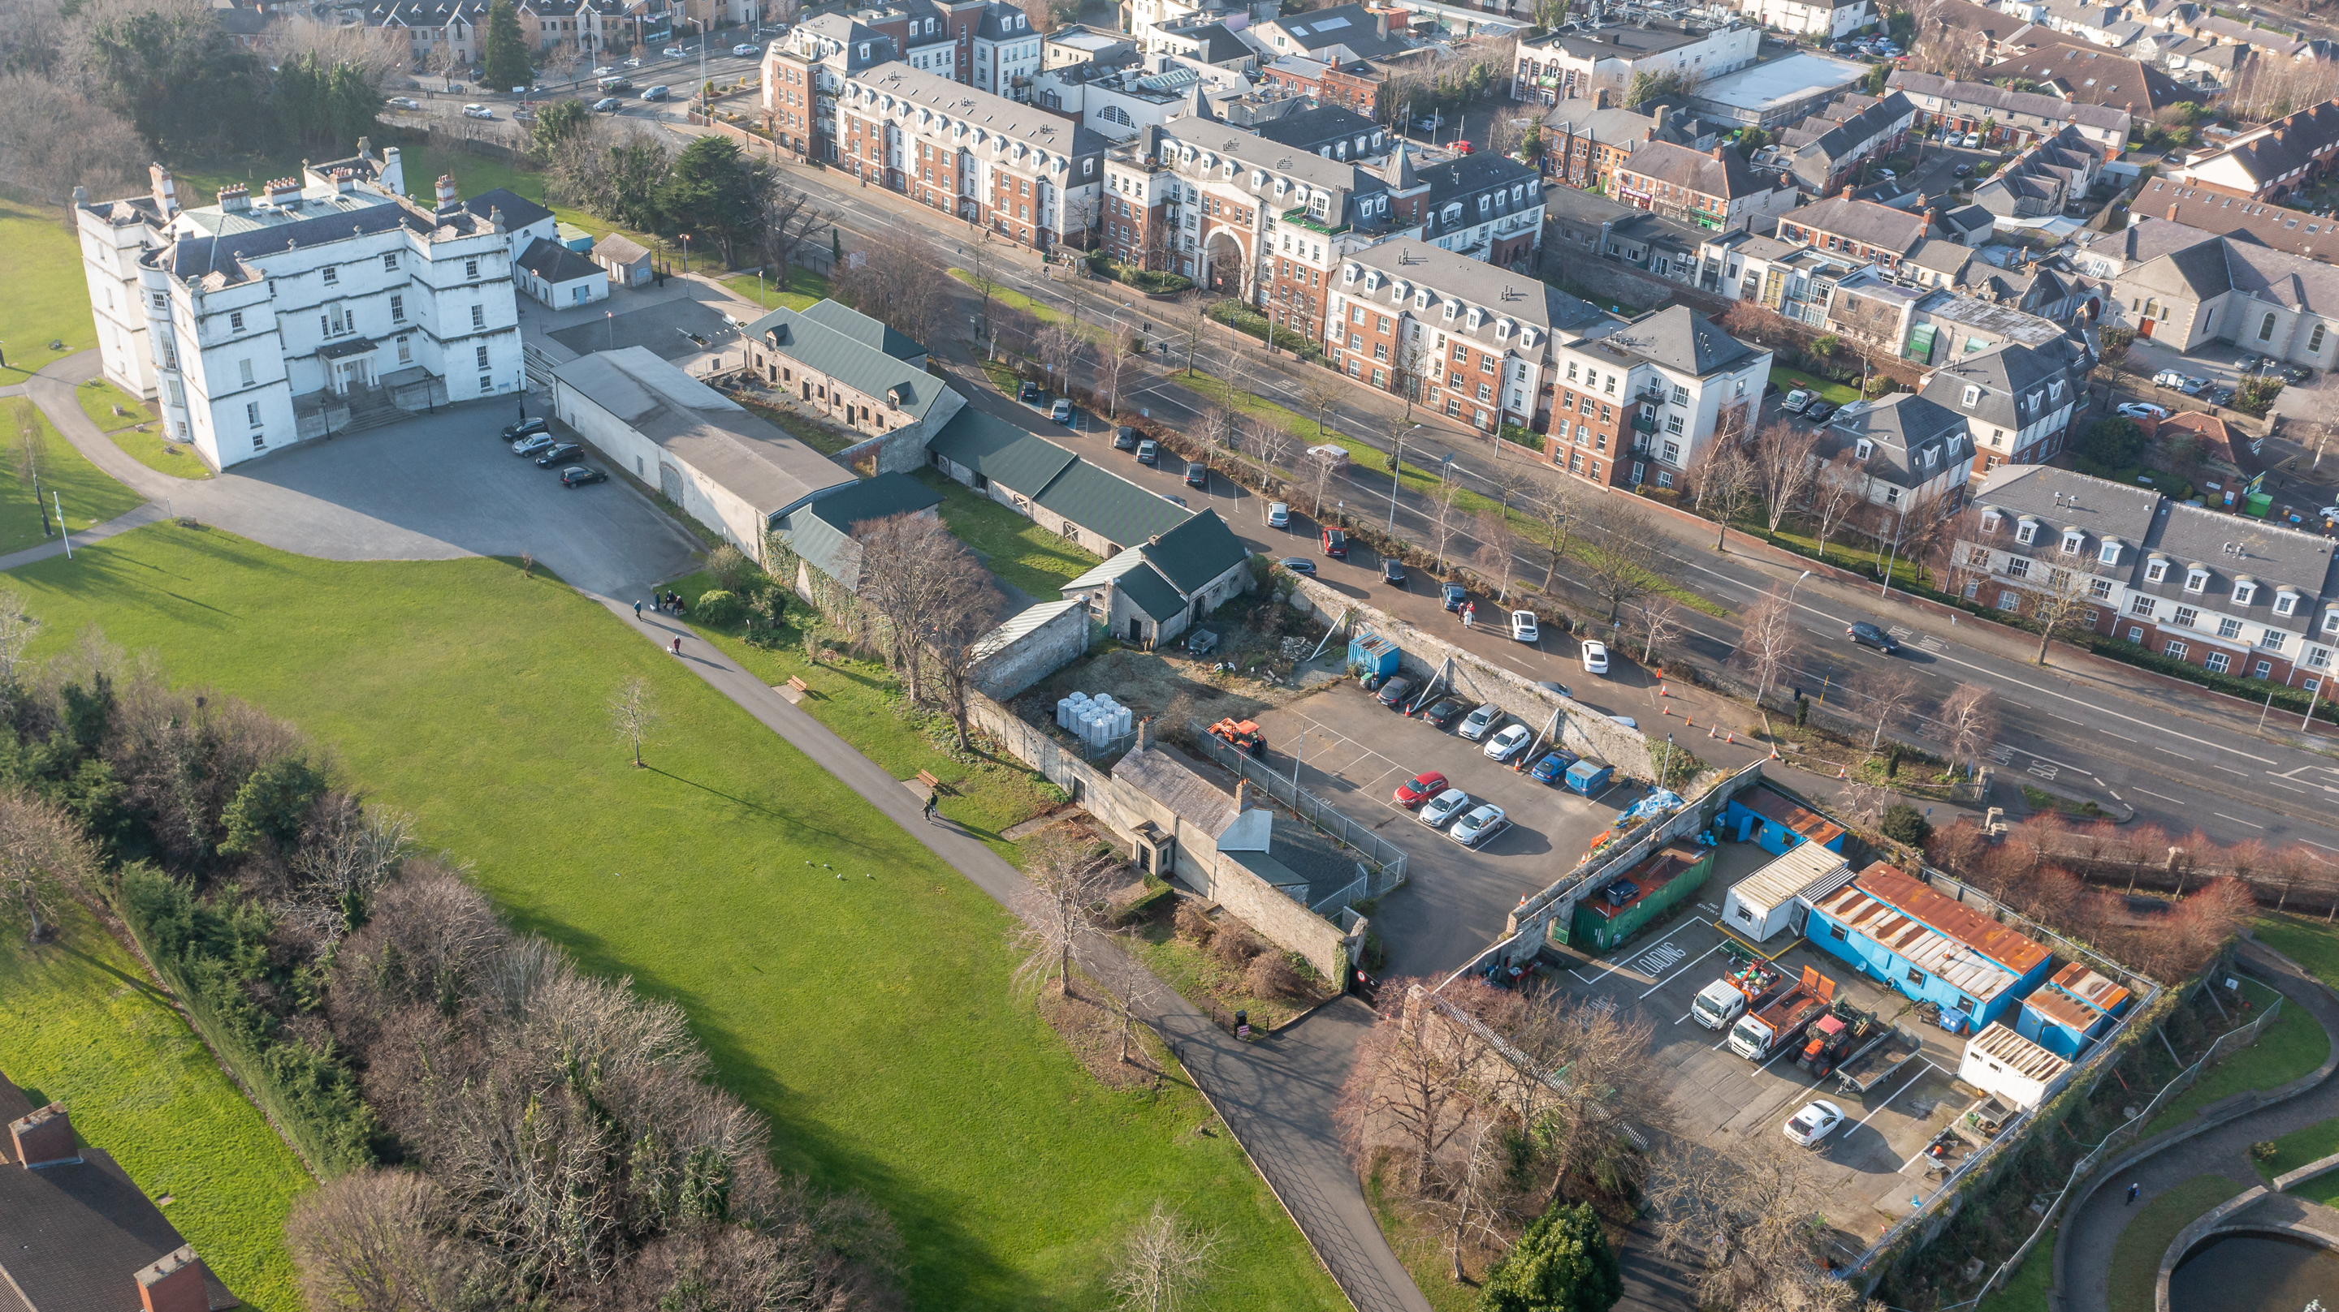
Development Opportunity
Mixed Use
Hospitality
Retail
Food
Lifestyle
Rathfarnham Courtyards
Project Update
SDCC
Asset Management
Building
Capital Budget: €5m
Design & Build
Operational Partner
Rental Income
Operational Partner
Proven Track Record
Appropriate Use(s)
Building Fit-out
Long-term Lease
Building Operations
Design Partner

Slide 3
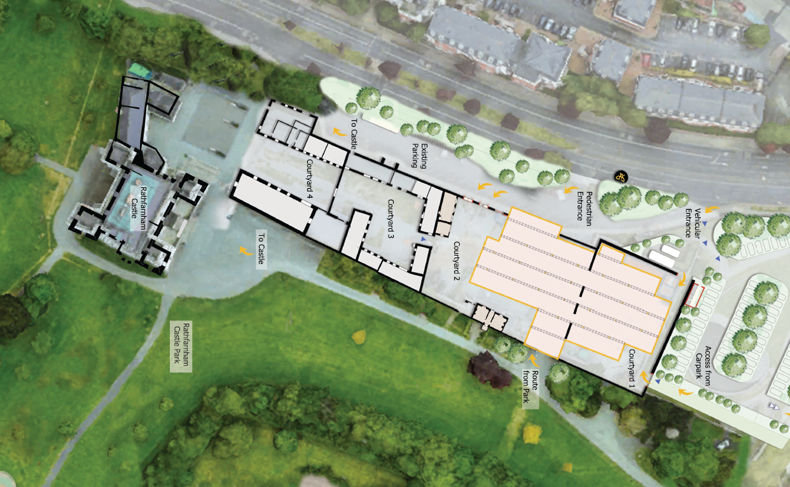
Rathfarnham Courtyards
Project Update
1,400 SQM
Floor Area
2,700 SQM
Courtyard Area
Procurement
Prior Information Notice
Expressions of Interest
Competitive Dialogue
Final Tender Invite

Slide 4
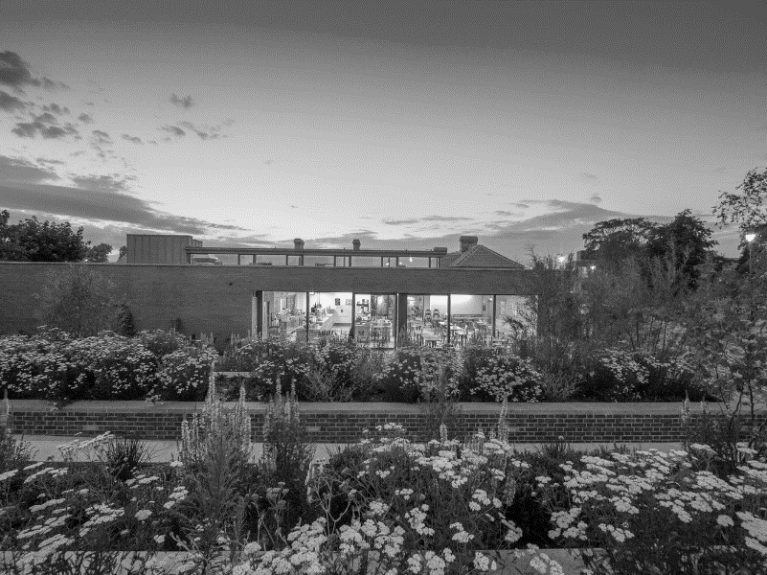
Tourism Strategy
Indicative Timeline
Tenders Received
Tender Assessment Panel
Strategy Review
Heritage/Tourism Survey
Tender Preparation
Consultant Appointed
Strategy Preparation
Tourism Strategy Public Consultation
June 2022
July 2022
September 2022
January 2023
February 2023
May 2023
Tourism Strategy Consultant Tender
Draft Tourism Strategy
Elected Members Update
Final Tourism Strategy
Council Meeting

Slide 5
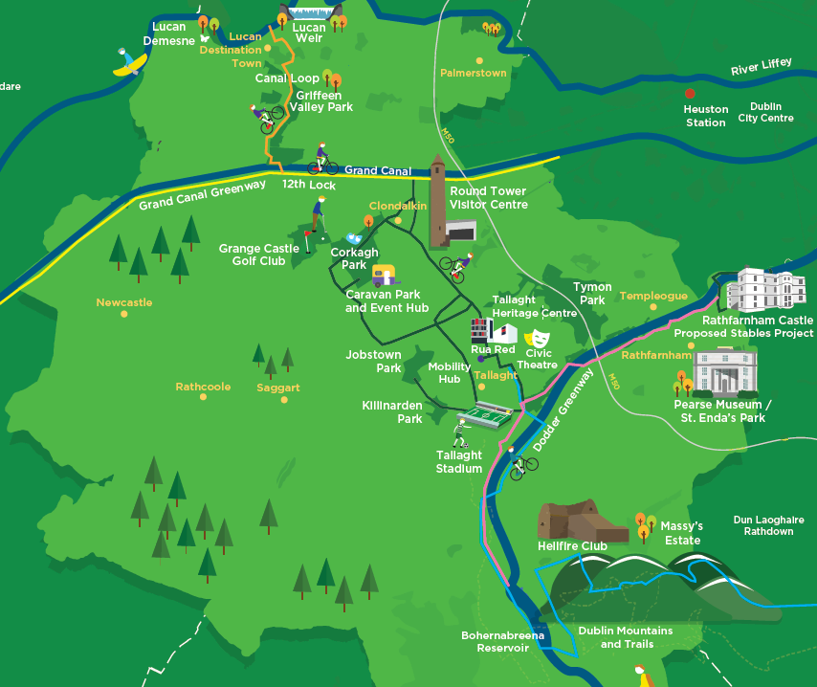
Tourism Strategy
Assembling the Jigsaw
Strategic Assets
Robust Proposition
Flagship Projects
Dublin Mountains
Rathfarnham Courtyards
Heritage Centre in Tallaght
Corkagh Park
Destination Lucan
Greenways
Heritage Trails
Round Tower Visitor Centre

Slide 6
Heritage Centre in Tallaght
Project Update
Interpretation
Stakeholder Engagement
Research & Analysis
International Best Practice
Segmentation
People & Place
County Hall
Civic
Theatre
Tallaght Library
Proposed Heritage Centre Site
Design Consultants
Rua Red
Tenders Received
Preferred Tender Finalisation
Concept Design
Interpretative Consultants Input
Part 8

Slide 7
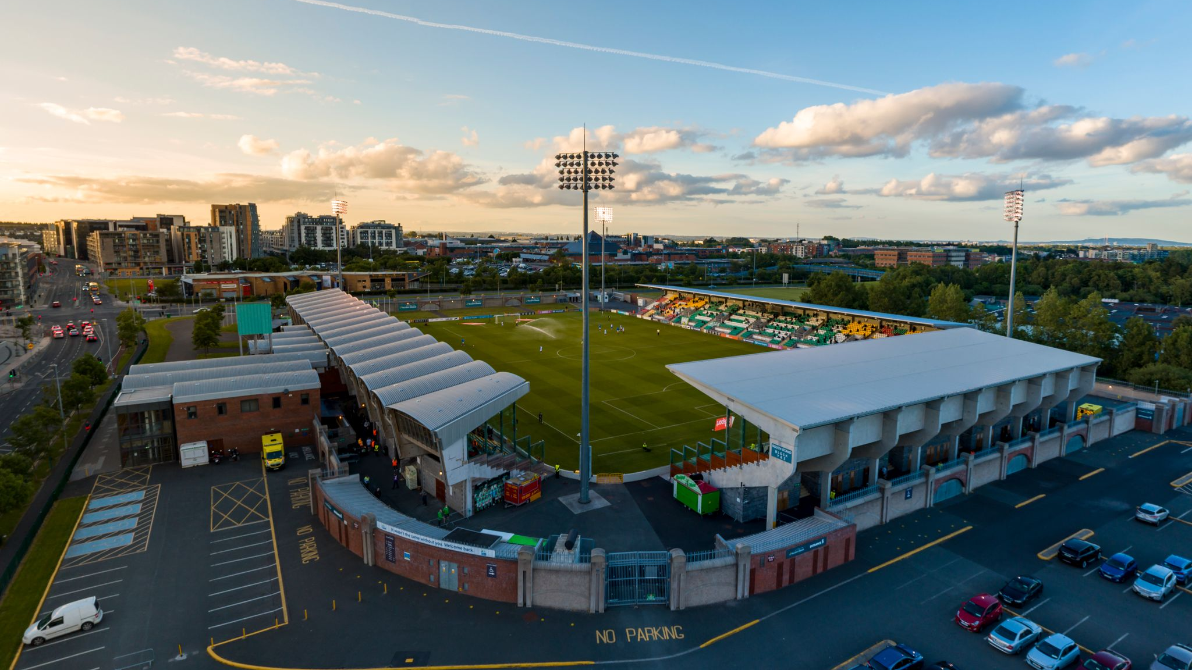
Tallaght Stadium
Branding Update
Unique Opportunity
Municipal Stadium
Current Investment
Profile & Track Record
6+ Year Contract
Long-term Partner
Destination South Dublin
Two Stage Tender Process
Stage 1: Qualification Questionnaire
Stage 2: Restricted Invitation to Tender
September 12th Tender Process Starts
Success Factors
Brand Fit
Local Benefit/Legacy
Stadium Objectives
Enhanced Stadium Brand/Experience
Community Investment
October 13th Tender Process Closes
November/December: Stage 2
Q1 2023: Announce Successful Partner

Slide 8

Tourism Event & Festival Grants
Project Update
TEFG Activity 2022
7 Applications
1 Withdrawn
3 Approved in Principle
1 Awaiting Further Information
2 Complete (Masters Basketball & Race Series)
Total Grants Paid: €13,060
Out of County Visitors: 779
Out of Country Visitors: 103
Remaining Events Estimated Attendance: 11,000/12,000
Corkagh Park Urban Picnic
Tymon Park Market
Rathfarnham Castle Christmas Event

Slide 9
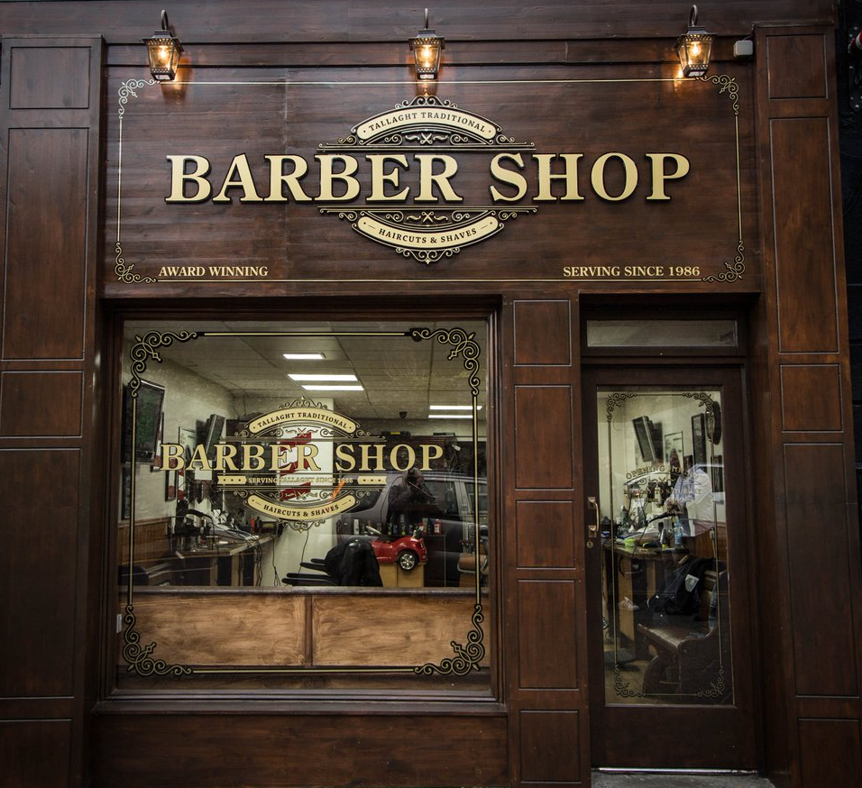
Shopfront Grant Scheme
Project Update
Scheme Context
9th Year Operating
80 Premises Supported
Grant Support: 50% of Overall Costs
Annual Winner
SFG Activity 2022
15 Applications
2 Rejected
6 Awaiting Further Information
3 Ongoing
Total Grants Awarded: 8* (4 applicants from 2021)
Total Grants Paid: €22,765.73

Slide 10
THANK YOU
Questions

