Slide 1
Traveller accommodation programme Mid-term review 2019-2024 Housing Strategic policy committee 8th September 2022

Slide 2
Mid term review- time frame
Section 17(1)(a) of the Housing (Traveller Accommodation) Act, 1998: “a relevant housing authority shall review its TAP at least once in each three year period, or at such time as directed by the Minister”
July 2022 DHLGH directed mid-term review of current TAPs by no later than 31st August 2022.
Extension sought by CCMA - Housing SPC & LTACC due to meet on 8^{th &} 9th September 2022
Department granted some flexibility with deadline, but advised that local authorities should ‘continue to work to the critical path timeframe to be able to revert as quickly as possible after the deadline’
Where local authority decides not to amend TAP – DHLGH to be informed by 16th Sept 2022
Following review, if a local authority decides that an amendment to TAP is required, amended TAP must be adopted within seven months of publication of notice of intention to amend TAP

Slide 3
Consultation & SUBMISSIONS
Local Traveller Accommodation Consultative Committee (LTACC)
Local Traveller Support Groups
Groups who originally made submissions for TAP
Newspaper Advert – 11th-25th August 2022
Consultation Portal
Housing SPC
7 submissions received

Slide 4
Summary of submissions
Drawdown of Funding
Caravan Loan Scheme
Development and Refurbishment of Existing Sites
Fuel Poverty
Energy Upgrades
KPI’s
Homelessness
HAP/RAS
Consultation
Traveller Involvement
Transient Sites
Ethnic Identifier
Equality and Human Rights Duty

Slide 5
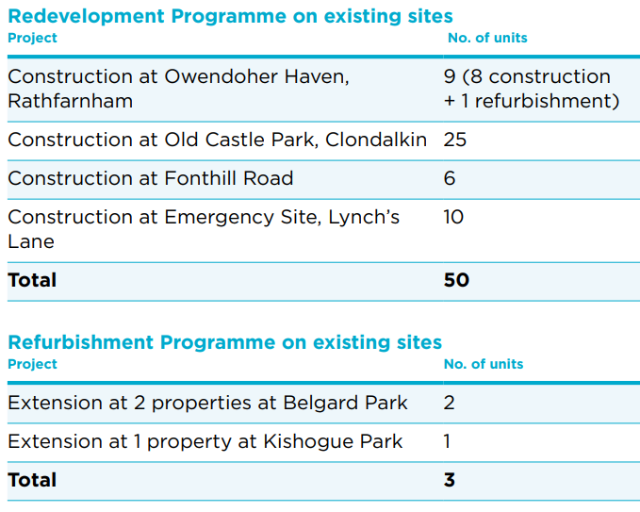
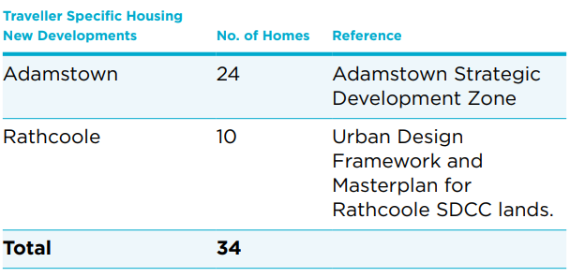
TAP Estimate of FUTURE ACCOMODATION NEEDNEED
TAP 2019-2024 adopted July 2019:
Construction of new sites
Redevelopment of existing sites /units
Casual vacancies & standard social housing

Slide 6
New sites & REDEVELOPMENT/Relocation of EXISTING SITES
Site | No. of Units /Households | Comment
Adamstown SDZ (4 sites) | 24 | 6 units to be delivered in Q4 2022 & balance in 2024/25
Newcastle LAP | 6 | Indicative 2024 timeframe for delivery through Part V
Rathcoole | 10 | Indicative 2025 timeframe for delivery subject to revised masterplan
Fonthill | 7 | Part 8 approved June 2022 for group housing to replace existing temporary accommodation – site start expected in Q4 2022
Owendoher Haven | 9 | Redevelopment of bays into group houses – design to ACM Q4 2022
Old Castle Park | 18 | Redevelopment of site in mix of houses/bays based on extensive consultation – design to ACM Q4 2022
Lynch’s Lane | 10 | Proposal to replace existing emergency 3-bay site not proceeding
Lock Road | 6 | 4 families relocated to standard social housing
Whitestown Way | 5 | Declined relocation to permanent accommodation

Slide 7
TAP 2019-2024 ACCOMMODATION targets STANDARD SOCIAL HOUSING & TA CASUAL VACANCIES
Standard Social Housing | TAP Target | Allocated
2019 | 10 | 7
2020 | 10 | 13
2021 | 11 | 4
2022 | 11 | 10
2023 | 11 | -
Total | 53 | 34
TA Casual Vacancies | TAP Target | Allocated
2019 | 11 | 9
2020 | 11 | 4
2021 | 11 | 5
2022 | 11 | 1
2023 | 11 | -
Total | 55 | 19
65% of cumulative standard social housing target met to date with known offers to Traveller households (there is anecdotal evidence that additional Traveller households have accepted standard social housing but not formally identified due to lack of ethic identifier for social housing applicants)
34% of cumulative TA casual vacancies target met to date (additional offers accepted will increased this figure to 51%)

Slide 8
Temporary Sites, Current vacancies & PROVISION OF CARAVANS/MOBILE HOMES/MEDICAL CHALETS
Temporary Sites | No. of Units /Families | Comment
Lock Road | 6 | 4 families relocated to standard social housing
Whitestown Way | 5 | Declined relocation offer
Currently Vacant TA Units | No. of Units | Comment
Daletree, Stocking Hill & Belgard | 1 group house & 8 bays | Offers accepted & due for occupancy
Lynch’s Park, Greenhills & Hazel Hill | 9 group houses & 3 bays | Currently vacant
Caravans/Mobile Homes/Medical Chalets | Medical | Emergency / COVID | Caravan Loans | Totals
North of Naas Road: (Oldcastle Park, Kishogue, Lynch’s Park) | 4 | 5 | 6 | 15
South of Naas Road: (Belgard Park, Belgard Road, Hazel Hill, Owendoher, Stocking Hill, Cherryfield) | 1 | 5 | 6 | 12
Totals | 5 | 10 | 12 | 27

Slide 9
ADDITIONAL Considerations
Irish Human Rights and Equality Commission equality reviews ( July 2021) & statutory Public Sector Equality and Human Rights Duty
TAP and County Development Plan - Case Study Paper ‘Traveller Accommodation and the Local Authority Development Plan’ (Office of Planning Regulator, October 2021)
Annual estimate of Traveller households in the County (December 2021) – 105 families living in Group Housing ( 14 sharing) and 82 families living in serviced halting sites (18 sharing)
Regional commitment to review need for transient site(s) in Dublin after permanent accommodation provision
Ethnic identifier for social housing applicants
Data on Travellers in HAP/RAS and homeless accommodation through Expert Review Group programme board work

Slide 10
Mid -Term Review Progress & RECOMMENDATION
Recommendation to LTACC that there is no requirement to formally amend TAP
Based on:
data provided on allocations of standard social housing and Traveller accommodation to date and planned
Updates position on plans for new developments and redevelopment of existing sites
No alternative opportunities for new Traveller accommodation delivery in advance of plans outlined
Commitments:
Continue plans for accommodation delivery as per updates provided
Explore transient site options
Traveller homelessness research

