Slide 1
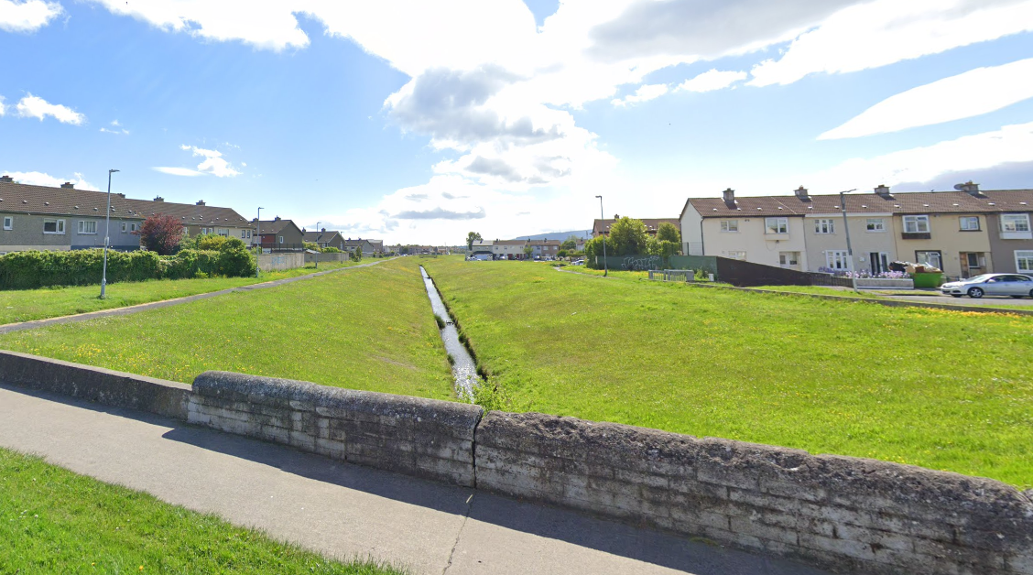
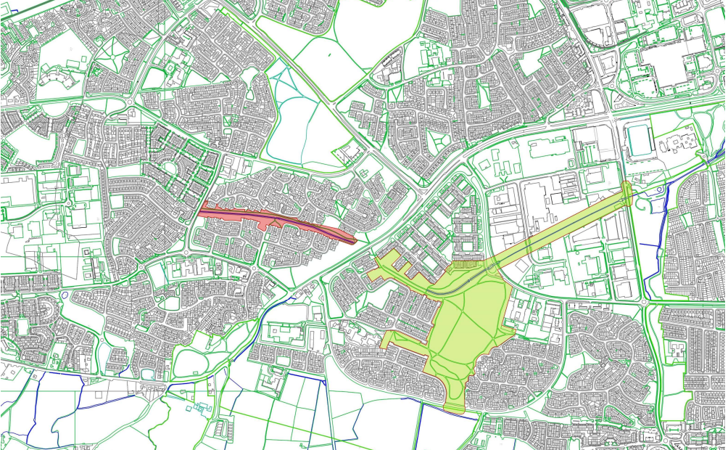
Whitestown Stream Upgrade PUBLIC REALM SECTION Part 8 Report Presentation
Context of project & location
Whitestown Stream is a linear open space, approx. 3ha (7.3 acres) in size, extending between Jobstown Road to the west and Blessington Road (N81) to the east, and bounded by Clonmore & Bawnlea.
It connects westwards with Killinarden Park (shortly to be upgraded) and onwards via the Whitestown Green Corridor to Sean Walsh Memorial Park, forming a significant continuous Green Infrastructure link in South Dublin
The Whitestown Stream corridor is zoned in the South Dublin County Development Plan 2022- 2028 as Objective OS, ‘To preserve and provide for open space and recreational amenities’

Slide 2
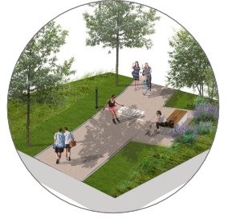
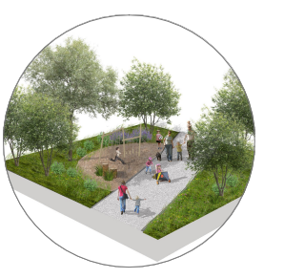
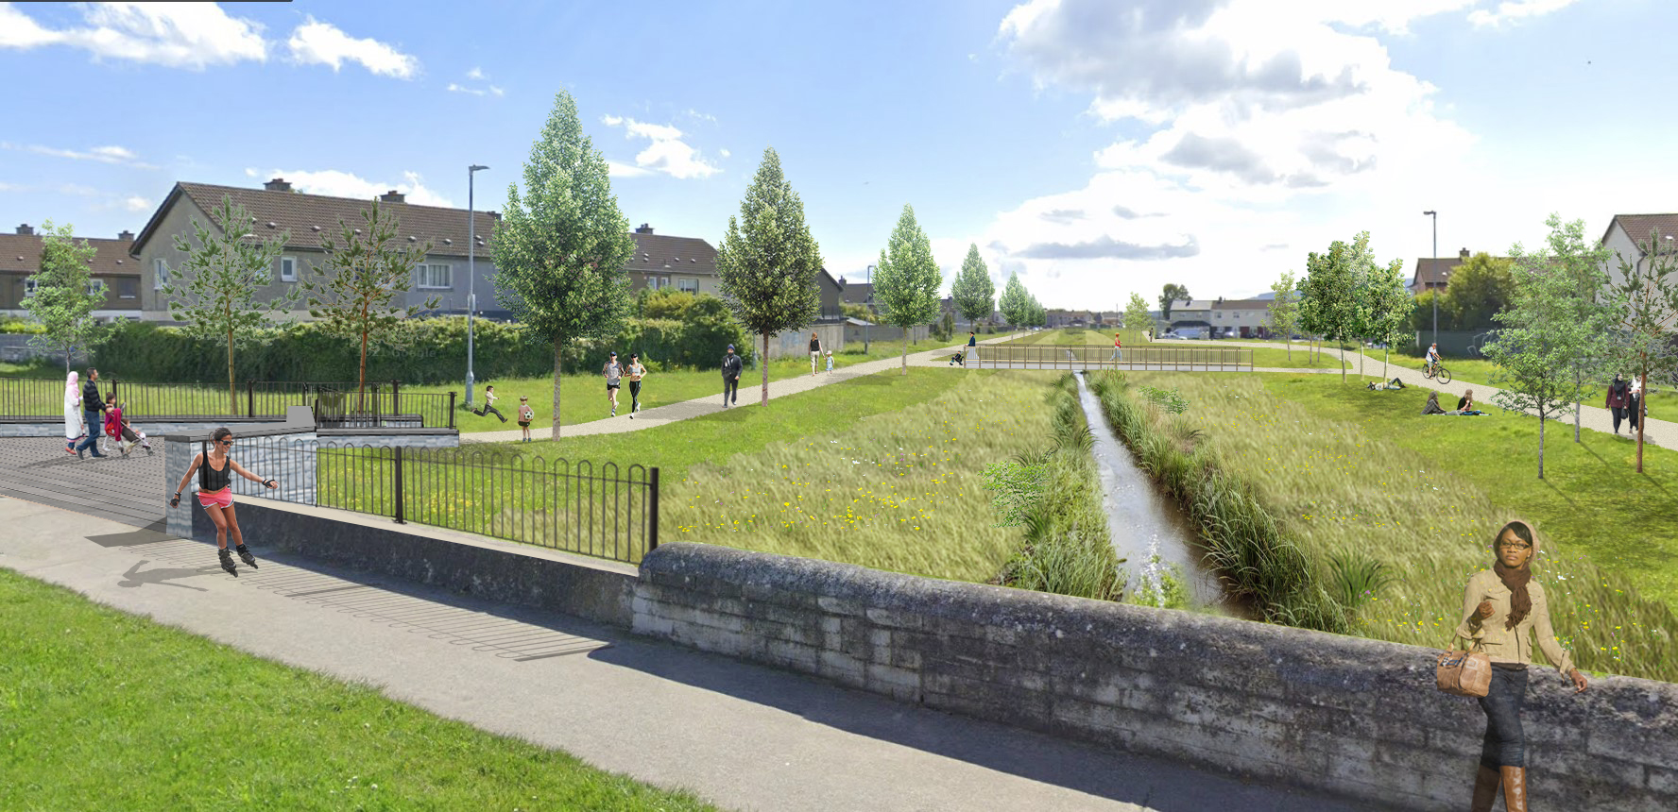
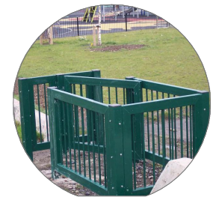
The Whitestown Stream Upgrade will consist of:
Upgrade of existing boundaries and access points
Provide new footpath at Cloonmore to complete footpath loop
Overlay existing footpaths
Upgrade existing bridge linking Bawnlea Avenue and Cloonmore Road and provide with 2 new bridges one at either end of the stream.
Remove graffiti as required from boundary walls and other locations, with the enhancement of existing service gates.
Removal low-level wall on the Southeast boundary of the park and incorporate landscape design into the recently completed N81 cycle scheme.
Construction of new boundary with access point at Cloonmore Ave & Gort lar.
Re-position boundaries (hidden corners) with possible future land ownership transfer from SDCC to 3rd parties (any land ownership transfer will be subject to a separate decision by the council).
Existing public lighting to be upgraded and proposed installation of new lighting columns
Planting of tree, shrubs, and wildflowers/bulbs and other plants.
­Play/exercise trail every 100m.
Installation of natural play area adjacent Cloonmore Rd.
All associated landscape design including furniture and planting.
All ancillary works.

Slide 3
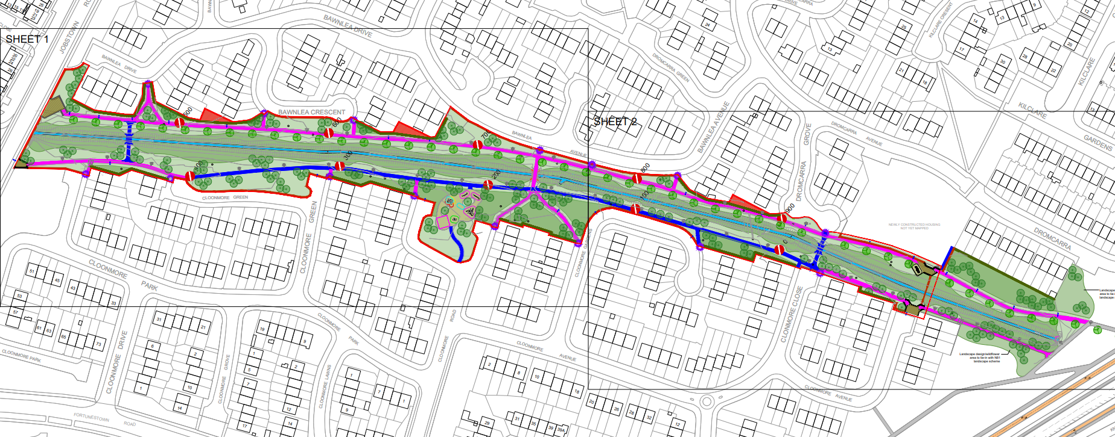
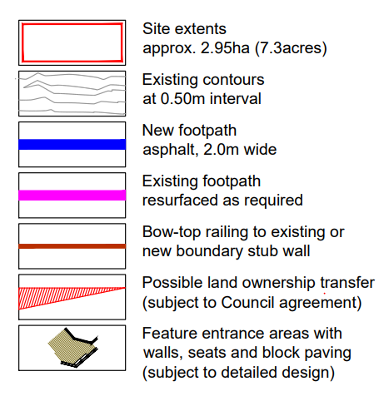
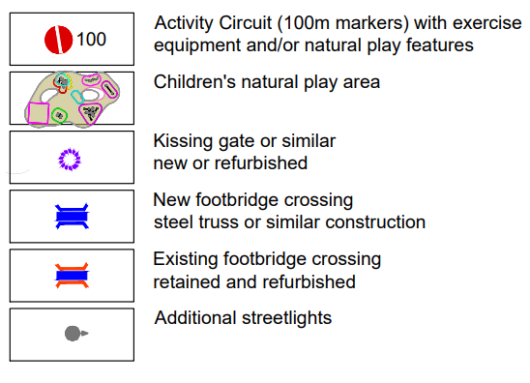
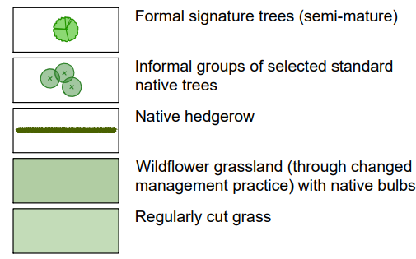
Proposed Landscape Masterplan/Layout

Slide 4
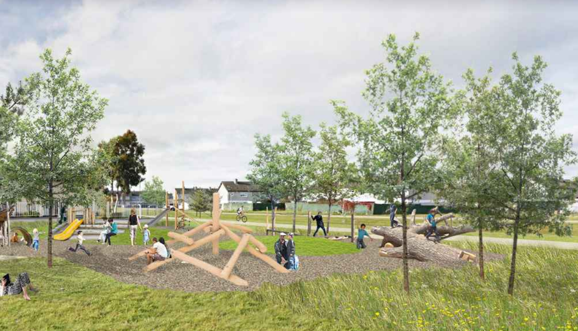
Summary of Whitestown Stream Part 8 Process
Non-Statutory Period
Initial presentation to Elected Members.
Consultation with SDCC staff.
Informal Non-Statutory Consultation with key community stakeholders (residents, schools, clubs, groups, etc)
Statutory Period
Public Consultation period 22nd July 2022 to 3rd September 2022
Issue of CE report and recommendation.
Nine (9) submissions were made during the Statutory Consultation process.
They have been summarized and responded to in the CE Report.

Slide 5
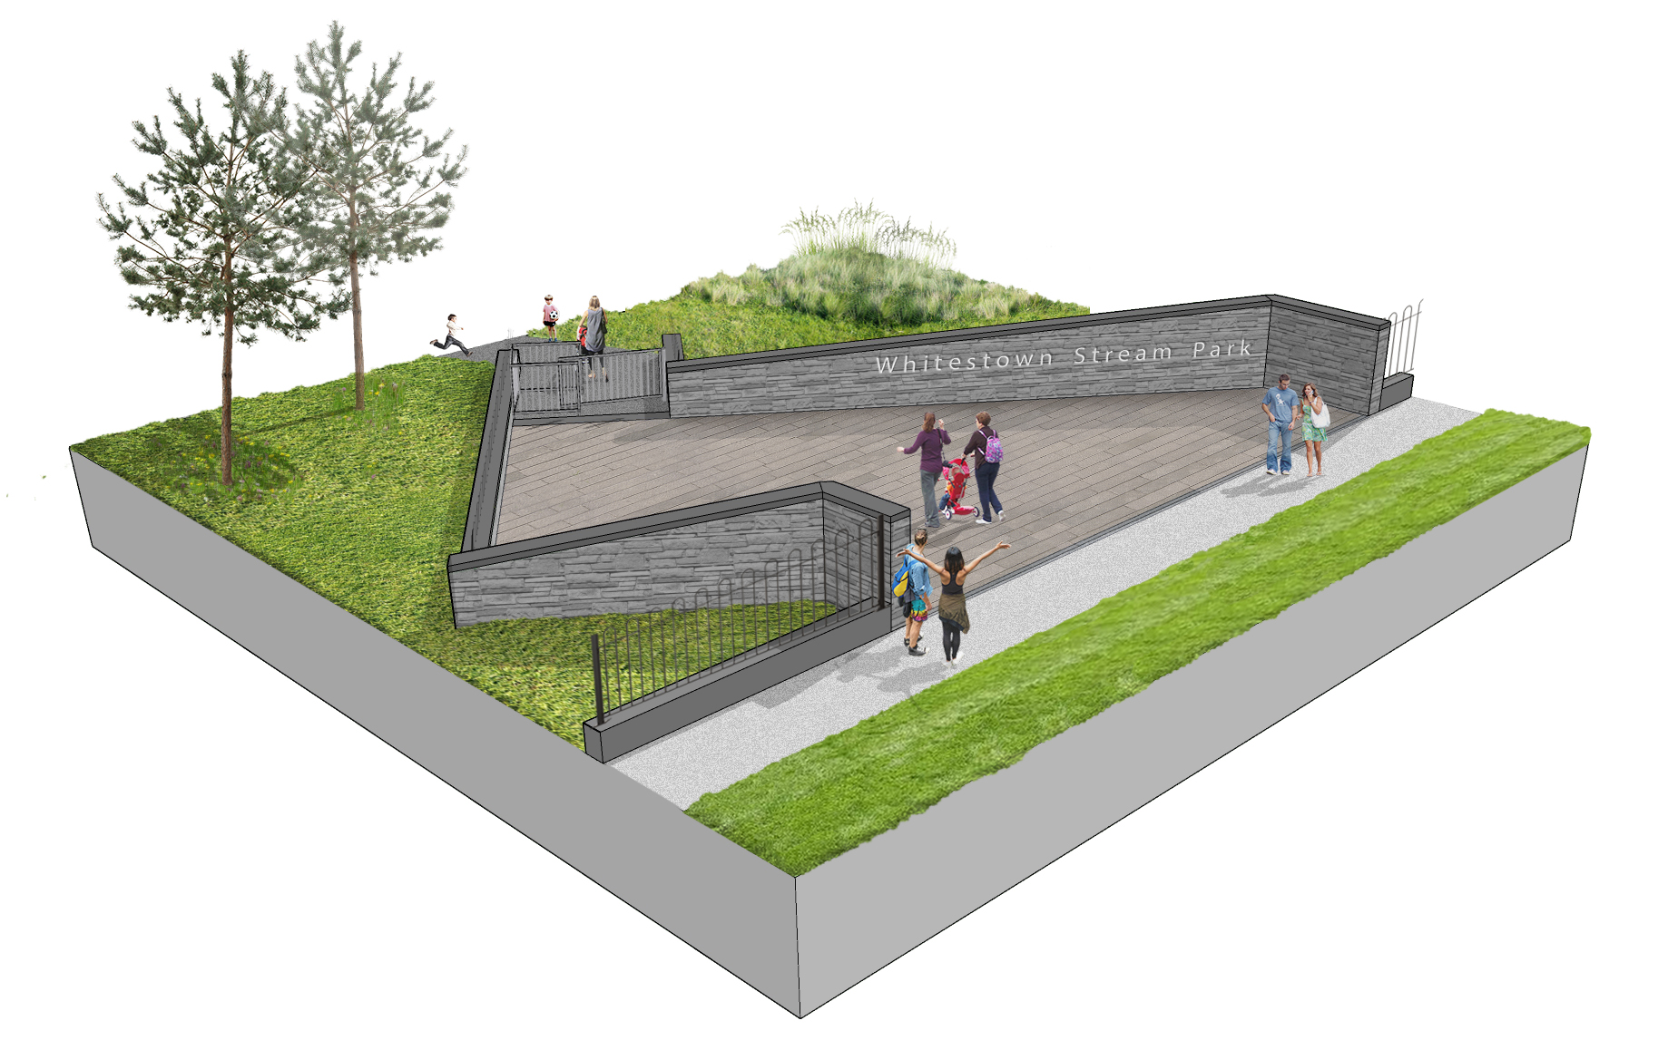
Issues/ Comments Raised: please see CE report for full summary, response and recommendation in relation to the submissions received.
Submissions received generally welcomed the development
Requests for biodiversity & pollinator planting
Stream enhancements such as SUDS
Request for community amenity space
Request for controlled access on boundaries (stop
scramblers and cars)
Concern regarding the playground
Reservations that anti-social behaviour may increase
Request for measures to stop people dumping/littering
Requests for additional lighting and CCTV cameras

Slide 6
Recommendations for Part 8 Adoption
Following consideration of the submissions, the Chief Executive is of the view that the issues raised by way of the submissions can be satisfactorily addressed at the detailed design stage, operational stages and as outlined in the foregoing report.
It is recommended that, as the proposal is consistent with the County Development Plan and the proper planning and sustainable development of the area, that the Council proceed with the Part 8 proposal for the upgrade of Whitestown Stream Local Park.

Slide 7
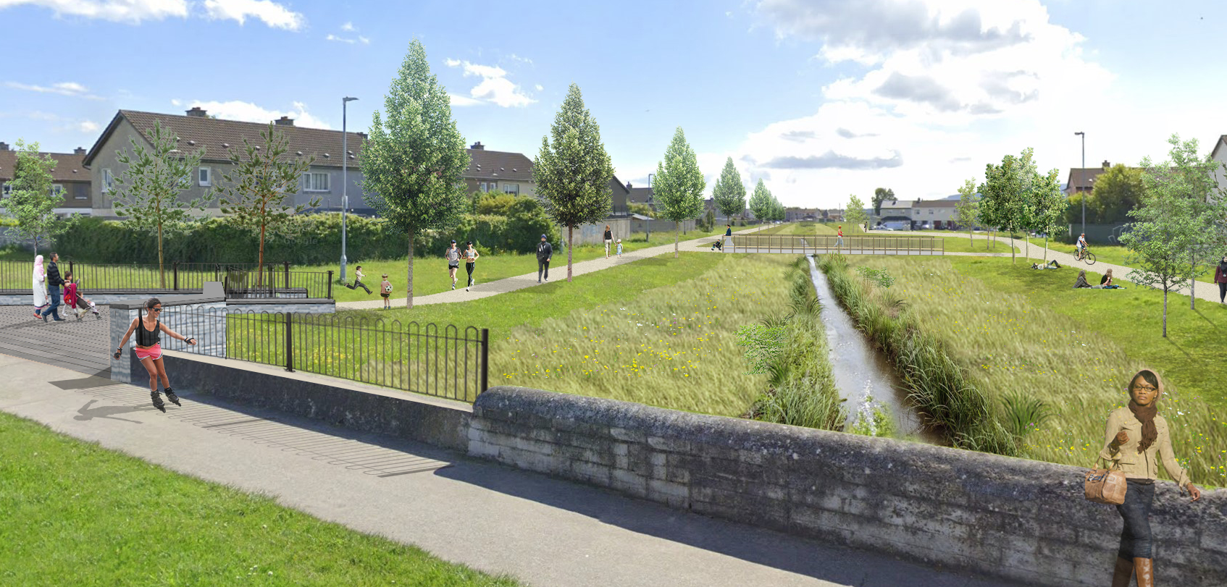
Thank You

