Slide 1
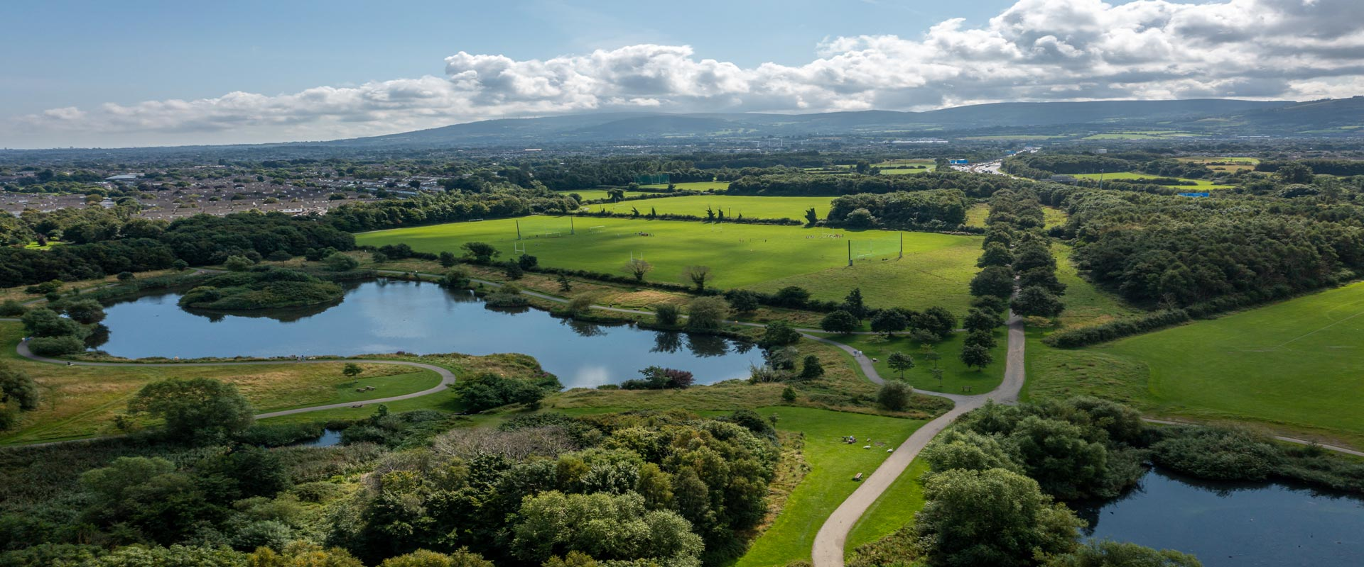
SDCC Environment, Public Realm and Climate Change SPC 6th September 2022

Slide 2
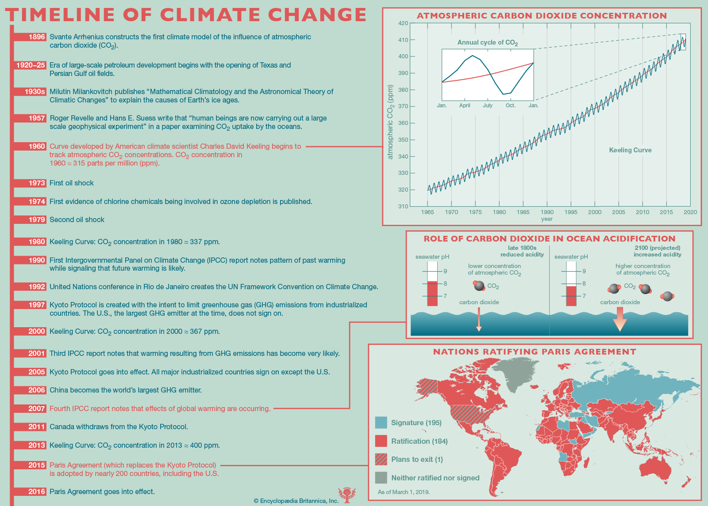
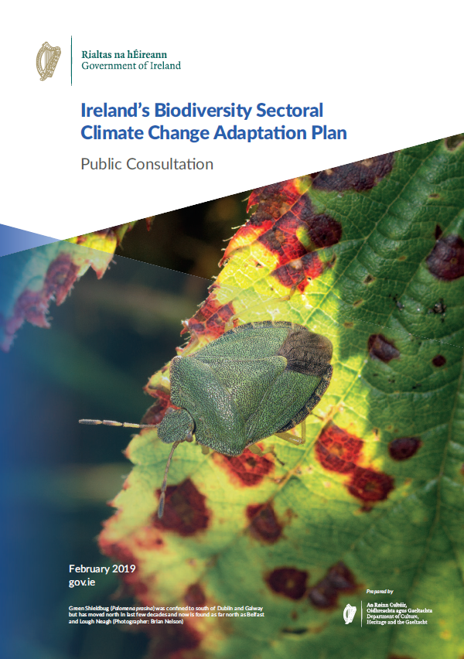
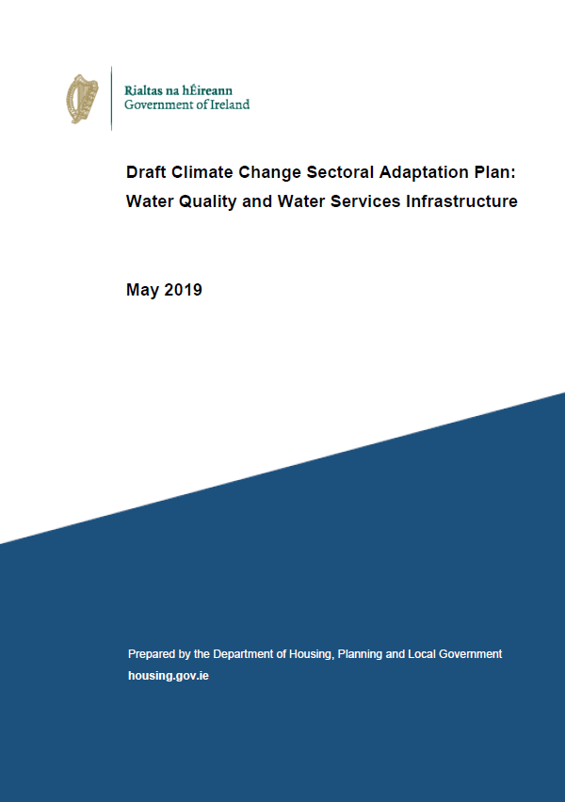
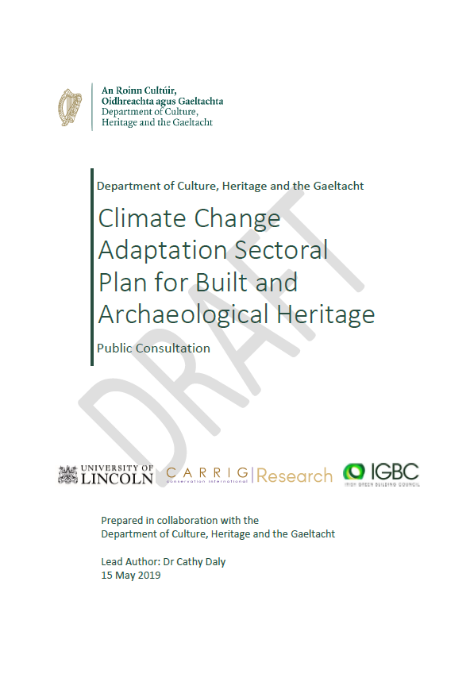
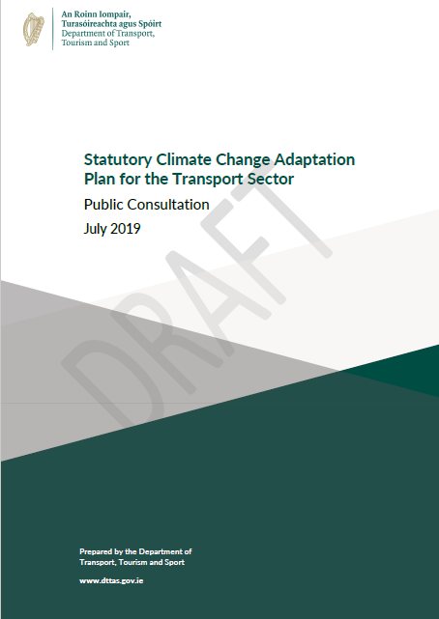
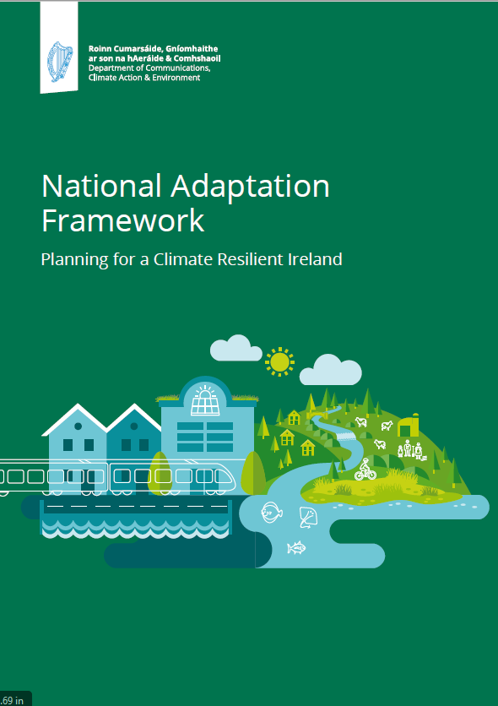
SDCC Climate Change Action Plan 2019-2024
International Conventions
European Climate Policy
National & Regional Climate Policy
12 Sectoral Plans
Local Authority Climate Change Action Plans

Slide 3
SDCC Climate Change Action Plan 2019-2024
6 Action Areas
Energy & Buildings
Transport
Flood Resilience
Nature Based Solutions
Resource Management
Citizen Engagement
4 Key Objectives
50% improvement in Energy Efficiency by 2030
50% reduction in GHG emissions by 2030
Make Dublin a Climate Resilient Region by reducing the impacts of future climate change related events
Actively engage and inform our citizens on Climate Change

Slide 4
SDCC Climate Change Action Plan 2019-2024
COUNCIL
SPC
EUROPEAN
COVENANT OF MAYORS
CARO
DECC
LGMA
Reporting Requirements of CCAP
Environment, Public Realm and Climate Change SPC and Council
Covenant of Mayors for Climate and Energy
Dublin Metropolitan CARO
DECC through SEAI
LGMA
REPORTING
CLIMATE ACTION STEERING GROUP
Director of Services EWCC
Director of Services LUTP
County Architect
Chairs of Action Area Teams
ACTION TEAM 1
ENERGY & BUILDINGS
ACTION TEAM 6
CITIZEN
ENGAGEMENT
ACTION UPDATES
ACTION TEAM 2
TRANSPORT
ACTION TEAM 5
RESOURCE MANAGEMENT
ACTION TEAM 4
NATURE BASED SOLUTIONS
ACTION TEAM 3
FLOOD RESILIENCE

Slide 5
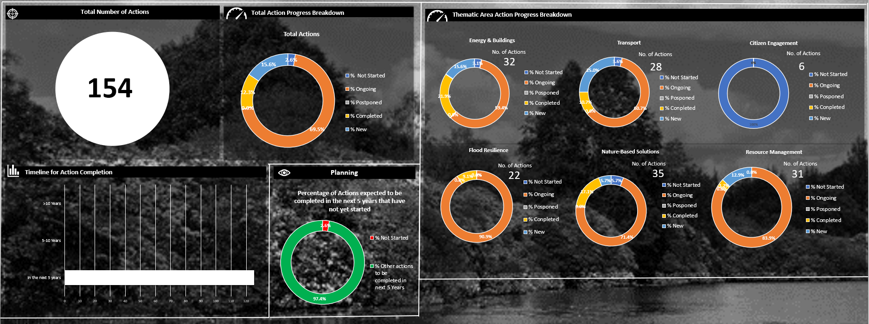
SDCC Climate Change Action Plan 2019-2024
SDCC progress Report to DECC End of September 2022

Slide 6
SDCC Climate Change Action Plan 2019-2024
ENERGY & BUILDINGS
Dublin Regional Energy Masterplan is complete
Public Lighting upgrades are ongoing, target for end of year 2022 – 1,700 upgrades to LED
County Development Plan adopted. Climate Change is fundamental to the plan
Energy Audits completed for Tallaght and Clondalkin Leisure Centre as part of developing Energy Performance Contracts for both facilities
SDCC Energy Review 2021 preliminary figures indicated 39.5% improvement in Energy Efficiency over baseline
Tallaght District Heating – groundworks are complete, DH to be fully commissioned by September. Will reduce CO² emissions by 1,500 tonnes / annum
Replacement of office lighting with LEDs, Phase 1,2 & 3 complete. Average reduction in consumption of 68% has been achieved and a 53 tonnes of CO² emissions have been avoided.
Home Energy Saving Kit scheme is continuing to operate successfully in South Dublin’s Libraries (Lucan, Ballyroan and Tallaght branches). 6 additional kits were received in 2022

Slide 7
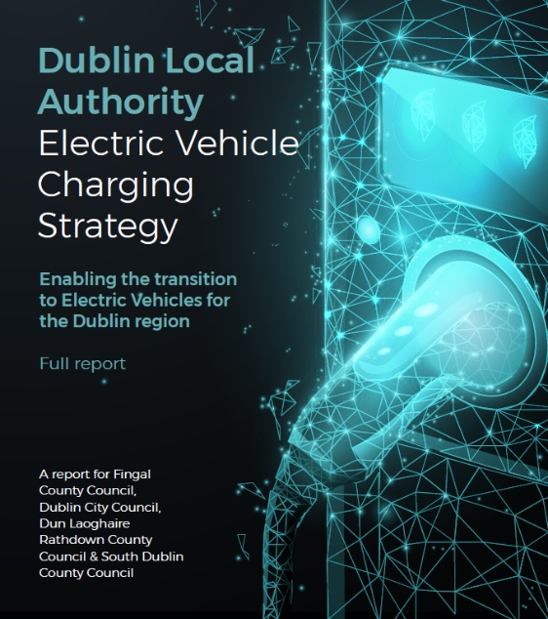
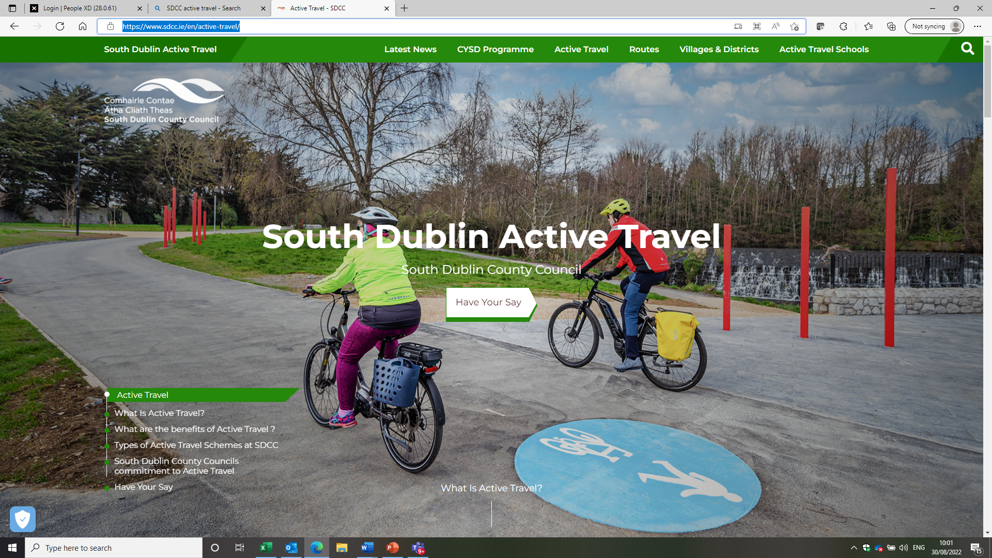
SDCC Climate Change Action Plan 2019-2024
TRANSPORT
Programme of Fleet Replacement – Review underway
Dublin Regional EV Strategy published
Cycle South Dublin – 21 live projects Over €18M was received in allocations for SDCC schemes in 2022
Over 400 bicycle parking spaces provided in 2022, expect 800 by end of year
Active Travel website launched Active Travel - SDCC
SDCC supporting BusConnects developments
Facilitate the installation of an innovative public e-bicycle hire pilot project with ESB .

Slide 8
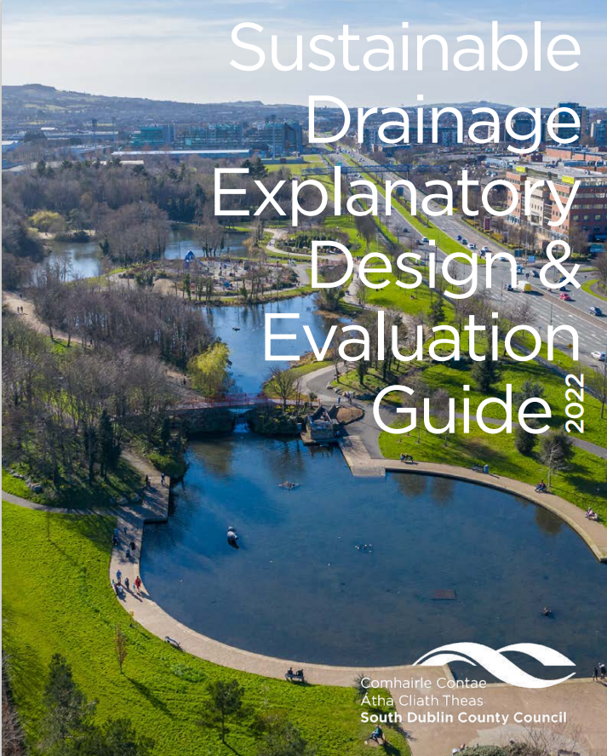
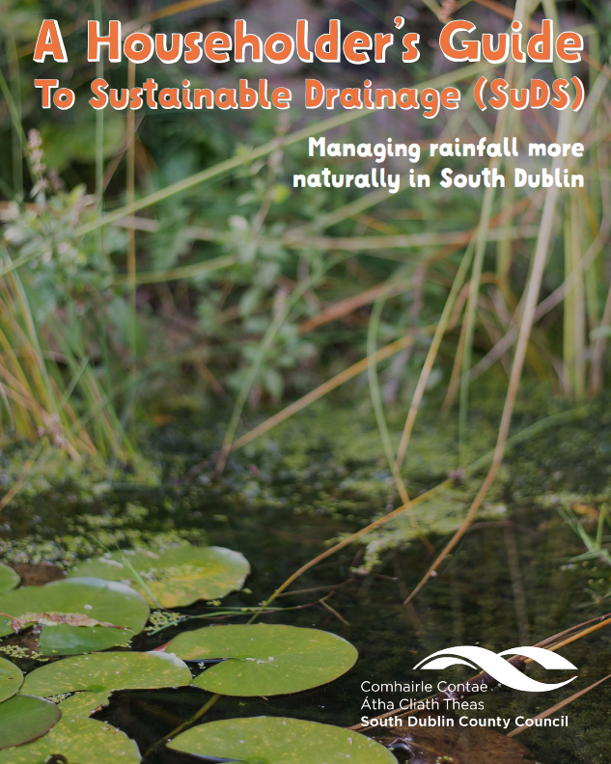
SDCC Climate Change Action Plan 2019-2024
FLOOD RESILIENCE
SuDS Guidance Documents published
Severe Weather and Flood Emergency Plans Updated
Strategic Flood Risk Assessment and Hydrological Assessment was completed
Integrated Constructed Wetlands Complete in Griffeen Valley, 2 ICWs in development in Dodder Valley
Weather Impact REgister (WIRE) App developed by CARO
SuDS Householders Guide published

Slide 9
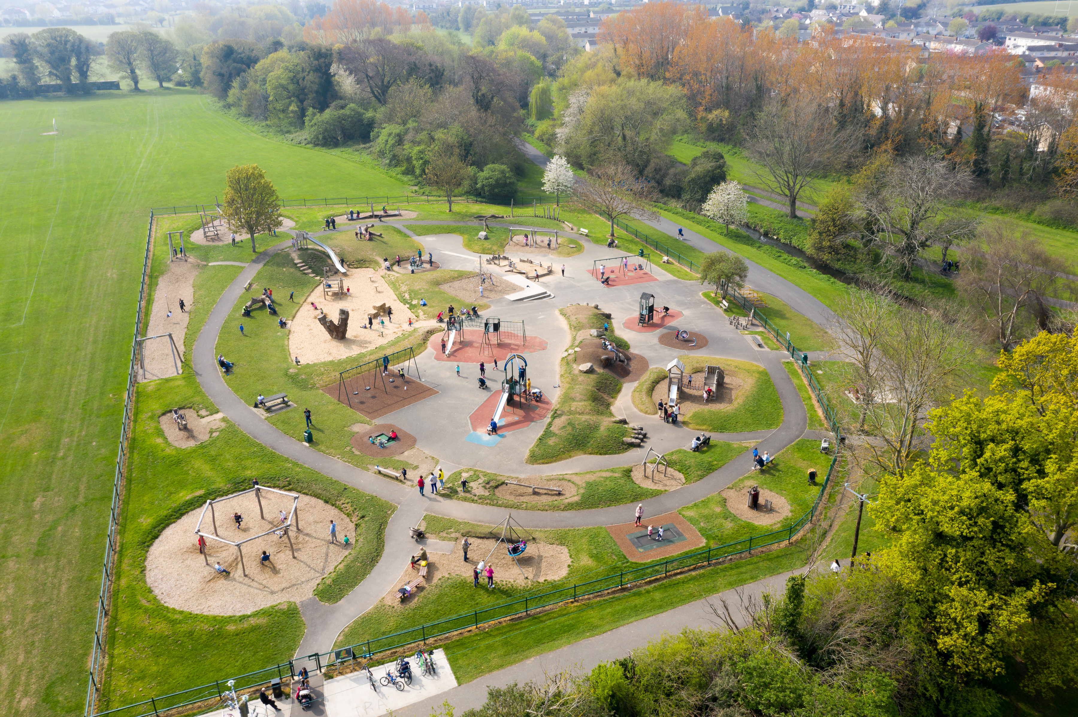
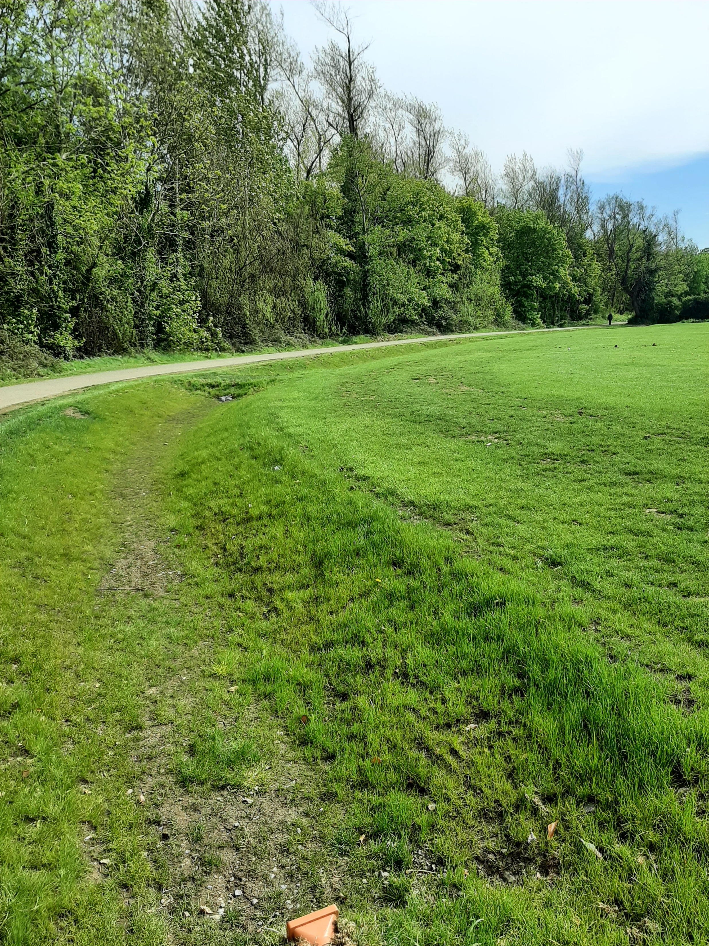
SDCC Climate Change Action Plan 2019-2024
NATURE BASED SOLUTIONS
Workshops on Nature Based Solutions delivered through SuDS guidance, CDP, Hydromorphological study, Greening Factor
Biodiversity Action Plan Complete, Implementing Actions
Green Infrastructure Strategy completed and incorporated into CDP
Natural play area programme completed
2,500 trees will be planted by end of year
Approx 18,000 trees surveyed in 2022
Invasive Alien Species video produced and presented to Parks Supervisory Staff
Green Roofs at Tymon park Intergenerational Centre, and Corkagh Park Pavilions
SuDS projects implemented

Slide 10
SDCC Climate Change Action Plan 2019-2024
RESOURCE MANAGEMENT
Waste Enforcement officers carrying out inspections and warning/enforcement notices
Promote the Stop Food Waste messages across our social media channels. We support the EPAs campaigns including Summer Food Waste campaign.
EPA Stop Food Waste will be at Climate Festival in Tymon Park as part DCAW
Fast Fashion documentary produced with the other Dublin Local Authorities supported by the Climate Innovation Fund
Arthurstown Landfill - solar array was suggested for the landfill to cover the base load. Additional 5MW commercial array to be assessed
Investigating Anaerobic Digestor as a environmentally friendlier solution to disposing of grass cutting

Slide 11
SDCC Climate Change Action Plan 2019-2024
Energy & Buildings New Actions
Identify register of opportunities to improve Green profile of Tallaght Stadium
Support CoDEMA with the development and progression of the DeliveREE project
Procure Energy Audits on County Hall, Clondalkin Office, Tallaght and Clondalkin Leisure Centres
Develop Implementation Plans for Clondalkin and Tallaght Decarbonising Zones
Align Objectives of Clondalkin Decarbonising Zones with Local Area Plan

Slide 12
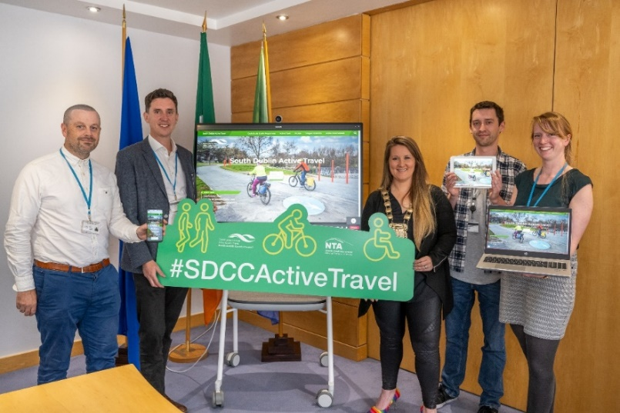
SDCC Climate Change Action Plan 2019-2024
Transport New Actions
Development of Draft Dublin Regional Air Quality Plan
Preparation of Interim Urban Traffic Related Air Pollution (UTRAP) Report
Participate in Clean Air Together air quality monitoring pilot project
Support School Streets projects (Safe Routes to Schools)
Support WeCount/I-Change Air quality monitoring project
Support South Dublin Sports Partnership on community active travel projects
Include/Support active travel options for travelling for Work

Slide 13
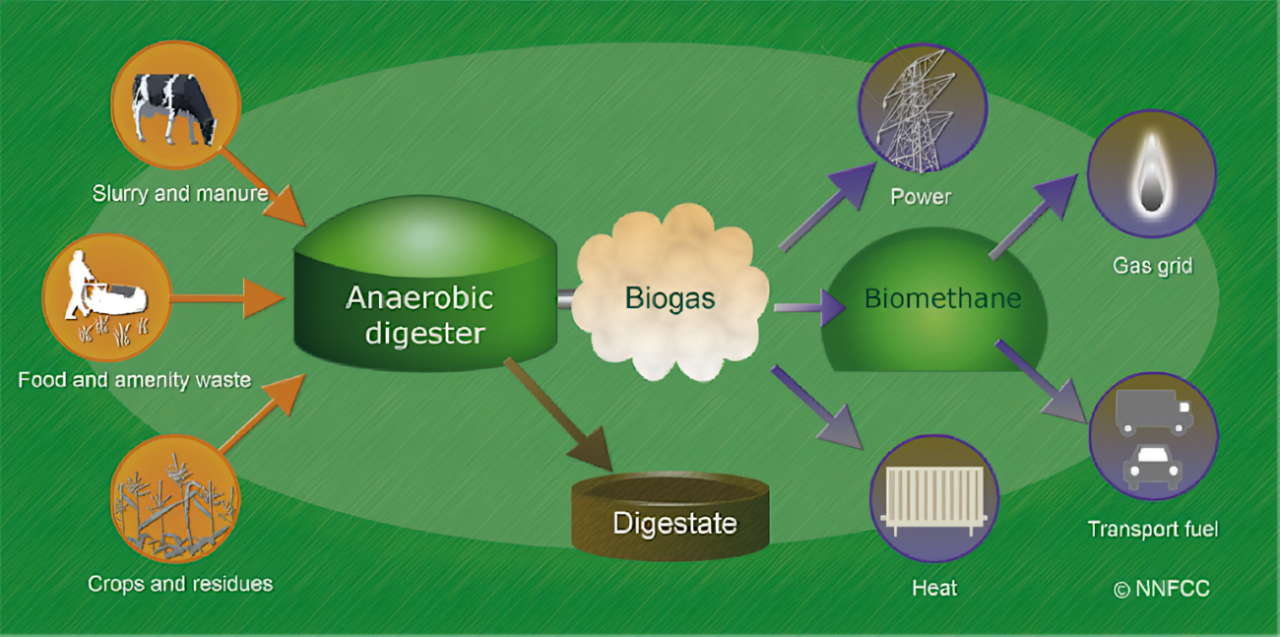
SDCC Climate Change Action Plan 2019-2024
Nature Based Solutions New Actions
Implement actions from the Biodiversity Action Plan
Carry out wetland surveys of lakes and ponds in South Dublin
Resource Management New Actions
Investigate sustainable solutions to the management of grass cuttings
Investigate option to replace fossil fuelled hand tools with battery powered alternatives
Provide Climate Awareness training for all staff
Establish Green Procurement working group

Slide 14
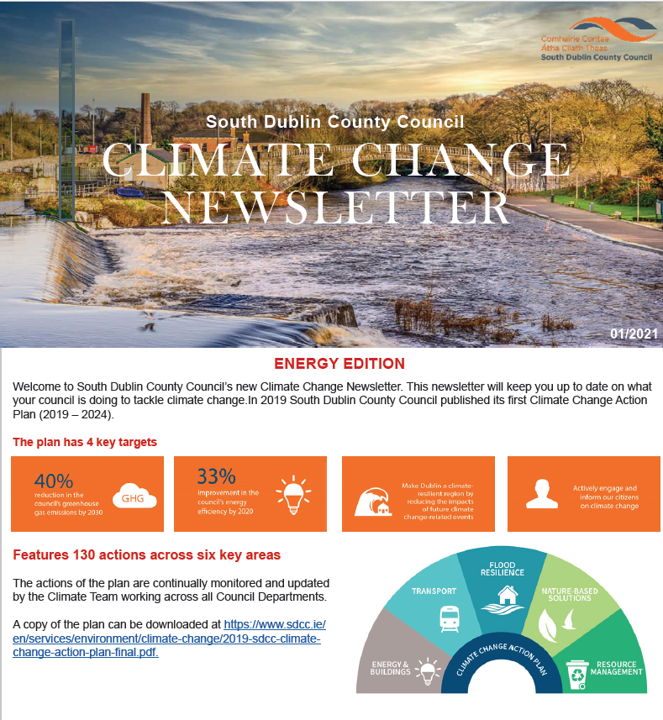
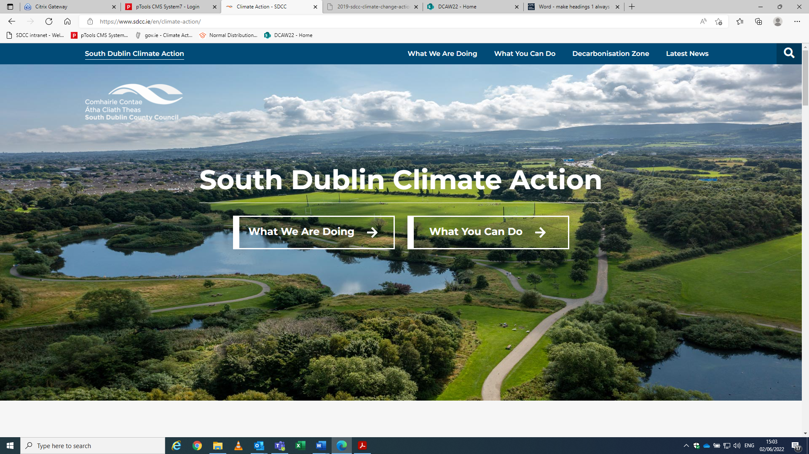
SDCC Climate Change Action Plan 2019-2024
Citizen Engagement New Actions
Develop SDCC Climate Change website
Produce Climate Action newsletters
Support the SEAI Sustainable Energy Communities project
Support GAA Green Clubs project
Support/Participate with DLAs Climate Action Awareness Campaign Climate Action Week
Support local schools and universities on Climate Change awareness projects and studies

Slide 15
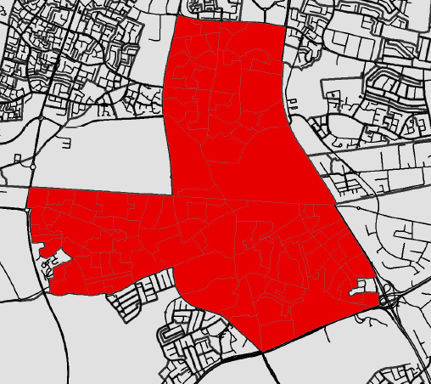
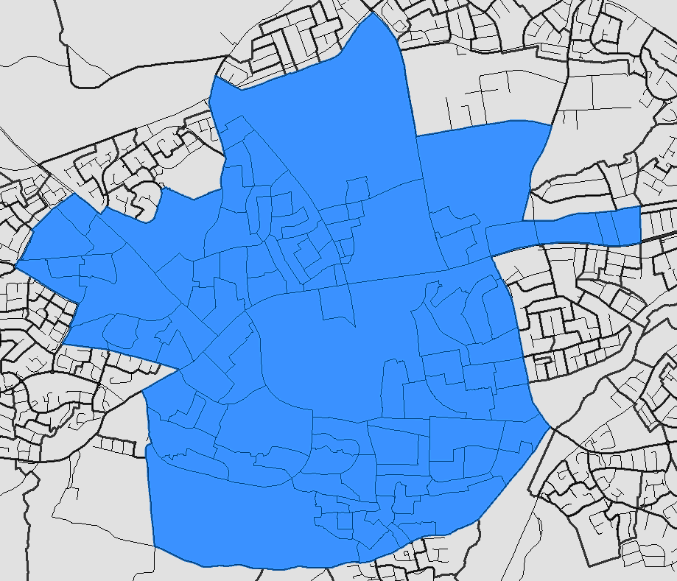
SDCC Climate Change Action Plan 2019-2024
Action 165 of the National Climate Action Plan (2019), to enable Ireland meet its carbon emissions reduction targets by 2030
February 2021 DHLGH issued a circular on Decarbonising Zones
April 2021 SDCC submitted proposal identifying Clondalkin and Tallaght
Awaiting Guidance, DECC took over action 165
4 DLAs approached CoDEMA to develop Decarbonising Zone Implementation Plans
CoDEMA – Establish Baseline Data
Project potential increases
Develop Gap to Target Analysis Register of Opportunities
Prepare Cost Estimates
Decarbonising Zones
Clondalkin
Tallaght

Slide 16
Thank You

