Slide 1
SHD Application Ref: SHD3ABP-313777-22
Applicant: Bluemont Developments
Location: Mortons Pub, Firhouse.
Presentation to: R.T.F.B. ACM 12th July 2022
Jim Johnston
Senior Executive Planner

Slide 2
Timelines
SHD Lodged with ABP on 10/06/22
5 Week Obs by 5.30pm on 14/07/22
8 Wks SDCC report due on 04/08/22
16 Week Decision due from ABP on 29/09/22
S.247 pre-planning meetings with SDCC as follows:
SHD1SPP016/20 13/01/21,
SHD1SPP016/20 09/04/21
SHD1SPP010/21 29/07/21
Tripartite meeting ref ABP-311459-21 on 24/01/22 with An Bord Pleanála, the applicant and SDCC.
Consultations

Slide 3
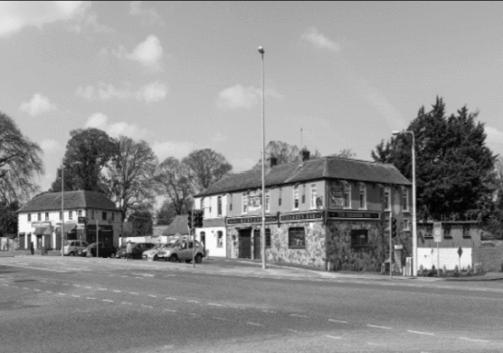

Slide 4
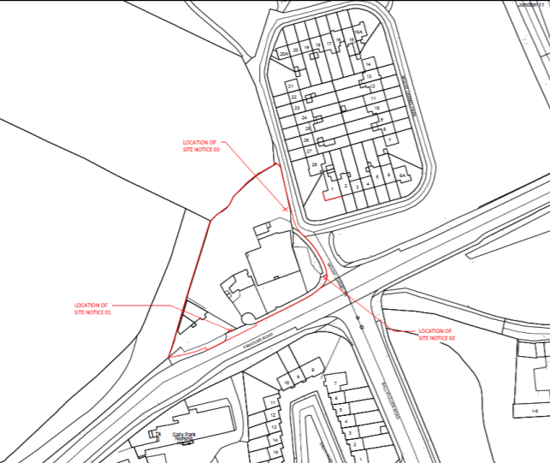

Slide 5
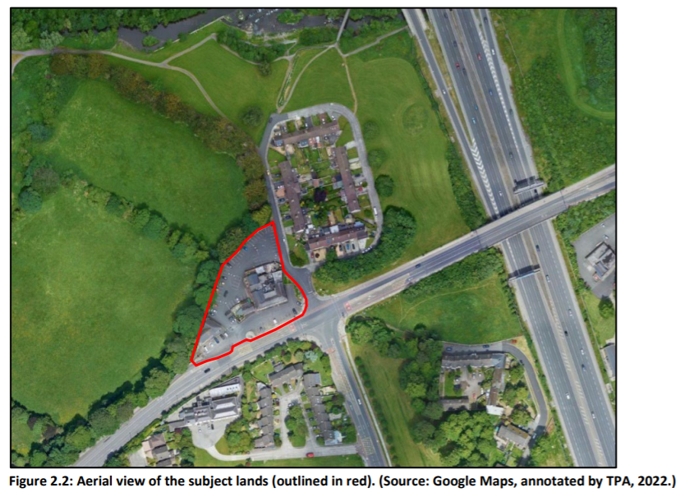

Slide 6
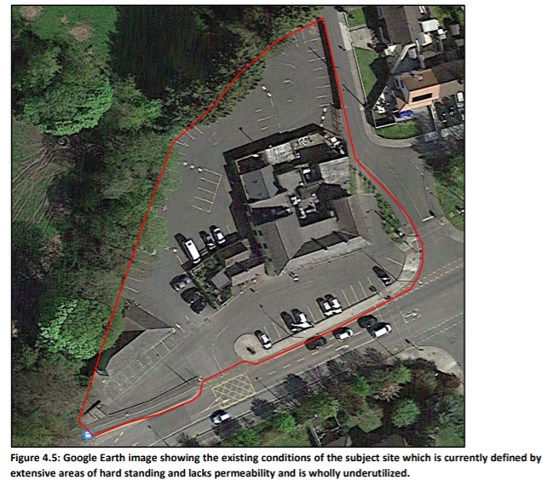

Slide 7
Proposed Development
The development will consist of the demolition of all structures on site (1,326 sq m), including:
• Two storey building formally used as public house, ancillary off-licence and associated structures (c. 972 sq m);
• Two storey building comprising an existing barber shop and betting office (260 sq m);
• Single storey cottage building and associated structures (c. 94 sq m); and
• Eastern boundary wall and gated entrance from Mount Carmel Park.
The development with a total gross floor area of c. 11,638 sq m, will consist of 100 apartments arranged in 2 blocks (Blocks 01 and 02) ranging between 3 and 5 storeys in height, over lower ground floor and basement levels, comprising:
• 96 apartments (consisting of 2 no. studio units; 45 no. one bedroom units; 10 no. two bedroom (3 person) units; 34 no. two bedroom (4 person) units; and 5 no. three bedroom units), together with private (balconies and private terraces) and communal amenity open space provision at podium and roof levels; and
• 4 duplex apartments (consisting of 2 no. one bedroom units and 2 no. two bedroom units (4 person) located within Block 01, together with private balconies and terraces.

Slide 8
The development will also consist of non-residential uses (c. 355 sq m), including:
• 1 café (58 sq m) and 1 office (c. 30 sq m) at ground floor level of Block 01;
• 1 medical unit(59 sqm) and 1 betting office(66 sqm) at ground floor level of Block 02;
• 1 barber shop (28 sq m) located at ground floor level between Blocks 01 and 02; and
• 1 crèche (c. 114 sq m) located at lower ground floor level of Block 01 and associated outdoor play area to the rear.
Vehicular access to the site will be from the existing access off Firhouse Road, including minor alterations to the existing access, and new and enhanced pedestrian infrastructure.
The development will also consist of the provision of public open space and related play areas; hard and soft landscaping including internal roads, cycle and pedestrian routes, pathways and boundary treatments, street furniture, basement car parking (80 no. spaces in total, including accessible spaces); motorcycle parking; electric vehicle charging points; bicycle parking (long and short stay spaces including stands); ESB substations, piped infrastructural services and connections to existing public services, (including relocation of existing surface water sewer and water main from within the application site onto the public roads area along Firhouse Road and Mount Carmel Park); ducting; plant; waste management provision; SuDS measures; stormwater management and attenuation; sustainability measures; signage; changes in levels; public lighting; and all ancillary site development and excavation works above and below ground.

Slide 9
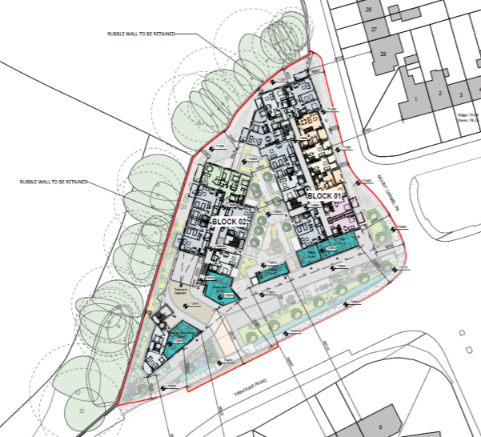

Slide 10
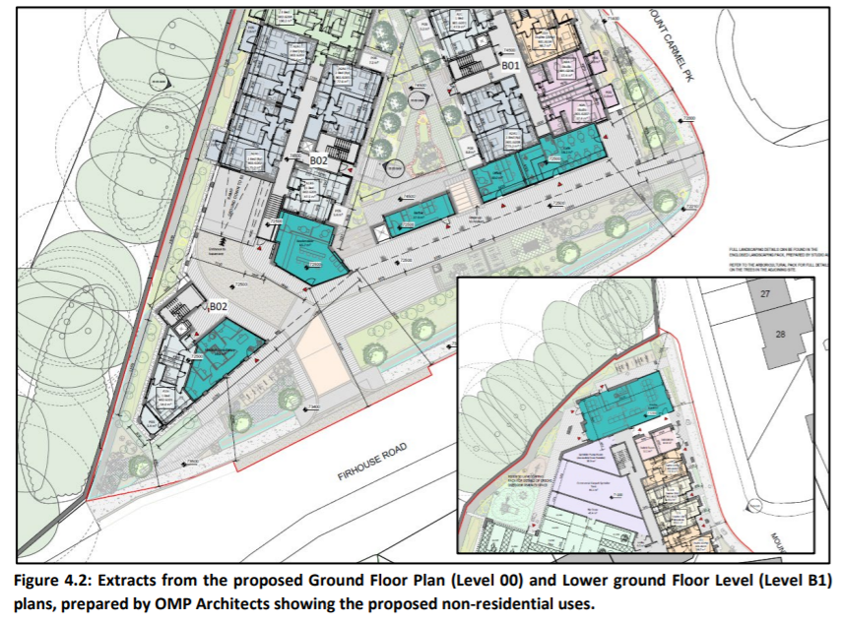

Slide 11
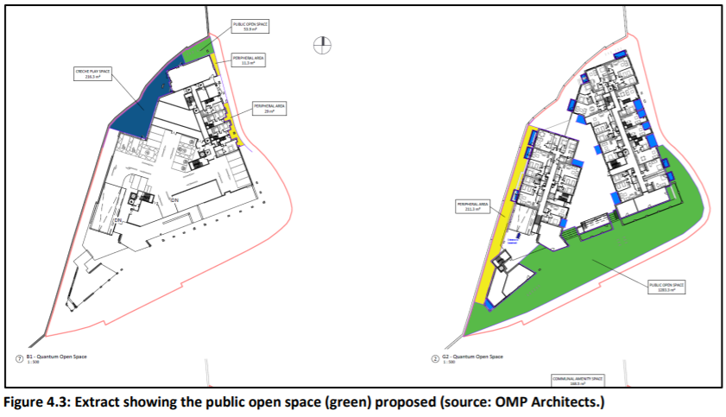

Slide 12
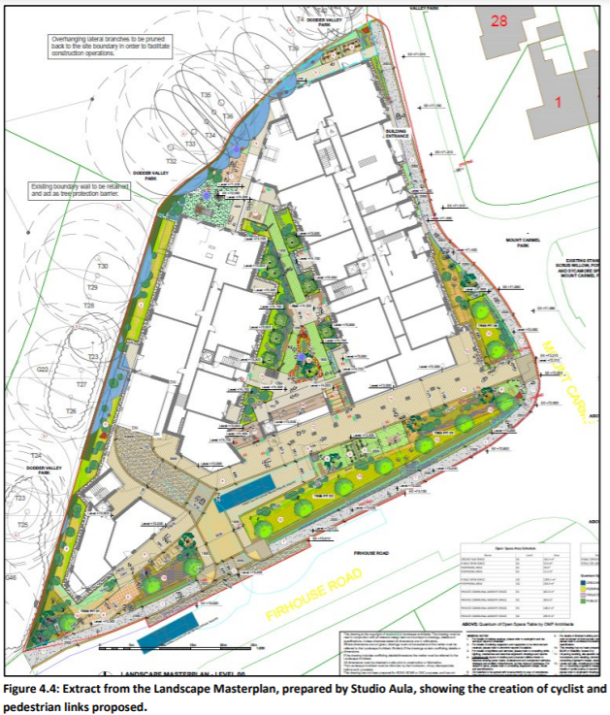

Slide 13
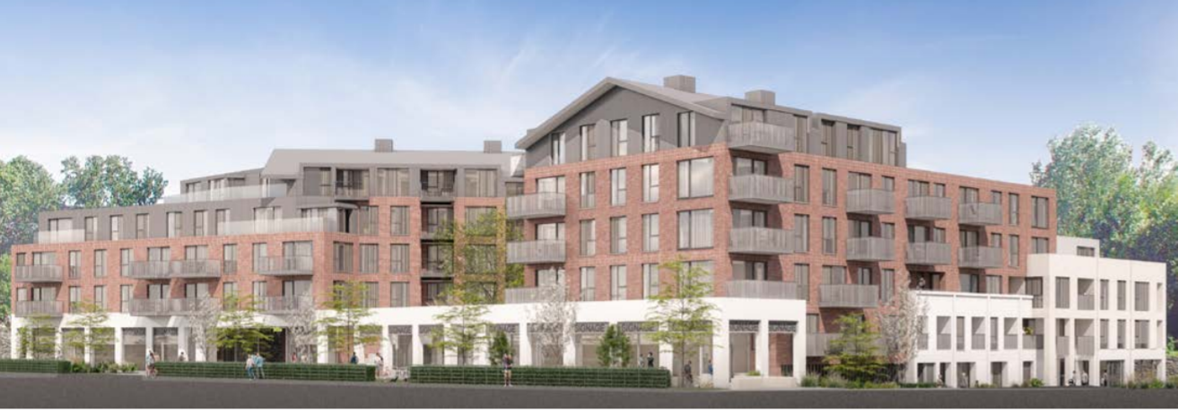

Slide 14
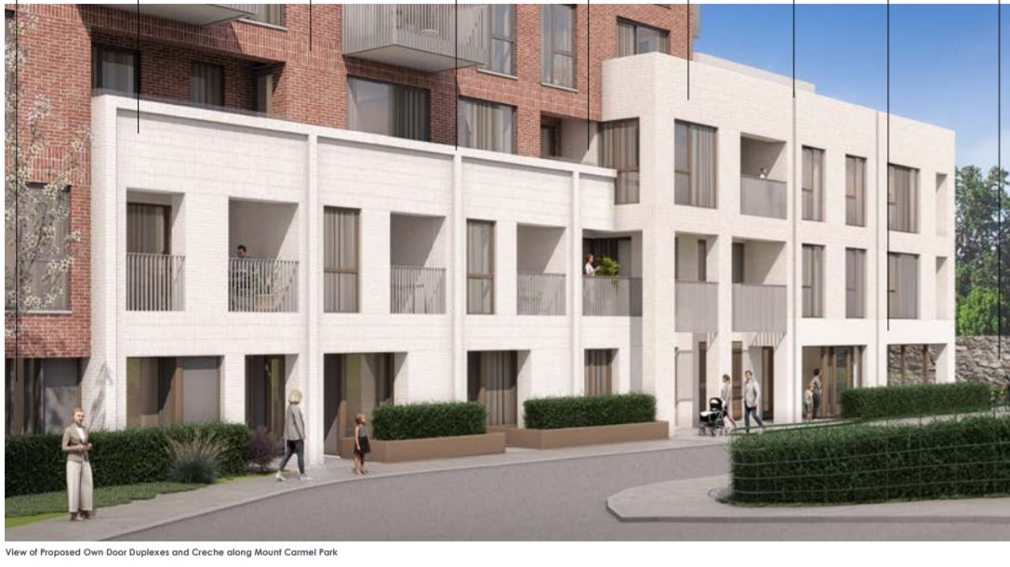

Slide 15
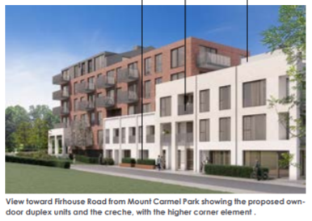

Slide 16
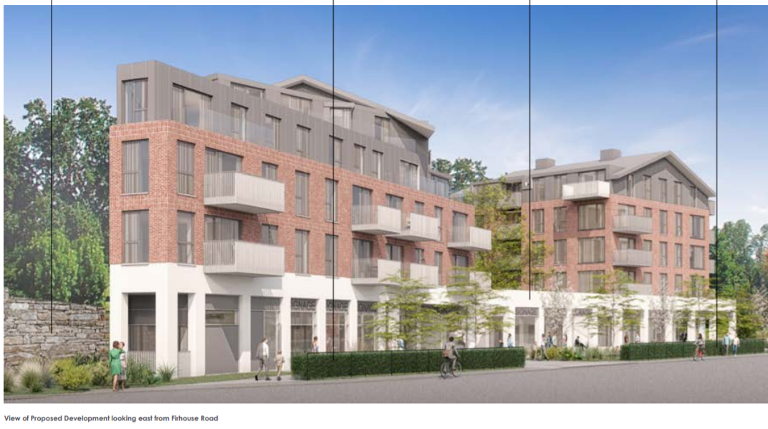

Slide 17
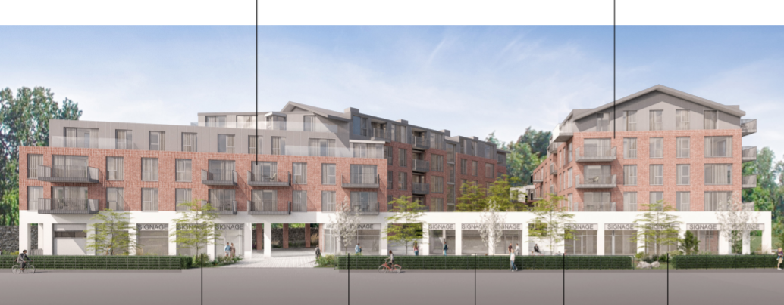

Slide 18
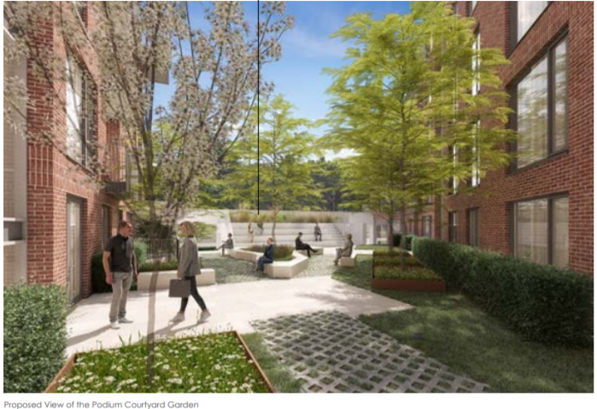

Slide 19
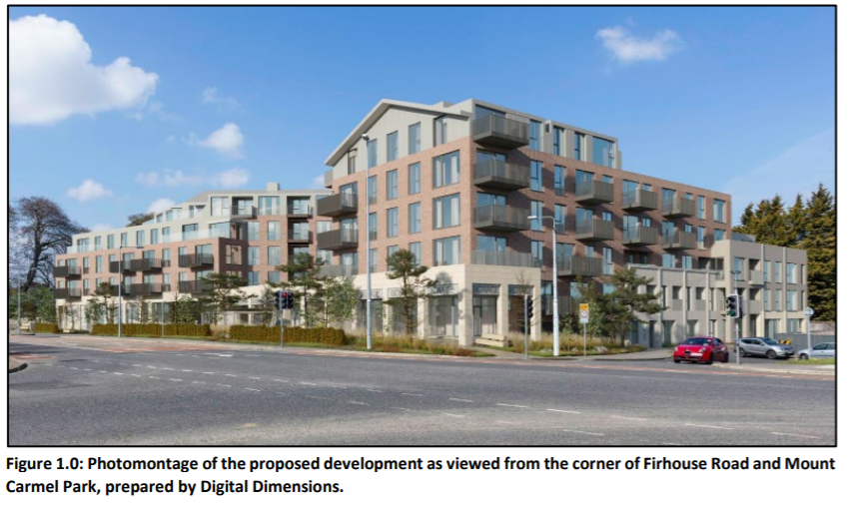

Slide 20
ABP comments – the Bord requested that the following issues be addressed
1 – Development Strategy: ‘Further justification for the proposal in light of the ‘LC’ zoning objective, ‘To protect, improve and provide for the future development of Local Centres’’, and non-residential uses at ground level proposed. The predominant use proposed in the scheme is residential, a local centre zoning would envisage a greater degree of mixed use in particular at ground level.’
2 – Architectural Design Approach: ‘Further justification for the height strategy, integration with the wider area and specifically how transition occurs in terms of design, presentation, quality community and place making. How transition occurs between the existing established development along Mount Carmel Park to the north east and the Firhouse Road and the proposed development, cognisance being had that this development will be highly visible on approach from the surrounding area.’
3 – Landscaping, Materials and Character: ‘Further justification of the visual impact, materials and finishes to the proposed buildings and hard & soft landscaping. Should address the character and identity and creation of inclusive people-friendly neighbourhood, regard being had, to the architectural treatment, landscaping, quality public and communal open spaces, pedestrian way finding and connectivity.

Slide 21
ABP comments continued:
4 – Residential Design: ‘Further justification of the quality of the proposed residential amenity. Have regard to, the ‘Guidelines for Planning Authorities on Sustainable Residential Development in Urban Areas’ (including the associated ‘Urban Design Manual’); the ‘Sustainable Urban Housing: Design Standards for New Apartments – Guidelines for Planning Authorities’ in particular with regard to number of single aspect and north facing units, and daylight and sunlight access to internal habitable areas and in particular to communal courtyards. Shadow Impact Assessment of communal open spaces, private open space and public open spaces. May require an amendment to the layout, improving the quality and providing extended hours of daylight and sunlight to the internal courtyards and to the public open space.’

Slide 22
The Board requested specific information on 18 items:
1 – A detailed Statement of Consistency: clearly outlining how the proposal is consistent with local planning policies having specific regard to the zoning objective of the site, “LC” – local centre and its applicability to the development site in question having regard to the concerns raised in the Planning Authority’s opinion.’
2 – Architectural Design Statement: a justification for the proposed development, having regard to, urban design considerations, visual impacts, site context, the locational attributes of the area, linkages through the site, pedestrian connections and national and local planning policy. Address finishes of the blocks, the design relationship between the individual blocks within the site, the relationship with adjoining development and the interface along the site boundaries, in particular, the Firhouse Road, Mount Carmel Park Housing Estate to the northeast and the Mount Carmel Park high amenity area and Protected Structure grounds including mature deciduous tree line and stone party boundary wall to the north. Include contextual plans and contiguous elevations and sections.’
3 – Material Contravention Statement: ‘justification, where the proposed development materially contravenes the Development Plan and other than in relation to the zoning of the land, indicating why permission should, nonetheless, be granted, having regard to a consideration specified in section 37(2)(b) of the Act of 2000.’

Slide 23
4 – Visual Impact Assessment: scale and massing of the proposal in the context of the transitional nature of the receiving environment, which includes domestic scale two storey development to the northeast in Mount Carmel Park Housing Estate. Should include long range views from the N81 and along Firhouse Road
5 – Material and Finishes: proposed building materials and finishes and the requirement to provide high quality and sustainable finishes and details.’
6 – Location, Hierarchy and Quantum of Open Space Provision: ‘Justification of these and communal and public open space (POS).
7 – Public Open Space v Communal Open Space: ‘What is designated as communal open space and what is designated as public open space and whether the public open space will be taken in charge, and if not, a maintenance costs, access and liabilities report to set out responsibility for open space areas.’
8 – Housing Quality Assessment: ‘details of a schedule of accommodation, to demonstrate compliance with the 2020 Guidelines on Design Standards for New Apartments.
9 – Residential Amenities: ‘potential overlooking, overshadowing and overbearing including drawings with levels and cross-sections showing the relationship between the proposed blocks within the scheme and to adjacent residential development.’

Slide 24
10 – Daylight and Shadow Impacts: ‘A Daylight and Shadow Impact Assessment of the proposed development.
11 – Water and Drainage Infrastructure: ‘Clarification regarding connection to water and drainage infrastructure having regard to the Irish Water submission, submitted to the Board on the 21.10.2021.’
12 – Planning Authority Opinion: ‘Response to issues raised in the PA Opinion received by An Bord Pleanála on the 23rd July 2021.’
13 - Life Cycle Report
14 – EIA Screening and Section 299B Statement The ABP Opinion notes the requirement for: ‘Where an EIAR is not being submitted the applicant should submit all necessary information referred to in article 299B(1)(b)(ii)(II) and article 299B(1)(c) of the Planning and Development Regulations 2001-2018 for the purposes of EIAR screening.’
15 – Ecological Impact Assessment, inclusive of a Bird and Bat Survey.
16 – Taken in Charge Areas
17 – Construction and Demolition Waste Management Plan
18 – Public Lighting

Slide 25
Statistics for Proposed Development
Units - 100 apartments
1 café (58 sq m) and 1 office (c. 30 sq m) at ground floor level of Block 01;
1 medical unit(59 sqm) and 1 betting office(66 sqm) at ground floor level of Block 02;
1 barber shop (28 sq m) located at ground floor level between Blocks 01 and 02; and
1 crèche (c. 114 sq m) located at lower ground floor level of Block 01 and associated outdoor play area to the rear.
Non res floorspace – 355 sqm
Unit breakdown: 2% studio, 49% 1 bed, 51% 2/3 bed,
Site area – 0.46ha
Density – 217 units per ha.
Car parking spaces – 80 in total, 77 basement and 5 surface
Bicycle parking – 270
Plot Ratio – 1.7
Site Coverage – 44%
Height – 3 – 5 storeys
Dual Aspect apartments – 50%
Public Open Space – 1,347sqm
Communal Open Space – 962sqm.
Applicants website - www.firhouseroadshd.com

Slide 26
Thank You
Questions

