Slide 1

Capital Projects
Progress Report
11/7/2022

Slide 2
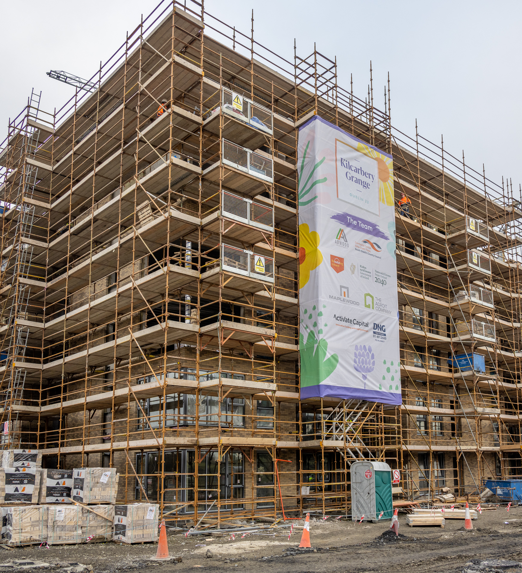
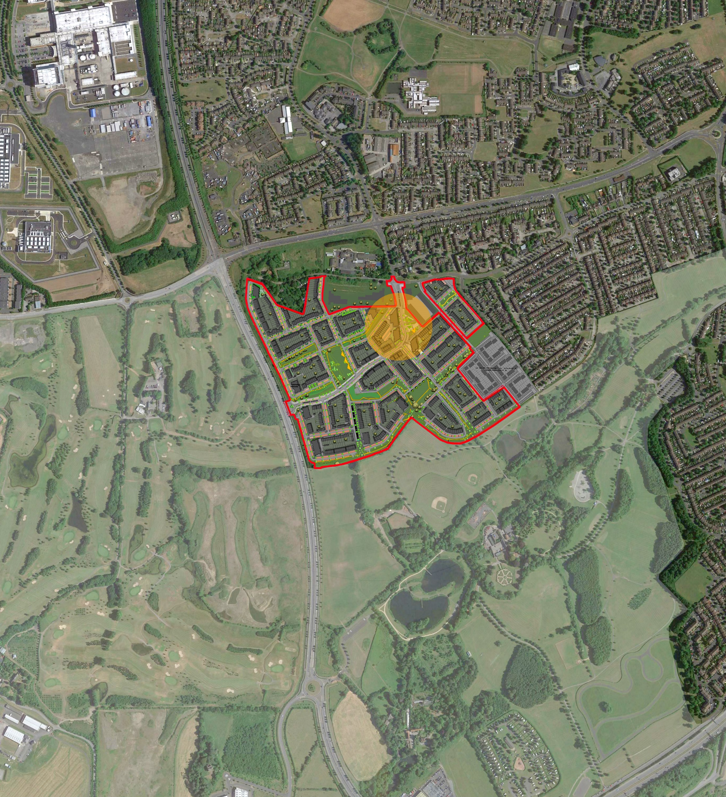
Kilcarbery and Other Large Sites
Kilcarbery - 2022 delivery - 16 affordable, 74 cost rental, 73 social.
Clonburris – Phase 1 Part 8 July – Phase 2 Part 8 June – see separate report on Clonburris.
Killinarden – LRD application to SDCC rather than SHD.
Belgard North Cost Rental Apartments – report to September Council meeting.
Rathcoole – new site layout, masterplan required.

Slide 3
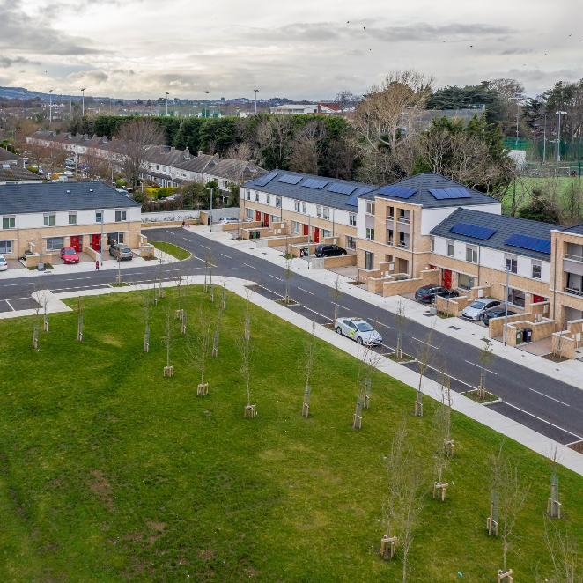
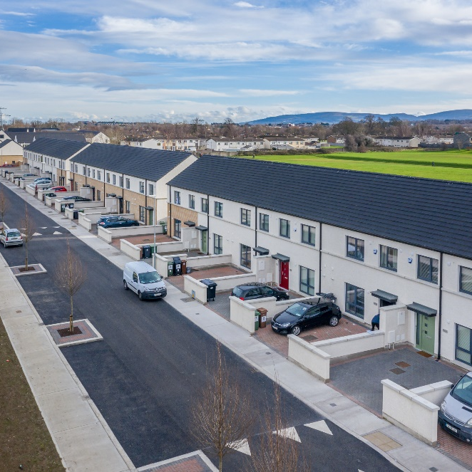
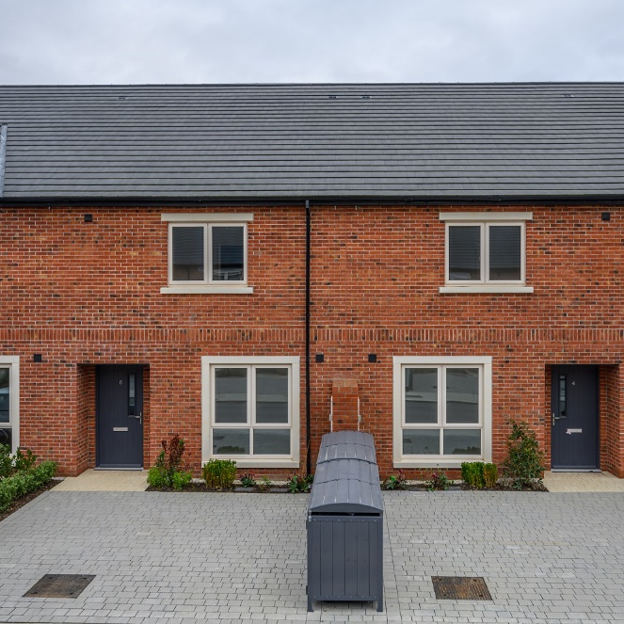
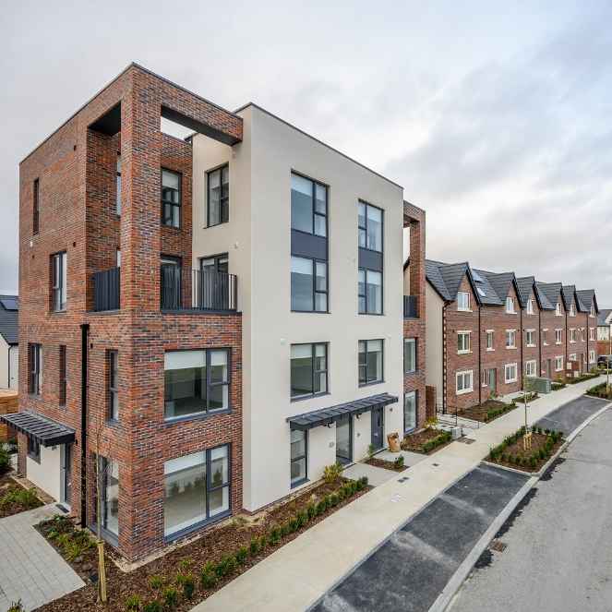
Housing Delivery
Fernwood/Maplewood – (40) due September 22.
Riversdale - (43) – due September 22.
Homeville (16) – contract determined.
St Catherines Knockmore ( 12 ) – due October 22.
St. Marks Ave. (41) – due December 22.
Templeogue (10) due Q1 2023.
Whitestown Way (81) due Q1 2023.
Nangor Road (93) – due Q4 2023.
Old Bawn (12) – to commence August 22.
Balgaddy (69) – tenders in – to commence August 22.
Old Nangor Road SIMON (10) – for retender.
Lindisfarne (19) – tender under assessment.
Design work progressing (4O) – St. Aongus, St. Ronans, Pearse Bros., Rossfield.
Lucan Road (4) – AHB considering options.

Slide 4
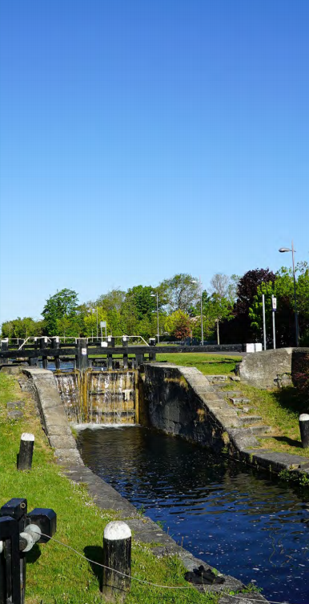


Clonburris
SDZ
URDF Preliminary Business Case
Submitted to DHLGH 03 Dec 2021
URDF Strategic Assessment Report
Approved by DHLGH Aug 2021
8,714 Homes for 23,000 people
€2.9bn Regen.
Programme
€520m Exchequer Returns
2,360 Direct Jobs
44% Social &
Affordable Homes
8 Schools &
90ha of Parkland
Date:
29.06.2022

Slide 5
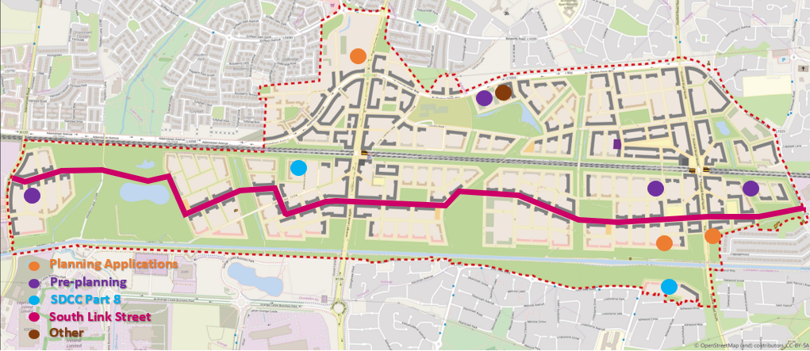
SDZ Activity
Planning
South Link Street and Utility Corridor (SDZ20A/0021) – Permission granted 12/08/21
Irish Water Pump Station (SDZ21A/0006) – Permission granted 08/11/21
Post primary school (SDZ21A/0013) – Permission granted 02/02/22
Cairn Homes 569 dwellings (SDZ21A/0022) – granted
SDCC Part 8
118 dwellings south of Grand Canal
263 dwellings adjacent to Kishogue
Other - Pre-planning
Fire station – agreement in principle – site selection underway.
SDZ Requirements
Phase 0 Requirements
  Surface Water Management Plan – Approved
  Water and Wastewater Strategy – Approved
  Parks and Landscape Strategy – Under review

Slide 6
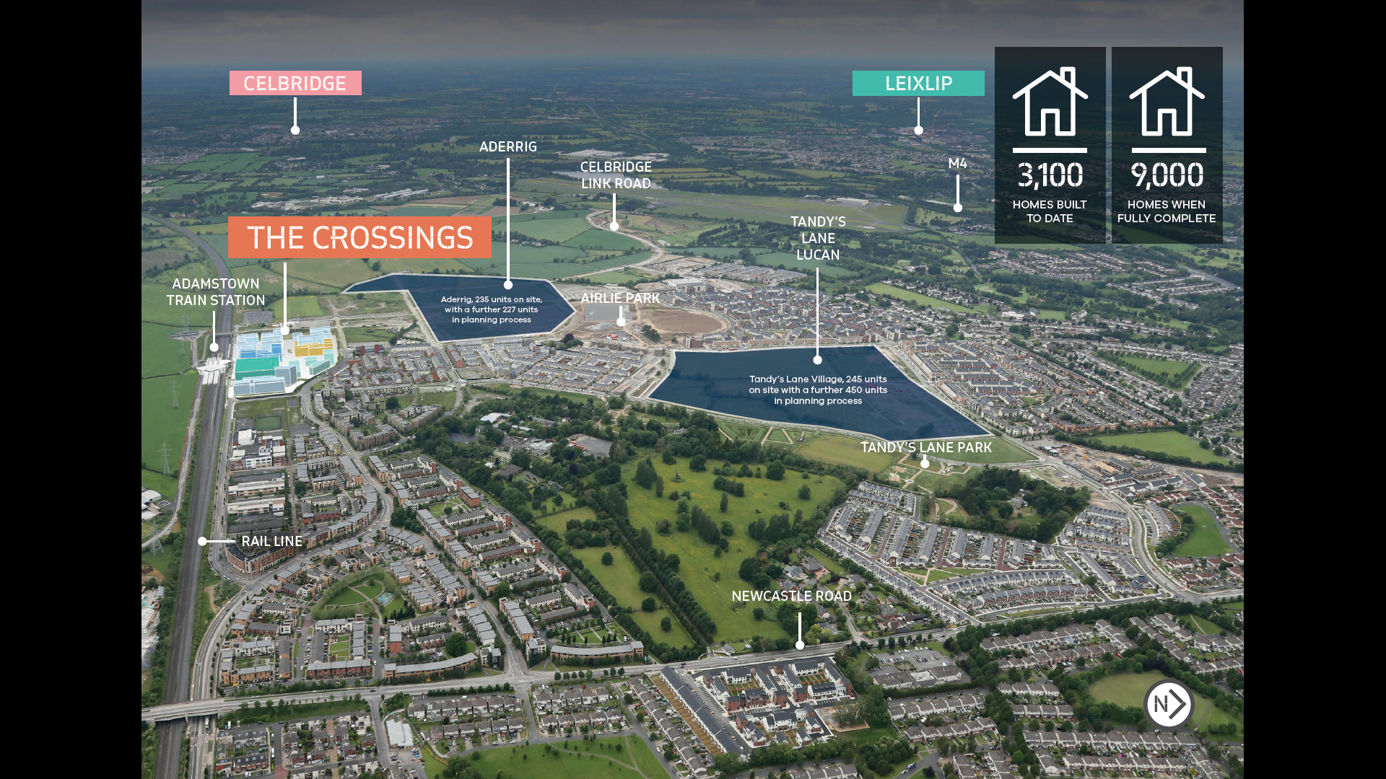
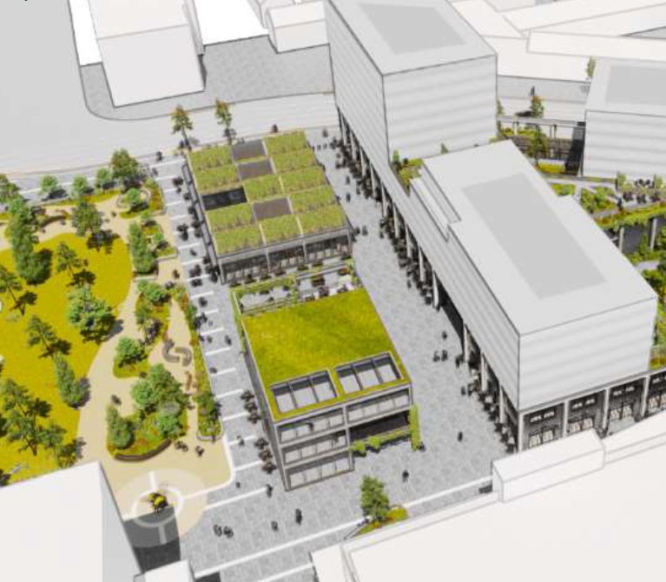
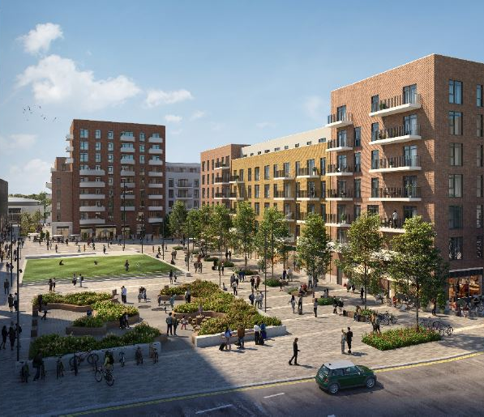
Adamstown
3,500 homes completed
The Crossings – 1,000 homes
11,700sqm of retail
Public Plaza, Library, Innovation Space
€13m public investment –URDF
Celbridge Link Road – August

Slide 7
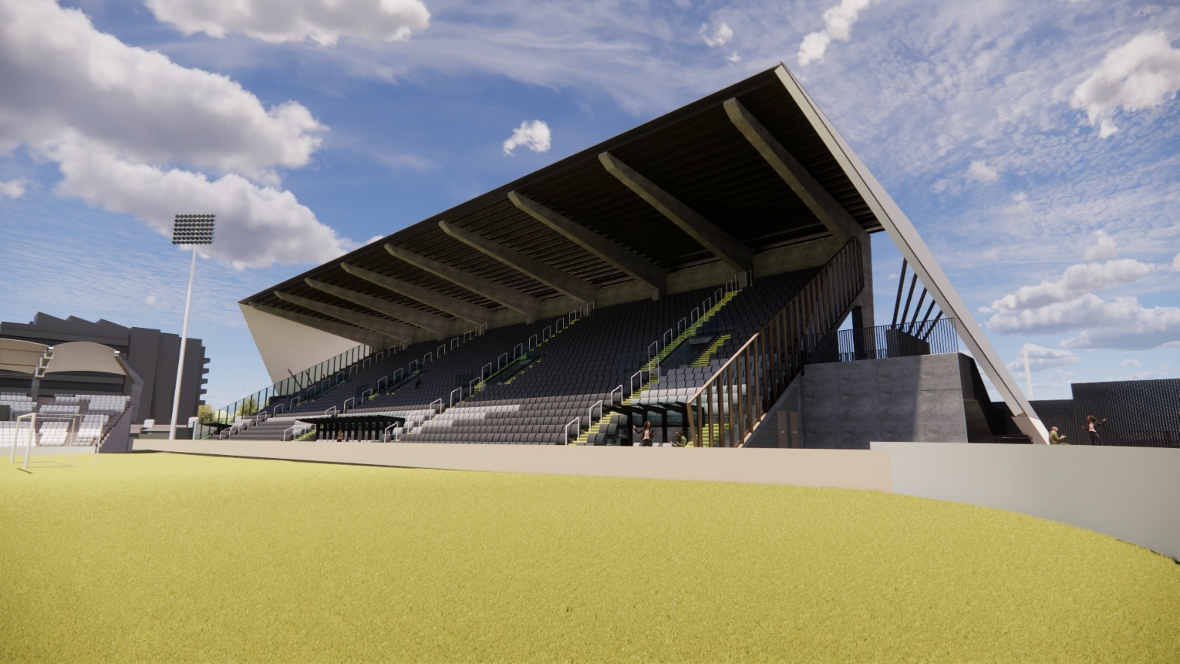
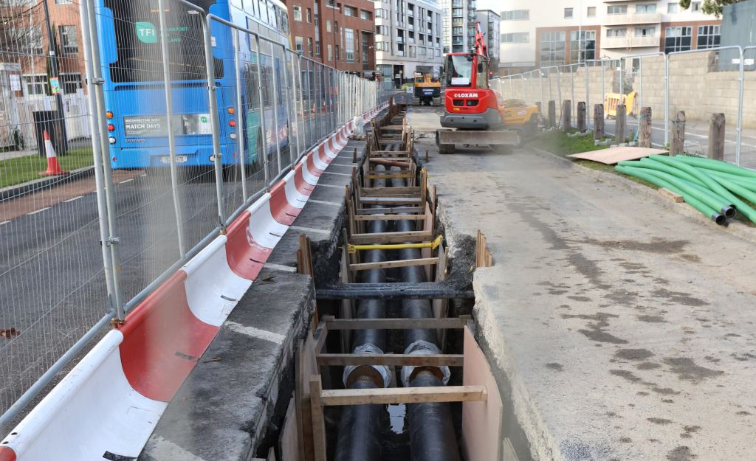
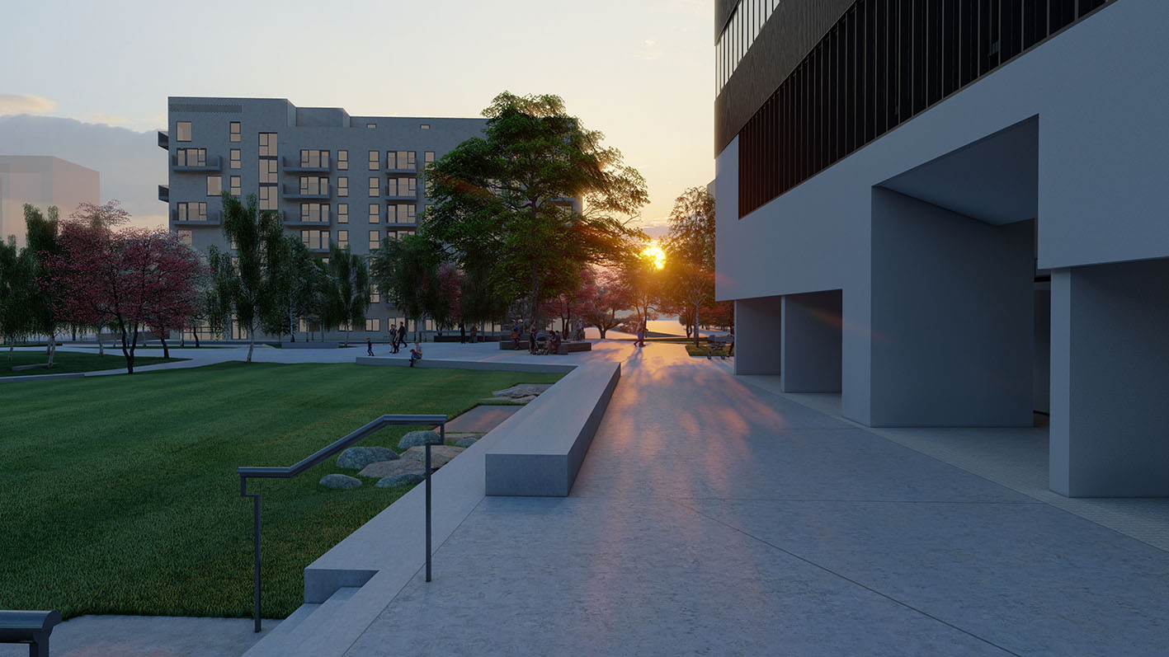
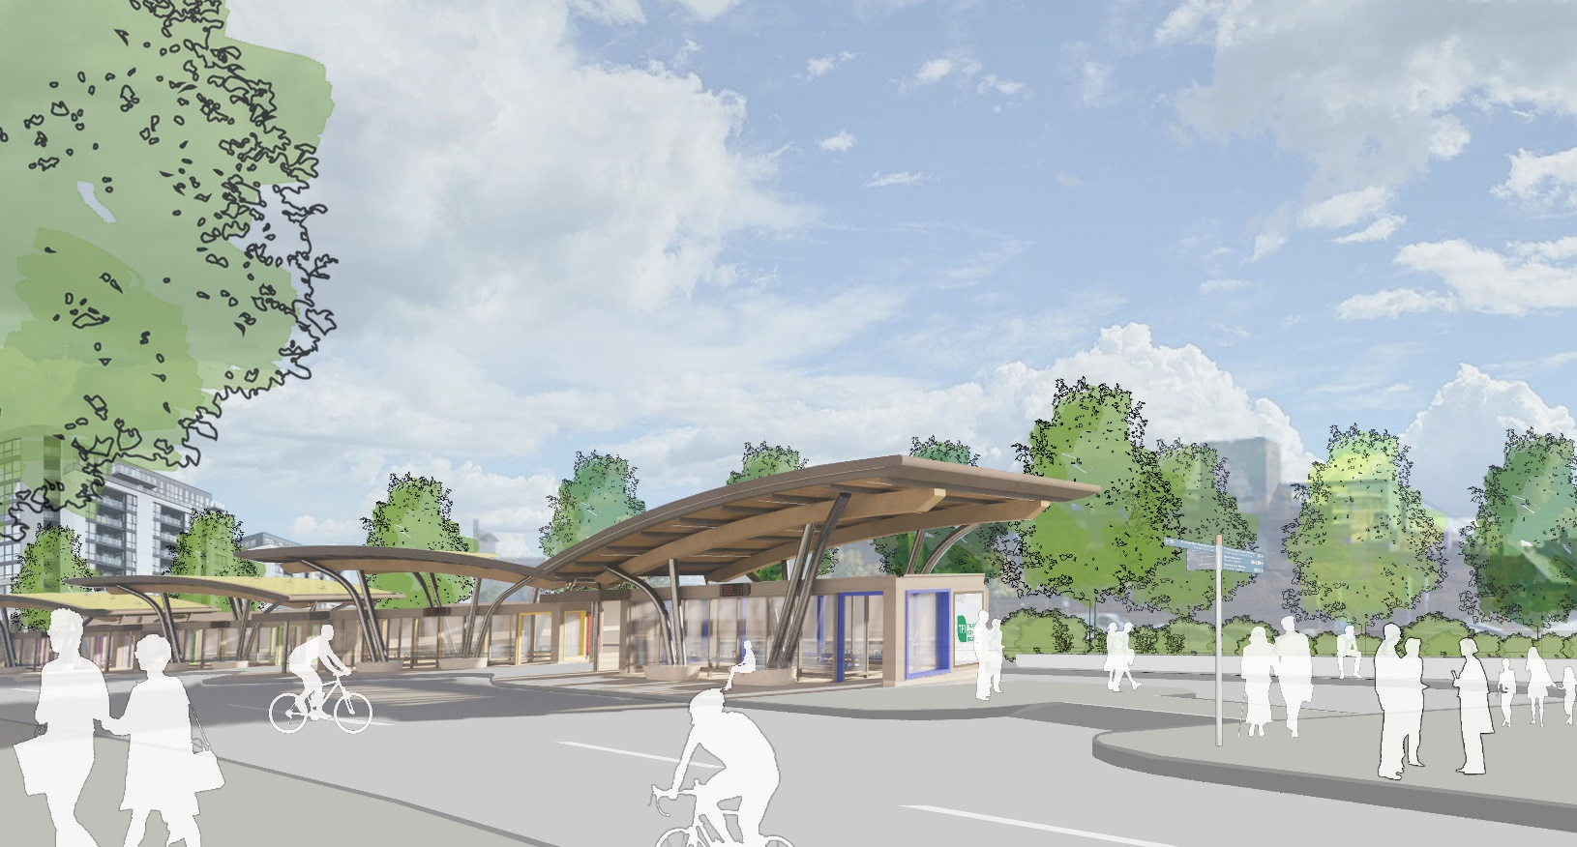
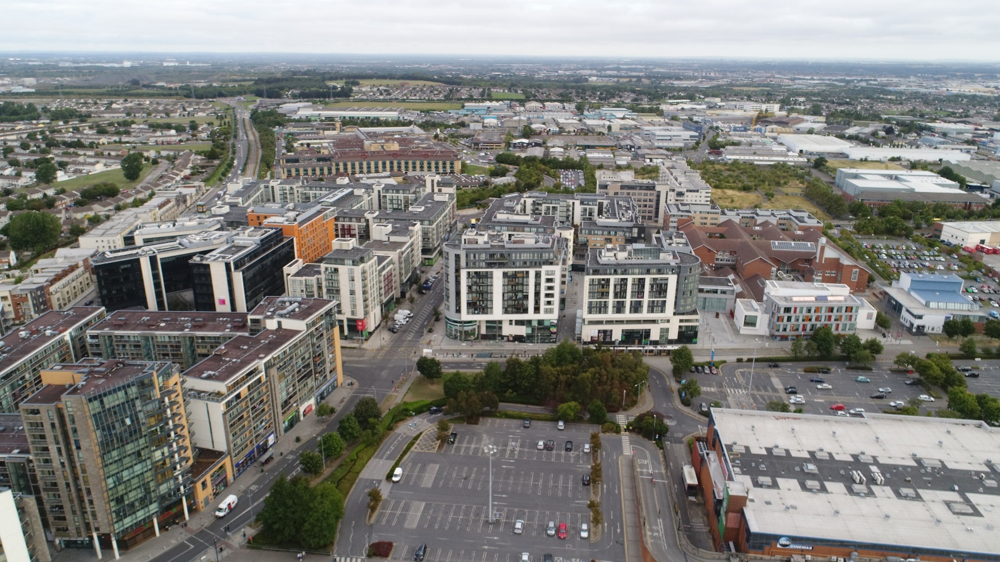
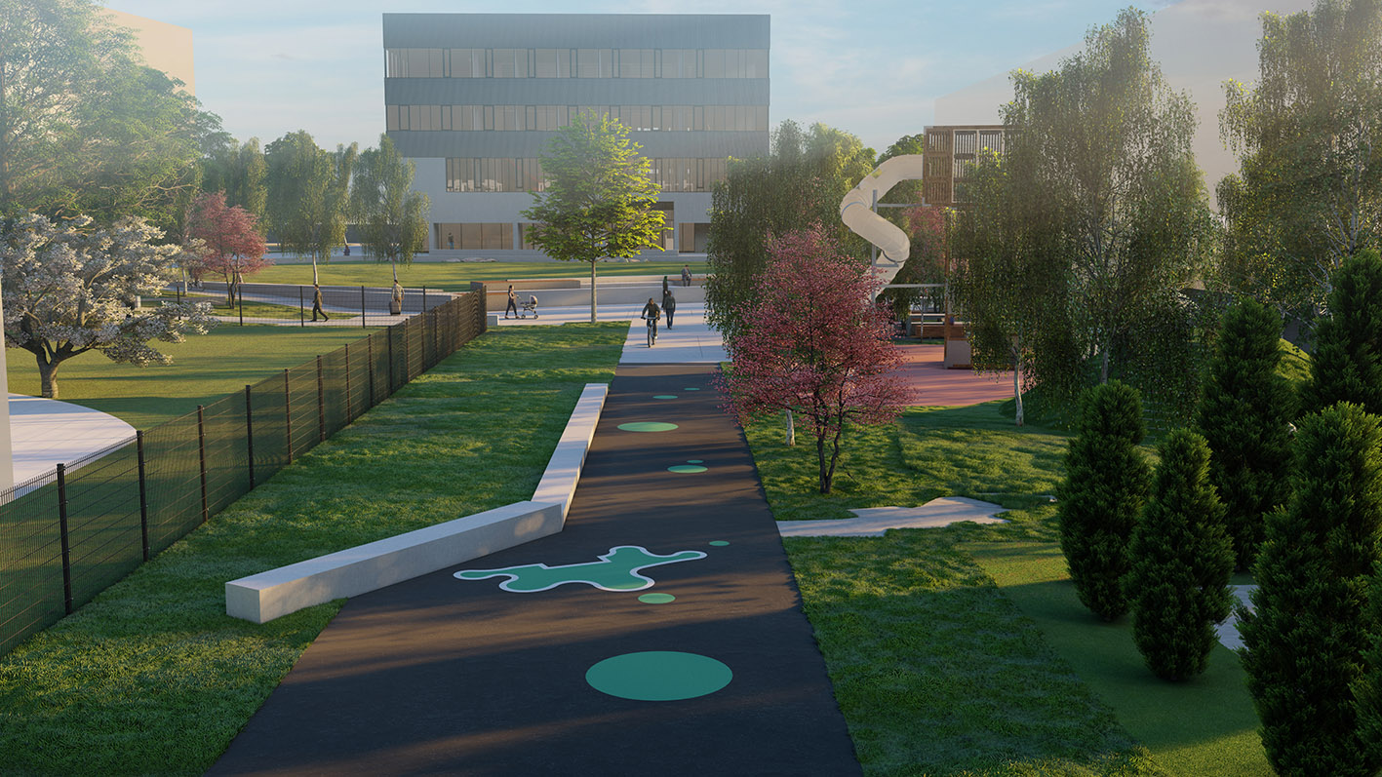
TALLAGHT TOWN CENTRE
Innovation Centre – onsite.
Stadium North Stand – onsite.
District Heating – September 22.
Innovation Square, Chamber Square, Mobility Hub, pedestrian links – one contract to commence in phases from September 2022.
Cost rental apartments – tenders will be assessed by end of August 2022.
Heritage Centre – Part 8 by February 2023.
Airton Link Road – on site by January 2023.

Slide 8
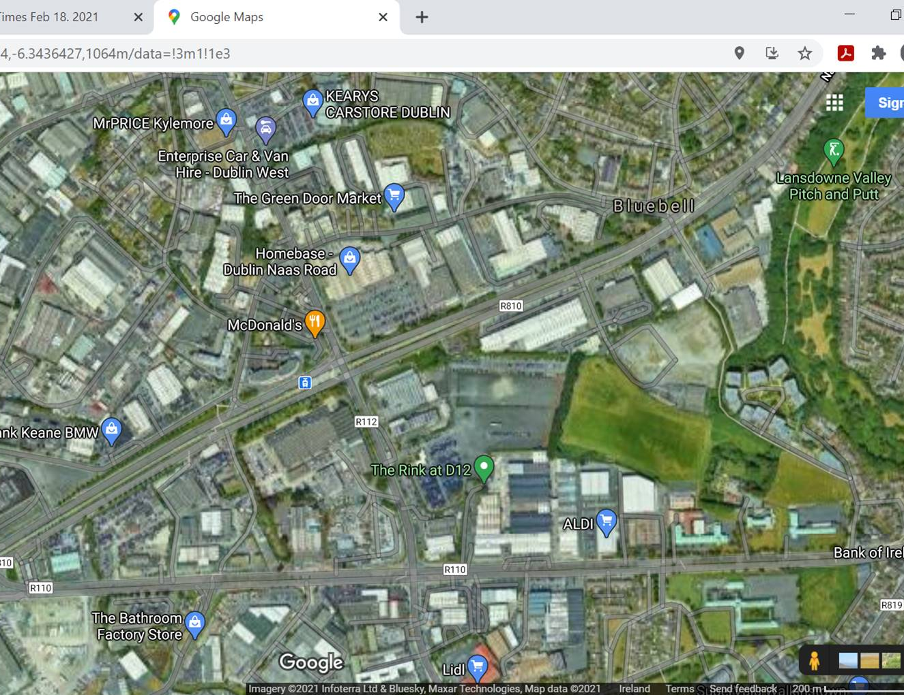
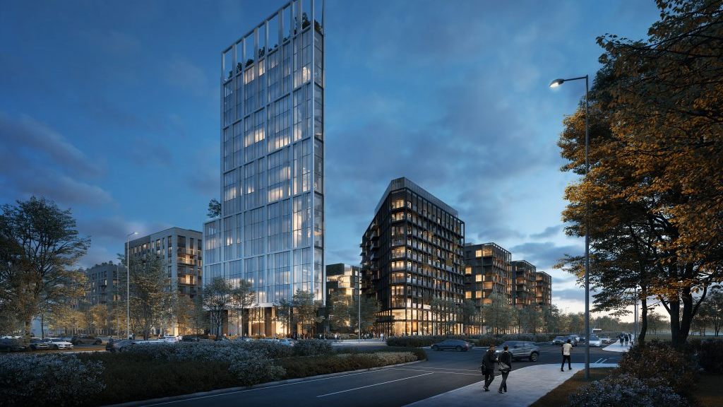
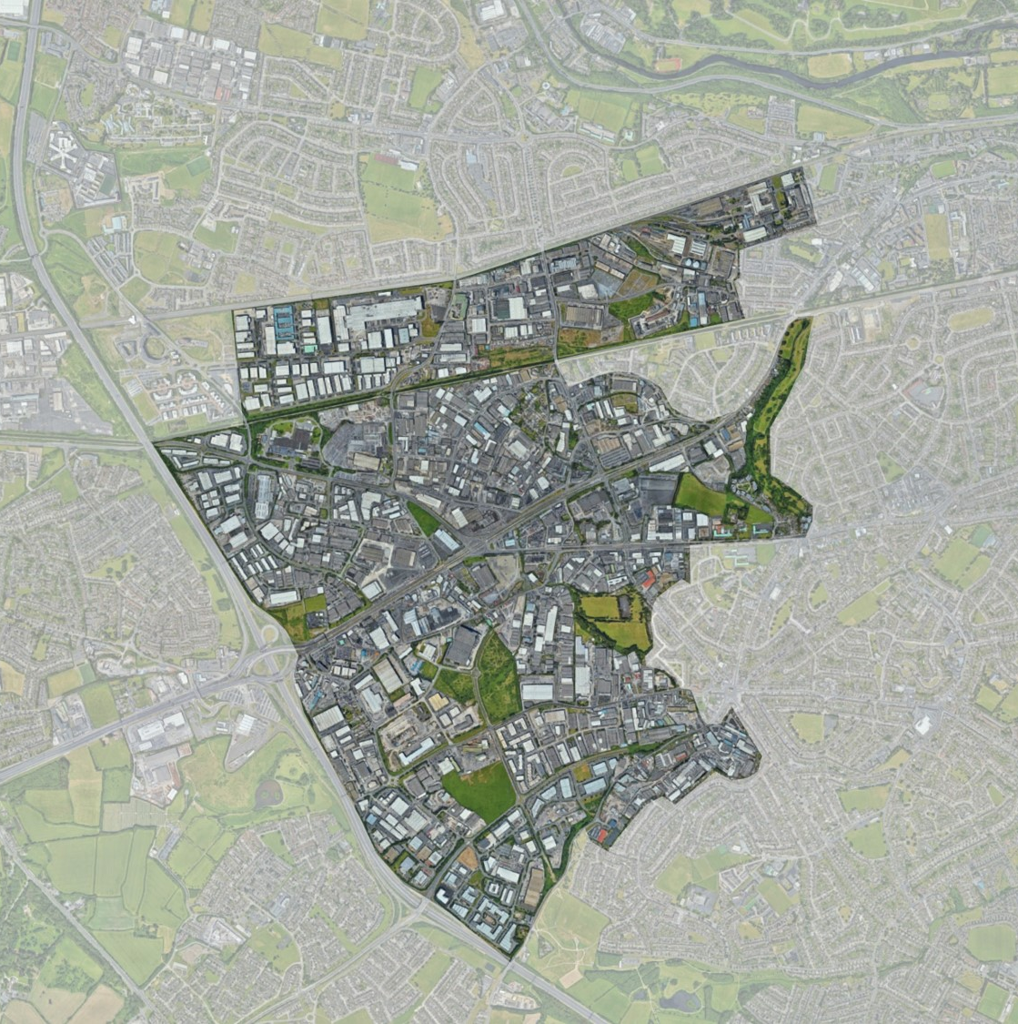
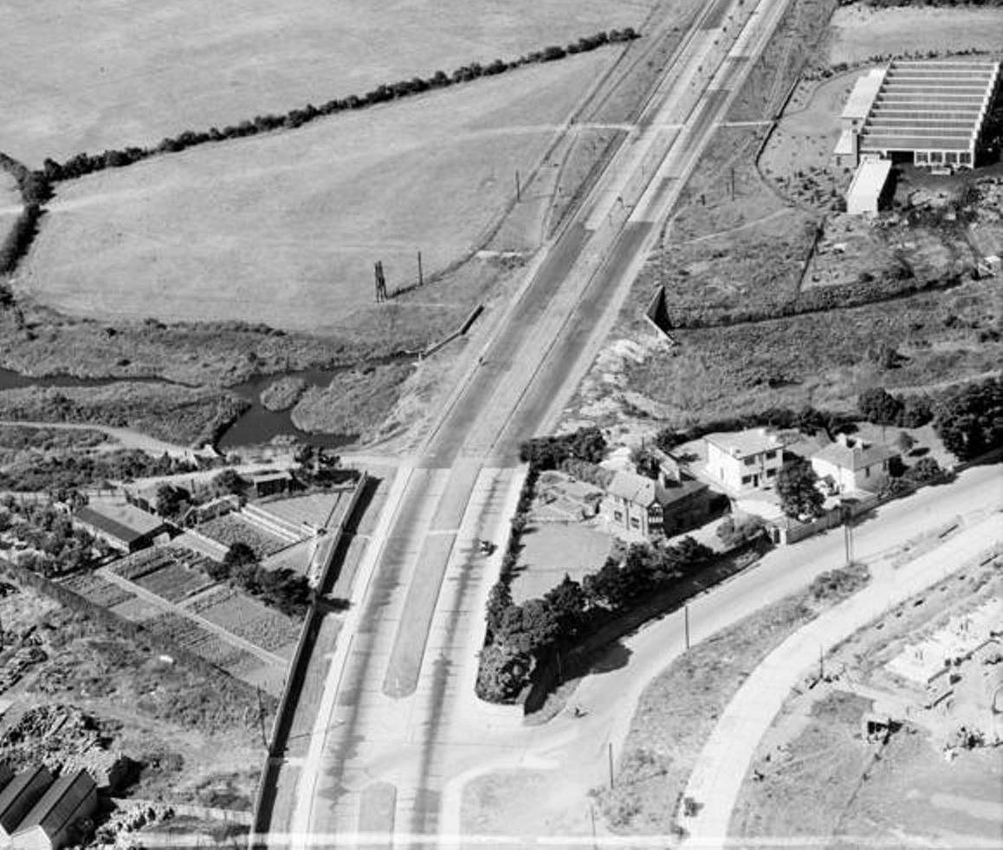
City Edge – Naas Road Regeneration
Strategic framework for regeneration up to 2070 presented to both Councils.
Potential – 40,000 homes, 75,000 jobs, €13b GVA per annum.
Report to issue to Minister O'Brien in coming days.
Hopeful of cross government support and funding for key enablers.
CDP variation and LAP.

Slide 9
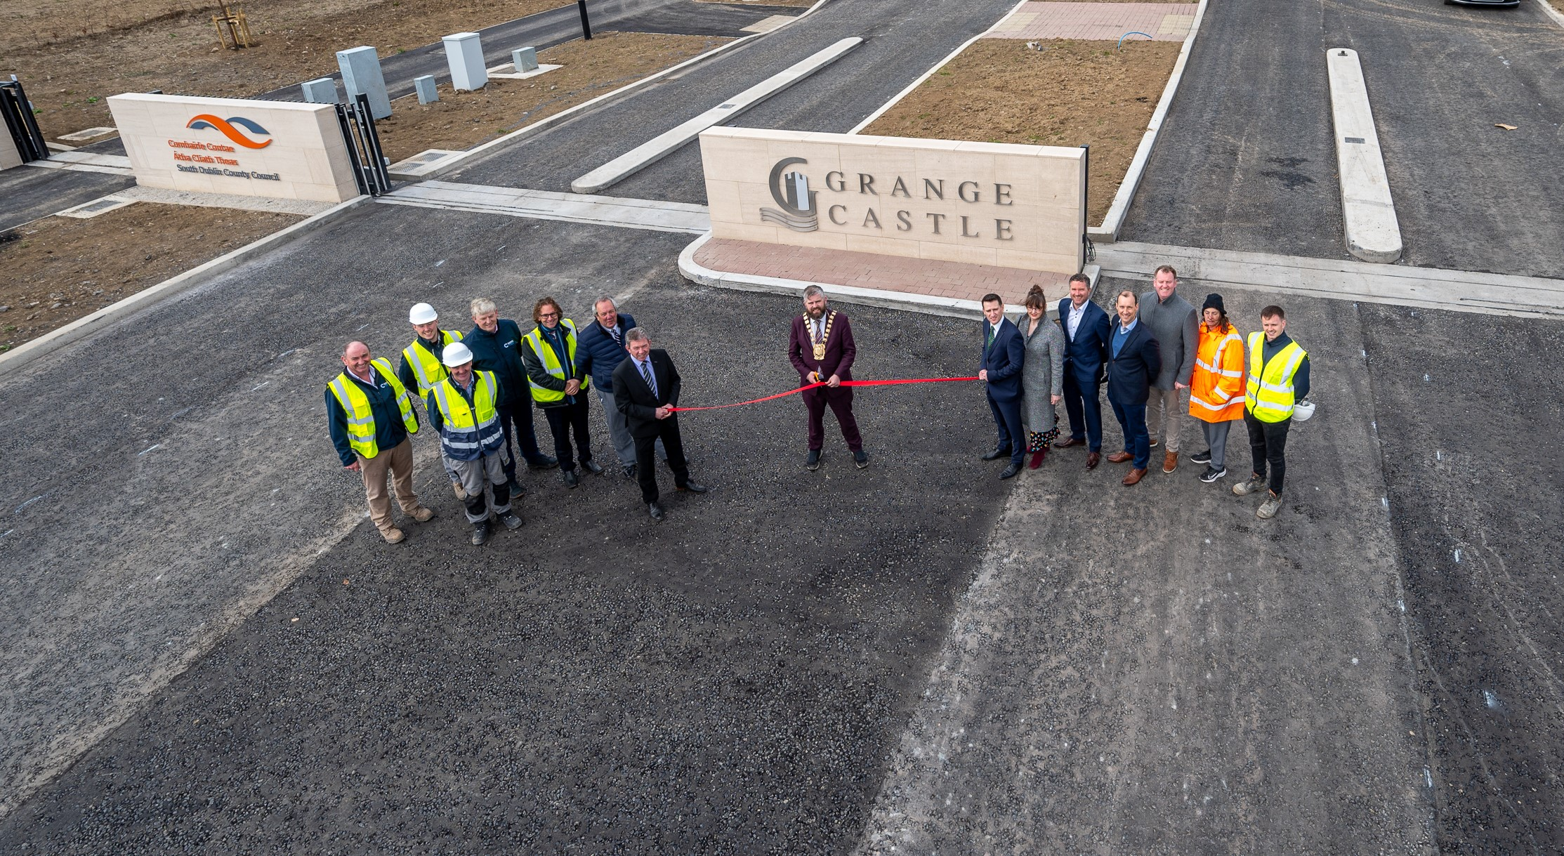
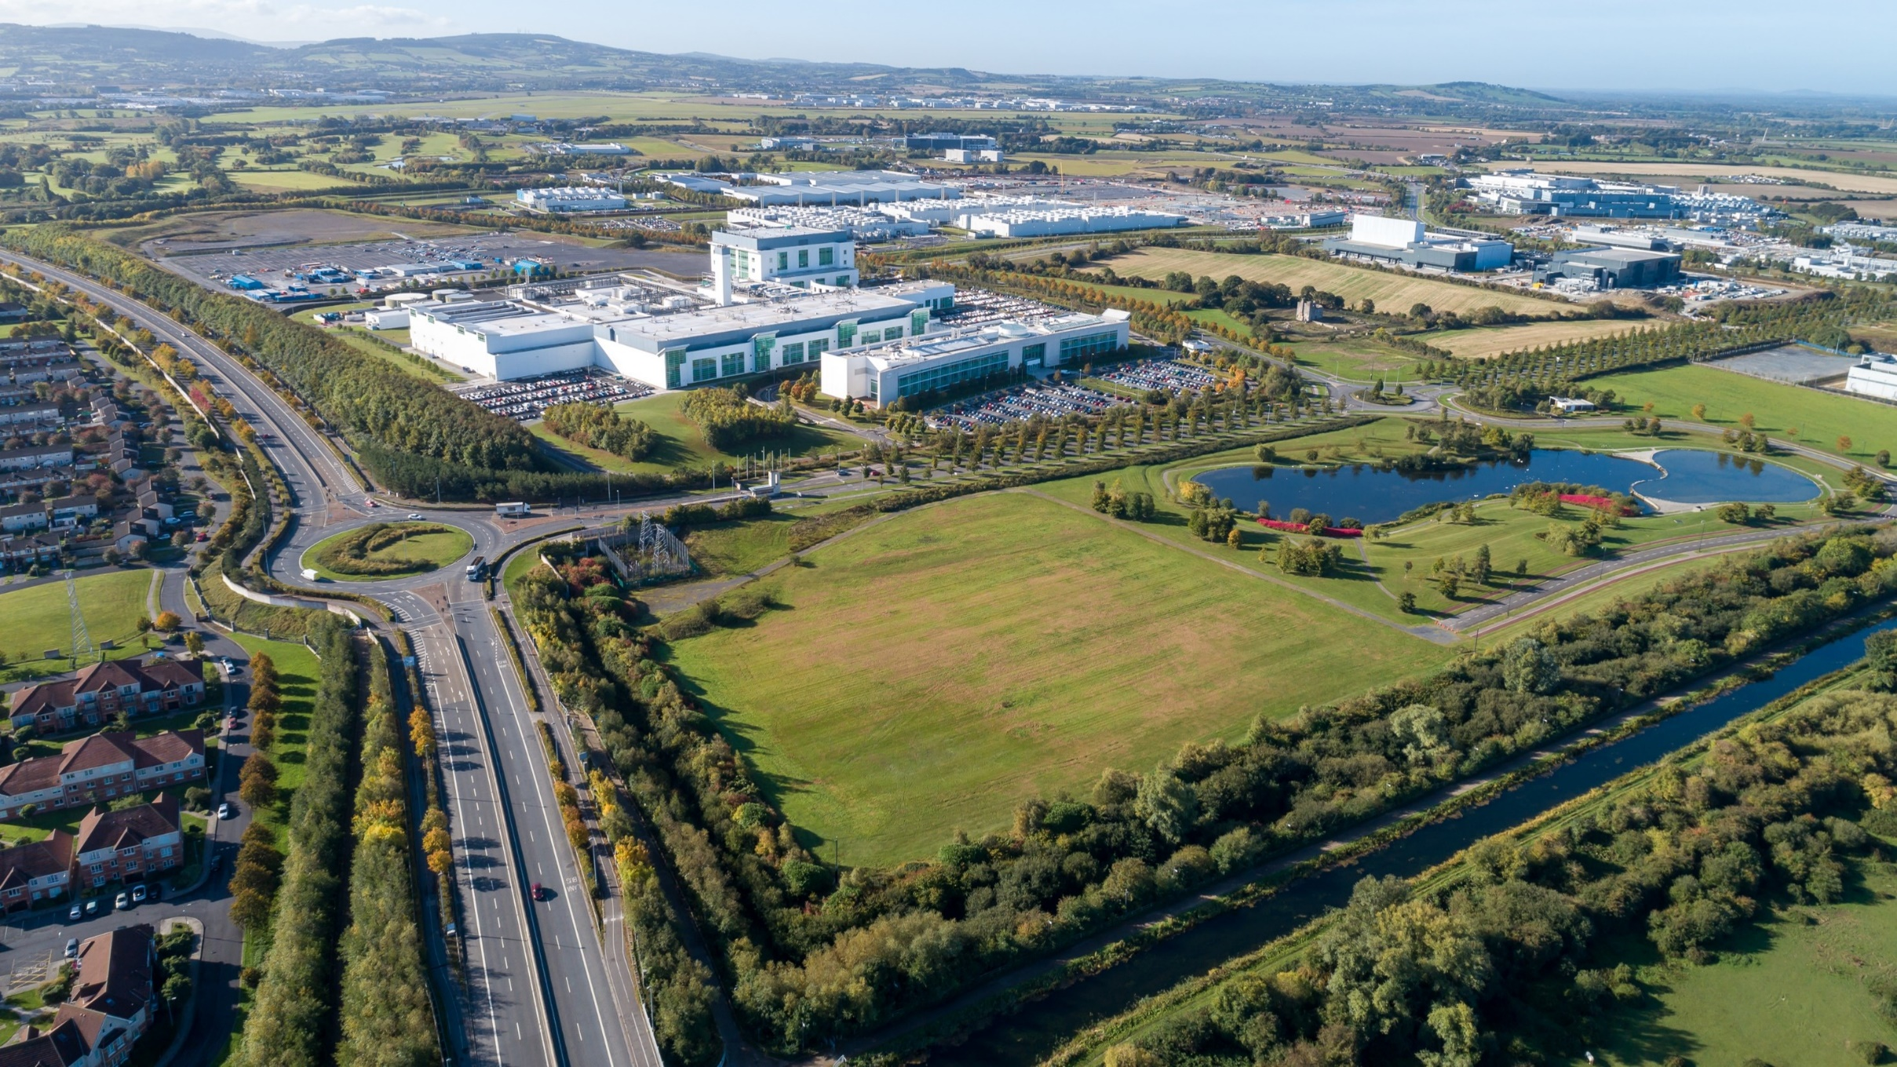
Grange Castle Business Park
Currently 6,500 jobs.
Lens Media potential 1,500 jobs.
New access road to additional 500 acres opened by Mayor.
Medium to long term jobs projection 20,000.
Looking at office potential in conjunction with Dart +.

Slide 10
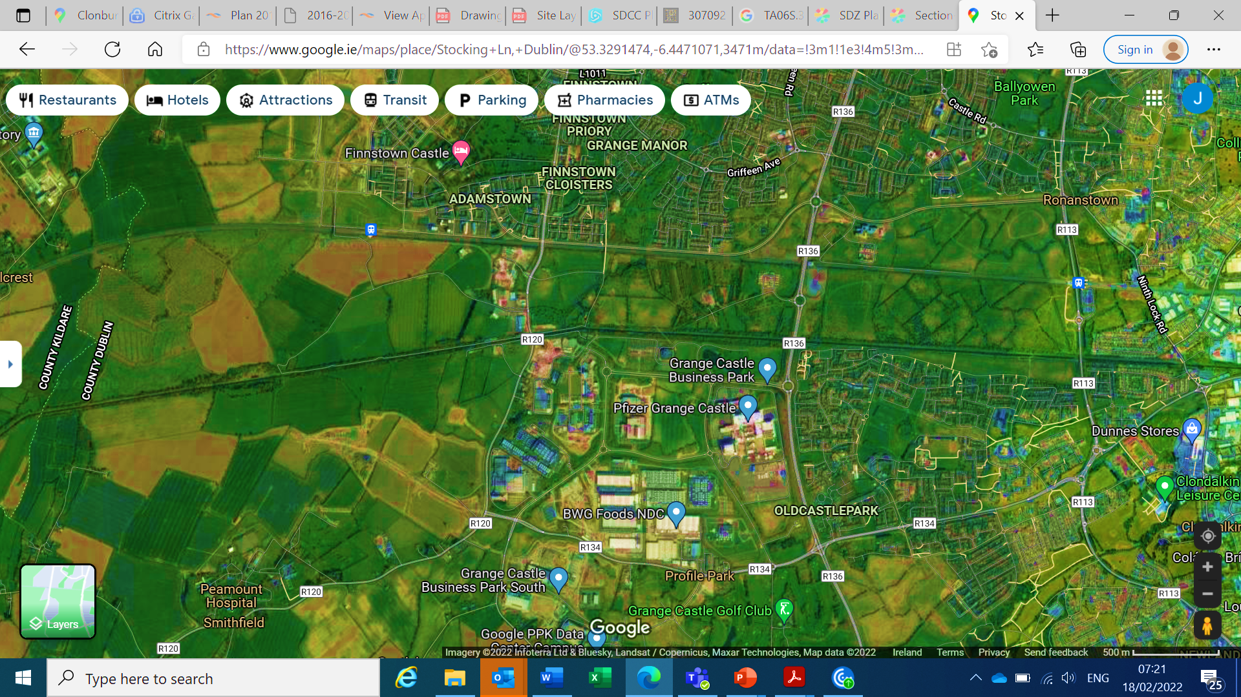
Adamstown SDZ
Kishogue Train Station
Adamstown Train Station
Clonburris Train Station
Clonburris SDZ
12th Lock Lands
Grand Canal
Grand Canal
Grange Castle
Office Opportunity
Grange Castle
Business Park
Grange Castle West

Slide 11
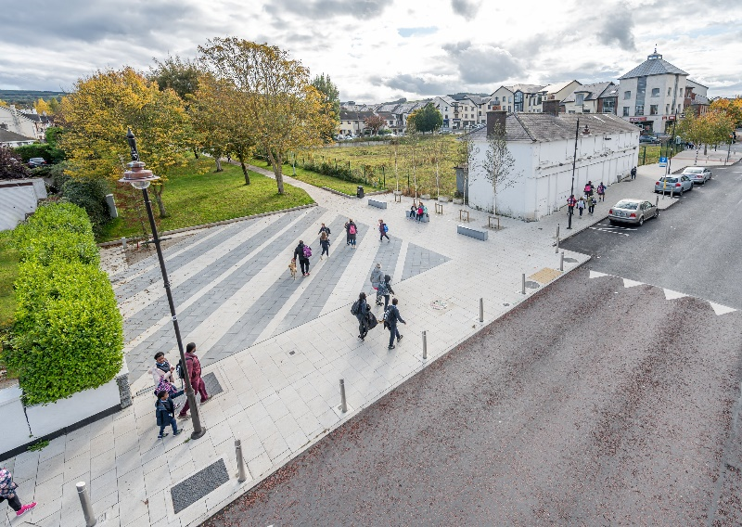
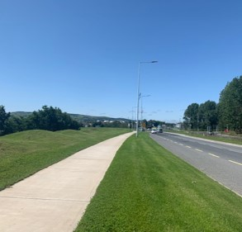
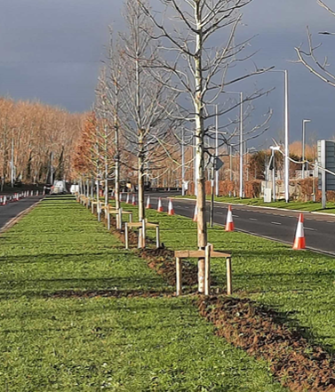
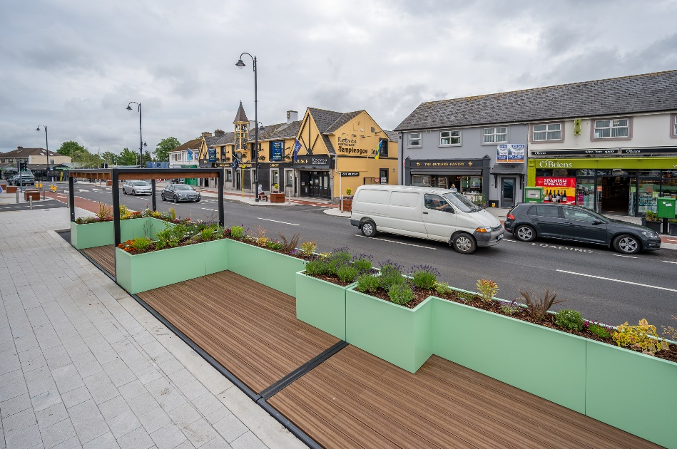
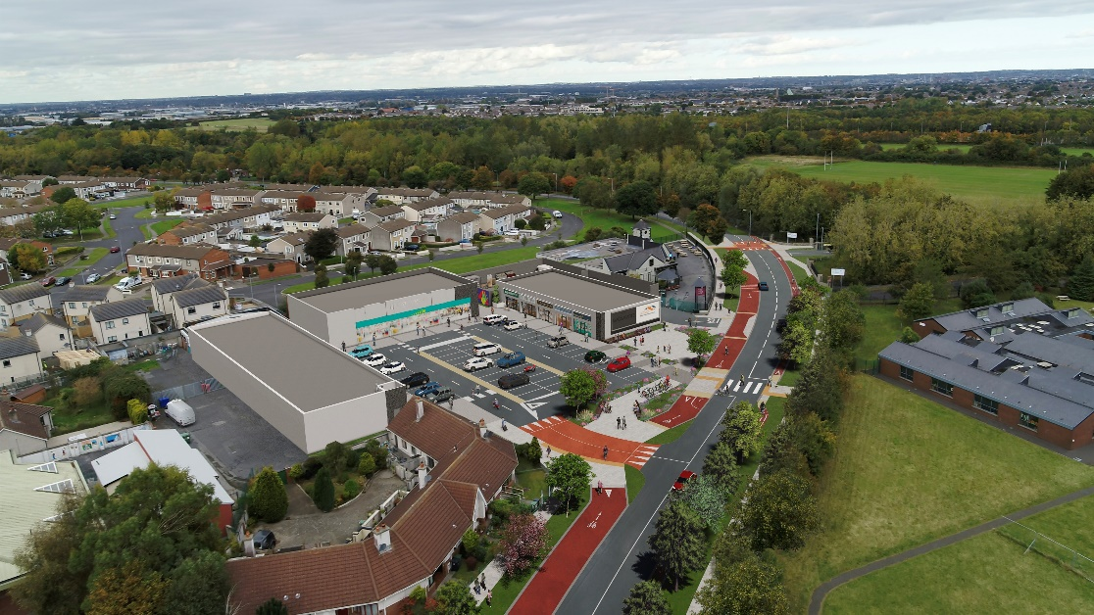
Village Enhancements and Aesthetics
Saggart and Templeogue complete.
Castletymon on site October 2022.
Rosemount District Enhancement Scheme about to commence design.
Clondalkin Village enhancements to be agreed with LAP.
Lucan on site January 2023.
N81 – Phases 1&2 complete – Phase 3 being scoped.

Slide 12
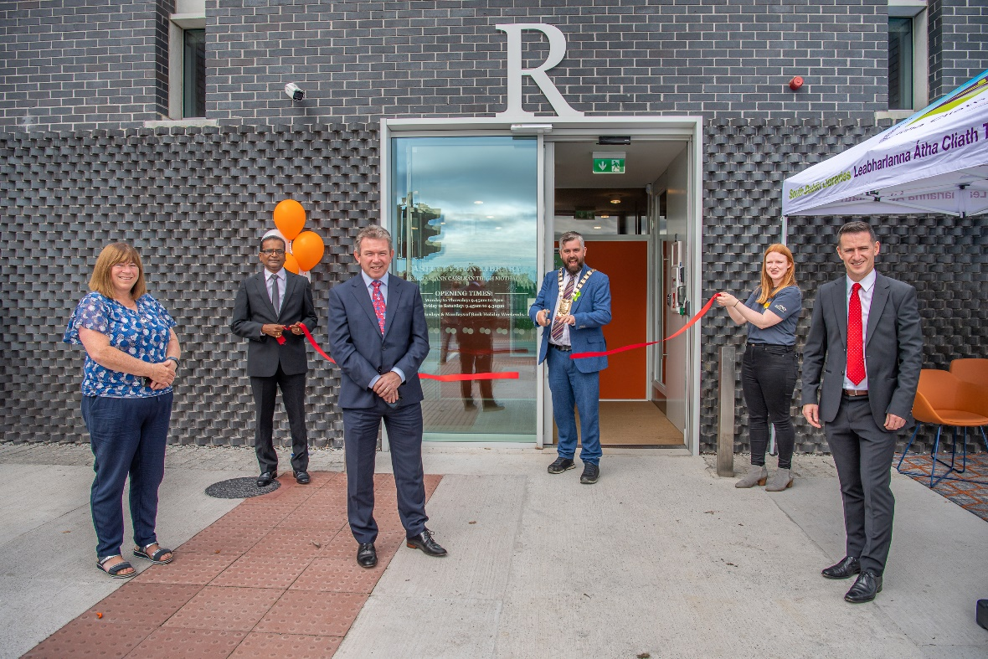
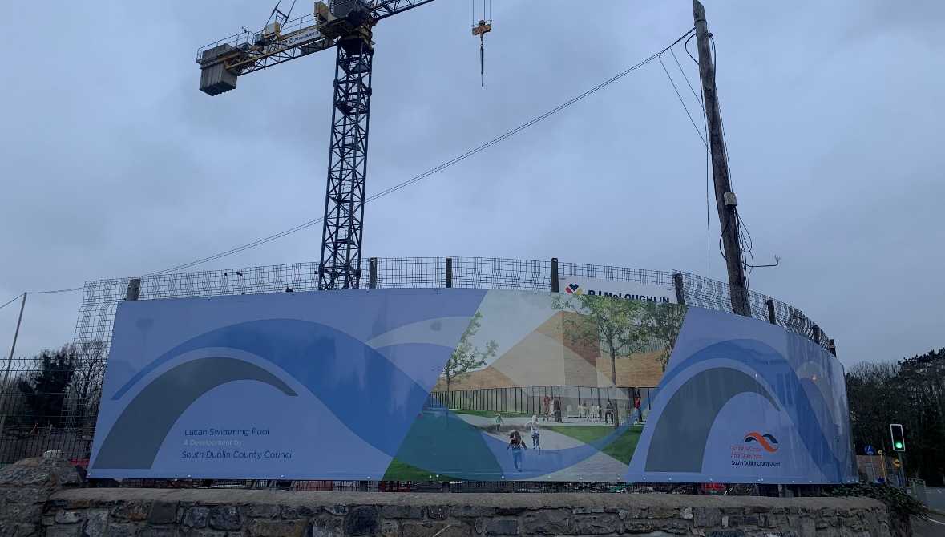
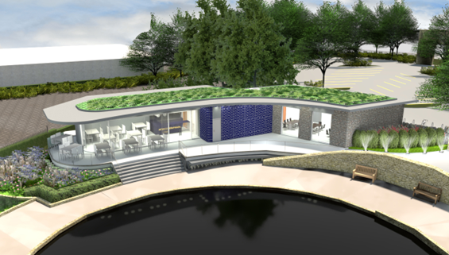
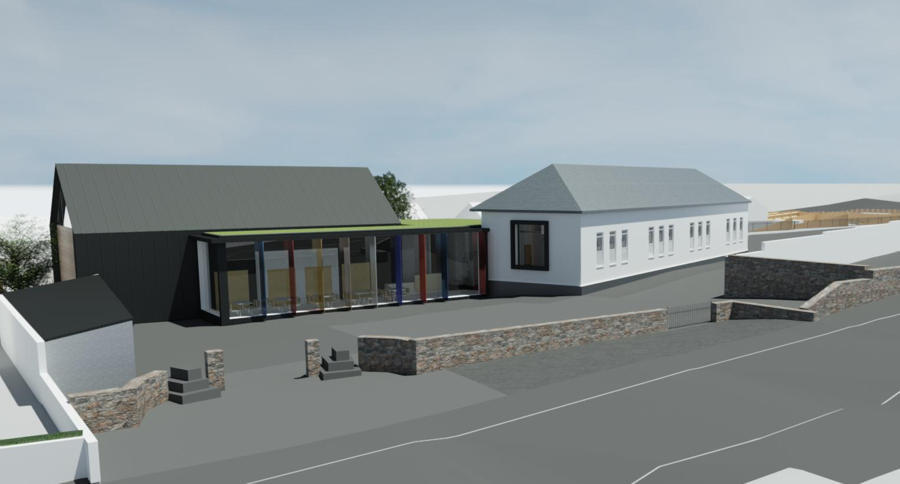
Community facilities
Lucan Pool and Leisure – December 22.
Templeogue Intergenerational Facility – onsite by October 2022.
Saggart Community Centre – onsite.
Adamstown Library – agree proposal with members by year end.
Citywest Community Centre – site agreed in principle.
Newcastle Community Centre – Part 8 October 22.
Citywest Library – EOI sought for design build.
Clondalkin Active Aged – Open 2022.
Balgaddy, Killinarden, Kilcarbery, Ballycullen – all advanced in planning.
Rathcoole Courthouse – onsite.

Slide 13
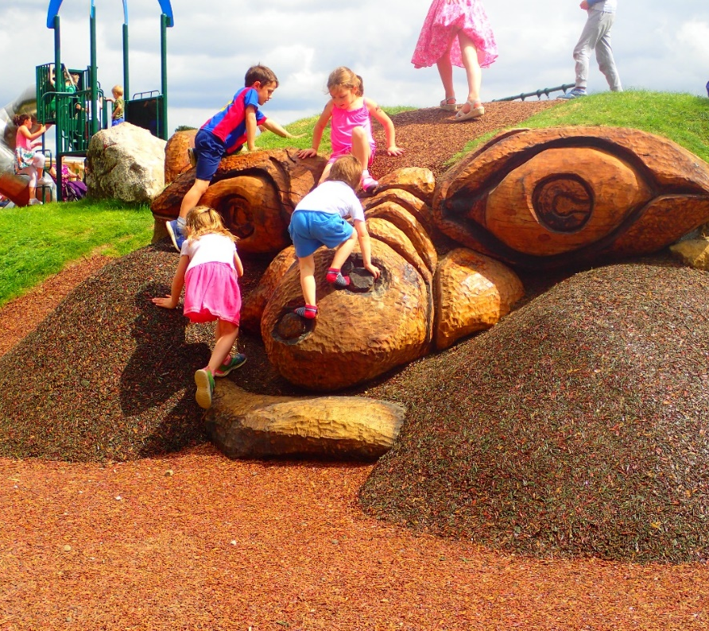
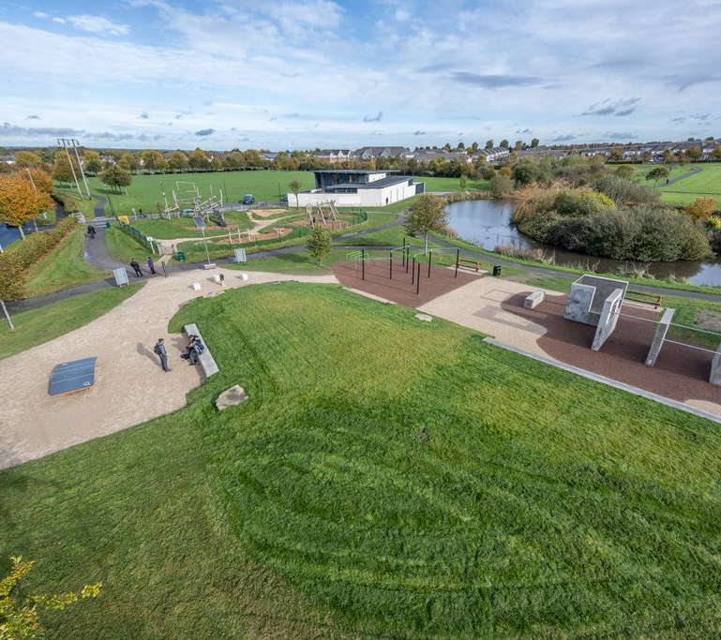
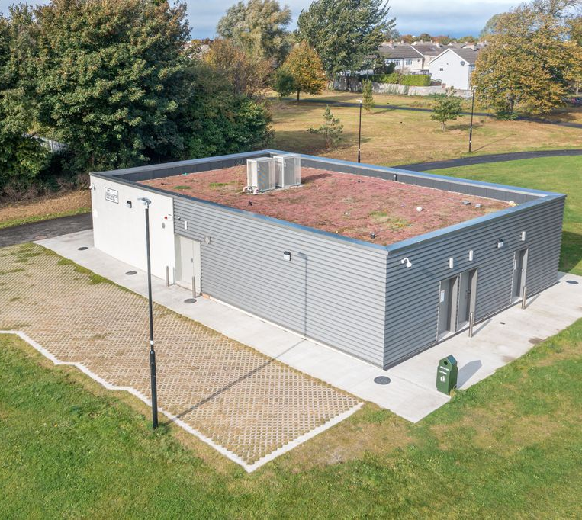
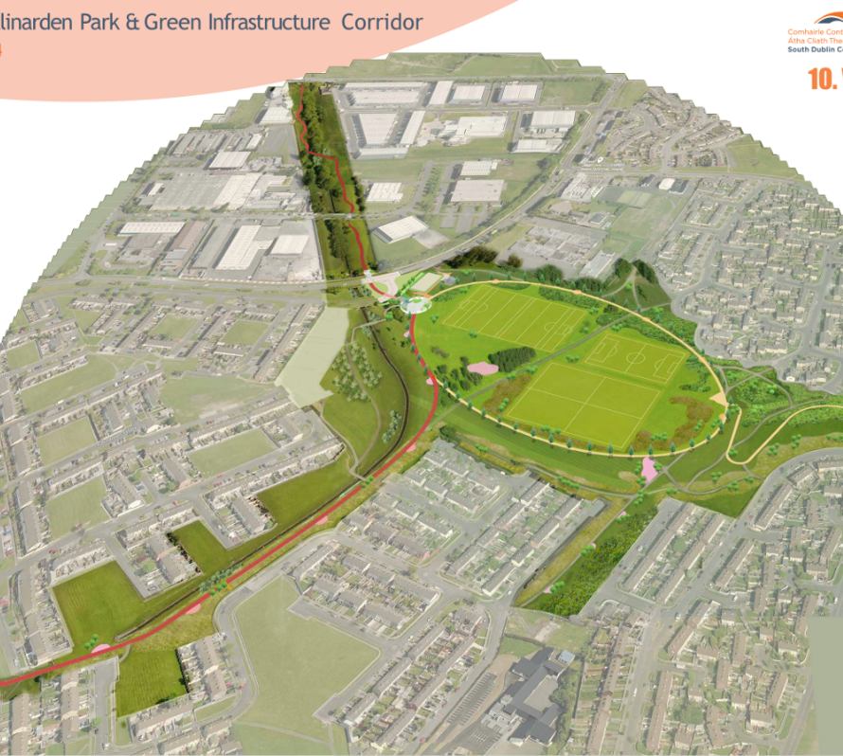
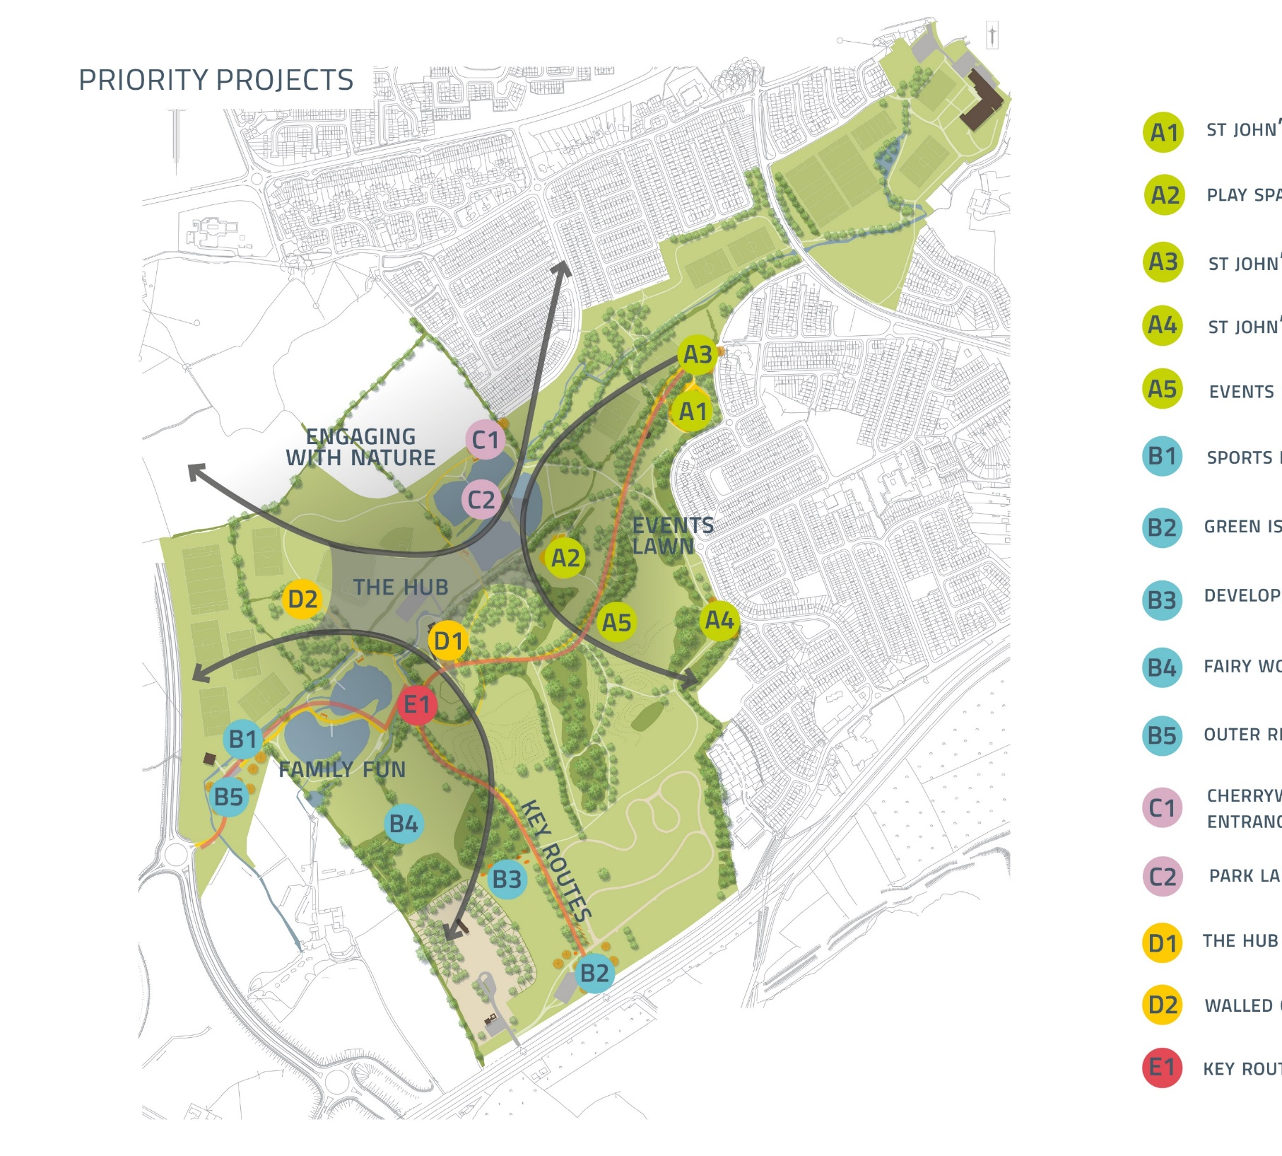
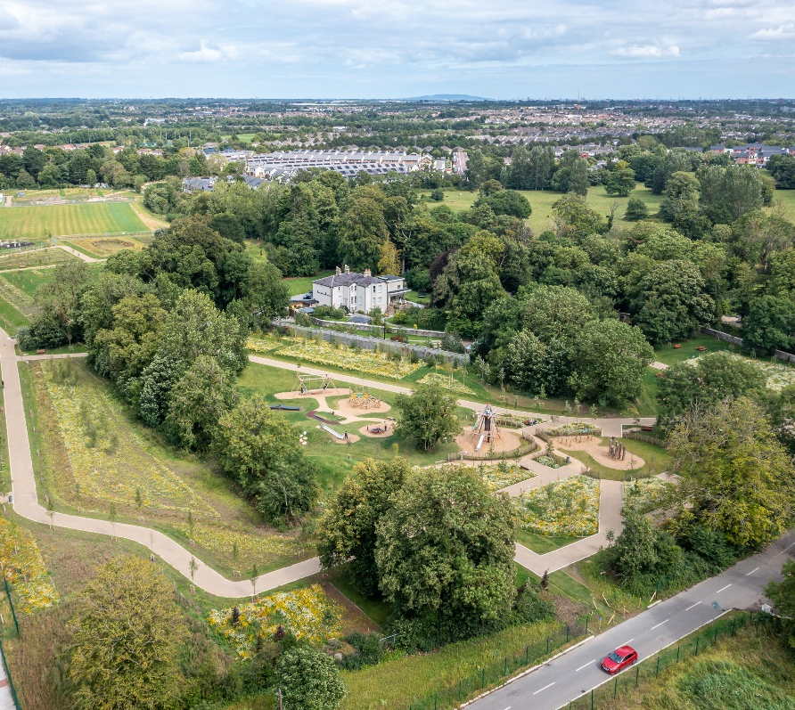
Parks, Pitches, Playgrounds & Pavilions.
Playspace Programme largely complete for now.
Teenspaces – next up Griffeen Valley and Bancroft.
Pavillions – Griffeen and Corkagh to tender July 2022 – onsite September 22.
Airlie Park – opening late Summer.
Killinarden Park – on site July 22.
St. Cuthberts Park – design consultants appointed.
Quarryvale and Jobstown – tender for consultants over the summer period.
Corkagh Park Hub etc. – construction tender August 22.
Mount Carmel Phase 3 – onsite September 22.
Sean Walsh Astro – onsite August 22. East of M50 under assessment.
Whitestown Stream amenity – onsite November 22.

Slide 14
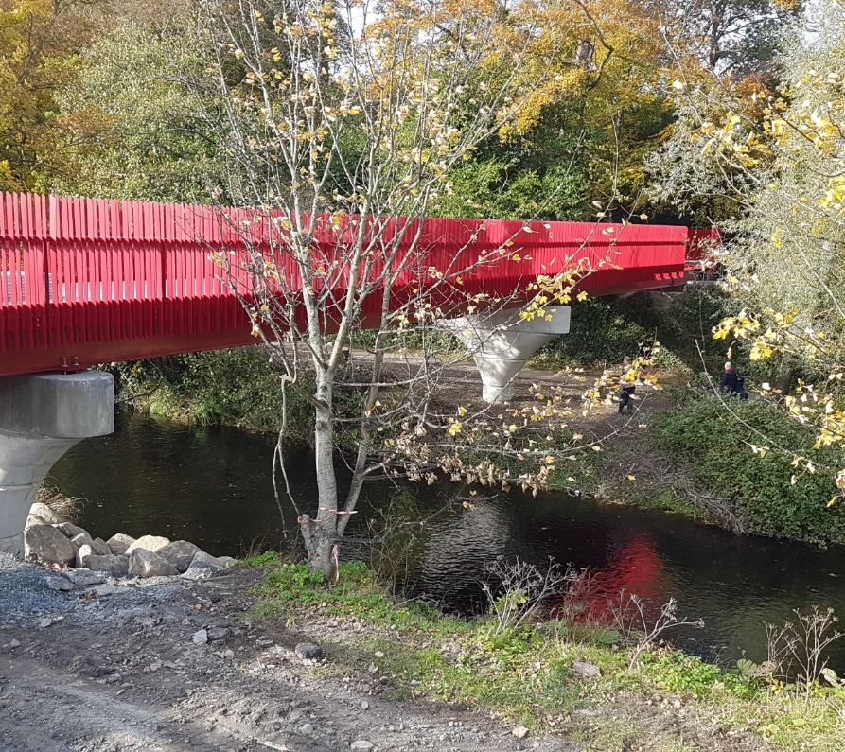
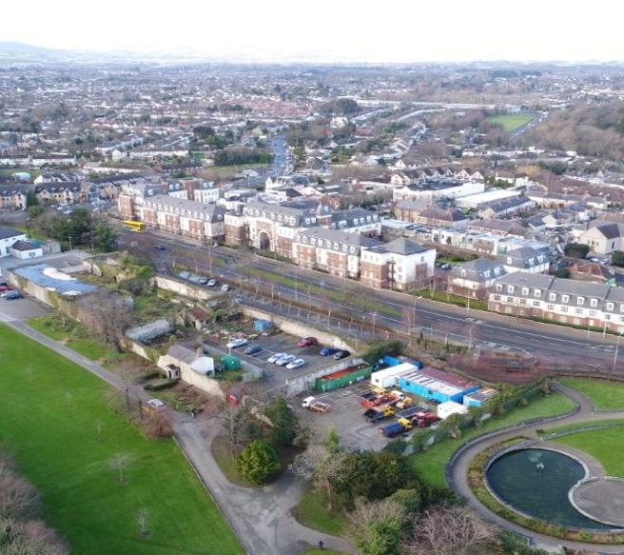
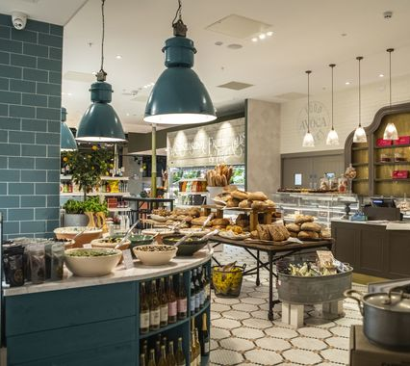
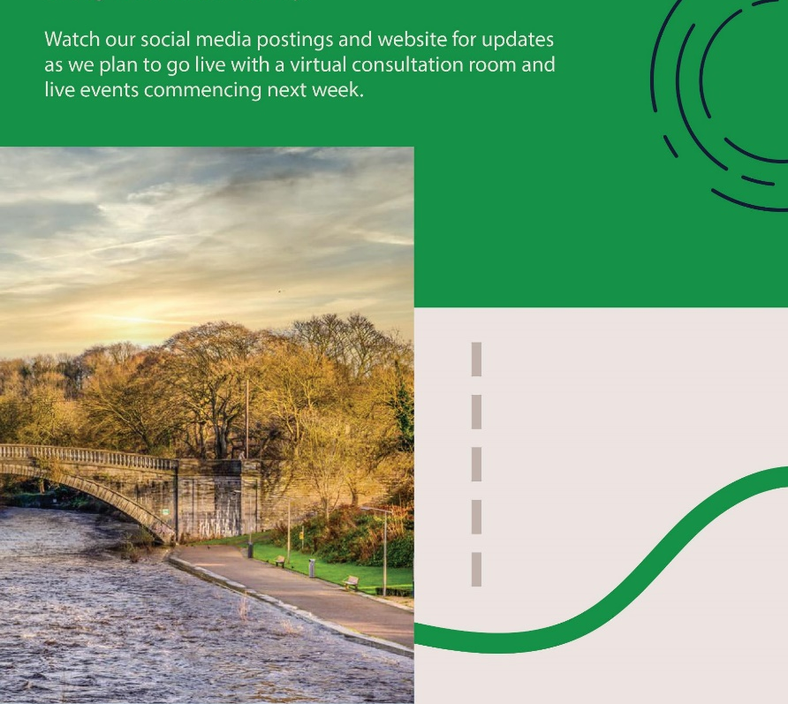
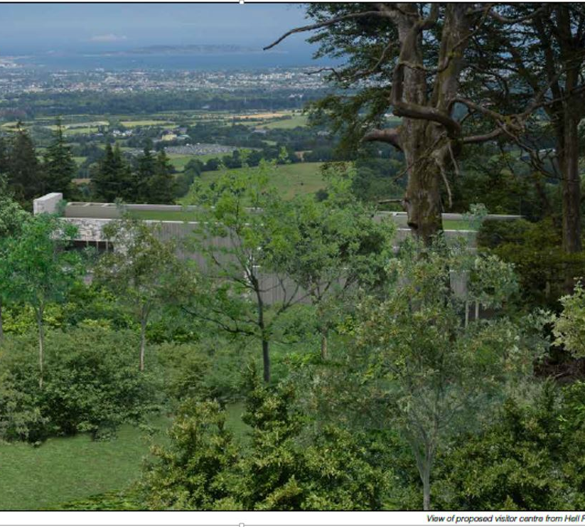
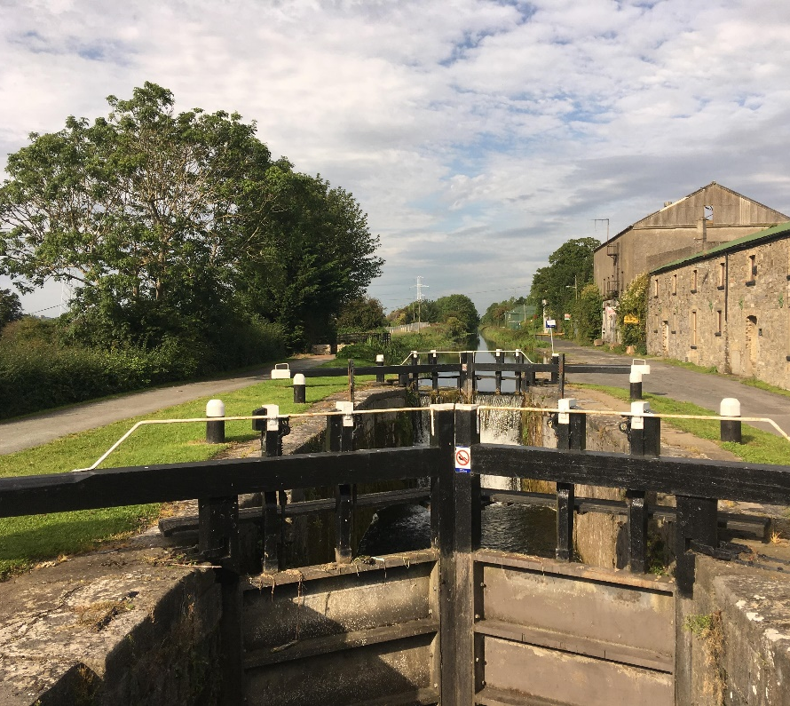
Tourism Promotion
Dublin Mountains – SC decision awaited.
Rathfarnham Castle – EOI document issued to market.
Dodder Greenway – Phase 4 onsite. Phase 5 (Blue Haven junction) on site Nov. 22.
Liffey Valley Greenway – Part 8 October 22.
Grand Canal Ext. – on site Q4 22.
12th Lock Study – underway.
Corkagh Park, Tallaght Stadium and Tallaght Heritage Centre – reported elsewhere.

Slide 15
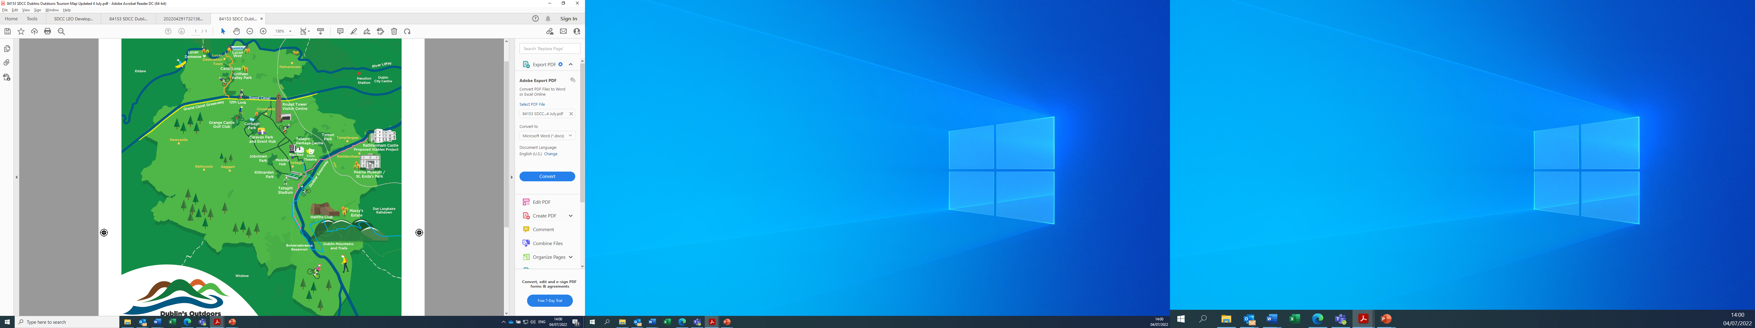

Slide 16
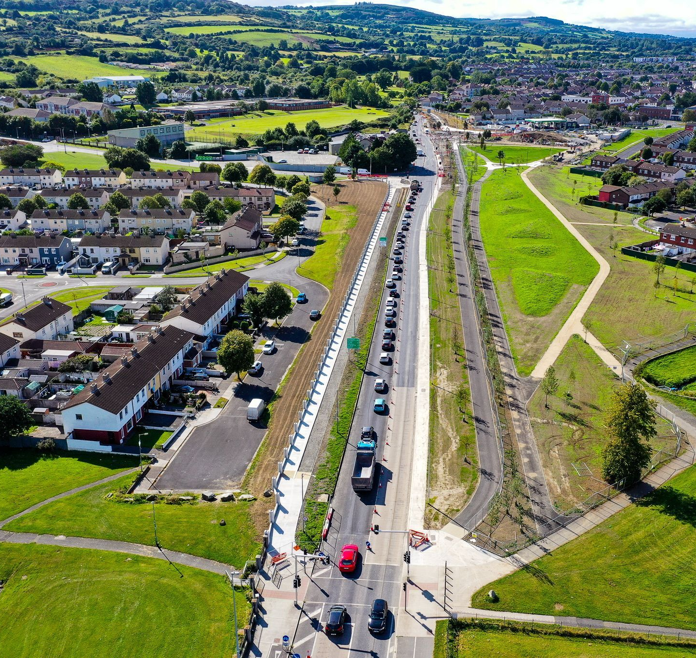
Cycle South Dublin
10-year Strategy.
63 routes - 263 km - €280m.
Includes Dodder and Canal Loop Greenways and final leg of Grand Canal Greenway.
Avonbeg, Grange Road & Jobstown recently completed.
Knocklyon Road & Old Bawn underway.
Templeville Road and Wellington Lane next up.

Slide 17
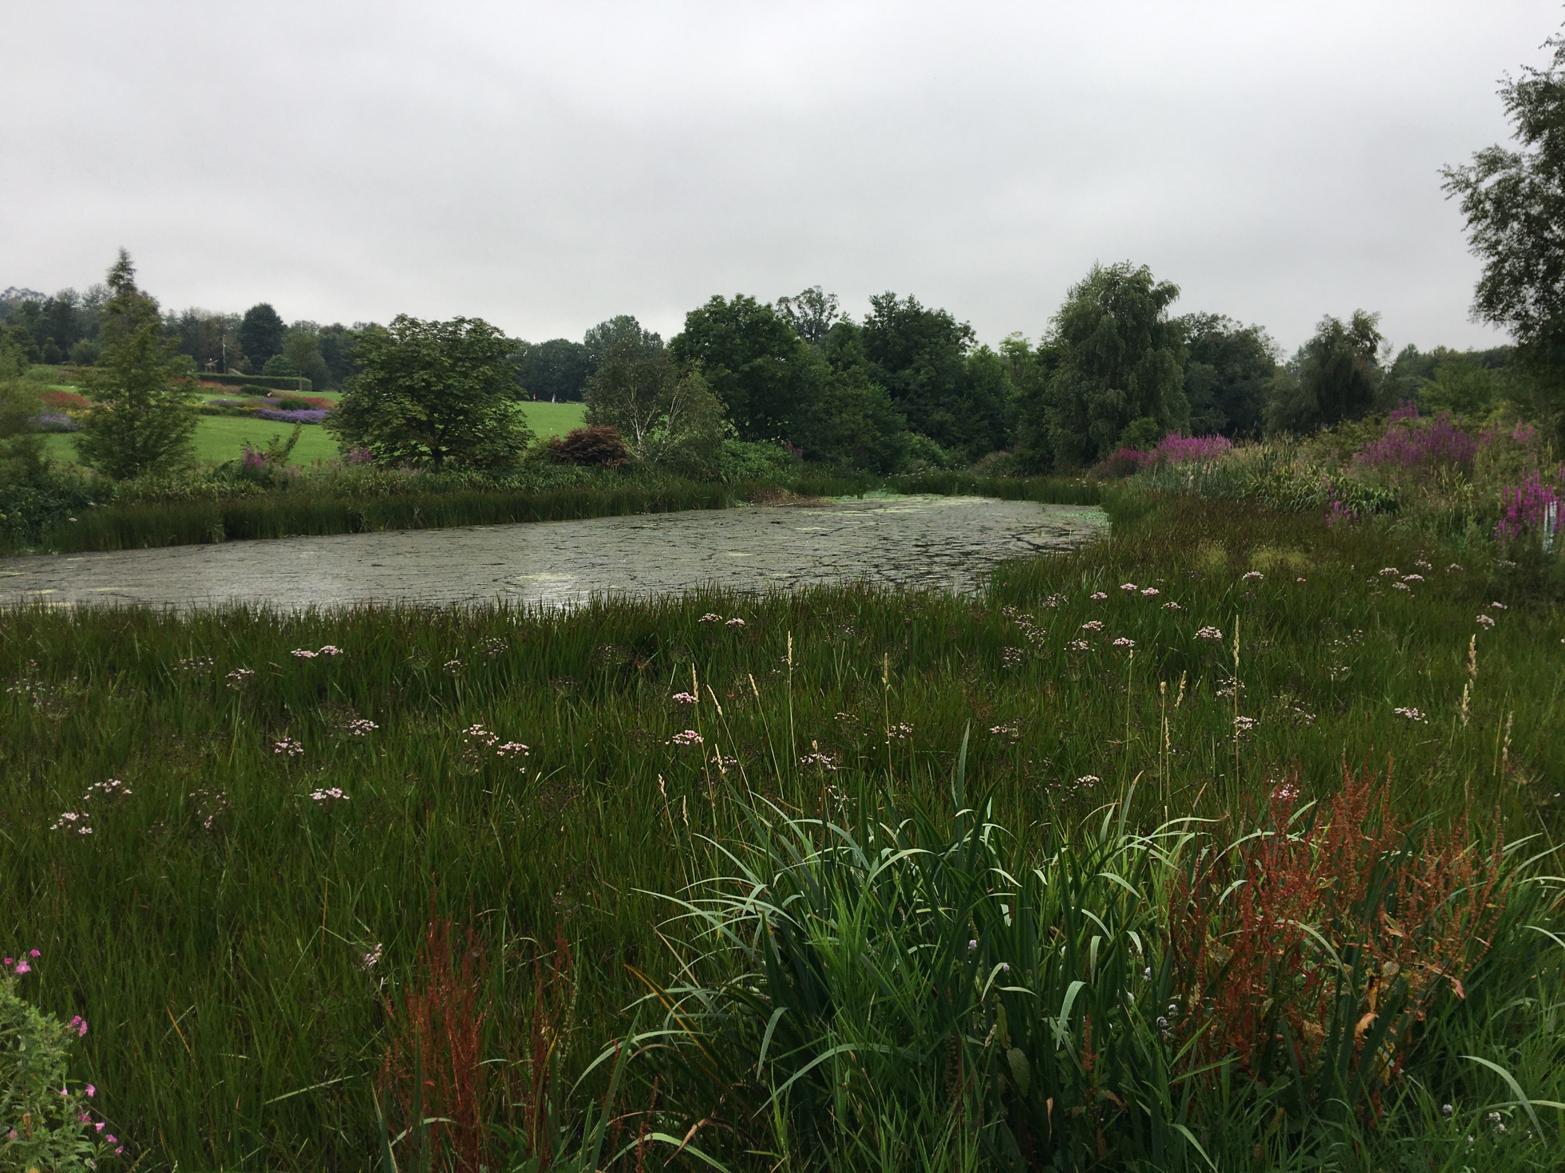
Flood Relief & Constructed Wetlands
Whitechurch FAS – court appeal decision expected late summer.
Camac FAS – design options review underway – informal public consultation held 28/29 June.
Poddle FAS – with ABP.
Griffeen Integrated Constructed Wetlands (ICW) onsite 4th July.
2 Dodder ICW projects to commence late August 22.
Kilnamanagh ICW Q1 2023

