Slide 1
Headed Item 9
Chief Executive’s Report on Part 8 Public Consultation for Proposed Development of 263 Social & Affordable Homes at Clonburris SDZ (Kishoge Development Area)
Meeting of South Dublin County Council
11th July 2022

Slide 2
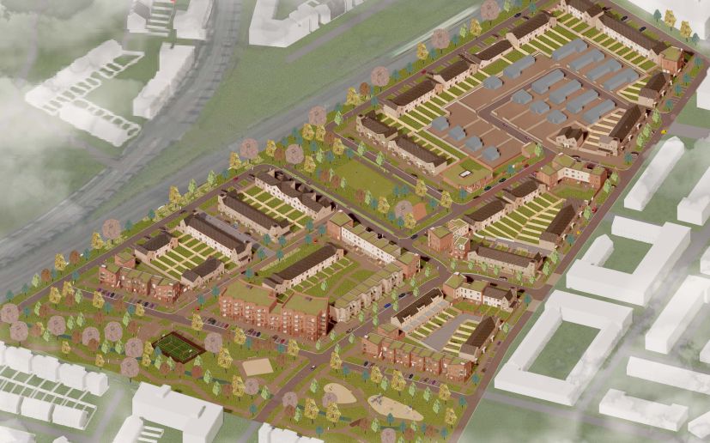
Background & Context
Prevailing social & affordable housing need + interim HNDA
Housing Delivery Action Plan 2022-2026 / Housing for All
Clonburris SDZ / development of site masterplan / existing residents
Aerial View of Proposed Development

Slide 3
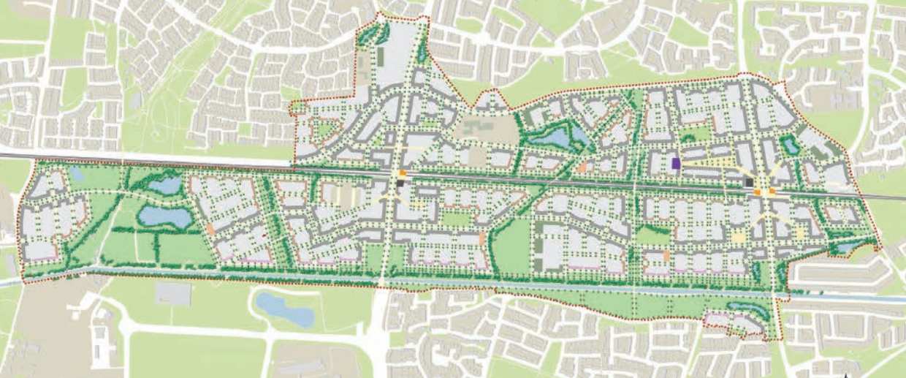
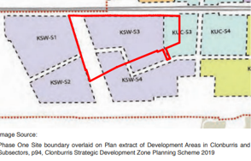
Clonburris SDZ
Kishoge Urban Centre
Kishoge South West
Proposed Development

Slide 4
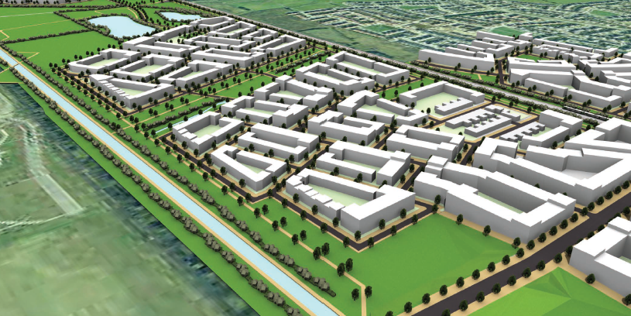
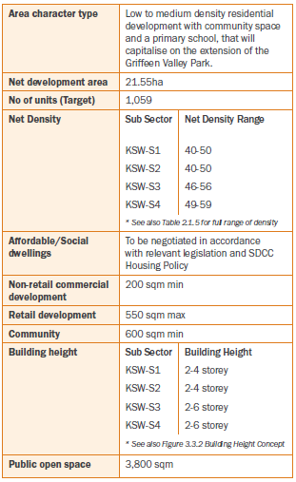
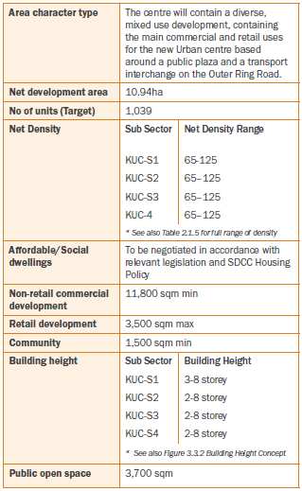
Clonburris SDZ

Slide 5
Proposed Development
AA (Habitats Directive) & EIA Screening undertaken
263 new homes originally proposed comprising:
2 single-storey, specially adapted houses
65 one-bed & 53 two-bed apartments
106 two-storey three-bed terraced/semi-detached houses
16 three-bed duplexes
15 three-storey four-bed houses & 6 two-storey four bed houses
281 m² community building & 46 m² homework room
253 no. car parking spaces, 169 cycle parking spaces, high quality amenity spaces incl. linear park, community green, landscaping
Revised junction at entrance from Lynch’s Lane, SUDs measures, ESB substations & all associated ancillary works

Slide 6
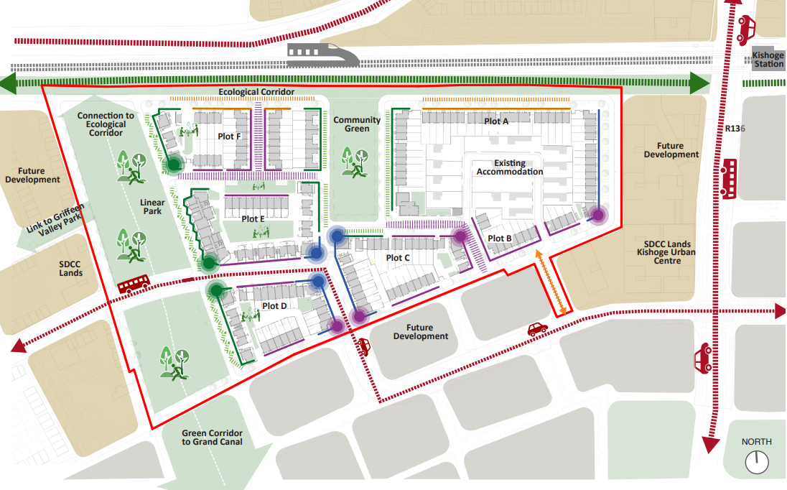
Proposed Site Strategy

Slide 7
Public Consultation
Extensive engagement with residents of Kishogue TA site & their representatives since 2020
ACM & LTACC briefings in April 2022
6-week public consultation 27th April-10th June 2022
9 submissions received relating to:
Density, height, location and design
Amenities, facilities, public realm and drainage
Traffic & transportation
Submissions from statutory bodies
Existing residents & their accommodation needs
Non-planning matters

Slide 8
Response to Submissions (1)
Location, Tenure, Design, Density & Height
High-quality neighborhood designed in accordance with current regs & best practice; must comply with SDZ requirements (location, density, height)
Medium density development SDZ targets: KSW-S3 (46 dph) / KSW-S4 (51 dph)
Shortfall in KUC-S3 density to be achieved in future urban core development
Building height – replace single-storey bungalows with two-storey homes
Access to Amenities and Facilities
Phased SDZ requirements for amenities etc.
Linear park and community facilities to be delivered with this development
Traffic and Transportation
Traffic & transport assessment & proposed future transport links in parallel with SDZ development
Statutory Body Submissions
All requirements & best practice will be complied with (CEMP, Archaeological assessment etc.) except requested reinstatement of hedgerow on Lynch’s Lane

Slide 9
Response to Submissions (2)
Existing Residents’ Accommodation Needs & Amenities
Combined submission on behalf of 12 households
Consultation/engagement & approval for any redevelopment
Phased development / relocation/redesign of existing accommodation first
Address existing residents’ accommodation needs
Retain existing community room (homework club) & provide play area
Privacy concerns – no three-storey development adjacent to Kishogue Park
----------------------------------------------------------------------------------------------------------
Extensive engagement with residents and representatives to date
Loss of three existing units of accommodation / offers & allocation of alternative accommodation have commenced
Relocation of existing TA accommodation does not align with SDZ & modifications to existing TA outside scope of this Part 8
Two-storey homes only adjacent to existing accommodation
Integrated community facility incorporating homework room
Continued priority engagement on future accommodation needs & preferences
Scope for play/communal areas for remaining residents

Slide 10
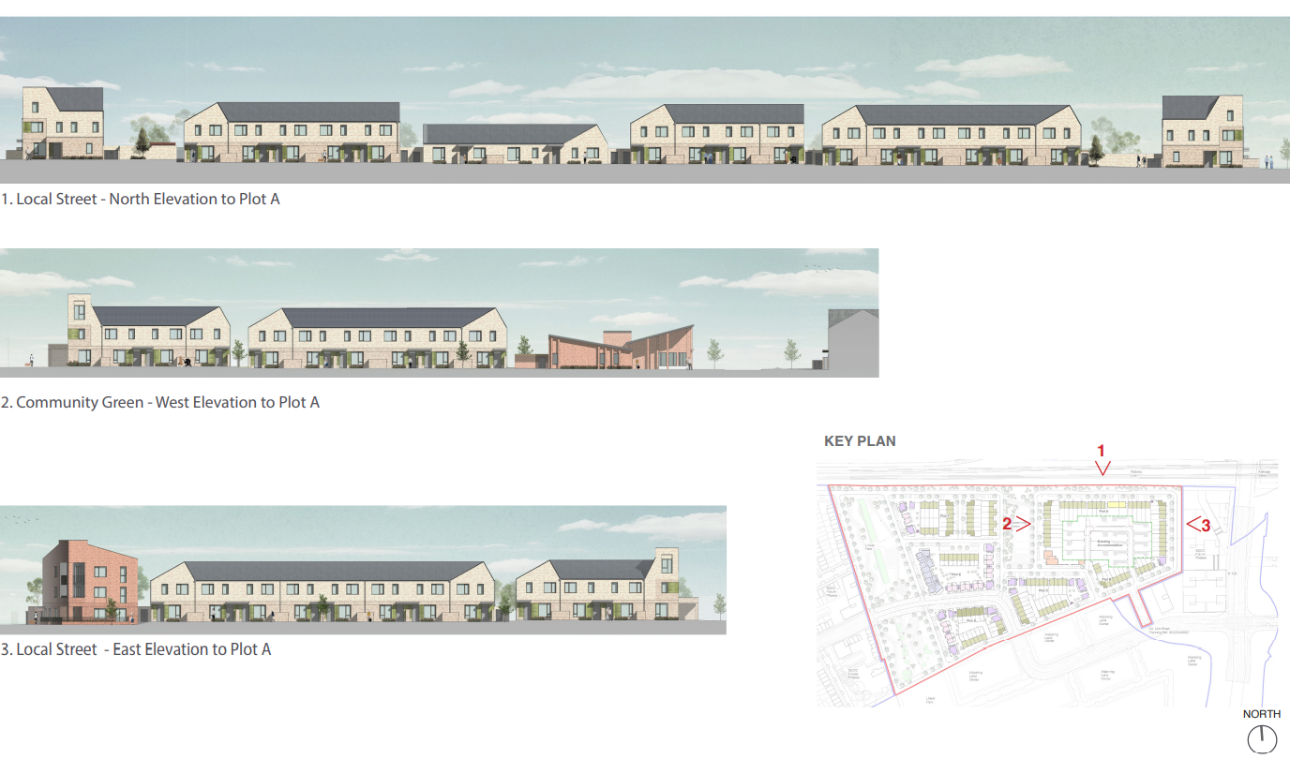
Proposed Development
2 single storey bungalows to be replaced
Community facilities integrating existing & new development

Slide 11
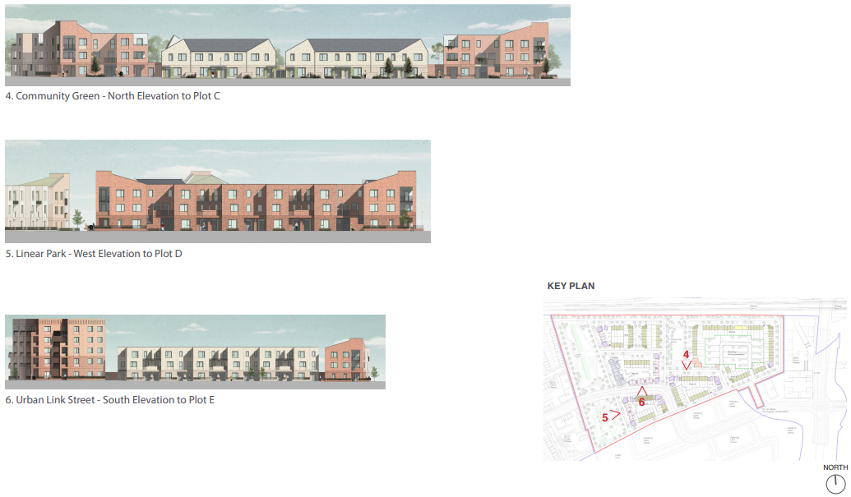
Proposed Development
Accommodation frontage to linear park
Potential cost rental development

Slide 12
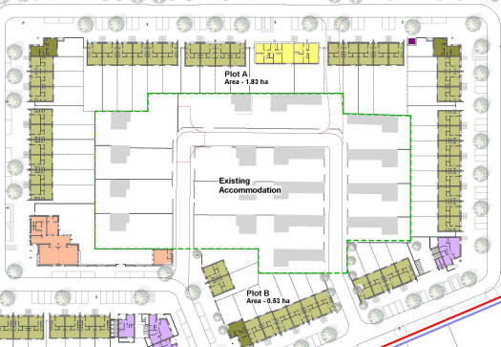
Key Points
Removal of two single storey bungalows in Plot A to be replaced by 5 two-storey three-bed terraced houses
Net gain of 3 additional homes in proposal
Total of 266 homes
Tenure mix: 93 social, 90 affordable purchase & 83 cost rental
Increased density to be achieved in remainder of KUC sector
Continued priority engagement with existing residents

Slide 13
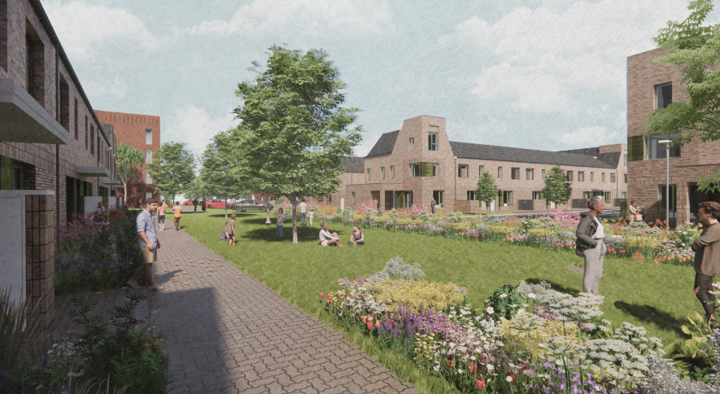
Recommendation
Overall proposal in accordance with proper planning & sustainable development of area & with Clonburris SDZ
Recommendation to Council to approve amended proposed development of 266 homes as outlined
Next Steps if Part 8 Approved:
Continued engagement with residents of Kishogue TA
Develop detailed integrated tenure design
Tender for contractor for projected construction start early in 2023 for delivery of first units by 2024
Funding applications to DHLGH under Affordable Housing Fund & Social Housing Investment Programme

Slide 14
Proposed Development of 263 Social & Affordable Homes at Clonburris SDZ (Kishoge Development Area)
CGI Image of Community Green & Adjacent Homes

