Slide 1
Wellington Lane Walking & Cycling Scheme
Progress & Timeline Update
11th July 2022 SDCC Council Meeting

Slide 2
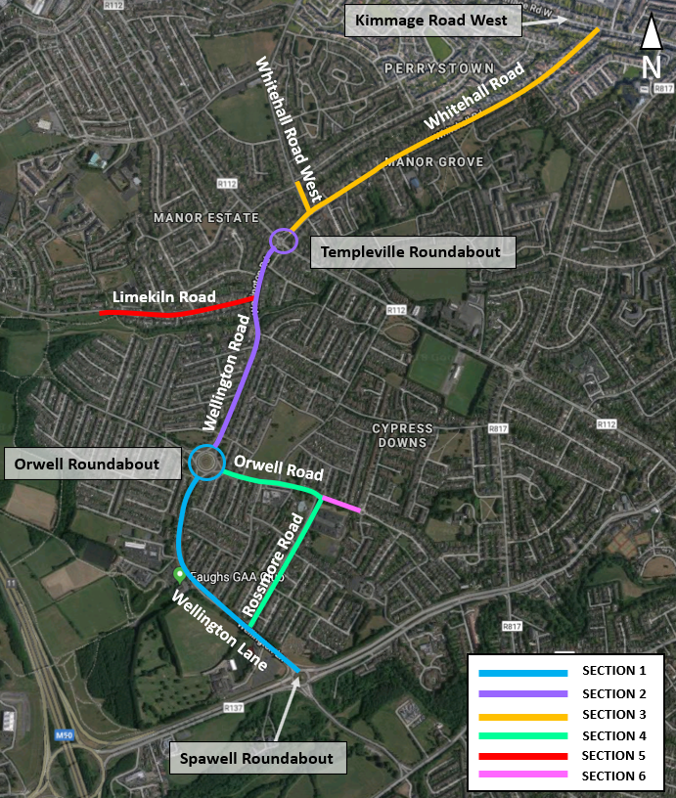
Context for Project
Provide improved cycle and pedestrian facilities along the scheme route to improve the overall safety for vulnerable road users;
Enhance connectivity for the surrounding residential developments to key trip attractors within the area such as the local parks, schools, playing pitches and local shops;
Improve modal shift for walking and cycling within the area for all users. Improving modal shift towards sustainable modes of travel will help to contribute towards Ireland’s Climate Action Plan for 2030 which aims to reduce overall greenhouse gas emissions by 51%.

Slide 3
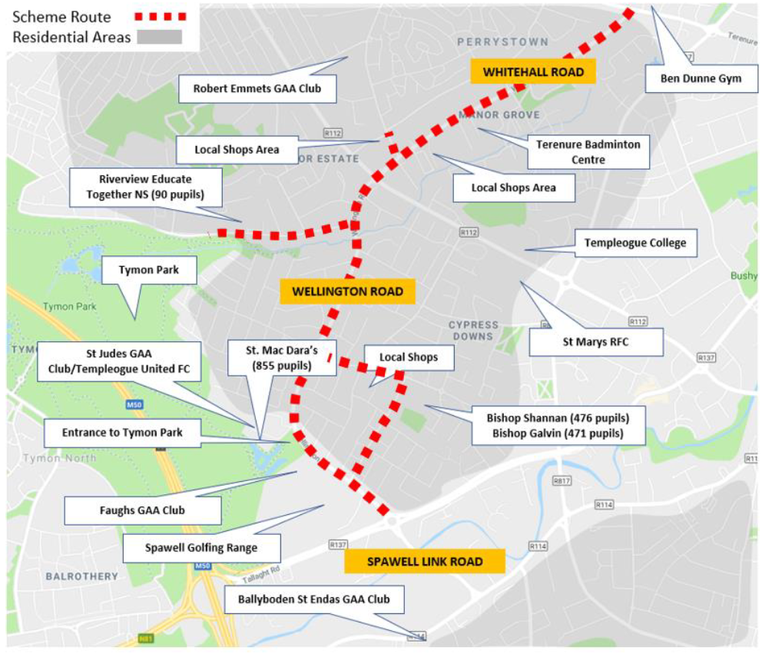
Key Points
Scheme length = 4.3km
Scheme provides for numerous active travel linkages
Upgrade of two large junctions (Orwell & Templeville)
Provision of School Zones
Proposals for landscaping & trees along the route

Slide 4
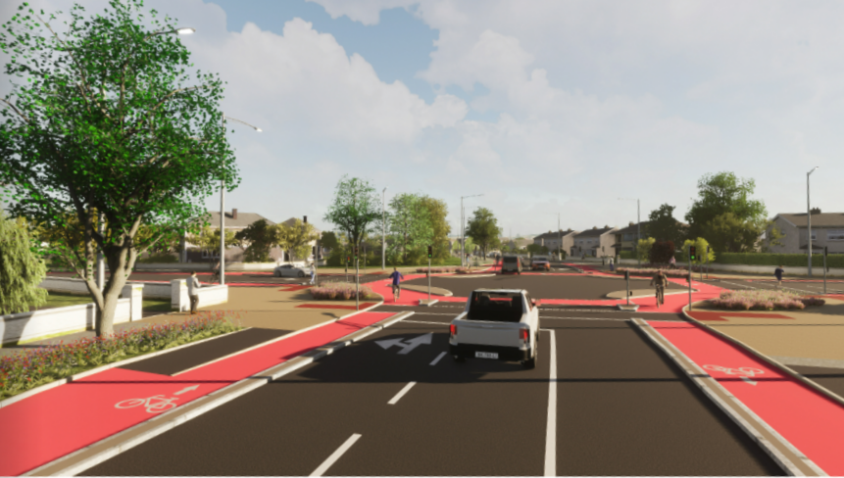
Next Steps
Finalise Preliminary Design (July 2022)
Launch Part 8 (End of July 2022)
Full Part 8 Report (Early September 2022)
Detailed Design (Q4 2022)
Begin Construction (Q2/Q3 2023)

