Slide 1
Canal Loop Urban Greenway
Progress & Timeline Update
SDCC Council
11th July 2022

Slide 2
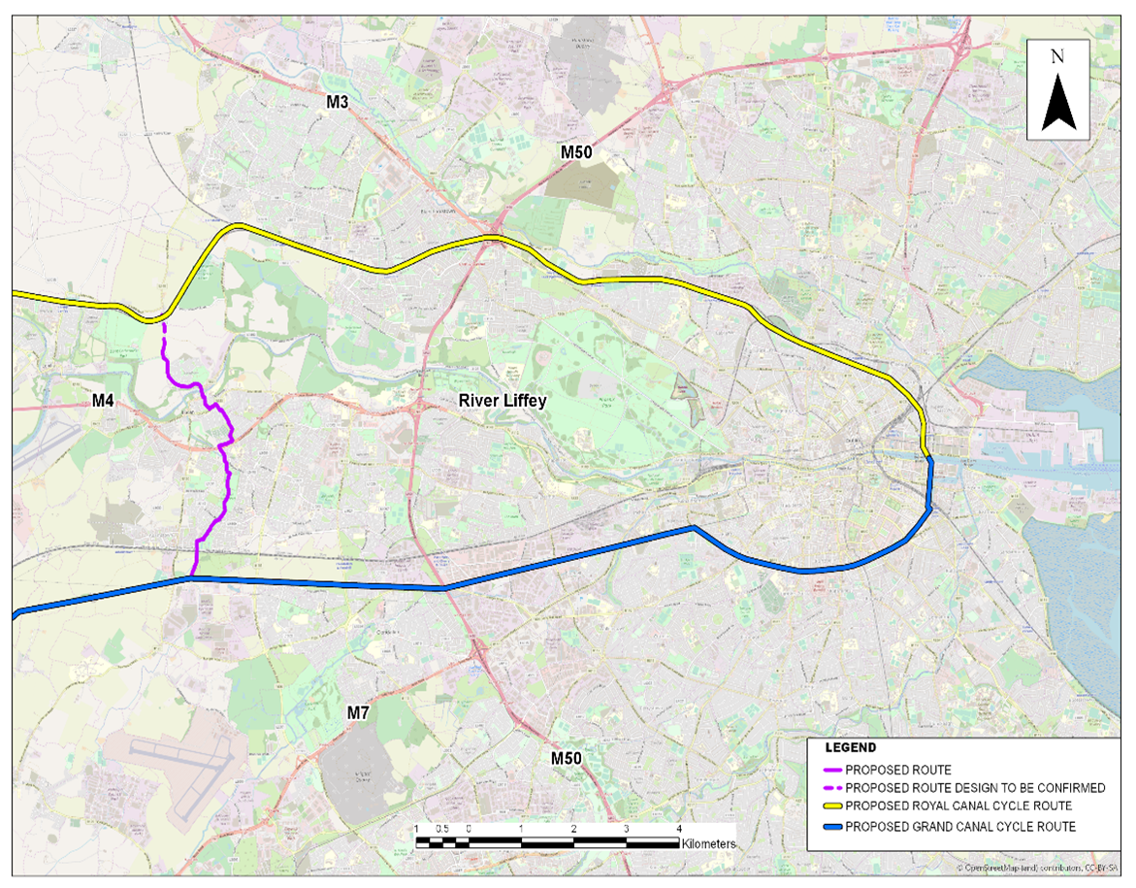
Context for Project
Canal Loop Urban Greenway (purple) will create a link between Royal (yellow) & Grand Canal Greenways (blue), forming a loop with canals (blue, purple, & yellow)
Create a network of high-quality cycling facilities,
Create Active Travel infrastructure to school and local amenities,
Promote Lucan as a village active travel destination for tourism and locals,
Promote village renewal, &
Promote cycling and walking.
Dublin Canal Greenway (Outer Loop 40 km)

Slide 3
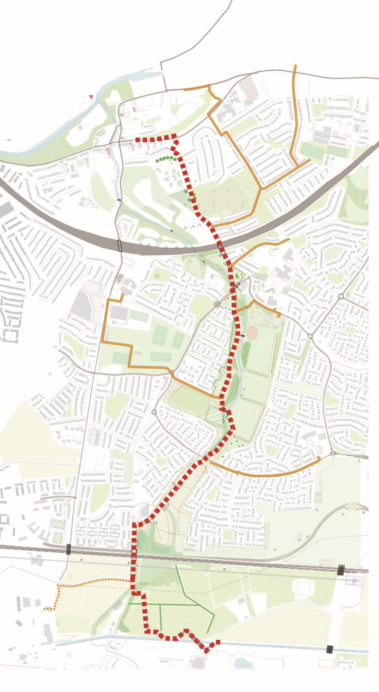
Project Update
Key Points
Proposed
4.5 km of walking and cycle facilities
3.6 km additional school & local connects
Biodiversity
100’s proposed trees

Slide 4
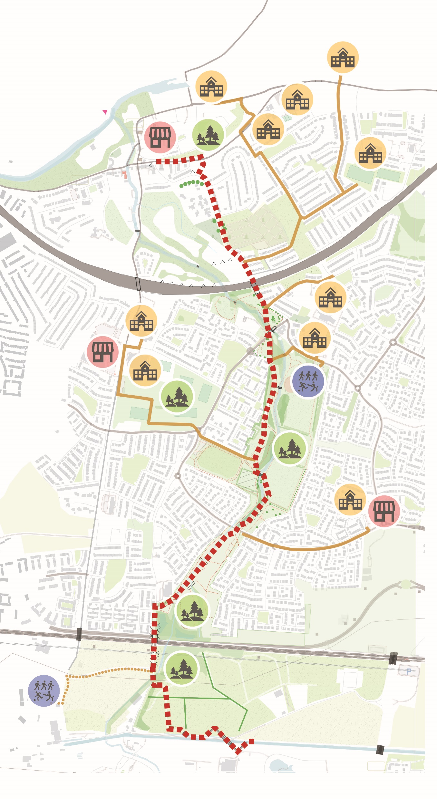
Project Update
Preferred Route
Local Connections
10+ School
2+ Village/District Centres
2 Community/Sport Centres
5+ Community Park

Slide 5
Next Steps
Complete Preliminary Design/Pre-planning
In consultation with the NTA
Part 8:
to launch late Summer 2022
Part 8 Report: Autumn 2022
Detailed Design: Q3/Q4 2022
Begin Construction: 2023

