Slide 1
Balgaddy Permeability Links Area committee Meeting 28th June 2022

Slide 2
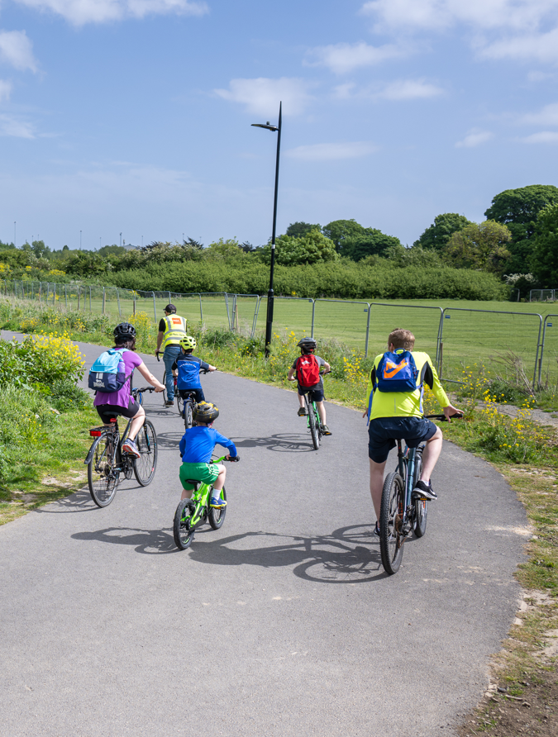
Balgaddy Permeability Links - Overview
Two permeability links from Tór an Rí & Méile an Rí to Thomas Omer Way
Evidence of existing desire lines – informal paths and passages through southern boundary
Links will provide safe and accessible active travel routes to schools & public transport by providing accessible shared-use pathways
Opportunity to link to Clonburris SDZ and onward to Grand Canal greenway and active travel network pending development south of Thomas Omer Way
Design allows for provision of kissing gates if required
Links to be incorporated into existing landscaping and will not present additional maintenance requirements
Public lighting included in the scheme

Slide 3
Balgaddy Permeability Links – Design Status
Designs developed for both links catering for known desire lines and providing accessible routes:
At western end, a direct stepped access to Tór an Rí Walk is provided in addition to a wheelchair accessible ramp to Tór an Rí Lane; at eastern end, single accessible route provided
Both links pass beneath 220kV ESB route. Design developed in consultation with ESB and liaison ongoing
Following finalisation of design and ESB review of works in vicinity of ESB infrastructure, construction tender documents to be prepared and issued
Construction expected to commence in 2022

Slide 4
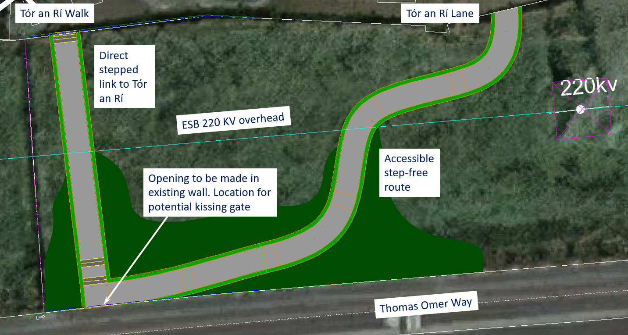
Balgaddy Permeability Links – Tór an Rí Link

Slide 5
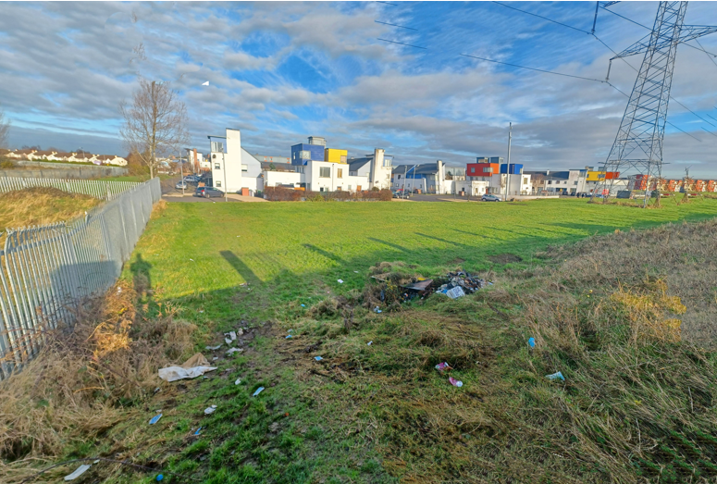
Balgaddy Permeability Links – Tór an Rí Link
Existing

Slide 6
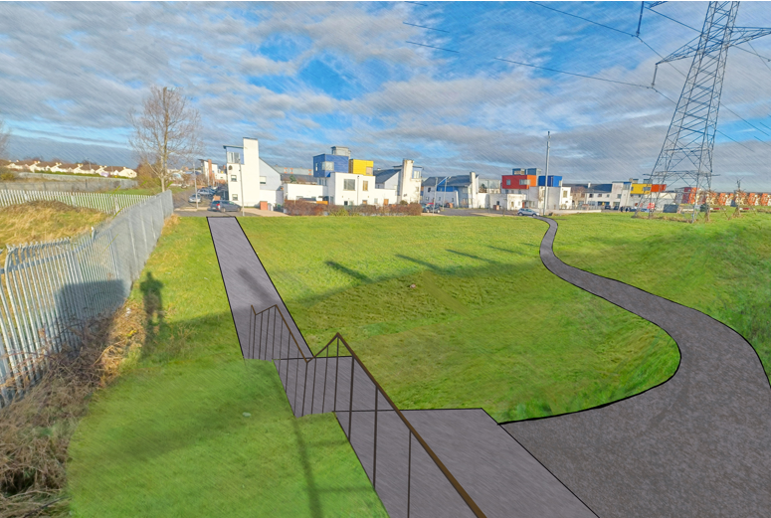
Balgaddy Permeability Links – Tór an Rí Link
Proposed

Slide 7
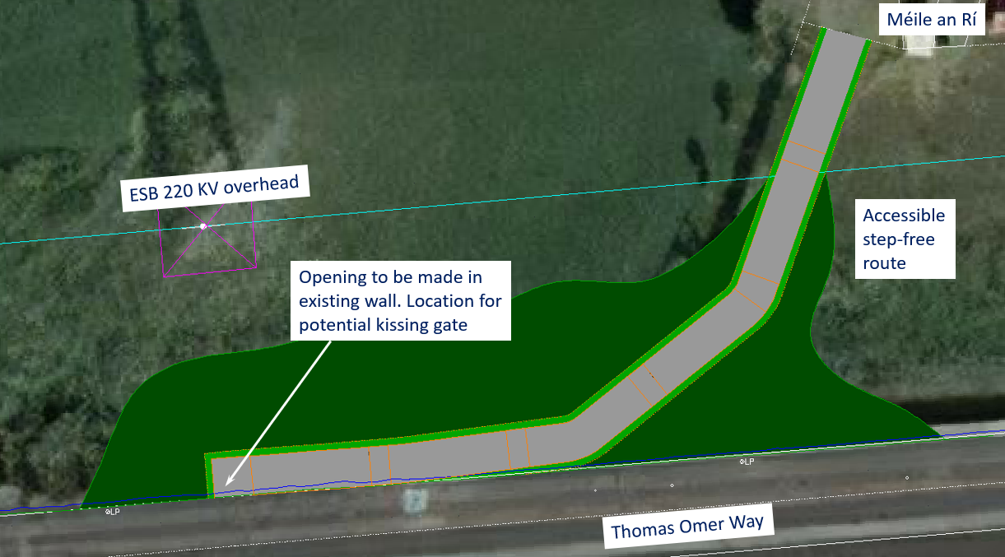
Balgaddy Permeability Links – Méile an Rí Link

Slide 8
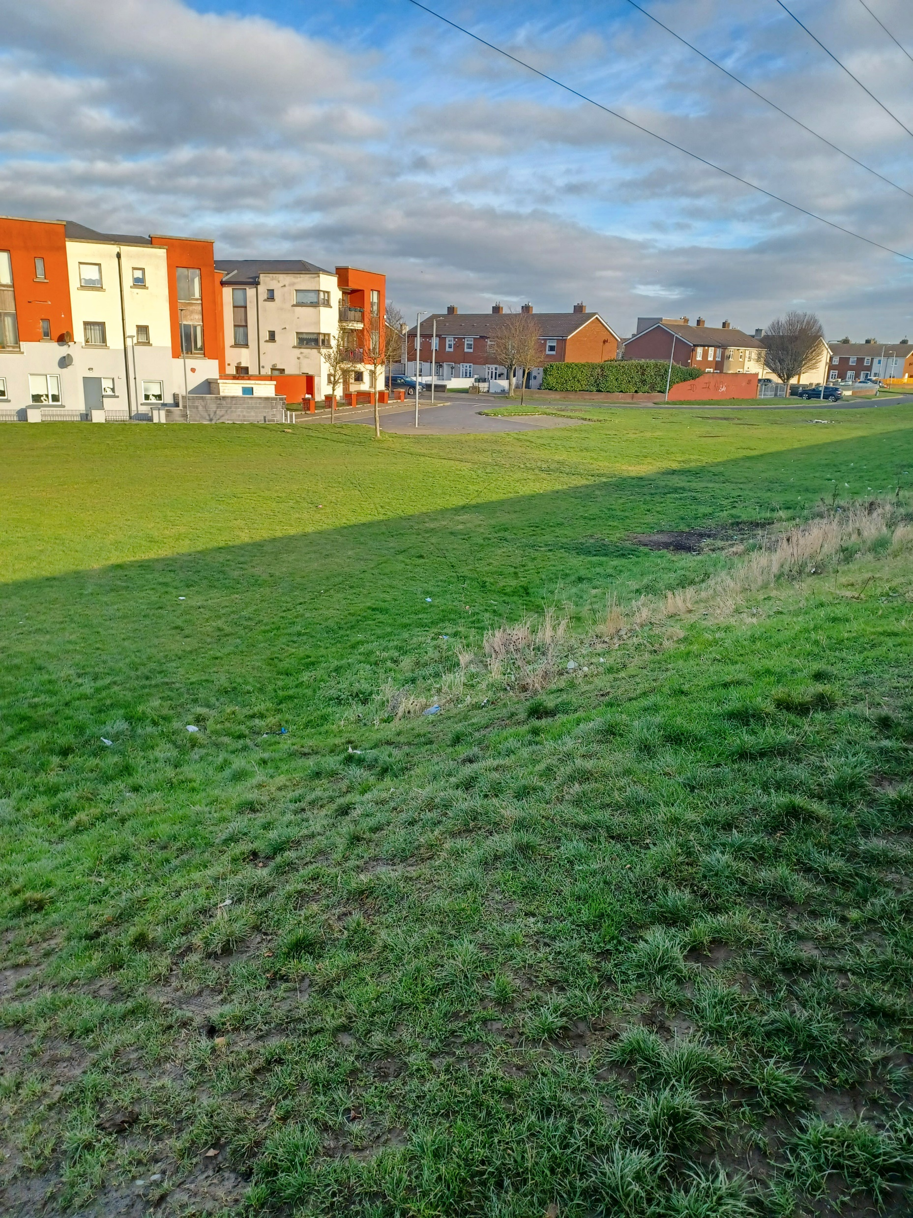
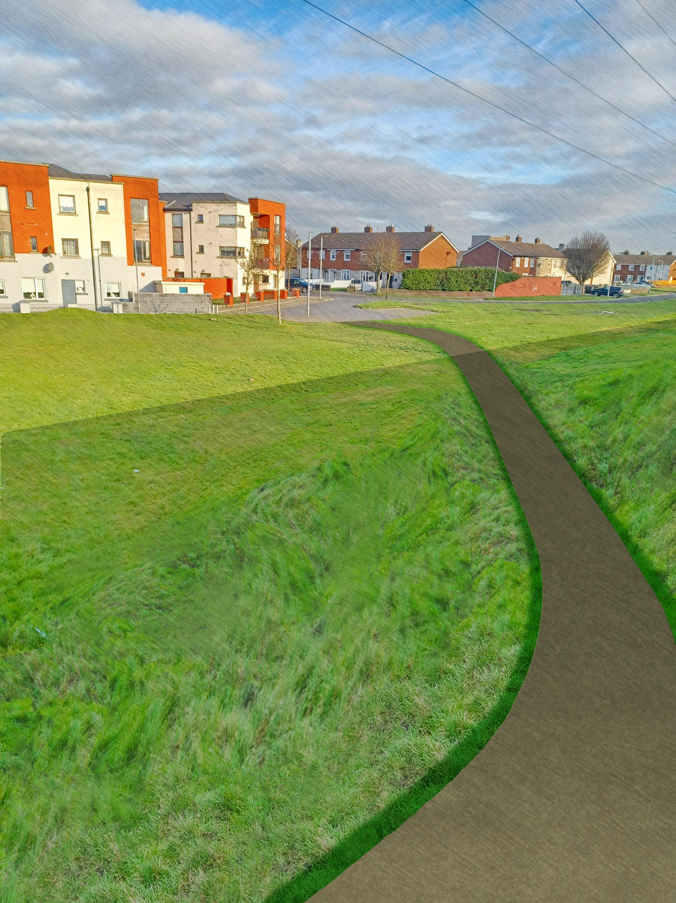
Balgaddy Permeability Links – Méile an Rí Link
Existing
Proposed

