Slide 1
Headed Item 10
Chief Executive’s Report on Part 8 Public Consultation for Proposed Development of 7 no. Traveller Group Houses at Fonthill Road, Co. Dublin
Meeting of South Dublin County Council
13th June 2022

Slide 2
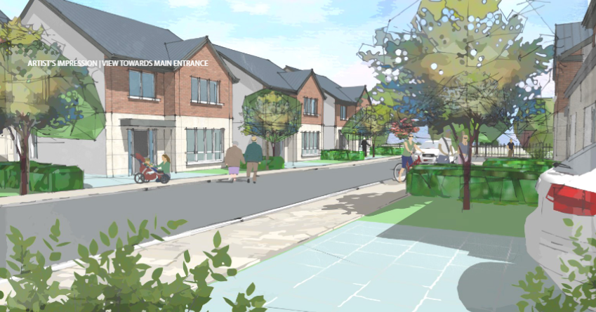
Proposed Development of 7 no.
Traveller Group Houses at Fonthill Road

Slide 3
Background & Policy Context
Traveller Accommodation Programme 2019-2024: Fonthill site listed for development - historic Part 8 approval
Seven local Traveller households on adjoining site in temporary accommodation - ongoing engagement with representatives on their housing needs (wider private development proposed on adjoining lands)
South Dublin County Development Plan 2016-2022: Housing Policy 5 Traveller Accommodation
H5 Objective 2: ensure TA located close to services, public transport
H5 Objective 3: long term sustainable TA developments
H5 Objective 4: TA is provided to highest standards with detailed consultation
Housing for All: (Objective 8) increased & improved Traveller accommodation

Slide 4
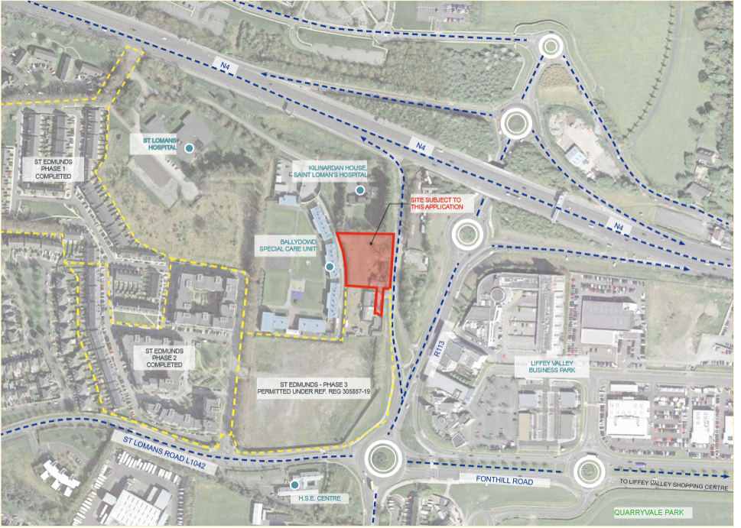
Proposed Development
0.36 ha site at Fonthill Road, Co. Dublin (accessed from N4-Fonthill Road North slip road)

Slide 5
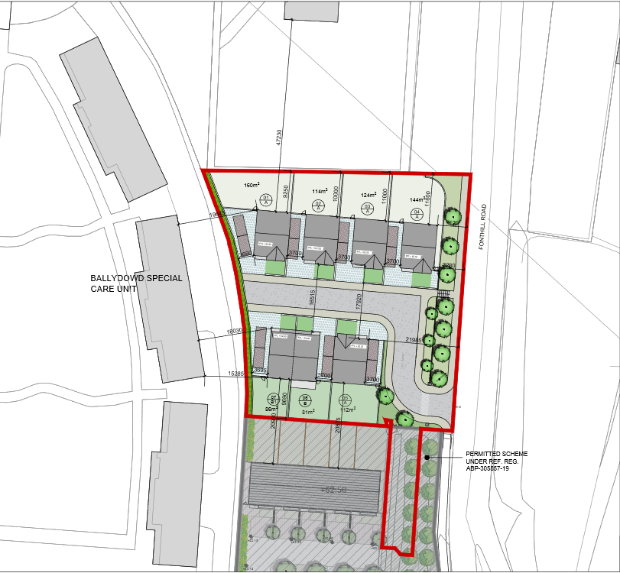
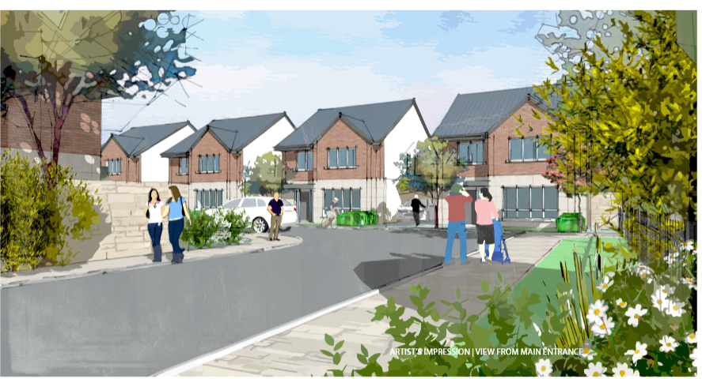
Proposed Development
7 Traveller-specific group houses comprising:
5 no. 4-bedroom 2-storey detached houses
1 no. 4-bedroom 2-storey, medically adapted, semi-detached house
1 no. 3-bedroom 2-storey, semi-detached house
In-curtilage car-parking, landscaping, & all associated works

Slide 6
Public Consultation Process,
Submissions & Responses
Briefings for local Area Committee & LTACC in Nov 2021
Extensive & ongoing engagement with local Traveller families
6-week formal public consultation period 14th April-31st May 2022
7 submissions received relating to Road Safety, Density/Design, Geology and Archaeology (incl. 3 relating to non-planning matters)
Responses:
Submissions fully addressed in CE Report
Road Safety audit proposed to examine access with recommendations to be incorporated into detailed design
Density & density in line with Traveller-specific accommodation
Archaeological measures will be undertaken with any requirements arising to be implemented as appropriate

Slide 7
Recommendation & Next Steps
CE Recommendation to Council to proceed with the proposed development as the proposal is in accordance with proper planning & sustainable development of the area
Next Steps if Part 8 Approved:
Proposed delivery through Part V agreement with developer of adjoining site
Develop detailed design in conjunction with developer & commence construction in Q4 2022 with projected delivery by Q4 2023
Traveller accommodation expenditure provided for this development in Council’s Three-Year Capital Programme 2022-24
Funding to be sought from DHLGH under national Traveller accommodation capital funding programme

