Slide 1
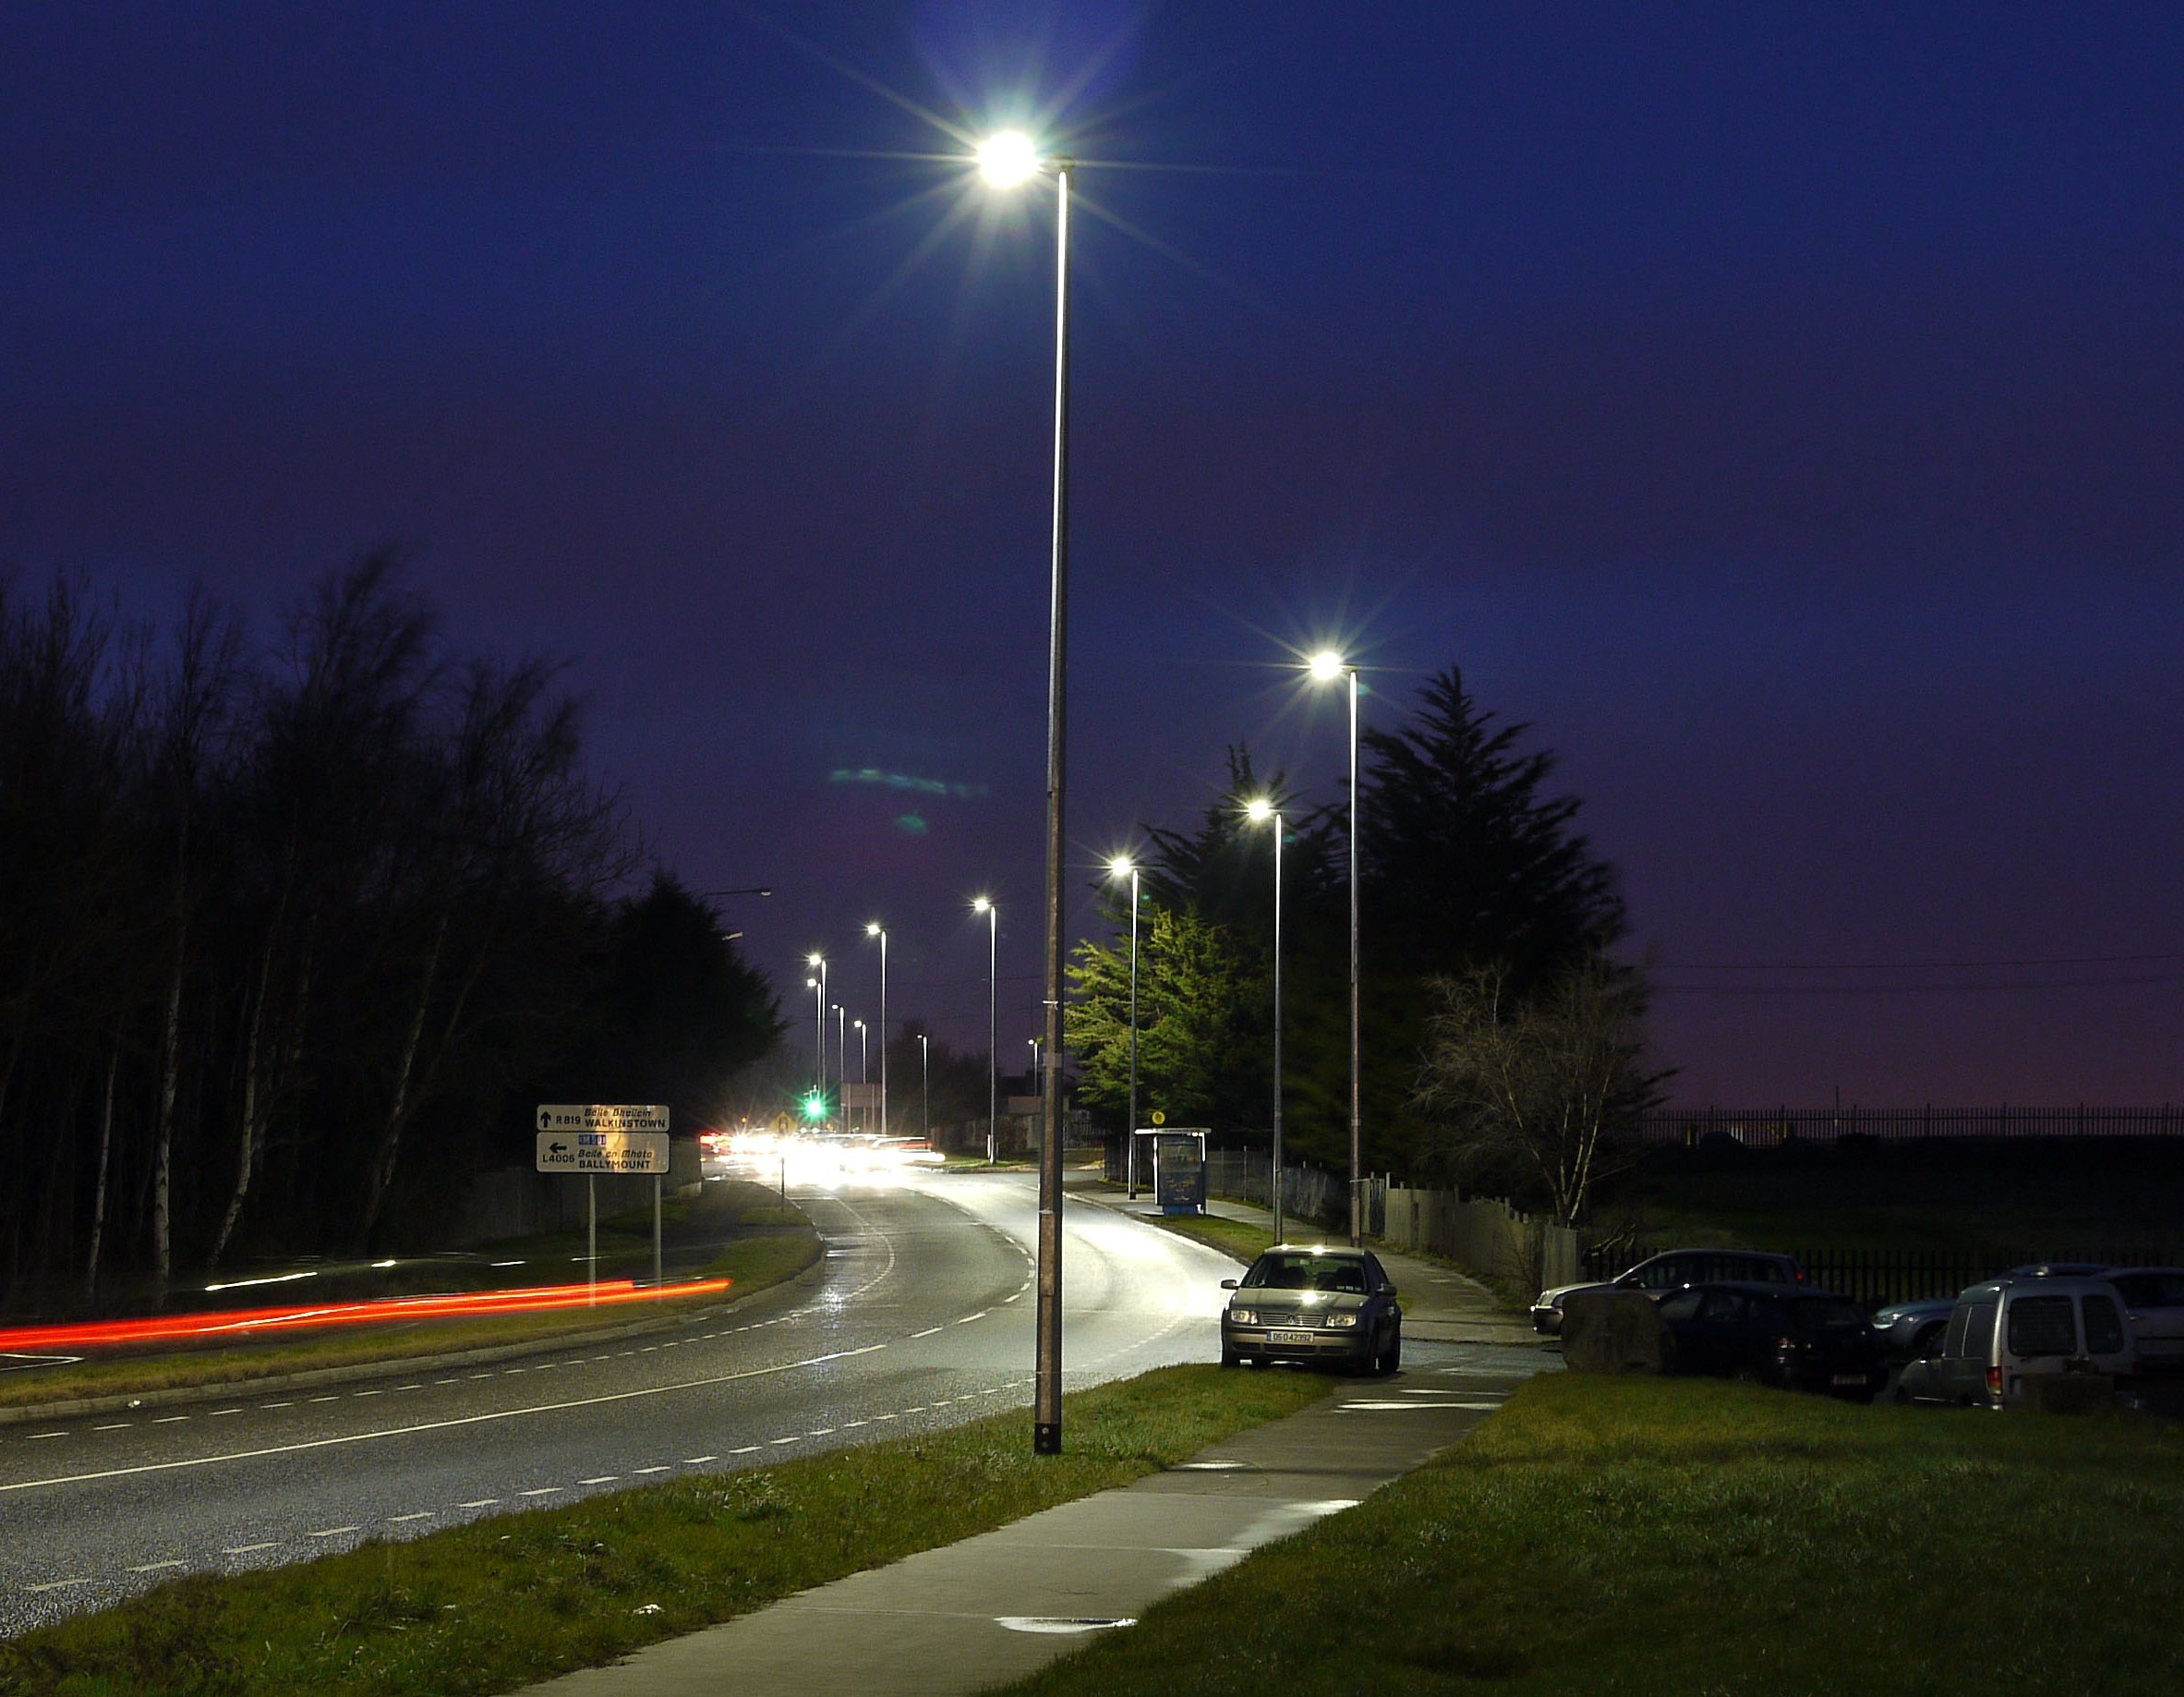
Update on Energy Efficiency LED Upgrades 2022
Land Use Planning and Transportation
June 2022

Slide 2
Current status June 2022
Total upgrades to LED to date approx. 14,250
8,750 SOX lanterns still to be upgraded
750 Lanterns upgraded to LED in Q1/Q2 2022
Original aim was to upgrade 1700 in 2022. The remaining target of 950 upgrades will only be partially completed due to technical issues – see below.
Electrical surveys are ongoing to identify the sequence of upgrades over the next 12 months in order to maximise resources.

Slide 3
Update on Q1/Q2 Programme
Target of 750 upgrades met
All estates previously presented were surveyed
The majority were suitable for upgrade without ESB intervention.
Where surveyed estates were found to be unsuitable, alternative estates were surveyed and those suitable were upgraded in order to ensure targets were met.

Slide 4
Q3/Q4 Programme (under ESBN Supplemental Agreement)
This document is now reaching the final stages of signature by both SDCC SMT and ESBN.
When this is complete, we can then commence the attached proposed programme for Q3/Q4.
The estates from last year’s programme that were unsuitable for upgrade will be prioritised under the ESB Supplementary Agreement programme
Any estates from the Q1/Q2 programme which were unable to upgrades will also be added to the ESBN SA programme
These estates are what constitute our proposed programme for the immediate short and medium term.

Slide 5
Upgrade Programme June - Dec 2022
ESTATE | LEA
Beverly Estate | Firhouse-Bohernabreena
Castlefield Manor | Firhouse-Bohernabreena
Coolamber Park | Firhouse-Bohernabreena
Cremorne | Firhouse-Bohernabreena
Idrone Estate | Firhouse-Bohernabreena
Knockfield Manor | Firhouse-Bohernabreena
Knocklyon Road | Firhouse-Bohernabreena
Old Bawn Road | Firhouse-Bohernabreena
Westbourne Lodge | Firhouse-Bohernabreena
Delaford Estate | Firhouse-Bohernabreena
Coolamber Court | Rathfarnham-Templeogue
Hermitage Estate | Rathfarnham-Templeogue
Knocklyon Road | Rathfarnham-Templeogue
The Priory | Rathfarnham-Templeogue
Templeville Drive | Rathfarnham-Templeogue
Templeville Road | Rathfarnham-Templeogue
Rathfarnham Wood | Rathfarnham-Templeogue

Slide 6
Upgrade Programme June - Dec 2022
ESTATE | LEA
Belgard Road | Tallaght Central
Cois Na hAbFhann | Tallaght Central
Dun An Oir | Tallaght Central
Millbrook Lawns Estate | Tallaght Central
Old Bawn Estate | Tallaght Central
Seskin View Road | Tallaght Central
Watergate | Tallaght Central
Watermeadow Drive | Tallaght Central
Watermeadow Park | Tallaght Central
Beech Park | Lucan
Airlie Heights | Lucan
Brookvale | Lucan

Slide 7
Agreements with External Bodies
Status of ESBN Agreement:
the CRU/Safe Electric Circular for the upgrade and certification of pre 1990s PL Stock has now been published
SDCC-ESBN Supplemental Agreement (SA) imminent – see above.
This stage of the programme is entirely reliant on ESBN resources. We are moving forward in good faith but expect operational on site bedding-in issues which may push our schedule significantly.
We are kicking off this programme with Rathfarnham Woods.

