Slide 1
Headed Item 11
Chief Executive’s Report on Part 8 Public Consultation for Proposed Development of 118 homes in Social & Affordable Housing Development at Clonburris SDZ (Canal Extension Site)
Meeting of South Dublin County Council
13th June 2022

Slide 2
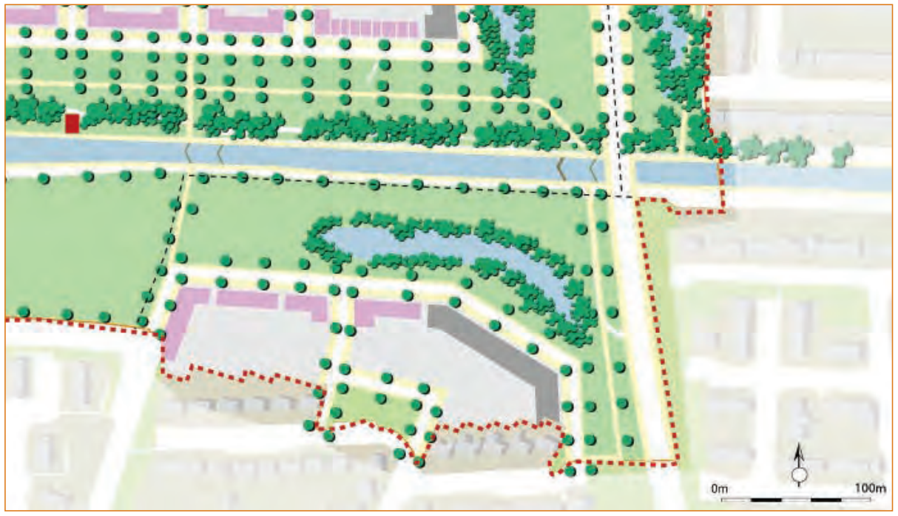
Background & Context
Prevailing social & affordable housing need + interim HNDA
SDCC Housing Delivery Action Plan 2022-2026 & Housing for All
Clonburris SDZ – Canal Extension Development Area

Slide 3
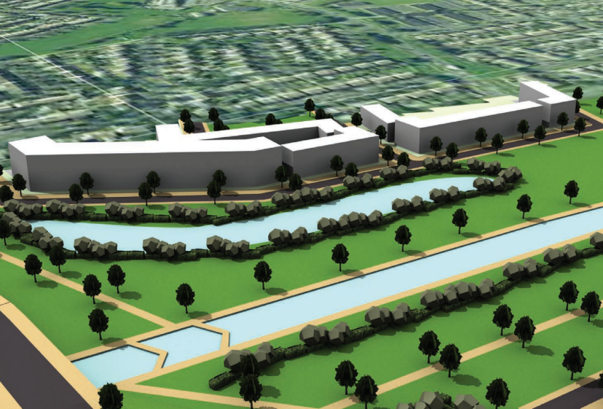
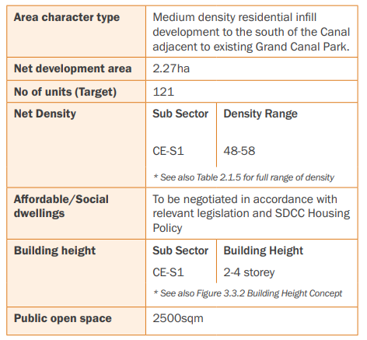
Proposed Development - SDZ

Slide 4
Proposed Development
AA (Habitats Directive) & EIA Screening
11 no. three-bed semi-detached/terraced houses
11 no. four-bed semi-detached/terraced houses
25 no. three-story buildings (each comprising a single-storey 2-bed apartment at ground level & 1 no. 3-bed duplex home above, i.e., 50 no. homes in total)
9 no. three-storey, stacked simplex (triplex) buildings (each comprising 3 no. 1-bed homes, i.e., 27 no. homes in total)
1 no. 4-storey apartment building comprising 19 no. apartments (15 no. one-bed apartments & 4 no. 2-bed apartments)
112 no. car parking spaces, approx. 140 no. cycle parking spaces, high-quality amenity spaces , landscape works, ESB substation, roundabout at Bawnogue Road entrance to development, SUDS measures & all associated ancillary site development works

Slide 5
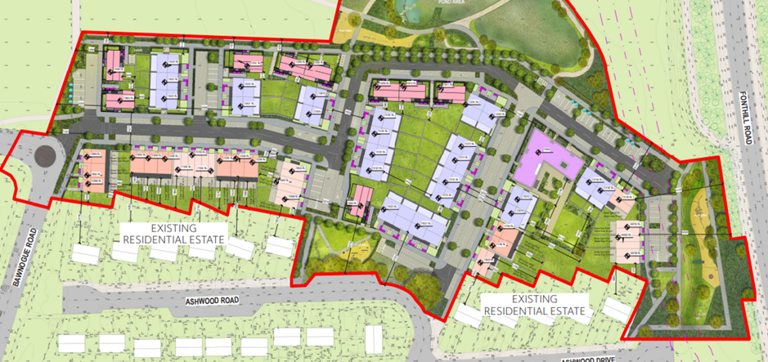
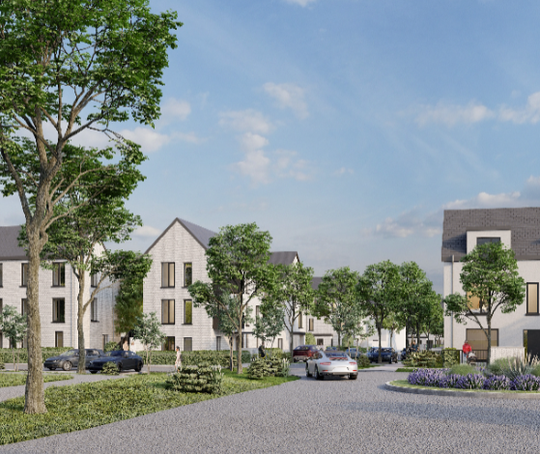
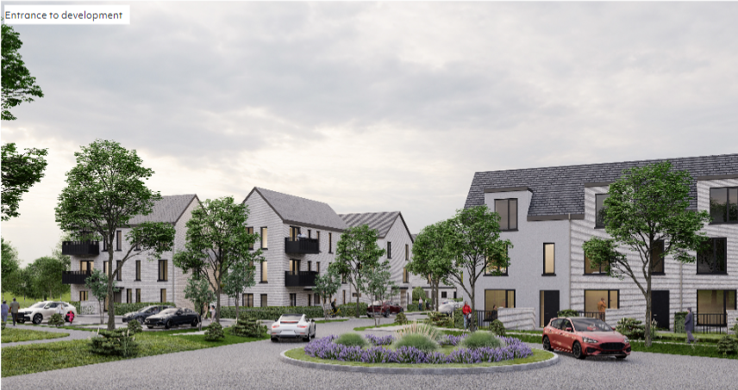
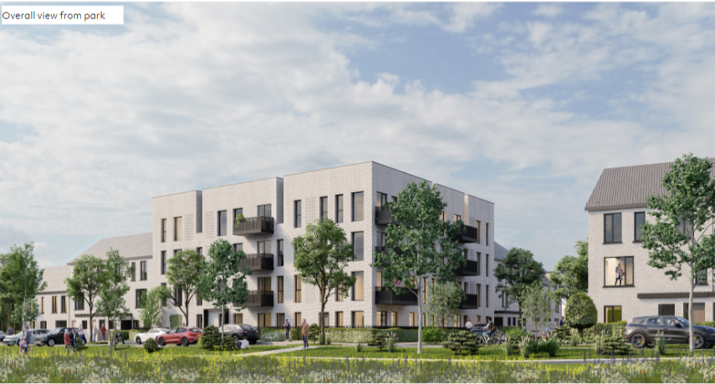
Proposed Development

Slide 6
Public Consultation Process
Briefing for local Area Committee in March 2022
6-week formal public consultation period 31st March-17th May 2022
Meeting with local residents’ representatives in May 2022
92 submissions received relating to:
Location, Tenure, Design, Density and Height
Transportation, Parking, Access and Permeability
Environmental Impact/Open Space/Public Realm/Play Spaces
Access to Amenities & Facilities
Drainage/SUDS
Boundary Treatment
Submissions from Statutory Bodies
Miscellaneous Issues

Slide 7
Overview of Submissions (1)
Location, Tenure, Design, Density and Height
Building height, tenure mix, distance from existing properties, location of development, building materials, height/impact on privacy
Transportation, Parking, Access & Permeability
Access to development, traffic volumes, lack of public transport, traffic calming, car parking provision, lack of cycling routes, overflow parking, concerns around proposed pedestrian & cycle route access through Ashwood Estate
Environmental Impact/Open Space/Public Realm/Play Spaces
Location of play space, loss of open/green space, impact on bio-diversity, removal of existing trees, impact to wildlife, impact on canal

Slide 8
Overview of Submissions (2)
Drainage / SUDS – impact on existing residents, piping system
Boundary treatment – for development, use of existing boundary walls for development
Other: Statutory body submissions
Lack of local amenities/services
Lack of public consultation
Impact on property values
Anti-social behaviour/estate management
Support for development

Slide 9
Responses to Submissions (1)
Location, Tenure, Design, Density & Height
Site location as per adopted SDZ –cannot relocate northwards
Scheme meets key SDZ objectives & requirements for the area:
develop high-quality neighbourhood extension to Ashwood
range of distinctive & diverse housing to Canal frontage
proposed permeability & movement connections
two to four storey building heights
compliance with SDZ density requirements
Medium density development 47 units per hectare
Min. 22m back‐to‐back distance between existing/new buildings
Revisions to Block D – reconfigured one unit facing existing homes & reconfigured adjacent block to remove potential overlooking
Designed in accordance with current regs and best practice

Slide 10
Responses to Submissions (2)
Transportation, Parking, Access & Permeability
Objective of SDZ - sustainable modes of transport , such as cycling & walking – key objective for this development area
Additional car parking to mitigate concerns regarding potential overflow car parking into adjacent estates (revised ratio 1:1)
Streets designed with emphasis on pedestrian movement, activity & place making
Fonthill Road – access to distributor road not recommended-due tosafety concerns - minimise disruption to vehicle movements,
Traffic calming measures incorporated into scheme
Drainage / SuDS
Drainage designed to minimise impact on receiving environment
Surface water run‐off directed to attenuation pond to the north

Slide 11
Responses to Submissions (3)
Environmental Impact/Open Space/Public Realm/Play Spaces
Full arborist assessment at detailed design stage – tree retention/minimal tree removal & mitigation through re-planting
Range of connected public realm facilities
Strategic Grand Canal Park to be developed adjacent to site
Contentious play space at entry at Ashwood to be retained – consultation with residents on design/layout
Full construction management plan before any development
Other
Statutory bodies’ requirements agreed
Consultation on boundary treatments
Phased amenities & facilities in wider SDZ
All comments & observations noted, some of which subject to separate & ongoing processes within SDCC.

Slide 12
Variations to Proposal
Following consideration of the submissions, the following variations are recommended:
Changed positioning of one unit in Block D & Block D reconfigured, with three- & four-bed houses replacing duplexes to minimise overlooking
Overall reduction of two homes in proposed development with revised total of 116 homes (60 affordable and 56 social homes)
Additional car parking spaces – new ratio per unit 1:1
---------------------------------------------------------------------------
Play space removal not recommended

Slide 13
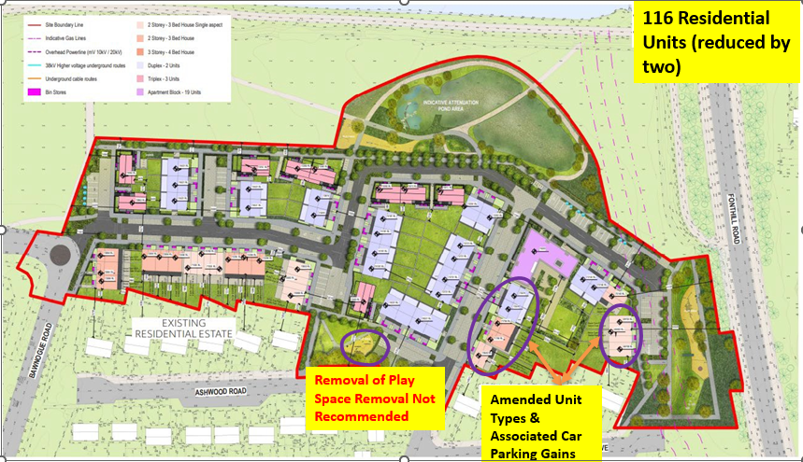
Variations to Proposal
Block D (Changes) | Published | Revised | Change
2 Bed Duplex (Ground Floor) | 4 | 0 | -4
2 Bed Duplex (2-storey over Ground floor) | 4 | 0 | -4
3 Bed House | 3 | 5 | +2
4 Bed House | 2 | 6 | +4
Net Impact |  |  | -2

Slide 14
Recommendation
Overall proposal in accordance with proper planning & sustainable development of area & with Clonburris SDZ
Recommendation to Council to approve proposed development with amendments as outlined
Next Steps if Part 8 Approved:
Develop detailed design & tender for contractor to achieve projected construction start early in 2023 for 2024 delivery
Funding applications to DHLGH under Affordable Housing Fund & Social Housing Investment Programme

