Slide 1

Headed Item 15
Update on Proposed Community Centre Develoments at:
Fortunetsown LAP/Citywest
Newcastle LAP
Orchard Lodge, Clondalkin
Meeting of South Dublin County Council
13th June 2022

Slide 2

Fortunestown LAP/Citywest
LAP requirements condition small community spaces
Potential for community facility of scale limited by lack of suitable sites
Sites assessment & protracted discussions with landowners
Proposed location at Cúil Dúin Avenue
Site of previously permitted creche
Proposal to combine creche and community facility in a three-storey development of circa 2,000 m² (outline plan submitted to Community team)
Subject to:
Planning (application to be lodged imminently)
Formal agreement with developer on costs, terms etc.
Community Dept. consultation on design & internal layouts
Post-planning 18-month construction timeline

Slide 3
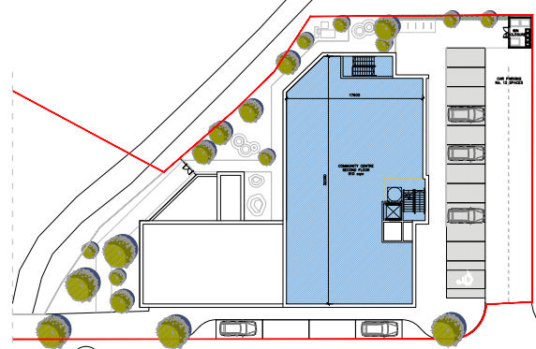
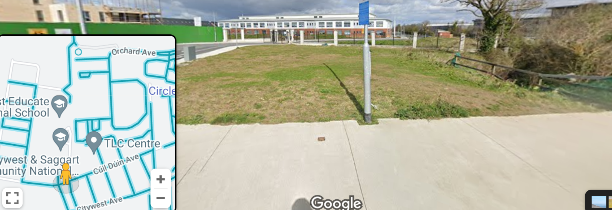
Fortunestown LAP/Citywest
Site location revised to more central site
Synergies of combined community & creche facility
Challenges on parking & existing watercourse

Slide 4
Newcastle Community Centre Upgrade & Extension
Existing privately owned centre at St. Finian’s Hall
Preferred option to build on established use to meet LAP requirement for additional community space
Extensive engagement with existing Board of Management, adjacent landowner & Planning Dept.
Proposals now being finalised for upgrade and 200m² extension
Will include café/kitchen area, accessible toilet, office space, additional multi-function space, reception area
Subject to:  BoM agreement on final design
● Landowner consent to Part 8 application
Funding in place in Three-Year Capital Programme
Part 8 to be advertised – summer 2022

Slide 5
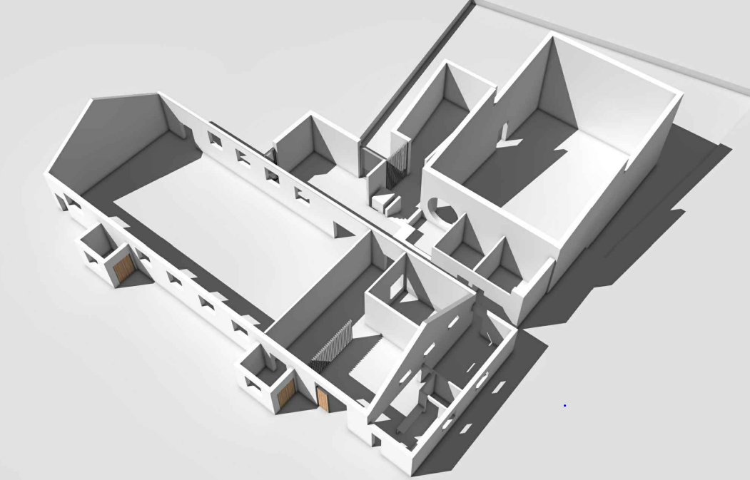
Newcastle Community Centre Upgrade & Extension

Slide 6
Orchard Lane Age Friendly Centre
Legal transfer of property completed Jan 2022
Ongoing engagement with local community representatives to:
  Explore preferred option for centre management
  Establishment of management company
  Final centre fit-out design depended on management option
Framework now in place for procurement of fit-out works
Contractor appointment July & works commence Aug/Sep

