Slide 1
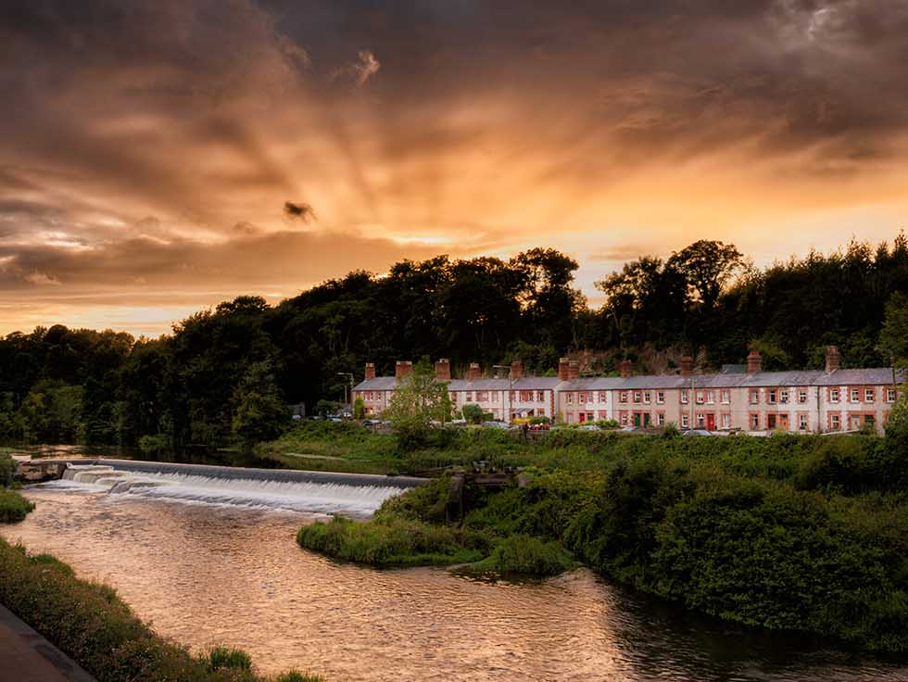
South Dublin
Tourism Strategy Consultation Process

Slide 2
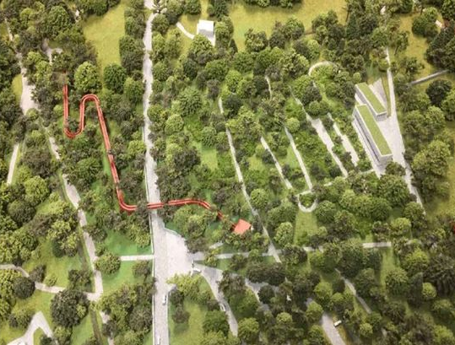
South Dublin Tourism Strategy 2015
Key Challenges
Tourism
Assets
Strategic
Approach
Marketing & Communications
Capital
Investment

Slide 3
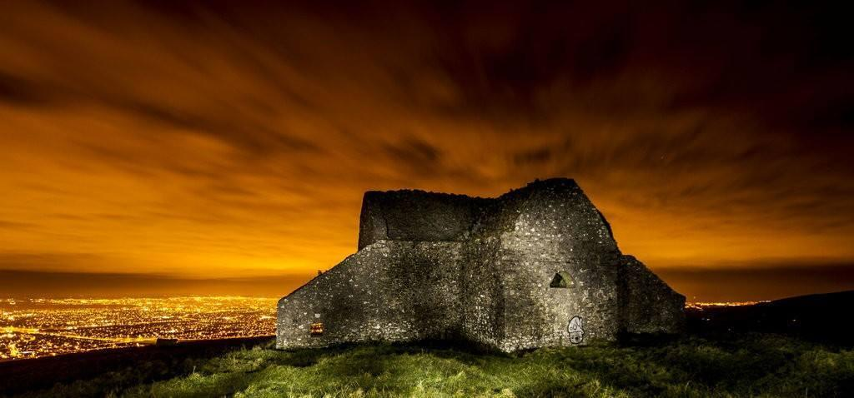
South Dublin Tourism Strategy 2015
Flagship Initiatives
Round Tower Visitor Centre
Greenways
Dublin Mountains Project
Rathfarnham Stables
Heritage Trails
Cultural Heritage

Slide 4
Clusters & Corridors
Grand Canal Corridor Dodder Greenway Corridor
Tallaght Activity Corridor Slade Valley Corridor
Liffey Valley
Rathfarnham/Marley

Slide 5
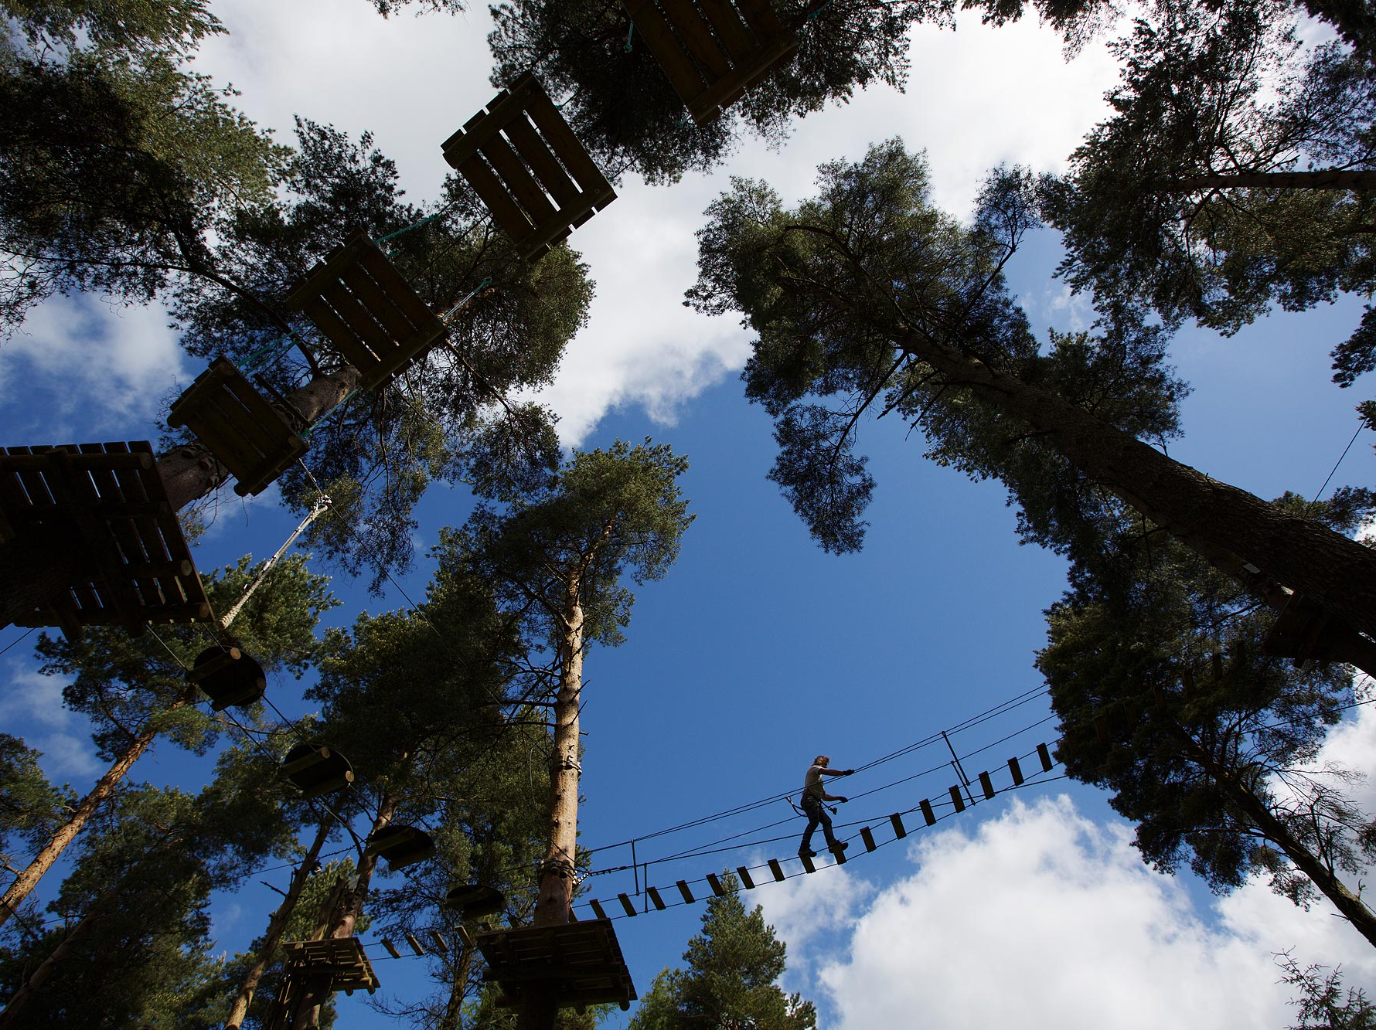
Visitor Targets & Economic Impact
2015
2025
Nights: 504,000
Spend: €26m
Jobs: 2,500
Nights: 1.2m
Spend: €62m
Jobs: 4,840

Slide 6
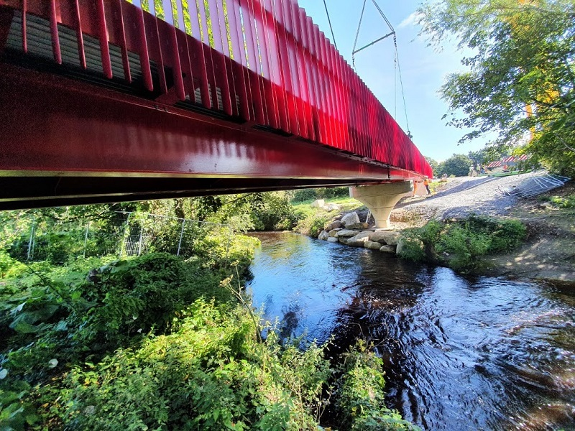
Current Activity
Dodder Valley
Liffey Valley
Grand Canal
Greenways
Dublin Mountains Project
Corkagh
Park
Outdoor
Markets
Destination
Lucan
Rathfarnham Stables
Tallaght Heritage Centre
Cycle
South Dublin
Tallaght
Stadium
Tallaght Public Realm
Liffey Valley & Tallaght Mobility Hubs
12th Lock Masterplan

Slide 7
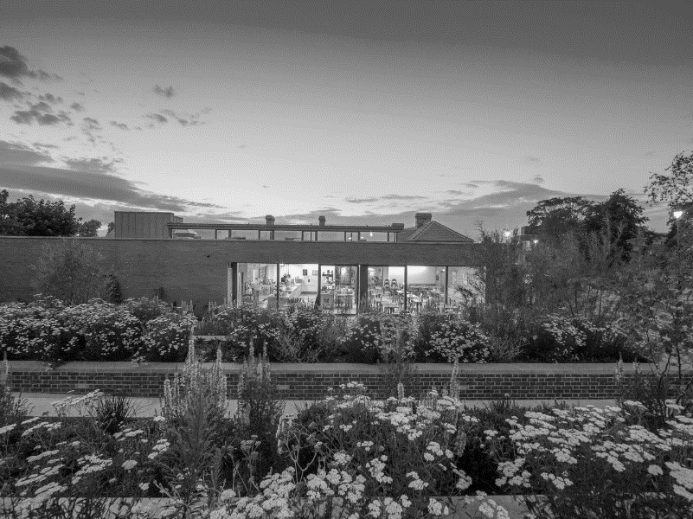
Tourism Strategy Timeline
Strategy Review
Heritage/Tourism Survey
Tender Preparation
Consultant Appointed
Strategy Preparation
Tourism Strategy Public Consultation
June 2022
July 2022
September 2022
December 2022
February 2023
April 2023
Tourism Strategy Consultant Tender
Draft Tourism Strategy
Elected Members Update
Final Tourism Strategy
Council Meeting

