Slide 1
Bus Connects Update LUPT SPC
26 May 2022

Slide 2
Content: Core Bus Corridors Bus Interchanges Further Spine Routes

Slide 3
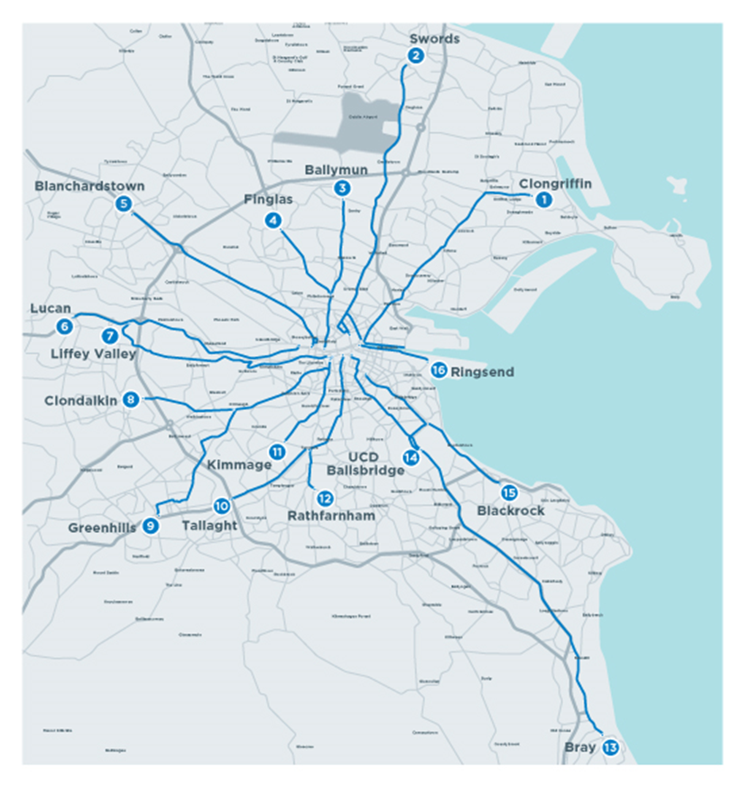
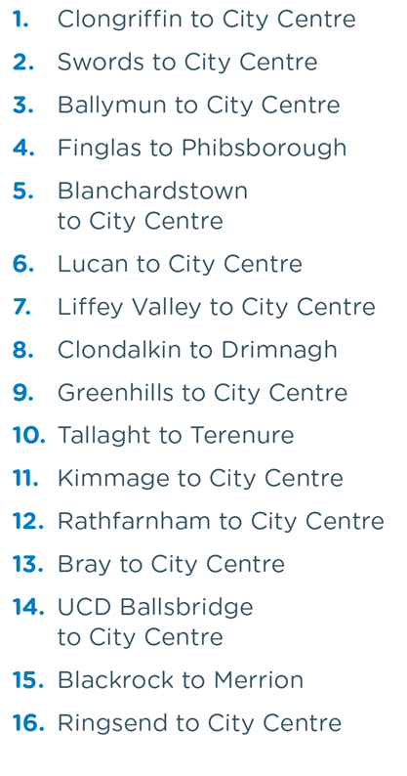
Core Bus Corridors

Slide 4
Core Bus Corridors
Blanchardstown to City Centre CBC Scheme
(in June)
Liffey Valley to City Centre CBC Scheme
Ballymun/
Finglas to City Centre CBC Scheme
Ringsend to City Centre CBC Scheme
Next Applications to An Bord Pleanála for Approval

Slide 5
The Planning Application Process:
When the SDCC Core Bus Corridor Applications are lodged with An Bord Pleanála:
An 8 week consultation Period
A submission to An Bord Pleanála will be €50 except for some prescribed bodies
Estimated Timeline:
July to December 2022
Sustainable transport for a better city | Busconnects
Timeline:
When each Scheme is lodged with the Bord
Information on each scheme can be found at:
The EIA Screening Report for the Lucan to City Centre Core Bus Corridor Scheme are available to download at the following link https://busconnects.ie/initiatives/core-bus-corridors/core-bus-corridor-information/lucan-to-city-centre/ and copies are available for inspection by members of the public.
Timeline:
Available to view online Now

Slide 6
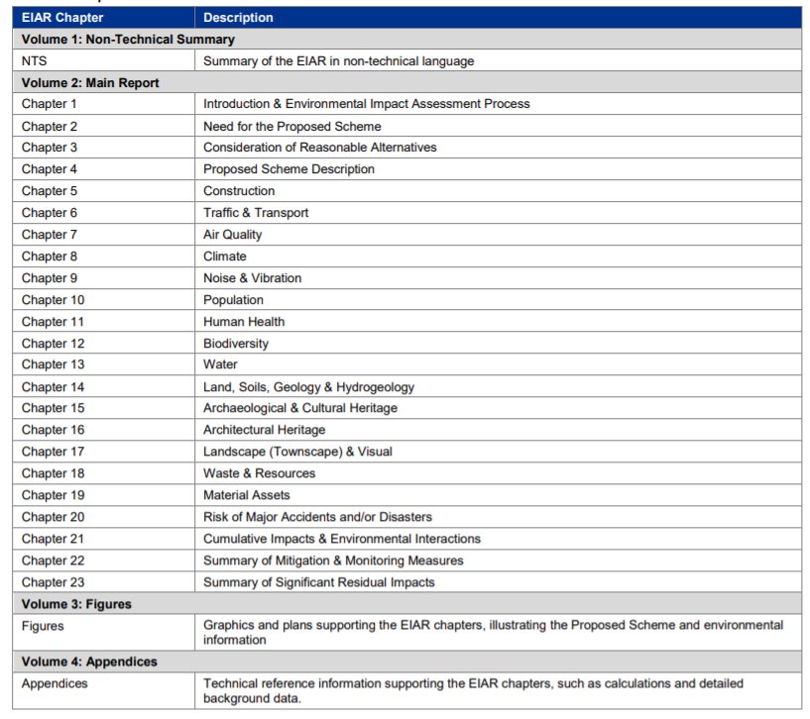

Slide 7
2. Bus Interchanges
Liffey Valley Interchange – Joint Venture NTA and LVSC
The Civil Contract is due to be completed September 2022.
And final fit out of the Interchange December 2022.
Interchange Opening Early in 2022.
Tallaght Interchange and Layover – NTA and SDCC Part 8 in Public Realm
Public Realm Contract
Stage 1 – Shortlisted Clonmel, Murphy and Wills Brothers
Tenders back on 10 June 2022
Possibly September Contract Start Date
15 months contract
Redcow Interchange
A 9-bay Interchange to service the new Spine Routes and the other Commercial Bus Operators

Slide 8
Proposed Red Cow Bus Interchange:

Slide 9
3. Further Bus Spine Routes
G-Spine - Services Starting August 2022:
G1: Parkwest Station, Nangor Road, Redcow Interchange: 12 to 15minute services at peak times
G2: Cherrywood, Palmerstown Avenue, Redcow Interchange: 1 bus hourly
S-Spine Southern Orbital Routes: Starting November 2022:
S6: Tallaght, Firhouse, UCD, Blackrock: 15-minute intervals at peak times:
S8: Citywest, Killinarden Heights, Tallaght, Knocklion, Ballinteer, Dun Laoghaire: 15-minute intervals at peak times:
W-Spine - Western Orbitals: Starting Spring 2023:
W2: Tallaght to Liffey Valley - every 15 mins at peak times
W4: Tallaght, Grangecastle Business Park, M50, Blanchardstown - ½ hourly services
W6: Tallaght to Maynooth – Temporary split service at Newcastle while awaiting Hazelhatch road Improvements - ½ hourly services

