Slide 1
Childhood Development Initiative Marian Quinn (CEO) Tara Scott (Programme & Quality Manager) May 2022

Slide 2
What is the Childhood Development Initiative (CDI)?
Part of the Area Based Childhood Programme
CDI is a CLG – Company Limited by Guarantee
Registered Charity and Not for Profit organisation
Charities Institute of Ireland ‘Triple Lock’ standard of Governance member
Volunteer Board of Management with agreed terms of office
Strategic Plan for the period 2021 -2024
EIQA Q-Mark Level 2 for excellence across Quality Management Systems and Processes
Funded mostly by Tusla

Slide 3
Board of Management
CEO
Restorative Practices Manager
Office and Finance Manager
Programme and Quality Manager
Business Development Manager
Restorative Practices Coordinator
Restorative Practices Quality Specialist
Ante Natal to Three Coordinator
Literacy Coordinator
Parenting Specialist
Chit Chat Coordinator
Training Coordinator
Data Specialist
Research Fellow
Literacy Quality Specialists
PCFs
SLT x2
Intern
Cleaner
Finance Administrator
Administrator
Social Media Coordinator

Slide 4
CDI Governance Chart 2021
Tusla
CDI Board
Department of Children, Equality, Disability, Integration and Youth.
Children’s Services Committee and Young People (CYPSC)
Local Community Development Committee (LCDC)
RP Ireland
CDI Team
Finance and Risk Sub-Committee
Human Resources Sub-Committee
ATTI Steering Committee
Research Advisory Sub Committee (RAC)
Indicates an advisory/supportive relationship
Indicates lines of accountability
Business Development Sub-Committee

Slide 5
Guiding principles
Identify need
Develop a coherent, community informed, integrated response
Design, implement and support the quality delivery of evidence-based programmes
Support inter-agency collaboration
Outcomes focused approaches
Evaluate what works and what doesn’t
Share the learning regarding programmes and processes in order to inform future policy and practice.

Slide 6
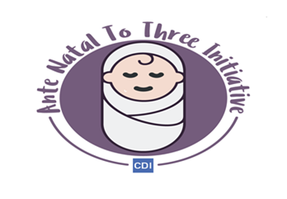
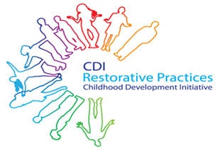
Programmes of work
Literacy
Doodle Den
Doodle Families
Dolly Parton’s Imagination Library
Doodle STEAM
AnteNatal to Three Initiative
Chit Chat
Powerful Parenting
Restorative Practices
CDI Training & Consultancy

Slide 7
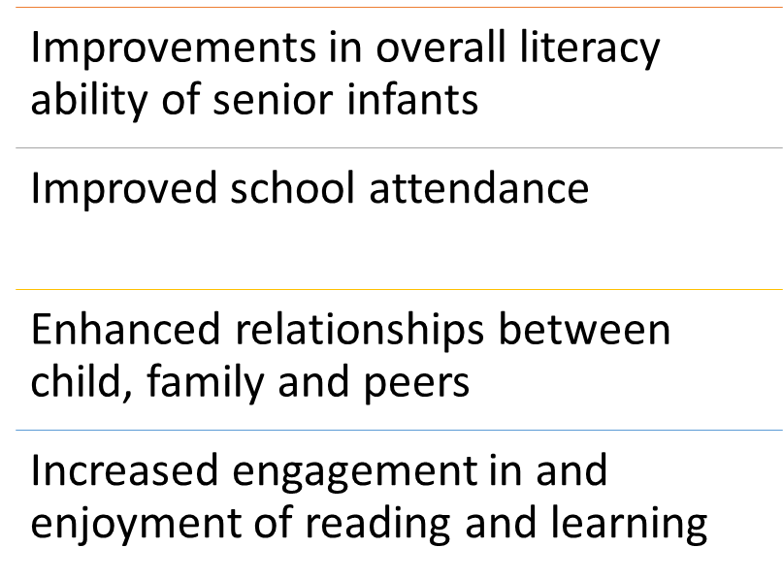
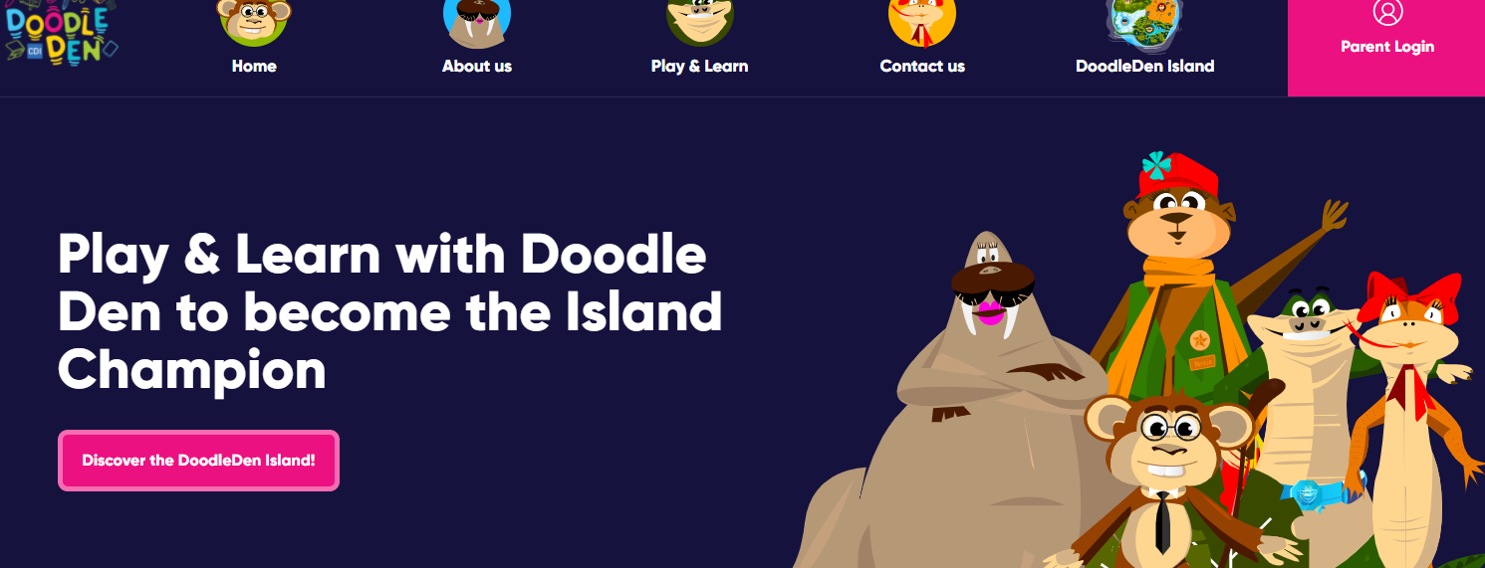
Doodle Den
Objectives:
Doodle Den is an after-school literacy programme.
Senior Infants, 1.5h, 3x week
The programme focuses on improving children’s literacy through a wide range of activities, with a child, parent, and family component, and it places a strong emphasis on parental engagement.
Doodleden.ie
Listed in Early Intervention Foundation
CPD accredited training

Slide 8
Doodle Den Outcome: Key literacy and social skills are improved in DD target schools
These are Actual values ->
Target values for 2021:
Social skills: 80%
Phonics skills: 70%
Writing skills: 70%
Sight vocab skills: 80%

Slide 9
Doodle Families
Doodle Families is a family literacy programme conducted in schools.
Eight week programme
It involves a one-hour session for parents/guardians and a separate one-hour session for children in First Class
Objectives:
The purpose of DF is to strengthen the links between the home and the school and to increase parental involvement, as well as to embed change in family literacy activities.

Slide 10
Doodle Families Outcome: Parents and Children have improved attitudes and practices towards literacy and school
These are Actual values ->
Targets for 2021:
Parents: 77%
Children: 68%

Slide 11
Dolly Parton’s Imagination Library
Free book gifting scheme for children 0-5, Dublin 24
Established in 2018 in Ireland
Library of 60 books
73% enrolment rate
200k books delivered this October 22
Objectives:
Promote positive attitudes about reading and the motivation to read among caregivers and children
Enhance the home learning literacy environment
Increased interactions between caregivers and children.

Slide 12
Dolly Parton’s Imagination Library Outcome: Parents and children have improved attitudes towards reading
These are actual values ->
Target for 2022:
Parent 96%
Child 95%

Slide 13
DPIL Outcome: Improved Home Learning Environment
These are actual values ->
Target – continued upward trend; books in the home increasing.
2022: maintain HLEI score 38-39.

Slide 14
AnteNatal to Three Initiative
ATTI Steering Group – information sharing and referral network for practitioners and agencies.
Objectives:
Communication and information sharing across a broad range of multi-disciplinary practitioners and service providers working with families in 0-3 age group
Supporting best practice and innovation though regular networking and learning events
Increased awareness of access pathways to services for families in this age group, resulting in quicker and more appropriate referrals.
Annual Network Events
Webinars
Infant Mental Health Masterclasses
Solihull Foundation and Advanced Training
Common framework and language for practitioners to promote and facilitate secure attachments within families
Reflective Practitioner Practice - CoPs

Slide 15
Chit Chat – in school SLT service
Social care model
Referrals received from EY practitioners, teachers, and parents
6 Community EY services (including an Early Start)
3 DEIS Primary schools
Parent and staff training
3 SLTs employed;
1 senior, 2 staff grade,
1 full time, 2 part time
Dual service policy & MOU with the local HSE SLT department
Objectives:
To promote children’s speech and language development and provide early intervention, where necessary
To provide training and support to parents
To provide training to staff in early years settings and primary schools

Slide 16
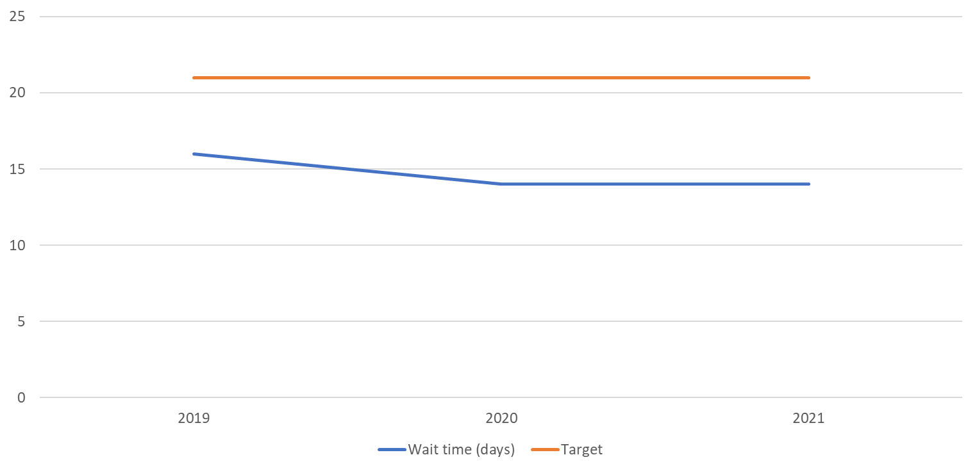
Chit Chat Outcome
Children have improved speech and language skills through appropriate access to assessment and intervention within their education setting.
Target: Time waiting for referral to initial assessment is no longer than 3 weeks
HSE: Referral to Initial Assessment – 14months
Referral to intervention – 48 months.
CC – Referral to Intervention – less than 3 weeks.

Slide 17
Powerful Parenting
Parental support programme aimed at improving engagement and relationships between Early Learning and Care settings and parents/carers
7 PCFs based in 7 ELC settings across Tallaght
Parent education programmes, collaboration, child development, signposting etc to support parents
PEAR training
Objectives:
Reduce parental stress
Increase positive relationships between parents/carers and child and services
Improve Home Learning Environment
Parents are supported in their parenting role

Slide 18
Powerful Parenting Outcome
Exceeded target in 2018/2019
Increase in parental stress recorded in 2019/2020 and 2020/2021
This may be attributed to the pandemic & various lockdowns. During this time PCFs reported that parents were experiencing social isolation, financial worries, lack of access to ELC services/schools, general services etc.

Slide 19
Evaluation 2020-21: Recommendations from the MSCA project
For research:
To continue measuring Parental stress (as a central dimension addressed by PP)
To consider evaluating PP’s impact on the quality of the Home Learning Environment or Parent-service partnerships.
To consider asking parents about their expectations or needs at pre-test (optional question)
To consider asking PCFs to record which dimensions they addressed in the support provided (e.g., emotional support, parenting support, practical support, first needs support, etc.)
To consider asking PCFs to register parents’ attendance to the parenting courses/formal supports
For practice:
To communicate about the PCF’s role (expectations and duties) among parents

Slide 20
Restorative Practices
Restorative Practices (RP) is an evidenced approach for:
Actively building and maintaining good relationships;
Preventing the escalation of conflict;
Resolving conflict in a healthy manner; and
Repairing harm when serious wrongdoing has occurred.
The RP programme achieves this by providing a range of Restorative Practices training courses and supports.
Objective:
Improve relationships and reduce conflict using Restorative Practices

Slide 21
RP Outcome: CDI’s Quality Assured RP Training is Expanded nationally and internationally
Target 2019: 1,200 trainees across Ireland
Actual 2021: 1,590 trainees across Ireland
RP training has been delivered to over 4k professionals, young people and parents to date

Slide 22
Engagements / Reach: 2021
Literacy:
Doodle Den: 150 Children, 31 Professionals
Doodle Families: 105 Children, 67 Parents/carers, 9 Professionals
DPIL: 4974 Children, 1491 Parents/carers
ATTI:
28 Professionals – Solihull Training
22 Professionals – IMH Masterclass
68 Professionals – Webinar / Roundtables / Launch
Powerful Parenting:
263 Parents/carers
131 Professionals
Chit Chat:
75 Children
207 Parents/carers

Slide 23
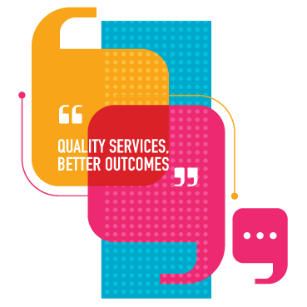
CDI Training and Consultancy Service
We provide support to services in the child and family sector.
Established to support improvements in service provision and outcomes for children in Ireland.
It aims to maximise the learning gained from implementing and researching new ways of working in Tallaght.
All income generated from the service will provide funding for CDI’s core work in areas of disadvantage.

Slide 24
Objectives:
CDI T&C is a social enterprise within CDI
We deliver high quality, professional trainings and consultancies
We speak from practical experience
We use evidence
We are experienced trainers and consultants
We can provide bespoke trainings and consultancy services. We work collaboratively with clients to ensure support is targeted to their needs
Competitive rates
As a social enterprise, any surplus generated is invested in work in disadvantaged areas

Slide 25
Questions?
Contact:
Marian Quinn marian@cdi.ie
Tara Scott tara@cdi.ie

