Slide 1
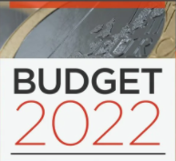
Residential Zoned Land Tax
LUPT SPC 26th May 2022

Slide 2
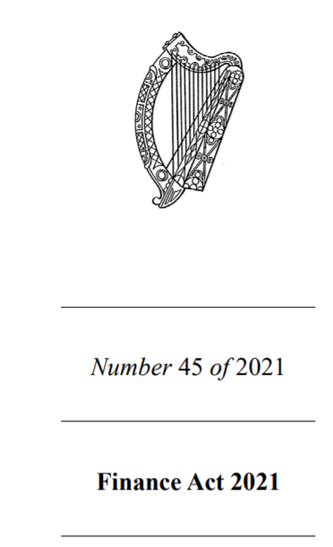
Overview
What is the Residential Zoned Land Tax?
What is the process
What are the timeframes?
Who is responsible?
What are the implications

Slide 3
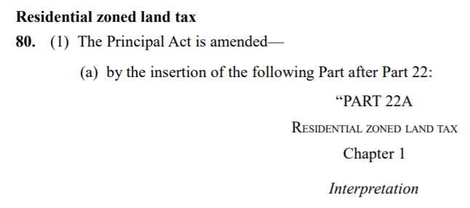
What is the Residential Zoned Land Tax?
Introduced under the Finance Act 2021 in December of that year
By 2023, it will replace the Vacant Site Levy
Tax will be collected by Revenue

Slide 4
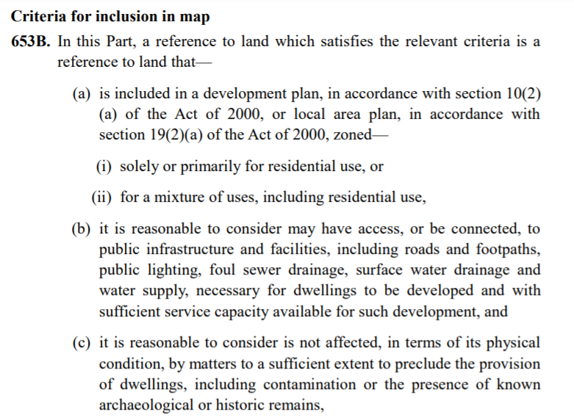
How will the Residential Zoned Land Tax work?
Stage 1
LA will draw up draft map using criteria in the Act
Publish a draft map by 1st Nov 2022
Submissions to be made by 1st Jan 2023
Submissions to indicate whether they wish to be excluded (doesn’t satisfy criteria) or included in the final map
LA evaluates and notifies owner by 1st April 2023.
Notes:
a number of exclusions from the zoned land tax, being: • existing habitable dwellings and their curtilage; • land that is used for certain infrastructure or facilities, for example utilities, transport, social or community or recreational purposes; • land where a site is designated as a derelict site and liable for the Derelict Sites Levy; and • land which is zoned for residential use but is used to provide services consistent with a residential area (such as a corner shop).

Slide 5
Residential Zoned Land Tax Process - Progression
Owner can appeal the determination within one month
Owner can request a variation of the zoning of their land
LA can publish a ‘supplemental map’ by 1st May 2023, where additions to the draft map have been identified
Further public consultation up to 1st June
Owner notified of LA determination by 1st August 2023
Determination may be appealed to An Bord Pleanála

Slide 6
Residential Zoned Land Tax Process – Zoning Submissions
An owner of identified lands can request a rezoning as part of their submission to the draft map or supplemental map
The LA will consider whether to propose to make a variation under section 13 of the Planning Acts

Slide 7
Residential Zoned Land Tax – Final Map
Final Map to be published by 1st December 2023
Any lands still on appeal or in JR are included
By 31st January 2024, and each year thereafter, revised maps are published

Slide 8
Charging - Residential Zoned Land Tax
Charged and levied annually from January 2024
Different dates where land meets criteria after 1st January 2022 (commences the third year after meeting the criteria)
Charged at a rate of 3%
It will remain a charge on the land
Revenue is responsible for collecting the charge

Slide 9
Residential Zoned Land Tax – Implications for Local Authority
Awaiting Guidelines for further clarity
May have zoning implications – impact on core strategy?
Significant and ongoing resource implications
Takes responsibility for collecting the levy from the LA
New tax appears to strengthen the ability to collect
Not clear how the tax is to be allocated / spent
Tax is at 3%, less than the vacant site levy which was increased to 7%
Size of site no longer has to be greater than 0.05ha (VRT

Slide 10
Residential Zoned Land Tax – Revenue Implications
Owners of land that falls under the zoned land tax will be required to file annual returns in the format prescribed with the Irish Revenue Commissioners.
Penalties will apply for failure to do so and will also apply in circumstances where the owner undervalues the land in question
Where land is already zoned for residential development on 1 January 2022, it will become chargeable from 1 January 2024.
If the land falls within the scope of the zoned land tax after 1 January 2022, then it will be chargeable on the third year after it comes within the scope of the tax.

