Slide 1
Innovation Centre
Update

Slide 2
Plan
Singular landmark 4 storey building
Views in 4 directions and southwards to the Dublin Mountains over the public park
Public area on ground floor with town hall space and café – open building designed to see through from side to side
Outdoor south facing café terrace space engaging with park
Central atrium space gives visual connection to upper levels
Lettable offices in various sizes on upper floors informed by Oxford Innovation - the successful operator
Break out space and tea stations on each level – space for conversations and chance encounters to happen
Provides a new location for work opportunity and employment
2 stair cores and one lift
Integrated staff facilities
Day and night presence

Slide 3
Description | % | Sq. M
Gross Internal Floor Area | 100 | 3019
Nett Area | 72.8 | 2188
Nett Lettable Area | 58.7 | 1773
Reception / Town Hall | 3.5 | 105
Café | 2.6 | 78
Caré - Kitchen | 1 | 30
Meeting Rooms | 4 | 120
Staff Office / Management Suite (Incl Directors Office) | 1 | 30
Pre-Business Area | 1.7 | 52
Comms Room | 0.3 | 9
Nett Internal Area | 72.8 | 2197
Common Area | 21.9 | 662
Internal Partitions | 5.3 | 160
Gross Internal Floor Area | 100 | 3019
Unit Type | Quantity
2 Person Suite | 5
3 Person Suite | 9
4 Person Suite | 16
5 Person Suite | 1
6 Person Suite | 6
7 Person Suite | 6
8 Person Suite | 1
9 Person Suite | 1
13 Person Suite | 1

Slide 4
Innovation Centre Tallaght
Timeline
Project Stage | Status | Date
Planning | Complete | 14/12/2020
Detailed Design | Complete | 10/06/2021
Final Tender- Construction | Complete | 01/02/2022
Project Implementation | Build in progress Mobilisation Plan Initiated | 04/04/2022
Project Completion | Target Date | 26/10/2023

Slide 5
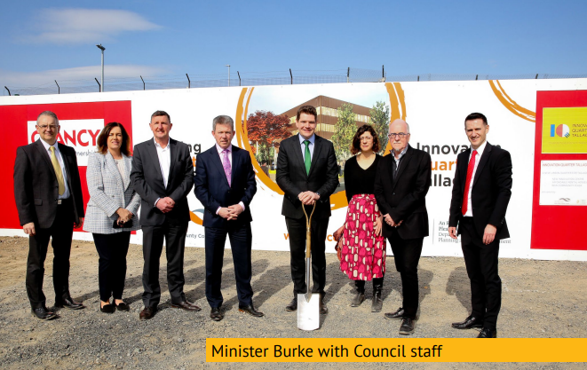
Sod Turning Ceremony - 22nd March

Slide 6
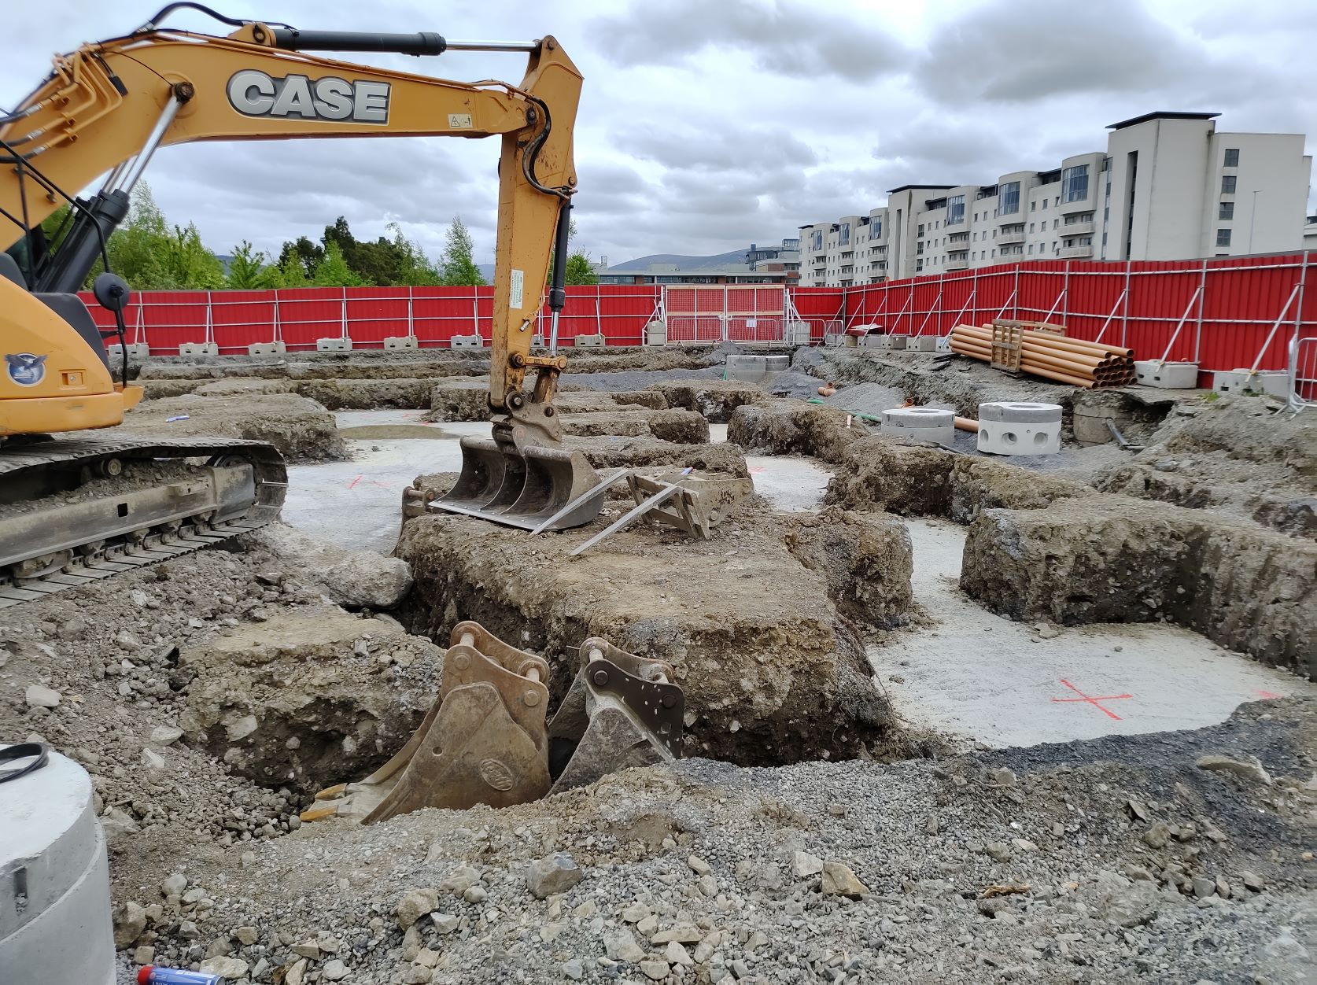
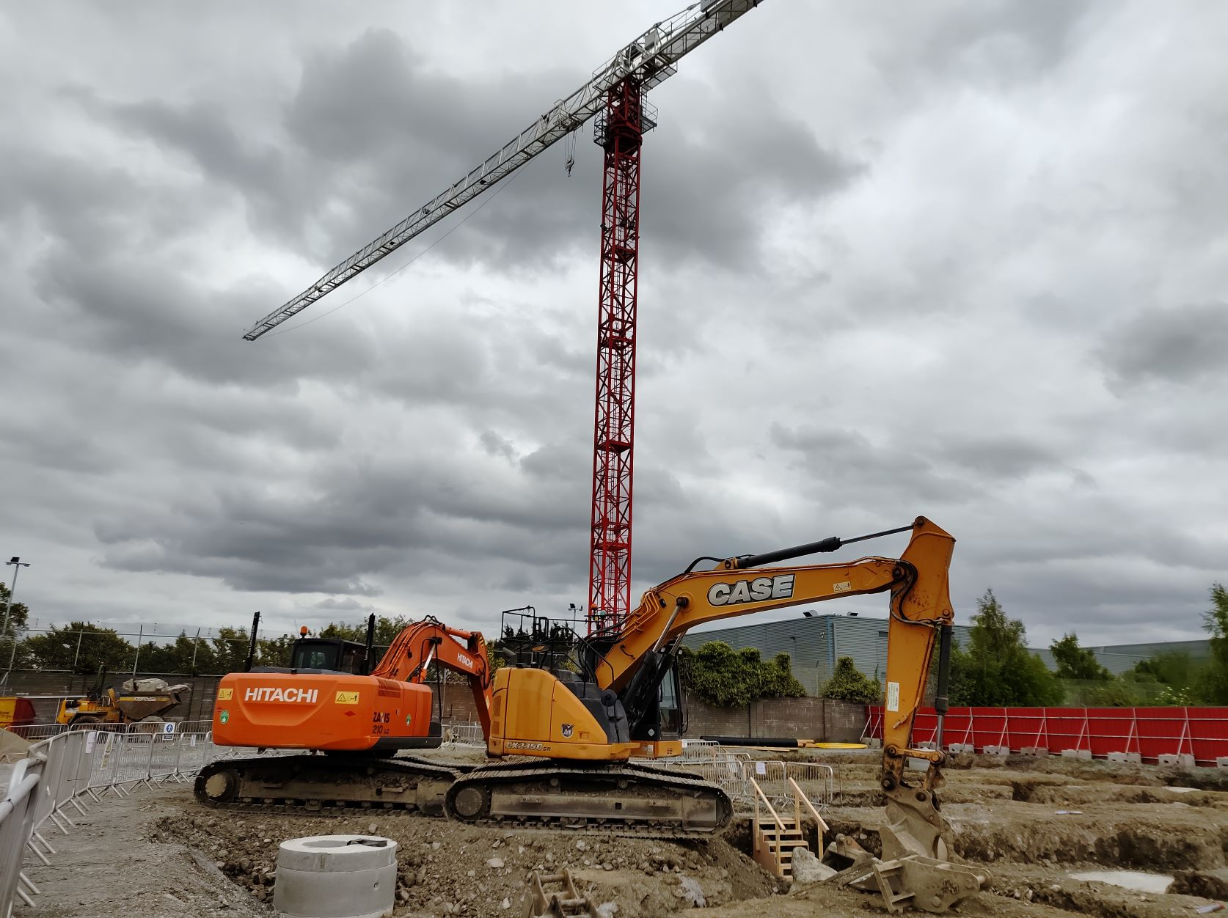
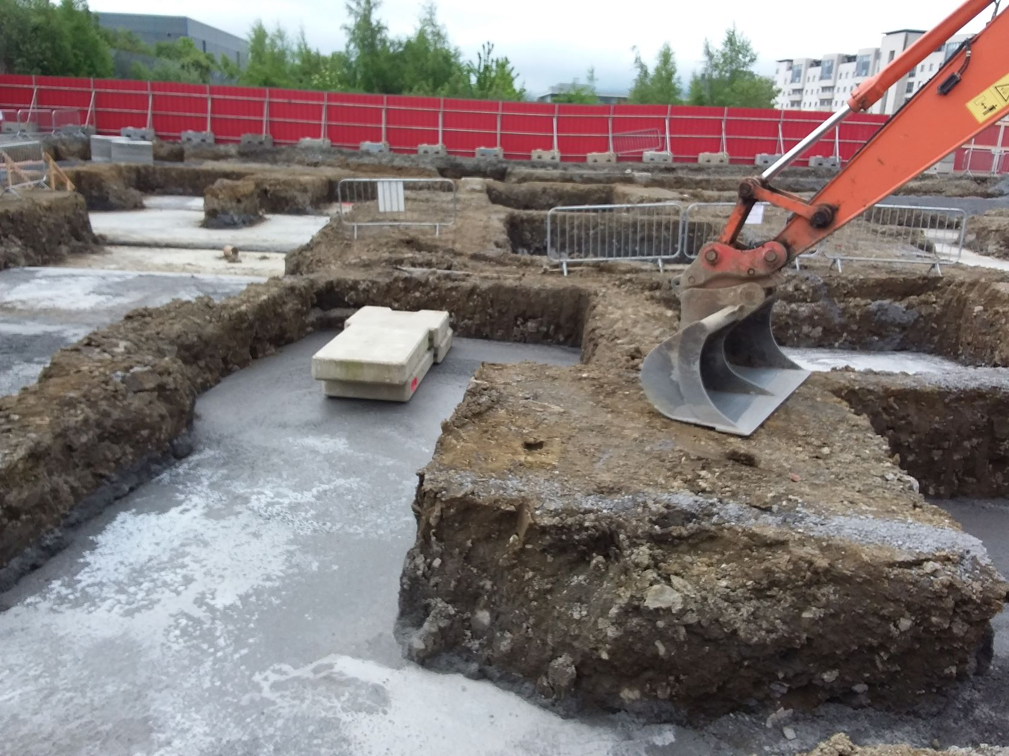
Construction Commenced 4th April

Slide 7
Oxford Innovation
Initial focus with OI is around marketing
  Working with Wonder Works to develop Work IQ
  Social Media accounts have been set up
    We will start raising awareness of the Innovation Centre and posting the build to generate interest
  Workiq.ie domain name acquired
  We expect to have a web landing page in place by the end of May
    OI are tendering for web developers to create the site
    Engaging with Irish based hosting companies

Slide 8
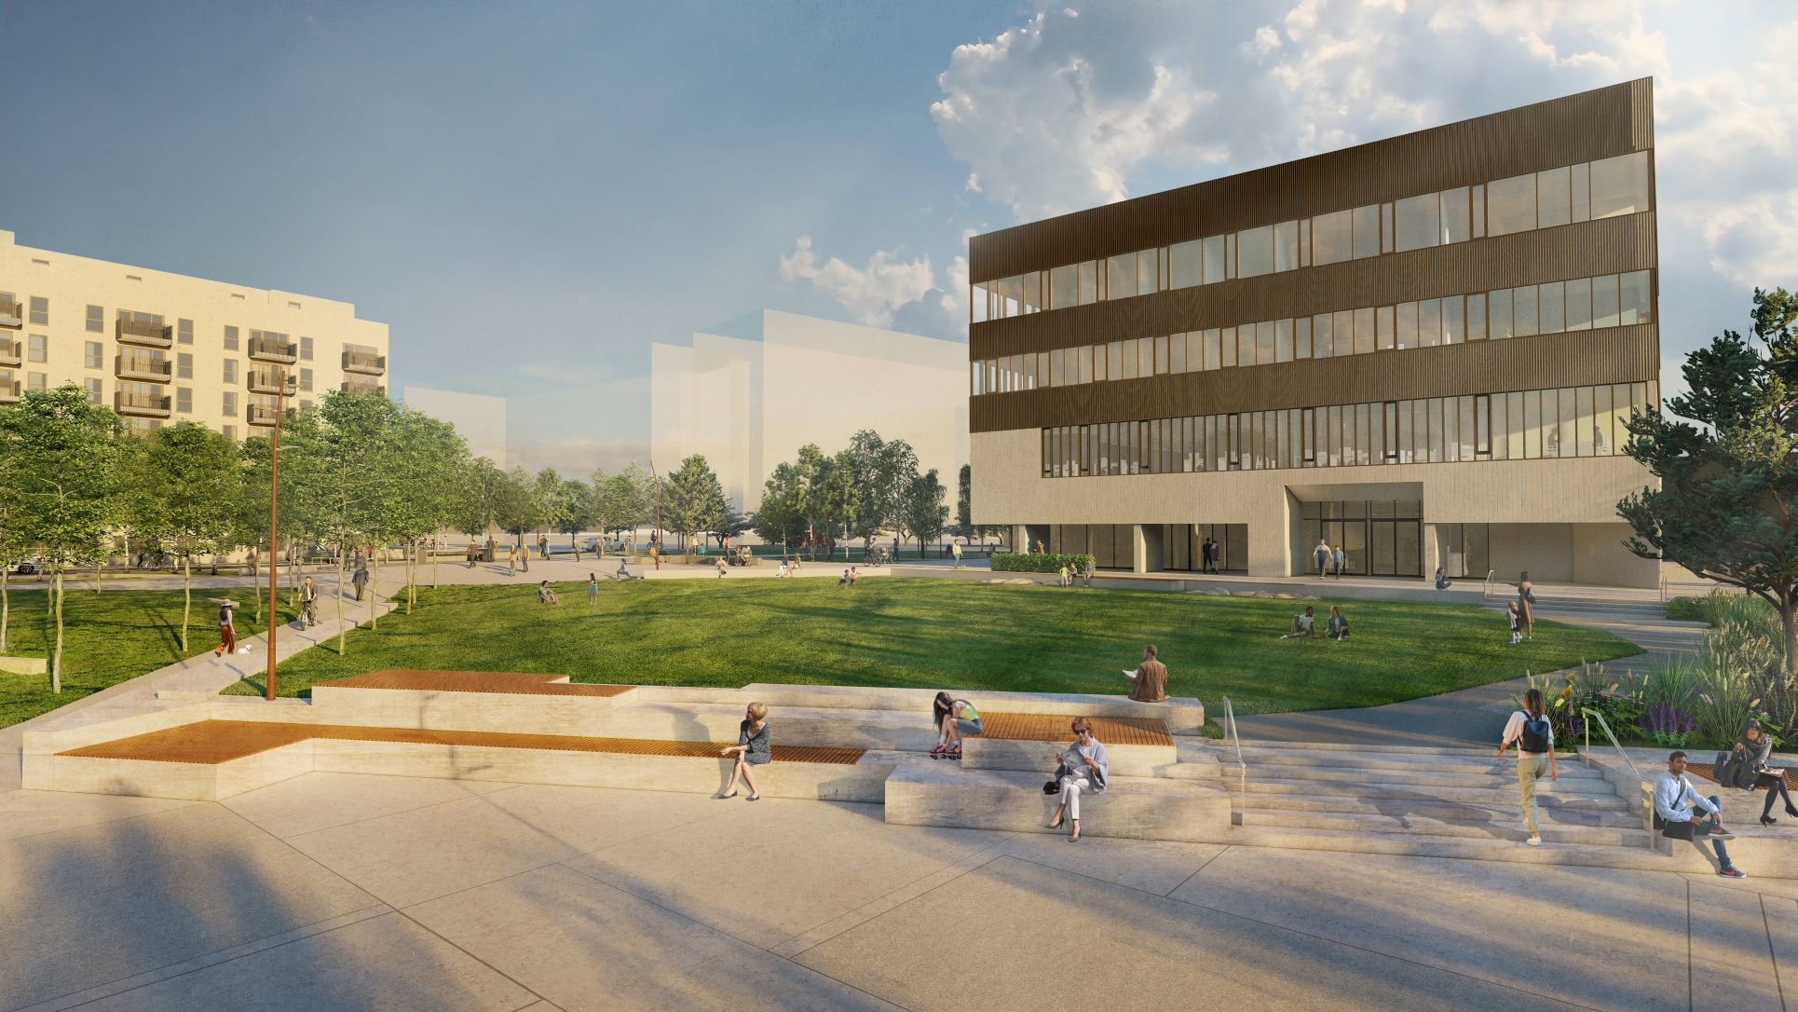

Slide 9
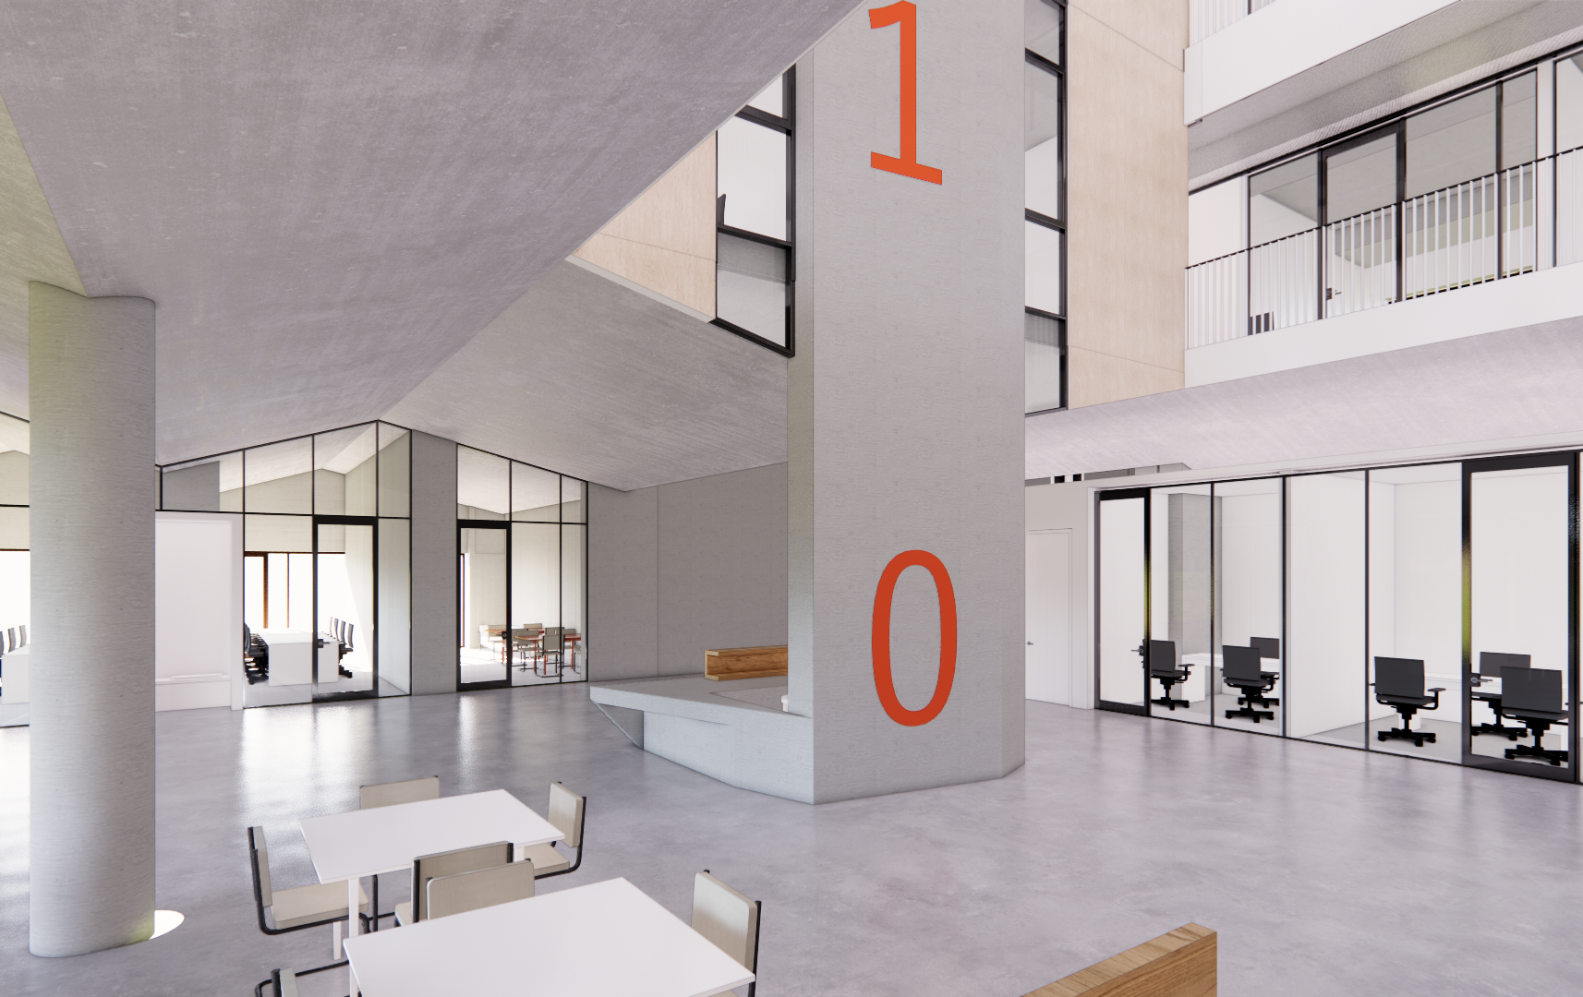
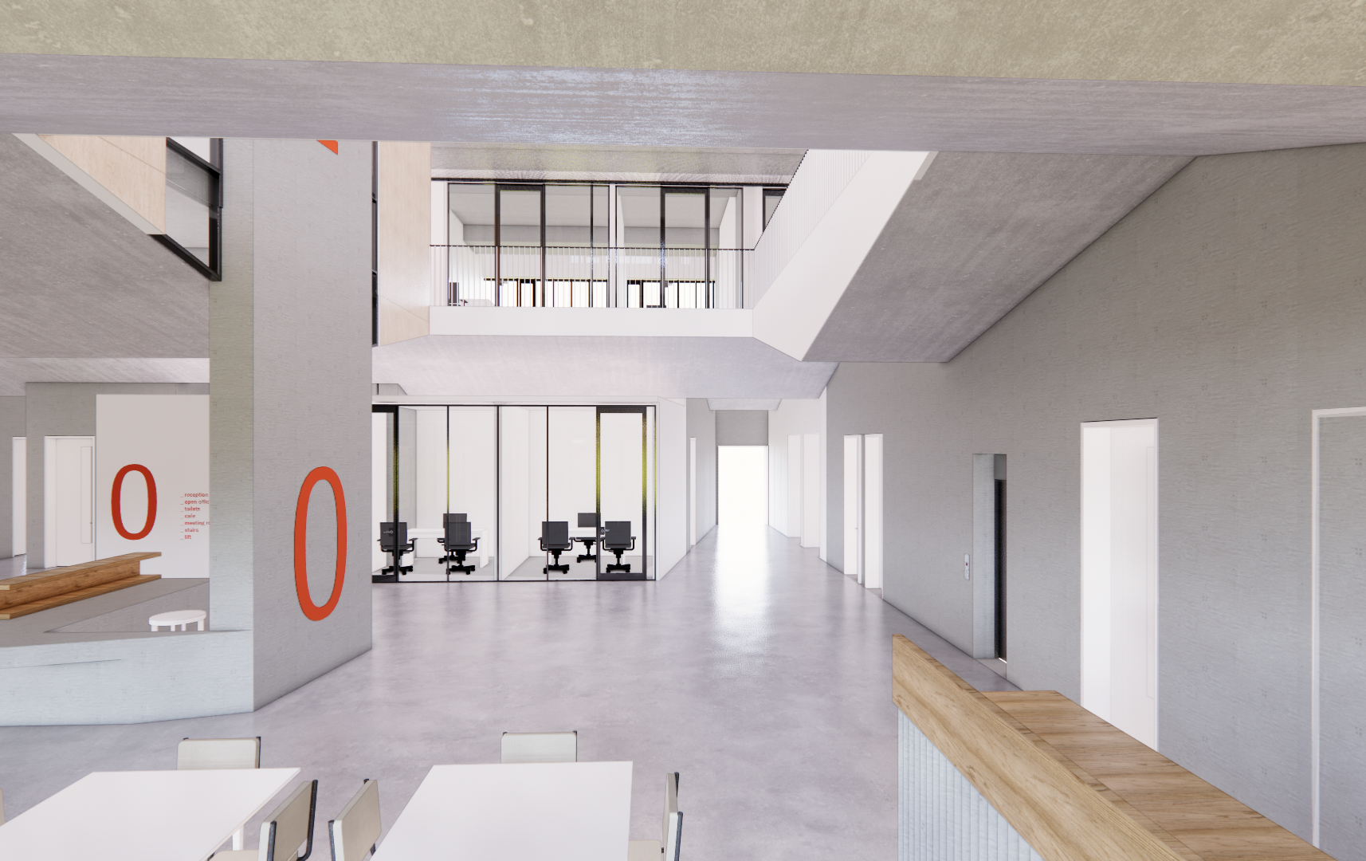

Slide 10
Thank You!

