Slide 1
Capital Projects Updates
Economic Enterprise and Tourism Development SPC
May 11th 2022

Slide 2
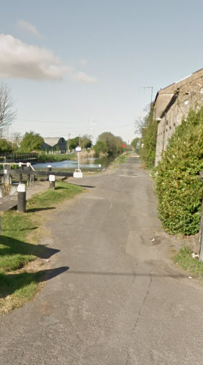
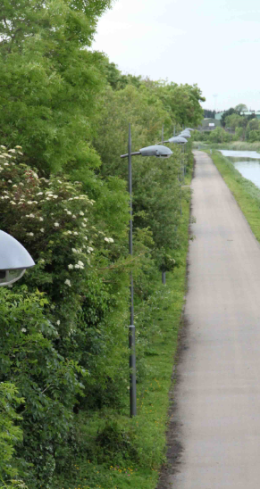
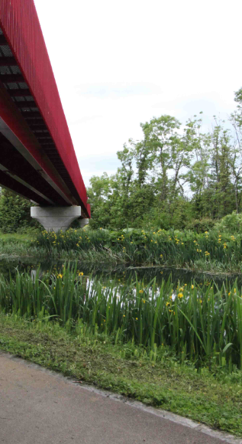
12th Lock Masterplan Strategic Location/ Key Projects
Adjacent Grange Castle, Clonburris, Adamstown
12th Lock to Hazelhatch Greenway Scheme
Canal Loops Project
Lucan Village Proposal

Slide 3
Brief for Consultants
Examine the potential and deliver a plan outlining recommendations /setting out phasing programme for delivery to achieve the following
to provide for additional public amenity
cultural/enterprise/artisan and craft space,
hotel, café and restaurant options
leisure facilities including potentially a marina /water related leisure activities in conjunction with Waterways Ireland.
To establish a destination amenity and a connection to and from the Clonburris SDZ and to the wider residential areas of Lucan, Adamstown and Clondalkin.
To complement and be an asset for the locality, the adjacent business park staff and the wider County and region

Slide 4
Update May 2022
Tender issued to consultants on Framework for Urban Design –March 2022
2 Tender Submissions received by end April 2022
Tender submissions evaluated and letters issued.
Standstill period to conclude 19th May 2022.
Initial meeting to follow directly.
Masterplan preparation timeline - 18 weeks in total.

Slide 5
Tallaght Stadium Project Progress 1. Pre-Cast Concrete Appointed June 2021 2. Final Design Stage 3. Construction Tender Stage 1 Complete 4. Stage 2 Tender issued Nov 2021 5. Tender assessment Jan 2022 6. Contract Negotiations Jan-Apr 2022 7. Contract signed Tuesday 10th May 2022 Construction to commence May 2022 Construction Programme designed to minimize impact on Fixtures -Ongoing engagement and meetings with SRFC

Slide 6
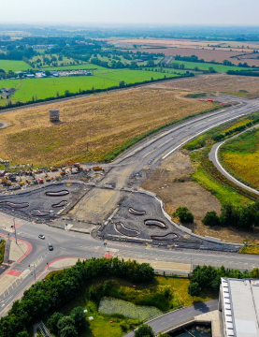
Grange Castle West Access Road
Project commenced March 2020
Main Contractor Clonmel Enterprises

Slide 7
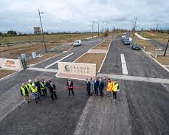
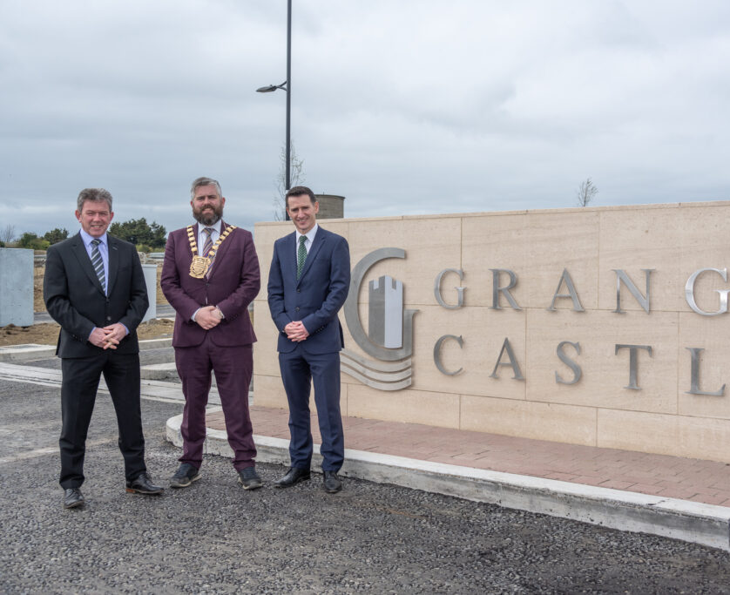
Grange Castle West Access Road
Official Opening 5th April 2022
Completion of Landscaping works to continue.
Launch of Grange Castle West Lands

