Slide 1
SHD Application Ref: SHD3ABP-313129-22
Applicant: Steeplefield Limited
Location: Former Chadwicks Builders Merchant, Greenhills Industrial Estate, Walkinstown, Dublin 12
Presentation to: R.T.F.B. ACM 10th May 2022
Colm Harte
Senior Executive Planner

Slide 2
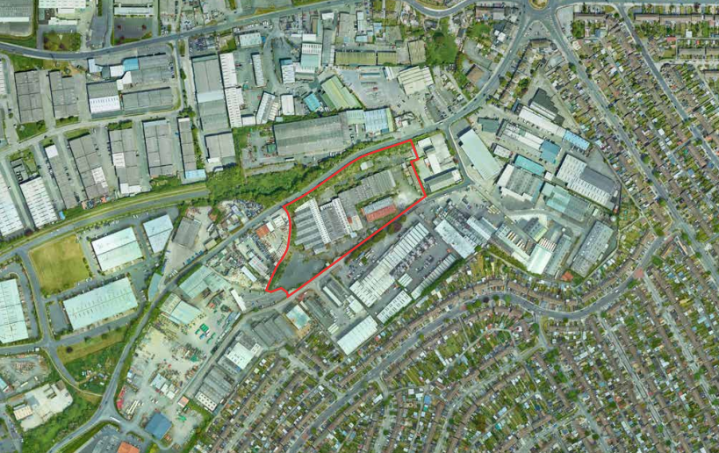
Application Site

Slide 3
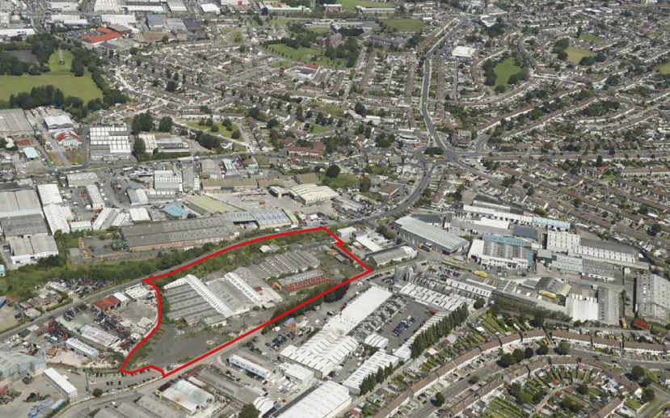
Walkinstown Roundabout
Greenhills Road
Application Site

Slide 4
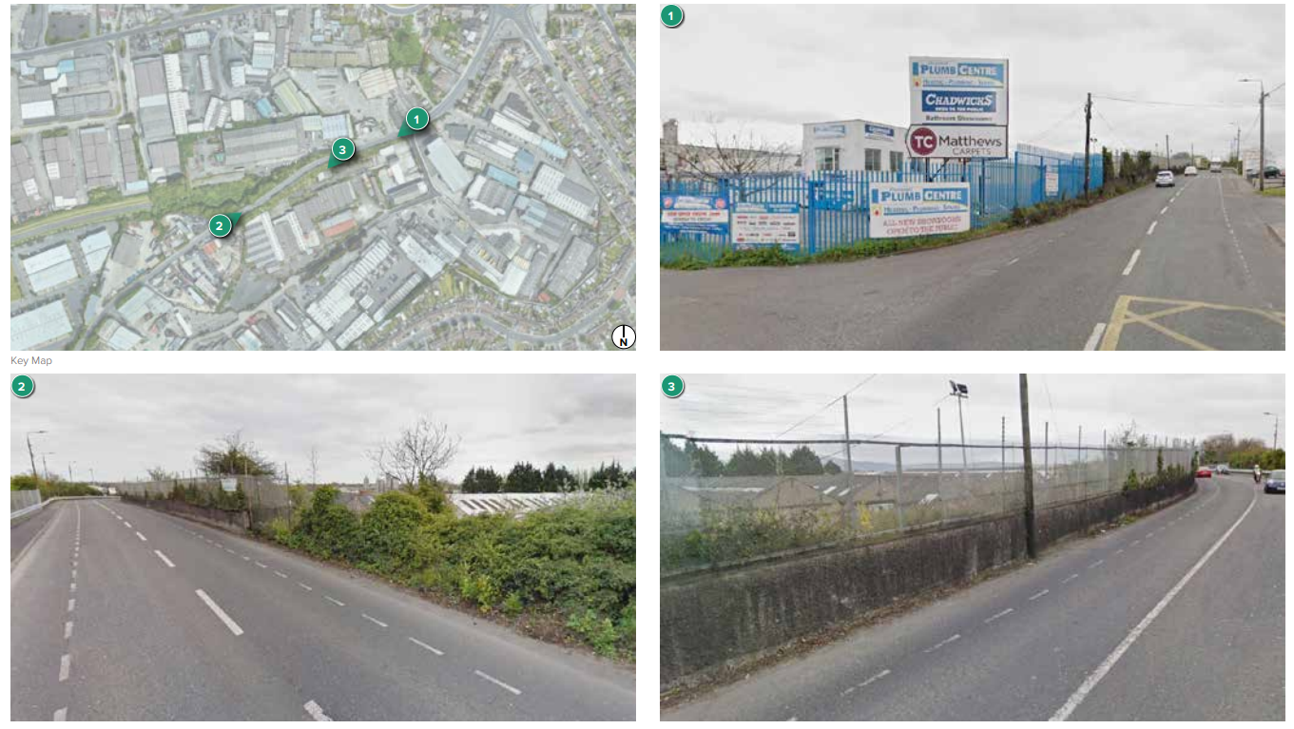
Walkinstown Roundabout
Application Site

Slide 5
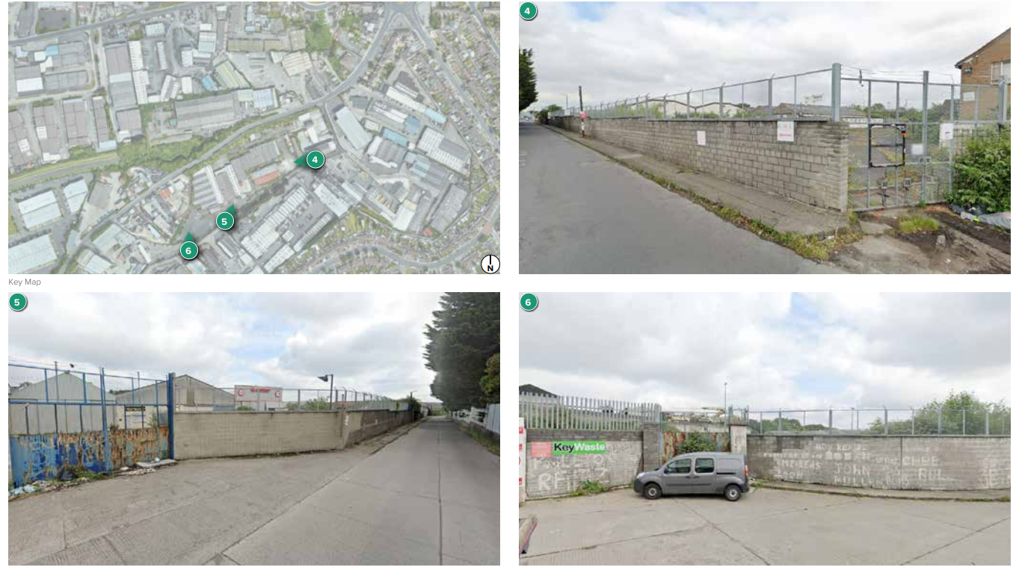
Walkinstown Roundabout
Application Site

Slide 6
Proposed Development
The development will consist of:
The demolition of the former Chadwicks Builders Merchant and the construction of a mixed-use Build-to-Rent residential and commercial development comprising 633 no. build-to-rent apartment units incorporating
292 no. one-beds,
280 no. two-beds and
61 no. three-beds,
The development would involve 4 no. blocks (A-D) ranging in height from 5 to 12 storeys
The proposed development would also involve the provision of 1 no. childcare facility and 10 no. commercial units as well as indoor communal residential amenity/management facilities including a co-working space, communal meeting room/ work space,
The construction of 3 no. vehicular entrances; a primary entrance via vehicular ramp from the north (access from Greenhills Road) and 2 no. secondary entrances from the south for emergency access and services (access from existing road to the south of the site) with additional pedestrian accesses proposed along Greenhills Road;

Slide 7
Proposed Development
Provision of 424 no. car parking spaces comprising 398 no. standard spaces, 21 no. mobility spaces and 5 no. car club spaces located at ground floor level car park located within Block A and accessed via the proposed entrance at Greenhills Road, a two-storey car park located within Blocks C and D also accessed from the proposed entrance at Greenhills Road and on-street parking at ground floor level adjacent to Blocks A and C. Provision of an additional 15 no. commercial/ unloading/ drop-off on-street parking spaces at ground floor level (providing for an overall total of 439 car parking spaces).
Provision of outdoor communal amenity space (5,020 sq.m.) comprising landscaped courtyards that include play areas, seating areas, grass areas, planting, and scented gardens located on podiums at first and second floor levels; provision of a communal amenity roof garden in Block C with seating area and planting (176 sq.m.); and inclusion of centrally located public open space (3,380 sq.m.) adjacent to Blocks B and C comprising grassed areas, planting, seating areas, play areas, water feature, flexible use space; and incidental open space/public realm;
This application is accompanied by an Environmental Impact Assessment Report (EIAR).

Slide 8
Timelines
SHD Lodged with ABP on 25/03/22
Third party Observation due by 5.30pm on 28/04/22
CE report due on 19/05/22
Decision due from ABP on 14/07/22
S.247 pre-planning meeting with SDCC as follows:
SHD1SPP002/21 on 09/03/2021
Tripartite meeting ref SHD2ABP-313129-20 held on 29/04/21 with An Bord Pleanála, the applicant and SDCC.
Consultations

Slide 9
ABP comments – the Bord requested that the following issues be addressed
City Edge Masterplan
Further consideration/clarification is required of how the proposed development responds to the preferred scenarios identified for the City Edge Project. Further consideration of this matter may require an amendment to the documents and/or design proposals submitted.
2. Density and Building Height
Further consideration is required of how the proposed development density and building heights up to 19 storeys align with National Planning Policy principles. Clarification is specifically required in relation to how the character of the site location and its public transport accessibility
3. Design Strategy
The prospective applicant should provide further justification and/or detail in relation to the design strategy. In particular, the prospective applicant should provide further justification in relation to the following:
The visual impact of the development
The elevational treatment of blocks;
The mass of development form;
The treatment of the frontage to Greenhills Road in both its current and anticipated future form; and
Connectivity through the site.

Slide 10
ABP comments continued:
Consideration is required of potential impacts upon future residential populations of the site, resulting from the existing uses.
Consideration is required of any matters that have the potential to be material contraventions of the Development Plan, with submission of a statement regarding the same if required.
Landscape drawings clarifying the quantum of public open space proposed and the quality, functionality/usability of the public open space.
Cross sections of the development should be submitted, clearly detailing the change in levels from the site to surrounding areas and how this will be addressed in both the existing and future conditions.
A report which addres daylight/sunlight analysis, micro-climate/wind impacts and noise impacts and a Daylight/Sunlight analysis.
A Housing Quality Assessment
Waste management details
Additional details, re Roads Department Planning Report, Parks report and Surface Water Drainage and Flood Risk report as indicated in Appendix 1 of the Planning Authority’s Opinion

Slide 11
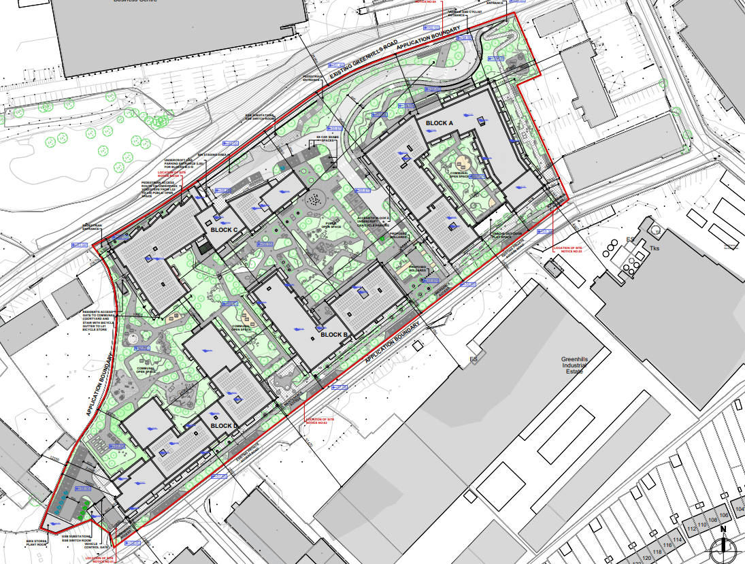

Slide 12
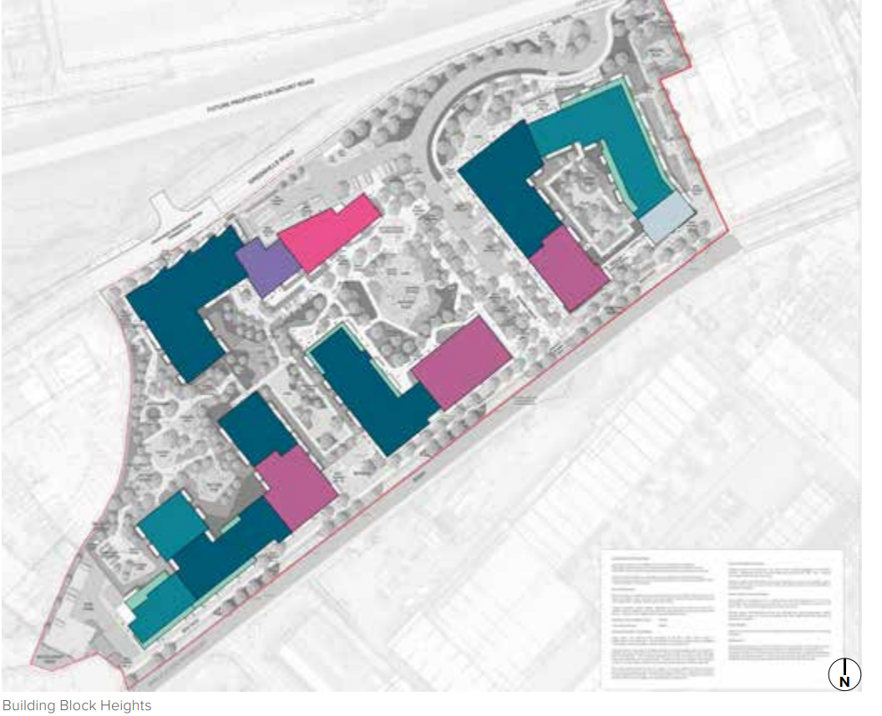
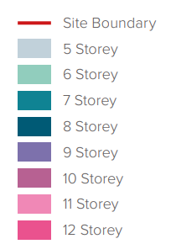

Slide 13
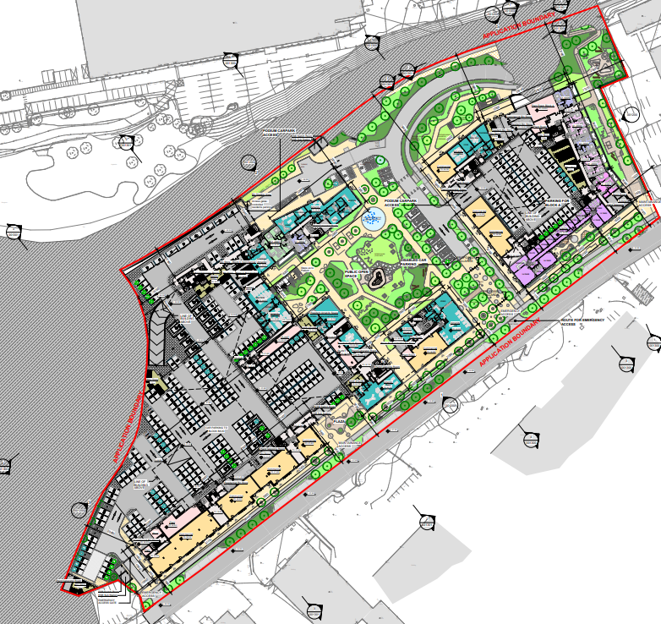

Slide 14
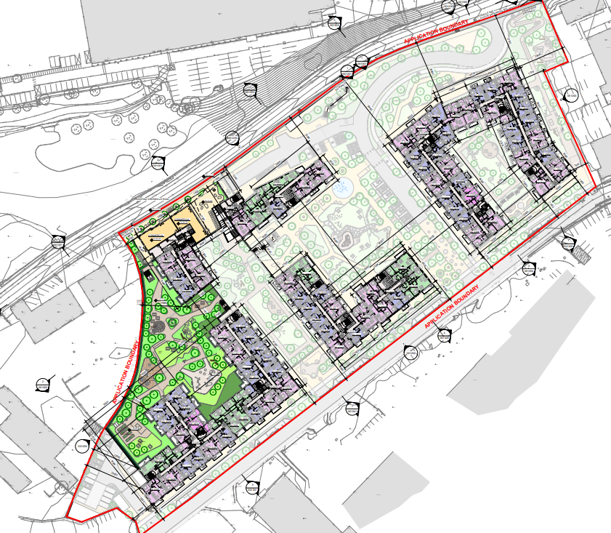

Slide 15
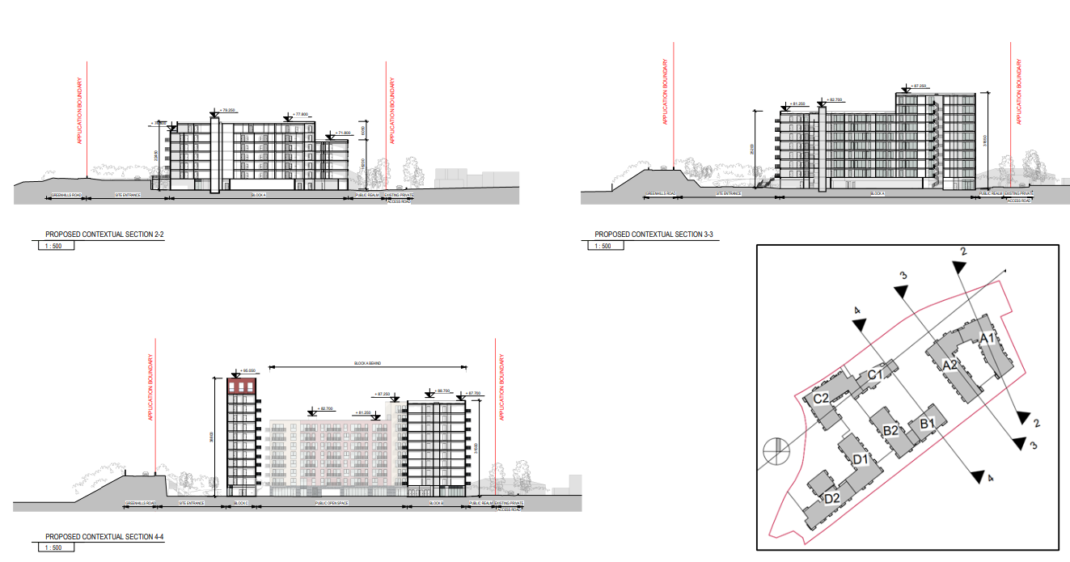

Slide 16
Statistics for Proposed Development
Proposal
The proposed development comprises the demolition of existing industrial units on site and the construction of a mixed-use residential development comprising 4 no. 5-12 storey blocks accommodating 633 no. Build-to-Rent apartments;
292 no. 1- bed apartments (46%);
25 no. 2-bed (3 Person) apartments (3.4%),
255 no. 2-bed (4 Person) apartments (41%),
61 no. 3-bed apartments (9.6%).
Site area – 11.12.ha.
Density – 226.9 dwellings per hectare .
Creche – creche (360m²) – Ground floor of Block A
Commercial – 10 retail/non-retail service/cafe units (1330 sq.m) at ground level
Car parking spaces – total 439 spaces
Bicycle parking – 1,035 bicycle spaces
Plot Ratio – 2.61
Site Coverage – 52%
Height – 5- 12 storeys
Dual Aspect apartments – 47%
Public Open Space – 3,380 sq.m (12% of site area)
Communal Open Space – 5520sq.m.
Applicants website - www.greenvaleshd.com

Slide 17
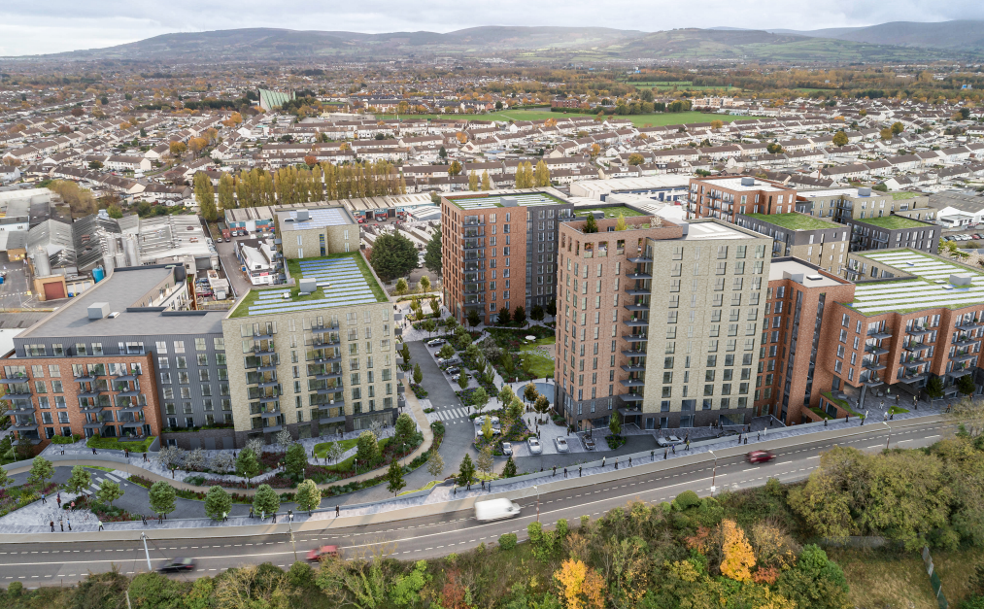
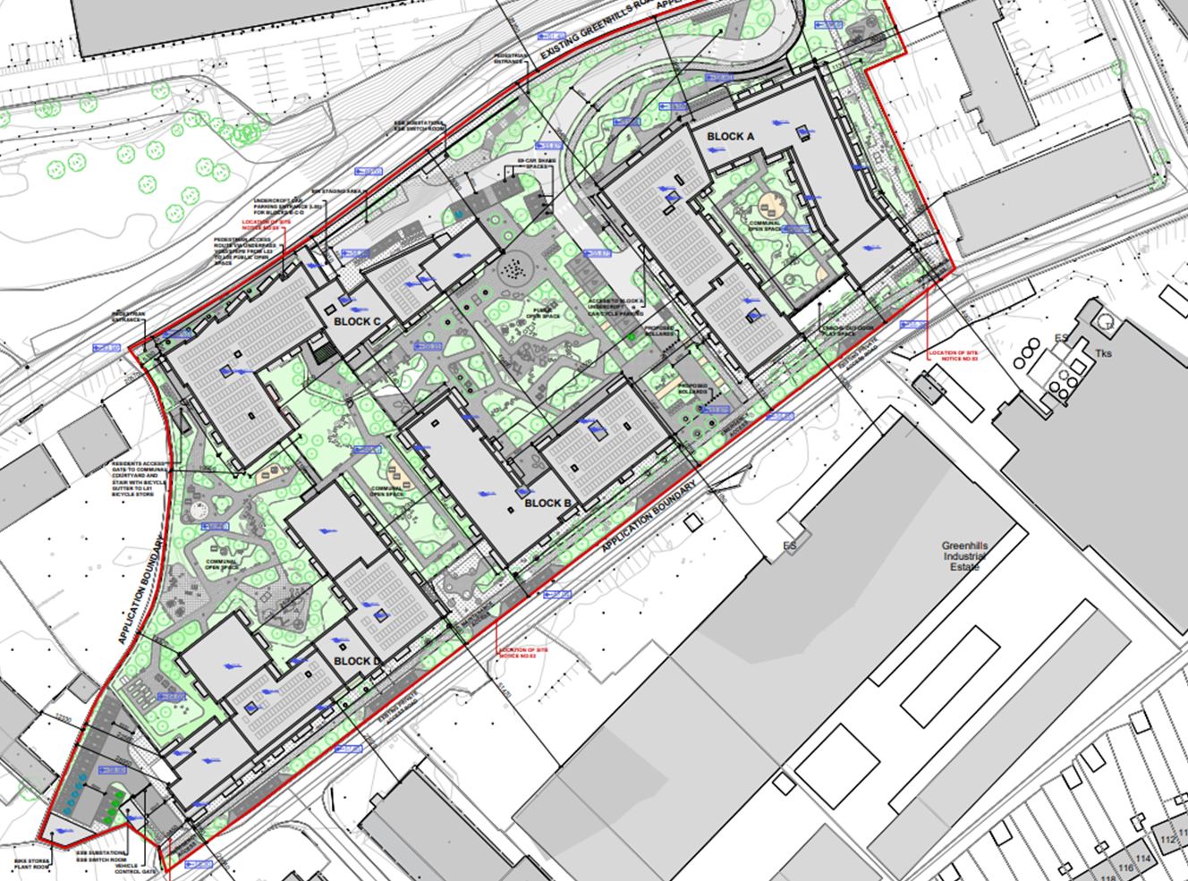
CGI view showing Greenhills Road Elevation

Slide 18
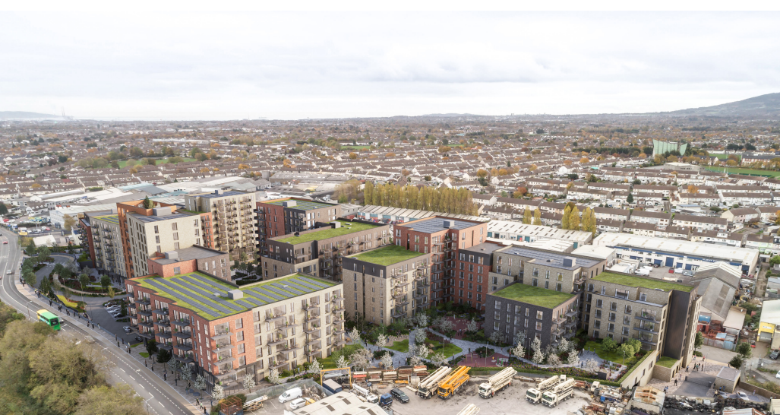
CGI view showing Greenhills Road Elevation

Slide 19
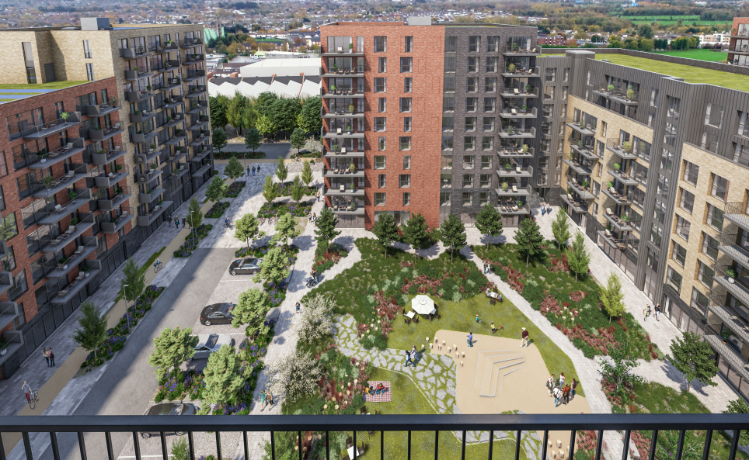
CGI view showing Public Open Space

Slide 20
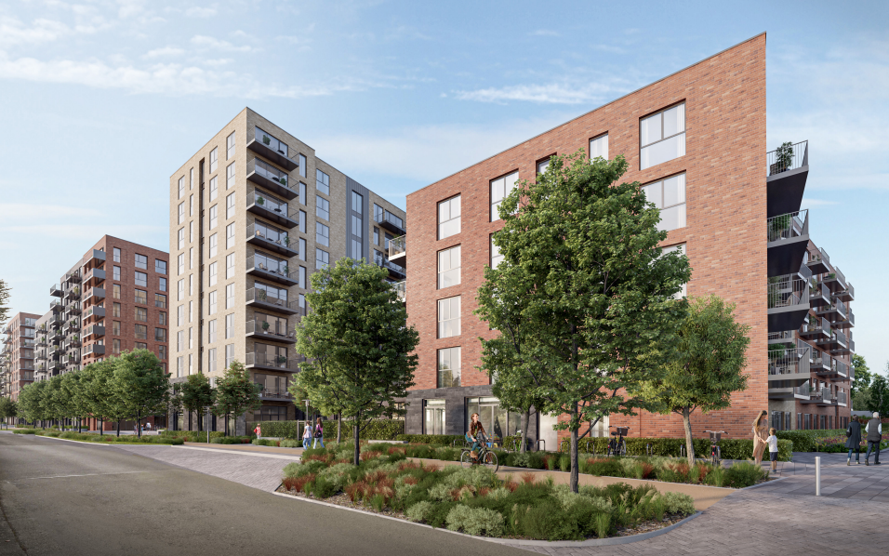
CGI view showing southern site boundary

Slide 21
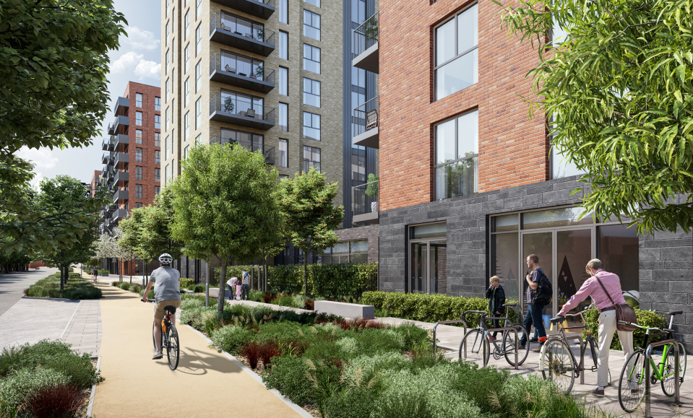
CGI view showing southern site boundary

Slide 22
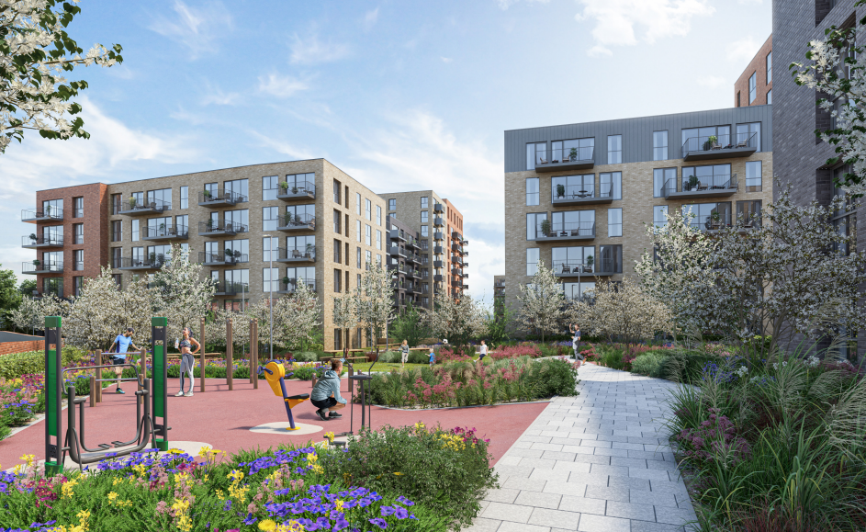
CGI view showing internal open space

Slide 23
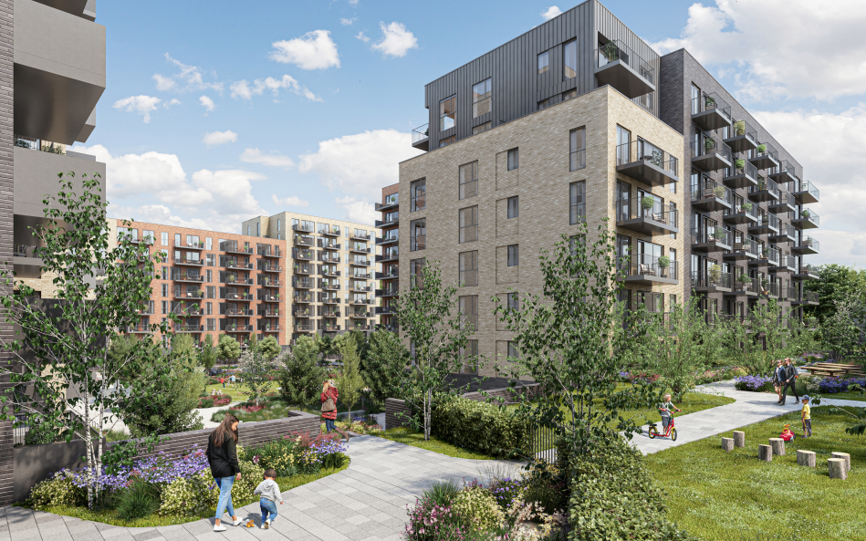
CGI view showing internal open space

Slide 24
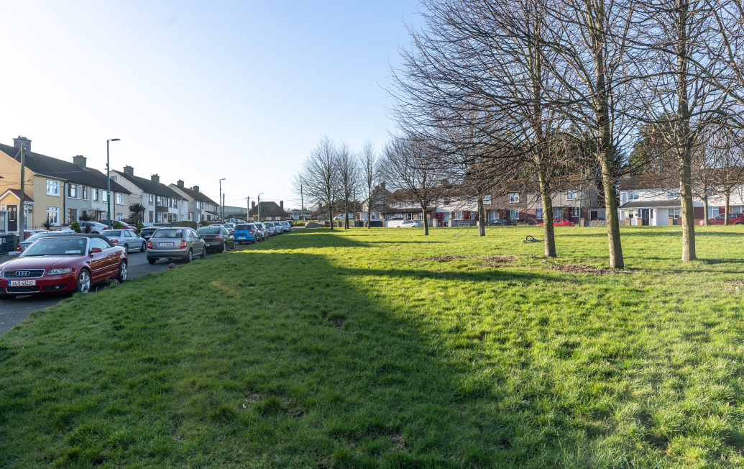
View from Walkinstown Crescent (Existing)

Slide 25
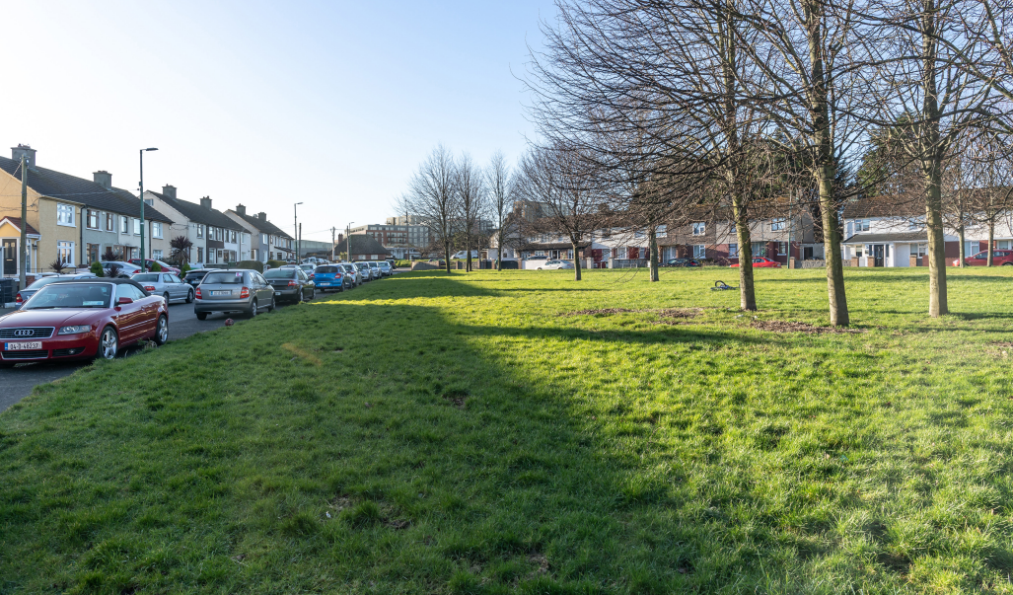
View from Walkinstown Crescent (Proposed)

Slide 26
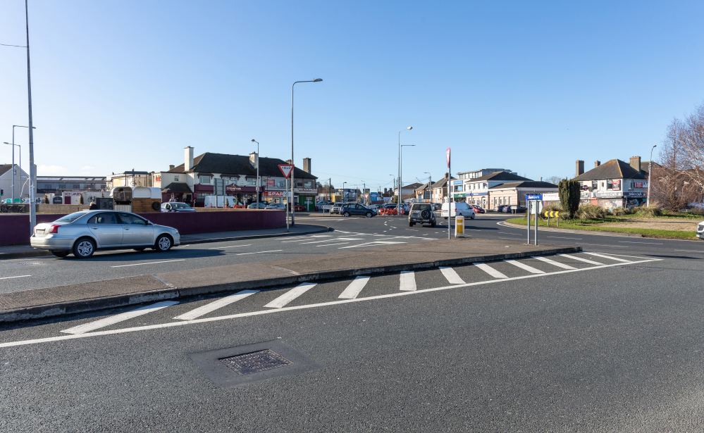
View from Walkinstown Roundabout (Existing)

Slide 27
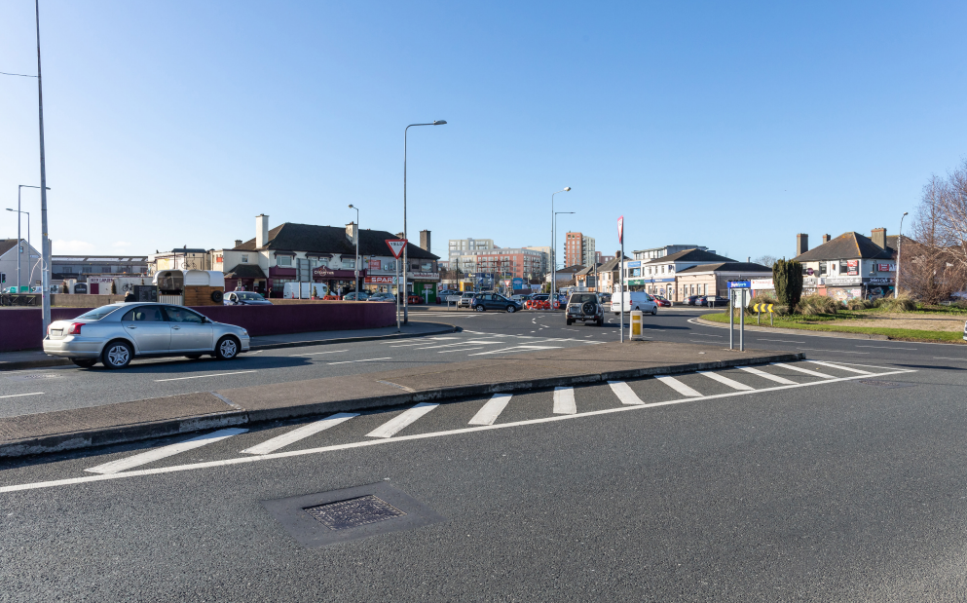
View from Walkinstown Roundabout (Proposed)

Slide 28
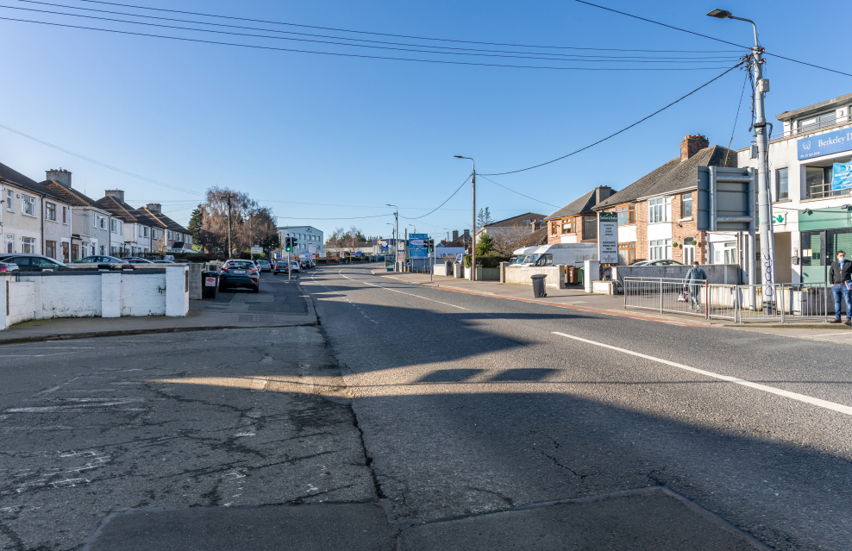
View from Walkinstown Roundabout (Existing)

Slide 29
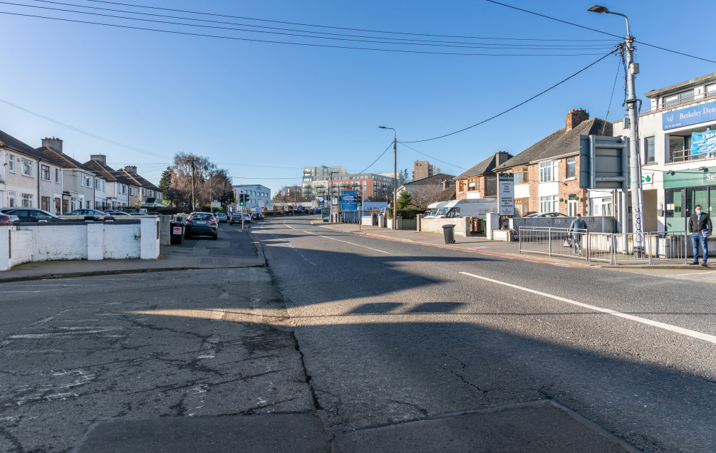
View from Walkinstown Roundabout (Proposed)

Slide 30
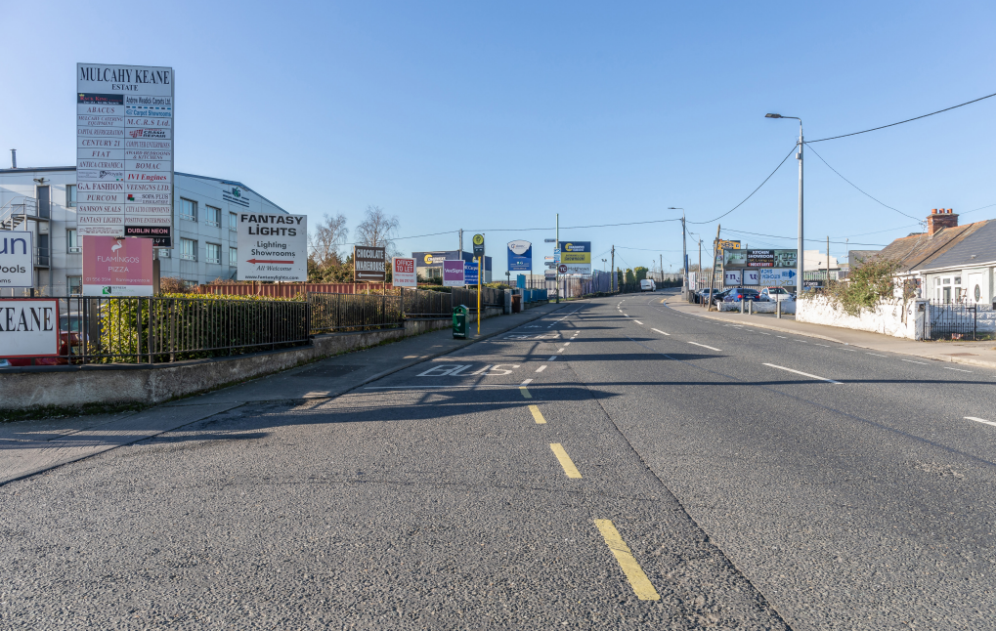
View from Greenhills Road (Existing)

Slide 31
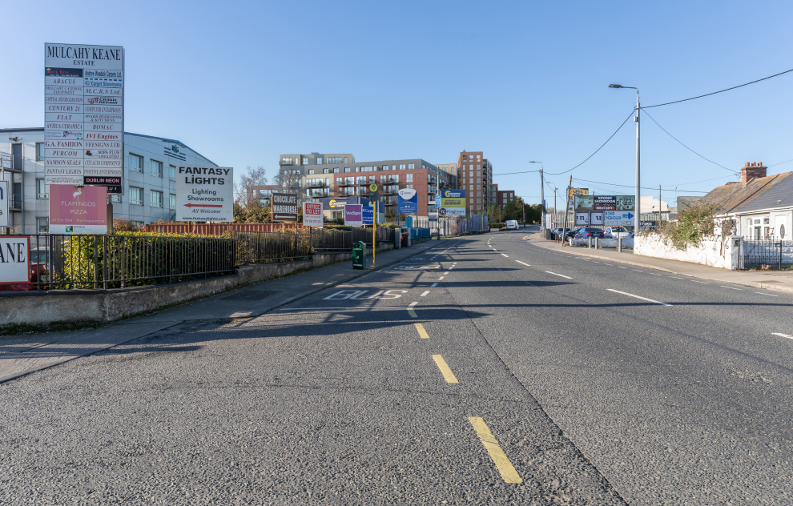
View from Greenhills Road (Proposed)

Slide 32
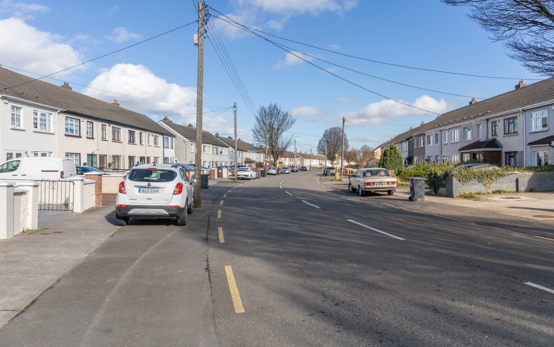
View from St James Road (Existing)

Slide 33
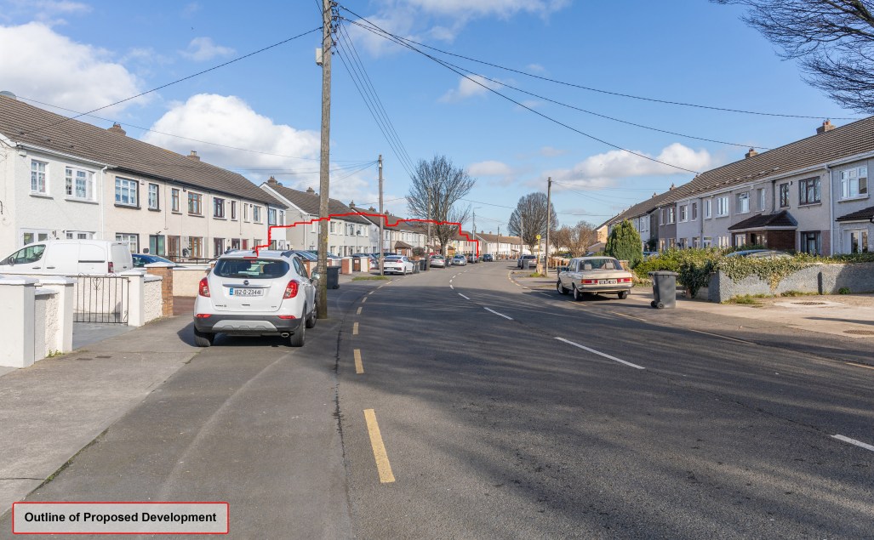
View from St James Road (Proposed)

Slide 34
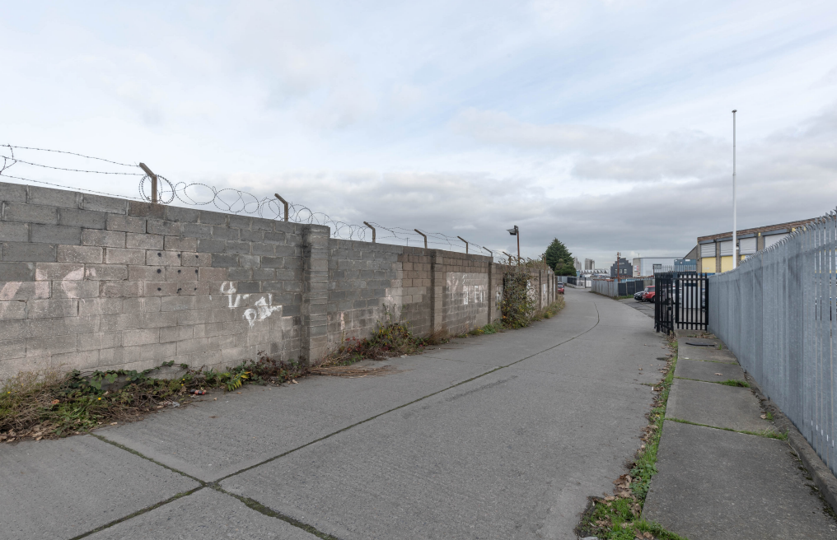
View from internal industrial estate road (Existing)

Slide 35
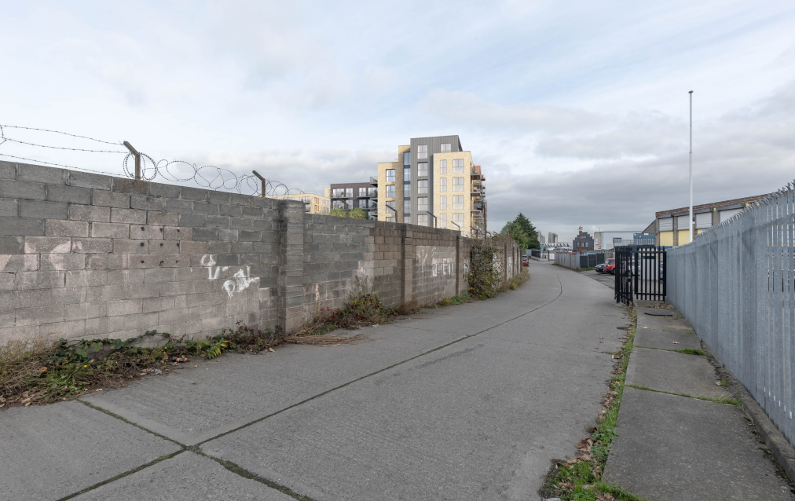
View from internal industrial estate road (Proposed)

Slide 36
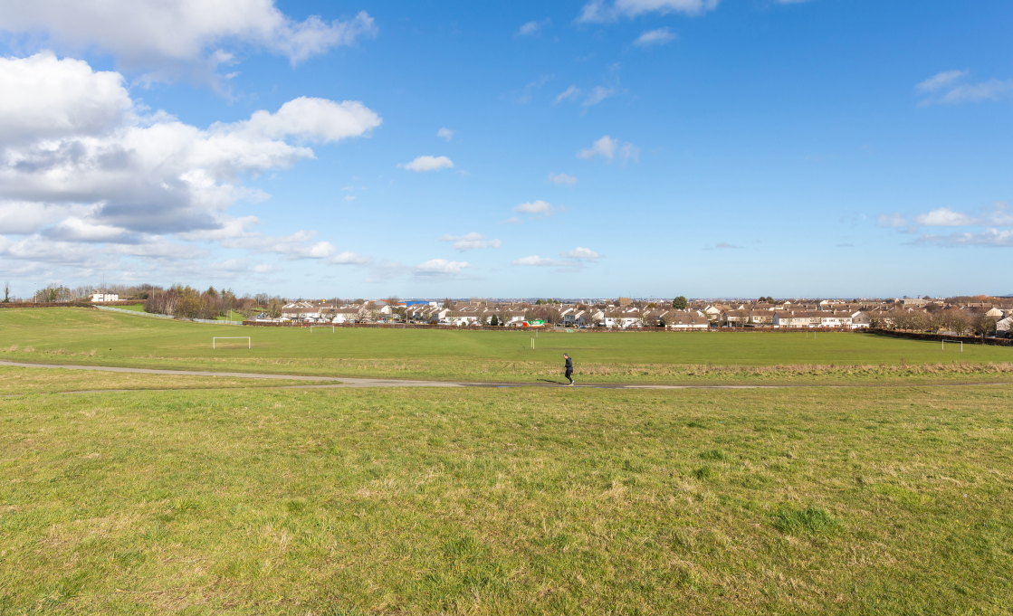
View from Tymon Park (Existing)

Slide 37
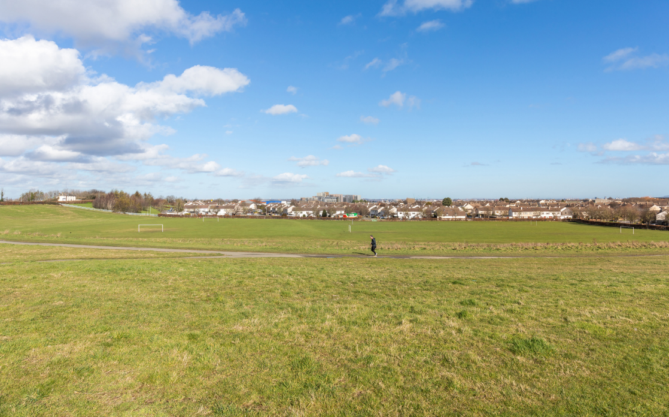
View from Tymon Park (Proposed)

Slide 38
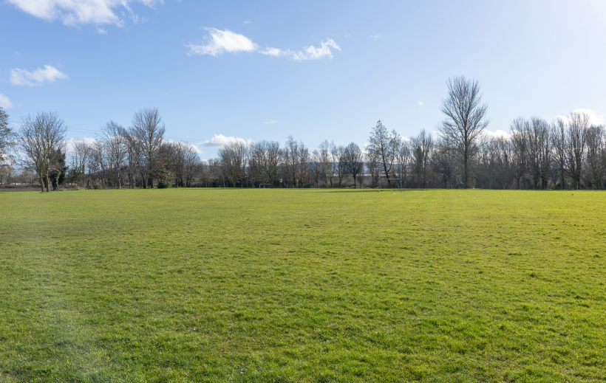
View from Walkinstown Avenue Park (Existing)

Slide 39
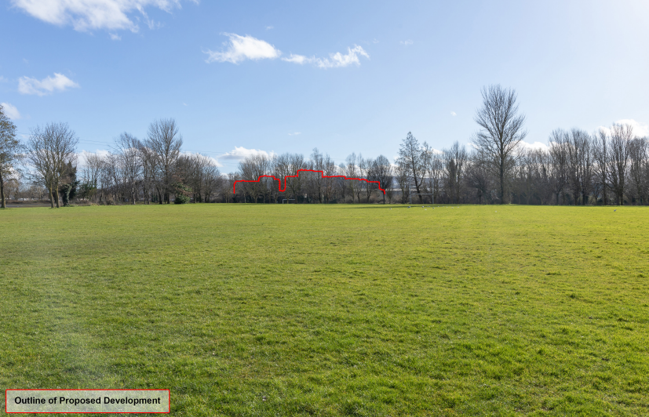
View from Walkinstown Avenue Park (Proposed)

Slide 40
Thank You
Questions

