Slide 1
South Dublin Libraries
Development Plan 2023 - 2027

Slide 2
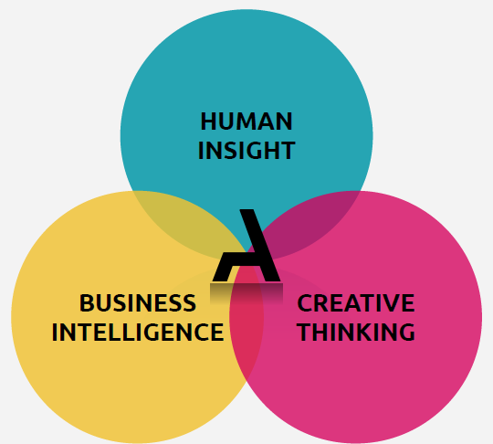
A different approach
Societal environment has changed
We need to catch and retain the attention of members and non-members alike
Rapid evolutions in technology
What was predictable is now uncertain

Slide 3
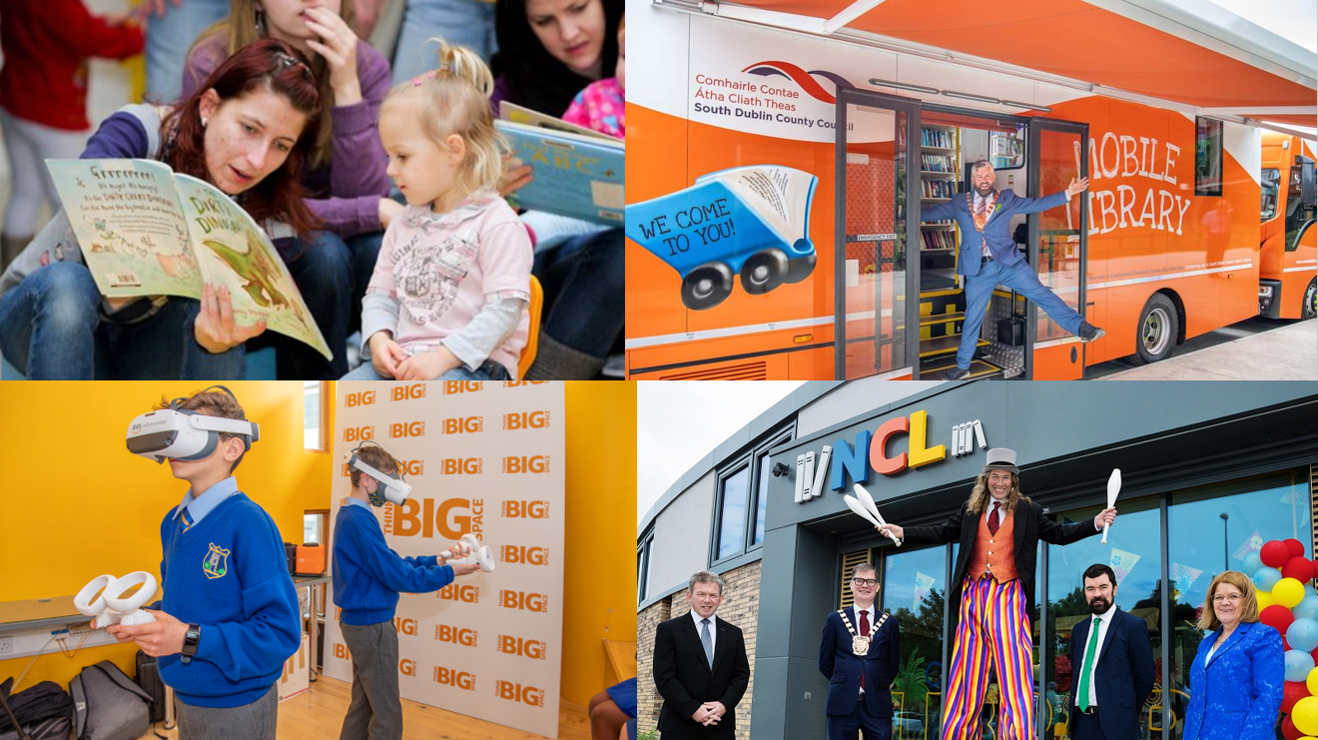
Open to You: 2018 – 2022 Highlights
Castletymon Library – Opened 2021
2 new mobiles libraries launched 2021
North Clondalkin Library – Opened 2020
Think Big Space
3D printers across the branch network
Decade of Centenaries
Family Literacy

Slide 4
The Biggest Challenge
Every user has an expectation
We have our approaches to service delivery
The difference between the two is referred to as the “Expectations Gap”

Slide 5
What makes us so special?
South Dublin Libraries Staff Member 2022
“If everything is important, then nothing is important.
If everything is a priority, then nothing is a priority”

Slide 6
Our new plan – What’s the approach
Classic Strategy
Design-led Strategy
Predictions
Data Collection
Execution from the top down
Experiments
Pattern recognition
Execution by the whole

Slide 7
AMBITION RELEVENCE OWNERSHIP

Slide 8
Who is helping us?
VHI
Johnson & Johnson
Enterprise Ireland
Irish Life
HSE
Revenue Commissioners
TU Dublin
National Health Library & Knowledge Service
Think Actionable an award winning insight, strategy and innovation consultancy

Slide 9
How will they help us?
What is our vision and purpose?
Who are our target audience?
How will we reach and capture that audience?
What do we need that we have, or don’t have, to achieve this?
How do we effectively manage the delivery of the strategy?

Slide 10
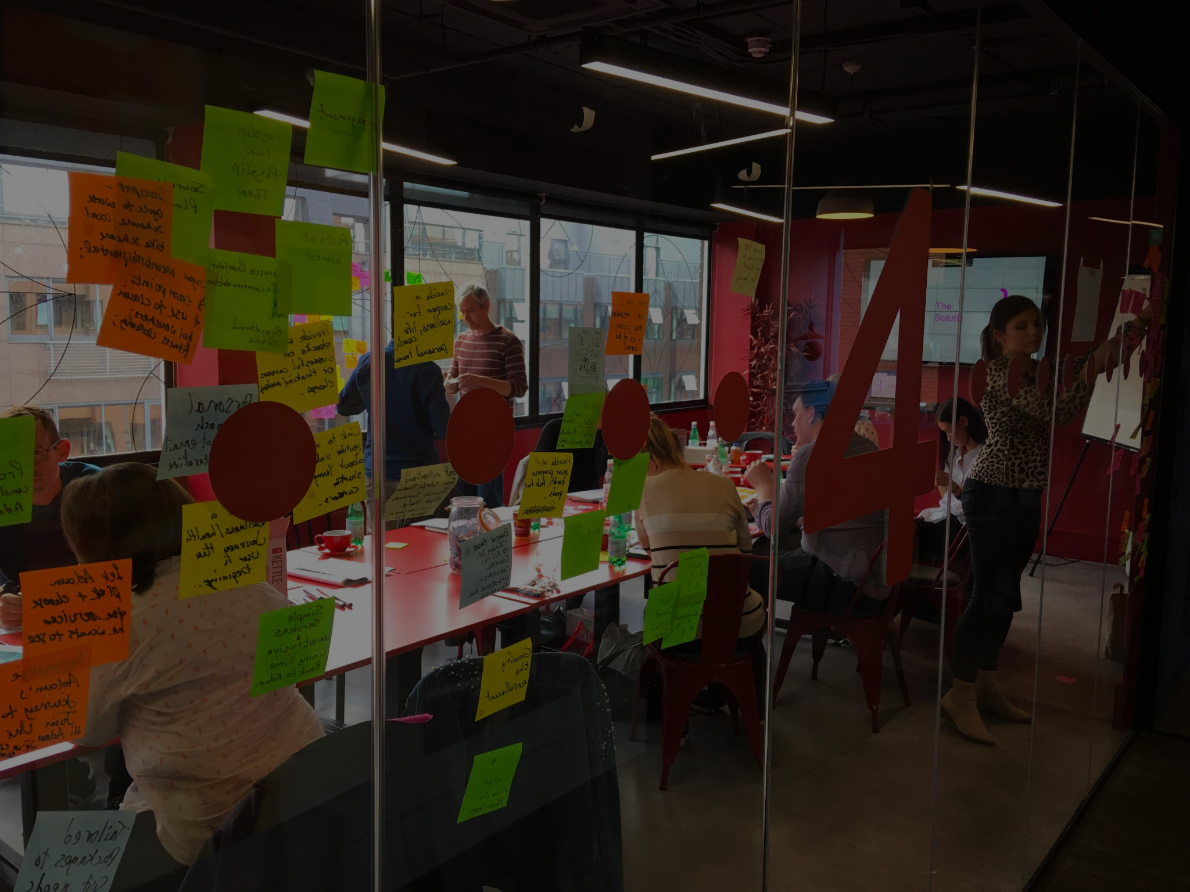
STRATEGY PLANNING SCHEDULE
Insight - Strategy - Innovation - Training
AUDIT
PHASE
(5-6 weeks)
Actionable & library management work through internal surveys and workshops to set working aspiration statement and identify barriers and opportunities. Desk research & analysis.
Engagement with library stakeholders, including the SPC and elected members
IDEATE PHASE
(2 weeks)
Creative brainstorming sessions with key internal and external stakeholders based on Audit, Research & Reframe findings. Identification of innovative initiatives to align with objectives
Progress review:
Monday 30th June
Progress review:
Monday 1st August
RESEARCH PHASE
(8-10 weeks)
large-scale public survey, consultation workshops,
focused interviews and in-library observational studies.
VALIDATE & EXECUTE PHASE
(4-6 weeks)
Detailing out of initiatives under each of the identified objectives. Drafting of a comprehensive development plan for presentation
Progress review:
Monday 4th July
Progress review:
Monday 5th September
REFRAME PHASE
(2 weeks)
Synthesis and analysis of all research and audit findings to identify themes and insights.
SEPTEMBER
Draft development plan
presentation to spc
October
Draft development plan
presentation to full council

