Slide 1
“National Waste Management Plan for A Circular Economy”
Hugh Coughlan
Regional Co-ordinator
Eastern - Midlands Regional Waste Management Planning Office

Slide 2
Outline
The Plan
The Process
Key Takeaways

Slide 3
Background
Waste Management Act Section 22
Waste Policy “A Resource Opportunity”
Regional Structures / Lead Authorities
3 Regional Plans National Coordination
Coordinated Implementation
“Waste Action Plan for the Circular Economy”

Slide 4
Plan Evaluation
Key Learnings:
Dependencies
Targets / Controls
Flexibility
Collaboration

Slide 5
Plan Evaluation
Recommendations:
Replacement Plan
Regional Focus
Retention of some objectives
Collaboration
Targets/Responsibilities

Slide 6
Big Changes
Single National Plan
Circularity
Collaboration
Co-ownership

Slide 7
Old Model
Draft Waste Management Plan
Engagement with Key Stakeholders

Slide 8
New Model
Engagement with Key Stakeholders
Draft Waste Management Plan

Slide 9
Key Challenges
PREVENTION
Continue the drive for reuse and prevention across all waste streams
RECYCLING
Continue to push up recycling rates
PLASTICS
Continue to reduce the use of single use plastics
TEXTILES
Address the impact of textiles on waste management
FOOD
Continue to improve segregation across all settings
TREATMENT
Move towards self sufficiency across all waste steams and process
CONSTRUCTION
Provide alternative uses and outlets for construction and demolition wastes
GOVERNANCE
Provide leadership and protect consumer rights

Slide 10
Key Themes
Consumption
“the action of using up a resource”
Capture
“the process of collecting a natural product so that it can be used”
Compliance
“the act of obeying an order rule or request”
Influence
Improve
Enable

Slide 11
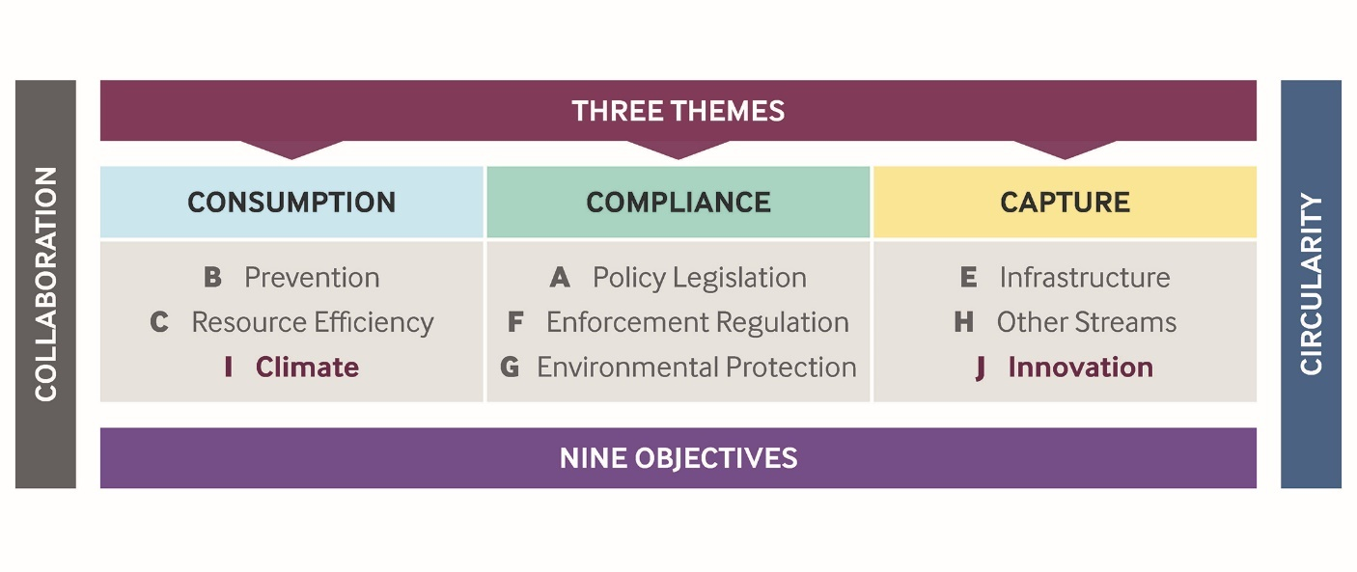
Bookends

Slide 12
Stakeholders
CIWM
Other PRI’s
Rediscovery Centre
CRNI
REPAK
WEEE Ireland
EPA
CEWEP
Citizens
CMI
IWMA
Apartment Owners
CRE
DECC
Academics
Other Govt Depts
CIF
CARO
Local Government Sector

Slide 13
Collaboration - Workshops
Q4 2021
Q1 2022
By Theme
Stakeholder Groups

Slide 14
Collaboration - Workshops
Workshop 1
Stakeholder participation, outreach, and data gathering.
Emerging Priorities and high-level Solutions
Draft Plan Publication
Writing of plan documents, policies, and actions
Workshop 2

Slide 15
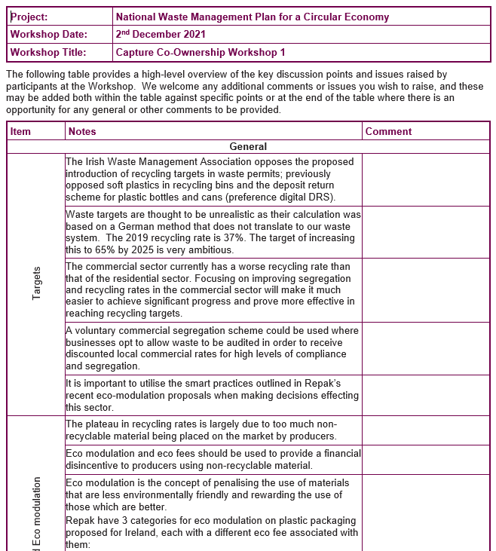
Workshop – Format
Pre.
Content
Post
Introduction
Poll Questions
Breakout Sessions
Miro Boards
Summary

Slide 16
Capture Theme…Strategy

Slide 17
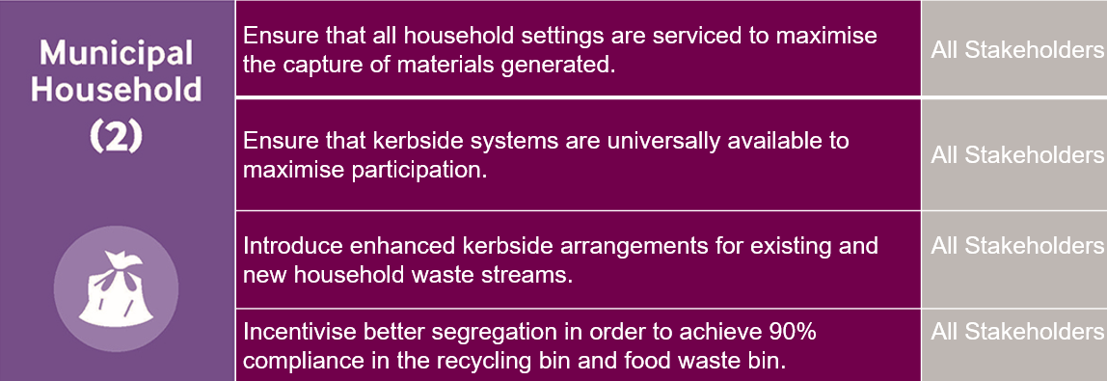
Capture Theme…Policy

Slide 18
Content
Stakeholder participation, outreach, and data gathering.
Emerging Priorities and high-level Solutions
Draft Plan Publication
Writing of plan documents, policies, and actions

Slide 19
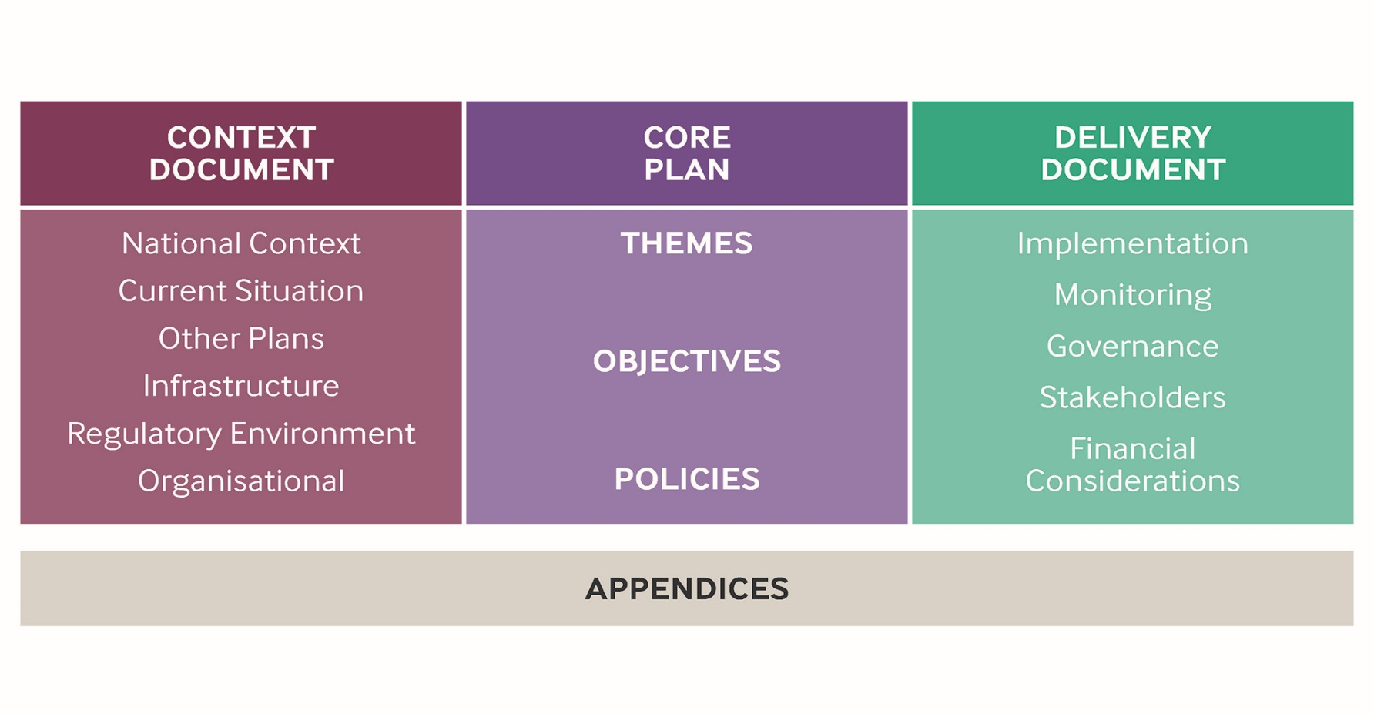
Plan Structure

Slide 20
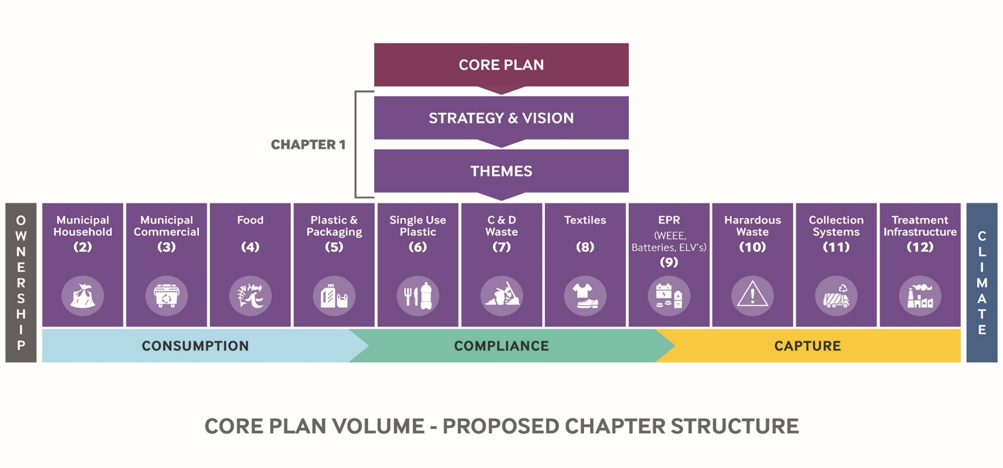
Core Content

Slide 21
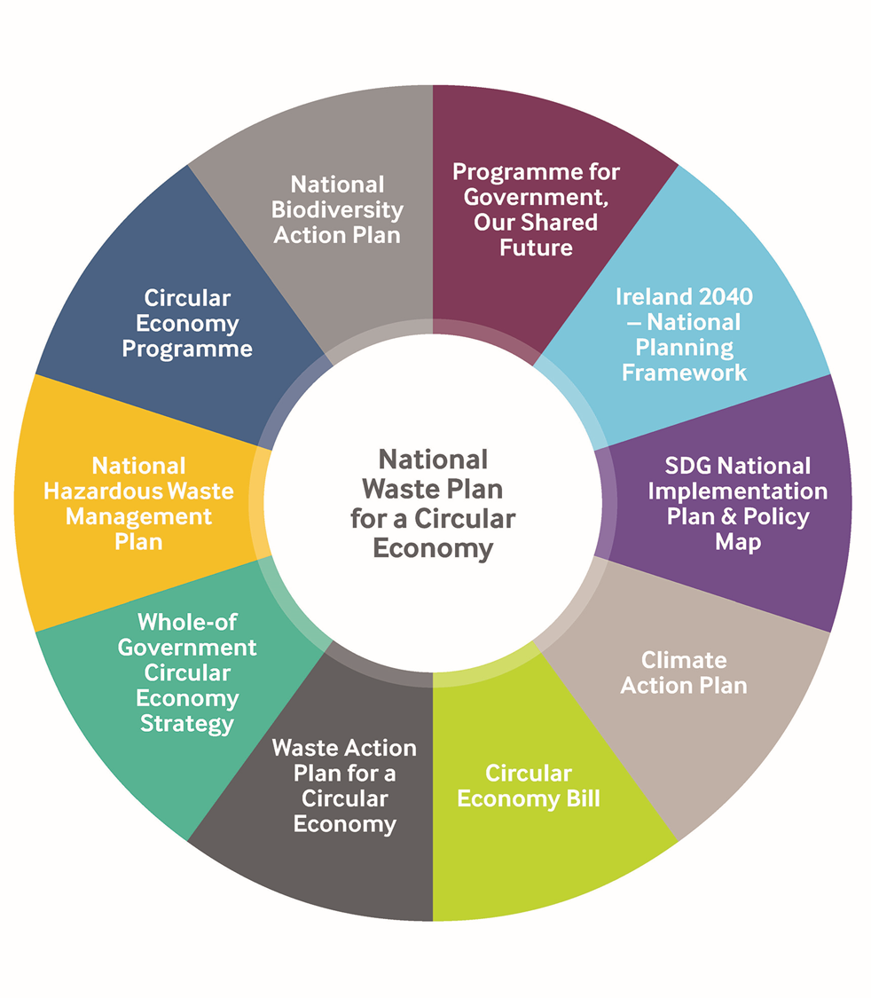
Core Considerations

Slide 22
Total Municipal Solid Waste - Projections 2020 – 2030

Slide 23
Recycling Targets –Municipal Waste 2020-2030

Slide 24
Construction and Demolition Waste - Projections 2020 – 2029

Slide 25
Key Takeaways…..

Slide 26
Governance & Structures
“A business as usual model will not deliver a more Circular Economy, an analysis of the requisite structures is necessary in order to position the sector to deliver its mandate and respond to the challenges and opportunities ahead”.

Slide 27
Resourcing
“The move to a more Circular Economy will undoubtedly present opportunities, however, there will still be a cost to the Local Government Sector both in terms of Financial & Human Resources and the consequential benefits will not always be felt within the Sector”.

Slide 28
Interdependencies
“The achievement of national policies and targets is fundamentally predicated on the interdependence of key stakeholders including Government, Local Government, The EPA, ABP, and Industry”.

Slide 29
Infrastructural Deficits and Responses
“Ireland has inadequate waste treatment capacity with continued dependence on waste exports. The private sector has responded with proposals which would alleviate this situation and contribute to self sufficiency”.

Slide 30
Continuity and Contingency
“Authorised waste treatment activities have inadequate business continuity provisions including contingency arrangements. While the LA sector is obligated to facilitate contingency planning it also seeks to condition waste activities in this regard”.

Slide 31
Monitoring and Mitigation
“The National Waste Management Plan for a Circular Economy will prioritise the monitoring of all waste data while promoting waste generation mitigation measures including prevention, reuse and circularity”.

Slide 32
Resourcing & Upskilling
“A collaborative approach is needed to transition to a Circular Economy and to ensure fitness of purpose increased resources and upskilling across are required across the local authority sector.”

Slide 33
Thank You
“National Waste Management Plan for a Circular Economy “

