Slide 1
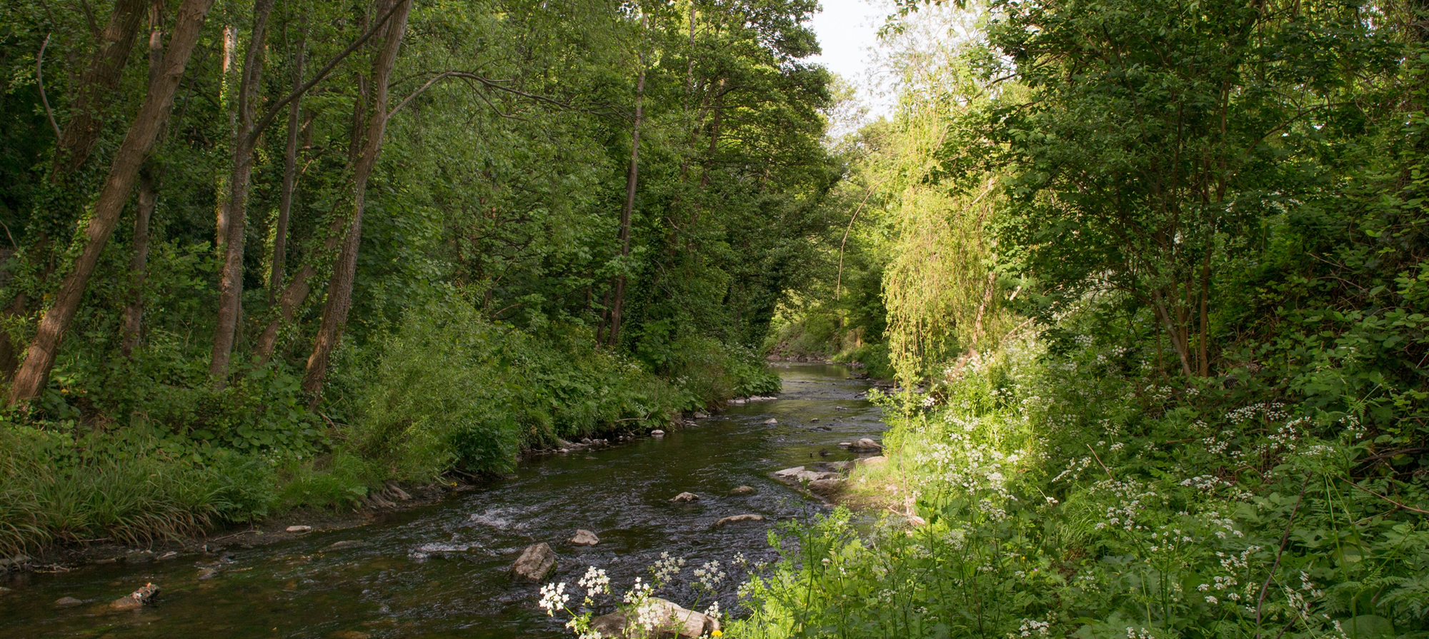
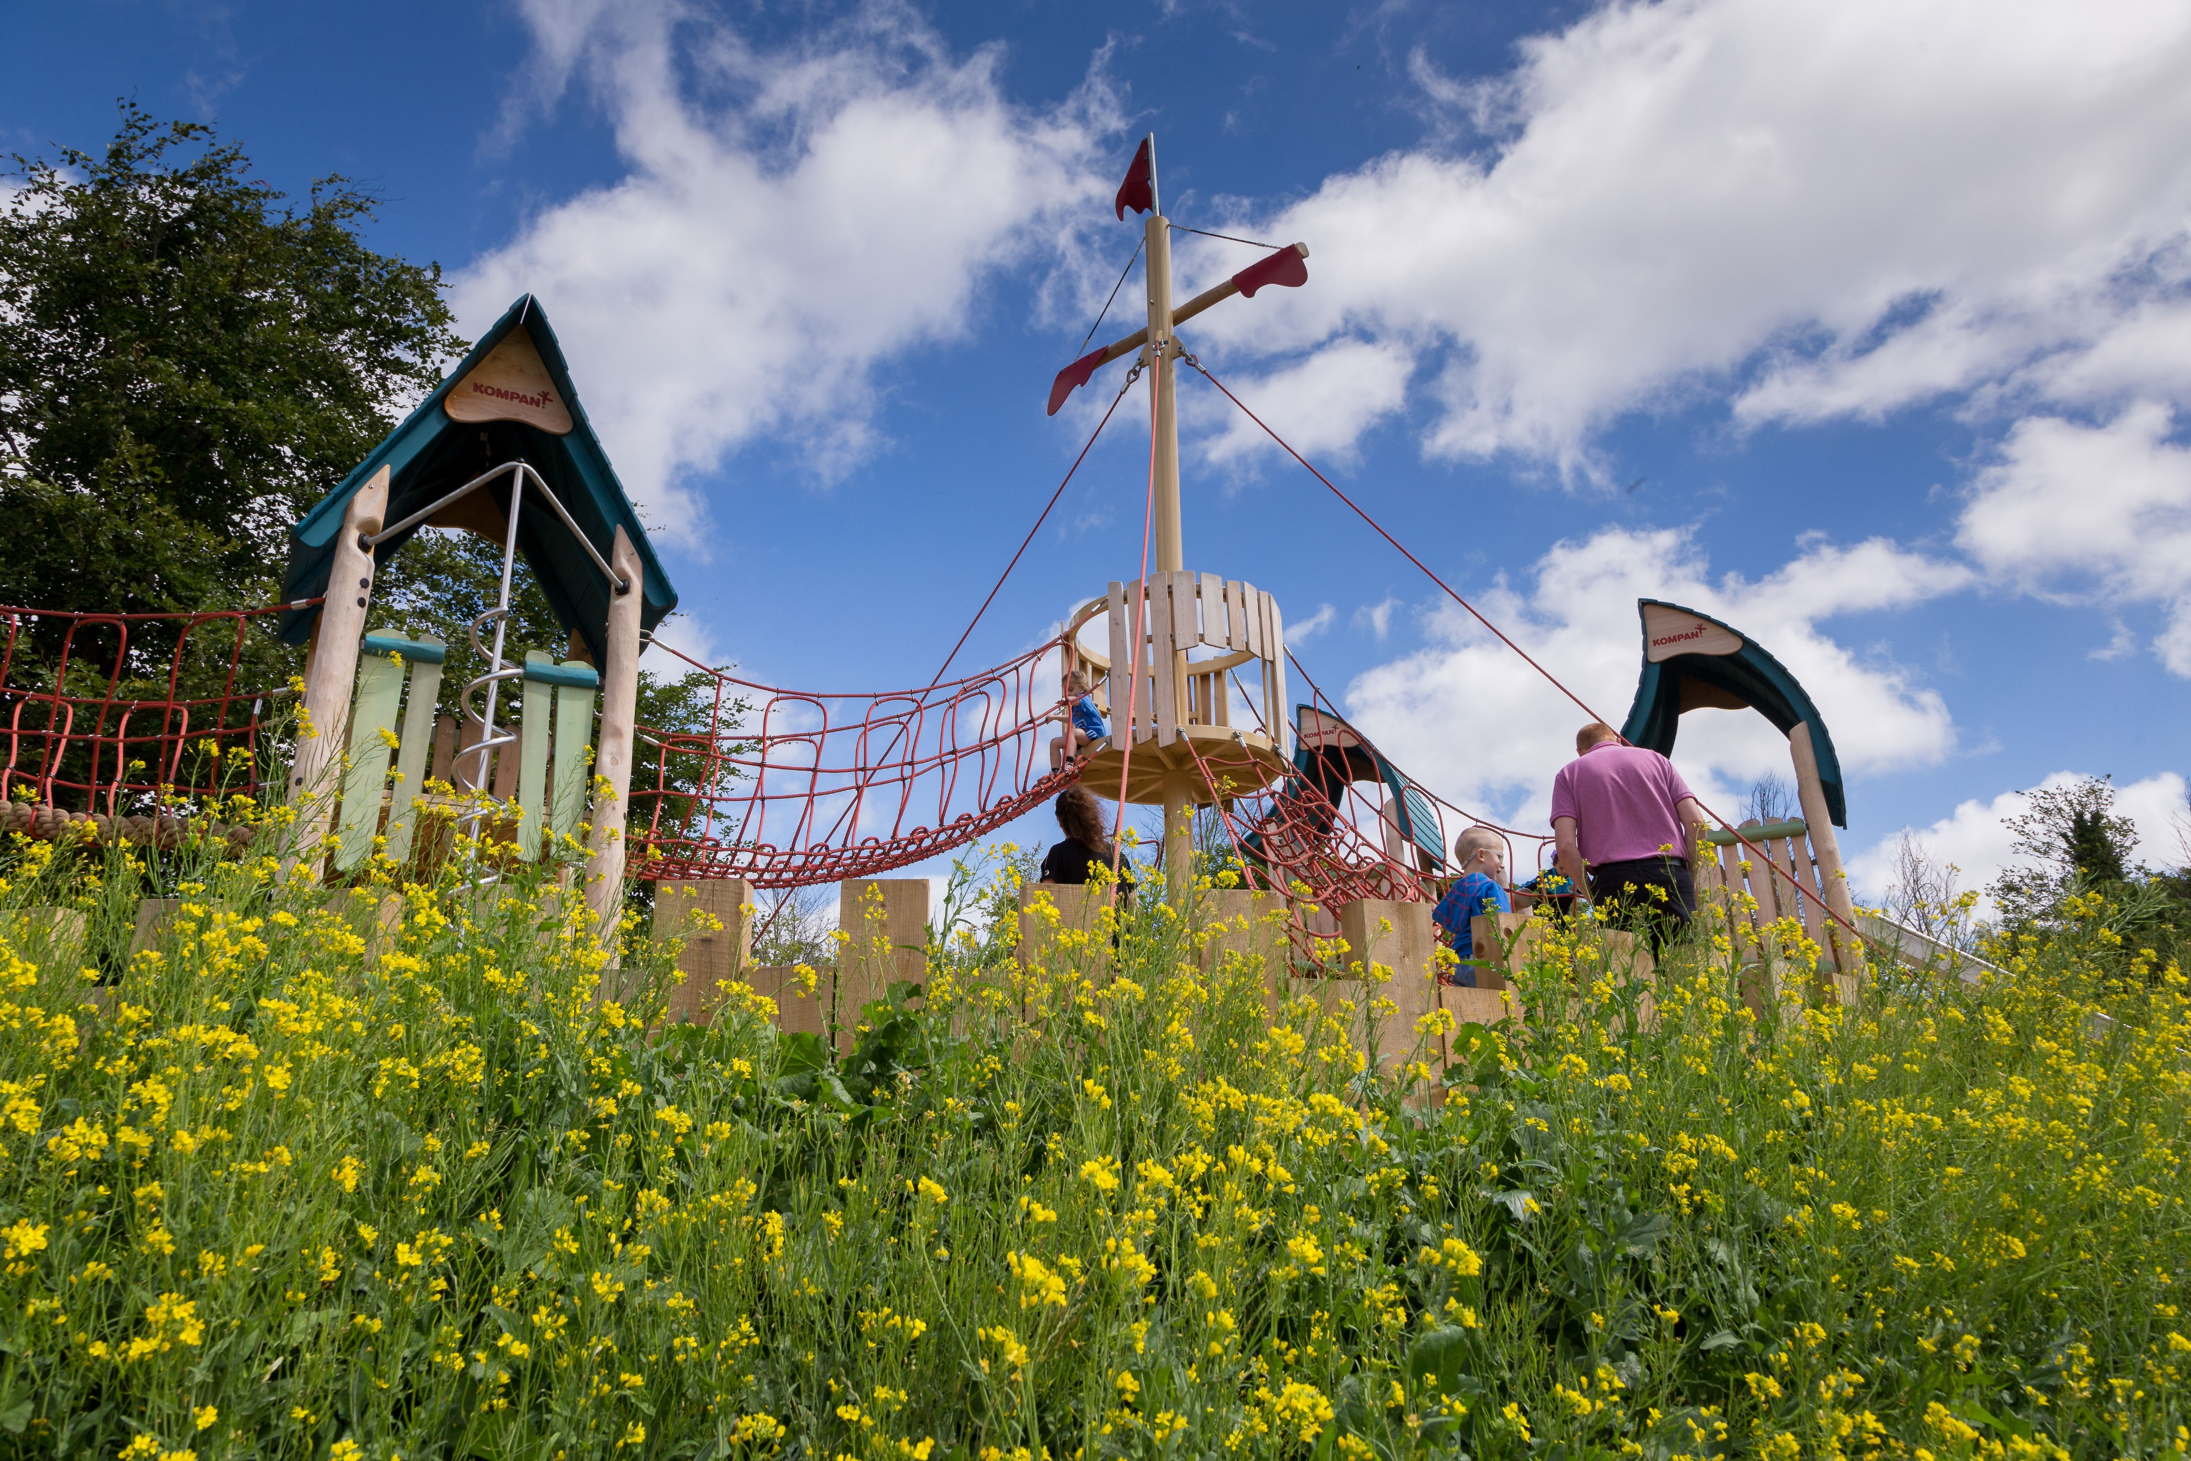
Parks and Open Space (POS) Strategy
Update
Green Infrastructure (GI) Strategy
Update
Update to EWCC SPC
03 05 2022

Slide 2
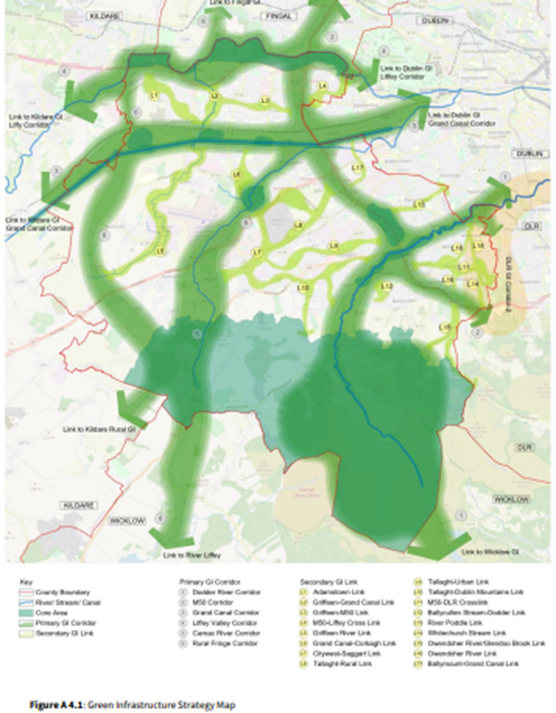
GI Strategy
Vision
Vision Promote the development of an integrated GI network for South Dublin County working with and enhancing existing biodiversity and natural heritage, improving our resilience to climate change and enabling the role of GI in delivering sustainable communities to provide environmental, economic and social benefits.
Chapter 4 of the draft Development Plan, alongside the associated maps and appendices, sets out the Green Infrastructure Strategy for the County.
chapter-4-gi.pdf (sdcc.ie)

Slide 3
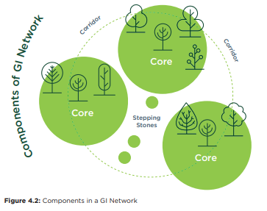
Components of GI:
GI Cores serve as anchors within the network.
They are ecological resources of regional / national importance, and / or high levels of outstanding amenity and act as points of origin / destination for wildlife at which essential ecological processes occur and serve as important recreational assets for South Dublin residents and visitors
Dublin Mountains, Liffey Valley, Grand Canal, Regional Parks.
GI Corridors are physical links that tie the network together.
They provide for movement of flora and fauna between GI Cores. Primary GI Corridors operate at the regional level; linking GI Cores within and beyond our own county. Local GI Corridors link Cores or Corridors within our county at a more local level.
Primary GI Corridors: Camac Valley, Dodder Valley, Rural Fringe
Local GI Corridors: Griffeen River Valley, tributaries of the Dodder River.
GI Stepping Stones are smaller areas of green space; important at the local level.
They are discrete pieces of GI Infrastructure that are not linked to a wider network as yet but can act as alternative ecological routes, as refuges for ecology or small zones of biodiversity and amenity within an urban or hard landscape area or an area of monoculture. GI stepping stones can be improved on or linked-up over time to become local or even primary GI Corridors.
Small open space areas proximal to GI Cores and Corridors, private gardens,wetlands, hedge and ditch combinations.

Slide 4
Draft CDP
The Draft Plan (Written Statement, including Appendices and maps) and associated SEA Environmental Report and AA Natura Impact Report are available here:
https://www.sdcc.ie/en/devplan2022/
The Green Infrastructure Strategy is contained within Chapter 4 and Appendix 4:
chapter-4-gi.pdf (sdcc.ie)
Appendices – SDCC
Current Stage:
CE report on material amendment
CDP adoption expected July 2022

Slide 5
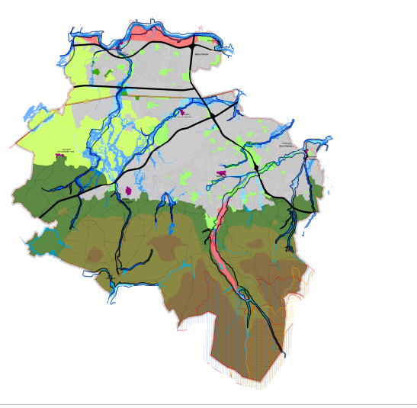
Draft CDP
GI Policies:
Over arching
Biodiversity
Sustainable Water Management
Climate Resilience
Recreation and Amenity (Human Health and Wellbeing)
Landscape, Natural, Cultural and Built Heritage

Slide 6
Greening Factor
GI Proposals will be assessed against the policies and objectives contained within the Green Infrastructure Strategy set out in the County Development Plan and the Greening Factor outlined below:
“An urban greening factor is a ratio between the amount of built area and non-built area within an urban area. The urban greening factor tool is used to assess and quantify the amount and quality of urban greening that a scheme provides”
An urban greening factor will be developed and applied during the lifetime of the Plan to all applications based on the submitted GI Infrastructure Plans and Landscape Plans. The urban greening factor will incorporate an appropriate scoring mechanism for greening urban areas based on best international practice and the unique GI features of the County.

Slide 7

Parks and Open Space (POS) Strategy Update

Slide 8
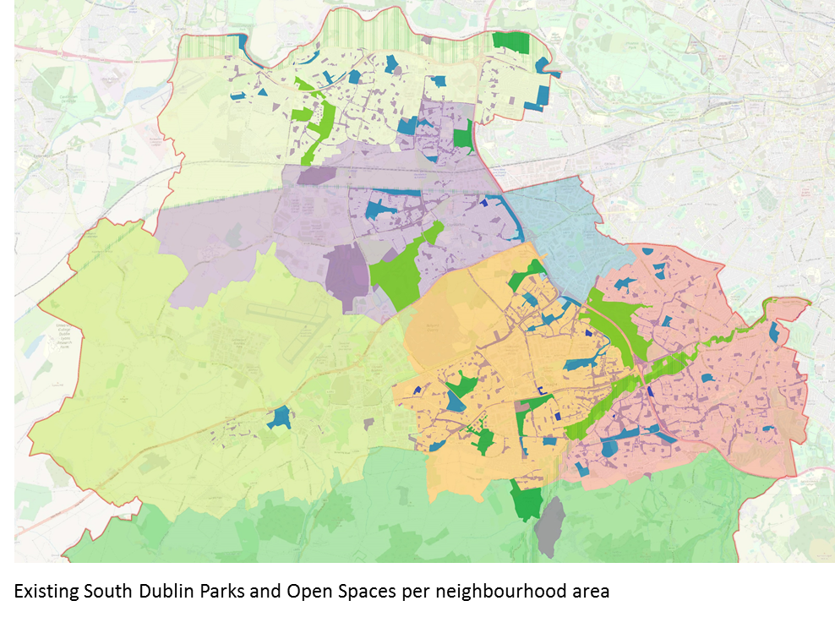
PARKS AND OPEN SPACES:
Are fundamental in contributing to a high quality of life for those living, working and visiting the County.
They provide habitats for ecological processes, a focal point for active and passive recreation, promote community interaction and help mitigate the impacts of climate change.
Open Space standards defined:
  Quantity
  Access
  Quality
Benchmarking of Standards
Application of Standards to South Dublin neighbourhoods (as per county development plan) is completed.

Slide 9
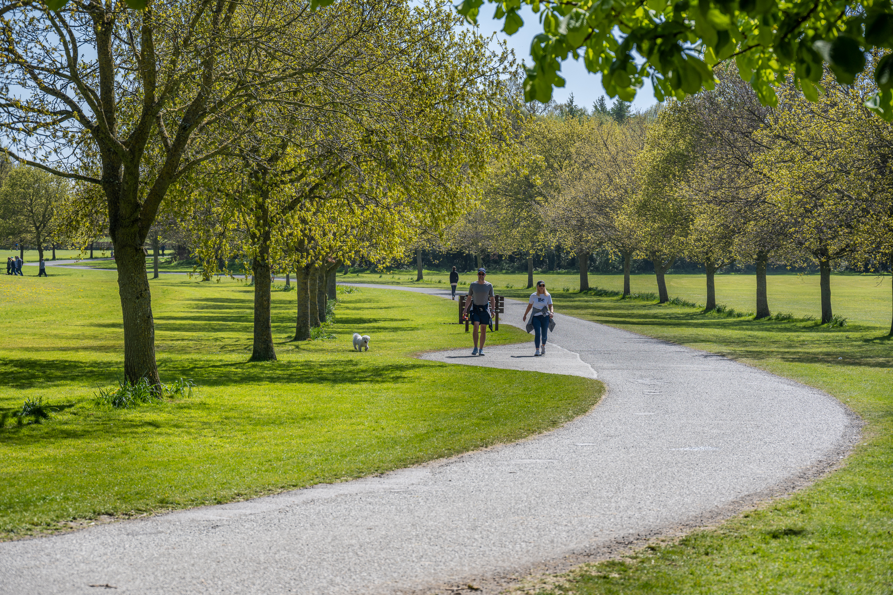
Parks and Open Spaces Strategy
  Parks and Open Space Survey & Review
Strategic level assessment has been carried out for Parks and Open Spaces.
Related policies and objectives included in Draft County Development Plan
Public Survey completed (4274 submissions received)
Review of Existing Parks completed.
Next Steps:
Review of existing facilities within parks and open spaces to develop recommendations for Strategy under relevant headings.
Provision of new open space: requirement has been identified and how this will be implemented is being drafted.

Slide 10
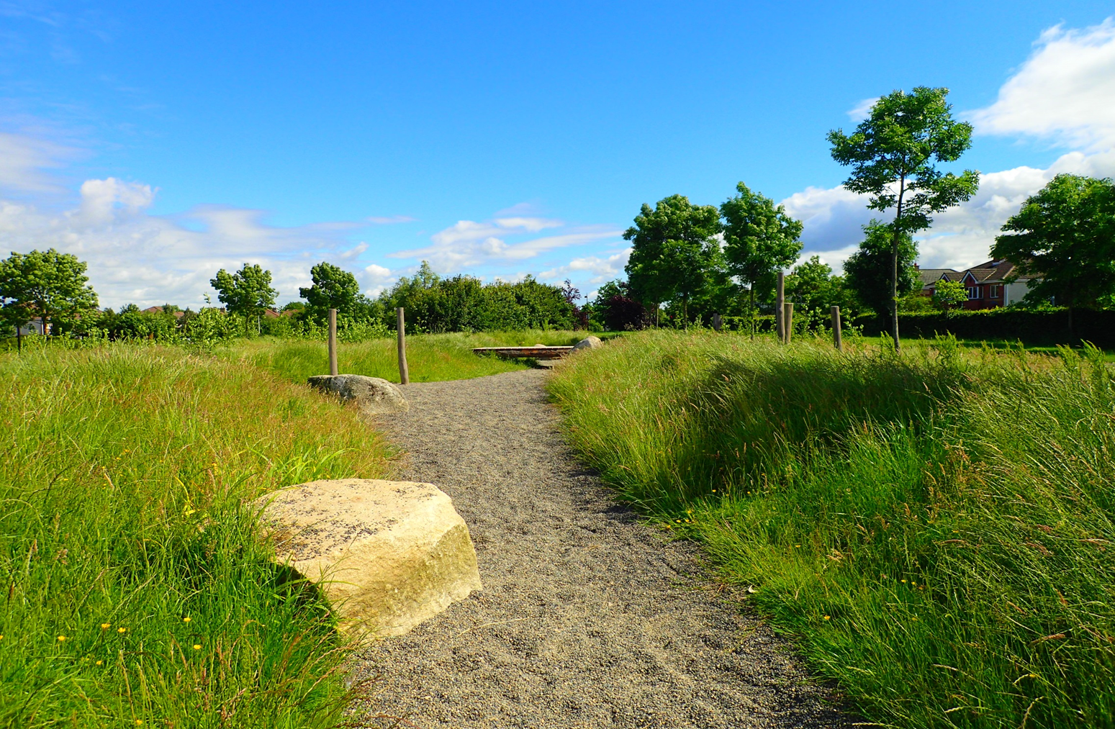
Parks and Open Spaces Strategy
  Parks and Open Space Review
Programme:
Draft POS Strategy: Sept SPC
Public Consultation: Sept / Oct
Final Document: Nov SPC
Strategy Approval: Dec / Jan Council Meeting

Slide 11
Parks and Open Space (POS) Strategy
Update
Thank you
Green Infrastructure (GI) Strategy
Update

