Slide 1
South Dublin Sports Pitch Strategy
Strategic Policy Committee
May 2022

Slide 2
SPORTS PITCH STRATEGY: 5 ACTIONS TO OPTIMISE CAPACITY
No.: | Action: | Location: | Priority
1 | Increase maintenance of pitches to improve match play equivalents | Targeted: Areas of high use, high demand, growing population | Ongoing Lifetime of strategy
2 | Develop revised allocation policy; including pitch sharing and multipurpose use of facilities | County wide | On-going
3 | Reserve ability to change configuration of pitches. | Targeted as tastes, demographics and / or local needs change | On-going
4 | Provide new pitches to meet capacity issues | New development areas, areas of growing population | On-going
5 | Provide AGPs to augment long term capacity and meet training need | 3-5 across county | On-going

Slide 3
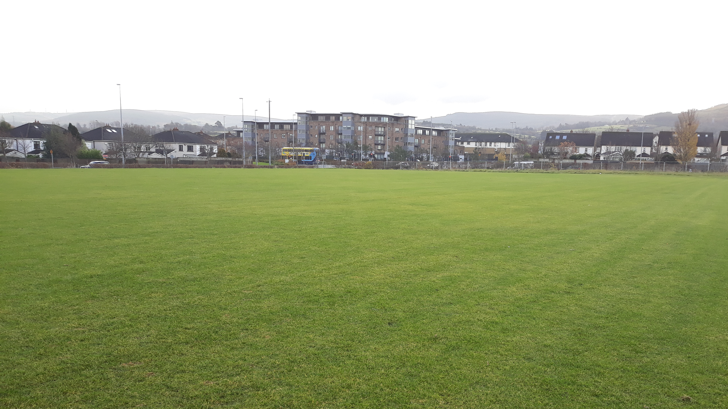
Maintenance of existing pitches:
Annual maintenance regimes: provide intensive maintenance to existing pitches
Maintain capital investment to facilitate increased match play on existing pitches:
Firhouse pitches (3 pitches completed)
Tymon pitches (2 completed and 1 completing establishment 2022)
Jobstown Park and Butler McGee Park (2 pitches completed)
Dodder Valley Old Bawn (existing pitch enhancements in tandem with pavillion provision completed.)
Capital investment in pitches to be continued (See separate slide on SCG’s)
Continue high level of communication between the council and clubs
Targeting higher use sites, shared sites and sites with high amount of community use
Athletics Track, Lucan (phase 1 completed and phase 2&3 now funded)
The annual pitch maintenance budget 2022 is €361,000 which includes a sum of €150,000 for engagement of specialist contractors to do minor drainage improvements as well as goal mouth repairs and replacement of goal posts. SDCC manage regular grass cutting of pitches by direct labour.
A once-off sum of €450,000 in 2022 provided for which will facilitate intensive maintenance programme.

Slide 4
Develop a revised allocation model in association with on-line booking system:
Review of current allocation model to increase pitch use efficiencies:
The South Dublin County Council’s Annual Allocation of Pitches/Sporting Facilities – Policy and Conditions can be found www.sdcc.ie/bookapitch
Improve on-line communication. Automate pitch allocation, pitch booking and pavilion booking systems:
The new online Pitch Allocation system went live for 2021/2022 season. Once clubs are allocated pitches via the online system they are given free access to “Pitch Manager” software which enables the club to manage and record all activity on the pitches allocated to them. Using this software is a condition of the Allocation of Pitch/Sporting Facilities – Policy & Conditions.
In 2021, the Council introduced a new online Pitch Allocation and Booking system which went live for the 2021/2022 playing season.
All clubs were required to register on the system
Clubs are required to fully engage in the usage of the software, which will then allow SDCC gather valuable key data to better manage and maintain pitches. It will also help identity any pitches that are underused and provide more availability for pitch sharing etc.
Any new clubs that wishes to apply for the use of playing pitches/sporting facilities are asked to email publicrealm@sdublincoco.ie and an invitation to register on the system will be issued, once registered an application can be made.

Slide 5
Meet the need for new pitch provision in areas of population growth
Sports Pitch Strategy Planned or new grass pitches- Update:
Dodder Valley Mt Carmel: (1 athletics track, 1 soccer pitch): Constructed and at establishment stage.
Adamstown SDZ parks: (1 multi sport sized AGP, 1 cricket pitch under construction, 1 GAA-sized pitch completed and establishing)
Clonburris SDZ parks (1 multi sport sized AGP, 1 soccer sized AGP, 5 soccer pitches planned)
Kiltipper Park Phase 2 (1 GAA sized pitch, 2 soccer pitches now funded)
Fortunestown LAP area (1-2 pitches planned via development)
Firhouse/ Ballycullen LAP area (1 GAA sized pitch-provided via development)
Newcastle LAP area (1 small sized pitch-provided via development)
Rathcoole area in conjunction with GAA TBC.
Rathcoole park: provision of a larger GAA sized pitch in conjunction with IW works-complete.

Slide 6
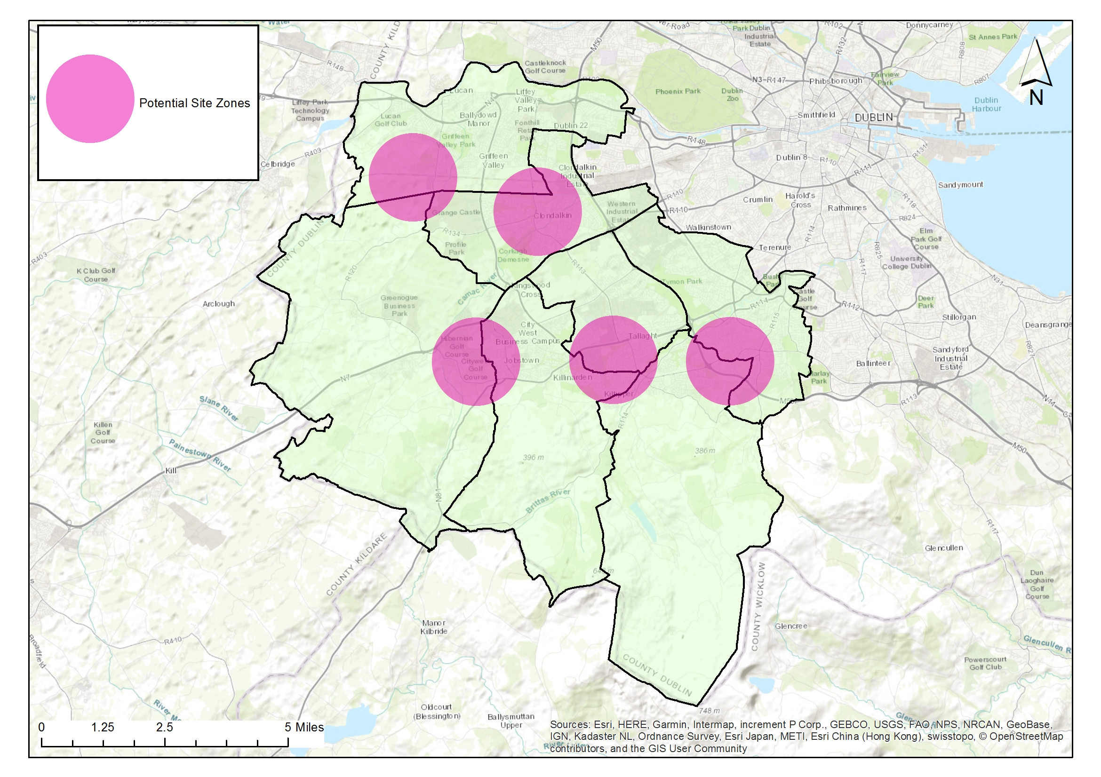
Provide 3-5 Artificial Grass Pitches (AGPs) to increase provision, usage and provide for training need.
The multi-use nature of AGP pitches should lead to sports hubs and efficiencies in use (GAA, Soccer and Rugby Union)
High capital outlay required; high use and meeting community demand shall be built into management structures
Provision to be made for replacement / repair over lifetime of the facility
AGP’s provide pitch capacity to meet increased population growth in higher density/ urban locations
AGP’s meet demand for increased match play
AGP’s remove training pressure from grass pitches with resultant higher standard of grass pitches.
Strategic locations, new development and high population areas; facilitates high use, late evening and flood lighting.
AGP’s provide all weather, year-round facilites. Provide ancillary facilites as required to maximise use.
AGP’s meet demand for training provision which is not currently being met.
AGPs:
Adamstown SDZ: Airlie Park under construction
Clonburris SDZ
Fortunestown LAP area / Rathcoole/ Newcastle area
Tallaght LAP: Part 8
East of County: Feasibility Stage completed.
€3million provided within capital budget for Astros

Slide 7
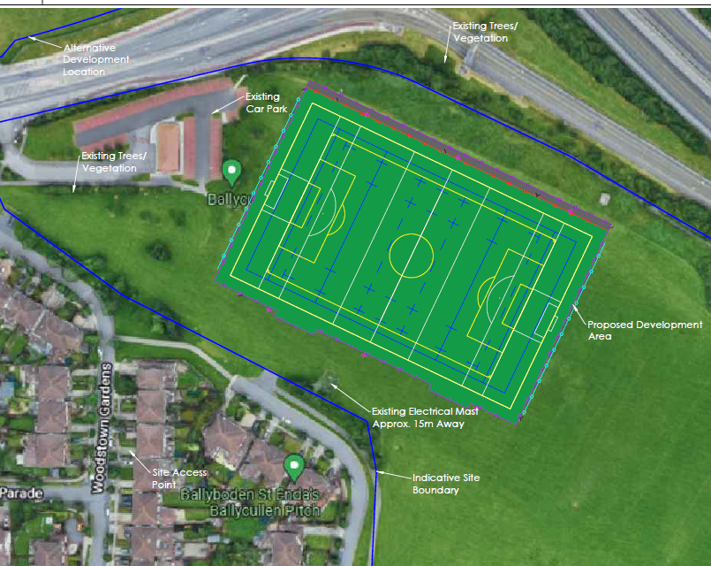
East of County Astro: Feasibility Report March 2022

Slide 8
Ancillary facilities
Storage Areas:
In larger parks with new pavilions:
Some storage to be provided in new changing rooms or will be provided in a railed off area adjacent to a pavilion
In open spaces without pavilions / changing rooms:
Railed off areas for storage of heavy-duty pitch infrastructure e.g. goalposts etc. will be considered.
These areas should ideally be in well overlooked areas with plenty of passive surveillance.
Hierarchy of provision: High usage areas with several clubs and pitches.
Funding:
Subject to funding:
May be sourced by sports capital grants, large scale infrastructure grants
Sports Governing body or club contributions could be facilitated
Security of Provision:
All ancillary facilites provided within public lands are linked to sports pitch use to allow for future proofing of provision and ownership of facilites is not limited to a club or sport. Facility shall remain available to SDCC.
Current pavilion programme (subject to funding):
Dodder Valley Old Bawn (complete)
Griffeen Valley Park (North) (tender preparation)
Corkagh Park (West) (tender preparation)
Tymon Park (West of M50)
Dodder Valley Mt Carmel (Part 8 completed)
Griffeen Valley Park (Arthur Griffith Park)
Collinstown Park

Slide 9
Sports Capital Grant application from 2021 Grants awarded in February 2022: €2,003,937.
SCP20 Lucan Athletics Track infield works Phase 3
€ 111,792
SCP20 Ball Courts Dodder Valley
€35,000
SCP20 Ball Courts Beechfield Park
€70,000
SCP20 Ball Stop Net Kilnamanagh
€10,500
SCP20 Storage Facilities Griffeen Park
€14,300
SCP20 Storage Facilities Greentrees Park
€14,300
SCP20 Storage Facilities Ballymount
€14,250
SCP20 Pavillion programme Dodder Valley Mt Carmel
€259,458
SCP20 Pavillion Programme Collinstown Pavillion Phase2
€230,905
SCP20 Water Sports Facility Lucan Demesne Phase 1
€233,512
SCP20 Bowling Green SWP
€150,000
SCP20 Dodder Valley Mt Carmel Pumptrack
€105,000
SCP20 Kiltipper pitches
€249,960
SCP20 Killinarden pitches
€249,960
SCP 20 Ballymount GAA Pitch
€35,000
SCP20 Clondalkin Park GAA Pitch
€35,000
SCP20 Glenaulin GAA Pitch
€35,000
SCP20 Weston Hockey Pitch Re-surfacing
€150,000

Slide 10
South Dublin Sports Pitch Strategy Update
Strategic Policy Committee
Thank you

