Slide 1
Canal Loop Urban Greenway
Progress Update
Lucan/Palmerstown/Fonthill Area Committee Meeting
26th April 2022

Slide 2
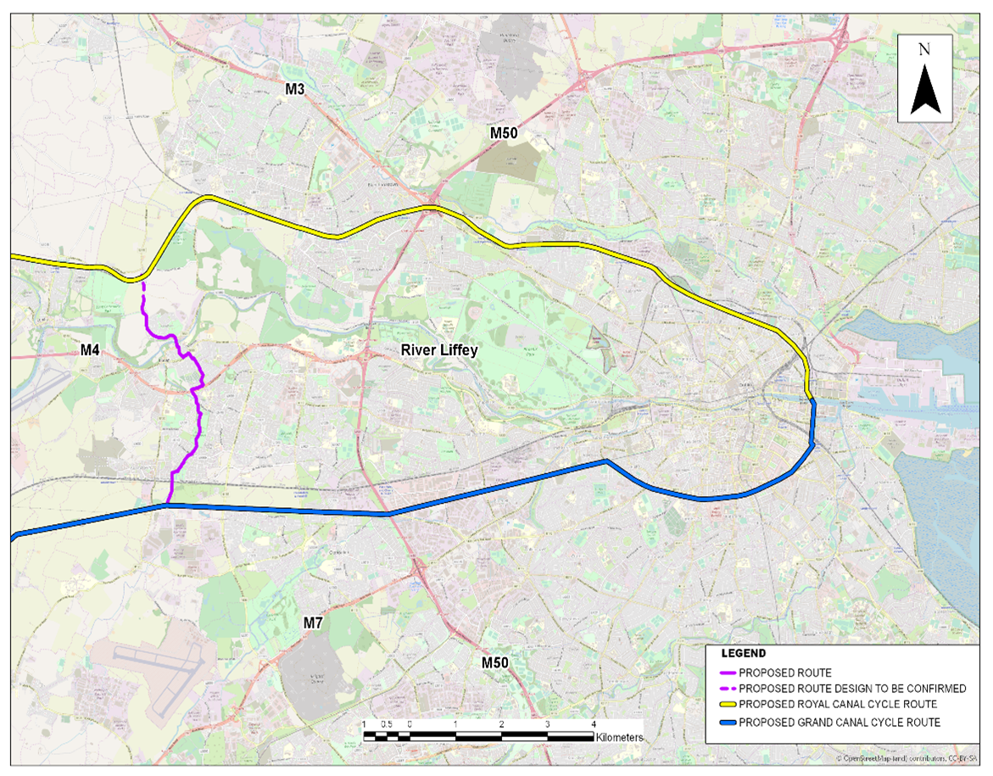
Context for Project
Link between Royal & Grand Canal Greenways (purple), creating a loop with canals (blue, purple, &yellow)
Promote Lucan as a village active travel destination for tourism and locals
Village renewal
Promote cycling and walking
Potential green route for local schools
Dublin Canal Greenway (Outer Loop 40 km)

Slide 3
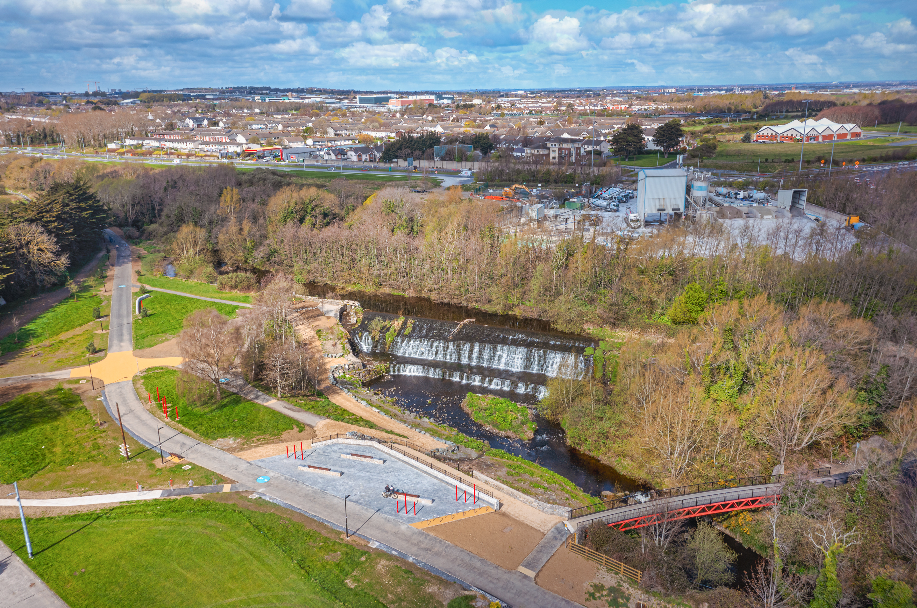
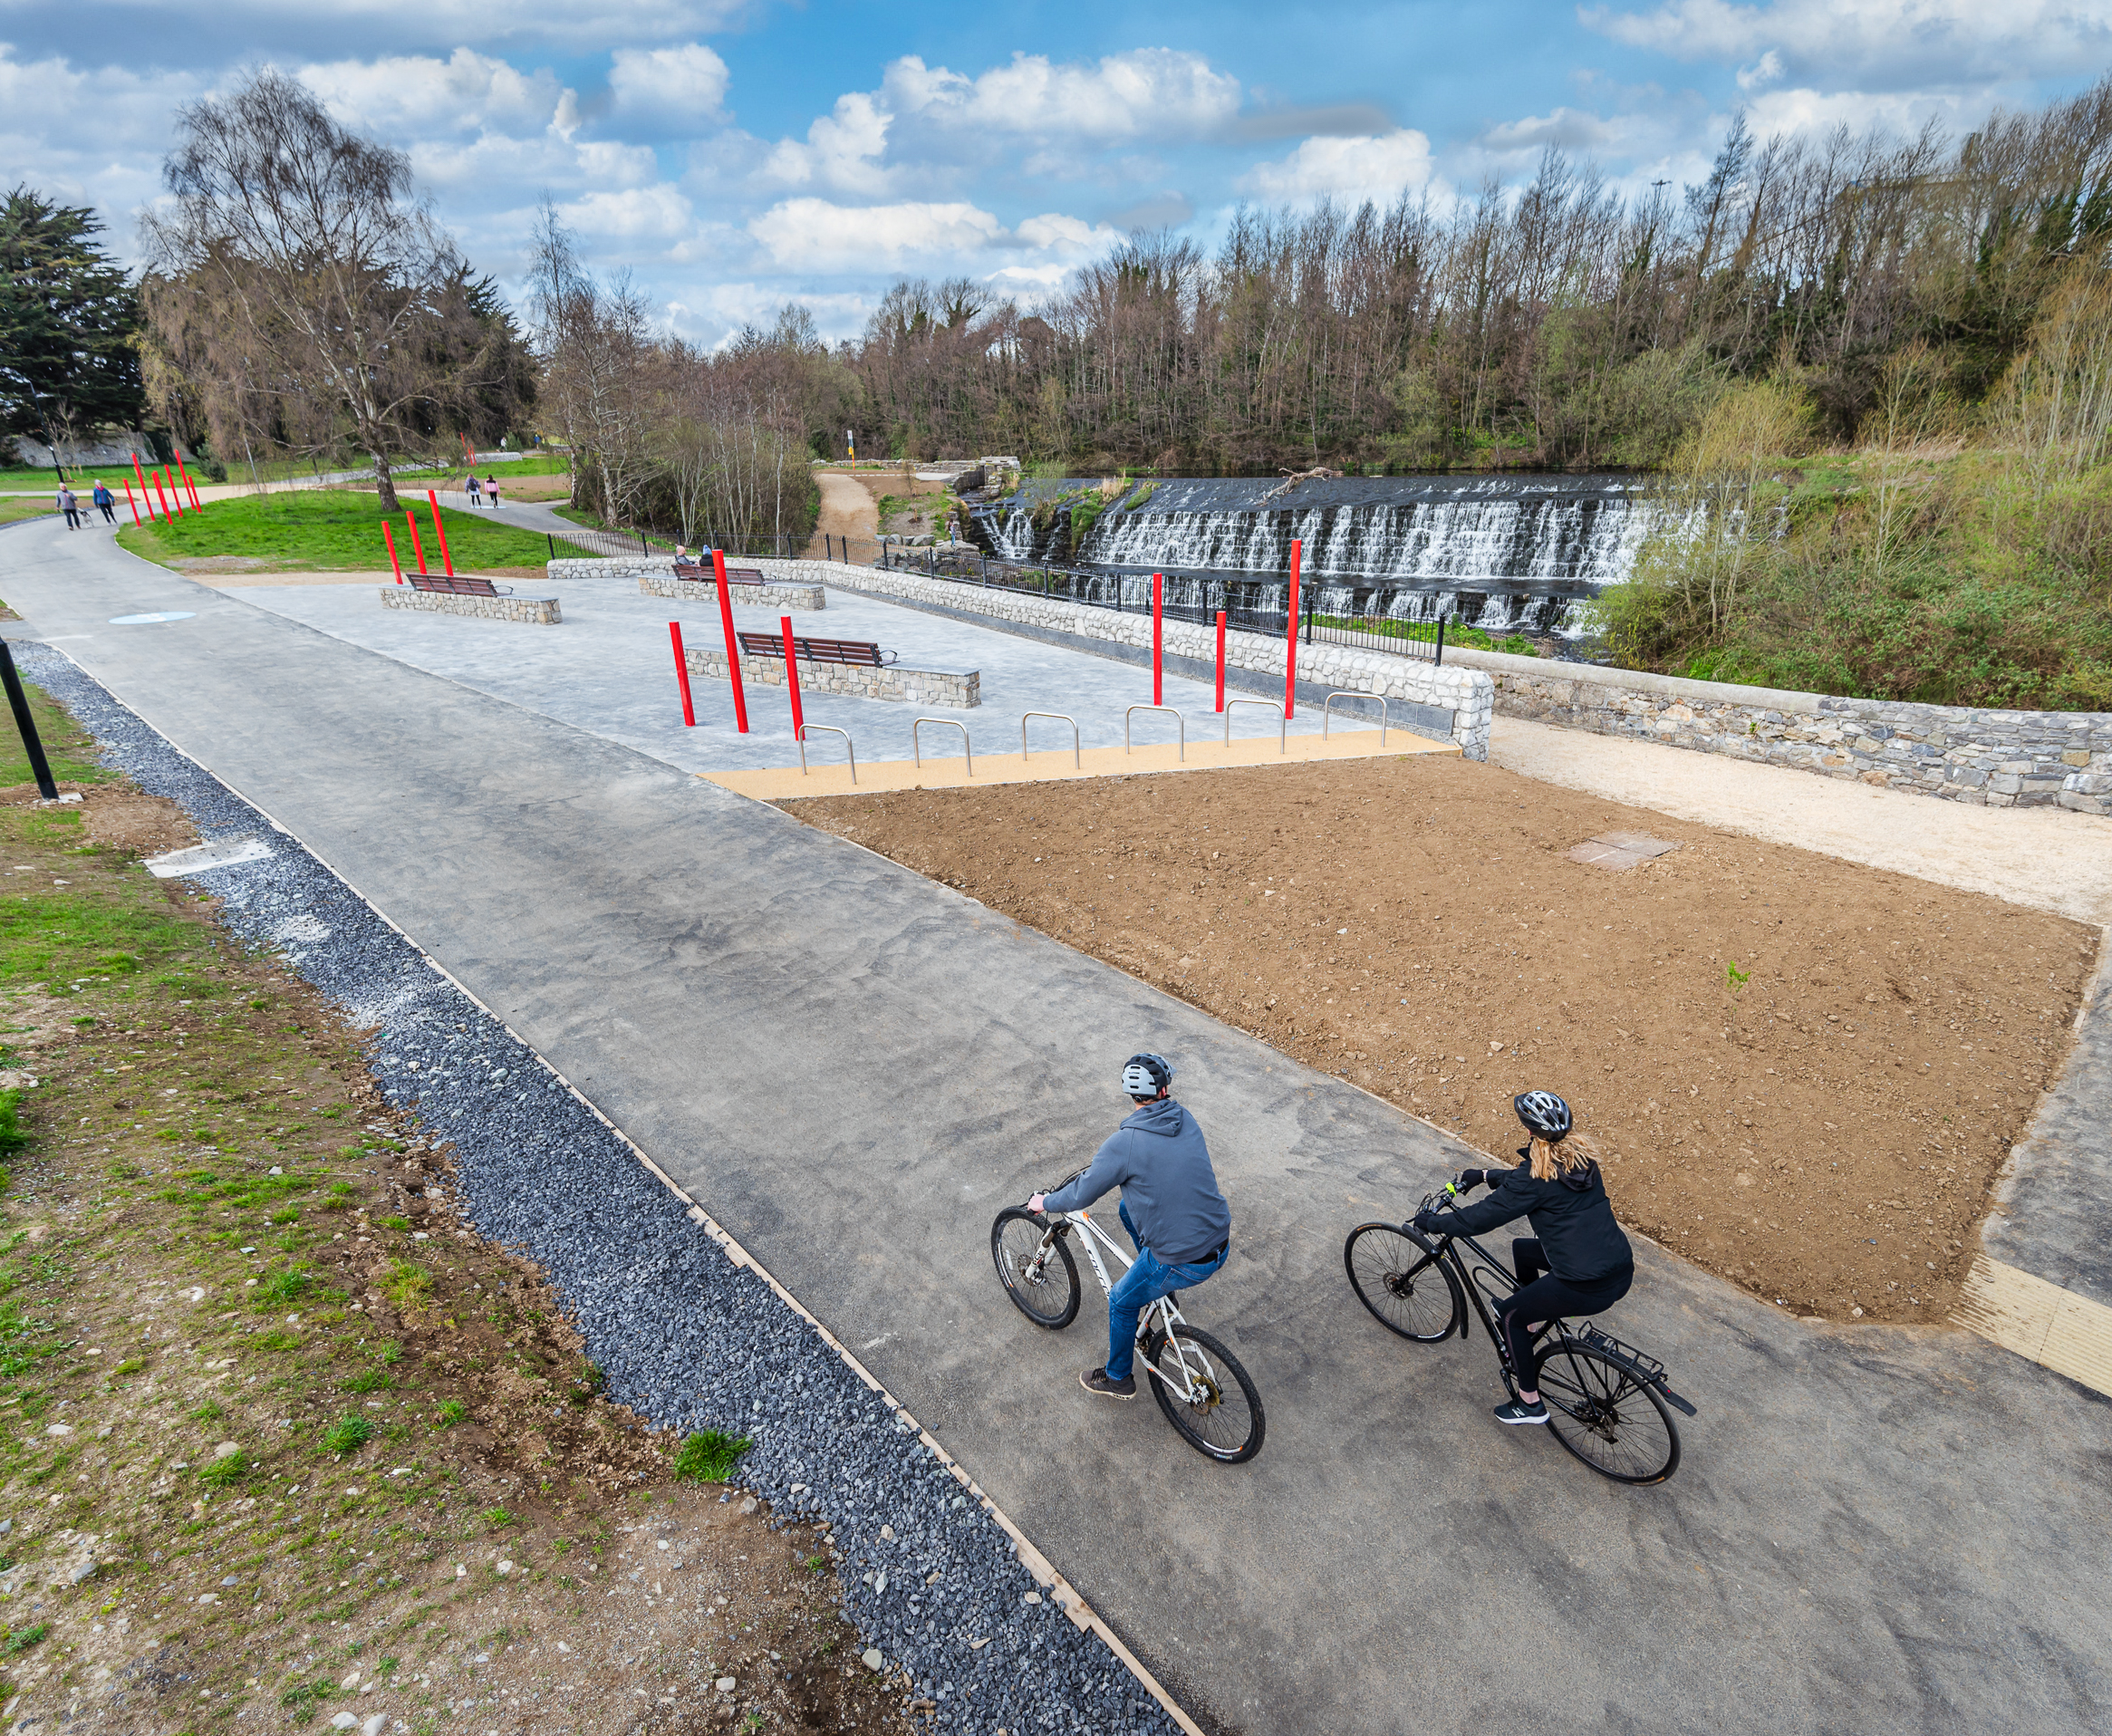
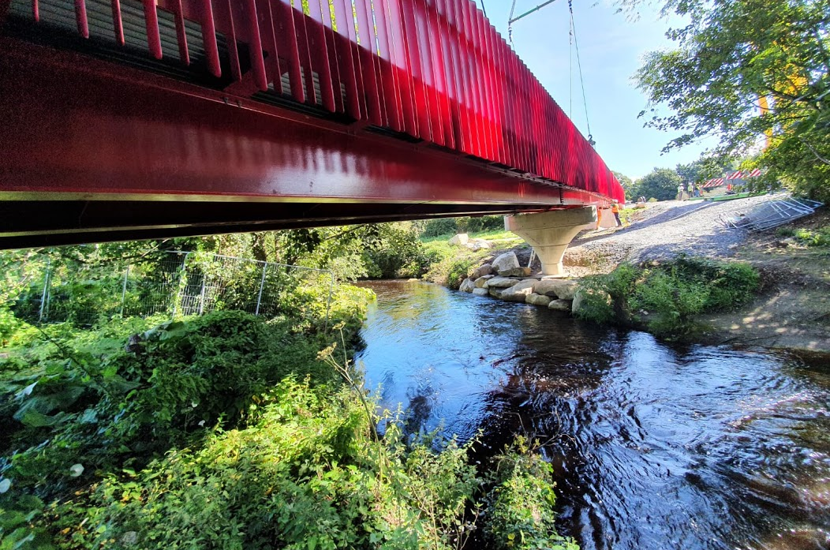
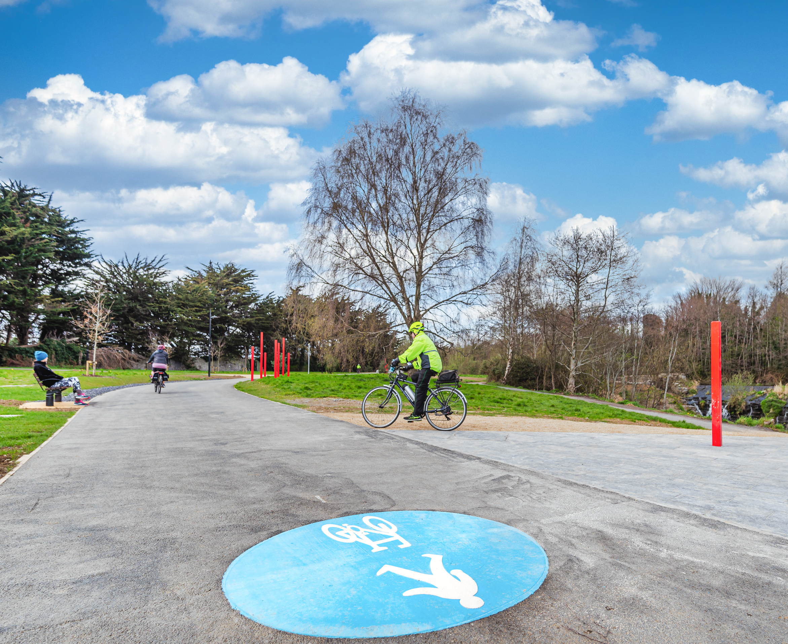
Project Precedents
Dodder Greenway
Parkland Links opened April 5th 2022
Reactions and take up is very positive
Improved access to local amenities
Increased access to local business such as the Edge Café
Safe walking and cycling facilities for all types of users
Increase biodiversity

Slide 4
Canal Loop Urban Greenway
Project Recap
Project Concept
Project concept commenced in 2017
Joint project between SDCC and the National Transport Authority (NTA)
Part of the implementation of the Greater Dublin Area Transport Strategy
Project Objectives
Connection between the cycle infrastructure on the Grand Canal and Royal Canal
Active Travel infrastructure for school going children
Cycle infrastructure to connecting local amenities (Lucan Village Griffeen Valley Park, Schools, Community Centre, etc.)

Slide 5
Project Recap
Project Progress to Date
Project Team formed in 2018; Technical Consultant appointed for Feasibility study
Over 30 route options examined
Multi-criteria route analysis carried out on the routes
Preferred route option identified
Non-Statutory Public Consultation held in March/April 2021.
July 2021 new project team created, and new consultant team appointed
The consultant team has been developing preliminary design for the preferred route and school connection links
Study Area for feasibility study

Slide 6
Project Recap
Non-Statutory Public Consultation 2021 - Results Summary
87% of responses were from Lucan residents
60% in favour, 25% against, 15% unsure
80% of school children were very happy with the proposals.
Main concerns was the impact on the existing Liffey Bridge
Second concern was impact on streetscaped/residential areas
As a result of the strong opposition to the proposed bridge this section has been omitted from the current scheme and will be examined further. The preferred Canal Loop route will terminate in Lucan Village.

Slide 7
Project Update
Proposals - Landscape Character Areas

Slide 8
Project Update
1: Lucan Village South
Non-Statutory Public Consultation 2021/2022 - Residents
There was 2 meeting with local Lucan residents in 2021
November 2nd (Sarsfield Residents)
November 23rd (Cherbury Residents)
During the Sarsfield meeting, an alternative alignment through Brookvale open space was suggested by the residents. Which, after review, has been incorporated into the emerging preferred route.
A leaflet drop for residents along a section emerging preferred route, March 2022
Lucan-Newlands Road Residents & Brookvale Estates
More than half responses have positive response & suggestion to improve the scheme
Notes:
Brookvale: 7 responses as of 20/4; 4 in favour, 2 against (parking/change concerns), 1 N/A

Slide 9
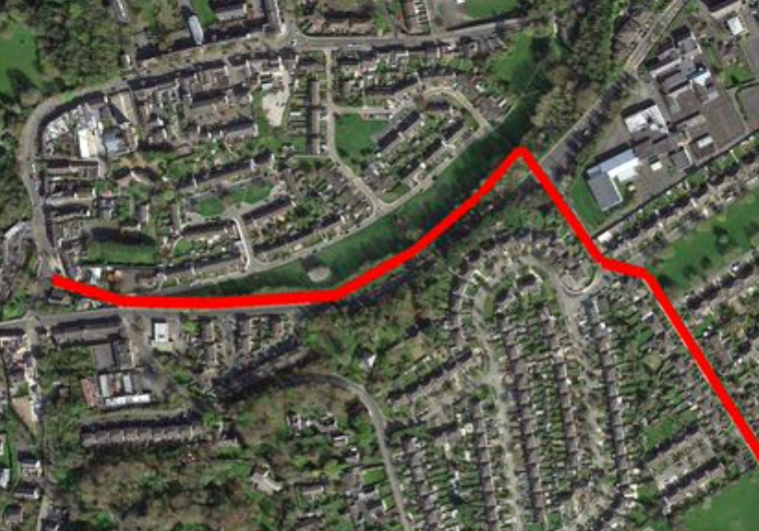
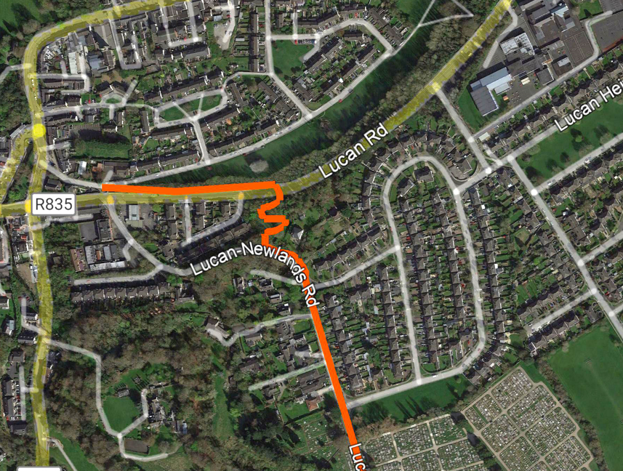
Project Recap
Consultation Results Summary
Route for Non-Statutory Public Consultation 2021
Route after Non-Statutory Public Consultation 2022
Route suggested by residents and featuring in consultation with residents via leaflet drop
Note: Requires land to be previously designated opening space to be taken-in-charge. Landowner has agreed in principle to complete the TIC process post development

Slide 10
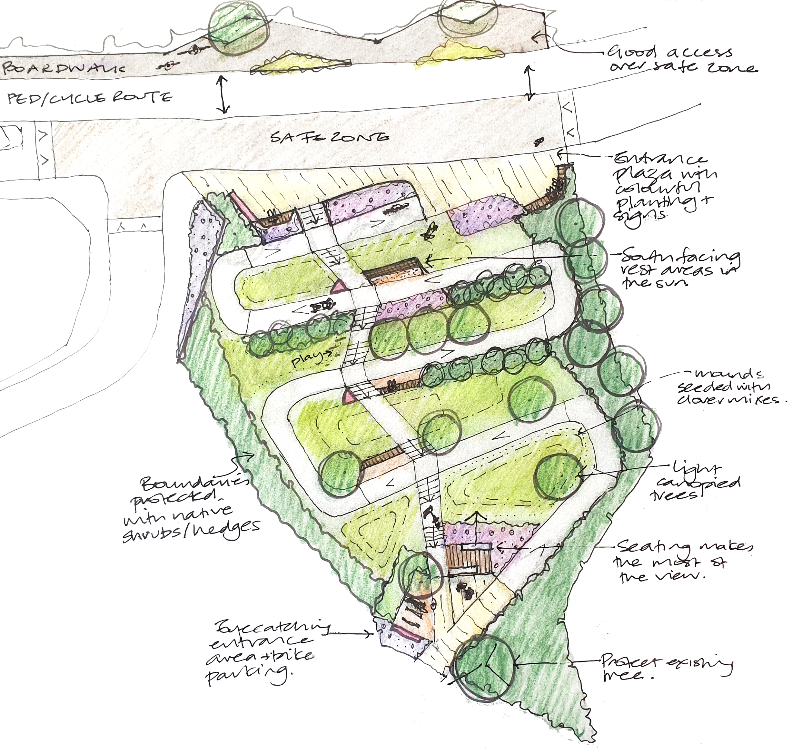
Project Update
1: Lucan Village South
Brookvale Park - Objectives
Retain the viewing point at the top of the hill
An entrance to the Lucan.
An accessible route for pedestrians & cyclists and other wheels.
Stepped access with rest places.
Low maintenance and preferable native planting for biodiversity
Boundaries that are protected by a thick native hedgerow and trees

Slide 11
Project Update
2: Upper Griffeen Valley Park
Upgraded entrances
Upgraded pathways
Proposed wayfinding, planting,
and landform features
3: Griffeen Valley Park
New entrance plaza
Upgraded junction and park entrances
Upgraded pathways (proposed layout under discussion with Public Realm)
Proposed wayfinding features

Slide 12
Project Update
4: Lower Griffeen Valley Park
Upgraded entrances
Upgraded pathways
Proposed wayfinding features
and planting to enhance the route
5: Haydens Lane
Clonburris SDZ to include active travel infrastructure
Temporary improvement and art installation proposed as short-term interventions

Slide 13
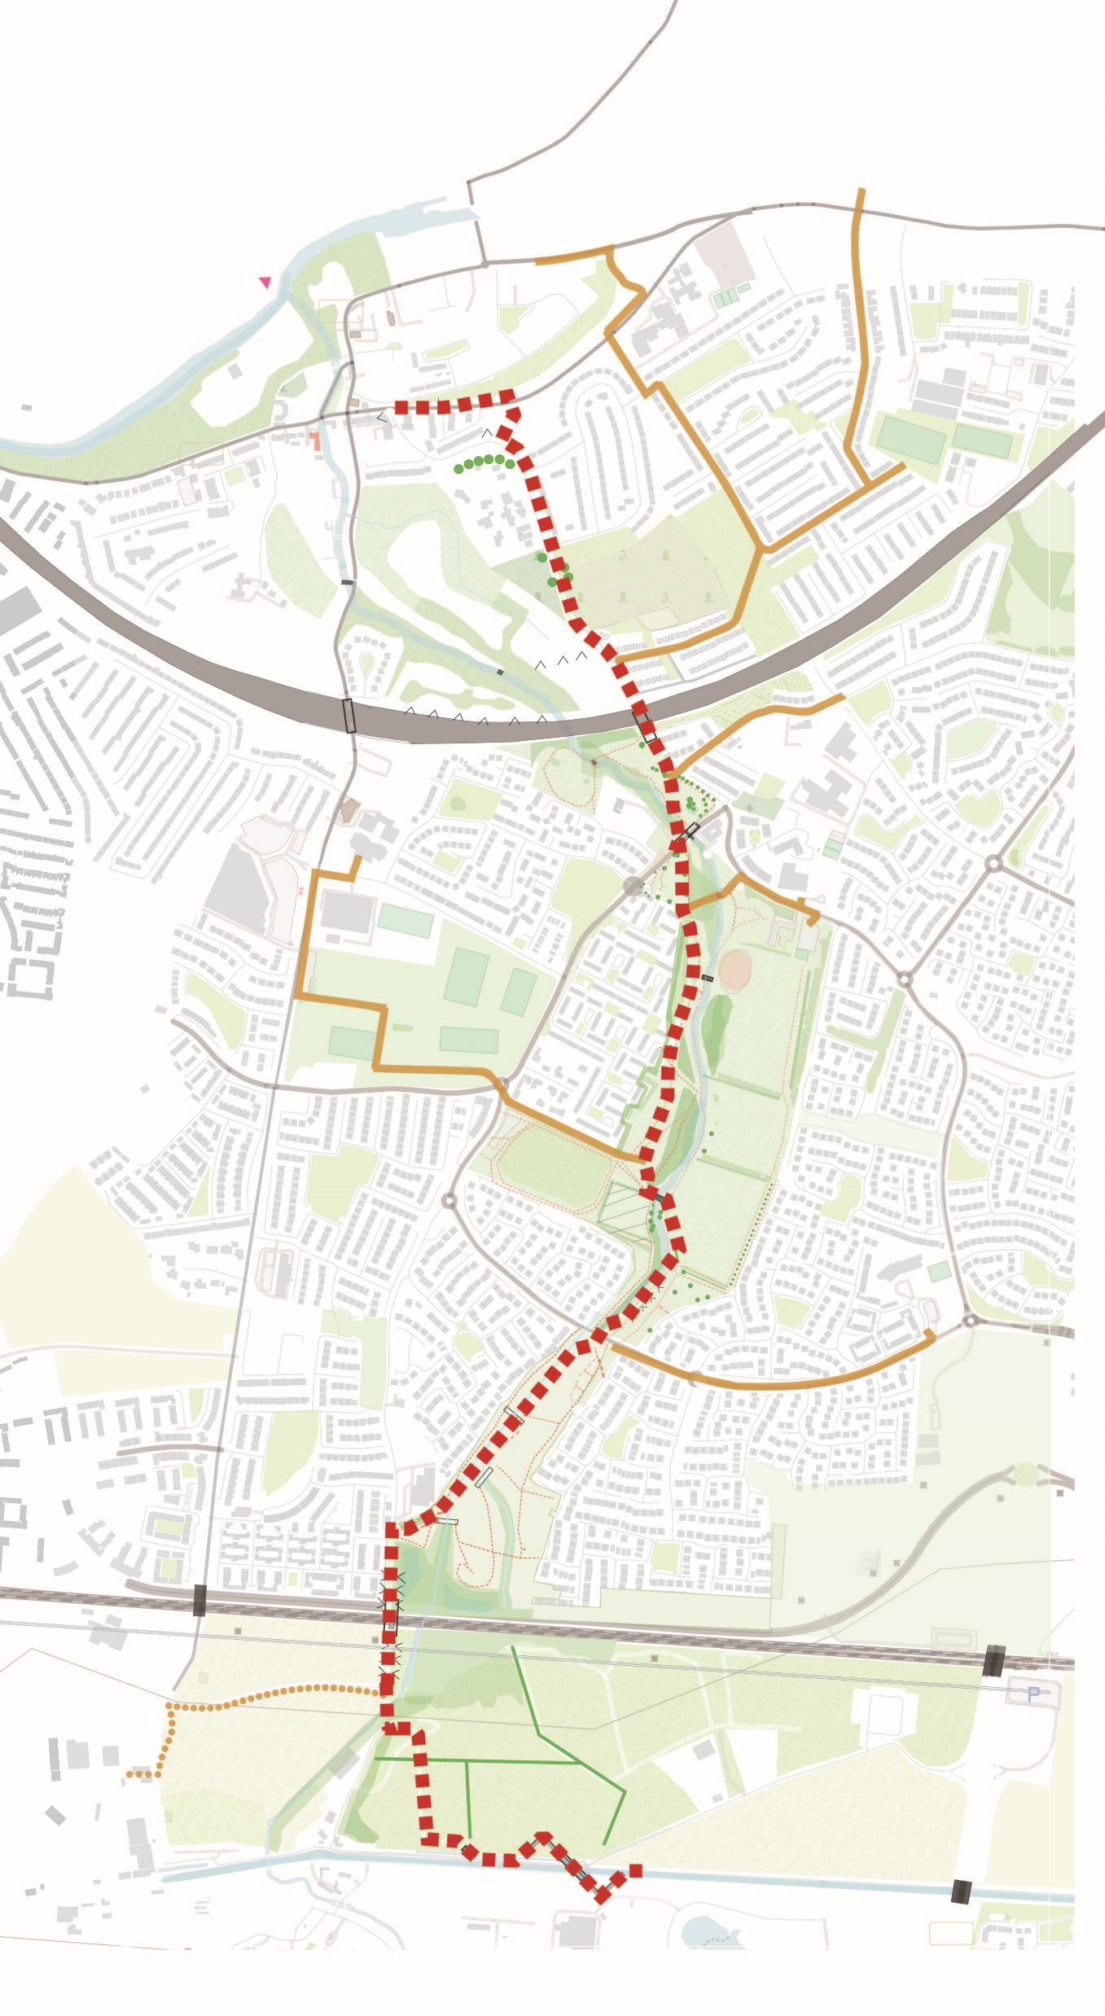
Project Update
Key Points
Proposed
4.5 km of walking and cycle facilities
3.6 km additional school & local connects
Biodiversity
300+ proposed trees

Slide 14
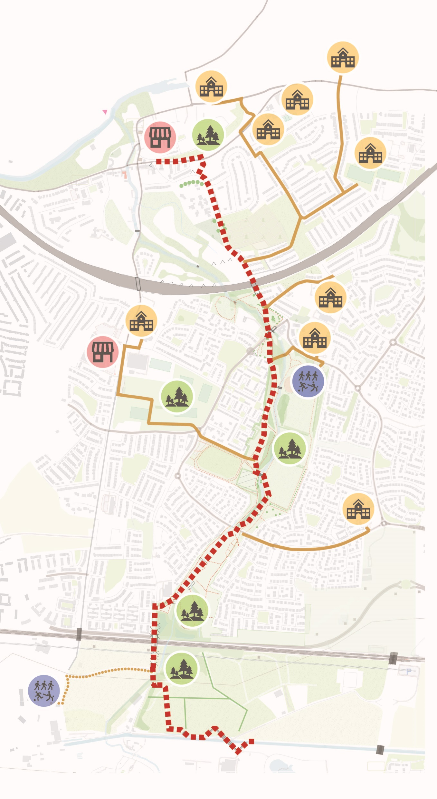
Project Update
Preferred Route
Local Connections
9+ School
2 Village/District Centres
2 Community/Sport Centres
4 Community Park

Slide 15
Next Steps
Complete Preliminary Design
In consultation with the NTA
Part VII: Aiming to Launch Summer 2022
Detailed Design: Q3 2022
Begin Construction: 2023

