Slide 1
SHD Application Ref: SHD3ABP-313059-22
Applicant: BCDK Holdings Ltd and Coill Avon Ltd
Location: Kilmashogue, Whitechurch Rd, Rathfarnham
Presentation to: R.T.F.B. ACM 12th April 2022
Jim Johnston
Senior Executive Planner

Slide 2
Timelines
SHD Lodged with ABP on 21/03/22
5 Week Obs by 5.30pm on 24/04/22
8 Wks SDCC report due on 15/05/22
16 Week Decision due from ABP on 11/07/22
S.247 pre-planning meeting with SDCC as follows:
SHD1SPP010/20 on 23/07/20 and SHD1SPP013/20 on 9/11/20
Tripartite meeting ref SHD2ABP-308723-20 held on 03/02/21 with An Bord Pleanála, the applicant and SDCC.
Consultations

Slide 3
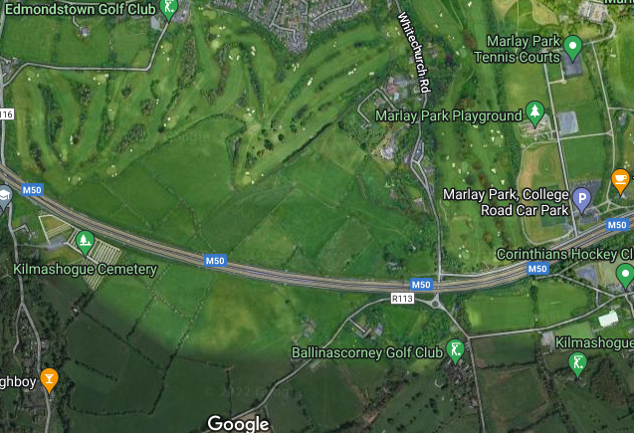

Slide 4
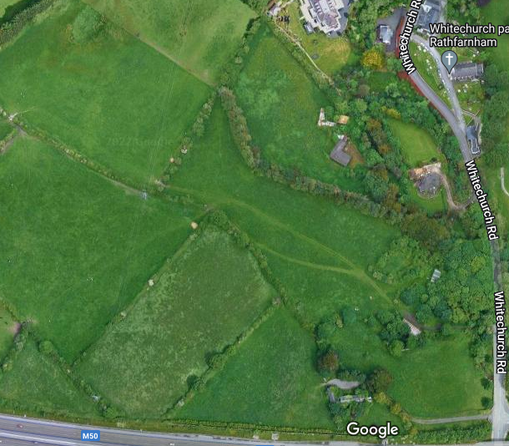

Slide 5
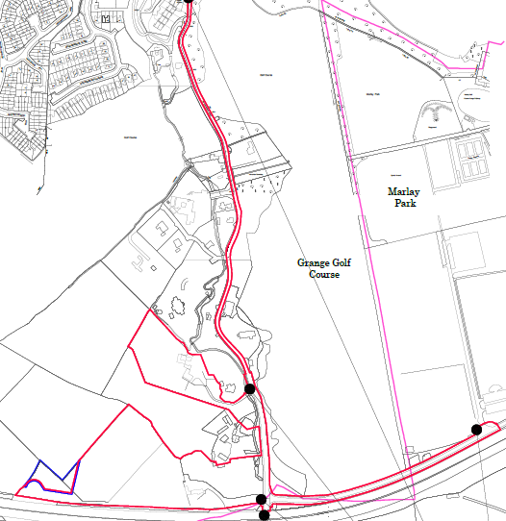

Slide 6
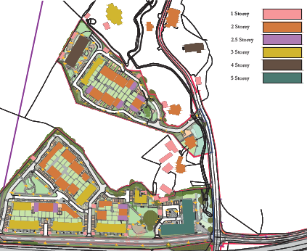

Slide 7
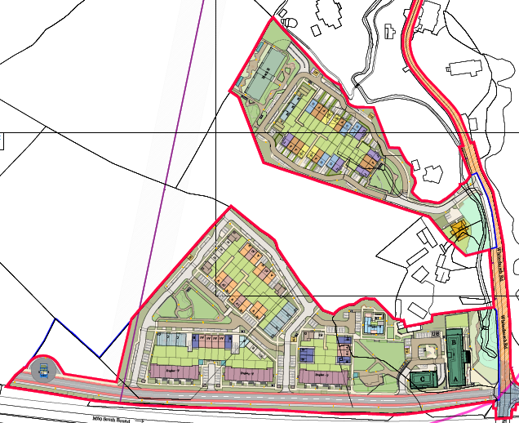

Slide 8
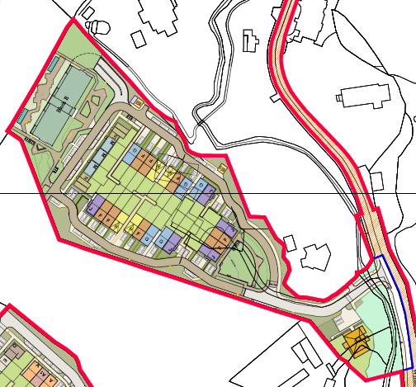

Slide 9
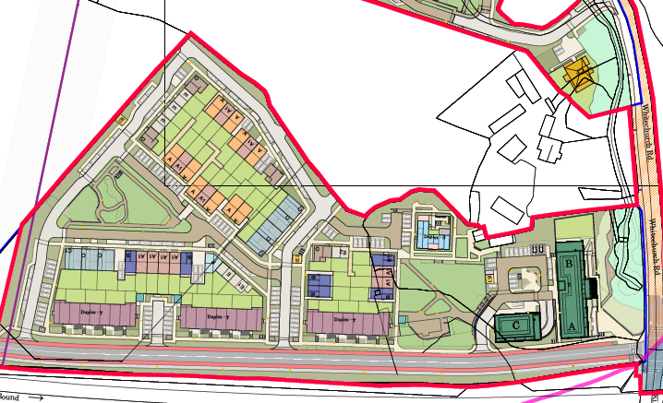

Slide 10
Proposed Development
The site is located on interlinked lands at Kilmashogue House and Coill Avon House, Whitechurch Road, Rathfarnham. The site is 6.77ha and includes the derelict Kilmashogue House (southern lands) and Coill Avon House (northern lands) and the adjacent Whitechurch Road and College Road, roads in the administrative areas of South Dublin County Council and Dun Laoghaire Rathdown County Council.
The development will consist of:-
• Demolition of Kilmashogue House/outbuildings and Coill Avon House/outbuildings;
• refurbishment and re-use of 2 stone outbuildings for community use, to be incorporated into an area of public open space on the southern lands;
• The construction of a mixed-use development comprising neighbourhood centre and 178 residential units comprising 72 houses, 38 apts and 68 duplex apts;
• The 72 houses will comprise 2, 2.5 and 3-storey detached, semi-detached and terraced units to include:-
o 6 no. 2-bed houses;
o 45 no. 3-bed houses;
o 21 no. 4-bed houses;

Slide 11
• The apartments (38 apts and 68 duplex apts) all with associated balconies/terraces are located across 7 buildings ranging in height from 3 to 5-storey consisting of 1 no. Block A/B, 1 no. Block C, 1 no. Block E, 1 no. Block S and 3 no. Blocks T as follows: -
o Block A/B: 5-storey over basement and podium accommodating 10 no. 1-bed apartments, 16 no. 2-bed duplex apartments and 1 no. 3-bed duplex apartment with associated balconies/terraces;
o Block C: 5-storey over basement - 4 no. 1-bed apartments and 8 no. 2-bed duplex apartments
o Block E: 4-storey over basement - 8 no. 1-bed apartments and 16 no. 2-bed duplex apartments
o Block S: 3-storey - 2 no. 2-bed duplex apartments and 1 no. 3-bed apartment and 1 No. 3-bed duplex apartments
o Block T: 3no. 3-storey buildings - 6 no. 1-bed apartments, 18 no. 2-bed duplex apartments, 9 no. 3-bed apartments and 6 no. 3-bed duplex apartments

Slide 12
• Block A/B and Block C are arranged around a landscaped podium. The neighbourhood centre is located below this podium and contains a 2-level creche (313m²) at lower ground and ground floor level, and 3 retail/non-retail service/cafe units (470m2) at ground level;
• The basement below Block A/B and Block C accommodates 50 car parking spaces, bicycle parking, bin stores, plant and staff service area (80m2);
• The basement below Block E accommodates 35 car parking spaces, bicycle parking, bin store and plant;
• A section of link street with footpath and cycle path (approx. 438 linear metres) extending from the junction of Whitechurch Road and College Road on an alignment parallel to the M50, to provide access to the southern development lands and incorporating a bus turning circle;
• A new signalised crossroads junction to connect the proposed link street with Whitechurch Road and College Road;
• Upgrade works to College Road including a new two-way cycle track and relocated footpath from the Whitechurch Road junction to provide connectivity to the Slang River pedestrian/cycle Greenway;
• Upgrades to the existing vehicular access and bridge at the entrance to Coill Avon House on Whitechurch Road;
• Foul sewer drainage works along Whitechurch Road from the southern lands to the existing junction at Glinbury housing estate;
• Landscaping, surface car parking, boundary treatments, infrastructure works, etc

Slide 13
ABP comments – the Bord requested that the following issues be addressed
1. Principle of proposal:
principle of the development in the context of H3 SLO 1 of South Dublin County Development Plan 2016 - 2022 and demonstrate that the proposal is not premature pending determination of a road layout/increased accessibility for the area.
2. Height, Density, Car Parking and Layout - Further justification of:
(i) height and density strategy for the site. Ensure design strategy for the site as it relates to height and density provides the optimal architectural solution for this site, in line with both local and national policy.
(ii) car parking strategy. Ensure the proposed car parking strategy provides the optimal solution for the site
(iii) layout of the proposed development particularly in relation to the 12 criteria set out in the Urban Design Manual and DMURS - examine areas of the site where increased height and density may be appropriate, for example along the proposed link road and overlooking the areas of open space.
3. Design and Materiality - justify design and demonstrate that the elevational treatments, external finishes, materials and detailing of buildings, and landscaping and surface/boundary treatments of the outdoor spaces would be high quality. A Building Lifecycle Report should also be submitted.

Slide 14
ABP comments continued:
1. A site layout plan which clearly identifies which areas are being included for the purposes of calculation of net and gross areas.
2. A report which address existing and future residential amenity and which includes matters such as daylight/sunlight analysis, micro-climate/wind impacts and noise impacts and a Daylight/Sunlight analysis.
3. A housing quality assessment which demonstrates compliance with the 2020 Guidelines on Design Standards for New Apartments, including a schedule of floor areas for all proposed units, clearly setting out the aspect (single, dual, triple) of each unit.
4. A site layout plan showing which areas are to be taken in charge
5. Construction and Demolition Waste Management Plan
6. Waste management details
7. Archaeological Impact Assessment
8. Childcare Demand Assessment
9. Additional details, re Roads Department Planning Report, Parks report and Surface Water Drainage and Flood Risk report as indicated in Appendix 1 of the Planning Authority’s Opinion

Slide 15
Statistics for Proposed Development
Proposal - mixed-use development comprising neighbourhood centre and 178 residential units comprising 72 houses and 106 apts (38 apts and 68 duplex apts); The 72 houses will comprise 2, 2.5 and 3-storey detached, semi-detached and terraced units to include:-
o 6 no. 2-bed houses;
o 45 no. 3-bed houses;
o 21 no. 4-bed houses;
Unit breakdown: 15.7% 1 bed, 37% 2 bed, 35.3% 3 bed, 12% 4 bed
Site area – 6.77ha.
Density – 41 units per ha.
Creche – creche (313m²) at lower ground and ground floor level, and (Block A/B and Block C)
Shop – 3 retail/non-retail service/cafe units (470m2) at ground level – all in Neighbourhood Centre
Car parking spaces – total 289 including 50 basement of Block A/B/C. 35 basement Block E
Bicycle parking – 162
Plot Ratio – 0.42
Site Coverage – 16%
Height – 2 to 5 storeys
Dual Aspect apartments – 57%
Public Open Space – 0.69ha (16% of site area)
Communal Open Space – 0.12ha. (apartments and duplex)
Applicants website - www.edmondstownshd.com.

Slide 16
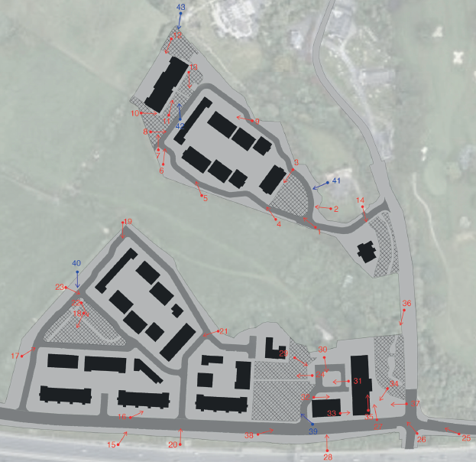

Slide 17
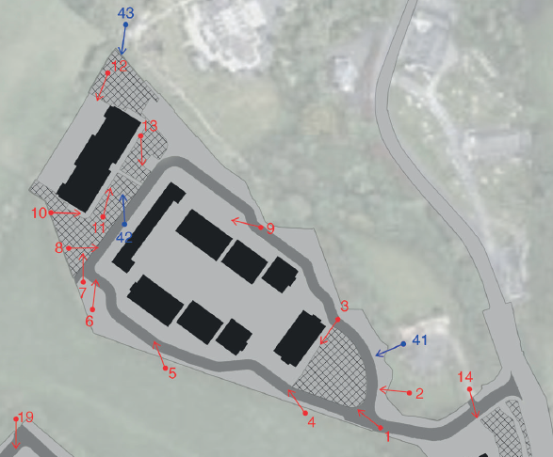

Slide 18
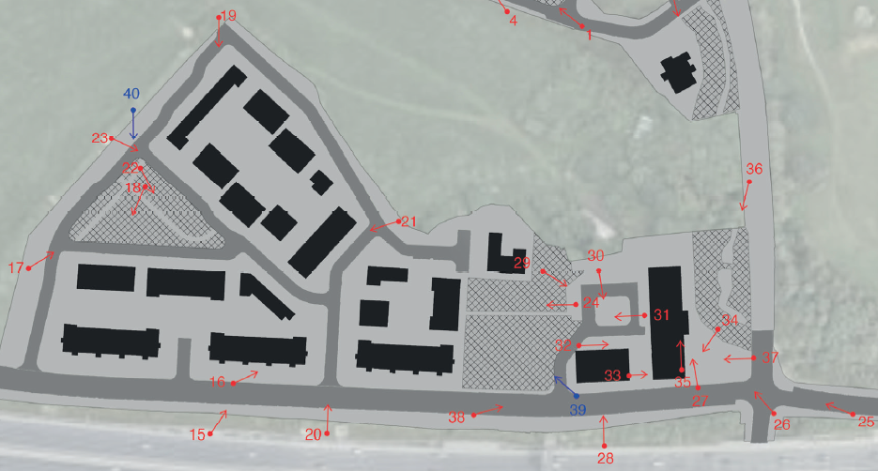

Slide 19
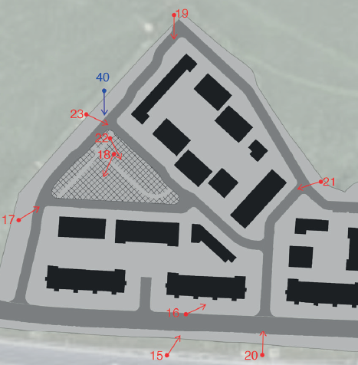

Slide 20
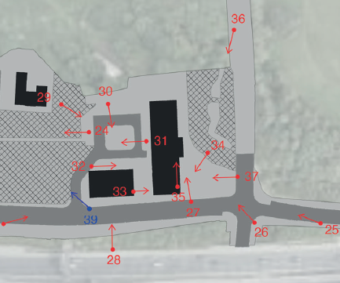

Slide 21
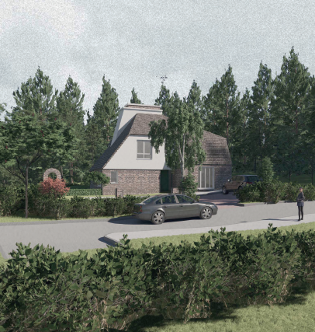
View 14

Slide 22
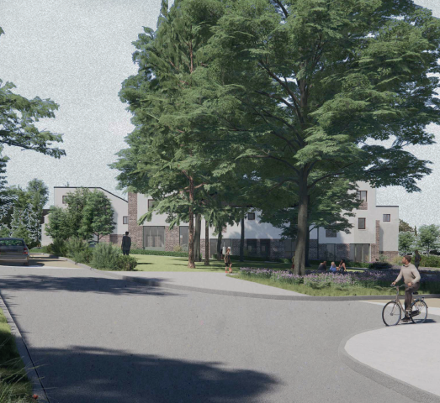
View 1

Slide 23
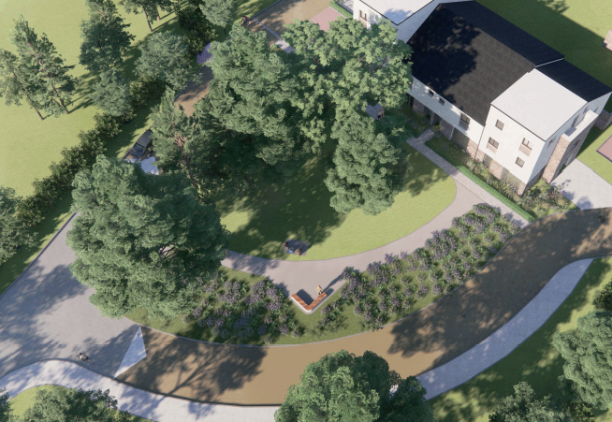
View 41

Slide 24
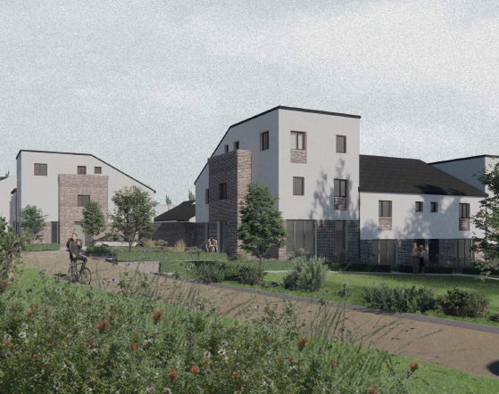
View 4

Slide 25
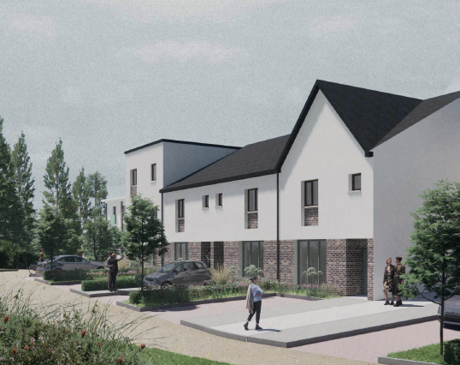
View 5

Slide 26
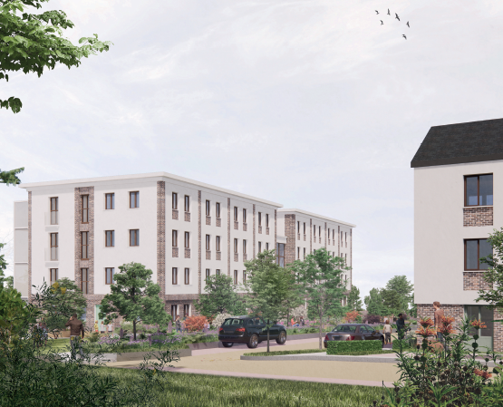
View 6

Slide 27
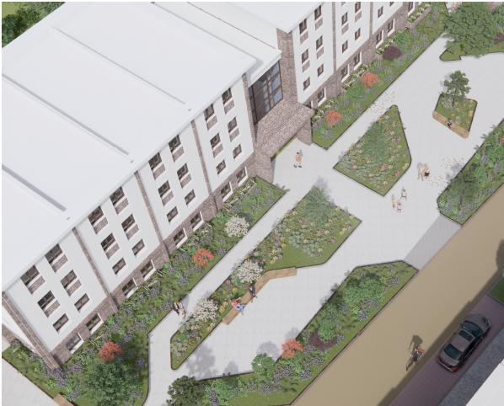
View 42

Slide 28
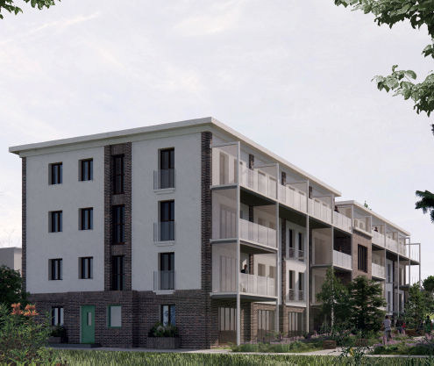
Week 12

Slide 29
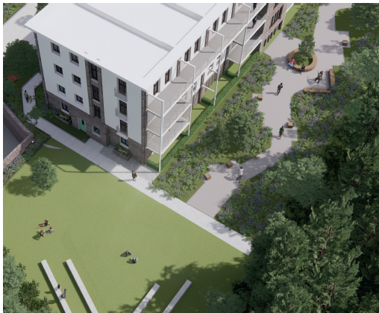
View 43

Slide 30
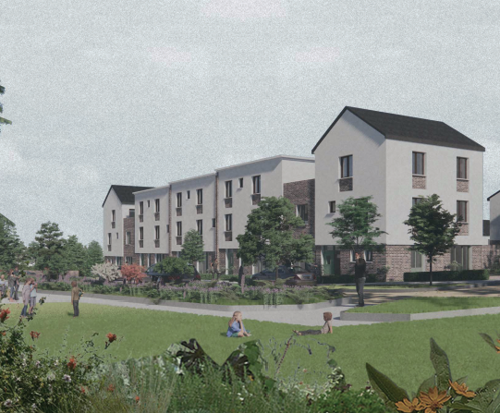
View 8

Slide 31
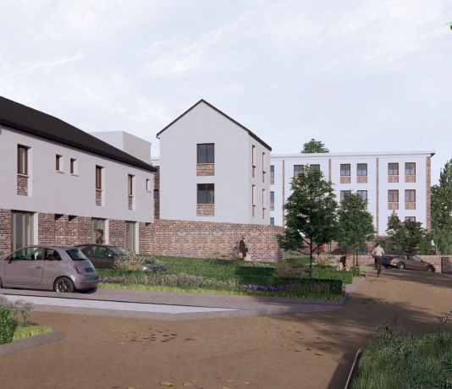
View 9

Slide 32
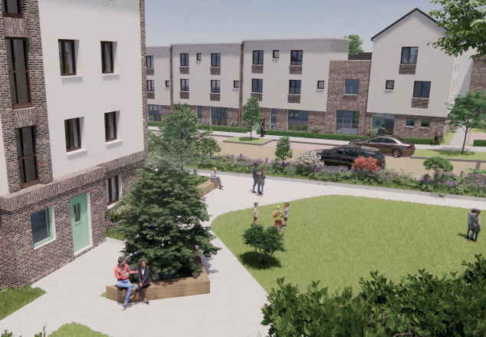
View 10

Slide 33
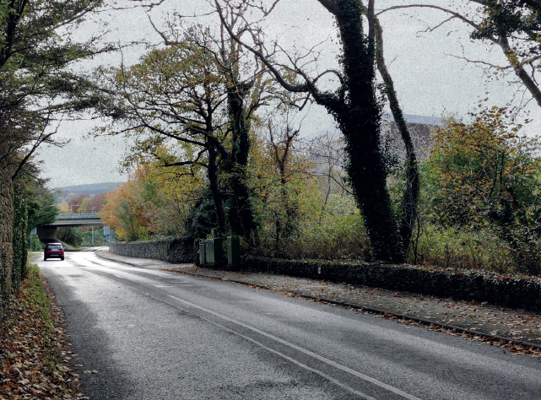
View 36

Slide 34
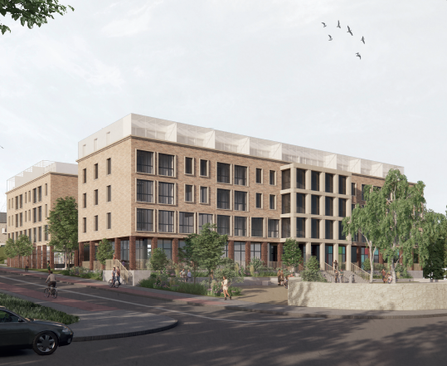
View 26

Slide 35
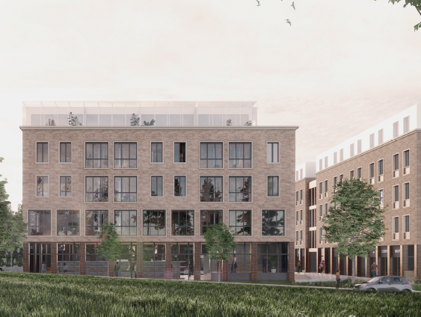
View 28

Slide 36
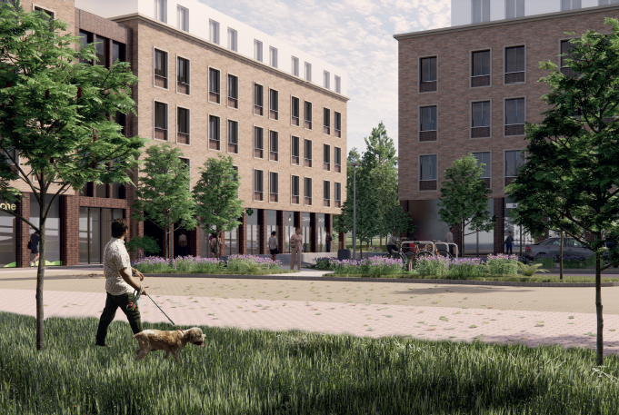
View 30

Slide 37
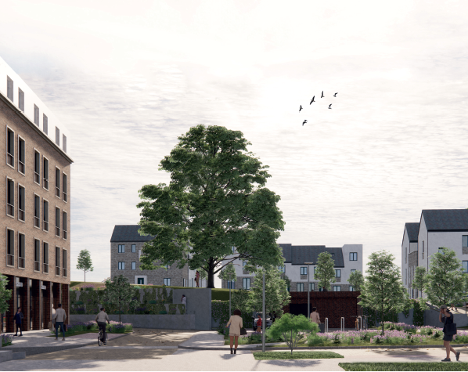
View 31

Slide 38
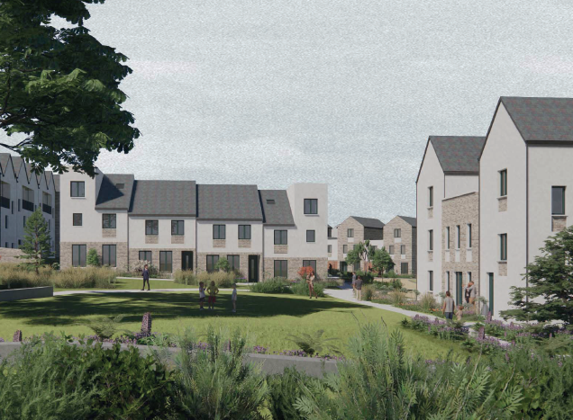
View 24

Slide 39
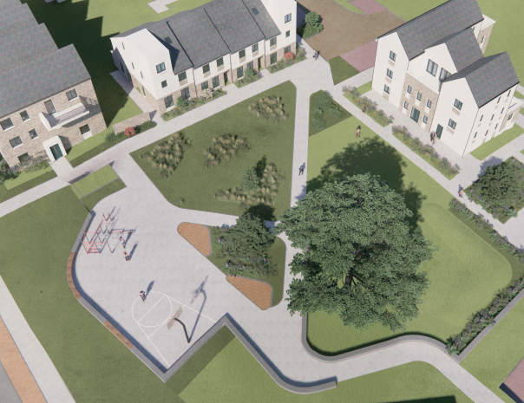
View 39

Slide 40
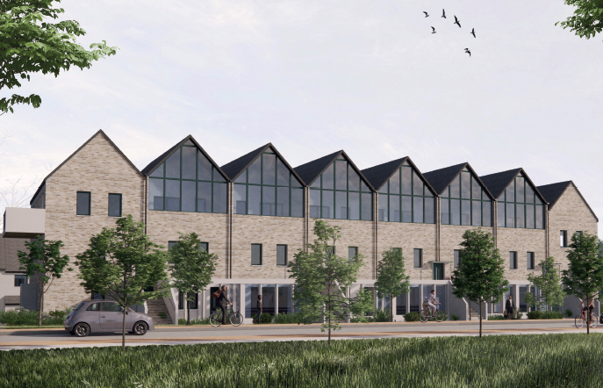
View 15

Slide 41
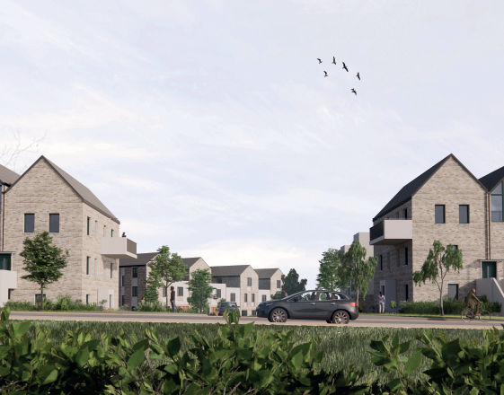
View 20

Slide 42
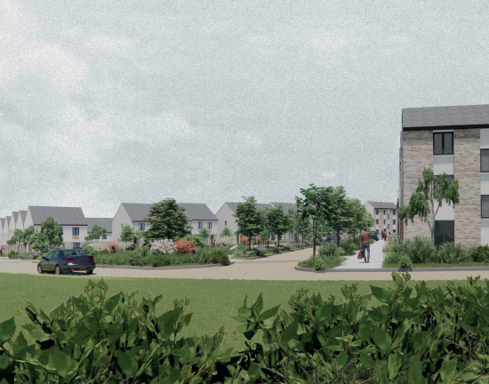
View 17

Slide 43
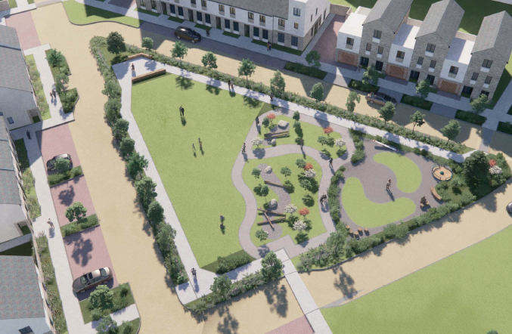
View 40

Slide 44
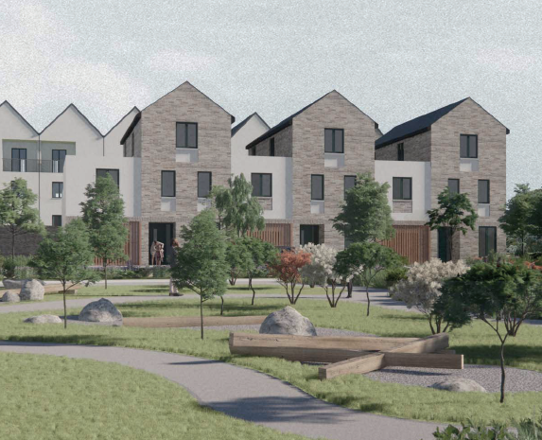
View 18

Slide 45
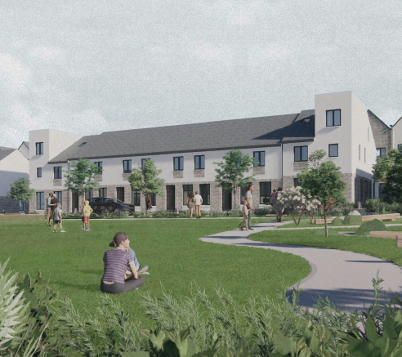
View 22

Slide 46
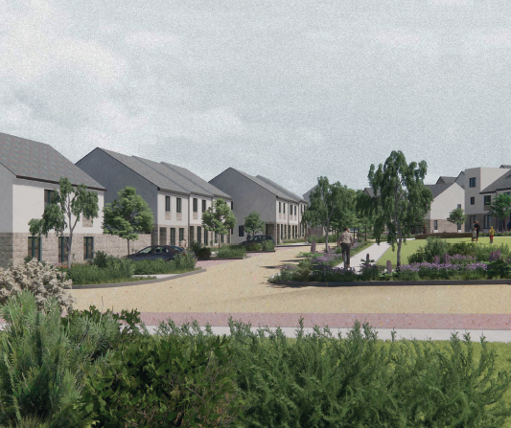
View 23

Slide 47
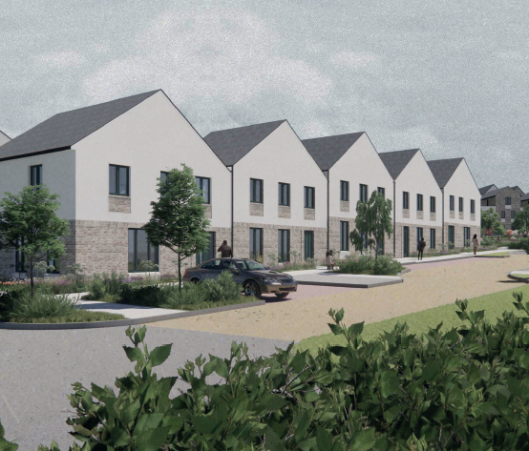
View 19

Slide 48
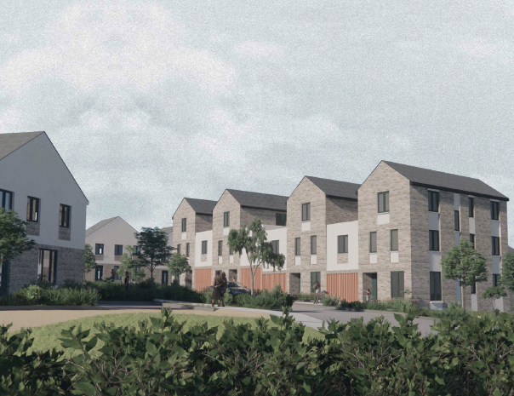
View 21

Slide 49
Thank You
Questions

