Slide 1
Balgaddy UPDATE Area committee Meeting 22nd MarCH 2021

Slide 2
Housing Voids/transfers 2022 to date
Status | Completed | In progress | Awaiting Contractor | Total
Number of Re-lets | 6 | 3 | 8 | 17
Type | Allocations | Transfers
No. of New Tenancies | 2 | 1

Slide 3
Painting/Communal Area//Targeted maintenance Works
Glass replacement ongoing in communal area
Remaining utility box covers to be tendered
Structural roof repairs Foxdene Avenue, contractor appointed
Communal Door Installation/ Fencing

Slide 4
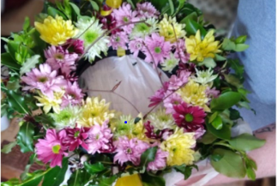
Upcoming Estate Management Initiatives
Easter
Two Day Easter Event planned for local children on 13th and 14th April in the Child and Family Centre. Creative art classes followed by Easter Egg hunts in the community garden.
Spring
Spring flower arrangement class for April in the Child and Family Ctr.
Networking Group with local agencies
To reconnect and recommence monthly meetings with local services in the area on March 30th

Slide 5
Better block Foundation & Balgaddy

Slide 6
Clean Up- Tor an Rí Lane

Slide 7
Clean Up- Tor an Rí Lane

Slide 8
Clean up- Foxdene Avenue

Slide 9
Clean up- Foxdene Avenue

Slide 10
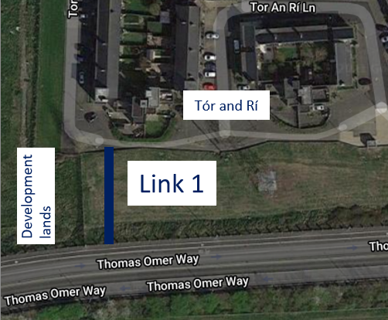
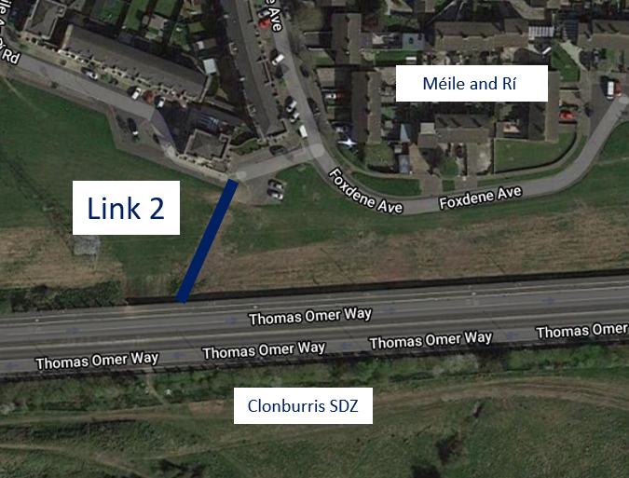
Estate Management enhancements Permeability routes
250k budget provision for street enhancement
Tór an Rí & Méile an Rí to Thomas Omer Way
Design fully accessible route
On site meeting held with ESB Networks
Draft design/ final route - May ACM

Slide 11
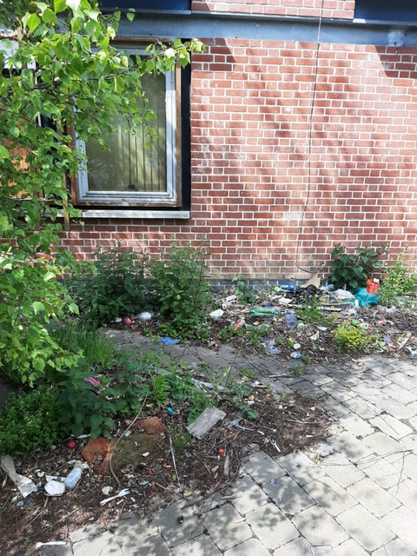
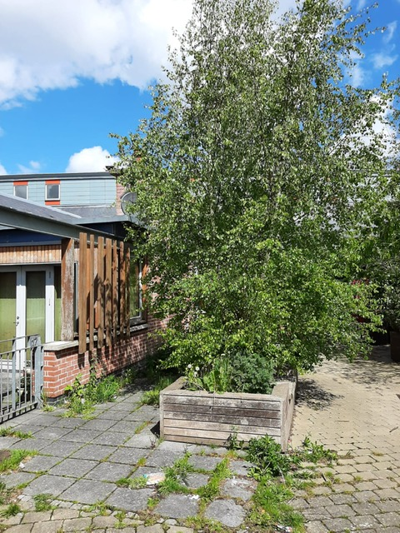
Estate Management enhancements age Friendly homes- Tor an Rí Lane

Slide 12
Healthy communities Programme
Funding under Sláintecare Programme
Installation of Calisthenics Equipment in Balgaddy
Interviews for co-ordinator post scheduled for March 2022

Slide 13
New social housing & community centre
Tender advertised for the design and build of 69 homes and a community facility advertised 11th February 2022
Deadline for responses 4th April 2022
Tender evaluation and preferred bidder selected prior to end of Q2 2022

