Slide 1
Astro Programme East of County
March 2022

Slide 2
SDCC’s Sports Pitch Strategy
Provide 3-5 Artificial Grass Pitches (AGPs) to increase provision, usage and provide for training need.
The multi-use nature of AGP pitches should lead to sports hubs and efficiencies in use (GAA, Soccer and Rugby Union)
High capital outlay required; high use and meeting community demand shall be built into management structures
Provision to be made for replacement / repair over lifetime of the facility
AGP’s provide pitch capacity to meet increased population growth in higher density/ urban locations
AGP’s meet demand for increased match play
AGP’s remove training pressure from grass pitches with resultant higher standard of grass pitches.
Strategic locations, new development and high population areas; facilitates high use, late evening and flood lighting.
AGP’s provide all weather, year-round facilites. Provide ancillary facilites as required to maximise use.
AGP’s meet demand for training provision which is not currently being met.

Slide 3
Sports Pitch Strategy: Recommendation: 3-5 Astros across the county. Potential locations shown

Slide 4
East of County Astro

Slide 5
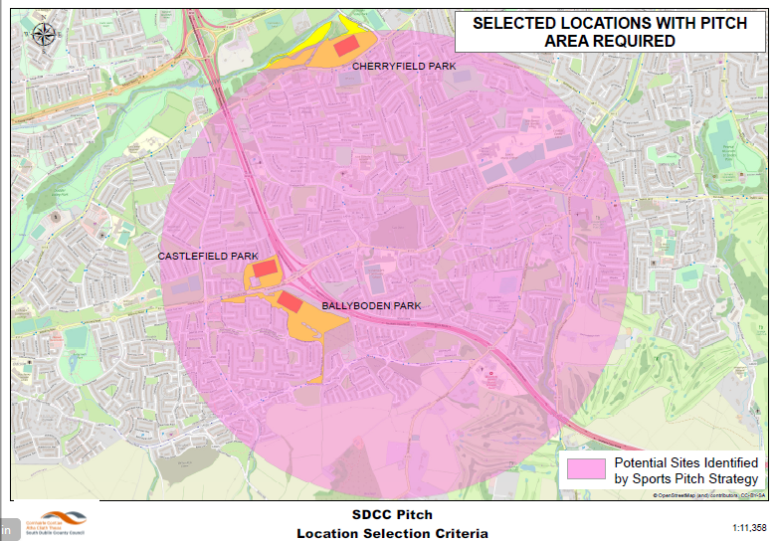
Comments:
Limited number of large public open spaces
Extensive mature residential areas.
High Level Selection Criteria:
Identify spaces close to large roads with public lighting e.g. close to junctions.
Public Open Space
Adherence to Sports Pitch Strategy
Suitable Location
Size capable of accommodating multi functional sports Astro.

Slide 6
Synthetic Pitch Feasibility Report
Feasibility Report Independent Review
A team of sports consultants led by Sports Labs Ltd. Were appointed to carry out an independent review of the 3 locations shown;
Cherryfield, Dodder Valley Park
Castlefield
Knocklyon Park, Woodstown
to determine which is most suitable to accommodate a multi sport Astro. Amongst other criteria the following have been assessed:
Technical suitability for astro use.
Multi-sport capability.
Access and parking.
Sensitivity to flood lighting.
The Feasibility Report including their options appraisal accompanies this presentation.

Slide 7
Synthetic Pitch Feasibility Report
CONCLUSIONS AND RECOMMENDATIONS
“Sports Labs recommends a new pitch to be located at the Woodstown site as, in our opinion, this represents the most suitable and appropriate option for the following main points:
There is good access, parking on-site or ability to provide additional parking if necessary.
There are no insurmountable spatial constraints
Residential buildings relatively distant
The site is flat and even
Ease of construction-reducing costs
Grass pitch usage at this site 7.5 - 9 hours per week versus 70 hours per week on a Astro pitch
Close to ideal N/S axis.”

Slide 8
Synthetic Pitch Development Plan Report
CONCLUSIONS AND RECOMMENDATIONS:
Option for an Astro at Knocklyon Park, Woodstown is recommended as summarised below:
Scored highest across matrix of factors.
Available Space (flexibility in planning, construction and use).
Lack of obvious major ecological constraints (subject to surveys at next stage).
Community Use links.
Planning considerations including the Sports Pitch Strategy.
Space for development of ancillary and / or complementary facilities over time if required.

Slide 9
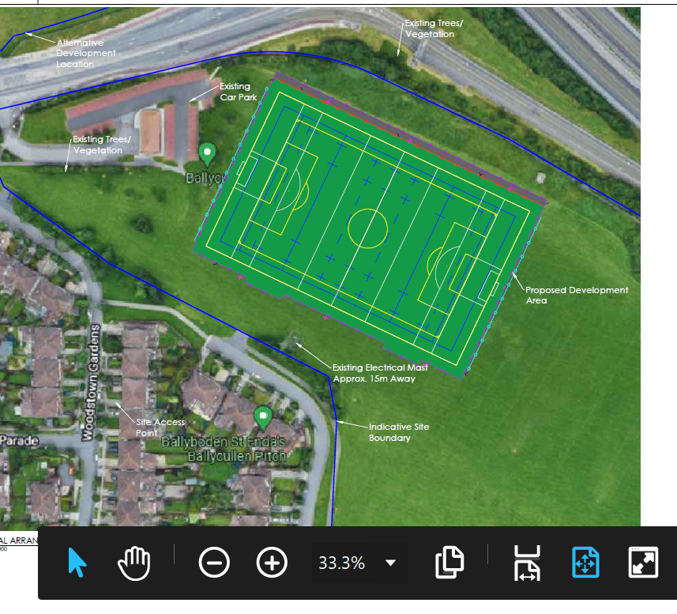
Synthetic Pitch Feasibility Report

Slide 10
Next steps
Knocklyon Park, Woodstown is the recommended location to proceed to preliminary design for an Astro in the East of the county.
Next steps are outlined as follows:
Consultation with local clubs, groups, residents and stakeholders to develop optimal design and layout and mitigate possible impacts.
Preliminary design, site investigations, ecological surveys, environmental reporting and screening.
Part 8 consultation and decision.
Detailed design.
Tender for construction
Construction period
Handover.
Programme to be confirmed.

