Slide 1
Tallaght Heritage Centre
Progress Report
14/3/22

Slide 2
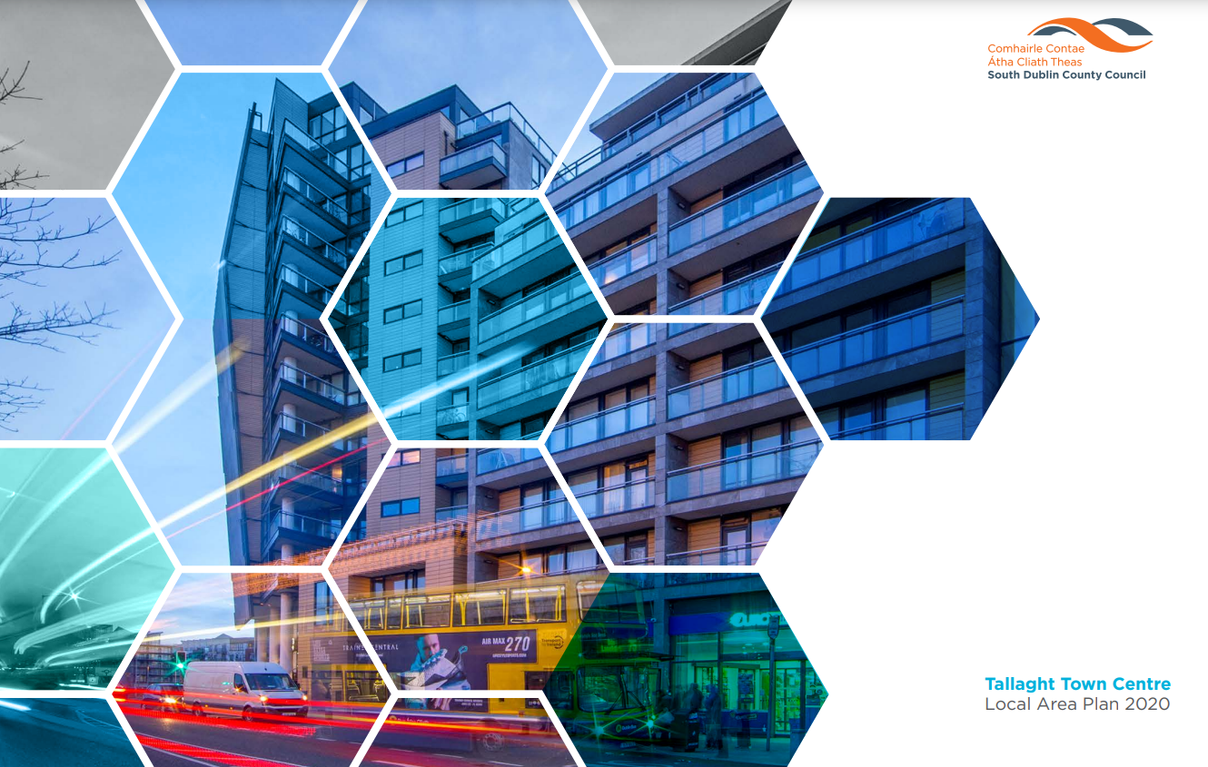
Capital Budget:
€3m

Slide 3
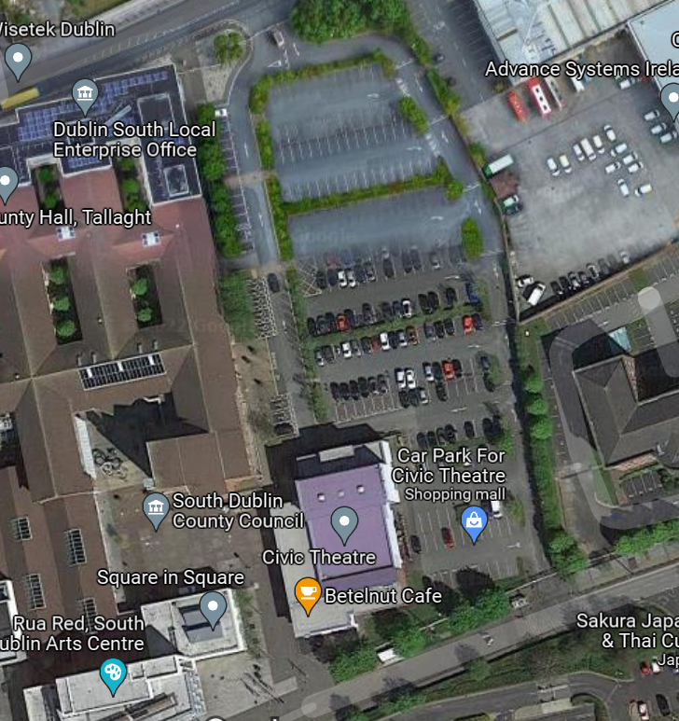
Heritage Centre Proposed Site
County Hall
Civic
Theatre
Proposed Heritage Centre Site
Tallaght Library
Rua Red
Meeting of the Tallaght ACM 28/2/22
Preferred Site Selected
X

Slide 4
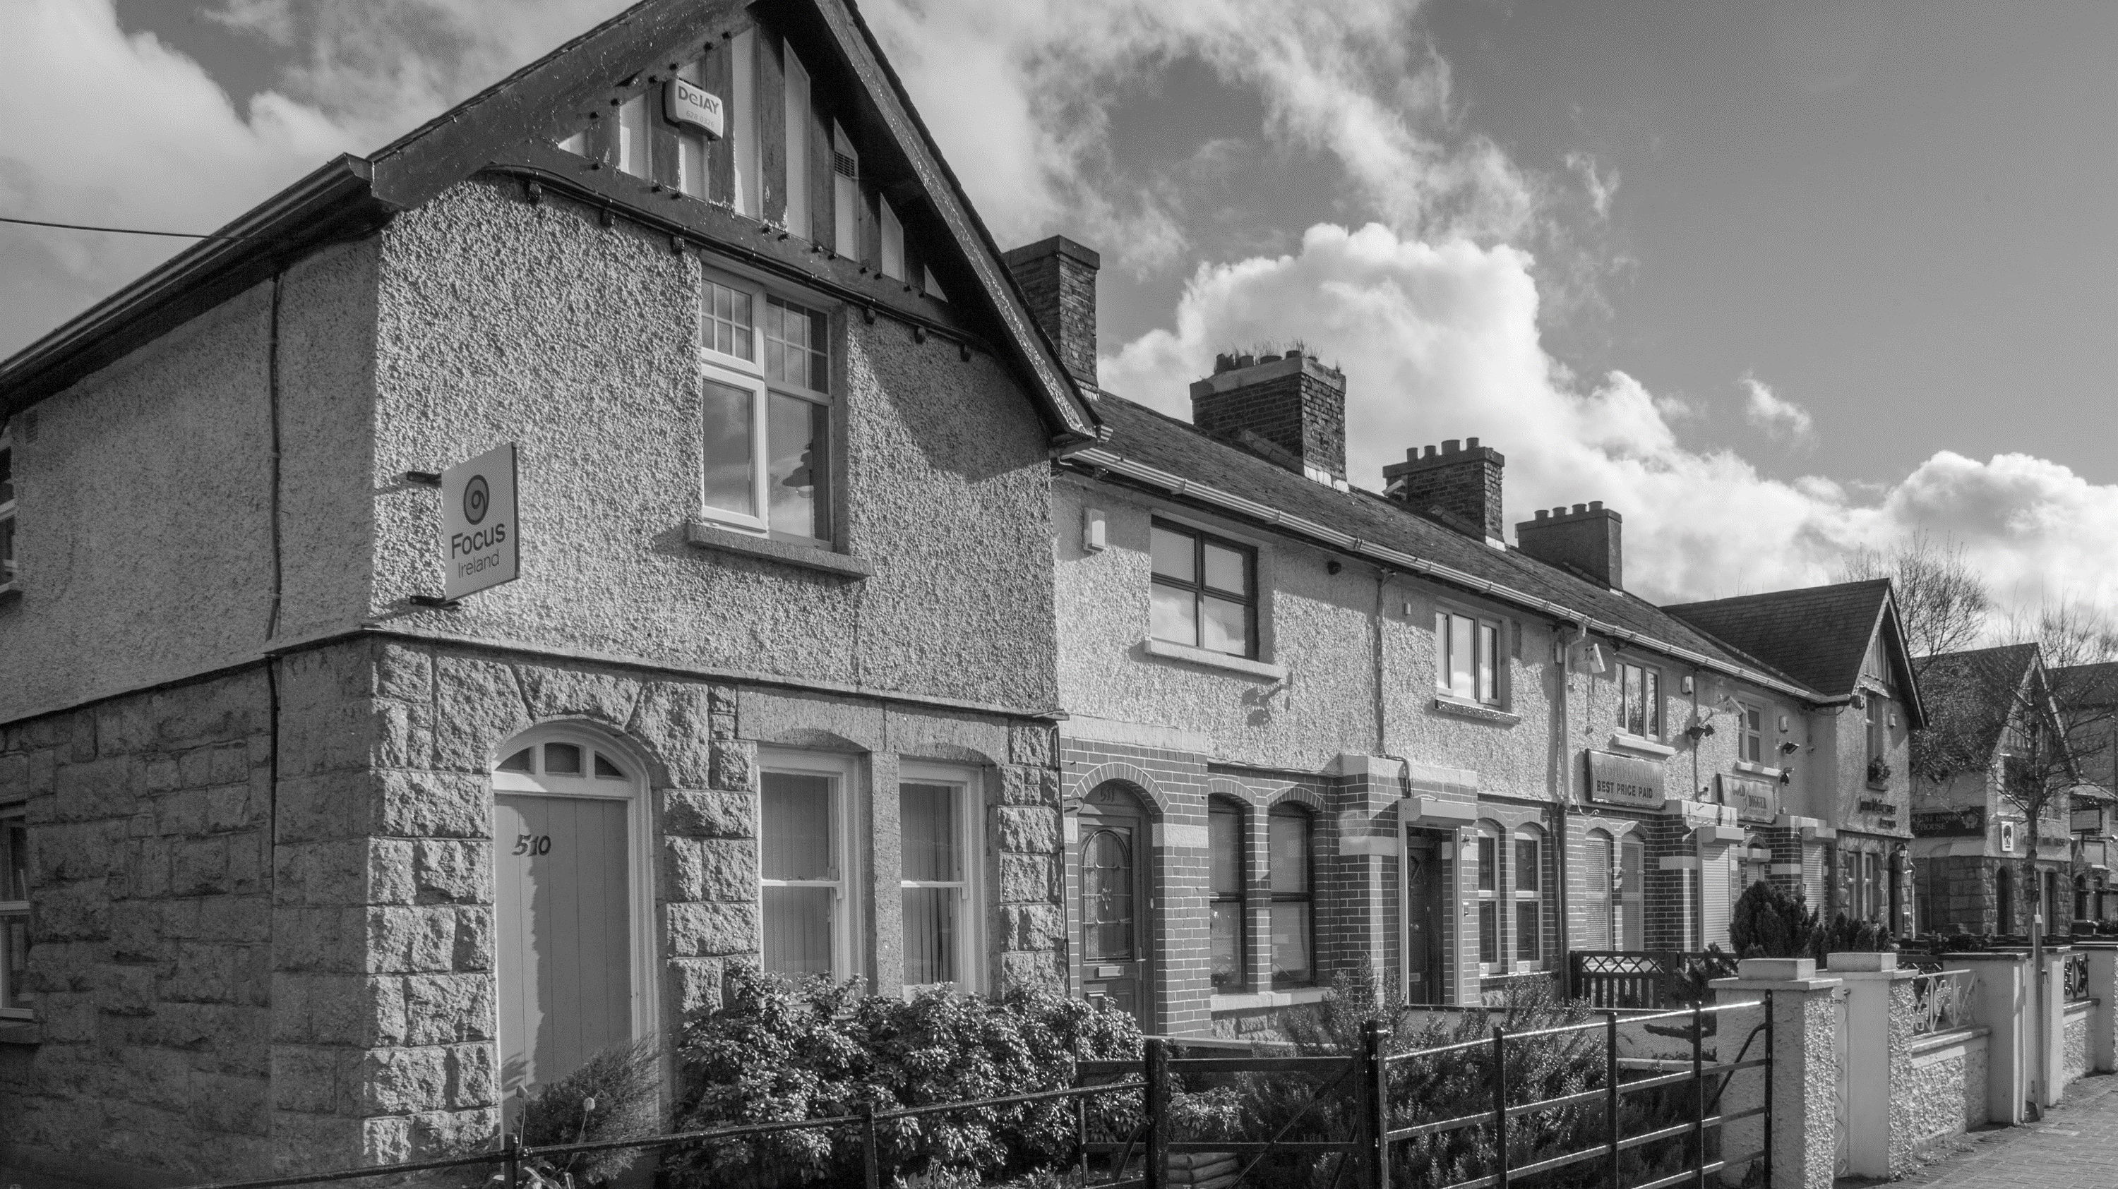
Heritage Centre
Interpretative Consultants
Work Package 1: Vision Roadmap
Work Package 2: Interpretative Strategy
Tender Issued January 2022
Tender Closed February 2022
Consultant Appointment March 2022

Slide 5
Project Timeline
Item | Work Activity | Date
1 | Issue tender for Interpretive Planning Consultant | Jan 2022
2 | Issue tender for Heritage Centre Design Consultant | Mar 2022
3 | Appointment of Interpretive Planning Consultant | Mar 2022
4 | Appointment of Design Consultant | May 2022
5 | Completion of Interpretative Vision Roadmap (Work Package 1) | Jul 2022
6 | Site Survey/Preliminary Building Concept Development | Jul 2022
7 | Complete Interpretative Strategy (Work Package 2) | Oct 2022
8 | Heritage Centre Part 8 submitted | Dec 2022
9 | Part 8 approved | Mar 2023
10 | Detailed Design & Contractor Tender (2-stage process) | Aug 2023
11 | Construction Contractor appointed | Jan 2024
12 | Commence construction | Feb 2024
13 | Complete construction | Apr 2025
14 | Heritage Centre opening | May 2025
Next Steps
Interpretative Consultants Appointment
Interpretative Vision Research & Development Stage
Procure Design Consultants
Commence Building Design Process

