Slide 1
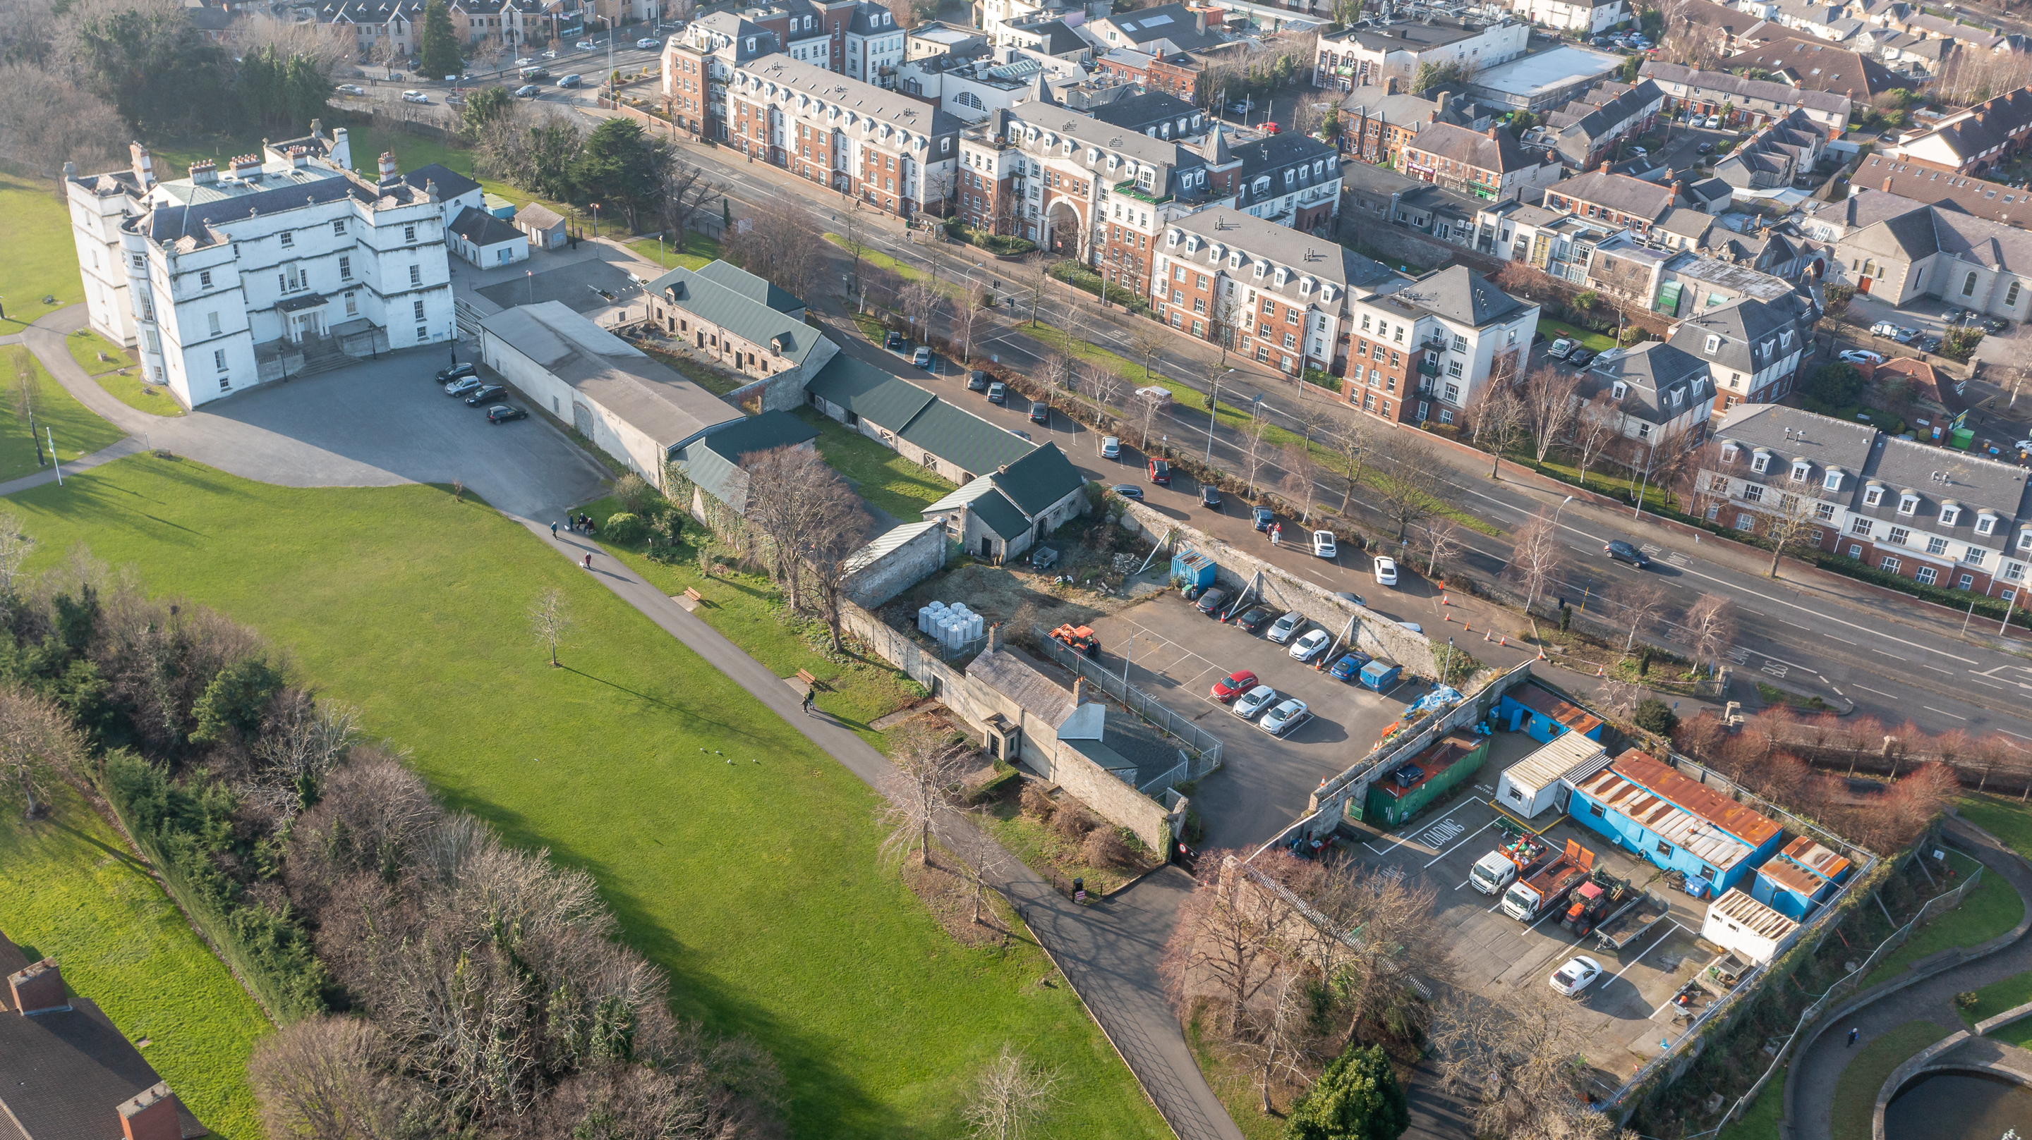
Rathfarnham Castle Outbuildings
Business Model & Procurement Approach

Slide 2
Overall Layout

Slide 3
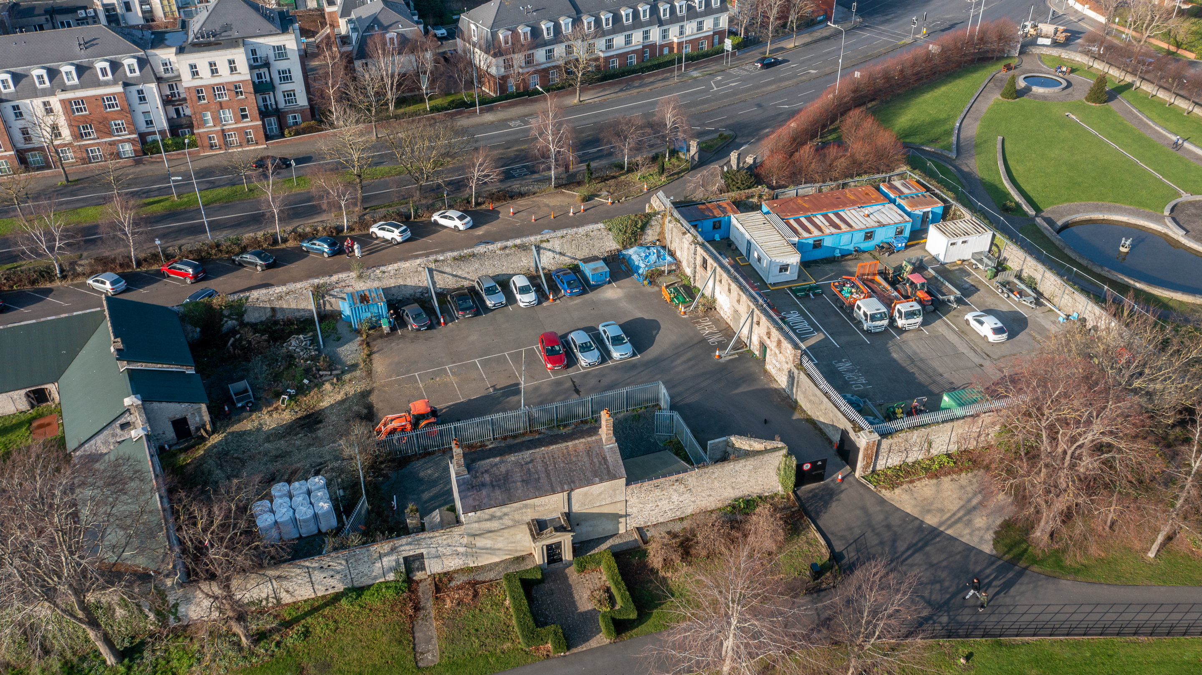
North Courtyard 1 & 2

Slide 4
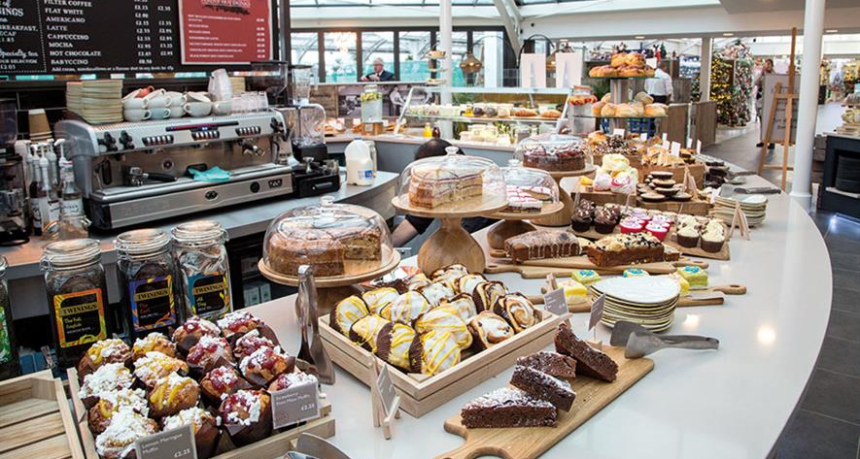
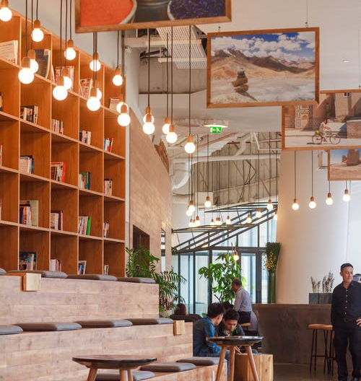
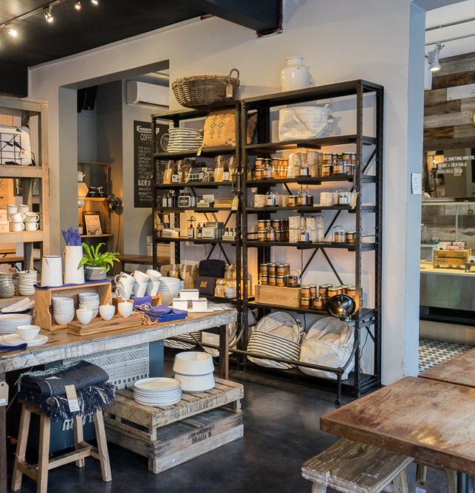
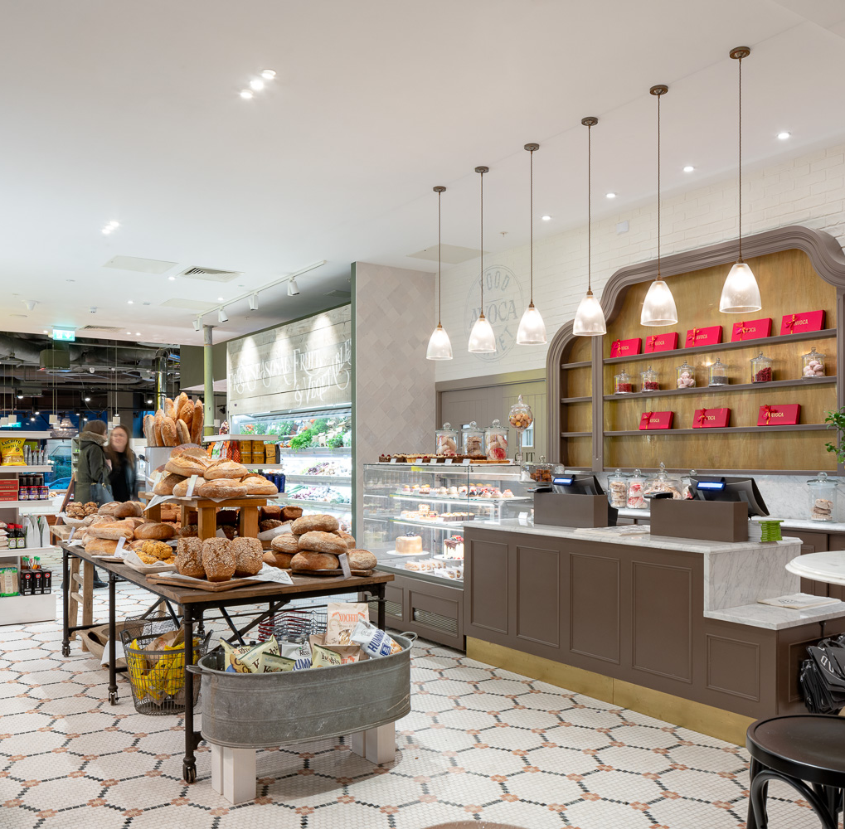
Business Model & Procurement
Development Opportunity
Mixed Use
Hospitality
Retail
Food
Lifestyle
SDCC
Asset Management
Building
Capital Budget: €5m
Design & Build
Operational Partner
Rental Income
Operational Partner
Proven Track Record
Appropriate Use(s)
Building Fit-out
Long-term Lease
Building Operations
Design Partner
Procurement
Prior Information Notice
Stage 1:
Prequalification
Stage 2: Competitive Dialogue

Slide 5
Building Design
Concept Drawing
Floor Area c.1,400 sq. metres

Slide 6
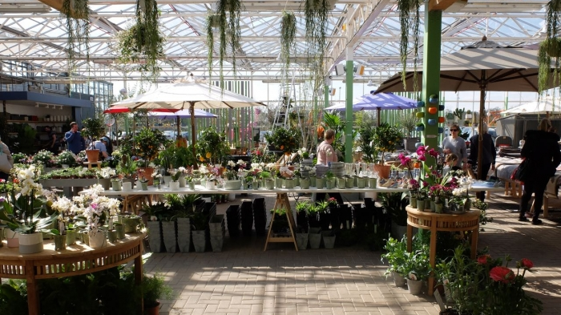
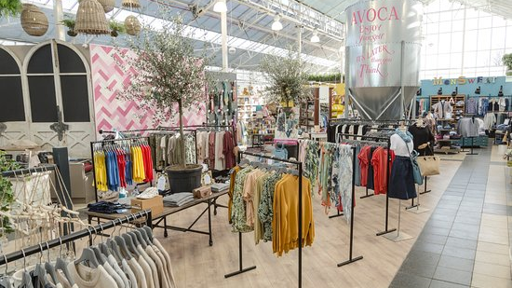
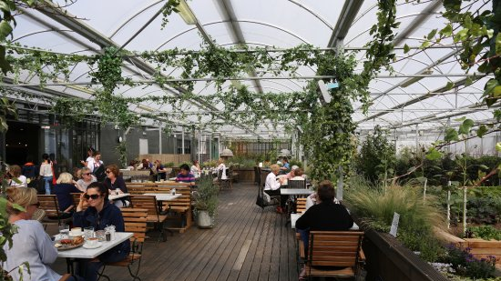
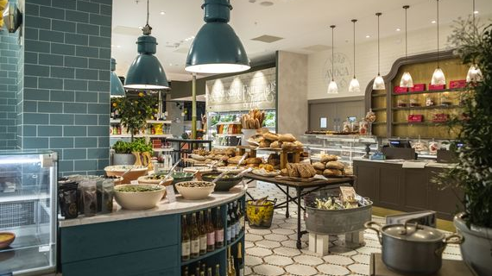
Market Examples

Slide 7
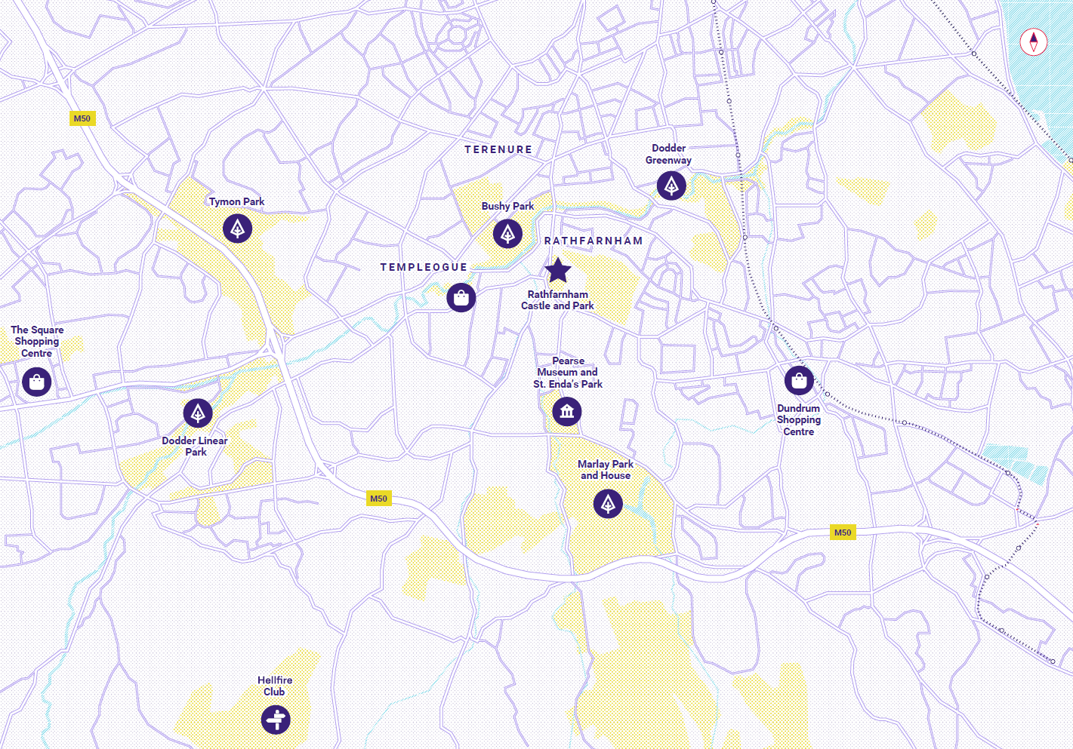
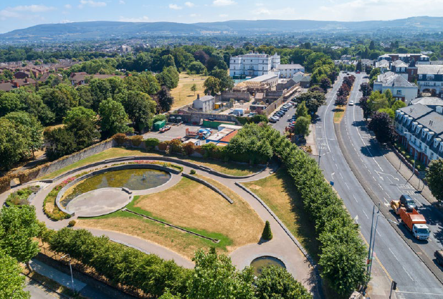
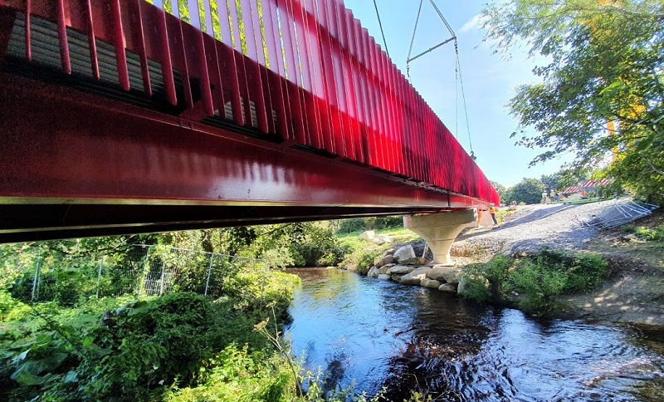
Catchment Area
32,000 People within 1km of Rathfarnham Castle & Outbuildings
Cycling & Walking
Connectivity to Other Amenities
Cark Parking

Slide 8
Indicative Project Timeline
Work Activity | Date
Prior Information Notice Issued | March 2022
Stage 1 Operator expression of interest process complete | May 2022
Commence procurement process for building design consultants | June 2022
Stage 2 tender for operator complete | September 2022
Building design consultants appointed | September 2022
Part 8 Agreed | June 2023
Construction contractor appointed | November 2023
Construction start date | January 2024
Construction project completion | January 2025

